Slide 1
Artificial Intelligence
Search

Slide 2
Search
Search permeates all of AI
What choices are we searching through?
Problem solving Action combinations (move 1, then move 3, then move 2...)
Natural language Ways to map words to parts of speech
Computer vision Ways to map features to object model
Machine learning Possible concepts that fit examples seen so far
Motion planning Sequence of moves to reach goal destination
An intelligent agent is trying to find a set or sequence of actions to achieve a goal
This is a goal-based agent

Slide 3
Problem-solving Agent
SimpleProblemSolvingAgent(percept)
state = UpdateState(state, percept)
if sequence is empty then
goal = FormulateGoal(state)
problem = FormulateProblem(state, g)
sequence = Search(problem)
action = First(sequence)
sequence = Rest(sequence)
Return action

Slide 4
Assumptions
Static or dynamic?
Environment is static

Slide 5
Assumptions
Static or dynamic?
Fully or partially observable?
Environment is fully observable

Slide 6
Assumptions
Static or dynamic?
Fully or partially observable?
Discrete or continuous?
Environment is discrete

Slide 7
Assumptions
Static or dynamic?
Fully or partially observable?
Discrete or continuous?
Deterministic or stochastic?
Environment is deterministic

Slide 8
Assumptions
Static or dynamic?
Fully or partially observable?
Discrete or continuous?
Deterministic or stochastic?
Episodic or sequential?
Environment is sequential

Slide 9
Assumptions
Static or dynamic?
Fully or partially observable?
Discrete or continuous?
Deterministic or stochastic?
Episodic or sequential?
Single agent or multiple agent?

Slide 10
Assumptions
Static or dynamic?
Fully or partially observable?
Discrete or continuous?
Deterministic or stochastic?
Episodic or sequential?
Single agent or multiple agent?

Slide 11
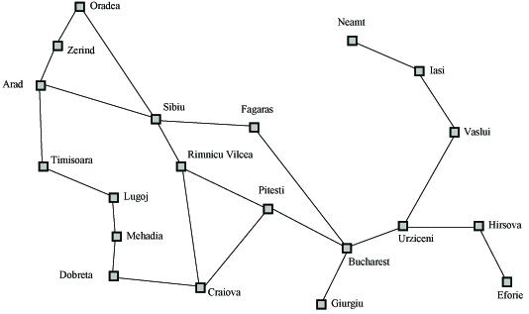
Search Example
Formulate goal: Be in Bucharest.
Formulate problem: states are cities, operators drive between pairs of cities
Find solution: Find a sequence of cities (e.g., Arad, Sibiu, Fagaras, Bucharest) that leads from the current state to a state meeting the goal condition

Slide 12
Search Space Definitions
State
A description of a possible state of the world
Includes all features of the world that are pertinent to the problem
Initial state
Description of all pertinent aspects of the state in which the agent starts the search
Goal test
Conditions the agent is trying to meet (e.g., have $1M)
Goal state
Any state which meets the goal condition
Thursday, have $1M, live in NYC
Friday, have $1M, live in Valparaiso
Action
Function that maps (transitions) from one state to another

Slide 13
Search Space Definitions
Problem formulation
Describe a general problem as a search problem
Solution
Sequence of actions that transitions the world from the initial state to a goal state
Solution cost (additive)
Sum of the cost of operators
Alternative: sum of distances, number of steps, etc.
Search
Process of looking for a solution
Search algorithm takes problem as input and returns solution
We are searching through a space of possible states
Execution
Process of executing sequence of actions (solution)

Slide 14
Problem Formulation
A search problem is defined by the
Initial state (e.g., Arad)
Operators (e.g., Arad -> Zerind, Arad -> Sibiu, etc.)
Goal test (e.g., at Bucharest)
Solution cost (e.g., path cost)

Slide 15
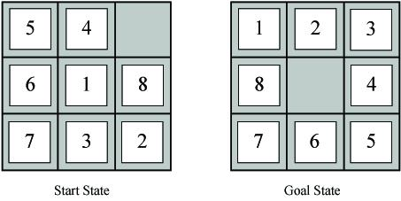
Example Problems – Eight Puzzle
States: tile locations
Initial state: one specific tile configuration
Operators: move blank tile left, right, up, or down
Goal: tiles are numbered from one to eight around the square
Path cost: cost of 1 per move (solution cost same as number of most or path length)
Eight puzzle applet

Slide 16
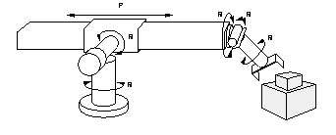
Example Problems – Robot Assembly
States: real-valued coordinates of
robot joint angles
parts of the object to be assembled
Operators: rotation of joint angles
Goal test: complete assembly
Path cost: time to complete assembly

Slide 17

Example Problems – Towers of Hanoi
States: combinations of poles and disks
Operators: move disk x from pole y to pole z subject to constraints
cannot move disk on top of smaller disk
cannot move disk if other disks on top
Goal test: disks from largest (at bottom) to smallest on goal pole
Path cost: 1 per move
Towers of Hanoi applet

Slide 18
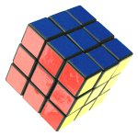
Example Problems – Rubik’s Cube
States: list of colors for each cell on each face
Initial state: one specific cube configuration
Operators: rotate row x or column y on face z direction a
Goal: configuration has only one color on each face
Path cost: 1 per move
Rubik’s cube applet

Slide 19
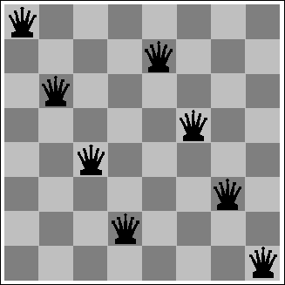
Example Problems – Eight Queens
States: locations of 8 queens on chess board
Initial state: one specific queens configuration
Operators: move queen x to row y and column z
Goal: no queen can attack another (cannot be in same row, column, or diagonal)
Path cost: 0 per move
Eight queens applet

Slide 20

Example Problems – Missionaries and Cannibals
States: number of missionaries, cannibals, and boat on near river bank
Initial state: all objects on near river bank
Operators: move boat with x missionaries and y cannibals to other side of river
no more cannibals than missionaries on either river bank or in boat
boat holds at most m occupants
Goal: all objects on far river bank
Path cost: 1 per river crossing
Missionaries and cannibals applet

Slide 21

Example Problems –Water Jug
States: Contents of 4-gallon jug and 3-gallon jug
Initial state: (0,0)
Operators:
fill jug x from faucet
pour contents of jug x in jug y until y full
dump contents of jug x down drain
Goal: (2,n)
Path cost: 1 per fill
Saving the world, Part I
Saving the world, Part II

Slide 22
Sample Search Problems
Graph coloring
Protein folding
Game playing
Airline travel
Proving algebraic equalities
Robot motion planning

Slide 23
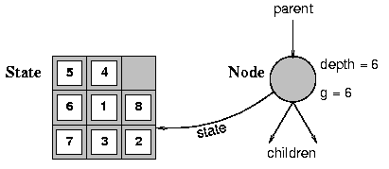
Visualize Search Space as a Tree
States are nodes
Actions are edges
Initial state is root
Solution is path from root to goal node
Edges sometimes have associated costs
States resulting from operator are children

Slide 24
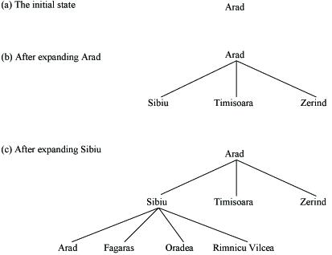
Search Problem Example (as a tree)

Slide 25
Search Function – Uninformed Searches
Open = initial state // open list is all generated states
// that have not been “expanded”
While open not empty // one iteration of search algorithm
state = First(open) // current state is first state in open
Pop(open) // remove new current state from open
if Goal(state) // test current state for goal condition
return “succeed” // search is complete
// else expand the current state by
// generating children and
// reorder open list per search strategy
else open = QueueFunction(open, Expand(state))
Return “fail”

Slide 26
Search Strategies
Search strategies differ only in QueuingFunction
Features by which to compare search strategies
Completeness (always find solution)
Cost of search (time and space)
Cost of solution, optimal solution
Make use of knowledge of the domain
“uninformed search” vs. “informed search”

Slide 27
Breadth-First Search
Generate children of a state, QueueingFn adds the children to the end of the open list
Level-by-level search
Order in which children are inserted on open list is arbitrary
In tree, assume children are considered left-to-right unless specified differently
Number of children is “branching factor” b

Slide 28
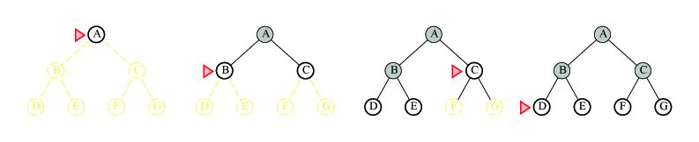
BFS Examples
b = 2
Example trees
Search algorithms applet

Slide 29
Analysis
Assume goal node at level d with constant branching factor b
Time complexity (measured in #nodes generated)
1 (1st level ) + b (2nd level) + b² (3rd level) + … + b^{d} (goal level) + (b^{d+1} – b) = O(b^{d}+1)
This assumes goal on far right of level
Space complexity
At most majority of nodes at level d + majority of nodes at level d+1 = O(b^{d+1})
Exponential time and space
Features
Simple to implement
Complete
Finds shortest solution (not necessarily least-cost unless all operators have equal cost)

Slide 30
Analysis
See what happens with b=10
expand 10,000 nodes/second
1,000 bytes/node
Depth | Nodes | Time | Memory
2 | 1110 | .11 seconds | 1 megabyte
4 | 111,100 | 11 seconds | 106 megabytes
6 | 10⁷ | 19 minutes | 10 gigabytes
8 | 10⁹ | 31 hours | 1 terabyte
10 | 10¹¹ | 129 days | 101 terabytes
12 | 10¹³ | 35 years | 10 petabytes
15 | 10¹⁵ | 3,523 years | 1 exabyte

Slide 31
Depth-First Search
QueueingFn adds the children to the front of the open list
BFS emulates FIFO queue
DFS emulates LIFO stack
Net effect
Follow leftmost path to bottom, then backtrack
Expand deepest node first

Slide 32
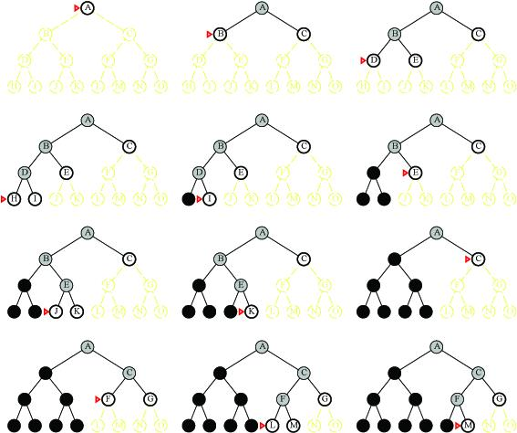
DFS Examples
Example trees

Slide 33
Analysis
Time complexity
In the worst case, search entire space
Goal may be at level d but tree may continue to level m, m>=d
O(b^{m})
Particularly bad if tree is infinitely deep
Space complexity
Only need to save one set of children at each level
1 + b + b + … + b (m levels total) = O(bm)
For previous example, DFS requires 118kb instead of 10 petabytes for d=12 (10 billion times less)
Benefits
May not always find solution
Solution is not necessarily shortest or least cost
If many solutions, may find one quickly (quickly moves to depth d)
Simple to implement
Space often bigger constraint, so more usable than BFS for large problems

Slide 34
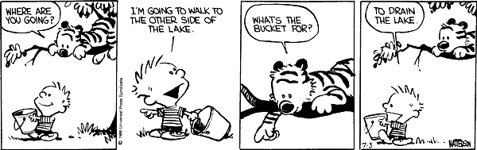
Comparison of Search Techniques
 | DFS | BFS
Complete | N | Y
Optimal | N | N
Heuristic | N | N
Time | b^{m} | b^{d+1}
Space | bm | b^{d+1}

Slide 35
Avoiding Repeated States
Can we do it?
Do not return to parent or grandparent state
In 8 puzzle, do not move up right after down
Do not create solution paths with cycles
Do not generate repeated states (need to store and check potentially large number of states)

Slide 36
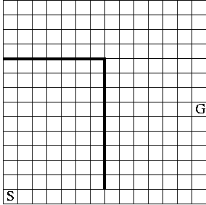
Maze Example
States are cells in a maze
Move N, E, S, or W
What would BFS do (expand E, then N, W, S)?
What would DFS do?
What if order changed to N, E, S, W and loops are prevented?

Slide 37
Uniform Cost Search (Branch&Bound)
QueueingFn is SortByCostSoFar
Cost from root to current node n is g(n)
Add operator costs along path
First goal found is least-cost solution
Space & time can be exponential because large subtrees with inexpensive steps may be explored before useful paths with costly steps
If costs are equal, time and space are O(b^{d})
Otherwise, complexity related to cost of optimal solution

Slide 38
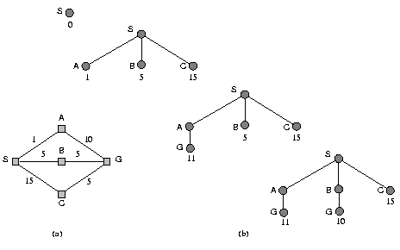
UCS Example

Slide 39
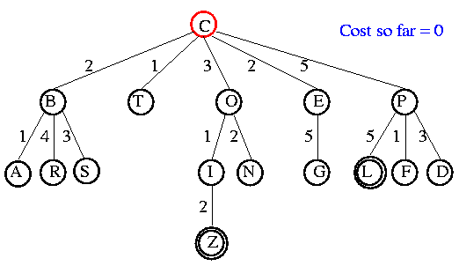
UCS Example
Open list: C

Slide 40
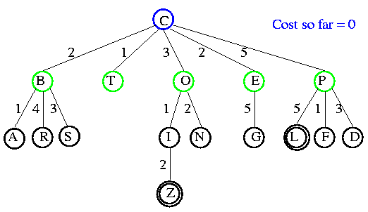
UCS Example
Open list: B(2) T(1) O(3) E(2) P(5)

Slide 41
UCS Example
Open list: T(1) B(2) E(2) O(3) P(5)

Slide 42
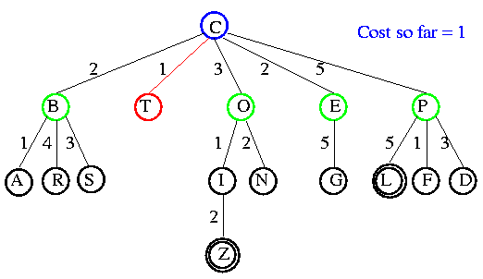
UCS Example
Open list: B(2) E(2) O(3) P(5)

Slide 43
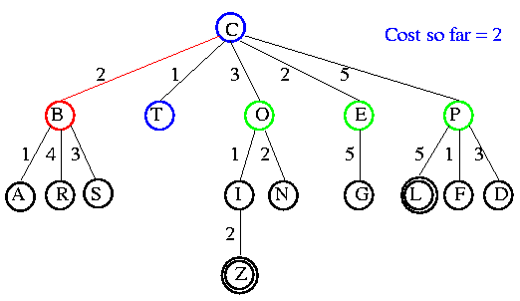
UCS Example
Open list: E(2) O(3) P(5)

Slide 44
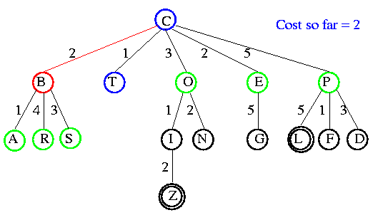
UCS Example
Open list: E(2) O(3) A(3) S(5) P(5) R(6)

Slide 45
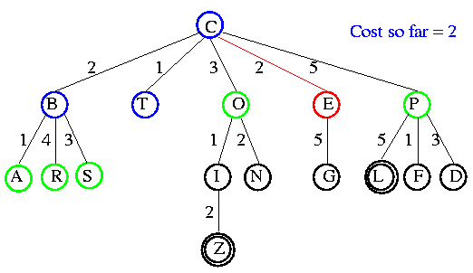
UCS Example
Open list: O(3) A(3) S(5) P(5) R(6)

Slide 46
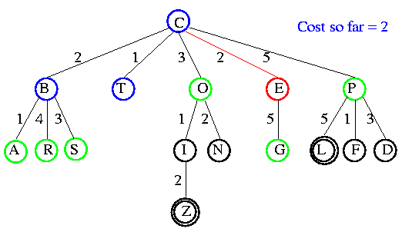
UCS Example
Open list: O(3) A(3) S(5) P(5) R(6) G(10)

Slide 47
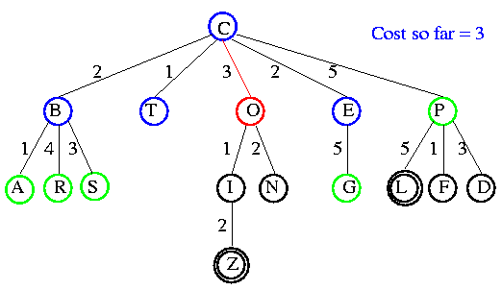
UCS Example
Open list: A(3) S(5) P(5) R(6) G(10)

Slide 48
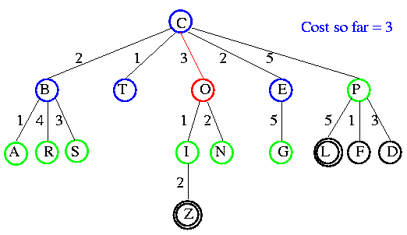
UCS Example
Open list: A(3) I(4) S(5) N(5) P(5) R(6) G(10)

Slide 49
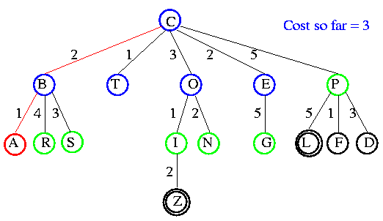
UCS Example
Open list: I(4) P(5) S(5) N(5) R(6) G(10)

Slide 50
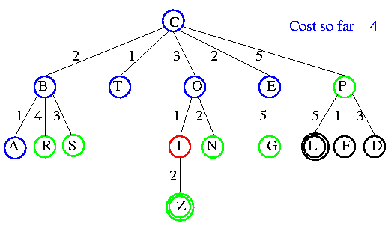
UCS Example
Open list: P(5) S(5) N(5) R(6) Z(6) G(10)

Slide 51
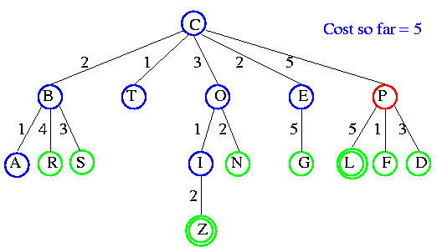
UCS Example
Open list: S(5) N(5) R(6) Z(6) F(6) D(8) G(10) L(10)

Slide 52
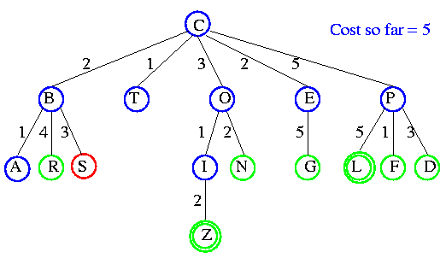
UCS Example
Open list: N(5) R(6) Z(6) F(6) D(8) G(10) L(10)

Slide 53
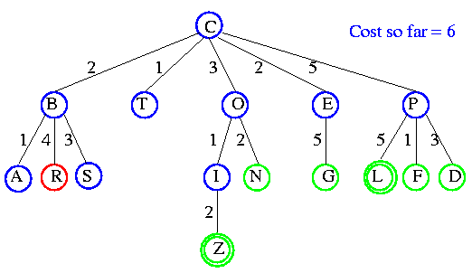
UCS Example
Open list: Z(6) F(6) D(8) G(10) L(10)

Slide 54
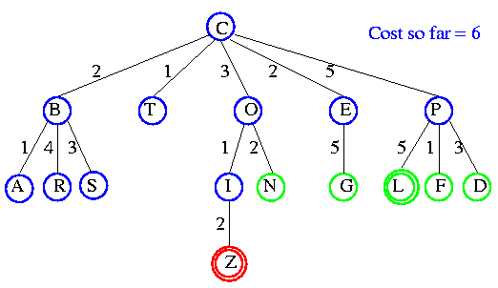
UCS Example
Open list: F(6) D(8) G(10) L(10)

Slide 55
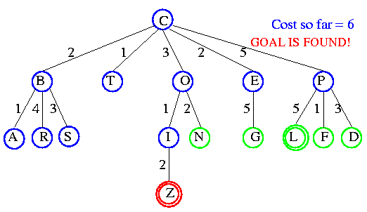
UCS Example

Slide 56
Comparison of Search Techniques
 | DFS | BFS | UCS
Complete | N | Y | Y
Optimal | N | N | Y
Heuristic | N | N | N
Time | b^{m} | b^{d+1} | b^{m}
Space | bm | b^{d+1} | b^{m}

Slide 57
Iterative Deepening Search
DFS with depth bound
QueuingFn is enqueue at front as with DFS
Expand(state) only returns children such that depth(child) <= threshold
This prevents search from going down infinite path
First threshold is 1
If do not find solution, increment threshold and repeat

Slide 58
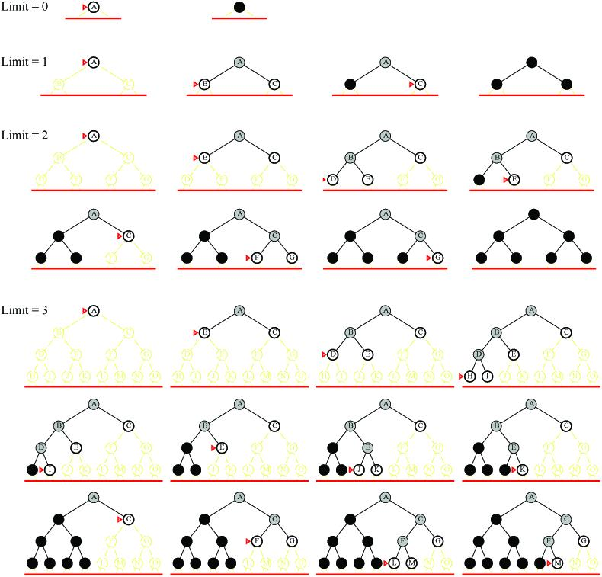
Examples

Slide 59
Analysis
What about the repeated work?
Time complexity (number of generated nodes)
[b] + [b + b²] + .. + [b + b² + .. + b^{d}]
(d)b + (d-1) b² ⁺ … + (1) b^{d}
O(b^{d})

Slide 60
Analysis
Repeated work is approximately 1/b of total work
Negligible
Example: b=10, d=5
N(BFS) = 1,111,100
N(IDS) = 123,450
Features
Shortest solution, not necessarily least cost
Is there a better way to decide threshold? (IDA*)

Slide 61
Comparison of Search Techniques
 | DFS | BFS | UCS | IDS
Complete | N | Y | Y | Y
Optimal | N | N | Y | N
Heuristic | N | N | N | N
Time | b^{m} | b^{d+1} | b^{m} | b^{d}
Space | bm | b^{d+1} | b^{m} | bd

Slide 62
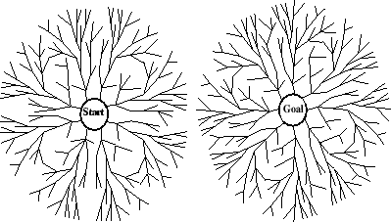
Bidirectional Search
Search forward from initial state to goal AND backward from goal state to initial state
Can prune many options
Considerations
Which goal state(s) to use
How determine when searches overlap
Which search to use for each direction
Here, two BFS searches
Time and space is O(b^{d/2})

Slide 63
Informed Searches
Best-first search, Hill climbing, Beam search, A*, IDA*, RBFS, SMA*
New terms
Heuristics
Optimal solution
Informedness
Hill climbing problems
Admissibility
New parameters
g(n) = estimated cost from initial state to state n
h(n) = estimated cost (distance) from state n to closest goal
h(n) is our heuristic
Robot path planning, h(n) could be Euclidean distance
8 puzzle, h(n) could be #tiles out of place
Search algorithms which use h(n) to guide search are heuristic search algorithms

Slide 64
Best-First Search
QueueingFn is sort-by-h
Best-first search only as good as heuristic
Example heuristic for 8 puzzle: Manhattan Distance

Slide 65
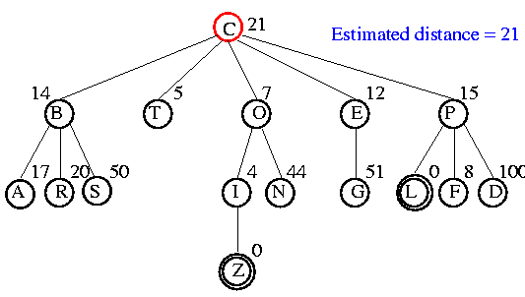
Example

Slide 66
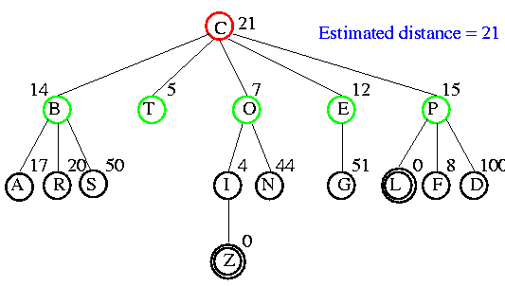
Example

Slide 67
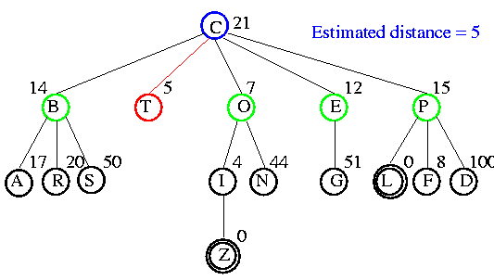
Example

Slide 68
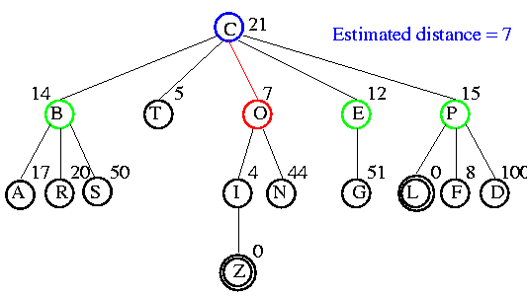
Example

Slide 69
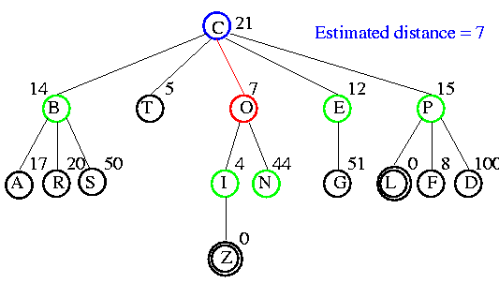
Example

Slide 70
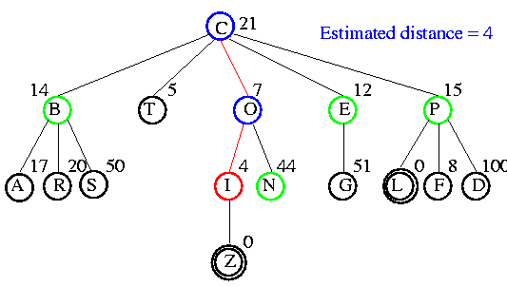
Example

Slide 71
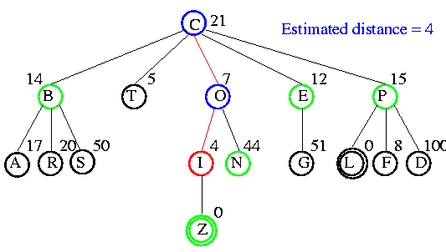
Example

Slide 72
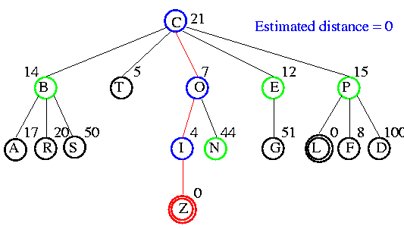
Example

Slide 73
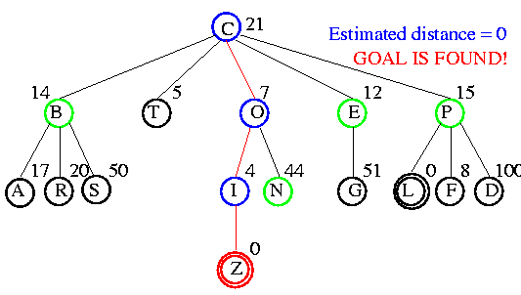
Example

Slide 74
Comparison of Search Techniques
 | DFS | BFS | UCS | IDS | Best
Complete | N | Y | Y | Y | N
Optimal | N | N | Y | N | N
Heuristic | N | N | N | N | Y
Time | b^{m} | b^{d+1} | b^{m} | b^{d} | b^{m}
Space | bm | b^{d+1} | b^{m} | bd | b^{m}

Slide 75
Hill Climbing (Greedy Search)
QueueingFn is sort-by-h
Only keep lowest-h state on open list
Best-first search is tentative
Hill climbing is irrevocable
Features
Much faster
Less memory
Dependent upon h(n)
If bad h(n), may prune away all goals
Not complete

Slide 76
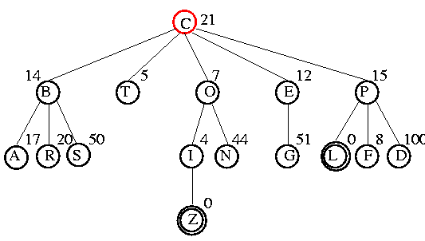
Example

Slide 77
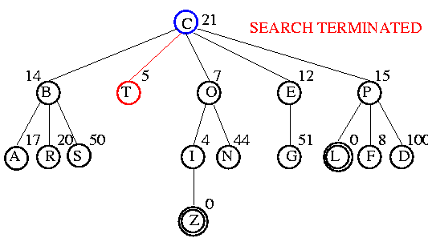
Example

Slide 78
Hill Climbing Issues
Also referred to as gradient descent
Foothill problem / local maxima / local minima
Can be solved with random walk or more steps
Other problems: ridges, plateaus
global maxima
local maxima

Slide 79
Comparison of Search Techniques
 | DFS | BFS | UCS | IDS | Best | HC
Complete | N | Y | Y | Y | N | N
Optimal | N | N | Y | N | N | N
Heuristic | N | N | N | N | Y | Y
Time | b^{m} | b^{d+1} | b^{m} | b^{d} | b^{m} | mn
Space | bm | b^{d+1} | b^{m} | bd | b^{m} | b

Slide 80
Beam Search
QueueingFn is sort-by-h
Only keep best (lowest-h) n nodes on open list
n is the “beam width”
n = 1, Hill climbing
n = infinity, Best first search

Slide 81
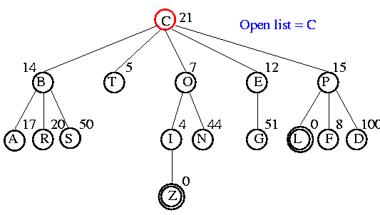
Example

Slide 82
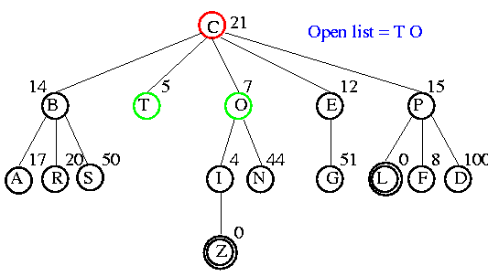
Example

Slide 83
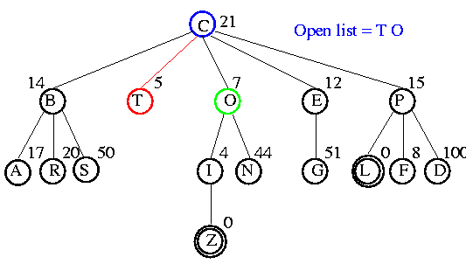
Example

Slide 84
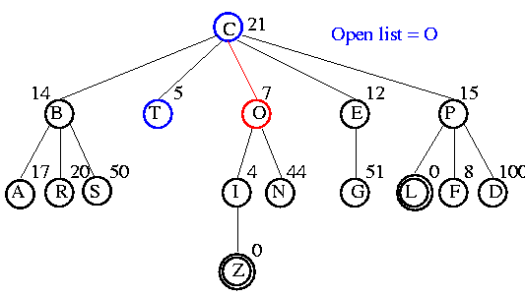
Example

Slide 85
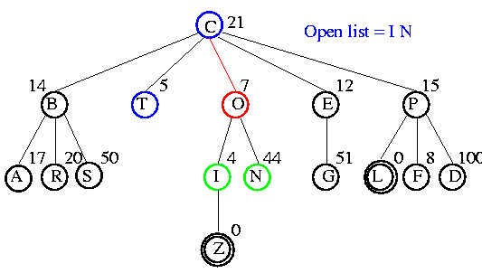
Example

Slide 86
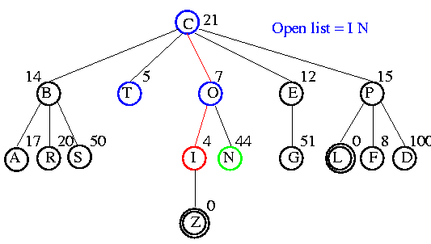
Example

Slide 87
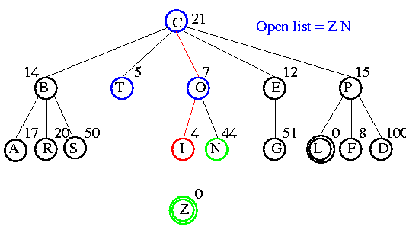
Example

Slide 88
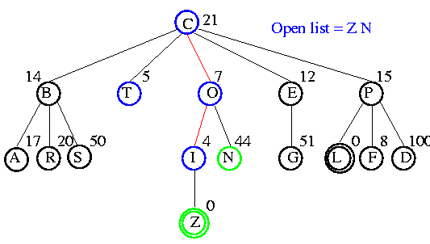
Example

Slide 89
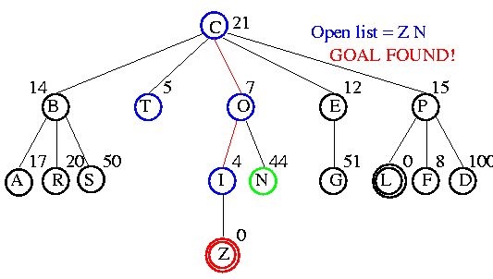
Example

Slide 90
Comparison of Search Techniques
 | DFS | BFS | UCS | IDS | Best | HC | Beam
Complete | N | Y | Y | Y | N | N | N
Optimal | N | N | Y | N | N | N | N
Heuristic | N | N | N | N | Y | Y | Y
Time | b^{m} | b^{d+1} | b^{m} | b^{d} | b^{m} | bm | nm
Space | bm | b^{d+1} | b^{m} | bd | b^{m} | b | bn

Slide 91
A*
QueueingFn is sort-by-f
f(n) = g(n) + h(n)
Note that UCS and Best-first both improve search
UCS keeps solution cost low
Best-first helps find solution quickly
A* combines these approaches

Slide 92
Power of f
If heuristic function is wrong it either
overestimates (guesses too high)
underestimates (guesses too low)
Overestimating is worse than underestimating
A* returns optimal solution if h(n) is admissible
heuristic function is admissible if never overestimates true cost to nearest goal
if search finds optimal solution using admissible heuristic, the search is admissible

Slide 93
Overestimating
A (15)
3
3
2
B (6)
C (20)
D (10)
15
6
20
10
5
E (20)
F(0)
G (12)
H (20)
I(0)
Solution cost:
ABF = 9
ADI = 8
Open list:
A (15) B (9) F (9)
Missed optimal solution

Slide 94

Example
A* applied to 8 puzzle
A* search applet

Slide 95

Example

Slide 96

Example

Slide 97

Example

Slide 98

Example

Slide 99

Example

Slide 100

Example

Slide 101

Example

Slide 102

Example

Slide 103

Optimality of A*
Suppose a suboptimal goal G₂ is on the open list
Let n be unexpanded node on smallest-cost path to optimal goal G₁
f(G₂) = g(G₂) since h(G₂) = 0
>= g(G₁) since G₂ is suboptimal
>= f(n) since h is admissible
Since f(G₂) > f(n), A* will never select G₂ for expansion

Slide 104
Comparison of Search Techniques
 | DFS | BFS | UCS | IDS | Best | HC | Beam | A*
Complete | N | Y | Y | Y | N | N | N | Y
Optimal | N | N | Y | N | N | N | N | Y
Heuristic | N | N | N | N | Y | Y | Y | Y
Time | b^{m} | b^{d+1} | b^{m} | b^{d} | b^{m} | bm | nm | b^{m}
Space | bm | b^{d+1} | b^{m} | bd | b^{m} | b | bn | b^{m}

Slide 105
IDA*
Series of Depth-First Searches
Like Iterative Deepening Search, except
Use A* cost threshold instead of depth threshold
Ensures optimal solution
QueuingFn enqueues at front if f(child) <= threshold
Threshold
h(root) first iteration
Subsequent iterations
f(min_child)
min_child is the cut off child with the minimum f value
Increase always includes at least one new node
Makes sure search never looks beyond optimal cost solution

Slide 106

Example

Slide 107

Example

Slide 108

Example

Slide 109

Example

Slide 110

Example

Slide 111

Example

Slide 112

Example

Slide 113

Example

Slide 114

Example

Slide 115


Example

Slide 116

Example

Slide 117

Example

Slide 118
Example

Slide 119

Example

Slide 120

Example

Slide 121

Example

Slide 122

Example

Slide 123

Example

Slide 124

Example

Slide 125

Example

Slide 126

Example

Slide 127

Example

Slide 128

Example

Slide 129

Example

Slide 130

Example

Slide 131

Example

Slide 132

Example

Slide 133

Example

Slide 134
Analysis
Some redundant search
Small amount compared to work done on last iteration
Dangerous if continuous-valued h(n) values or if values very close
If threshold = 21.1 and value is 21.2, probably only include 1 new node each iteration
Time complexity is O(b^{m})
Space complexity is O(m)

Slide 135
Comparison of Search Techniques
 | DFS | BFS | UCS | IDS | Best | HC | Beam | A* | IDA*
Complete | N | Y | Y | Y | N | N | N | Y | Y
Optimal | N | N | Y | N | N | N | N | Y | Y
Heuristic | N | N | N | N | Y | Y | Y | Y | Y
Time | b^{m} | b^{d+1} | b^{m} | b^{d} | b^{m} | bm | nm | b^{m} | b^{m}
Space | bm | b^{d+1} | b^{m} | bd | b^{m} | b | bn | b^{m} | bm

Slide 136
RBFS
Recursive Best First Search
Linear space variant of A*
Perform A* search but discard subtrees when perform recursion
Keep track of alternative (next best) subtree
Expand subtree until f value greater than bound
Update f values before (from parent) and after (from descendant) recursive call

Slide 137
Algorithm
// Input is current node and f limit
// Returns goal node or failure, updated limit
RBFS(n, limit)
if Goal(n)
return n
children = Expand(n)
if children empty
return failure, infinity
for each c in children
f[c] = max(g(c)+h(c), f[n]) // Update f[c] based on parent
repeat
best = child with smallest f value
if f[best] > limit
return failure, f[best]
alternative = second-lowest f-value among children
newlimit = min(limit, alternative)
result, f[best] = RBFS(best, newlimit) // Update f[best] based on descendant
if result not equal to failure
return result

Slide 138

Example

Slide 139

Example

Slide 140

Example

Slide 141

Example

Slide 142

Example

Slide 143

Example

Slide 144
Analysis
Optimal if h(n) is admissible
Space is O(bm)
Features
Potentially exponential time in cost of solution
More efficient than IDA*
Keeps more information than IDA* but benefits from storing this information

Slide 145
SMA*
Simplified Memory-Bounded A* Search
Perform A* search
When memory is full
Discard worst leaf (largest f(n) value)
Back value of discarded node to parent
Optimal if solution fits in memory

Slide 146

Example
Let MaxNodes = 3
Initially B&G added to open list, then hit max
B is larger f value so discard but save f(B)=15 at parent A
Add H but f(H)=18. Not a goal and cannot go deper, so set f(h)=infinity and save at G.
Generate next child I with f(I)=24, bigger child of A. We have seen all children of G, so reset f(G)=24.
Regenerate B and child C. This is not goal so f(c) reset to infinity
Generate second child D with f(D)=24, backing up value to ancestors
D is a goal node, so search terminates.

Slide 147
Heuristic Functions
Q: Given that we will only use heuristic functions that do not overestimate, what type of heuristic functions (among these) perform best?
A: Those that produce higher h(n) values.

Slide 148
Reasons
Higher h value means closer to actual distance
Any node n on open list with
f(n) < f*(goal)
will be selected for expansion by A*
This means if a lot of nodes have a low underestimate (lower than actual optimum cost)
All of them will be expanded
Results in increased search time and space

Slide 149
Informedness
If h1 and h2 are both admissible and
For all x, h1(x) > h2(x), then h1 “dominates” h2
Can also say h1 is “more informed” than h2
Example
h1(x):
h2(x): Euclidean distance
h2 dominates h1

Slide 150
Effect on Search Cost
If h2(n) >= h1(n) for all n (both are admissible)
then h2 dominates h1 and is better for search
Typical search costs
d=14, IDS expands 3,473,941 nodes
A* with h1 expands 539 nodes
A* with h2 expands 113 nodes
d=24, IDS expands ~54,000,000,000 nodes
A* with h1 expands 39,135 nodes
A* with h2 expands 1,641 nodes

Slide 151
Which of these heuristics are admissible? Which are more informed?
h1(n) = #tiles in wrong position
h2(n) = Sum of Manhattan distance between each tile and goal location for the tile
h3(n) = 0
h4(n) = 1
h5(n) = min(2, h*[n])
h6(n) = Manhattan distance for blank tile
h7(n) = max(2, h*[n])
Notes:
h1(S) = 7
h2(S) = 2+3+3+2+4+2+0+2 = 18

Slide 152
Generating Heuristic Functions
Generate heuristic for simpler (relaxed) problem
Relaxed problem has fewer restrictions
Eight puzzle where multiple tiles can be in the same spot
Cost of optimal solution to relaxed problem is an admissible heuristic for the original problem
Learn heuristic from experience

Slide 153
Iterative Improvement Algorithms
Hill climbing
Simulated annealing
Genetic algorithms

Slide 154
Iterative Improvement Algorithms
For many optimization problems, solution path is irrelevant
Just want to reach goal state
State space / search space
Set of “complete” configurations
Want to find optimal configuration (or at least one that satisfies goal constraints)
For these cases, use iterative improvement algorithm
Keep a single current state
Try to improve it
Constant memory

Slide 155

Example
Traveling salesman
Start with any complete tour
Operator: Perform pairwise exchanges

Slide 156

Example
N-queens
Put n queens on an n × n board with no two queens on the same row, column, or diagonal
Operator: Move queen to reduce #conflicts

Slide 157

Hill Climbing (gradient ascent/descent)
“Like climbing Mount Everest in thick fog with amnesia”

Slide 158


Slide 159
Local Beam Search
Keep k states instead of 1
Choose top k of all successors
Problem
Many times all k states end up on same local hill
Choose k successors RANDOMLY
Bias toward good ones
Similar to natural selection

Slide 160
Simulated Annealing
Pure hill climbing is not complete, but pure random search is inefficient.
Simulated annealing offers a compromise.
Inspired by annealing process of gradually cooling a liquid until it changes to a low-energy state.
Very similar to hill climbing, except include a user-defined temperature schedule.
When temperature is “high”, allow some random moves.
When temperature “cools”, reduce probability of random move.
If T is decreased slowly enough, guaranteed to reach best state.

Slide 161
Algorithm
function SimulatedAnnealing(problem, schedule) // returns solution state
current = MakeNode(Initial-State(problem))
for t = 1 to infinity
T = schedule[t]
if T = 0
return current
next = randomly-selected child of current
= Value[next] - Value[current]
if > 0
current = next // if better than accept state
else current = next with probability
Simulated annealing applet
Traveling salesman simulated annealing applet

Slide 162
Genetic Algorithms
What is a Genetic Algorithm (GA)?
An adaptation procedure based on the mechanics of natural genetics and natural selection
Gas have 2 essential components
Survival of the fittest
Recombination
Representation
Chromosome = string
Gene = single bit or single subsequence in string, represents 1 attribute

Slide 163


Slide 164
Humans
DNA made up of 4 nucleic acids (4-bit code)
46 chromosomes in humans, each contain 3 billion DNA
4^{3 billion} combinations of bits
Can random search find humans?
Assume only 0.1% genome must be discovered, 3(10⁶) nucleotides
Assume very short generation, 1 generation/second
3.2(¹⁰¹⁰⁷) individuals per year, but 10^{1.8(107)} alternatives
10¹⁸¹⁰⁶ years to generate human randomly
Self reproduction, self repair, adaptability are the rule in natural systems, they hardly exist in the artificial world
Finding and adopting nature’s approach to computational design should unlock many doors in science and engineering

Slide 165
GAs Exhibit Search
Each attempt a GA makes towards a solution is called a chromosome
A sequence of information that can be interpreted as a possible solution
Typically, a chromosome is represented as sequence of binary digits
Each digit is a gene
A GA maintains a collection or population of chromosomes
Each chromosome in the population represents a different guess at the solution

Slide 166
The GA Procedure
Initialize a population (of solution guesses)
Do (once for each generation)
Evaluate each chromosome in the population using a fitness function
Apply GA operators to population to create a new population
Finish when solution is reached or number of generations has reached an allowable maximum.

Slide 167
Common Operators
Reproduction
Crossover
Mutation

Slide 168
Reproduction
Select individuals x according to their fitness values f(x)
Like beam search
Fittest individuals survive (and possibly mate) for next generation

Slide 169
Crossover
Select two parents
Select cross site
Cut and splice pieces of one parent to those of the other
1 1 1 1 1
0 0 0 0 0
1 1 0 0 0
0 0 1 1 1

Slide 170
Mutation
With small probability, randomly alter 1 bit
Minor operator
An insurance policy against lost bits
Pushes out of local minima
Population:
1 1 0 0 0 0
1 0 1 0 0 0
1 0 0 1 0 0
0 1 0 0 0 0
Goal: 0 1 1 1 1 1
Mutation needed to find the goal

Slide 171
Example
Solution = 0 0 1 0 1 0
Fitness(x) = #digits that match solution
A) 0 1 0 1 0 1 Score: 1
B) 1 1 1 1 0 1 Score: 1
C) 0 1 1 0 1 1 Score: 3
D) 1 0 1 1 0 0 Score: 3
Recombine top two twice.
Note: 64 possible combinations

Slide 172
Example
Solution = 0 0 1 0 1 0
C) 0 1 1 0 1 1
D) 1 0 1 1 0 0
E) 0 | 0 1 1 0 0 Score: 4
F) 1 | 1 1 0 1 1 Score: 3
G) 0 1 1 0 1 | 0 Score: 4
H) 1 0 1 1 0 | 1 Score: 2
Next generation:
E) 0 0 1 1 0 0
F) 0 1 1 0 1 0
G) 0 1 1 | 1 0 0 Score: 3
H) 0 0 1 | 0 1 0 Score: 6
I) 0 0 | 1 0 1 0 Score: 6
J) 0 1 | 1 1 0 0 Score: 3
DONE! Got it in 10 guesses.

Slide 173
Issues
How select original population?
How handle non-binary solution types?
What should be the size of the population?
What is the optimal mutation rate?
How are mates picked for crossover?
Can any chromosome appear more than once in a population?
When should the GA halt?
Local minima?
Parallel algorithms?

Slide 174

GAs for Mazes

Slide 175
GAs for Optimization
Traveling salesman problem
Eaters
Hierarchical GAs for game playing

Slide 176
GAs for Control
Simulator

Slide 177
GAs for Graphic Animation
Simulator
Evolving Circles
3D Animation
Scientific American Frontiers

Slide 178

Biased Roulette Wheel
For each hypothesis, spin the roulette wheel to determine the guess

Slide 179
Inversion
Invert selected subsequence
1 0 | 1 1 0 | 1 1 -> 1 0 0 1 1 1 1

Slide 180
Elitism
Some of the best chromosomes from previous generation replace some of the worst chromosomes from current generation

Slide 181
K-point crossover
Pick k random splice points to crossover parents
Example
K = 3
1 1 | 1 1 1 | 1 1 | 1 1 1 1 1 -> 1 1 0 0 0 1 1 0 0 0 0 0
0 0 | 0 0 0 | 0 0 | 0 0 0 0 0 0 0 1 1 1 0 0 1 1 1 1 1

Slide 182
Diversity Measure
Fitness ignores diversity
As a result, populations tend to become uniform
Rank-space method
Sort population by sum of fitness rank and diversity rank
Diversity rank is the result of sorting by the function 1/d²

Slide 183
Classifier Systems
GAs and load balancing
SAMUEL

