Slide 1
Artificial Intelligence
Adversarial Search

Slide 2
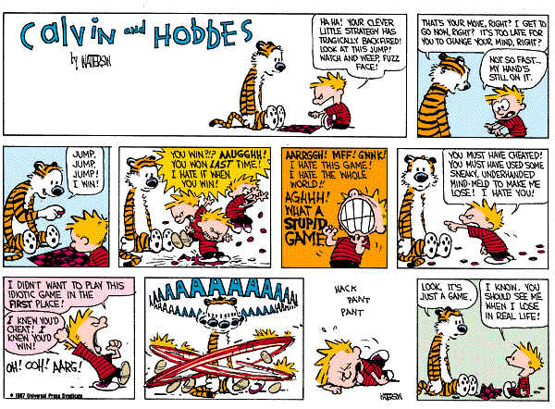
Game Playing

Slide 3
Why Study Game Playing?
Games allow us to experiment with easier versions of real-world situations
Hostile agents act against our goals
Games have a finite set of moves
Games are fairly easy to represent
Good idea to decide about what to think
Perfection is unrealistic, must settle for good
One of the earliest areas of AI
Claude Shannon and Alan Turing wrote chess programs in 1950s
The opponent introduces uncertainty
The environment may contain uncertainty (backgammon)
Search space too hard to consider exhaustively
Chess has about 10⁴⁰ legal positions
Efficient and effective search strategies even more critical
Games are fun to target!

Slide 4
Assumptions
Static or dynamic?
Fully or partially observable?
Discrete or continuous?
Deterministic or stochastic?
Episodic or sequential?
Single agent or multiple agent?

Slide 5
Zero-Sum Games
Focus primarily on “adversarial games”
Two-player, zero-sum games
As Player 1 gains strength
Player 2 loses strength
and vice versa
The sum of the two strengths is always 0.

Slide 6
Search Applied to Adversarial Games
Initial state
Current board position (description of current game state)
Operators
Legal moves a player can make
Terminal nodes
Leaf nodes in the tree
Indicate the game is over
Utility function
Payoff function
Value of the outcome of a game
Example: tic tac toe, utility is -1, 0, or 1

Slide 7
Using Search
Search could be used to find a perfect sequence of moves except the following problems arise:
There exists an adversary who is trying to minimize your chance of winning every other move
You cannot control his/her move
Search trees can be very large, but you have finite time to move
Chess has 10⁴⁰ nodes in search space
With single-agent search, can afford to wait
Some two-player games have time limits
Solution?
Search to n levels in the tree (n ply)
Evaluate the nodes at the nth level
Head for the best looking node

Slide 8
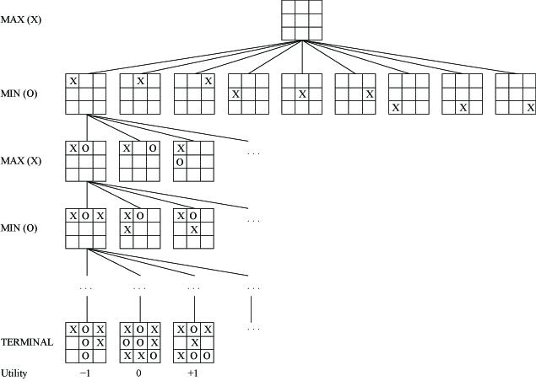
Game Trees
Tic tac toe
Two players, MAX and MIN
Moves (and levels) alternate between two players

Slide 9
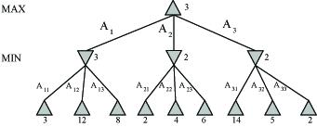
Minimax Algorithm
Search the tree to the end
Assign utility values to terminal nodes
Find the best move for MAX (on MAX’s turn), assuming:
MAX will make the move that maximizes MAX’s utility
MIN will make the move that minimizes MAX’s utility
Here, MAX should make the leftmost move
Minimax applet

Slide 10
Minimax Properties
Complete if tree is finite
Optimal if play against opponent with same strategy (utility function)
Time complexity is O(b^{m})
Space complexity is O(bm) (depth-first exploration)
If we have 100 seconds to make a move
Can explore 10⁴ nodes/second
Can consider 10⁶ nodes / move
Standard approach is
Apply a cutoff test (depth limit, quiescence)
Evaluate nodes at cutoff (evaluation function estimates desirability of position)

Slide 11
Static Board Evaluator
We cannot look all the way to the end of the game
Look ahead ply moves
Evaluate nodes there using SBE
Tic Tac Toe example
#unblocked lines with Xs - #unblocked lines with Os
Tradeoff
Stupid, fast SBE: Massive search
These are “Type A” systems
Smart, slow SBE: Very little search
These are “Type B” systems
Humans are Type B systems
Computer chess systems have been more successful using Type A
They get better by searching more ply

Slide 12
Comparison

Slide 13
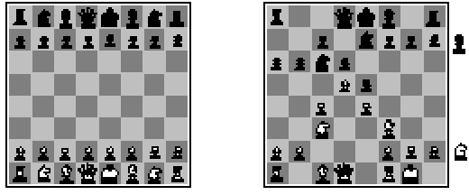
Example
Chess, SBE is typically linear weighted sum of features
SBE(s) = w₁f₁(s) + w₂f₂(s) + … + w_{n}f_{n}(s)
E.g., w₁ = 9
F₁(s) = #white queens - #black queens
For chess:
4 ply is human novice
8 ply is typical PC or human master
12 ply is grand master

Slide 14
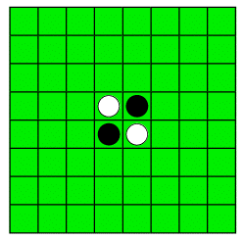
Example
Othello
SBE1: #white pieces - #black pieces
SBE2: weighted squares

Slide 15
Alpha-Beta Pruning
Typically can only look 3-4 ply in allowable chess time
Alpha-beta pruning simplifies search space without eliminating optimality
By applying common sense
If one route allows queen to be captured and a better move is available
Then don’t search further down bad path
If one route would be bad for opponent, ignore that route also
Max
2
7
1
No need to
look here!
Maintain [alpha, beta] window at each node during depth-first search
alpha = lower bound, change at max levels
beta = upper bound, change at min levels

Slide 16
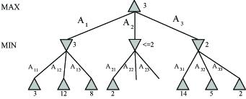
Example

Slide 17
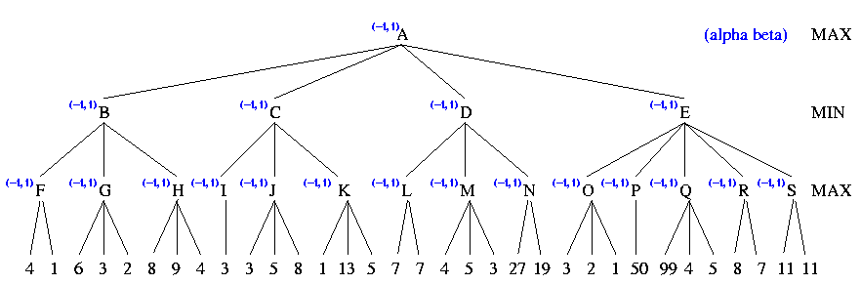
Example

Slide 18
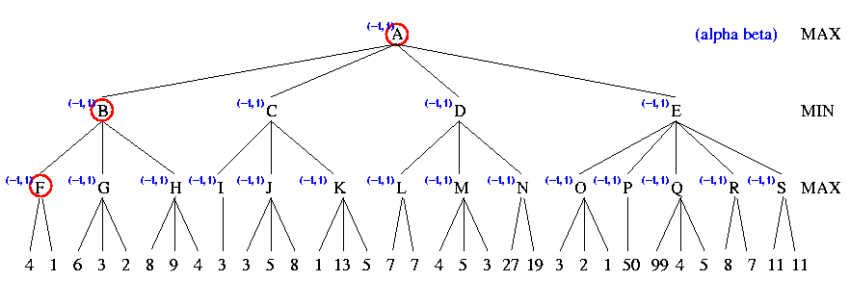
Example

Slide 19
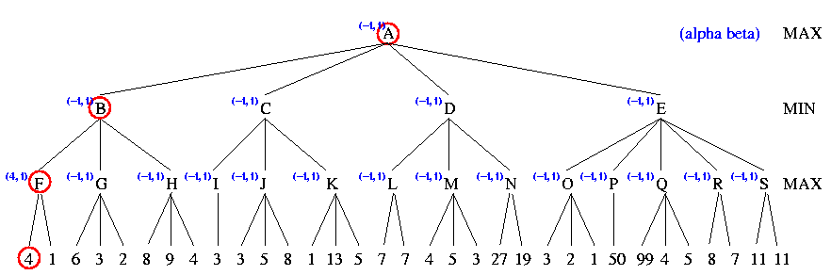
Example

Slide 20
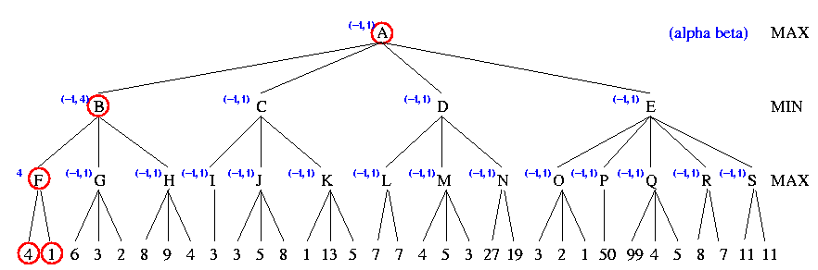
Example

Slide 21
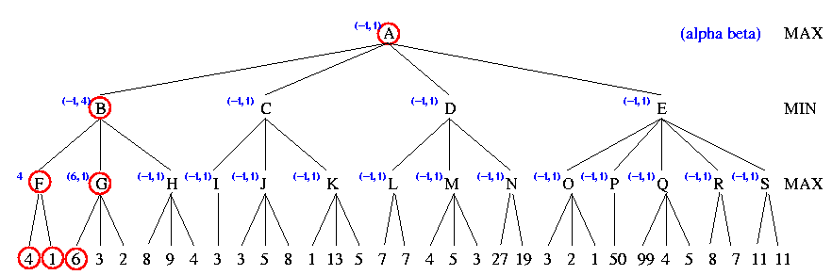
Example

Slide 22
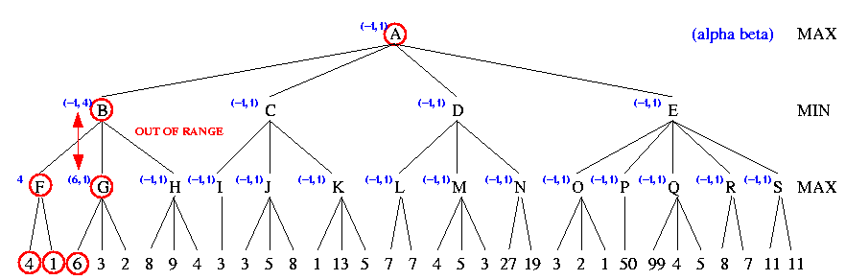
Example

Slide 23
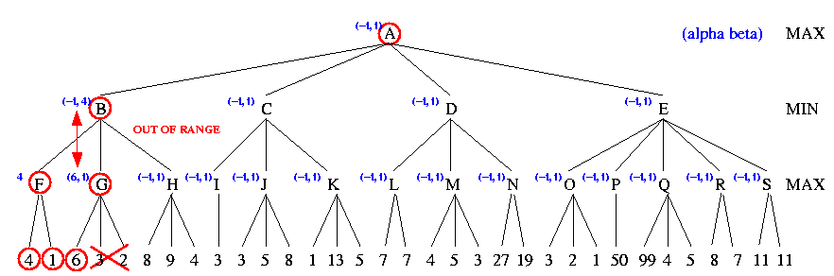
Example

Slide 24
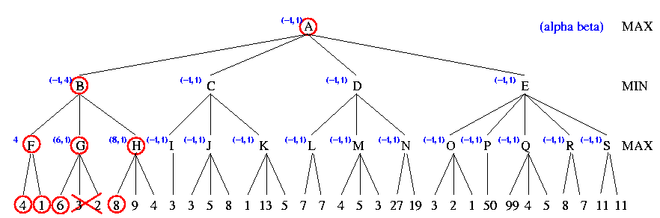
Example

Slide 25
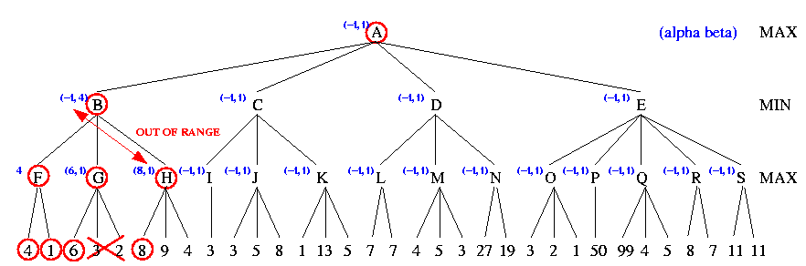
Example

Slide 26
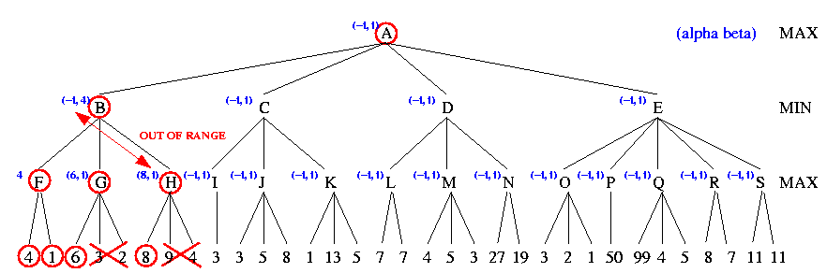
Example

Slide 27
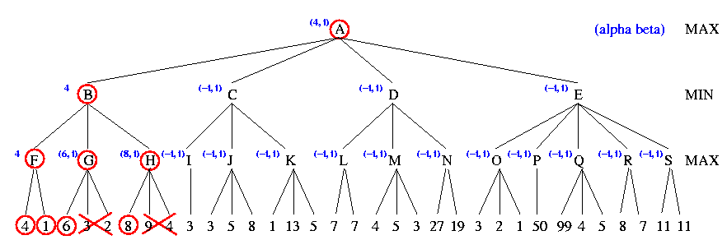
Example

Slide 28
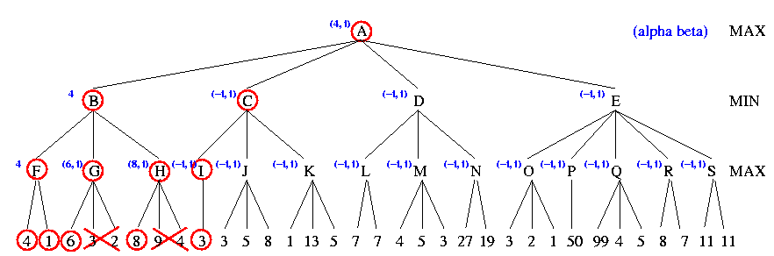
Example

Slide 29
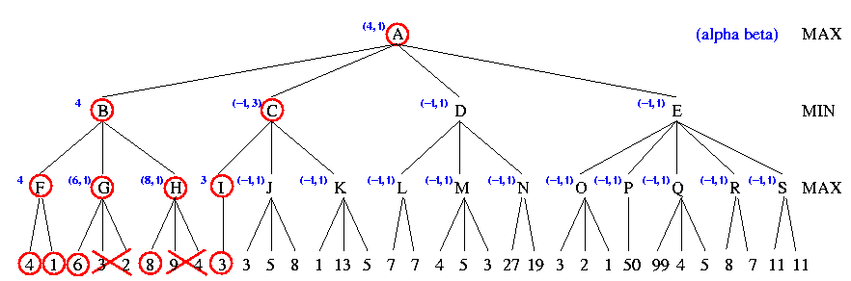
Example

Slide 30
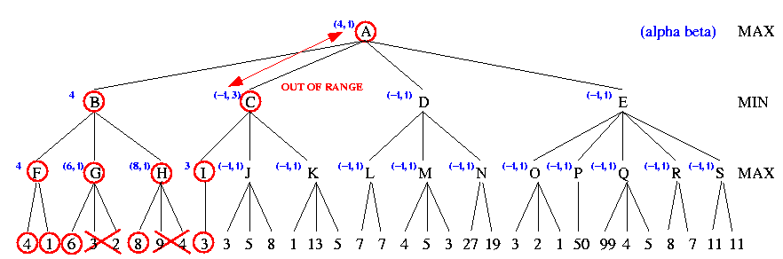
Example

Slide 31
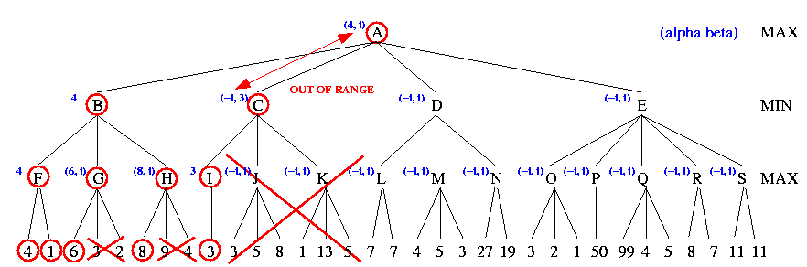
Example

Slide 32
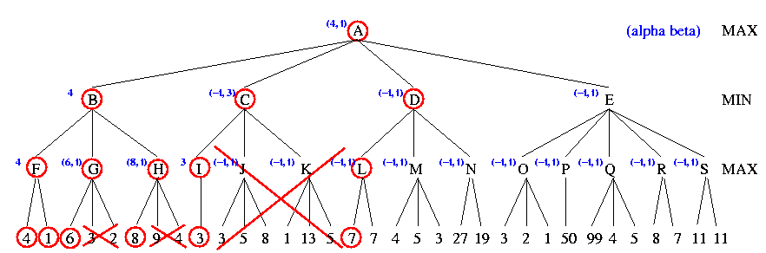
Example

Slide 33

Example

Slide 34
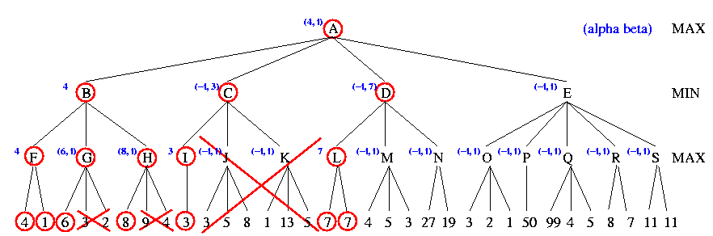
Example

Slide 35
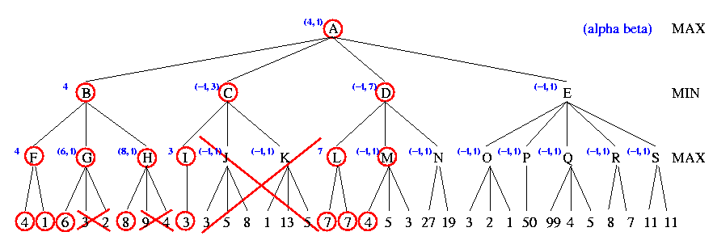
Example

Slide 36
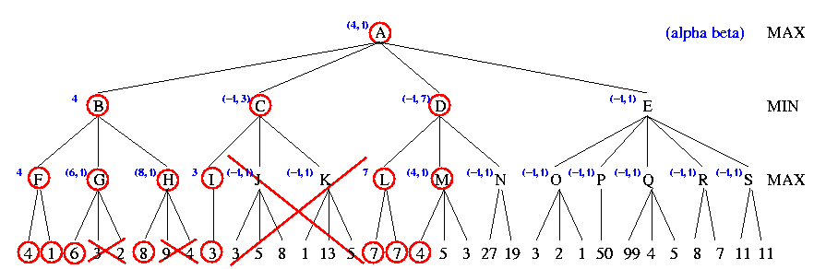
Example

Slide 37
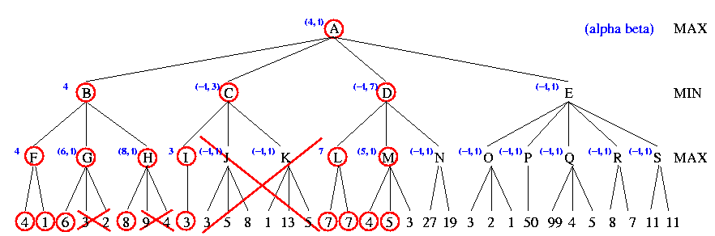
Example

Slide 38
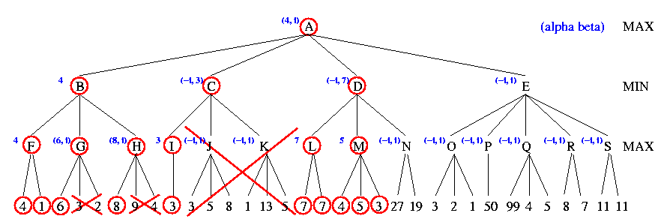
Example

Slide 39

Example

Slide 40
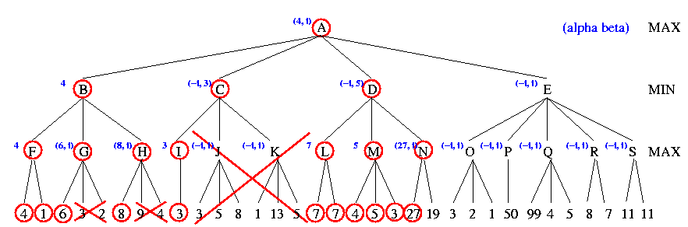
Example

Slide 41
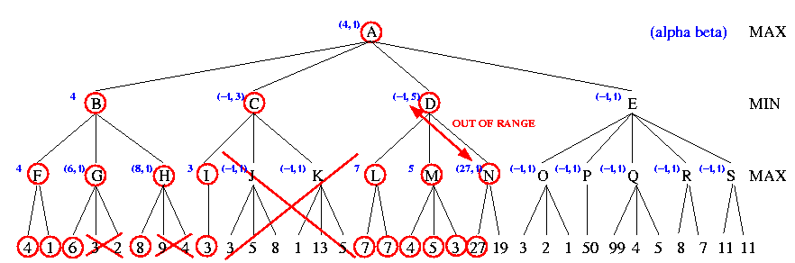
Example

Slide 42
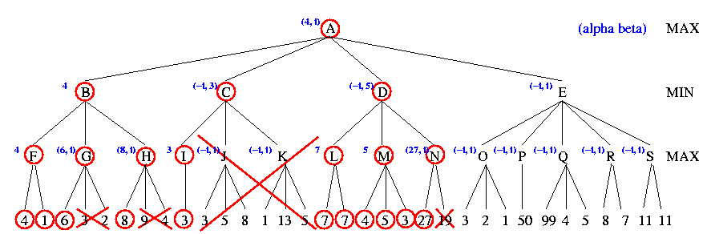
Example

Slide 43
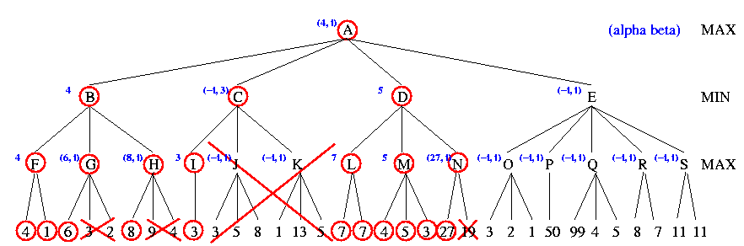
Example

Slide 44

Example

Slide 45
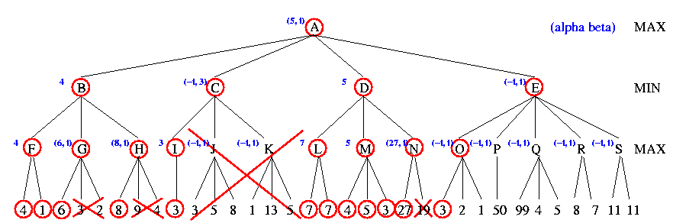
Example

Slide 46

Example

Slide 47
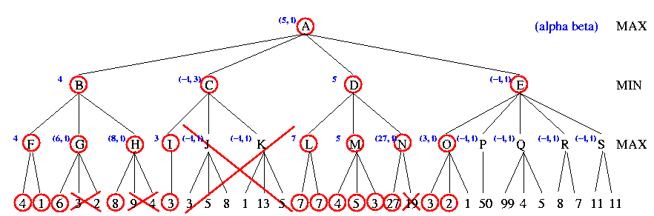
Example

Slide 48
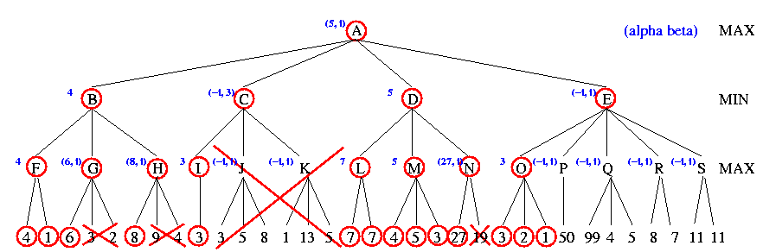
Example

Slide 49

Example

Slide 50
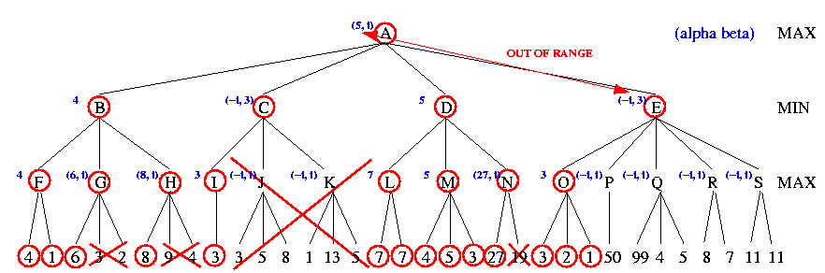
Example

Slide 51
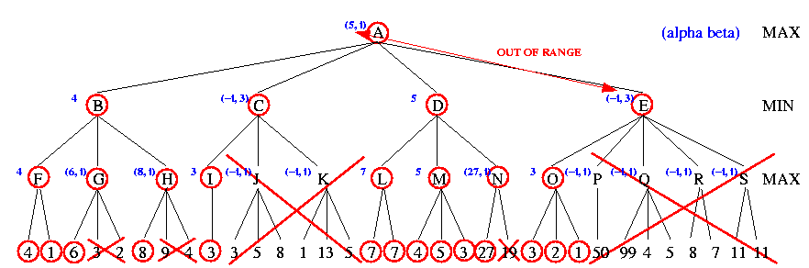
Example

Slide 52
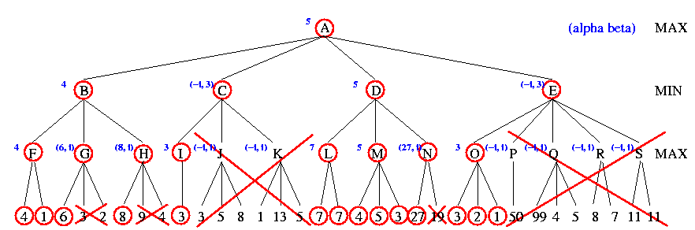
Example

Slide 53
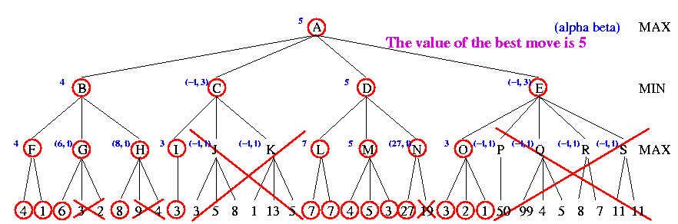
Example

Slide 54
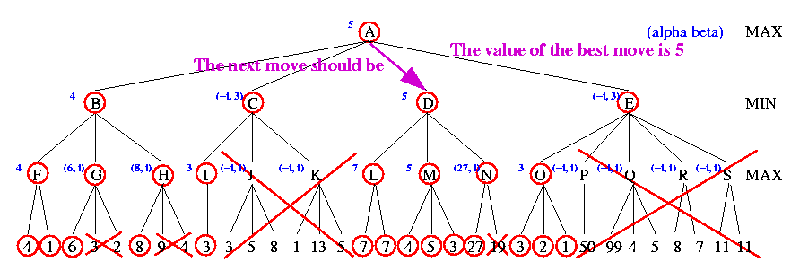
Example

Slide 55
Bad and Good Cases for Alpha-Beta Pruning
Bad: Worst moves encountered first
Good: Good moves ordered first
If we can order moves, we can get more benefit from alpha-beta pruning
4 MAX
+----------------+----------------+
2 3 4 MIN
+----+----+ +----+----+ +----+----+
6 4 2 7 5 3 8 6 4 MAX
+--+ +--+ +--+ +-+-+ +--+ +--+ +--+ +--+ +--+--+
6 5 4 3 2 1 1 3 7 4 5 2 3 8 2 1 6 1 2 4
4 MAX
+----------------+----------------+
4 3 2 MIN
+----+----+ +----+----+ +----+----+
4 6 8 3 x x 2 x x MAX
+--+ +--+ +--+ +--+ +-+-+
4 2 6 x 8 x 3 2 1 2 1

Slide 56
Alpha Beta Properties
Pruning does not affect final result
Good move ordering improves effectiveness of pruning
With perfect ordering, time complexity is O(b^{m/2})

Slide 57
Problems with a fixed ply: The Horizon Effect
Lose queen
Lose pawn
The “look ahead horizon”
Lose queen!!!
Inevitable losses are postponed
Unachievable goals appear achievable
Short-term gains mask unavoidable consequences (traps)

Slide 58
Solutions
How to counter the horizon effect
Feedover
Do not cut off search at non-quiescent board positions (dynamic positions)
Example, king in danger
Keep searching down that path until reach quiescent (stable) nodes
Secondary Search
Search further down selected path to ensure this is the best move
Progressive Deepening
Search one ply, then two ply, etc., until run out of time
Similar to IDS

Slide 59
Variations on 2-Player Games Multiplayer Games
to move
1 (1 2 3)
+------------------+ +---------------------+
2 (1 2 3) (-1 5 2)
+--------+ +-----+ +--------+ +-------+
3 (1 2 3) (6 1 2) (-1 5 2) (5 4 5)
/ \ / \ / \ / \
1 (1 2 3) (4 2 1) (6 1 2) (7 4 -1) (5 -1 -1) (-1 5 2) (7 7 -1) (5 4 5)
Each player maximizes utility
Each node stores a vector of utilities
Entire vector is backed up the tree
3-player example: If in leftmost state, should player 3 choose first move because higher utility values?
Result will be terminal state with utility values (v1=1, v2=2, v3=3)
This vector is backed up to the parent node
Need to consider cooperation among players

Slide 60
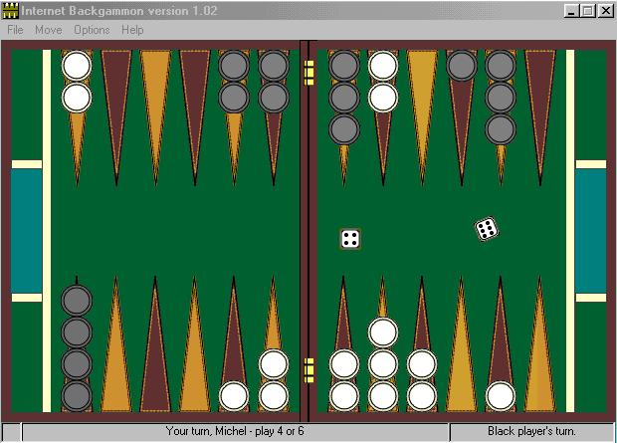
Nondeterministic Games
In backgammon, the dice rolls determine legal moves

Slide 61
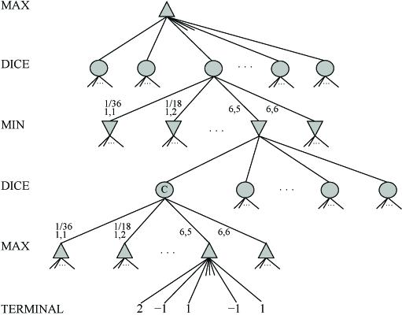
Nondeterministic Games

Slide 62
Nondeterministic Game Algorithm
Just like Minimax except also handle chance nodes
Compute ExpectMinimaxValue of successors
If n is terminal node, then ExpectMinimaxValue(n) = Utility(n)
If n is a Max node, then ExpectMinimaxValue(n) = max_{s∈Successors(n)} ExpectMinimaxValue(s)
If n is a Min node, then ExpectMinimaxValue(n) = min_{s∈Successors(n)} ExpectMinimaxValue(s)
If n is a chance node, then ExpectMinimaxValue(n) = ∑_{s∈Successors(n)} P(s) * ExpectMinimaxValue(s)

Slide 63
Status of AI Game Players
Tic Tac Toe
Tied for best player in world
Othello
Computer better than any human
Human champions now refuse to play computer
Scrabble
Maven beat world champions Joel Sherman and Matt Graham
Backgammon
1992, Tesauro combines 3-ply search & neural networks (with 160 hidden units) yielding top-3 player
Bridge
Gib ranked among top players in the world
Poker
Pokie plays at strong intermediate level
Checkers
1994, Chinook ended 40-year reign of human champion Marion Tinsley
Chess
1997, Deep Blue beat human champion Gary Kasparov in six-game match
Deep Blue searches 200M positions/second, up to 40 ply
Now looking at other applications (molecular dynamics, drug synthesis)
Go
2008, MoGo running on 25 nodes (800 cores) beat Myungwan Kim
$2M prize available for first computer program to defeat a top player

