Slide 1
Chapter 4: Processes
Process Concept
Process Scheduling
Operations on Processes
Cooperating Processes
Interprocess Communication
Communication in Client-Server Systems

Slide 2
Process Concept
An operating system executes a variety of programs:
  Batch system – jobs
  Time-shared systems – user programs or tasks
Textbook uses the terms job and process almost interchangeably
Process – a program in execution; process execution must progress in sequential fashion
A process includes:
  program counter
  stack
  data section

Slide 3
Process State
As a process executes, it changes state
  new: The process is being created
  running: Instructions are being executed
  waiting: The process is waiting for some event to occur
  ready: The process is waiting to be assigned to a process
  terminated: The process has finished execution

Slide 4

Diagram of Process State

Slide 5
Process Control Block (PCB)
Information associated with each process
Process state
Program counter
CPU registers
CPU scheduling information
Memory-management information
Accounting information
I/O status information

Slide 6
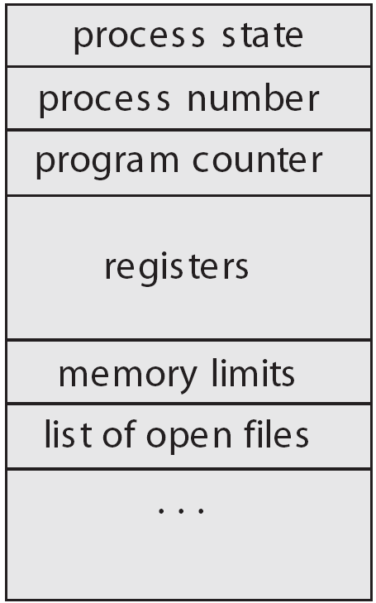
Process Control Block (PCB)

Slide 7

CPU Switch From Process to Process

Slide 8
Process Scheduling Queues
Job queue – set of all processes in the system
Ready queue – set of all processes residing in main memory, ready and waiting to execute
Device queues – set of processes waiting for an I/O device
Process migration between the various queues

Slide 9

Ready Queue And Various I/O Device Queues

Slide 10

Representation of Process Scheduling

Slide 11
Schedulers
Long-term scheduler (or job scheduler) – selects which processes should be brought into the ready queue
Short-term scheduler (or CPU scheduler) – selects which process should be executed next and allocates CPU

Slide 12

Addition of Medium Term Scheduling

Slide 13
Schedulers (Cont.)
Short-term scheduler is invoked very frequently (milliseconds) ⇒ (must be fast)
Long-term scheduler is invoked very infrequently (seconds, minutes) ⇒ (may be slow)
The long-term scheduler controls the degree of multiprogramming
Processes can be described as either:
  I/O-bound process – spends more time doing I/O than computations, many short CPU bursts
  CPU-bound process – spends more time doing computations; few very long CPU bursts

Slide 14
Context Switch
When CPU switches to another process, the system must save the state of the old process and load the saved state for the new process
Context-switch time is overhead; the system does no useful work while switching
Time dependent on hardware support

Slide 15
Process Creation
Parent process create children processes, which, in turn create other processes, forming a tree of processes
Resource sharing
  Parent and children share all resources
  Children share subset of parent’s resources
  Parent and child share no resources
Execution
  Parent and children execute concurrently
  Parent waits until children terminate

Slide 16
Process Creation (Cont.)
Address space
  Child duplicate of parent
  Child has a program loaded into it
UNIX examples
  fork system call creates new process
  exec system call used after a fork to replace the process’ memory space with a new program

Slide 17
C Program Forking Separate Process
#include <stdio.h>
#include <unistd.h>
int main(int argc, char *argv[])
{
int pid;
/* fork another process */
pid = fork();
if (pid < 0) { /* error occurred */
fprintf(stderr, "Fork Failed");
exit(-1);
}
else if (pid == 0) { /* child process */
execlp("/bin/ls","ls",NULL);
}
else { /* parent process */
/* parent will wait for the child to complete */
wait(NULL);
printf("Child Complete");
exit(0);
}
}

Slide 18

Processes Tree on a UNIX System

Slide 19
Process Termination
Process executes last statement and asks the operating system to decide it (exit)
  Output data from child to parent (via wait)
  Process’ resources are deallocated by operating system
Parent may terminate execution of children processes (abort)
  Child has exceeded allocated resources
  Task assigned to child is no longer required
  If parent is exiting
    Some operating system do not allow child to continue if its parent terminates
      All children terminated - cascading termination

Slide 20
Cooperating Processes
Independent process cannot affect or be affected by the execution of another process
Cooperating process can affect or be affected by the execution of another process
Advantages of process cooperation
  Information sharing
  Computation speed-up
  Modularity
  Convenience

Slide 21
Producer-Consumer Problem
Paradigm for cooperating processes, producer process produces information that is consumed by a consumer process
  unbounded-buffer places no practical limit on the size of the buffer
  bounded-buffer assumes that there is a fixed buffer size

Slide 22
Bounded-Buffer – Shared-Memory Solution
public interface Buffer
{
// producers call this method
public abstract void insert(Object item);
// consumers call this method
public abstract Object remove();
}

Slide 23
Bounded-Buffer – Shared Memory Solution
import java.util.*;
public class BoundedBuffer implements Buffer
{
  private static final int BUFFER SIZE = 5;
  private int count; // number of items in the buffer
  private int in; // points to the next free position
  private int out; // points to the next full position
  private Object[] buffer;
  public BoundedBuffer() {
    // buffer is initially empty
    count = 0;
    in = 0;
    out = 0;
    buffer = new Object[BUFFER SIZE];
}
  // producers calls this method
  public void insert(Object item) {
  // Slide 4.24
  }
  // consumers calls this method
  public Object remove() {
  // Figure 4.25
  }
}

Slide 24
Bounded-Buffer – Insert() Method
public void insert(Object item) {
while (count == BUFFER SIZE)
; // do nothing -- no free buffers
// add an item to the buffer
++count;
buffer[in] = item;
in = (in + 1) % BUFFER SIZE;
}

Slide 25
Bounded Buffer – Remove() Method
public Object remove() {
Object item;
while (count == 0)
; // do nothing -- nothing to consume
// remove an item from the buffer
--count;
item = buffer[out];
out = (out + 1) % BUFFER SIZE;
return item;
}

Slide 26
Interprocess Communication (IPC)
Mechanism for processes to communicate and to synchronize their actions
Message system – processes communicate with each other without resorting to shared variables
IPC facility provides two operations:
  send(message) – message size fixed or variable
  receive(message)
If P and Q wish to communicate, they need to:
  establish a communication link between them
  exchange messages via send/receive
Implementation of communication link
  physical (e.g., shared memory, hardware bus)
  logical (e.g., logical properties)

Slide 27
Implementation Questions
How are links established?
Can a link be associated with more than two processes?
How many links can there be between every pair of communicating processes?
What is the capacity of a link?
Is the size of a message that the link can accommodate fixed or variable?
Is a link unidirectional or bi-directional?

Slide 28
Direct Communication
Processes must name each other explicitly:
  send (P, message) – send a message to process P
  receive(Q, message) – receive a message from process Q
Properties of communication link
  Links are established automatically
  A link is associated with exactly one pair of communicating processes
  Between each pair there exists exactly one link
  The link may be unidirectional, but is usually bi-directional

Slide 29
Indirect Communication
Messages are directed and received from mailboxes (also referred to as ports)
  Each mailbox has a unique id
  Processes can communicate only if they share a mailbox
Properties of communication link
  Link established only if processes share a common mailbox
  A link may be associated with many processes
  Each pair of processes may share several communication links
  Link may be unidirectional or bi-directional

Slide 30
Indirect Communication
Operations
  create a new mailbox
  send and receive messages through mailbox
  destroy a mailbox
Primitives are defined as:
send(A, message) – send a message to mailbox A
receive(A, message) – receive a message from mailbox A

Slide 31
Indirect Communication
Mailbox sharing
  P₁, P₂, and P₃ share mailbox A
  P₁, sends; P₂ and P₃ receive
  Who gets the message?
Solutions
  Allow a link to be associated with at most two processes
  Allow only one process at a time to execute a receive operation
  Allow the system to select arbitrarily the receiver. Sender is notified who the receiver was.

Slide 32
Synchronization
Message passing may be either blocking or non-blocking
Blocking is considered synchronous
  Blocking send has the sender block until the message is received
  Blocking receive has the receiver block until a message is available
Non-blocking is considered asynchronous
  Non-blocking send has the sender send the message and continue
  Non-blocking receive has the receiver receive a valid message or null

Slide 33
Buffering
Queue of messages attached to the link; implemented in one of three ways
  1. Zero capacity – 0 messages
  Sender must wait for receiver (rendezvous)
  2. Bounded capacity – finite length of n messages
  Sender must wait if link full
  3. Unbounded capacity – infinite length
  Sender never waits

Slide 34
Client-Server Communication
Sockets
Remote Procedure Calls
Remote Method Invocation (Java)

Slide 35
Sockets
A socket is defined as an endpoint for communication
Concatenation of IP address and port
The socket 161.25.19.8:1625 refers to port 1625 on host 161.25.19.8
Communication consists between a pair of sockets

Slide 36

Socket Communication

Slide 37
Remote Procedure Calls
Remote procedure call (RPC) abstracts procedure calls between processes on networked systems.
Stubs – client-side proxy for the actual procedure on the server.
The client-side stub locates the server and marshalls the parameters.
The server-side stub receives this message, unpacks the marshalled parameters, and peforms the procedure on the server.

Slide 38

Execution of RPC

Slide 39
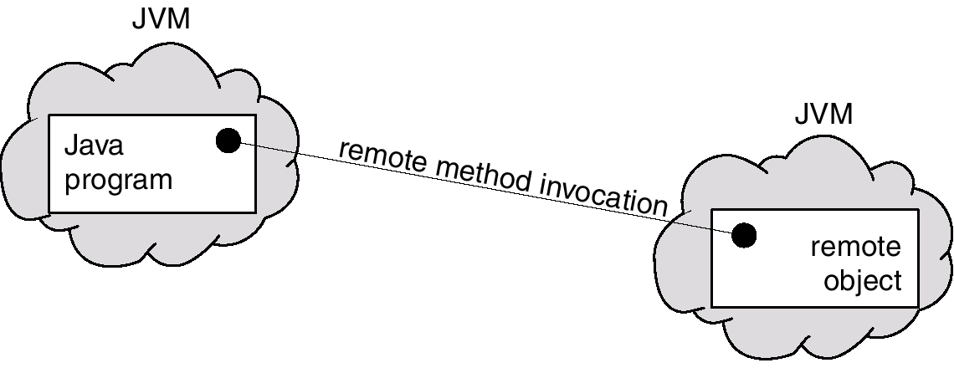
Remote Method Invocation
Remote Method Invocation (RMI) is a Java mechanism similar to RPCs.
RMI allows a Java program on one machine to invoke a method on a remote object.

Slide 40
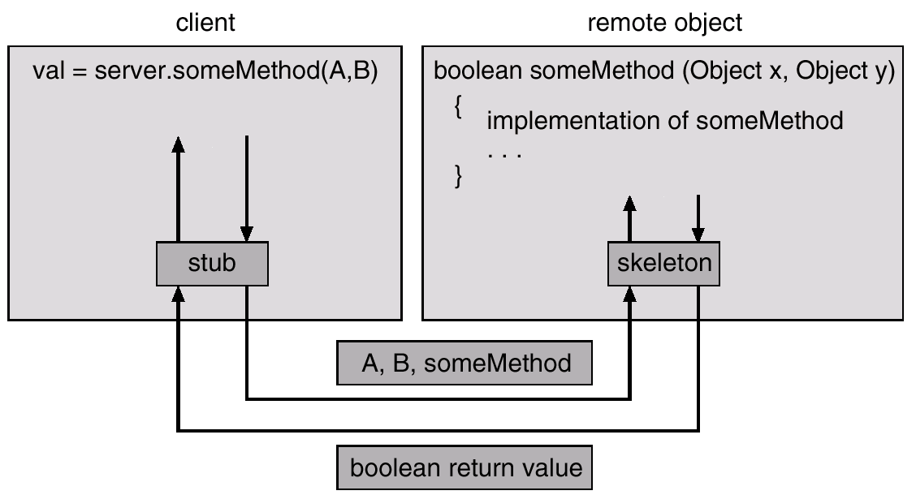
Marshalling Parameters

Slide 41
Threads
A thread (or lightweight process) is a basic unit of CPU utilization; it consists of:
  program counter
  register set
  stack space
A thread shares with its peer threads its:
  code section
  data section
  operating-system resources
  collectively know as a task.
A traditional or heavyweight process is equal to a task with one thread

Slide 42
Threads (Cont.)
In a multiple threaded task, while one server thread is blocked and waiting, a second thread in the same task can run.
  Cooperation of multiple threads in same job confers higher throughput and improved performance.
  Applications that require sharing a common buffer (i.e., producer-consumer) benefit from thread utilization.
Threads provide a mechanism that allows sequential processes to make blocking system calls while also achieving parallelism.
Kernel-supported threads (Mach and OS/2).
User-level threads; supported above the kernel, via a set of library calls at the user level (Project Andrew from CMU).
Hybrid approach implements both user-level and kernel-supported threads (Solaris 2).

Slide 43
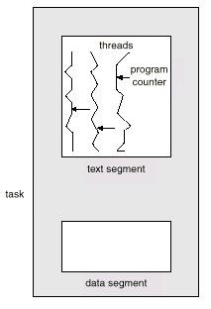
Multiple Threads within a Task

Slide 44
Threads Support in Solaris 2
Solaris 2 is a version of UNIX with support for threads at the kernel and user levels, symmetric multiprocessing, and
real-time scheduling.
LWP – intermediate level between user-level threads and kernel-level threads.
Resource needs of thread types:
  Kernel thread: small data structure and a stack; thread switching does not require changing memory access information – relatively fast.
  LWP: PCB with register data, accounting and memory information,; switching between LWPs is relatively slow.
  User-level thread: only need stack and program counter; no kernel involvement means fast switching. Kernel only sees the LWPs that support user-level threads.

Slide 45

Solaris 2 Threads

