Slide 1
JAVASCRIPT
A dynamic computer programming language.
It is lightweight and most commonly used as a part of web pages.
Its implementations allow client-side script to interact with the user and make dynamic pages.
It is an interpreted programming language with object-oriented capabilities.
The script should be included in or referenced by an HTML document for the code to be interpreted by the browser.
JavaScript made its first appearance in Netscape 2.0 in 1995 with the name LiveScript.

Slide 2
The JavaScript code is executed when the user submits the form, and only if all the entries are valid, they would be submitted to the Web Server.
JavaScript can be used to trap user-initiated events such as button clicks, link navigation, and other actions that the user initiates explicitly or implicitly.
Advantages:
Less server interaction: You can validate user input before sending the page off to the server. This saves server traffic, which means less load on your server.
Increased interactivity: You can create interfaces that react when the user hovers over them with a mouse or activates them via the keyboard.
Richer interfaces: You can use JavaScript to include such items as drag-and-drop components and sliders to give a Rich Interface to your site visitors.

Slide 3
Limitations of Javascript:
Client-side JavaScript does not allow the reading or writing of files. This has been kept for security reason.
JavaScript cannot be used for networking applications because there is no such support available.
JavaScript doesn't have any multithreading or multiprocessor capabilities.

Slide 4
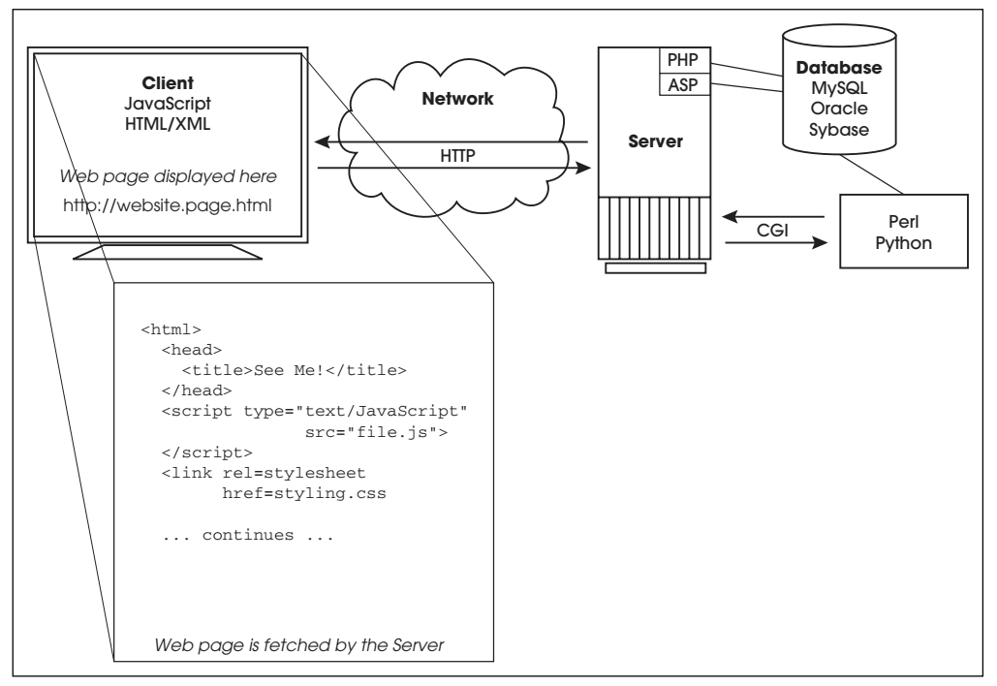
The life cycle of a typical Web page

Slide 5
The applications involved in the life cycle of a Web page: 1. A browser (Firefox, Internet Explorer, Safari, Opera). This is where JavaScript lives! 2. A network (HTTP). 3. A server (Apache, Windows IIS, Zeus). 4. A server module (PHP, ASP.NET, ColdFusion, Java servlet). 5. External files and/or a database (MySQL, Oracle, Sybase).

Slide 6
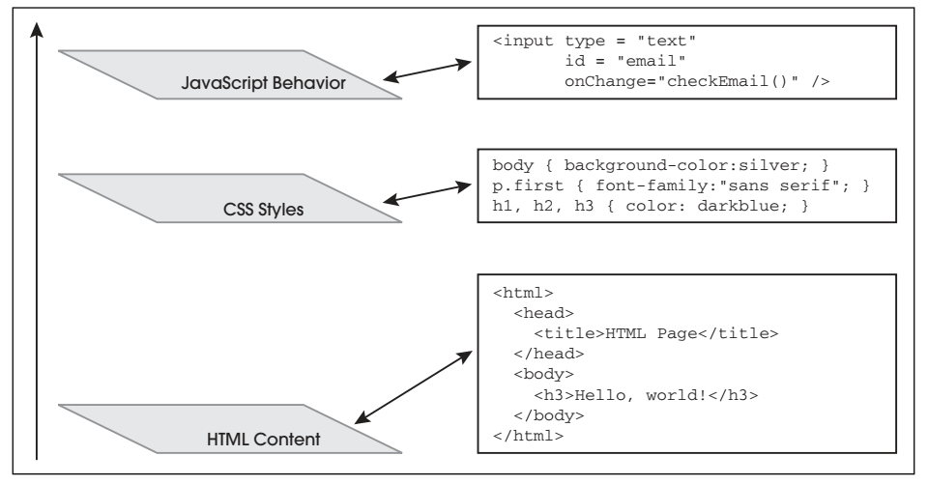
Three layers that make up a Web page

Slide 7
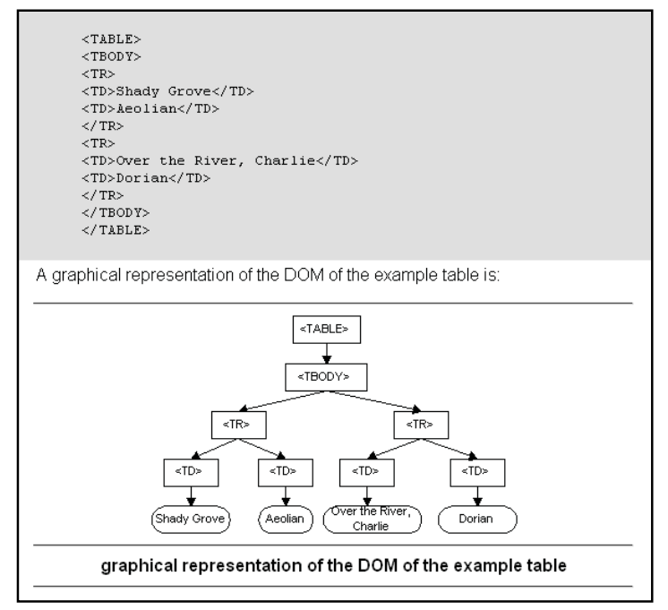
Document Object Model(DOM) of Table

Slide 8
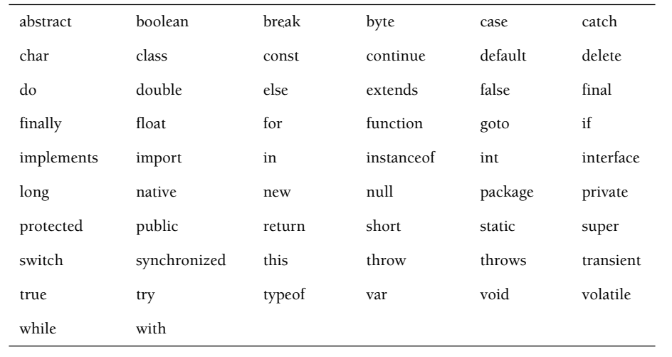
RESERVED KEYWORDS

Slide 9
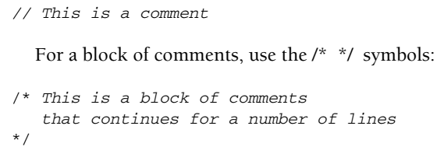
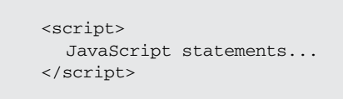

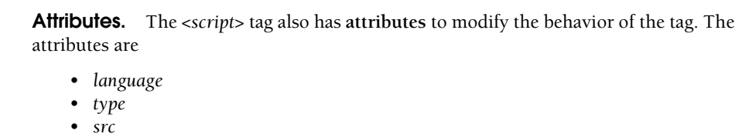
Comment Lines

Slide 10
Syntax
<script language="javascript" type="text/javascript">
JavaScript code
</script>
Language: This attribute specifies what scripting language you are using. Typically, its value will be javascript.
Type: This attribute is what is now recommended to indicate the scripting language in use and its value should be set to "text/javascript".
Example

Slide 11
Ways to include JavaScript in an HTML File
1. Script in <head>...</head> section:
If you want to have a script run on some event, such as when a user clicks somewhere.
2. Script in <body>...</body> section:
If you need a script to run as the page loads so that the script generates content in the page.
In this case, you would not have any function defined using JavaScript.
3. Script in <body>...</body> and <head>...</head> sections:
You can put your JavaScript code in <head> and <body> section altogether
4. Script in an external file and then include in <head>...</head> section:
Where you are reusing identical JavaScript code on multiple pages of a site.
You are not restricted to be maintaining identical code in multiple HTML files.

Slide 12
Data Types
Two types of Data used in JavaScript such as:
Primitive data types are the simplest building blocks of a program.
JavaScript supports three core or basic data types: • numeric • string • Boolean In addition to the three core data types, there are two other special types that consist of a single value: • null • undefined
Composite data types, also called complex types, consist of more than one component. Objects, arrays, and functions.
Objects contain properties and methods, arrays contain a sequential list of elements, and functions contain a collection of statements.
.

Slide 13
Data Types
The null keyword represents “no value,” meaning “nothing,” not even an empty string or zero. It is a type of JavaScript object.
When a variable is assigned null, it does not contain any valid data type.
A variable that has been declared, but given no initial value, contains the value undefined and will produce a runtime error if you try to use it .
The word undefined is not a keyword in JavaScript. If compared with the == equality operators, null and undefined are equal, but if compared with the identity operator, they are not identical
.

Slide 14
Data Types
var a = 10;
var b = 10.98;
var c = “Sachin”;
var d ; // undefined
var p = null;
.

Slide 15
DIALOG BOXES
The document object is defined within a window and write() and writeln() are methods that manipulate the document.
The window is also an object and has its own methods.
The window object uses dialog boxes to interact with the user.
The dialog boxes are created with three methods:
alert ()
prompt ()
confirm ()

Slide 16
alert ()
It is used to send a warning to the user or alert him or her to do something.
It is also commonly used for debugging to find out the results of a calculation, if the program is executing in an expected order, and so on.
The alert() method creates a little independent window—called a dialog box—that contains a a user-customized message placed after a small triangle, and beneath it, an OK button.
It doesn’t require the window object name in front of it as window.alert(). Because the window is the top-level browser object, it doesn’t have to be specified.

Slide 17
alert ()
The message for the alert dialog box is any valid expression, variable, or a string of text enclosed in matching quotes, and sent as a single argument to the alert() method.
Don’t overuse the alert box on your Web site. It can be seriously annoying for visitors. Use the alert box for its intended purpose: to alert visitors about input or processing problems and briefly explain how to correct them.
Syntax:
alert("String of plain text");
alert(expression);

Slide 18
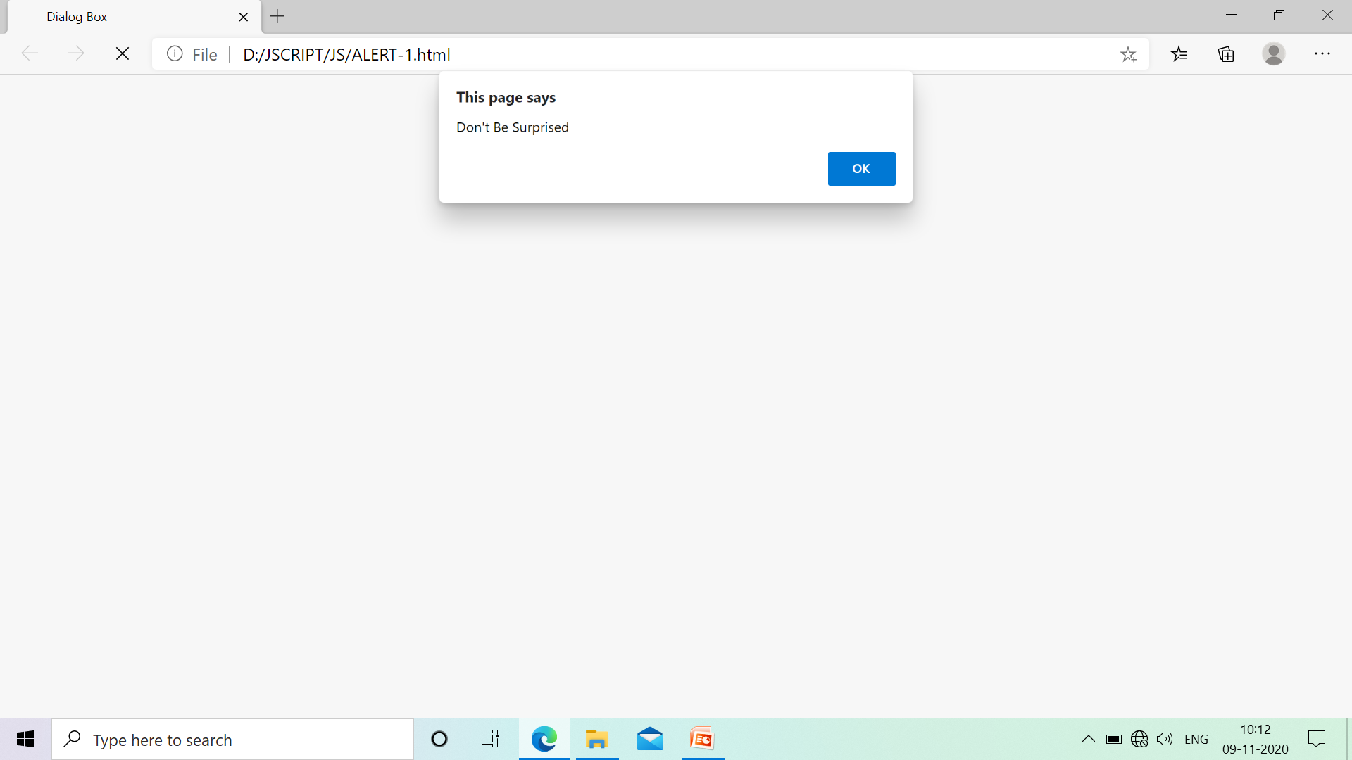

Slide 19
prompt()
A prompt() method asks the user for some small amount of information such as a password, completion of a form input, or personal information, such as nickname or title.
Because JavaScript does not provide a simple method for accepting user input, the prompt dialog box and HTML forms are used.
The prompt dialog box pops up with a simple textfield box. After the user enters text into the prompt dialog box, its value is returned.
This method takes two arguments: a string of text that is normally displayed as a question to the user, prompting the user to do something, and another string of text that is the initial default setting for the box. If this argument is an empty string, nothing is displayed in the box.
The prompt() method always returns a value. If the user clicks the OK button, all the text in the box is returned; otherwise null is returned.

Slide 20
Syntax:
prompt(message);
prompt(message, default Text);

Slide 21
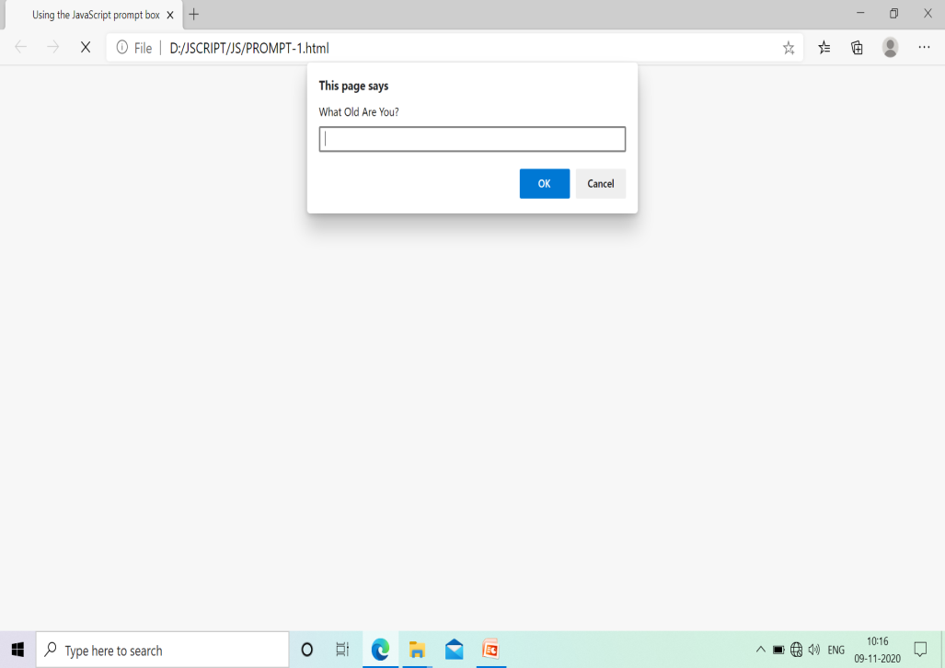
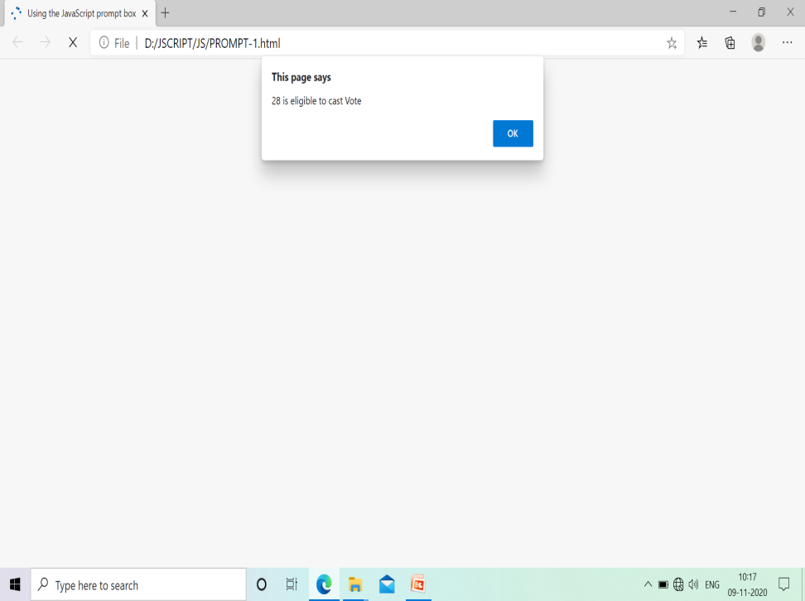

Slide 22



Slide 23
confirm ()
It is used to confirm a user’s answer to a question. The user must agree before the action is completed.
A question mark will appear in the box with an OK button and a Cancel button.
If the user clicks the OK button, true is returned; if he or she clicks the Cancel button, false is returned.
This method takes only one argument, the question you will ask the user.

Slide 24
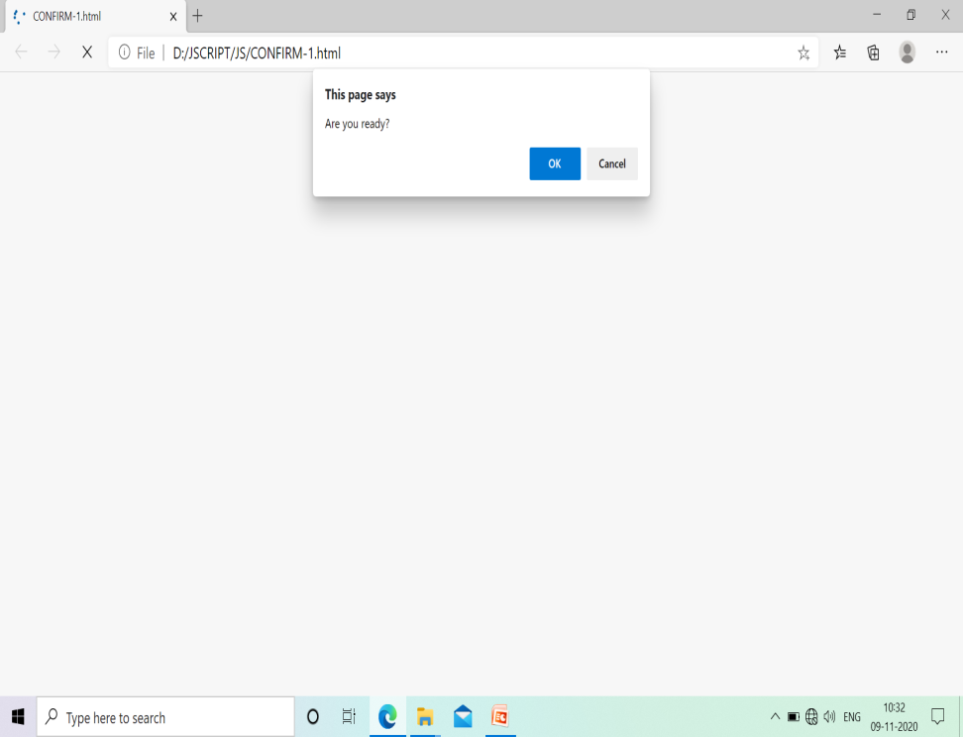


Slide 25
CANCEL

Slide 26
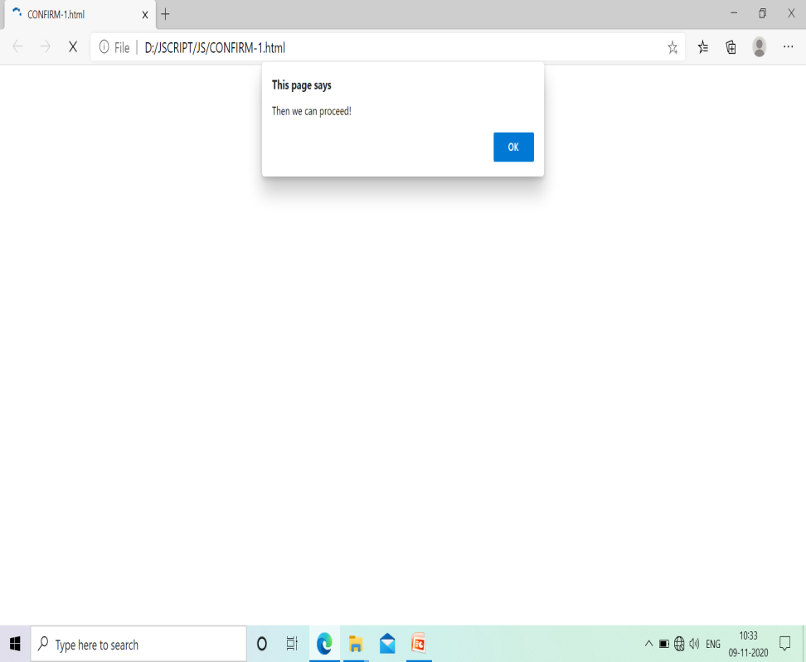
OK

Slide 27
DATA TYPE CONVERSION
JavaScript automatically converts values
when it assigns values to a variable or evaluates an expression. If data types are mixed (i.e., a number is compared with a string, a Boolean is compared with a number, a string is compared with a Boolean), JavaScript must decide how to handle the expression.
Most of the time, letting JavaScript handle the data works fine, but there are times when you want to force a conversion of one type to another.
JavaScript provides three functions to convert the primitive data types. They are:
String ()
Number ()
Boolean ()

Slide 28
parseInt() Function
This function converts a string to a number.
It starts parsing at the beginning of the string and returns all integers until it reaches a non-integer and then stops parsing.
If the string doesn’t begin with an integer, NaN (not a number) is returned.
However, if the string begins with a leading 0x or 0X or a leading 0, then JavaScript assumes you want the 0x to represent the beginning of a hex value and a single 0 to represent the start of an octal value.
In the two-argument format, the first argument to parseInt() is a string containing a number base (radix) ranging from 2 to 36. The default is base 10.
parseInt(String, NumberBase); Default base is 10
parseInt(String);

Slide 29
parseFloat()
The parseFloat() function is just like the parseInt() function except that it returns a floating- point number.
If the string being parsed does not start with a number, NaN (not a number) is returned.
parseFloat(String);

Slide 30
eval() function
The eval() function evaluates a string as a JavaScript expression, returning the result of the execution.
If there is no result, undefined is returned.
The eval() function takes a primitive string as its argument, not a String object.
If a String object is used, it will be returned as is.
Syntax:
eval(String);
Ex: eval("(5+4) / 3");

Slide 31
CLASS
A class is a template or blueprint that describes the properties and behavior of all objects that belong to that specific class .
It doesn’t have a class keyword.
A new JavaScript class is defined by creating a simple function. The name of the function will serve as the class name for an object, and the function will define its properties and methods; it serves as a blueprint or prototype of the object.
When the function is called with the new keyword, it acts as a constructor; that is, it builds the new object and then returns a reference to it.
Only the name of the method is assigned to a property, i.e., a reference to the function’s definition. There are no parentheses following the name.

Slide 32
this Pointer
this is initialized to point to this newly created object.
The this keyword is a sort of shorthand reference that keeps track of the current object.
When a function is used as a constructor, the this keyword is used to set the properties for the object that was just created.
In a function definition, this refers to the "owner" of the function.

Slide 33
Object
JavaScript is called an object-based language because it doesn’t technically meet the criteria of the more heavy-duty languages, but it certainly behaves as an object-oriented language.
Objects are composite data types.
JavaScript can represent data such as a string or a number as an object, and it lets you create your own objects.
Windows and buttons, forms and images, links and anchors are all objects.
The object is made up of a collection of properties or attributes.
JavaScript supports several types of objects, as follows:
1. User-defined objects defined by the programmer. 2. Core or built-in objects, such as Array, Date, String, and Number ( “JavaScript Core Objects”). 3. Browser objects, the BOM. 4. The Document objects, the DOM .

Slide 34
Constructor
A constructor is a special kind of function that creates the blueprint for an object.
The new keyword precedes the name of the constructor that will be used to create the object. By convention, constructor names start with a capital letter to distinguish them from ordinary functions.
The new operator is used to create an instance of an object.
To create an object, the new operator is followed by the name of a function.
The new operator treats the function as a constructor. This function may be a JavaScript constructor or one that is user-defined.
JavaScript comes with several built-in constructors, such as Object(), Array(), Date(), and RegExp().
A reference to the object is returned and assigned to a variable.

Slide 35
Object constructor
JavaScript provides a special predefined constructor function called Object(), used with the new keyword, to build a generic object.
The return value of the Object() constructor is assigned to a variable.
The variable contains a reference to an instance of a new object.
Ex:
var person = new Object(); var day = new Array(“Sunday", “Monday", “Saturday"); var holiday = new Date("July 4, 2011");

Slide 36
Properties of the Object
Properties describe the object.
The object name is followed by a dot and a property.
The properties are accessible only via their object.
The window is the top object in the Browser Object Model.
It is the parent of all parents; the document is an object but, because it is subordinate to the window, it is also a property of the window object.
Ex: window.document.bgColor = “blue";

Slide 37
Methods of the Object
Methods are special functions that object-oriented languages use to describe the object’s behavior.
Methods are attached to the object with a dot and are only accessible via that object.
The dot syntax is used to call the methods.
A function is a stand-alone unit of statements and a method is attached to an object, is accessed only via the object, and can be referenced by the this keyword.
Like functions, methods also take arguments and can return a value.

Slide 38
Object literals
Object literals enable you to create objects that support many features without directly invoking a function.
Syntax: var object = { property1: value, property2: value }; 1. A colon separates the property name from its value. 2. A comma separates each set of name/value pairs from the next set. 3. The comma should be omitted from the last name/value pair. Even with nested key/value pairs, the last key/value pair does not have a comma. 4. The entire object is enclosed in curly braces.
The value assigned to a property can be of any data type, including array literals and object literals.
Limitations: The code is not reusable; that is, you would have to retype the code to use it again within the program, whereas you can use a constructor function to create multiple instances of an object.

Slide 39
Advantages: When a function acts as constructor you have to keep track of the order of arguments that will be passed, and so on. Not so with object literals.

Slide 40
Manipulating Objects
1. The with Keyword
2. The for/in Loop
The with Keyword: It is used as a kind of shorthand for referencing an object’s properties or methods.
The object specified as an argument to with becomes the current object for the duration of the block that follows.
The properties and methods for the object can be used without naming the object or using the dot syntax.
The with keyword allows the methods of an object to be called without the object’s name and a dot
Syntax : with(department)
{ document.write(dname, dno);
}

Slide 41
2. The for/in Loop: It can be used to iterate through a list of object properties or array elements.
The for/in loop reads: for each property in an object (or for each element in an array) get the name of each property (element), in turn, and for each of the properties (elements), execute the statements in the block that follows.
The for/in loop is a convenient mechanism for looping through the properties of an object.
Syntax :
for(var property_name in object)
{ statements; }

Slide 42
Extending Objects with Prototypes / Inheritance
To implement inheritance JavaScript extends the class with a prototype.
JavaScript functions are automatically given an empty prototype object.
If the function acts as a constructor function for a class of objects, the prototype object can be used to extend the class.
Each object created for the class is also given two properties, a constructor property and a prototype property.
The constructor property is a reference to the function that created this object, and the prototype property a reference to its prototype object.
This property allows the object to share properties and methods.
When values are assigned to an object’s prototype property, they are automatically extended to all instances of the class.
After an object has been created, new properties and methods can be added to the prototype object, and any objects created after that will automatically inherit the new properties and methods.

Slide 43
Properties and Methods of All Objects
All user-defined objects and built-in objects are descendants of the object called Object.
The Object object has its own properties and methods that can be accessed by any objects derived from it.
Property :constructor, prototype.
Method : toString() , valueOf(), hasOwnProperty(property), isPrototypeOf(object)

Slide 44
JavaScript Core Objects / Built-in Objects
JavaScript provides built-in objects that deal with the date and time, math, strings, regular expressions, numbers, and other useful entities.
Array
Date and Time
Math
String etc.

Slide 45
Array
An array is a collection of like values—called elements—such as an array of colors, an array of strings, or an array of images.
Each element of the array is accessed with an index value enclosed in square brackets.
An index is also called a subscript. There are two types of index values: a nonnegative integer and a string.
Arrays indexed by numbers are called numeric arrays and arrays indexed by strings are called associative arrays.
Syntax: var array_name = new Array();
Example: var months = new Array(); months[0]="January"; months[1]=“February";
Syntax: var array_name = new Array(100);
Example:
var week = new Array("Sunday", "Monday", "Tuesday");
var week = [“Sunday", "Monday", "Tuesday”];

Slide 46
Date Object
JavaScript provides the Date object for manipulating date and time.
Time is measured in milliseconds (one millisecond is one thousandth of a second).
Because client-side JavaScript programs run on a browser, the Date object returns times and dates that are local to the browser, not the server.
If no arguments are passed to the Date object constructor, it returns the local date and time (based on the accuracy of the clock on your client machine).
There are five formats that can be passed as arguments when creating a Date object.
Syntax: mydate = new Date()
new Date("Month dd, yyyy hh:mm:ss") new Date("Month dd, yyyy") new Date(yy,mm,dd,hh,mm,ss) new Date(yy,mm,dd) new Date(milliseconds)

Slide 47
Date Object Methods
Method | Use
getDate | Returns the day of the month (1–31)
getDay | Returns the day of the week (0–6); 0 is Sunday, 1 is Monday, and so on
getHours | Returns the hour (0–23)
getMonth | Returns number of month (0–11); 0 is January, 1 is February, and so on
setDate(value) | Sets day of the month (1–31)
toGMTString() | Returns the date string in universal format
toString() | Returns string representing date and time

Slide 48
Date Object Properties
Property | Description
Constructor | Returns the function that created the Date object's prototype
Prototype | Allows you to add properties and methods to an object

Slide 49
Date Object Methods
Method | Description
getDate() | Returns the day of the month (from 1-31)
getDay() | Returns the day of the week (from 0-6)
getFullYear() | Returns the year
getHours() | Returns the hour (from 0-23)
getMonth() | Returns the month (from 0-11)
setDate() | Sets the day of the month of a date object

Slide 50
Math Object
Unlike other objects, you don’t have to create an instance of the Math object with the new keyword.
It is a built-in object and has a number of properties and methods .
The Math object always starts with an uppercase M.
The Math object allows you to work with more advanced arithmetic calculations, such as square root, trigonometric functions, logarithms, and random numbers, than are provided by the basic numeric operators.
Example: Math Property: Math.PI =3.14592653589793116 (Pi, ratio of the circumference of a circle to its diameter)

Slide 51
Math Object Methods
Method | Use
Math.abs(Number) | Returns the absolute (unsigned) value of Number
Math.ceil(Number) | Rounds Number up to the next closest integer
Math.floor(Number) | Rounds Number down to the next closest integer
Math.log(Number) | Returns the natural logarithm of Number (base E)
Math.max(Number1,Number2) | Returns larger value of Number1 and Number2
Math.random() | Generates pseudorandom number between 0.0 and 1.0
Math.toString(Number) | Converts Number to string

Slide 52
Wrapper Objects (String, Number, Function, Boolean)
A wrapper is an object bearing the same name as the primitive data type it represents.
For each of the primitive data types (string, number, and Boolean), there is a String object, a Number object, and a Boolean object.
These objects are called wrappers and provide properties and methods that can be defined for the object.
Advantage: Its ability to apply and extend properties and methods to the object, which in turn, will affect the primitive.

Slide 53
String Object
A string is a sequence of characters enclosed in either double or single quotes.
The String object is a core JavaScript object that allows you to treat strings as objects.
The String object is also called a wrapper object because it wraps itself around a string primitive, allowing you to apply a number of properties and methods to it.
We can create a String object implicitly by assigning a quoted string of text to a variable, called a string primitive, “The Building Blocks: Data Types, Literals, and Variables”, or by explicitly creating a String object with the new keyword and the String() object constructor method.
Either way, the properties and methods of the String object can be applied to the new string variable.
Syntax: var string_name = "string of text"; var string_name = new String("string of text");

Slide 54
String Object Properties
Property | Use
length | Returns the length of the string in characters
constructor | Returns the function that created the String object
prototype | Extends the definition of the string by adding properties and methods.

Slide 55
String Object Properties
In JavaScript, the constructor property returns the constructor function for an object.
The return value is a reference to the function, not the name of the function:
For JavaScript numbers the constructor property returns function Number() { [native code] }
For JavaScript strings the constructor property returns function String() { [native code] }
For JavaScript booleans the constructor property returns function Boolean() { [native code] }

Slide 56
String Object Methods
Methods | Formats as HTML
String.blink() | <blink>String</blink>
String.bold() | <b>String</b>
String.sub() | <sub>String</sub> (creates a subscript)
charAt(index) | Returns the character at a specified index position
replace(searchValue, replaceValue) | Replaces searchValue with replaceValue.
slice(startpos, endpos) | Returns string containing the part of the string from startpos to endpos.
toLowerCase() | Converts all characters in a string to lowercase letters
toString() | Returns the same string as the source string
valueOf | Returns the string value of the object
substr(startpos, endpos) | Returns a subset of string starting at startpos up to, but not including, endpos.

Slide 57
Number Object
The Number object, like the String object, gives you properties and methods to handle and customize numeric data.
The Number object is a wrapper for the primitive numeric values which means you can use a primitive number type or an object number type and JavaScript manages the conversion back and forth as necessary.
The Number() constructor takes a numeric value as its argument.
If used as a function, without the new operator, the argument is converted to a primitive numeric value, and that number is returned; if it fails, NaN is returned.
Syntax:
var number = new Number(numeric value); //Object var number = numeric value; // Primitive data type

Slide 58
How to Access Values of Control Elements of Form
1. getElementById:
Synatx:
document.getElementById(“TextBoxId”).value;
2. getElementsByName:
Synatx:
document.getElementsByName(“TextBoxName”)[Index].value;
3. getElementsByTagName:
Synatx:
document.getElementsByTagName(“TagName”)[Index].value;
4. getElementsByClassName:
Synatx:
document.getElementsByClassName(“ClassName”)[Index].value;

Slide 59
5. querySelector:
Synatx:
document.querySelector(“Selector”).value;
It uses a CSS selector to select the element.
document.querySelector(“#Selector”).value; // by Id
document.querySelector(“.Selector”).value; // by class
6. querySelectorAll:
Synatx:
document.querySelectorAll(“Selector”)[Index].value;
document.querySelectorAll(“#Selector”[0]).value; // by Id
document.querySelectorAll(“.Selector”)[0].value; // by class

Slide 60
AJAX
AJAX stands for Asynchronous JavaScript And XML.
AJAX is not a programming language.
It is a technique for creating better, faster, and more interactive web applications with the help of XML, HTML, CSS, and Java Script.
AJAX just uses a combination of:
i) A browser built-in XML-Http Request object (to request data from a web server)
ii) JavaScript and HTML DOM (to display or use the data)
AJAX allows web pages to be updated asynchronously by exchanging data with a web server behind the scenes.
This means that it is possible to update parts of a web page, without reloading the whole page.

Slide 61
It uses XHTML for content, CSS for presentation, along with Document Object Model and JavaScript for dynamic content display.
With AJAX, when you hit submit button, JavaScript will make a request to the server, interpret the results, and update the current screen. In the purest sense, the user would never know that anything was even transmitted to the server.
It is a web browser technology independent of web server software.
A user can continue to use the application while the client program requests information from the server in the background.

Slide 62
Advantages:
i) Allows applications to render without data and fill data as the application gets it from the server.
ii) provide platform independence to application developers.
iii) Faster page renders and more responsive applications.
iv) No rerenders of whole pages are needed to update only a single area.
Disadvantages:
Any user whose browser does not support JavaScript or XML Http-Request, will not be able to properly use pages that depend on Ajax.
Multiple server requests need more data consumed at the client-side.
Failure of any one request can fail the load of the whole page.

