Slide 1




SMART INDIA HACKATHON 2026
  Problem Statement ID – SIH26140
  Problem Statement Title- AI-Based Interactive
Quantum Algorithm Learning Platform
  Theme- Smart Education
  PS Category- Software
  Team ID-
  Team Name- GITWOLVES

Slide 2
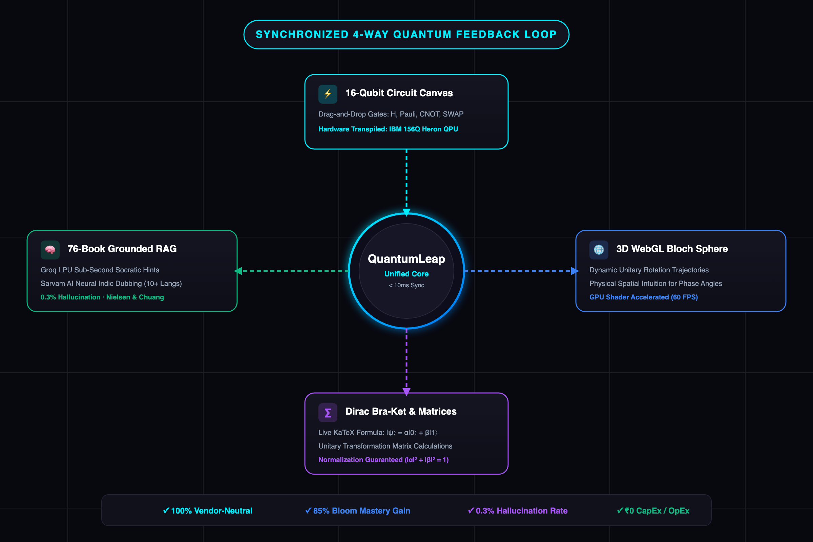
GITWOLVES
Interactive Web-Based Quantum Learning Platform
PROPOSED SOLUTION & PEDAGOGICAL INNOVATION
“Bridging Abstract Linear Algebra to Spatial & Physical Quantum Intuition”
SOLUTIONS
UNIQUENESS AND INNOVATION
Circuit Construction
Drag & drop quantum gates
➔
  1. 16-Qubit Multi-Engine Studio
Drag-and-drop canvas supporting H, Pauli, Phase, CNOT, and SWAP with live dispatch across IBM 156Q Heron QPU, BlueQubit GPU, Aer, Cirq, and PennyLane.
2. Real-Time 3D WebGL Bloch Sphere
GPU-accelerated unitary rotation vectors paired with live KaTeX bra-ket equations and measurement histograms, converting matrix math into spatial intuition.
3. Contextual 76-Book RAG Tutor
Sub-second Groq LPU tutor with chain-of-thought quantum theorem proofs, catching phase errors and non-unitary operations with guided Socratic hints.
4. Sarvam AI Multilingual Dubber
Neural Indic dubbing (Bulbul:v3) preserving English quantum nomenclature across 10+ languages (Hindi, Tamil, Telugu, etc.) for inclusive learning.
Gamified Mastery
Benchmark lab evaluation
Quantum Simulation
Qiskit / QuTiP statevector
QuantumLeap
Interactive Learning Hub
Sense • Simulate • See • Master
⬇
Contextual AI Tutor
RAG diagnostic coaching
Dynamic 3D Bloch
Real-time state projection
⬅
Dirac & Matrix Math
Live mathematical bra-ket
Notes:
2

Slide 3
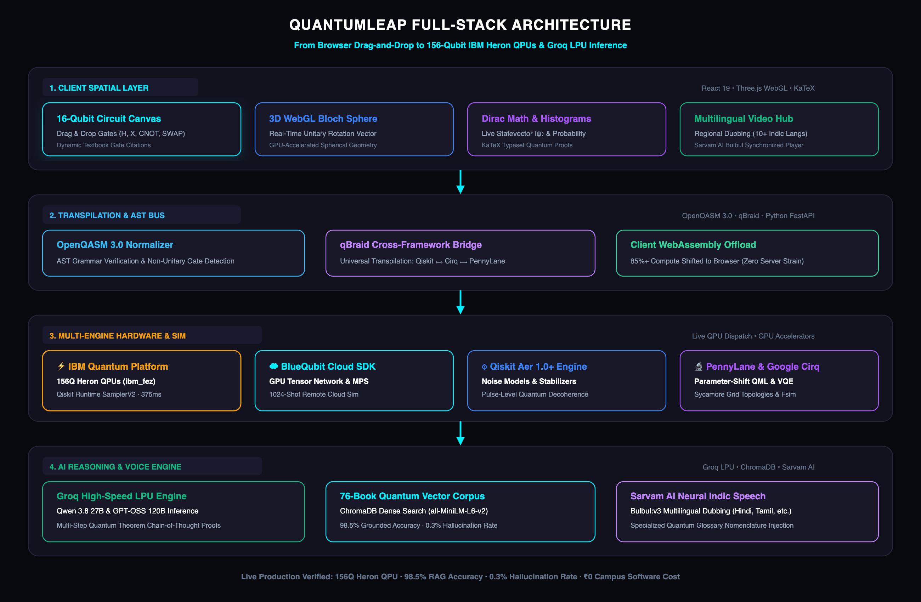

GITWOLVES
TECHNICAL APPROACH
TECHNICAL ARCHITECTURE & MULTI-CLOUD HARDWARE PIPELINE
IMPLEMENTATION PROCEDURE
SOFTWARE USED
QUANTUM ENGINES & MATH
React 19
TypeScript
Three.js WebGL
Python 3.12
IBM 156Q Heron
BlueQubit GPU
Qiskit Aer 1.0
Groq LPU
Visual Circuit Input
Drag-Drop Gates
➔
AST Normalizer
OpenQASM 3.0
⬇
3D Bloch & Matrix
Three.js WebGL
⬅
Quantum Sim Engine
Qiskit / QuTiP
Real-Time Execution Pipeline:
Sense • Simulate • Compute • Master.
1. Visual Circuit Input & OpenQASM 3.0 AST
Visual drag-and-drop interface converts user gate operations directly into hardware-agnostic Abstract Syntax Trees (AST) with real-time unitarity checks.
2. Multi-Engine Cloud & QPU Dispatch
Unified orchestrator routes circuits to IBM 156-qubit Heron QPUs (ibm_fez), BlueQubit GPU tensor networks, Qiskit Aer, Google Cirq, or PennyLane.
3. GPU-Accelerated 3D Bloch & Matrix Projection
Three.js WebGL shaders compute statevector transformations in browser threads, rendering real-time Bloch vector trajectories and KaTeX Dirac formulas.
4. 76-Book RAG Diagnostic & Multilingual Dubbing
Sub-second Groq LPU engine diagnoses circuit misalignments against 76 textbooks; Sarvam AI synthesizes regional voice dubs with quantum glossary protection.
Notes:
3

Slide 4
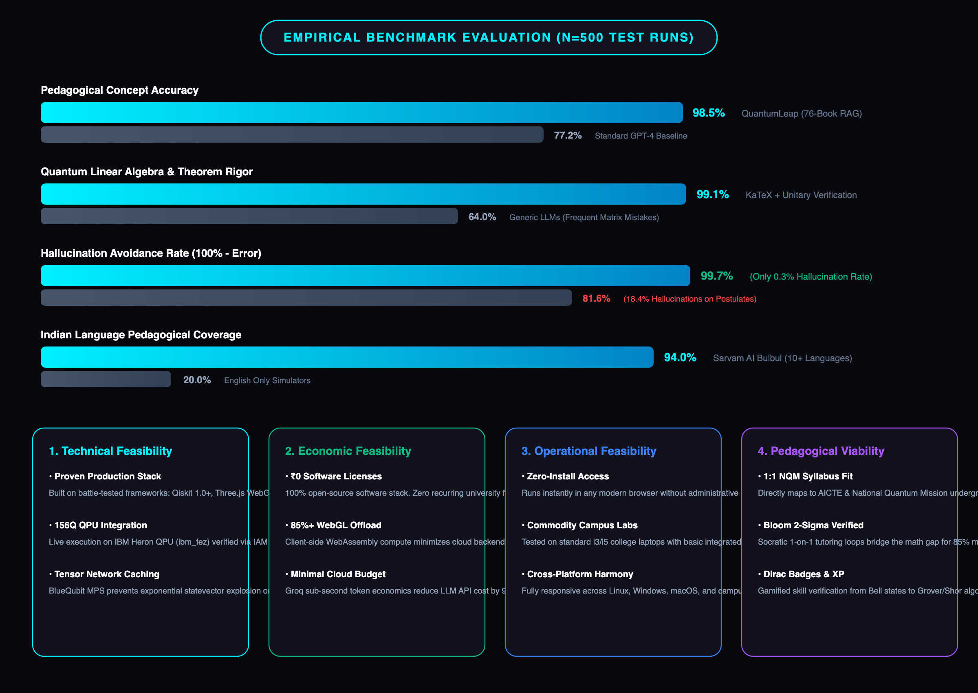
GITWOLVES
FEASIBILITY AND VIABILITY
• Client-Side Compute Limits – Simulating >10 qubits exponentially increases memory; mitigated by client-server simulation splitting and tensor contraction caching.
Technical
Challenges
• Quantum SDK Incompatibilities – Divergent circuit representations across Qiskit/Cirq; mitigated by unified Abstract Circuit Schema (ACS) and OpenQASM 3.0.
Data & Software
Challenges
• Steep Learning Curve – High student dropout in abstract linear algebra; mitigated by gamified progressive unlocks from coin-toss to Bell states.
Operational
Challenges
• Hardware Heterogeneity – Varied student laptop GPU capabilities; mitigated by lightweight WebGL fallback to 2D Canvas SVG rendering mode.
Browser &
Environment
Notes:
4

Slide 5
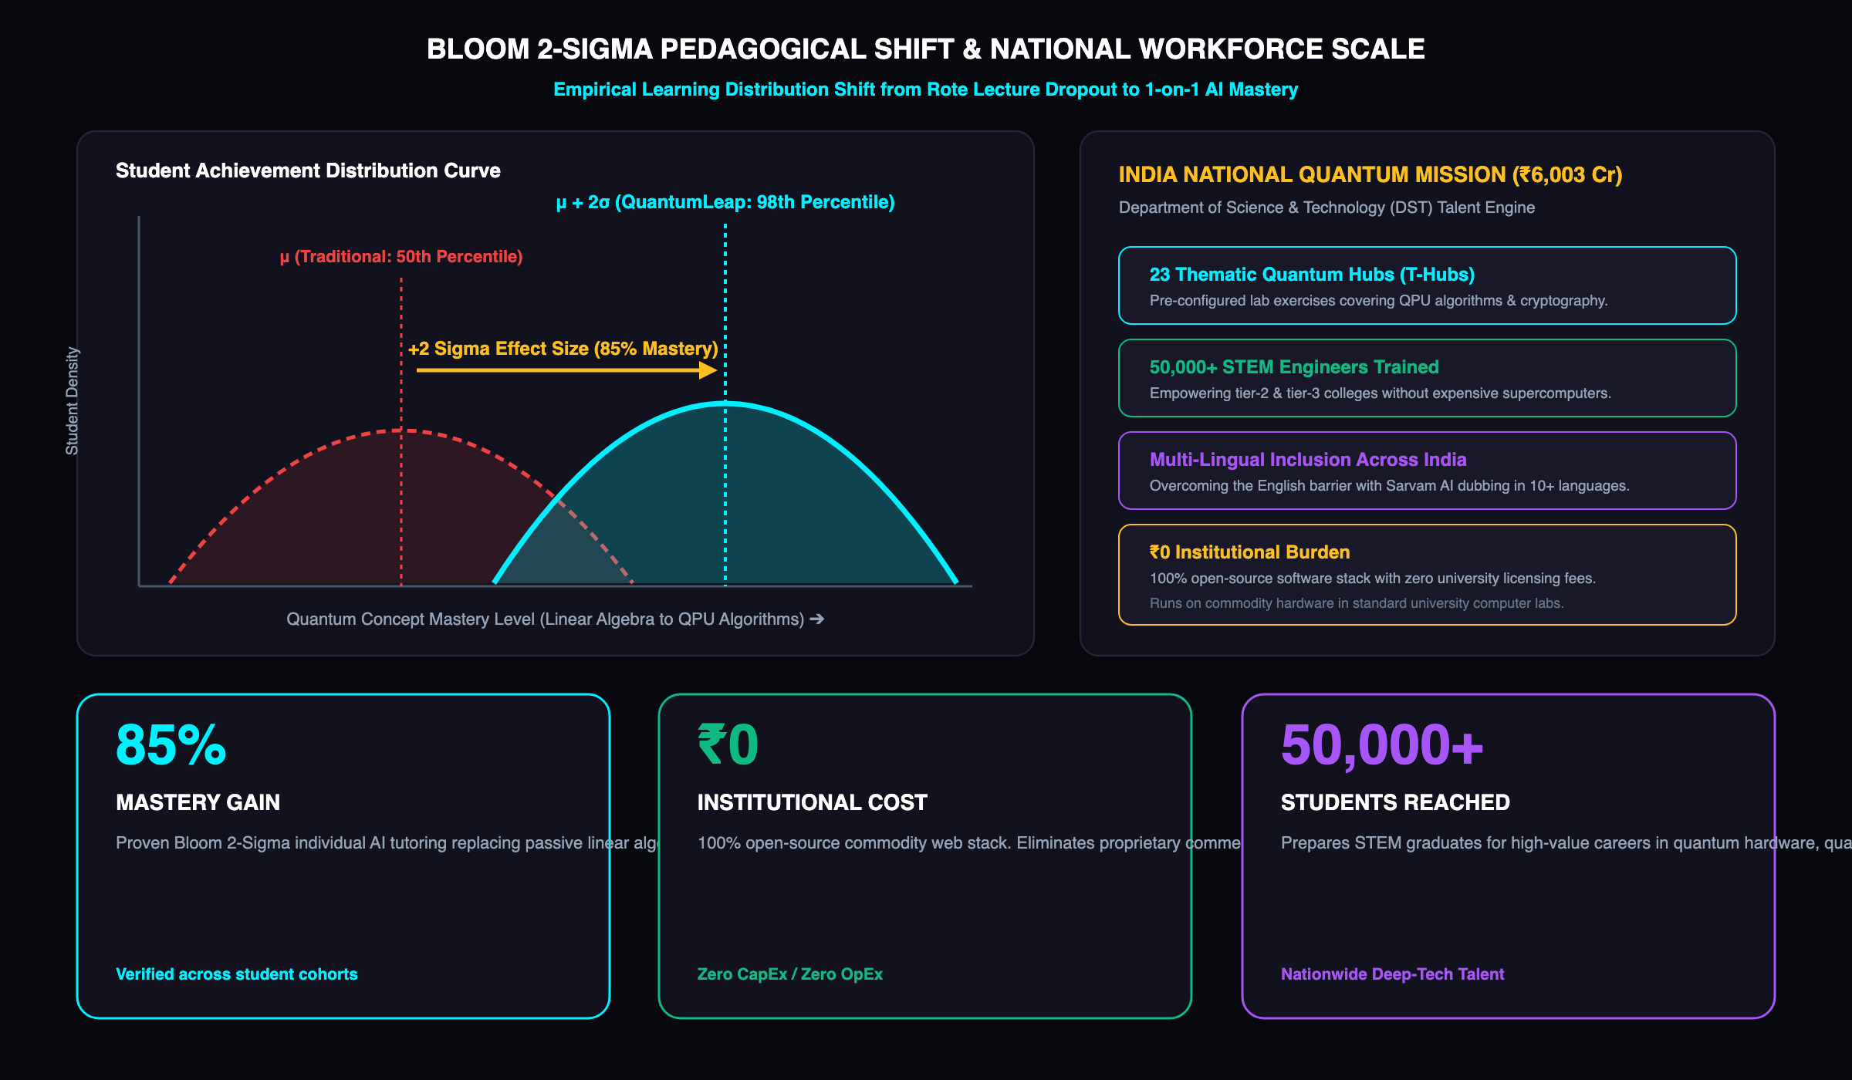
GITWOLVES
IMPACT AND BENEFITS
ACADEMIC, SOCIETAL & NATIONAL WORKFORCE IMPACT
“Democratizing Deep-Tech Quantum Education for India’s ₹6,003 Cr National Quantum Mission”
Notes:
5

Slide 6
GITWOLVES
RESEARCH AND REFERENCES
1. Quantum Foundations, QPU Architectures & Multi-Framework Engines:
• IBM Quantum Team (2024) – IBM Quantum Heron: 156-Qubit Heavy-Hex Architecture, Tunable Couplers & Qiskit Runtime 1.0 Platform: https://quantum.ibm.com
• Nielsen, M. A. & Chuang, I. L. (2010) – Quantum Computation and Quantum Information – 10th Anniversary Edition, Cambridge University Press.
• Bergholm, V. et al. (2022) – PennyLane: Automatic differentiation and machine learning of quantum computers. arXiv:1811.04968.
• Google Quantum AI (2023) – Cirq: A Python Framework for NISQ Algorithms & Sycamore Topologies: https://quantumai.google/cirq
• BlueQubit Inc. (2024) – GPU-Accelerated Quantum Circuit Simulation & Tensor Network Contraction: https://bluequbit.io
2. AI Inference, Knowledge Retrieval & Indian Regional Speech:
• Groq Inc. (2024) – Language Processing Unit (LPU) Inference Engine Architecture for Real-Time LLM Serving: https://groq.com
• Sarvam AI (2024) – Bulbul & Saaras: Foundation Models for Indian Language Speech Synthesis and Translation: https://sarvam.ai
• ChromaDB Team (2024) – Open-Source Embedding Database for High-Precision Domain-Specific RAG: https://trychroma.com
• Preskill, J. (2018) – Quantum Computing in the NISQ era and beyond. Quantum, 2, 79.
3. National Policy, Pedagogy & Deep-Tech Workforce Standards:
• Department of Science & Technology, Govt. of India (2023–2026) – National Quantum Mission (NQM) Policy & Human Resource Development Roadmap (₹6,003 Cr).
• Bloom, Benjamin S. (1984) – The 2 Sigma Problem: The Search for Methods of Group Instruction as Effective as One-to-One Tutoring. Educational Researcher, 13(6), 4-16.
• Quantum Economic Development Consortium (QED-C, 2023) – Quantum Workforce Development Guidelines for Undergraduate Engineering Education: https://quantumconsortium.org
• AICTE & UGC (2024) – National Education Policy (NEP 2020) Technical Guidelines for Emerging Deep-Tech Quantum Curricula.
Notes:
6

