Slide 1
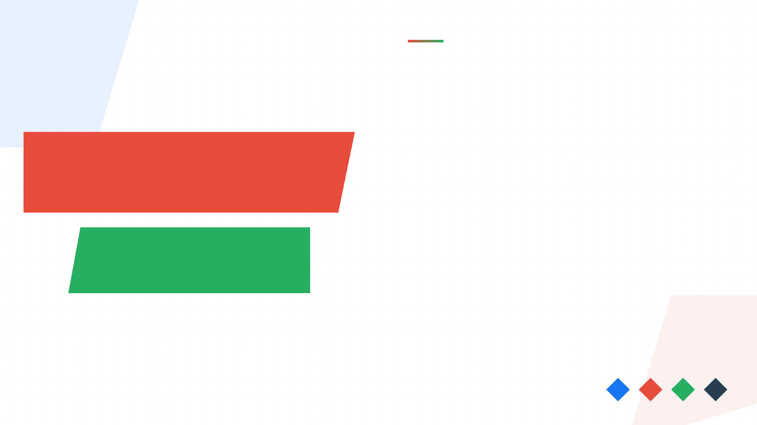
Building an Accessible Multilingual Translation System
The Problem
Digital Language Divide: 7,000+ languages, but most lack quality translation tools
Leveraging Meta's NLLB-200 model to provide high-quality translation for 200+ languages through an intuitive web interface.
Our Solution
NLLB-200 Model + Gradio Web Interface
200+
44%
Languages Supported
BLEU Improvement
3.3B
Web
Model Parameters
Deployment Ready

Slide 2
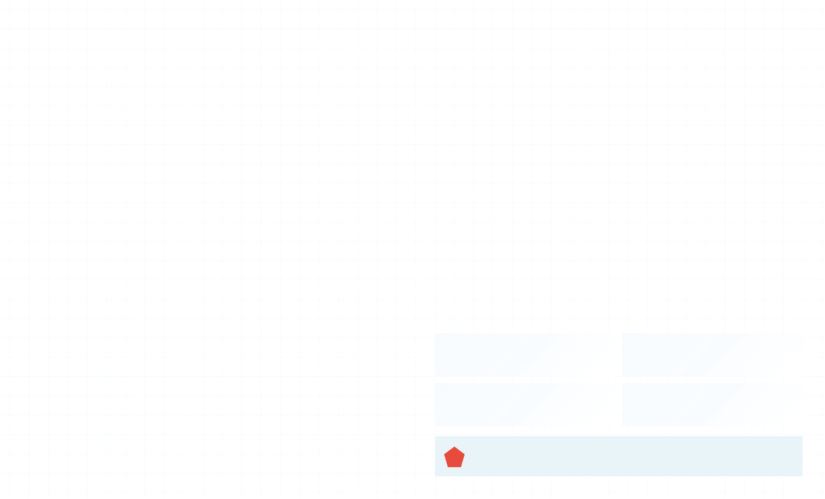
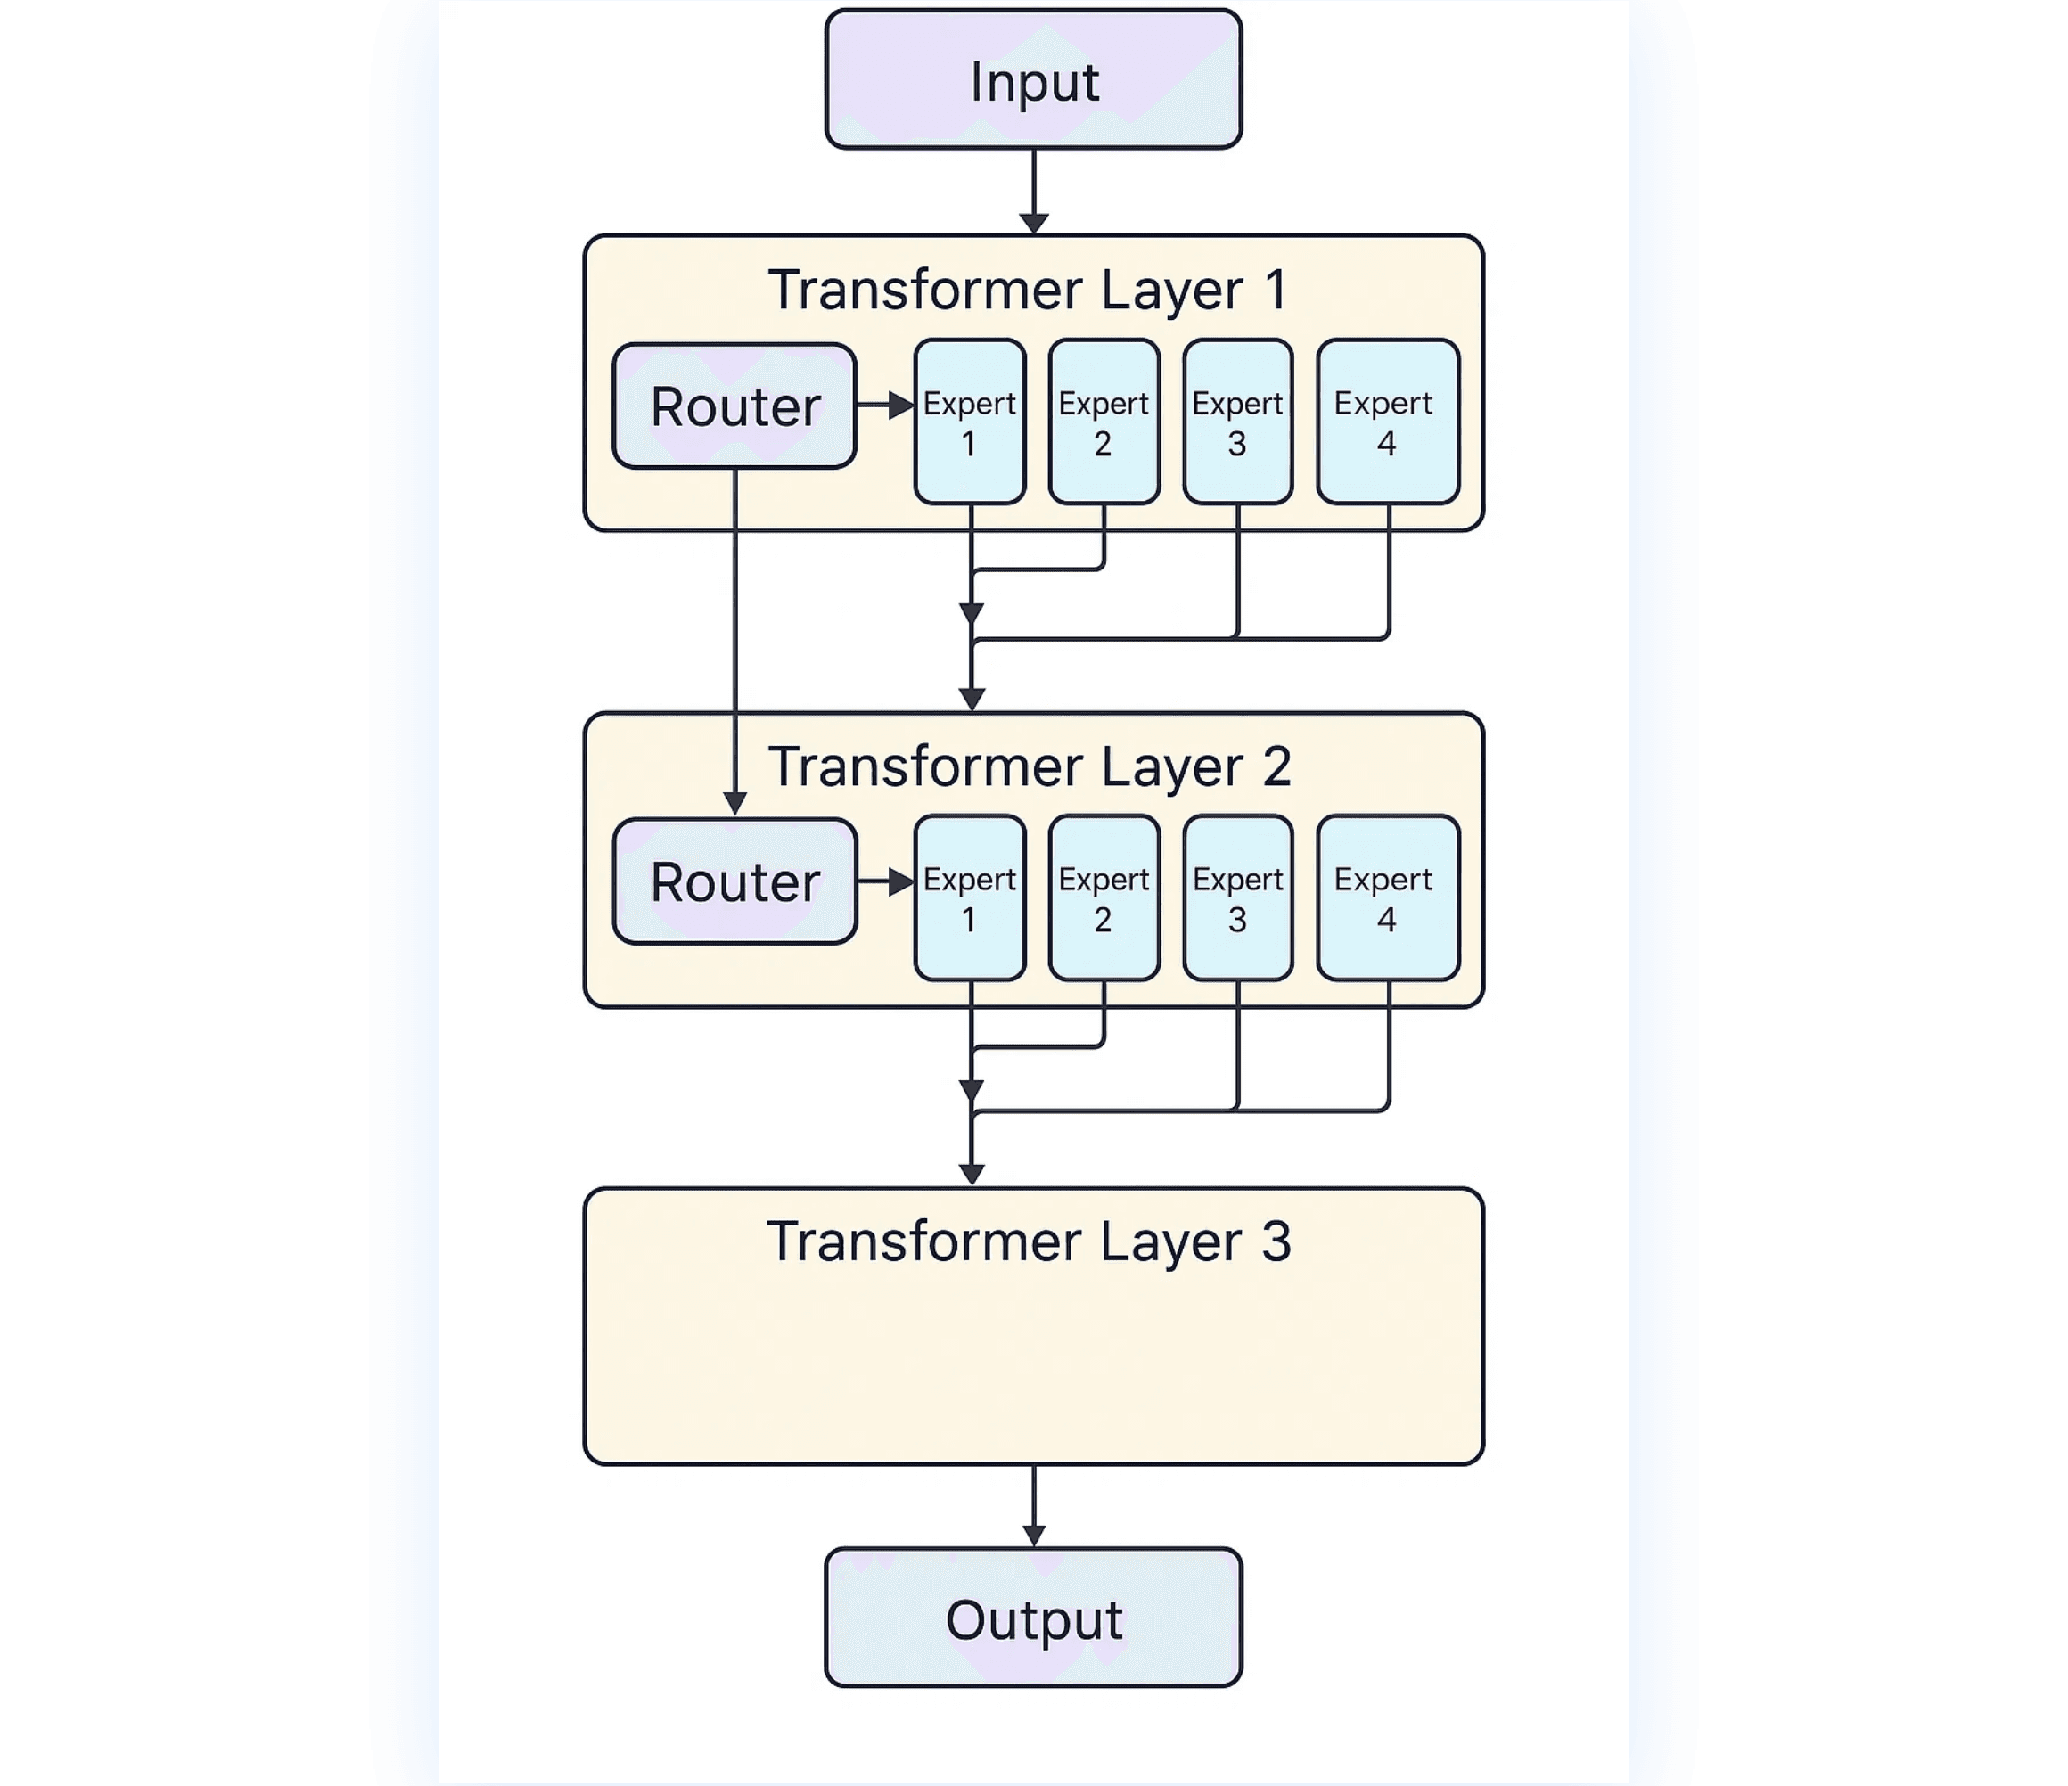
Model Architecture
How NLLB-200 Scales to 200 Languages Without Sacrificing Quality
Transformer Encoder-Decoder
Foundation architecture enabling parallel processing and self-attention mechanisms for understanding and generating language.
Sparsely-Gated MoE
64 experts per layer, Top-2 routing. Enables 3.3B parameters while maintaining constant computational cost per token.
Shared Vocabulary
Single 256K SentencePiece tokenizer for all 200 languages, enabling cross-lingual transfer and knowledge sharing.
Language Conditioning
Target language explicitly specified via forced_bos_token_id, enabling direct many-to-many translation without pivot languages.
64
Top-2
Experts/Layer
Routing
256K
3.3B
Vocabulary
Parameters
Result: 44% relative improvement in BLEU scores over previous state-of-the-art, especially strong on low-resource languages.

Slide 3
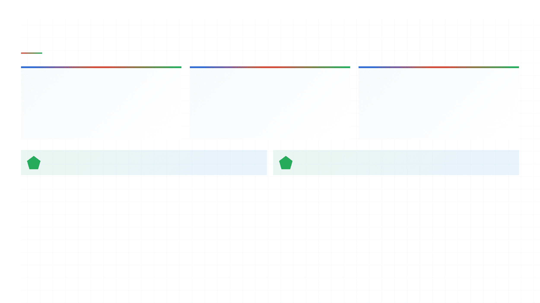
Implementation
Deploying a 3.3B Parameter Model with Gradio
01
02
03
Model Selection
Core Translation Function
Gradio UI & Deployment
Chose 3.3B variant for optimal quality-to-latency tradeoff. Also tested 600M and 1.3B models.
Implements tokenization, forced decoding with target language, and beam search for quality.
Built interactive web interface with language dropdowns, text areas, and swap button.
Hugging Face Integration: AutoModelForSeq2SeqLM for seamless loading
Key Parameter: forced_bos_token_id enables many-to-many translation
Deployment: Web-based, no installation required
Language Mapping: 200+ human-readable names mapped to NLLB language codes
Beam Search: 4-beam search for higher-quality, more fluent translations

Slide 4
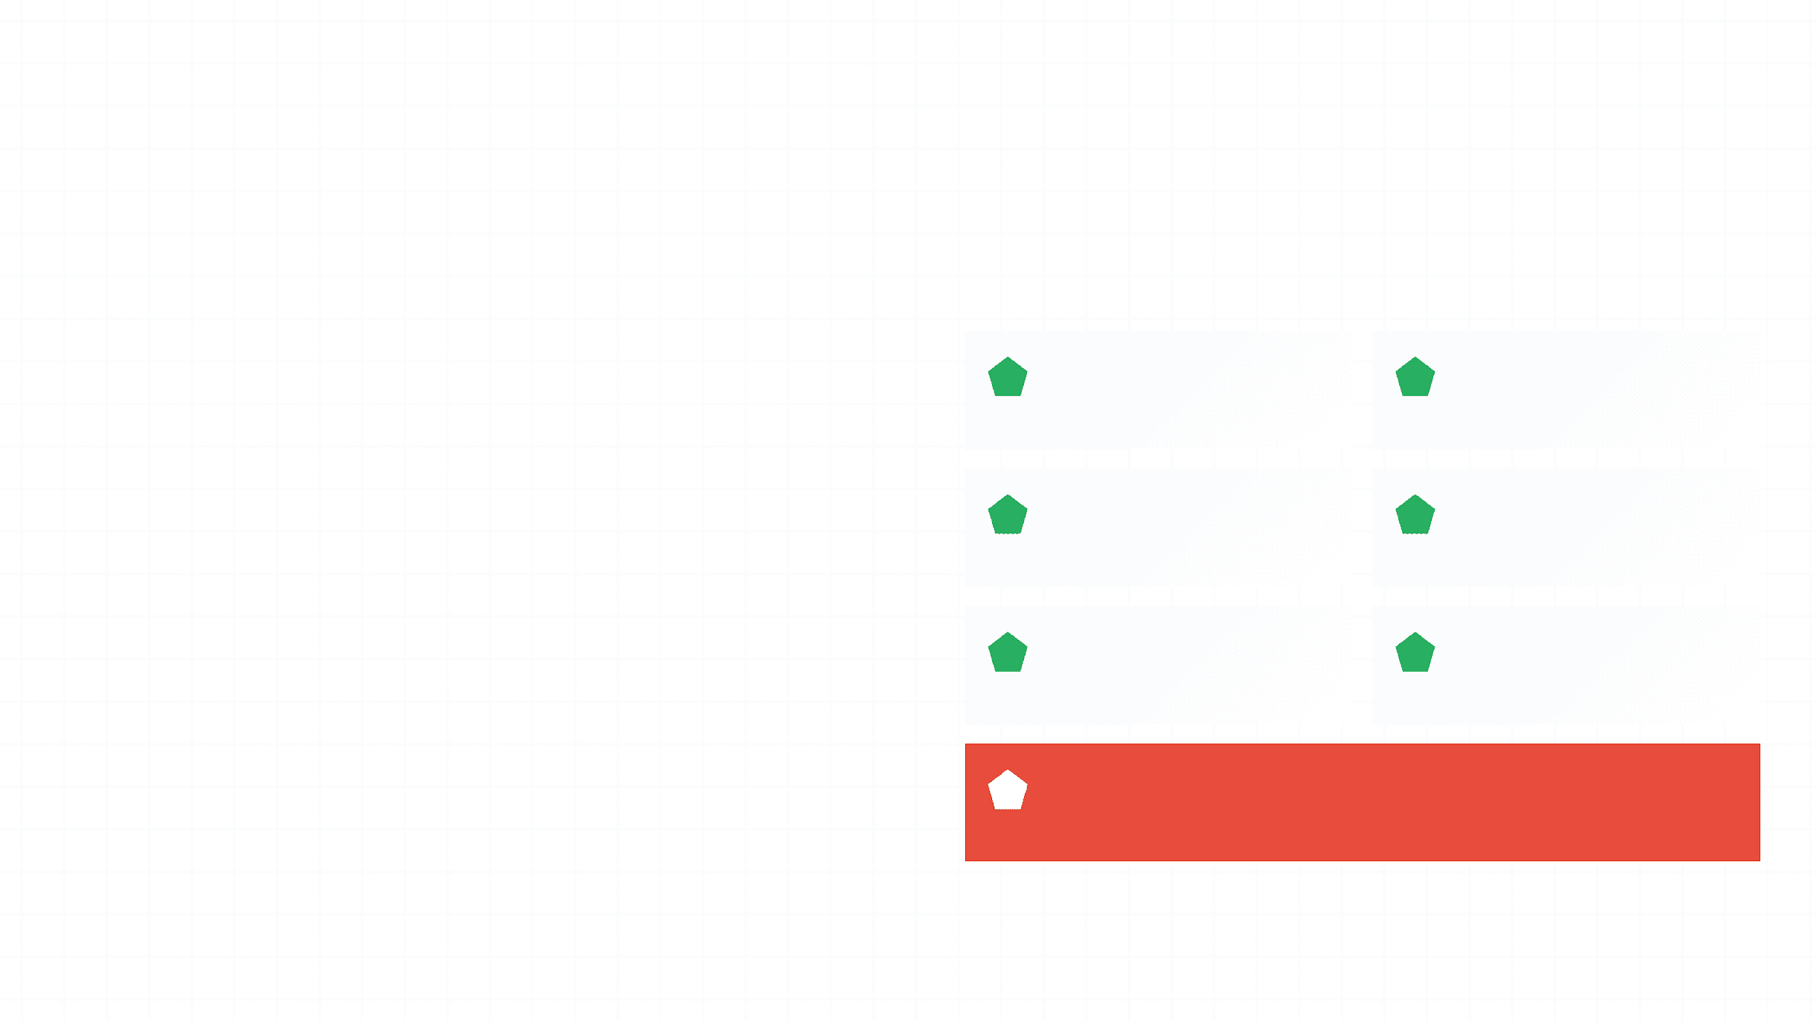
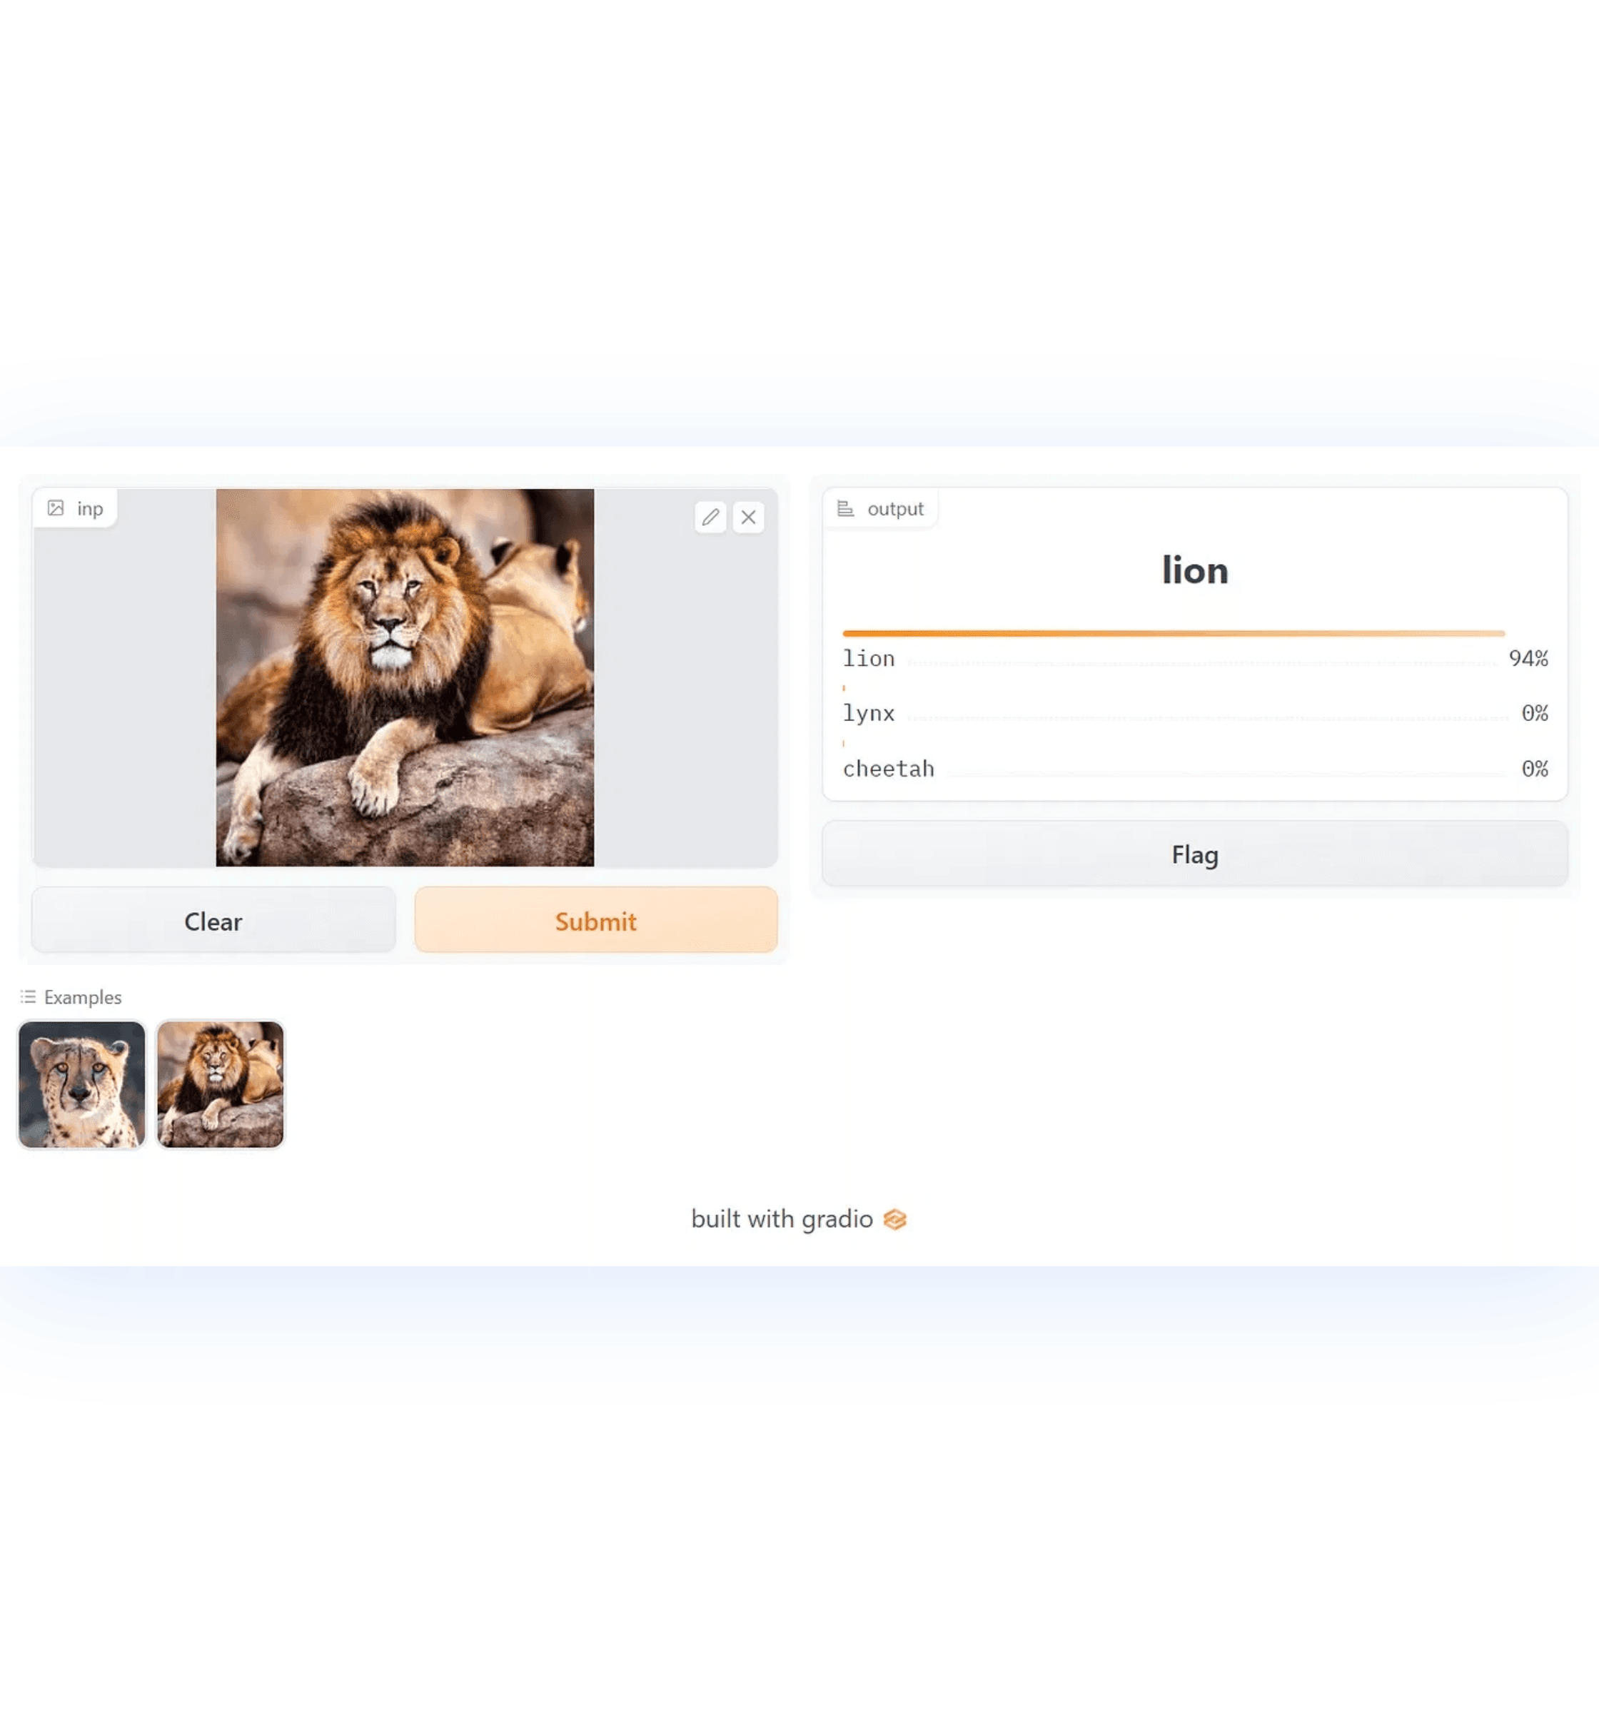
Key Advantages
Why This Implementation Successfully Addresses the Problem
200+ Languages
High Quality
Unified system supporting all languages in a single model
44% improvement over previous SOTA, especially for low-resource
Web Accessible
Fully Deployable
No installation required, works on any device with browser
Production-ready system, not just research code
Cost-Effective
Extensible
Leverages open-source model, no expensive retraining
Foundation for language detection, TTS/STT, fine-tuning
Impact: Advancing Digital Equity
Practical demonstration of how cutting-edge AI can address real-world inequities and serve underserved language communities

Slide 5
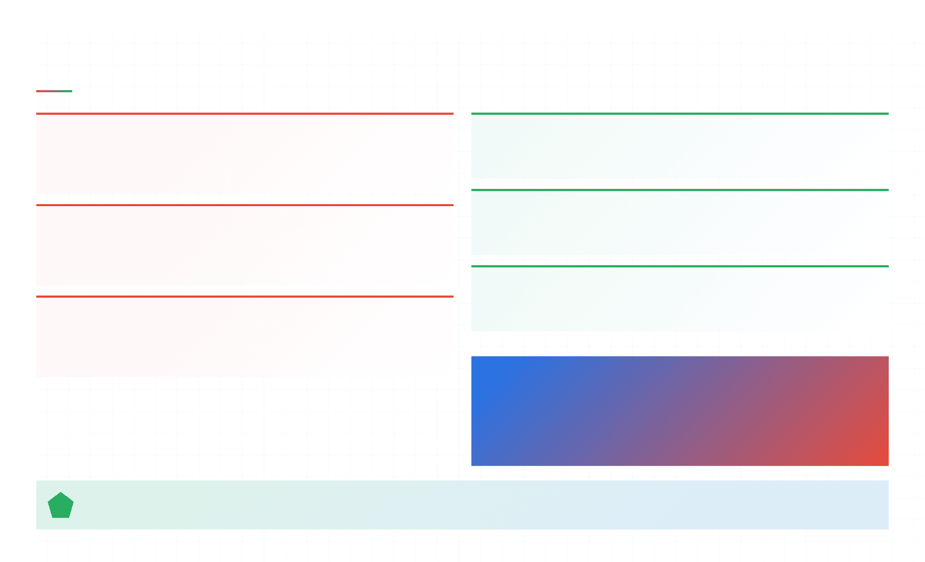
Challenges & Solutions
Challenges Encountered and Paths Forward
Computational Requirements
Quantization Solution
3.3B model requires 20+ GB RAM to load
8-bit or 4-bit quantization reduces memory footprint to 8-10 GB while maintaining translation quality
CPU inference: 10-30 seconds per translation
GPU Deployment
Inference Latency
GPU acceleration (NVIDIA A100 or RTX 4090) achieves sub-second inference latency for real-time translation
Beam search improves quality but increases latency
Trade-off between quality and speed
Dynamic Beam Selection
Implement variable beam sizes based on use case—larger for critical translations, smaller for speed
Fine-tuning Complexity
MoE models require specialized regularization to prevent overfitting
Expert Output Masking, high dropout needed
Future Improvements
🔍 Automatic Language Detection
🎤 Text-to-Speech & Speech-to-Text
📚 Domain-Specific Fine-tuning
☁️ Cloud Deployment (Hugging Face, AWS)
Key Insight: All limitations are addressable with additional development. The core achievement—a practical, accessible, high-quality translation system for 200+ languages—has been successfully demonstrated.

