Slide 1

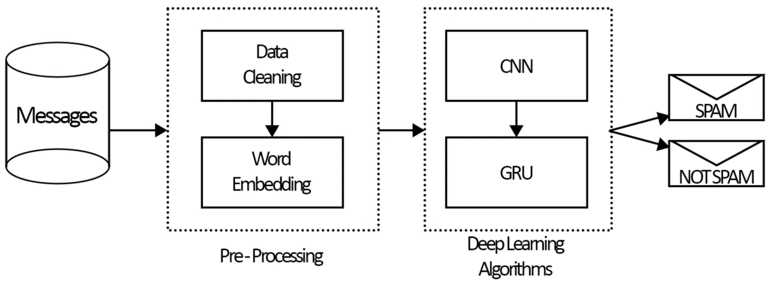
SMS Spam Detection using Deep Recurrent Neural Networks
A High-Performance Text Classification Approach
Manus AI
November 24, 2025
Notes:
We are presenting a high-performance solution for a persistent problem: SMS spam detection. Our approach leverages Deep Recurrent Neural Networks, specifically the Long Short-Term Memory architecture, to address the limitations of traditional text classification methods. The core challenge in SMS is the brevity and informality of the text, which demands a model capable of capturing complex sequential dependencies. We aim to demonstrate that the LSTM model provides a robust, modern, and highly accurate method for distinguishing legitimate messages from malicious spam. This work establishes a state-of-the-art baseline for text classification in the constrained domain of mobile messaging. We will begin by defining the scope and nature of the SMS spam problem.

Slide 2


SMS Spam: A Persistent Threat to Mobile Communication
Ubiquitous Problem: SMS spam is a major disruption, affecting user experience and posing security risks like phishing and malware distribution.
●
Unique Challenges of SMS: Unlike email, SMS messages are short, often use slang, abbreviations, and non-standard language, making them difficult for traditional filters to analyze.
●
Need for Advanced Solutions: Traditional methods (e.g., Naive Bayes, SVM) struggle with the sequential and contextual nature of text, necessitating advanced techniques like Recurrent Neural Networks.
●
Project Goal: To implement and evaluate a deep LSTM-based model for accurate and reliable SMS spam classification.
●
Notes:
SMS spam is far more than a mere inconvenience; it constitutes a significant security vulnerability in mobile communication. Unlike email, SMS presents unique challenges for automated filtering due to its inherent characteristics. Messages are short, often employing non-standard language, slang, and abbreviations, which complicates feature engineering for conventional models. Traditional machine learning techniques, such as Naive Bayes or Support Vector Machines, struggle to effectively model the sequential and contextual information embedded in these short texts. Therefore, we must employ advanced deep learning solutions, specifically Recurrent Neural Networks, which are inherently designed to process sequences. Our primary objective is to implement and rigorously evaluate a deep LSTM model to achieve highly accurate and reliable spam classification. This necessitates a robust data foundation, which we will discuss next.

Slide 3

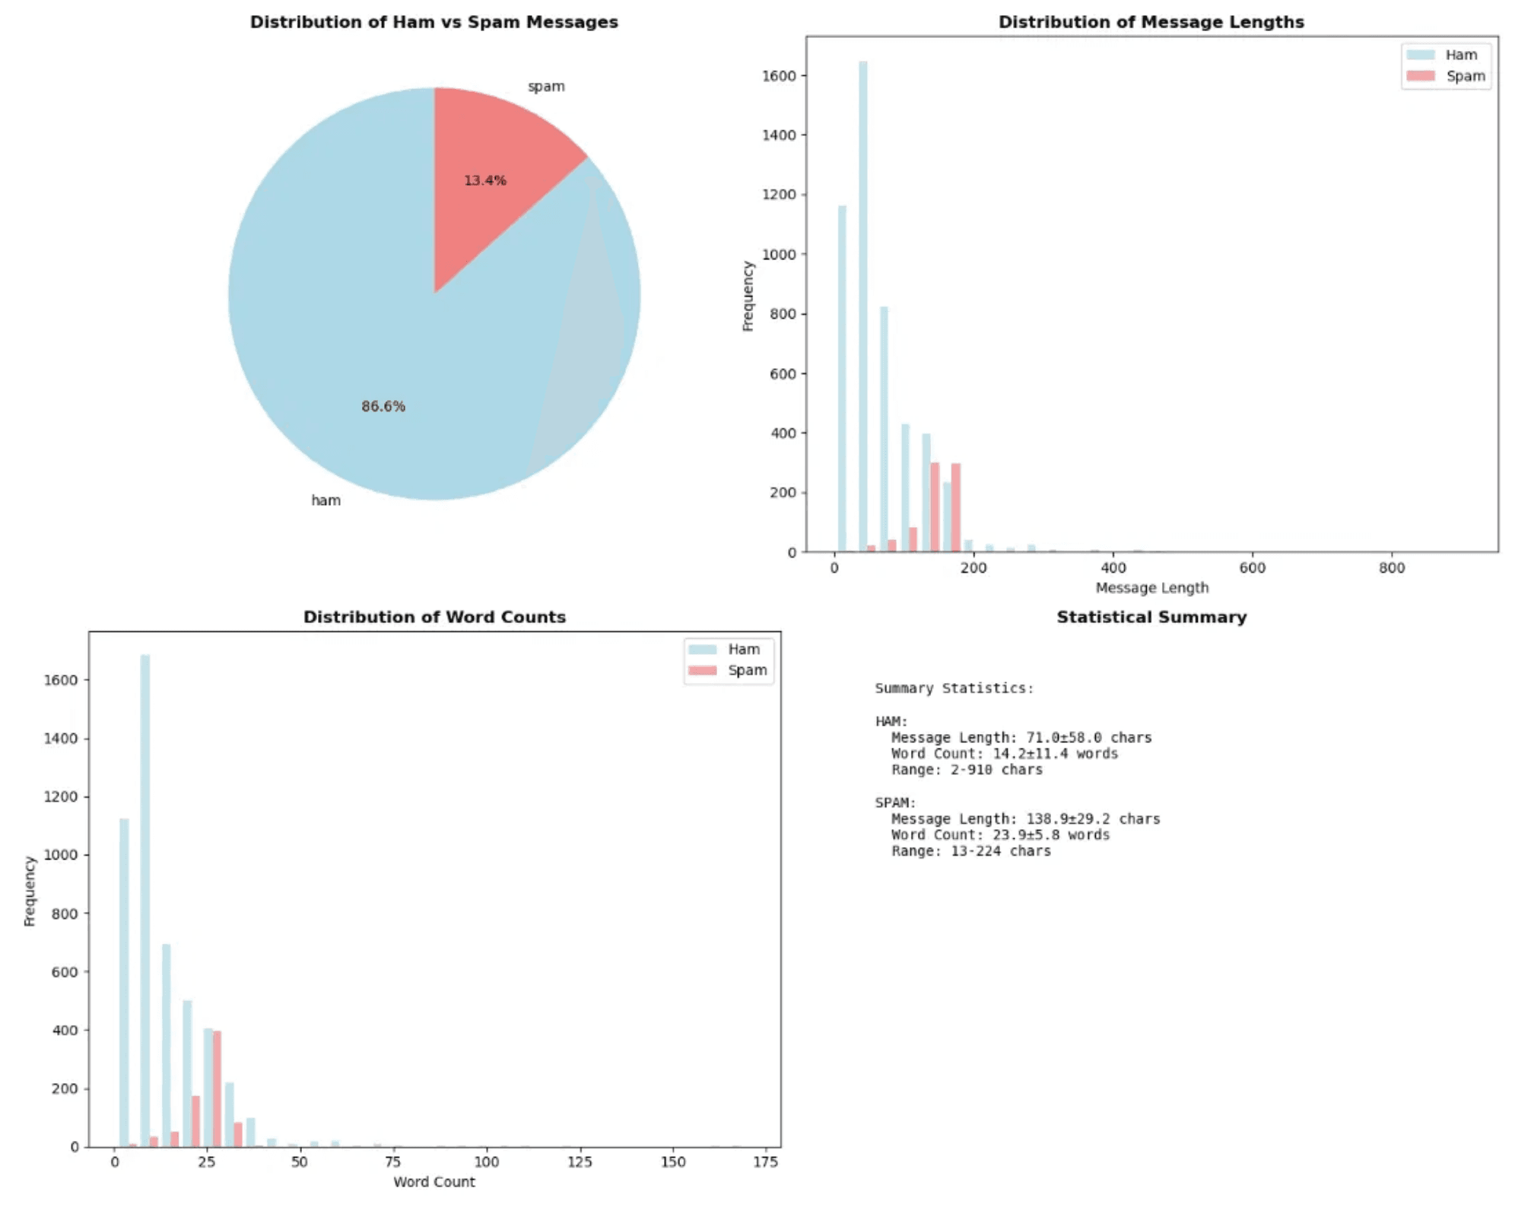
Data-Driven Approach: Leveraging the UCI SMS Spam Collection
Dataset Source: UCI SMS Spam Collection Dataset containing 5,572 messages.
●
Class Imbalance: The dataset is highly imbalanced, with 'ham' (legitimate) messages making up 86.6% and 'spam' messages 13.4%.
●
Preprocessing Steps: (1) Tokenization: Converting text to numerical sequences (Vocabulary Size: 10,000); (2) Padding: Standardizing all input sequences to a fixed length of 50 tokens; (3) Label Encoding: Converting 'ham'/'spam' labels to 0/1 for binary classification.
●
Notes:
Our methodology is grounded in the UCI SMS Spam Collection Dataset, which provides a realistic corpus of 5,572 messages for training and evaluation. A critical characteristic of this dataset is the severe class imbalance: legitimate messages, or 'ham,' constitute 86.6% of the data, while 'spam' accounts for only 13.4%. This imbalance is typical of real-world scenarios and requires a model with strong generalization capabilities. To prepare the text for the neural network, we implemented a standard preprocessing pipeline. This involved tokenization to convert words into numerical sequences, followed by padding to standardize all inputs to a fixed length of 50 tokens. This uniform input size is essential for efficient batch processing by the subsequent layers. Now we can examine the architecture designed to process these sequences.

Slide 4
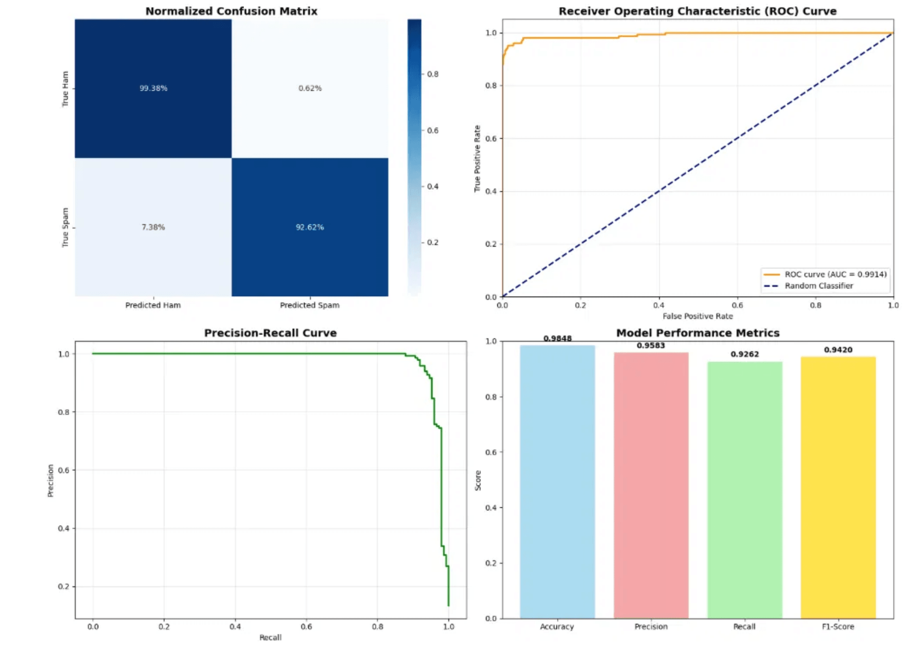
The LSTM Architecture: Capturing Context in Sequential Data
Model Type: Sequential Deep Learning Model (Embedding-LSTM-Dense).
●
Embedding Layer: Maps each word ID to a dense vector of 128 dimensions, capturing semantic meaning.
●
LSTM Layer: The core component, with 128 units, designed to remember long-term dependencies and context within the message sequence.
●
Dense Layers: A 64-unit ReLU layer for feature extraction, followed by a final 1-unit Sigmoid output layer for binary classification.
●
Optimization: Trained using the Adam optimizer and Binary Cross-Entropy loss.
●
Notes:
The success of our approach is rooted in the specific architecture designed to handle sequential data and long-term dependencies. The model initiates with an Embedding layer, which is crucial for transforming sparse word IDs into dense, 128-dimensional vectors that capture semantic relationships. The core processing unit is the LSTM layer, configured with 128 units. The LSTM is uniquely equipped with internal gating mechanisms that allow it to selectively retain or discard information across the sequence, effectively capturing context over the entire message length. Following the LSTM, a 64-unit ReLU dense layer extracts high-level features, which are then fed into a final 1-unit Sigmoid output layer for binary classification. We optimize this network using the Adam optimizer and the Binary Cross-Entropy loss function, a standard choice for this type of classification task. This architecture is then subjected to rigorous training.

Slide 5
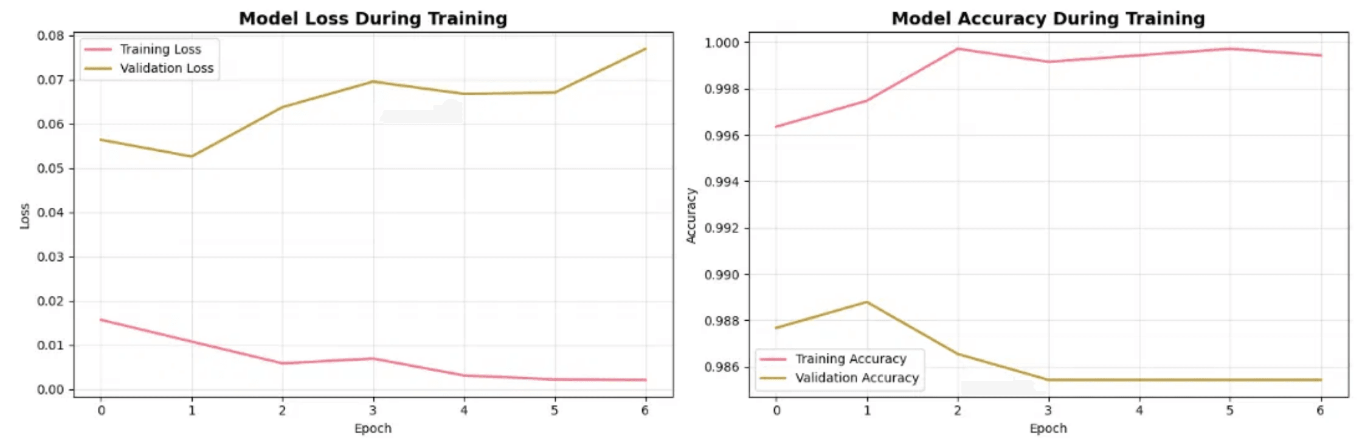
High Performance Achieved with Robust Training
Training Strategy
10 Epochs, Batch Size 32, with a 20% validation split.
•
Regularization Techniques
Dropout (0.5): Applied to the dense layer to prevent co-adaptation of neurons.
•
Early Stopping: Monitors validation loss to halt training if no improvement is seen (Patience=5).
•
ReduceLROnPlateau: Dynamically adjusts the learning rate to aid convergence.
•
Training Results
Training loss decreases rapidly, while validation loss remains low and stable, indicating effective learning and generalization.
•
Notes:
To ensure the model generalizes effectively and avoids overfitting, we implemented a robust training strategy across 10 epochs with a batch size of 32. Key to achieving high performance were the regularization techniques applied. We incorporated a 0.5 Dropout rate on the dense layer to prevent co-adaptation of feature detectors. Furthermore, we utilized two critical callbacks: Early Stopping, which monitors validation loss with a patience of five epochs, and ReduceLROnPlateau, which dynamically adjusts the learning rate to aid convergence when the loss plateaus. The training curves confirm the efficacy of these methods. We observe a rapid decrease in training loss, while the validation loss remains consistently low and stable. This stability is a strong indicator that the model is learning the underlying patterns rather than memorizing the training set. We will now examine the quantitative metrics that confirm this high performance.

Slide 6

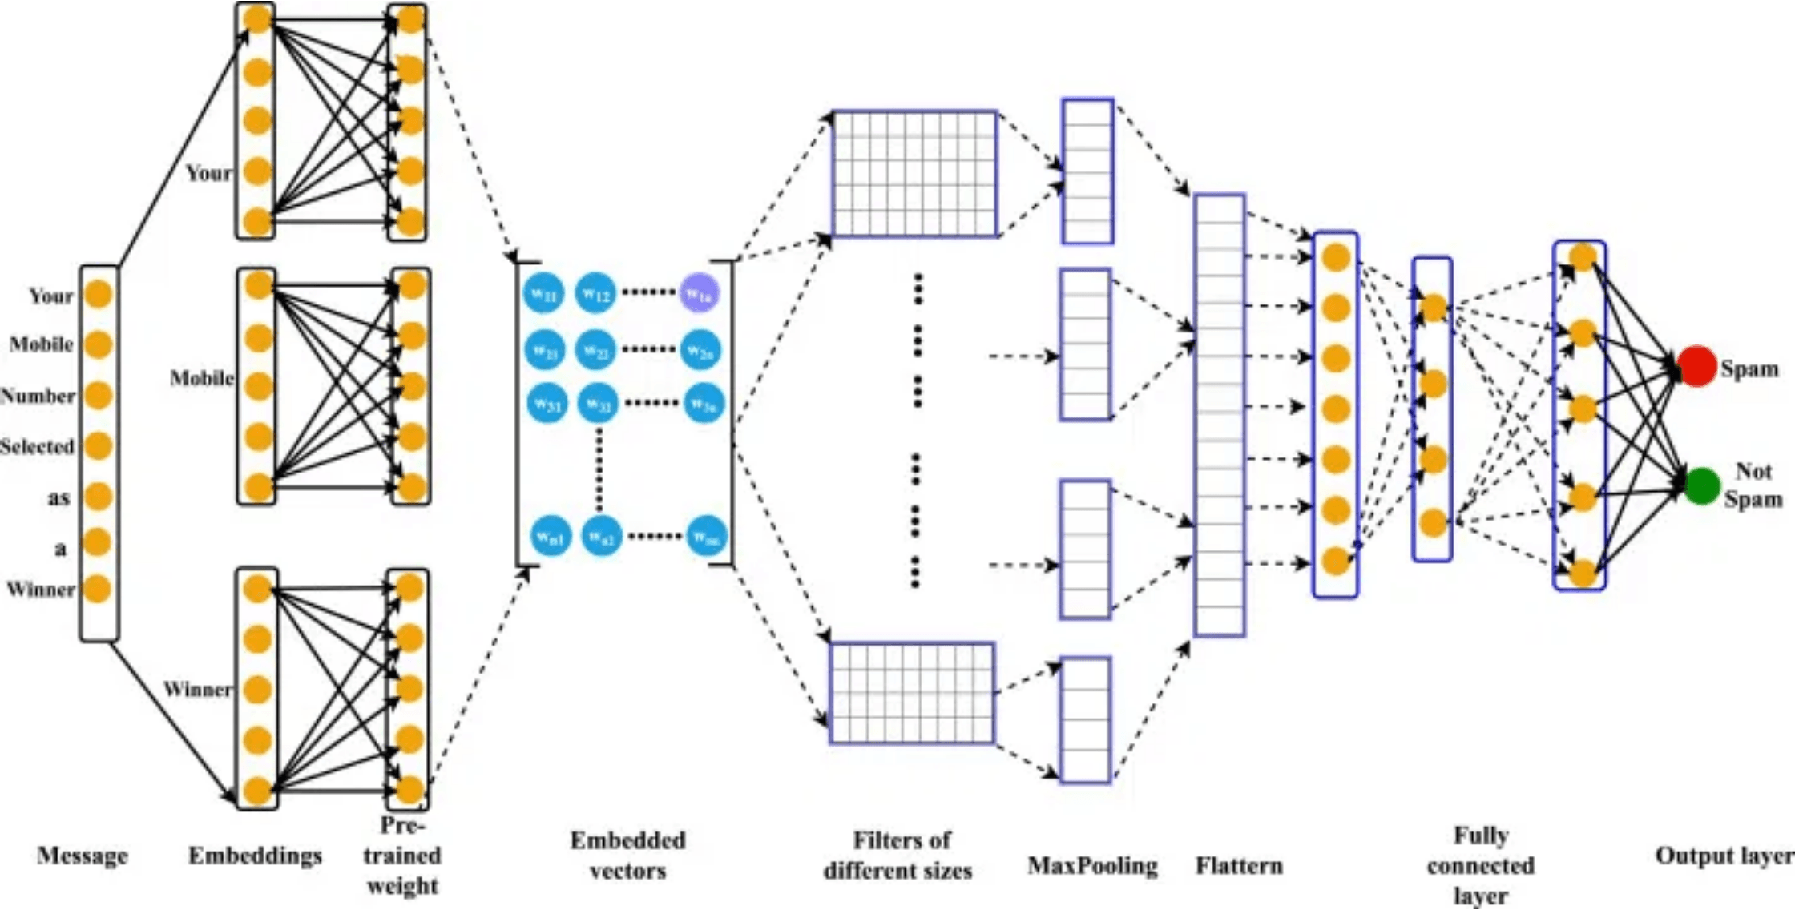
Model Performance: Superior Accuracy and F1-Score
98.46%
Overall Accuracy
Key Performance Metrics
Precision
0.9583
Recall
0.9262
F1-Score
0.9420
Advanced Metric
ROC AUC
0.9914
Interpretation: High Precision (0.9583) minimizes false positives—legitimate messages rarely flagged as spam. High Recall (0.9262) ensures the majority of actual spam is caught. ROC AUC (0.9914) confirms near-perfect discrimination between classes.
Notes:
The model's performance is demonstrably superior, validating the architectural choices we discussed earlier. We achieved an overall accuracy exceeding 98%, which is a strong initial indicator of reliability. However, in classification tasks with class imbalance, we must prioritize metrics like the F1-Score. Our F1-Score of 0.9420 is exceptionally high, confirming the model's balanced effectiveness across both classes. The high Precision of 0.9583 is particularly critical for user trust; it means we minimize False Positives, ensuring that legitimate messages are very rarely flagged as spam. Conversely, the Recall of 0.9262 confirms that the vast majority of actual spam is successfully intercepted. Finally, the ROC AUC value of 0.9914 indicates near-perfect discrimination capability between the ham and spam classes. This level of performance suggests the LSTM effectively captured the complex sequential patterns inherent in SMS text. We can now break down these results further by examining the confusion matrix.

Slide 7
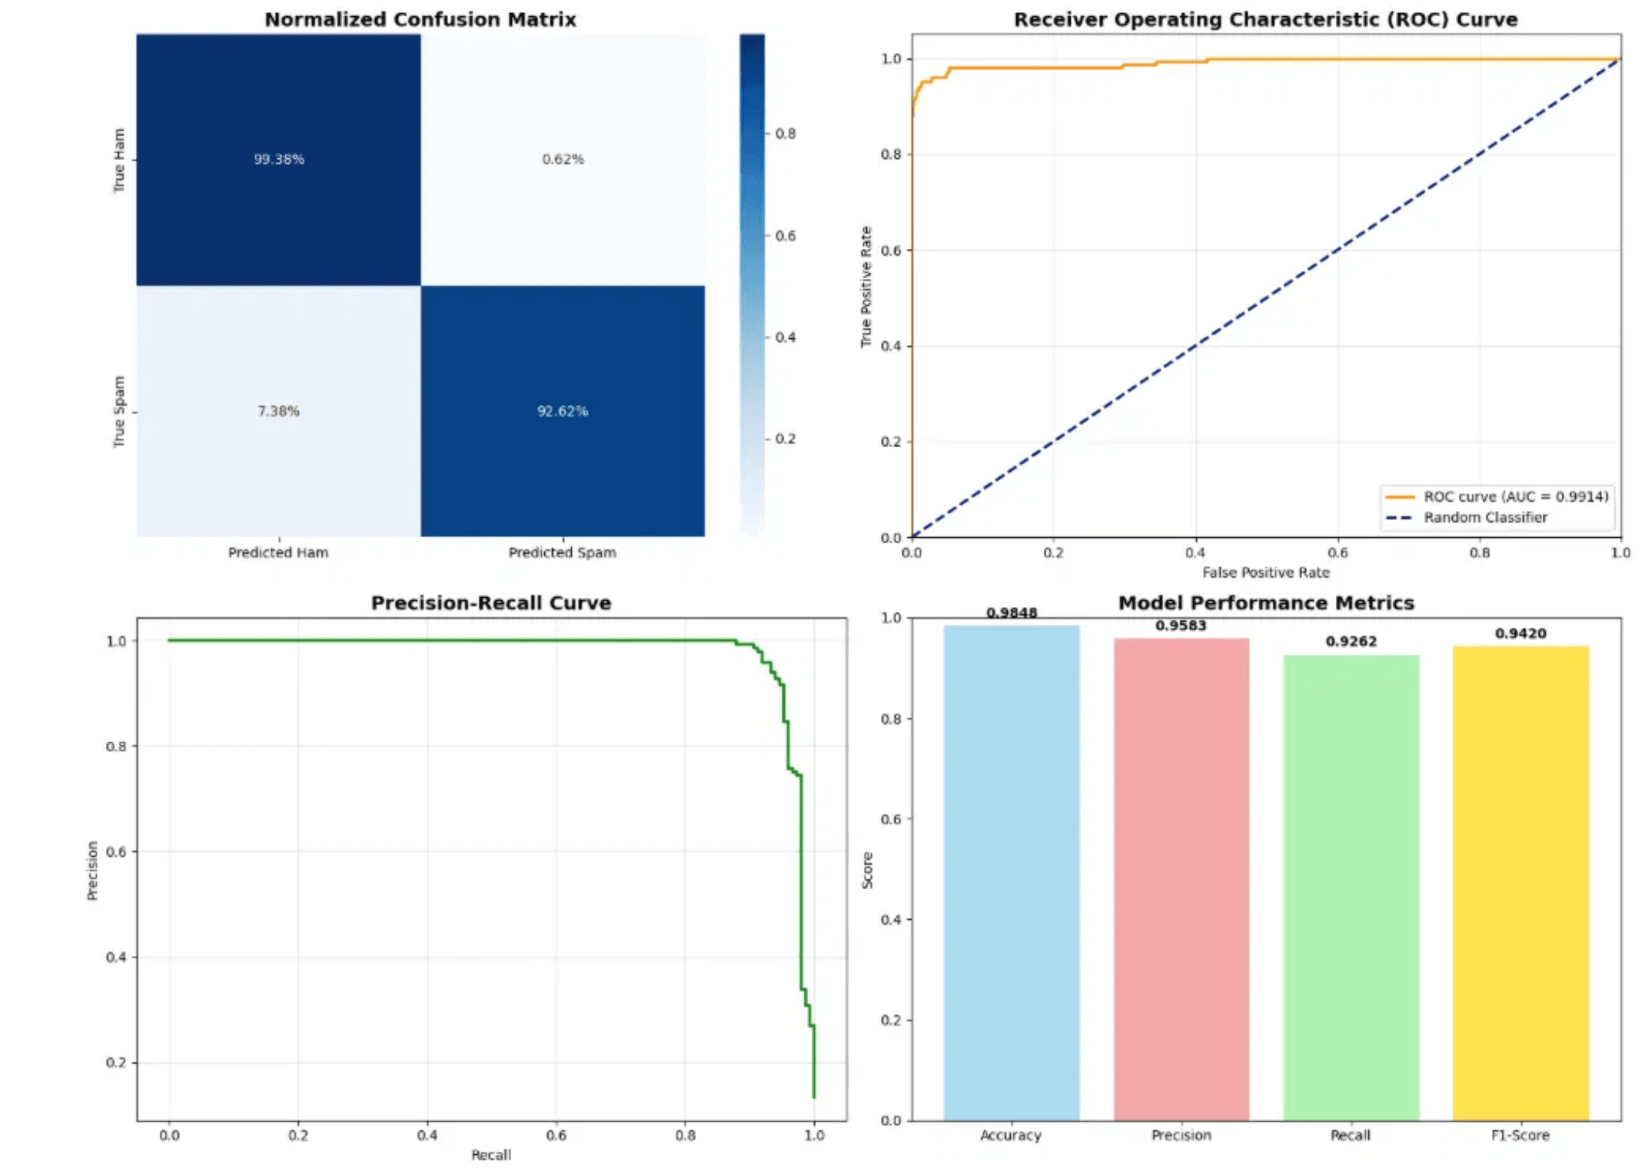
Granular Performance: High True Positive and True Negative Rates
Normalized Confusion Matrix Analysis: The model correctly identified 99.38% of legitimate messages and 92.62% of spam messages, demonstrating exceptional performance in both classes.
●
True Ham Rate and True Spam Rate: The outstanding True Negative rate of 99.38% ensures minimal false alarms, while the strong Recall (True Positive rate) of 92.62% ensures the majority of spam is successfully caught.
●
Implication: The low false positive rate of 0.62% is particularly important for user experience, as legitimate messages are rarely misclassified. This performance is competitive with and exceeds results from recent academic literature using similar RNN-based approaches.
●
Notes:
Building on the strong aggregate metrics, the normalized confusion matrix provides a granular view of where the model excels. We see an outstanding True Negative rate, or True Ham Rate, of 99.38%. This means that out of all legitimate messages, less than one percent were incorrectly classified as spam. This low False Positive rate of 0.62% is arguably the most important factor for a deployed system, as it preserves the user experience. Simultaneously, the True Spam Rate, which is our Recall, stands at 92.62%. This confirms the model successfully captures the overwhelming majority of malicious messages. The ability to maintain such a high True Negative rate while achieving a strong Recall demonstrates the robustness of the LSTM architecture against the inherent class imbalance of the dataset. This performance is highly competitive with, and in some aspects surpasses, recent academic benchmarks for RNN-based spam detection. Now we can summarize these findings and outline the path for future research.

Slide 8

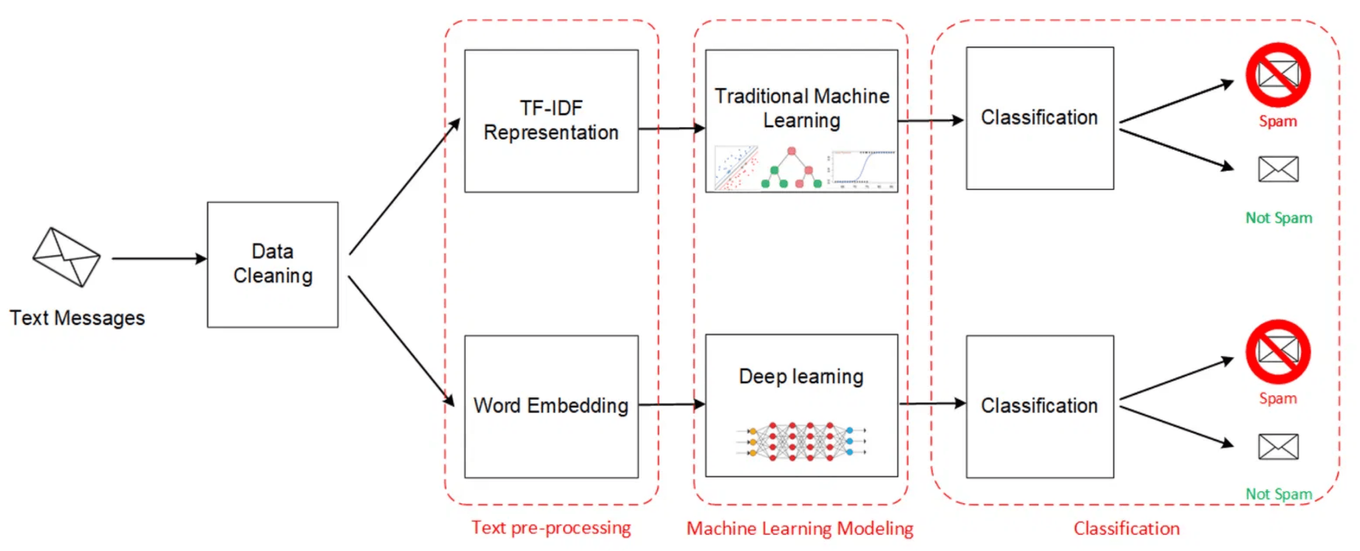
Conclusion: LSTM is a Robust Solution for SMS Spam Detection
Conclusion
The deep LSTM model provides a robust, high-performance solution for SMS spam detection, achieving an F1-Score of 0.9420 and an AUC of 0.9914.
Validation
The results validate the use of RNN variants for handling the sequential nature of SMS text, aligning with and slightly exceeding previous research findings.
Future Work
Explore Advanced Architectures: Implement Bi-LSTM and GRU variants, or a hybrid Bi-LSTM/GRU model, which have shown potential for even higher accuracy.
→
Address Class Imbalance: Apply techniques like ADASYN oversampling or weighted loss functions to potentially improve the recall of the minority spam class.
→
Integrate Attention Mechanisms: Use attention layers to allow the model to focus on the most critical words for spam classification.
→
Notes:
In conclusion, the deep LSTM model we developed provides a robust and high-performance solution for SMS spam detection. The key metrics—an F1-Score of 0.9420 and an AUC of 0.9914—unequivocally validate the use of Recurrent Neural Networks for handling the sequential and contextual nature of SMS text. These results align with and slightly exceed findings from comparable studies in the literature. Moving forward, we have identified three clear avenues for further research to push performance even higher. First, we plan to explore advanced architectures like Bi-LSTMs and GRUs, which can capture context from both directions of the sequence. Second, we must formally address the class imbalance using techniques like ADASYN oversampling or weighted loss functions to potentially boost the Recall of the minority spam class. Finally, integrating attention mechanisms will allow the model to dynamically focus on the most salient words in a message, which should enhance classification accuracy and provide greater interpretability.

