Slide 1


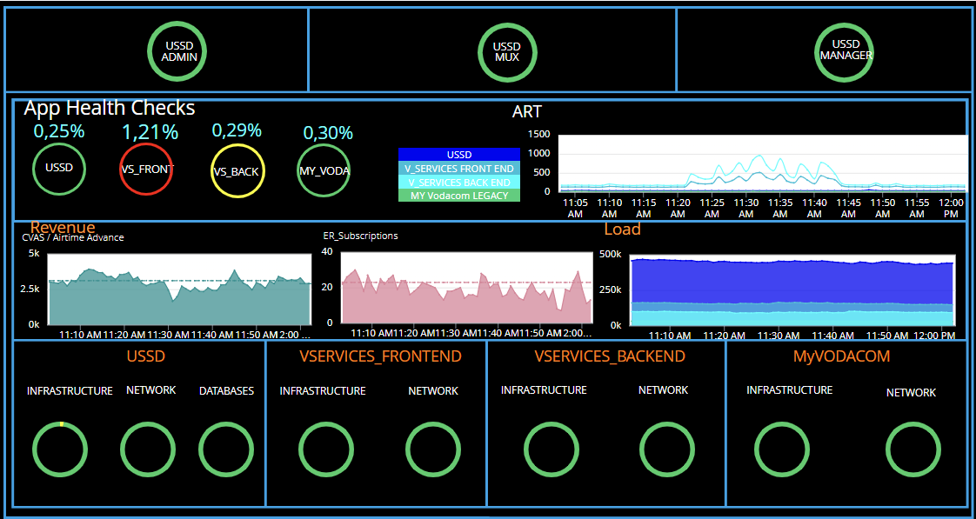
USSD
Good/Healthy/Normal
Warning/Caution
Critical/Error/Failure
USSD tiers
Health status based on error percentage. Warning at 1% and Critical at 2 %
Average response time line graph for the specified applications
Information points and analytics graph displaying the overall revenue for each application, compared to a default baseline.
Overall application performance checking Ussd, Myvodacom, coreservice front end and backend calls per minute load
Status of physical infrastructure and network metrics, packet loss, and data throughout the applications

Slide 2
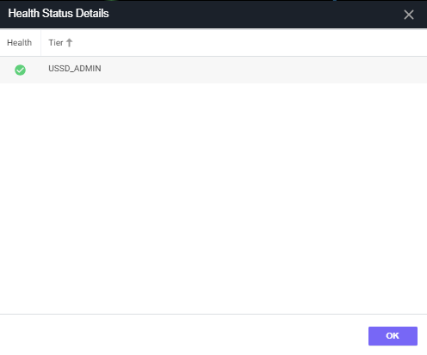
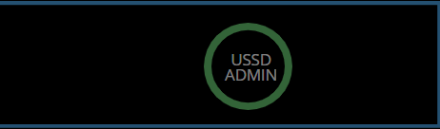
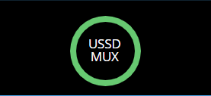
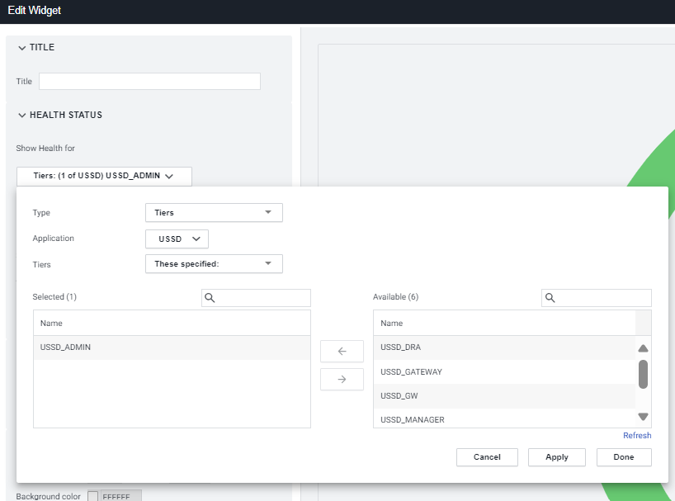

USSD
Good/Healthy/Normal
Warning/Caution
Critical/Error/Failure
Monitored Metrics
The nodes under each tier
These tiers also are fetched by adding a widget as the screenshot shows

Slide 3
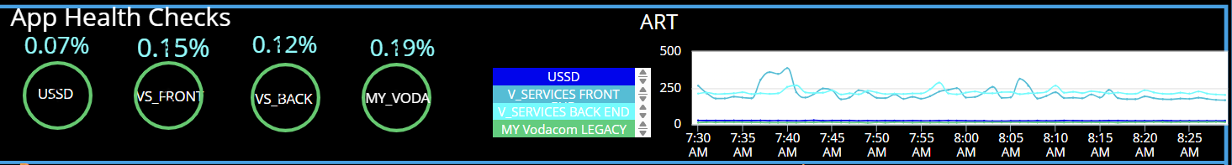
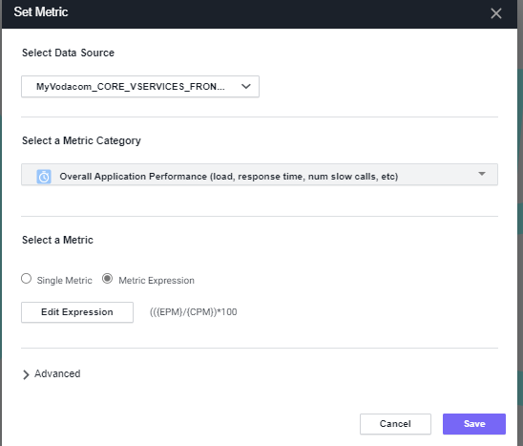
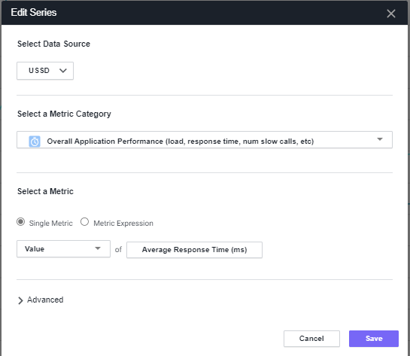
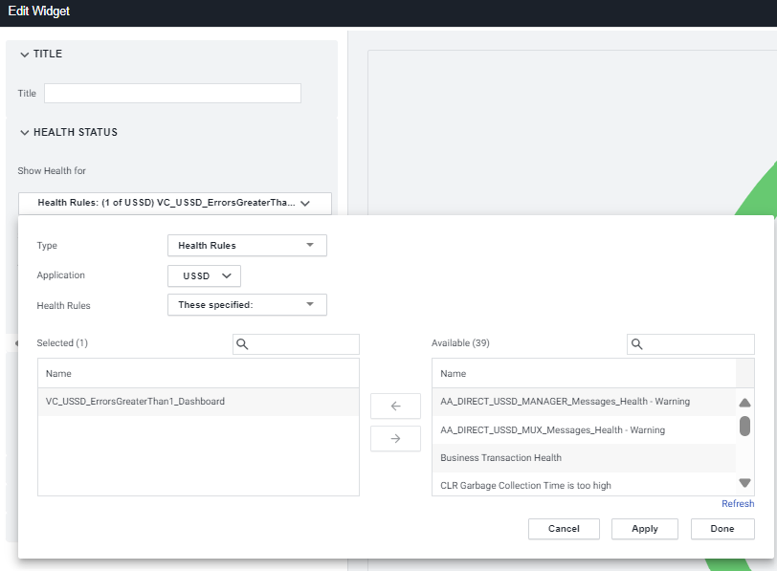
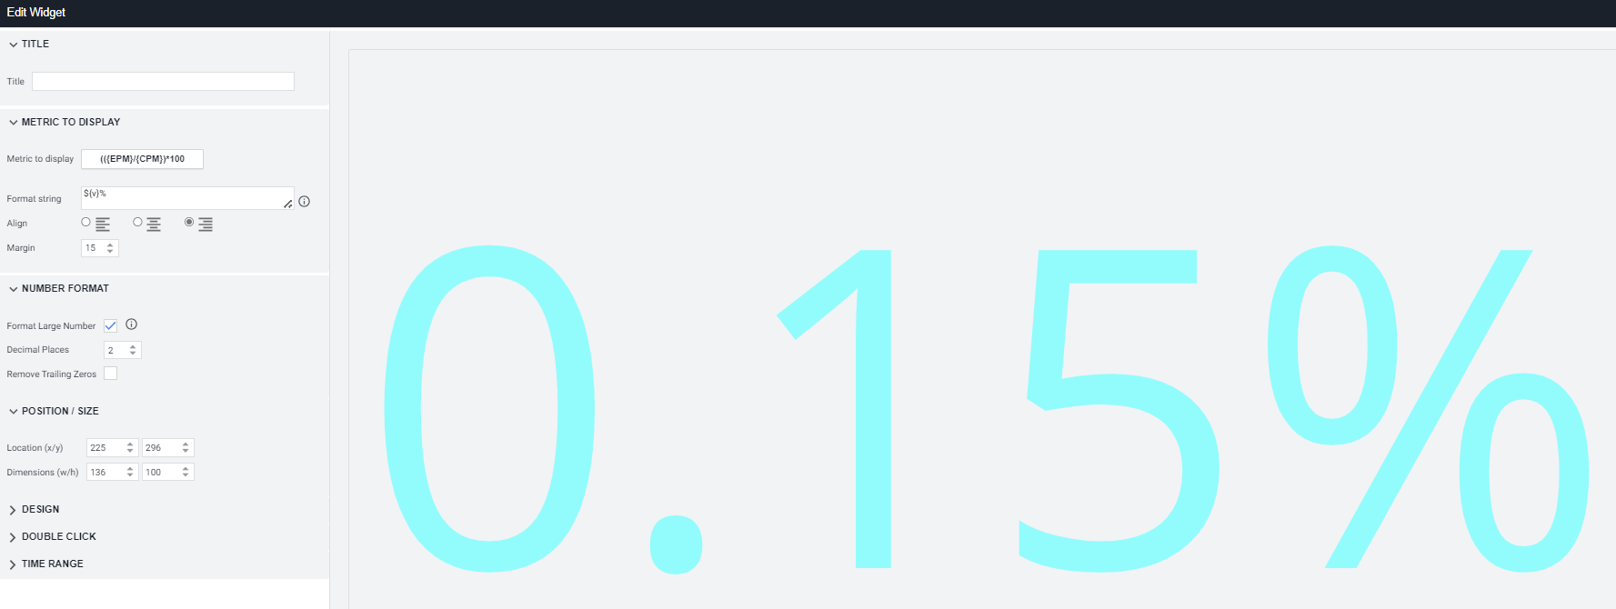
USSD
Good/Healthy/Normal
Warning/Caution
Critical/Error/Failure
Monitored Metrics
We monitor these health checks by calling HR called error greater then 1
This is the overall average response time chart of the 4 applications.

Slide 4
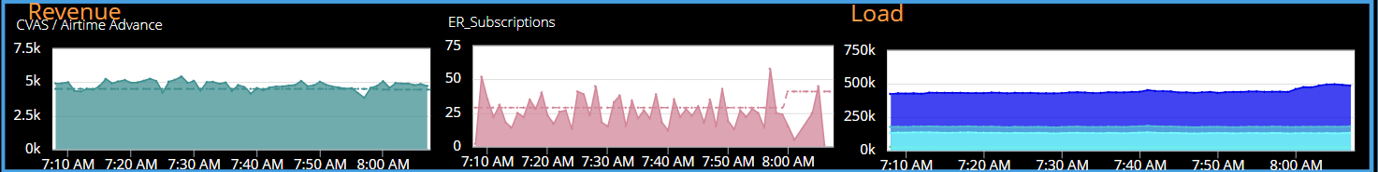
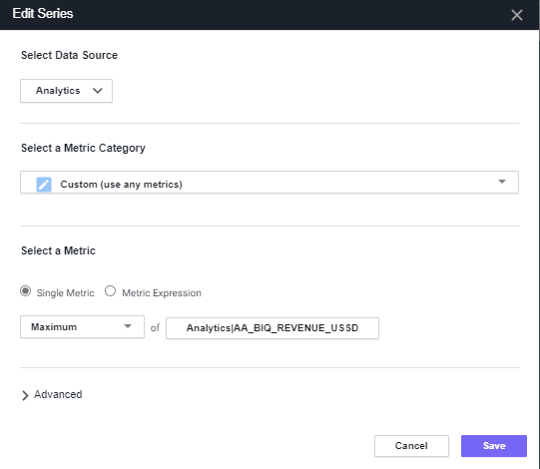
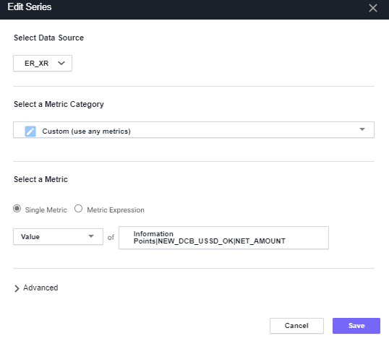
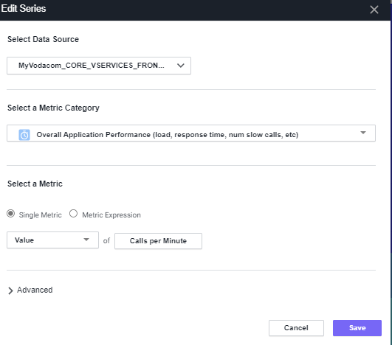
USSD
Good/Healthy/Normal
Warning/Caution
Critical/Error/Failure
Monitored Metrics
Common metrics critical to identifying performance issues include CPU usage, Error rates, Response times, Request rates, User experience data/feedback
Status of physical infrastructure and network metrics, packet loss, and data throughout the applications
The revenue chart is pulled by adding a widget and call analytics
ER Subscriptions revenue chart is pulled by calling information point under the XR application
This is an overall performance of the following application:
Ussd, myVodacom, myVoda core service front and back
We add calls per minute metric

Slide 5
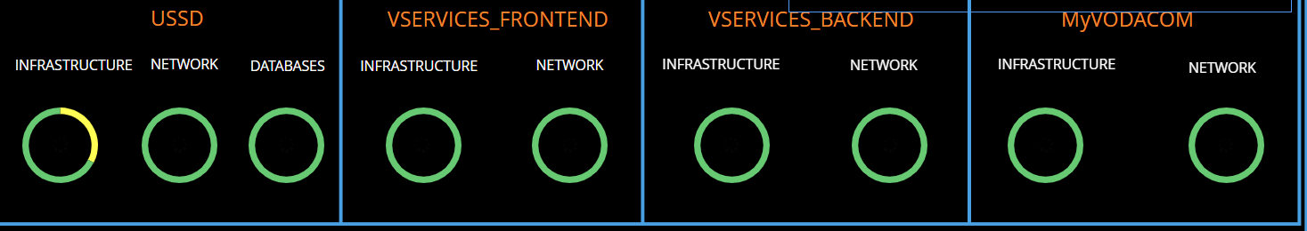
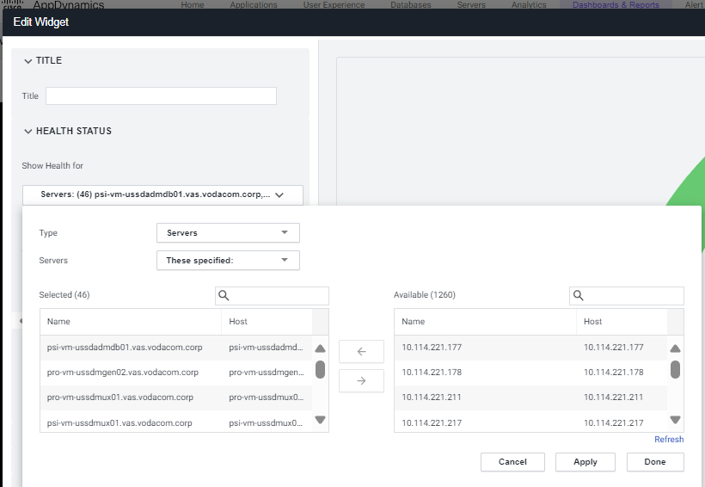
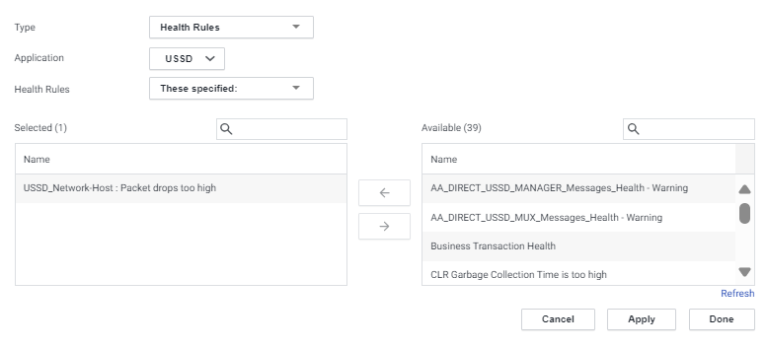
USSD
Good/Healthy/Normal
Warning/Caution
Critical/Error/Failure
Monitored Metrics
This is the view of each applications infrastructure network and database.
Anything that goes wrong on the 3 mentioned, it will be indicated here as yellow or red. Then we need to investigate the health rules, servers further.
How we add HR and servers on our dashboards.

