Slide 1


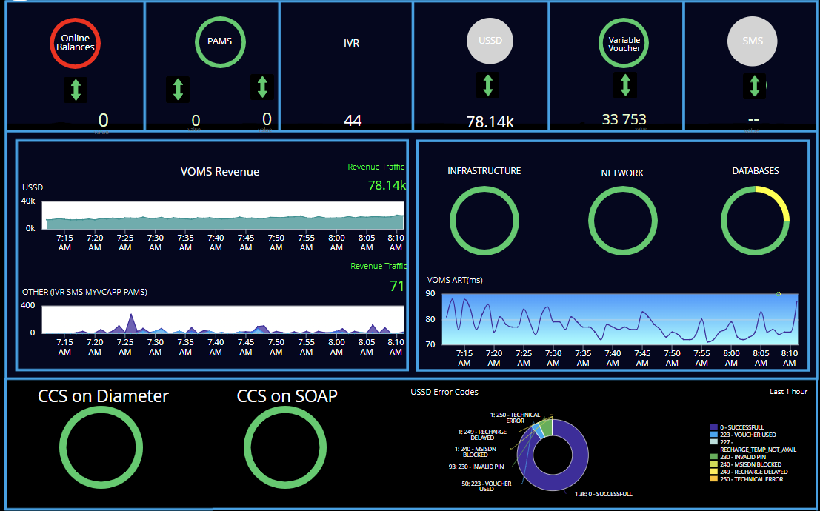
VOMS
Good/Healthy/Normal
Warning/Caution
Critical/Error/Failure
computer based system that allows customers to interact with the vodacom telephone system through their phone keypad or voice commands.
UPSTREAM ONLINE bundles and incoming TOP 4 FI Transactions
Prepay account manager:
USSD is the redemption channel
These are vouchers from Shoprite.
One of the redemption channel
Analytics revenue breakdown by visual graph and the total sum
Status of physical infrastructure, database performance, network metrics, packet loss, and data throughout
Indicator showing high average response time for CCS diameter connections.
Non-airtime Recharges: Data/SMS/voice, the recharge will be sent to CCS via
SOAP using the SOID
VOMS overall performance graph displaying the average response time over a specified period
Errors coming through to USSD

