Slide 1
Hierarchical Network Fusion for Multi-Modal Electron Micrograph Representation Learning with Foundational Large Language Models
Sakhinana Sagar Srinivas Geethan Sannidhi Venkataramana Runkana
TRDDC & IIIT Pune
June 29, 2025
MultiFusion-LLM

Slide 2
Outline
1
Introduction
2
Proposed Method: MultiFusion-LLM
3
Experiments & Results
4
Conclusion
MultiFusion-LLM

Slide 3
Motivation & Core Challenges
Context:
Electron micrographs are essential for nanoscale inspection in semiconductor manufacturing and nanomaterials research.
Sub-7nm technology nodes introduce complex, hierarchical visual patterns and structural heterogeneity.
Conventional vision models (CNNs, ViTs) often fail under distributional shifts due to limited inductive priors and lack of domain knowledge integration.
Key Challenges:
High Intra-Class Variability: Visual heterogeneity within the same nanomaterial category complicates generalization.
High Inter-Class Similarity: Different nanomaterials exhibit overlapping structural motifs and textures.
Spatial Heterogeneity: Salient patterns occur at multiple spatial resolutions, necessitating multi-scale representation learning.
Research Objective
Design a multi-modal, hierarchical representation learning framework that synergistically fuses patch-based and graph-based visual encodings with domain-specific language model insights to enable robust nanomaterial classification under complex visual distributions.
MultiFusion-LLM

Slide 4

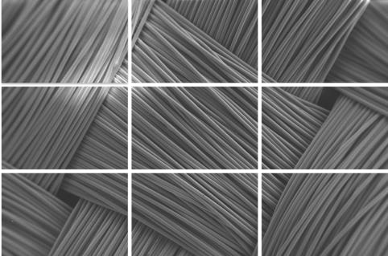












Core Insight: Multi-Modal Representation Learning
Electron micrographs contain hierarchical, multi-scale structures that cannot be fully captured using a single modality.
Figure: A micrograph is jointly represented as (a) a patch sequence for modeling spatial dependencies and (b) a vision graph encoding local structural relationships.
Key Design Hypothesis
By combining patch sequence representations (spatial layout) with vision graphs (structural priors), and grounding them in domain-specific technical knowledge from Large Language Models (LLMs), we can enable more discriminative and generalizable classification of electron micrographs.
MultiFusion-LLM

Slide 5
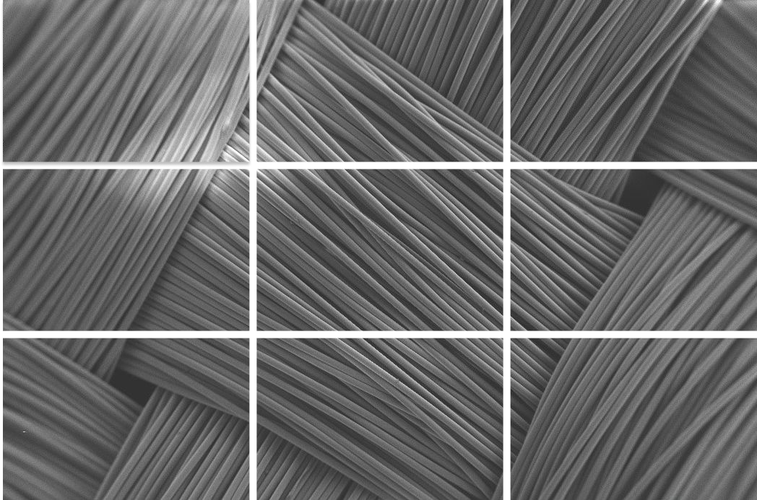
Hierarchical Visual-Linguistic Fusion
Electron Micrograph
a)
Hierarchical Network Fusion (HNF)
Hierarchical Embedding
Output Layer (MHA layer)
Nearest Neighbour Graph
Attention Pooling
Zero-Shot Prompting
Textual Explanations
Text-level Embedding
b)
LLM
LM
Visual Stream: Electron micrographs are tokenized into multi-resolution patch sequences and vision graphs. Hierarchical Network Fusion (HNF) uses Neural ODEs and Graph Chebyshev Convolutions across layers to generate cross-modal visual embeddings.
Textual Stream: Zero-shot CoT prompts query LLMs (e.g., GPT-3.5) to generate technical nanomaterial descriptions, which are encoded by smaller language models (e.g., DeBERTa) using Masked Language Modeling.
Fusion Layer: A Multi-Head Cross-Attention mechanism aligns and integrates the hierarchical visual embeddings with text-level embeddings for robust multi-class classification.
MultiFusion-LLM

Slide 6
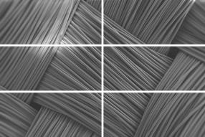





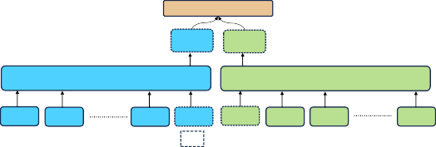
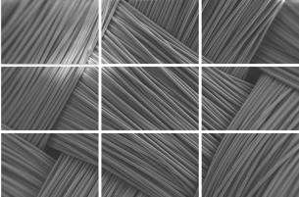



The Visual Processing Backbone
The Hierarchical Network Fusion (HNF) is a cascading, multi-layered visual backbone designed to capture both fine- and coarse-grained visual cues from electron micrographs through multi-scale representation learning.
^{h}fus
Layer (l+1) Gating Mechanism
መ_{𝐡} ^{(l+1)}
_{𝐞ො} (l+1)
CLS VN
Neural ODE
GNN Layer
Top k-Neigbour Graph
3x2 Patches
_{h1}(l+1)
(l+1)
_{h2}(l+1) _{hn}
^{hCLS(l+1) eVN e}1
(l+1) (l+1)
CLS VN
(l+1)
e₂
_{en}(l+1)
VN
Layer (l)
Gating Mechanism
_{መ𝐡} (l)
CLS
(l)
^{𝐞ො}VN
Neural ODE
GNN Layer
Top k-Neigbour Graph
3x3 Patches
(l)
h₁
(l)
h₂
_{hn}(l)
(l)
^{h}CLS
CLS
_{eVN}(l)
VN
(l) (l)
e₁ e₂
_{en}(l)
VN
Figure: HNF constructs a hierarchical representation by processing both patch sequences and vision graphs at increasing patch resolutions across layers.
MultiFusion-LLM

Slide 7
Multi-Scale Visual Backbone: Sequence-Graph Fusion
HNF employs an inverted pyramid architecture where each layer corresponds to a distinct patch size, progressively increasing in resolution to model hierarchical dependencies. At each layer:
The electron micrograph is represented as:
A patch sequence (<cls> token included) for modeling long-range spatial dependencies.
A vision graph, constructed using k-nearest neighbor (kNN) similarity between patch
embeddings, with a global virtual node.
Patch embeddings are evolved using bidirectional Neural ODEs, modeling continuous inter-patch dynamics.
Graph structure is encoded using Graph Chebyshev Convolution (GCC), capturing local structural context.
A Mixture-of-Experts (MoE)-based gating mechanism integrates the CLS token and virtual node embedding, producing a unified hierarchical embedding.
Objective
Fuse spatial (sequence) and structural (graph) modalities to construct scale-aware, cross-domain embeddings for robust micrograph representation.
MultiFusion-LLM

Slide 8
Why Involve Large Language Models?
The Limitation of Visual-Only Models
Purely visual models lack real-world context. They don’t know that “nanowires” are thin, elongated structures or that “MEMS devices” have intricate, manufactured patterns.
This ambiguity can lead to errors.
The Solution: Inject Domain Knowledge
Need: To ground visual features with explicit, high-level scientific and technical knowledge.
Methodology:
1
Generate Knowledge: Use a foundational LLM (e.g., GPT-3.5) to create detailed descriptions of each material class (synthesis, properties, applications, etc.).
Embed Knowledge: Fine-tune a smaller language model on this text to create powerful, domain-specific textual embeddings.
2
MultiFusion-LLM

Slide 9
How to Fuse Vision and Text?
We have a powerful visual embedding from HNF and a powerful text embedding from the LLM. Simple concatenation is not enough.
Need: A sophisticated mechanism that can find complex, context-dependent alignments between the two modalities. It needs to answer: “Which parts of the visual embedding are most relevant to the concept of ‘porous sponge’ described in the text?” Methodology:
The MHA layer lets the two modalities “talk” to each other.
The visual embedding can query the text embedding to find relevant concepts and extract contextual information.
Simultaneously, the text embedding can query the visual embedding to ground abstract scientific concepts in specific visual patterns.
This creates a deeply integrated, unified representation for final classification.
The Multi-Head Attention (MHA) Layer
MultiFusion-LLM

Slide 10
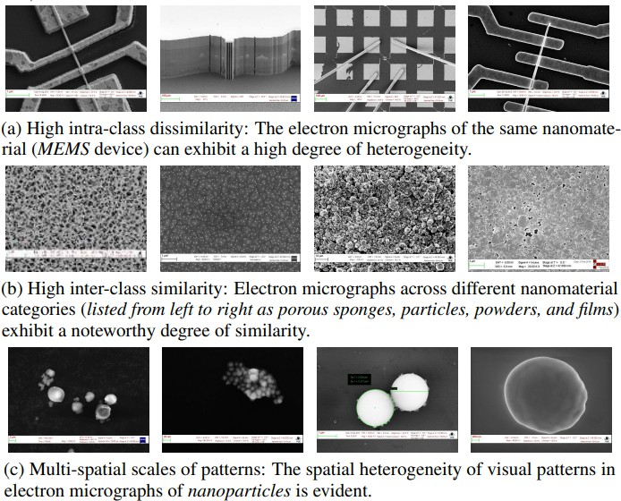
Experimental Setup
Primary Dataset: SEM Dataset, containing 21k electron micrographs across 10 nanomaterial categories.
MultiFusion-LLM

Slide 11
Comparison with Vision-Based Baselines
Our method significantly outperforms existing state-of-the-art models.
Table: Top-N accuracy on the SEM dataset.
Algorithm | Top-1 | Top-2 | Top-3 | Top-5
ResNet | 0.512 | 0.766 | 0.891 | 0.906
SwinT | 0.675 | 0.766 | 0.891 | 0.938
T2TViT (Prev. SOTA) | 0.702 | 0.859 | 0.906 | 0.938
MultiFusion-LLM (w/ BARD) | 0.852 | 0.899 | 0.927 | 0.953
MultiFusion-LLM (w/ GPT-3.5) | 0.947 | 0.965 | 0.986 | 0.991
Key Takeaway
Our model achieves a 25.8% relative improvement in Top-1 accuracy over the next-best baseline, demonstrating the power of our multi-modal fusion approach.
MultiFusion-LLM

Slide 12
Is Every Component Necessary?
We systematically removed key parts of our model to measure their impact.
Table: Performance impact of disabling model components.
Algorithm Variant | Avg-Precision | Avg-Recall | Avg-F1 Score
Full Model (Baseline) | 0.941 | 0.945 | 0.939
w/o HNF (No visual hierarchy) | 0.776 | 0.753 | 0.745
w/o LLMs (No text knowledge) | 0.714 | 0.726 | 0.721
w/o MHA (Simple fusion) | 0.827 | 0.831 | 0.823
Conclusion
Removing any component—the hierarchical visual network (HNF), the LLM-based knowledge, or the smart attention fusion—causes a significant drop in performance. This validates our design choices.
MultiFusion-LLM

Slide 13
Conclusion
We proposed MultiFusion-LLM, an end-to-end framework for nanomaterial classification that integrates hierarchical visual representations with LLM-derived domain knowledge.
The Hierarchical Network Fusion (HNF) module captures both fine- and coarse-grained features via multi-scale patch sequences and vision graphs, refined through Neural ODEs and Graph Chebyshev Convolutions.
Using Zero-shot Chain-of-Thought (CoT) prompting, we extract rich technical descriptions from foundational LLMs and distill them into compact text embeddings via masked language modeling with smaller LMs.
A Multi-Head Cross-Attention mechanism fuses vision and text embeddings, enabling semantic alignment and improving classification under distributional shifts.
The framework outperforms all baselines on the SEM dataset, achieving a Top-1 accuracy of 94.7%, with consistent improvements across multiple datasets and ablation settings.
Our approach enables robust, interpretable, and high-throughput characterization of nanomaterials from electron micrographs—advancing automated inspection in semiconductor manufacturing and materials discovery.
Impact
MultiFusion-LLM

Slide 14
Thank You!
Questions?
MultiFusion-LLM

