Slide 1
BCDV 4032
Building Scalable Blockchain Application
Group 19
Minio and DataDog
Group Members
Sarthak Kaushik(Saki) (101471600)
Harshil Vaghani (101427596)

Slide 2
Minio on Kubernetes
Overview
It is high-performance kubernetes-native object storage
It is compatible to AWS S3 storage system.
It is an open source software.
It is built for large scale AI/ML, data lake and database workloads.
It is software defined and runs on any cloud.

Slide 3
Why Minio for Object store?
Bucket & Object Immutability
Encryption
Active-Active Replication for Object Storage
Automated Data Management Interface
Object Storage Built for S3
Multi cloud gateway
Scalable object storage

Slide 4
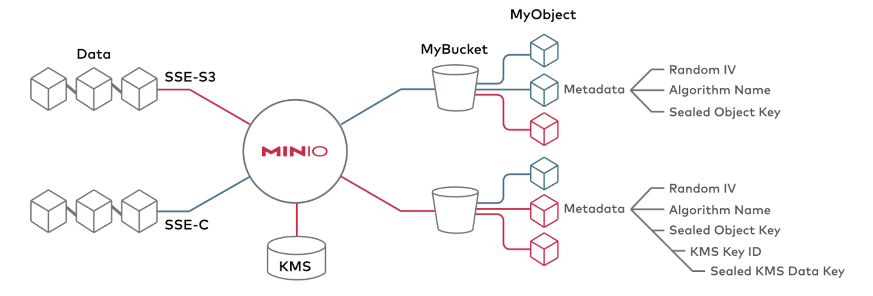
Encryption:

Slide 5
Why use Minio on Kubernetes?
Deploy, Manage and Secure S3-like infrastructure.
Freedom to innovate without public cloud lock-in or disruption.
Control over the software stack with flexibility.
External load balancing.
Monitoring and Alerting
Logging and Auditing

Slide 6
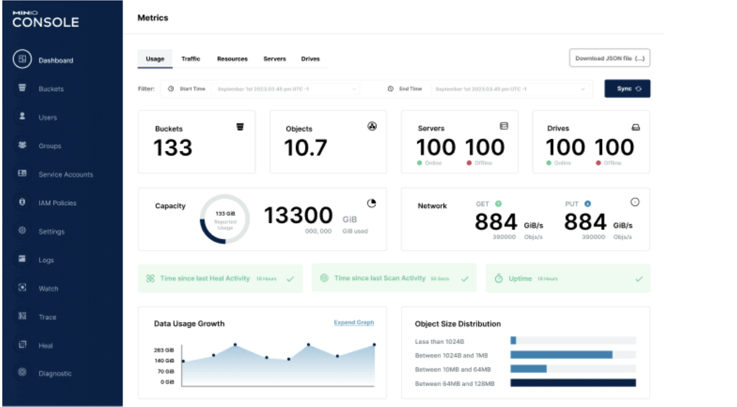
Minio Dashboard

Slide 7
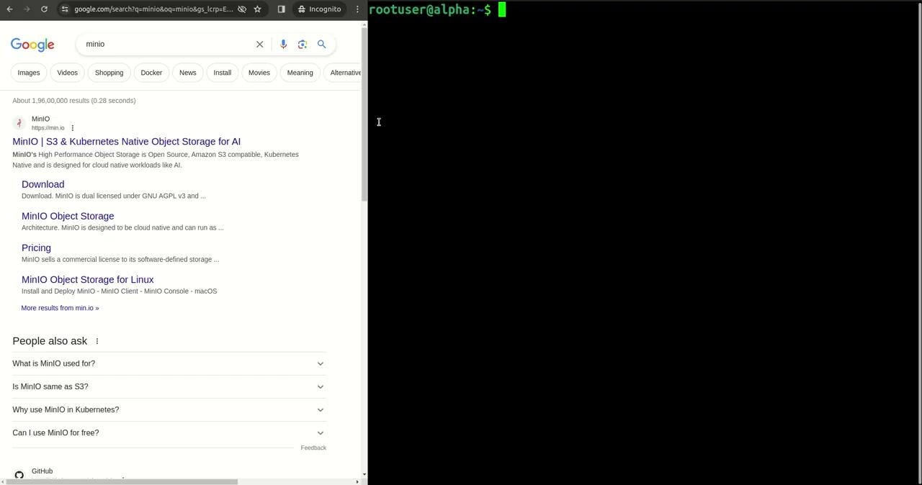
Deploying Minio through Kubernetes

Slide 8
DataDog on Kubernetes
Overview
It is an observability tools only for cloud scale applications.
It provides teams with a unified view of all their system, app and services.
It can collect metrics, traces and logs from across your entire stack.
It collects all telemetry data in one place and tracks it over the time.
It is a tool for maintaining the health and performance of the system.
It basically provides UI for kubernetes operations like checking logs, scalability and so on.

Slide 9
What it offers?
Integration with third party software or services
UI based Dashboard
Continuous profilers
Log management
Synthetic Monitoring
Event and Security
Network Monitoring
Continuous testing

Slide 10
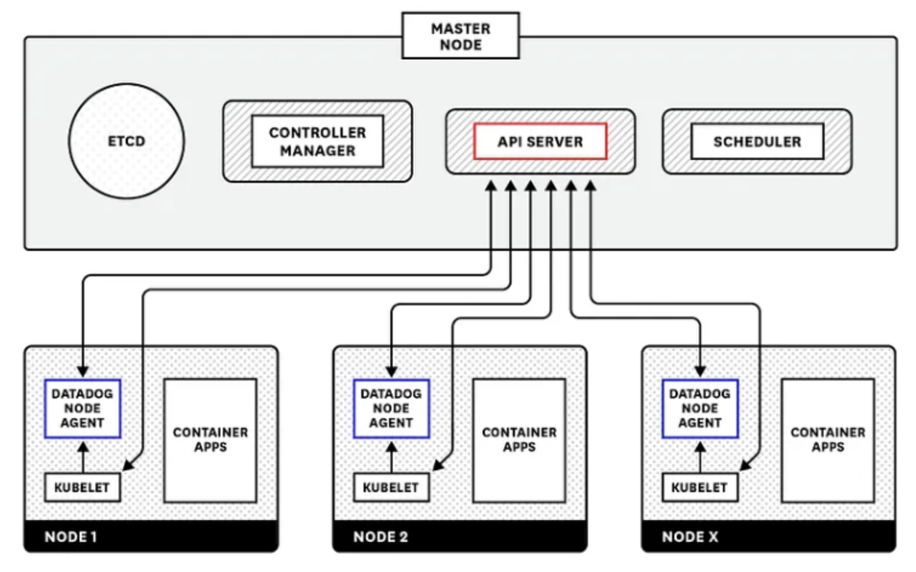
How DataDog works on Kubernetes?

Slide 11
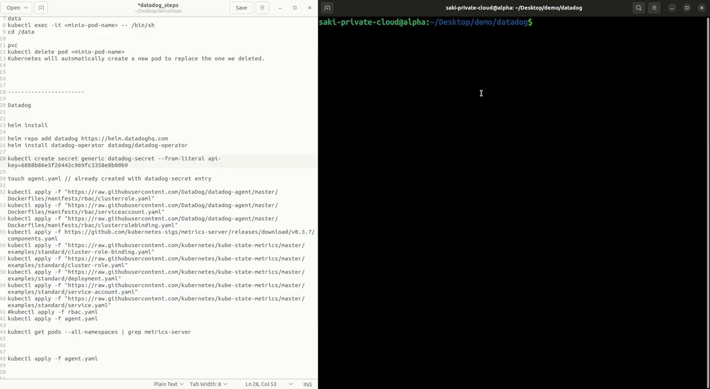
Deploying Datadog through Kubernetes

