Slide 1
Presentation on
University of Barishal

Slide 2

Knowledge is Power

Slide 3
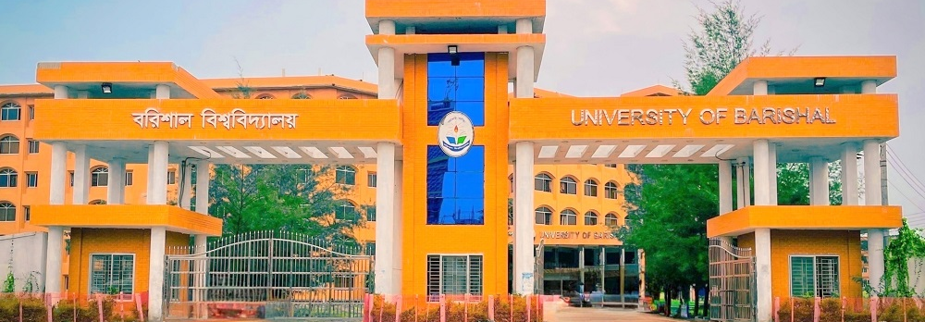
University of Barishal
University of Barishal is a public university located in Barishal, a divisional city in southern Bangladesh. It is the country's 33rd public university

Slide 4
CHART

Slide 5
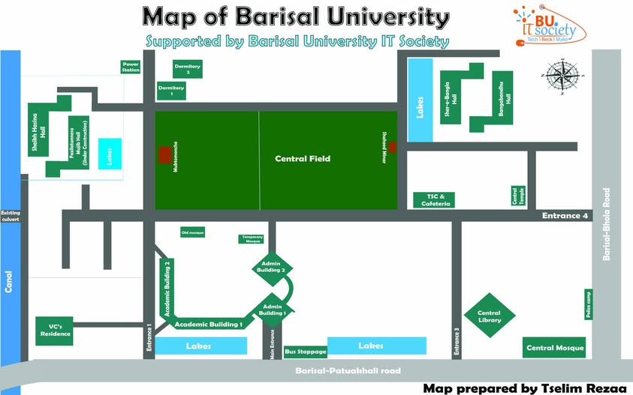
SHAPES

Slide 6
DIVITIONAL STUDENT
DIVITION | STUDENT | YEAR
DHAKA | 30 | 2017
BARISHAL | 80 | 2018
KHULNA | 25 | 2019
RAJSHAHI | 26 | 2020
RANGPUR | 42 | 2021
MYMENSING | 45 | 2022
COTTOGRAM | 51 | 2023
SYLHET | 19 | 2024

Slide 7


