Slide 1

Car Classification Using Convolutional Neural Networks
By Hasan Al Jamil (1811737042) &
Sakib Sadman Shajib (1731201042)

Slide 2
Intention
Car Identification using deep learning and CNN
Explore model development environments and different Convolutional Neural Networks
Notes:
Computer vision could potentially be used to automate traffic censuses and other tasks that require identification of vehicles.
The Stanford 196 Cars dataset contains 16,185 images of 196 different types of cars, which
can be used to train a supervised learning system to determine the make and model of a vehicle in a photograph.

Slide 3
Car Classification
Dataset
Stanford Cars Dataset
Model 1
TensorFlow Keras for model development and Transfer Learning from Xception CNN Model
Model 2
Pytorch for Model Development and Transfer Learning from Resnet CNN Model
Notes:
The Cars dataset contains 16,185 images of 196 classes of cars. The data is split into 8,144 training images and 8,041 testing images, where each class has been split roughly in a 50-50 split. Classes are typically at the level of Make, Model, Year

Slide 4
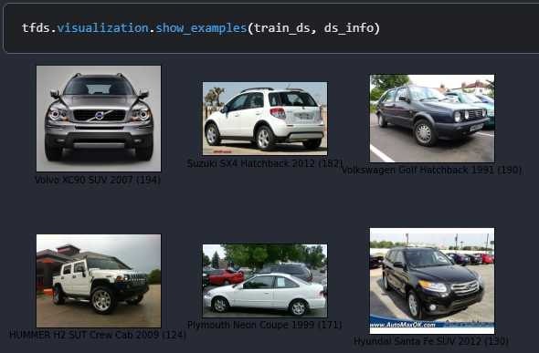
Dataset Sample

Slide 5
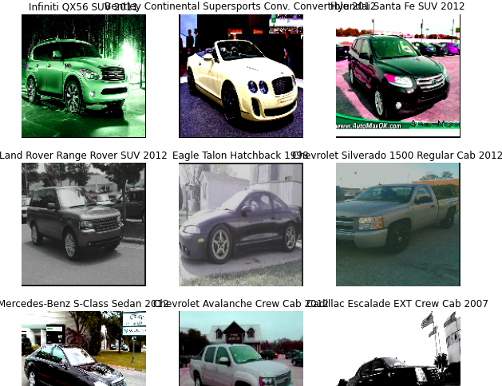
TensorFlow Keras and Xception CNN
Standardizing The Data
-150x150
Normalizing/scaling RGB pixel values between -1 and 1
Preprocessing
Random Data Augmentation
Cropping/padding
Flipping
Hue
Contrast
Saturation
Notes:
##Dataset loaded
For our TensorFlow Implementation, lucky, TFDS module, collection of datasets ready to be used with TensorFlow (no preprocessing and readying it for Tensorflow friendly API
## Standardizing the data
Our raw images have a variety of sizes. In addition, each pixel consists of 3 integer values between 0 and 255 (RGB level values). This isn't a great fit for feeding a neural network. We need to do 2 things:
Standardize to a fixed image size. We pick 150x150.
Normalize pixel values between -1 and 1. (for small weight values as large integer values slow down training and isn’t expected by Xception)
Here, we'll do image resizing in the data pipeline (because a deep neural network can only process contiguous batches of data), and we'll do the input value scaling as part of the model (Normalization Layer), when we create it.
(We want our Model to take Raw data as input opposed to preprocessed Data, As exporting the model elsewhere would require reimplementation of same preprocessing pipeline.
## Preprocessing
When you don't have a large image dataset, it's a good practice to artificially introduce sample diversity by applying random yet realistic transformations to the training images, such as random horizontal flipping or small random rotations. This helps expose the model to different aspects of the training data while slowing down overfitting.
Additionally, let's the data and use caching and prefetching to optimize load speed

Slide 6
TensorFlow Keras and Xception CNN
Model Creation
Load Xception CNN Model Trained on ImageNet dataset
Normalization Layer to scale RGB input
We set our batchnorm layers from Xceptions to Inference mode, as its needed for tuning the model later
Add a spatial global average pooling 2D layer
Add a dropout layer for regularization to prevent overfitting
Add output Layer with 196 outputs and Softmax activation function for classification
Adam optimizer (best performance in similar tests)
Sparse categorical cross entropy for loss function for (not one hot encoded data)(saves memory time and computation)
100 epochs
Sparse categorical accuracy measured as a metric
Fine tuning
Relatively low learning rate used for Adam (1e-5) (preventing
Sparse categorical cross entropy for loss function
100 epochs
Sparse categorical accuracy measured as a metric
Notes:
## Build a model
1. We add a Normalization layer to scale input values (initially in the [0, 255] range) to the [-1, 1] range, because this is the format that is expected by the pre-trained model that comes next.
2. We start with a pre-trained model that's trained on the ImageNet dataset, which includes a large number of images with a large number of different labels, but doesn't not include as much specificity regarding vehicle types as the cars196 dataset does. Training these models from scratch is tricky; it is much easier to start with a pre-trained model and fine tune it for use for a different task.
3. We add our own classification layer at the end of the model, with 96 outputs representing our 96 vehicle classes, and "softmax" activation which forces the output values to all be between 0 and 1, and to all sum to 1.
4. We add a Dropout layer before the above classification layer, for regularization.
We need the number of outputs in the final layer to equal the number of variables or classes we want to predict: in this case, 196 vehicle types.
We use a softmax activation on the on the final layer for classification problems, but if we want to use this model for regression we would only have to change the number of desired outputs and set `activation=None`.

Slide 7
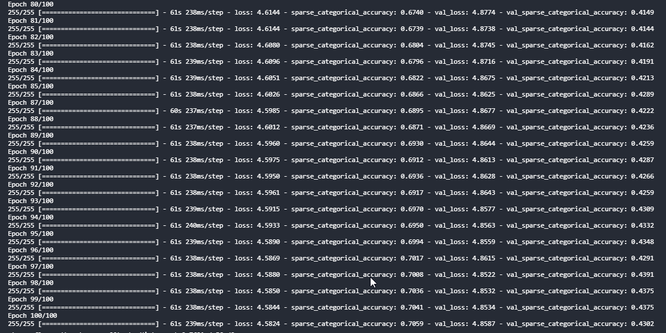
Results
Notes:
Would have liked to use MLflow the different models and test it and deploy the model for real life testing
As we can see our loss is still decreasing meaning that our model is yet not overfitted and the accuracy is still increasing. I believe with more iteration this model will be able to have an even better prediction rating

Slide 8
ResNet CNN using PyTorch
Data Processing
Training Model
Evaluating Model

Slide 9
Data Processing
Standardization:
Resize Training and Testing Images to 400x400.
Pre-Processing:
Data Augmentation to Training Data.
Convert the Images to PyTorch Tensor
Normalize the image with the range (-1, 1).

Slide 10
Training Model
Model Creation:
Download ResNet (34 layers) from TorchVIsion.
Replace Fully Connected Layer with an untrained Linear Layer of CLASS_NUM = 196
Use a Cross Entropy Loss criterion, which is a combination of a LogSoftmax and NLLLoss in one single class.
A Stochastic gradient descent optimizer,
and a Learning Rate Scheduler that reduces the learning rate by a times of 0.1, if the training accuracy hasn’t improved 0.9 per epoch.
The training accuracy at 10th epoch is 90%

Slide 11
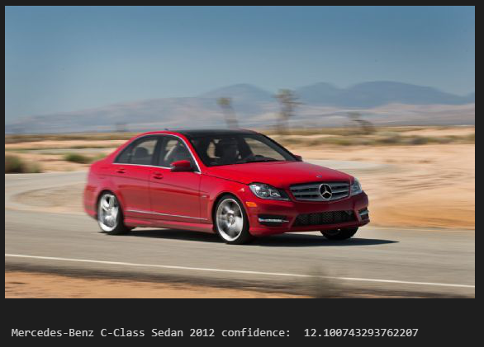
Evaluating Model
It can currently test single images, but the image needs to go through a Data Processing Pipeline
The model output the list of class prediction with a level of confidence. We take the prediction with the highest confidence value as the output class.

Slide 12
Future Development
Adding in Early stopping to avoid overfitting of our Data in the Xceptions based model.
Implement a better Optimizer for the ResNet model such as AdamOptimizer.

