Slide 1
CSE 365: Communication Engineering
Chapter 4: Digital Transmission

Slide 2
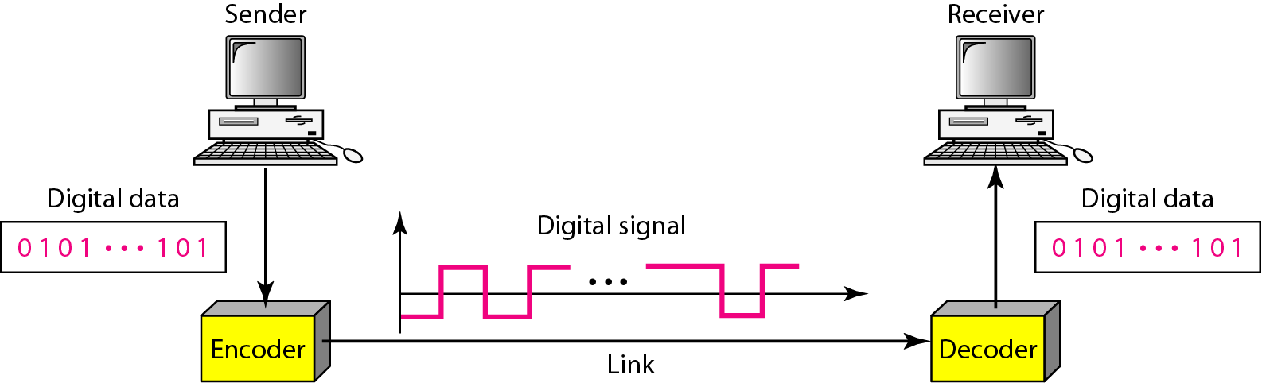
Digital-to-Digital Conversion
Line Coding - Process of converting digital data to digital signal
Line coding and decoding
Notes:
In this section, we see how we can represent digital data by using digital signals. The conversion involves three techniques: line coding, block coding, and scrambling. Line coding is always needed; block coding and scrambling may or may not be needed.

Slide 3
Signal Element vs. Data Element
A data element is the smallest entity that can represent a piece of information, i.e. the bit.
A signal element is the shortest unit (timewise) of a digital signal.
In data communication, a signal element carries data elements.
Data elements are being carried; signal elements are the carriers.
Notes:
Common Characteristics of coding schemes

Slide 4
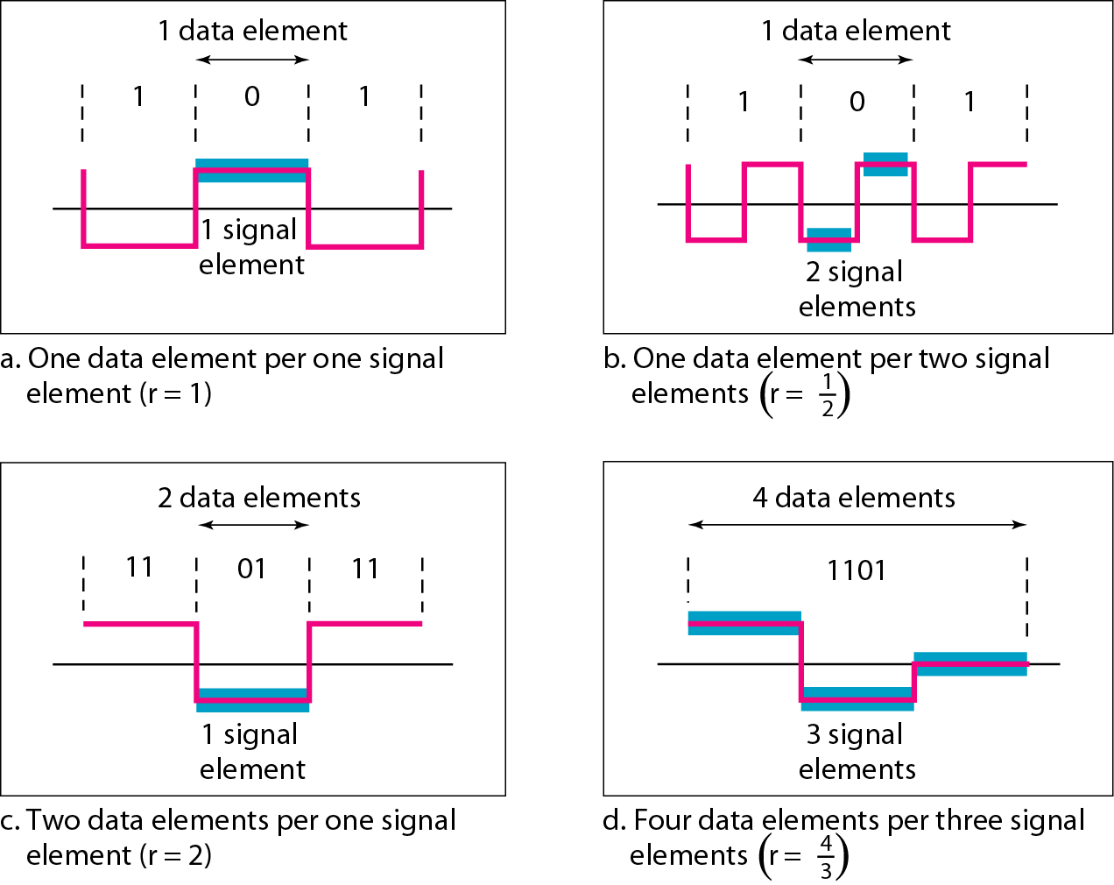
Signal Element vs. Data Element

Slide 5
Data Rate vs. Signal Rate
The data rate defines the number of data elements (bits) sent per sec - bps. It is often referred to the bit rate.
The signal rate is the number of signal elements sent in a second and is measured in bauds. It is also referred to as the modulation rate or pulse rate or baud rate.
Goal is to increase the data rate whilst reducing the baud rate.
The relationship between data rate (N) and signal rate (S) is:
S = N/r baud
S_{ave} = c x N x 1/r baud;
where N is data rate, c is the case factor (worst, best & avg.) and r is the ratio between data element & signal element
Notes:
Worst case - Maximum signal rate
Best case – Minimum signal rate

Slide 6
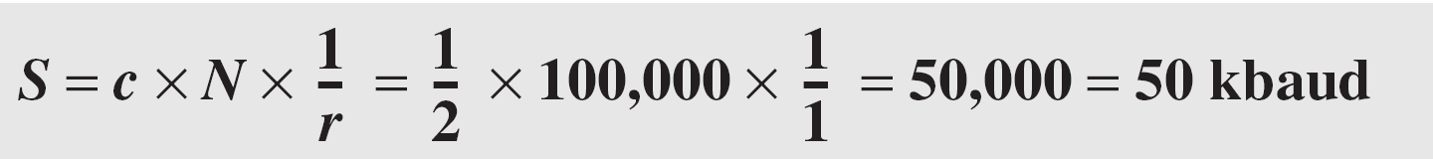
Example 4.1
A signal is carrying data in which one data element is encoded as one signal element ( r = 1). If the bit rate is 100 kbps, what is the average value of the baud rate if c is between 0 and 1?
Solution
We assume that the average value of c is 1/2 . The baud rate is then

Slide 7
Bandwidth
A digital signal is non-periodic with an infinite signal (From previous lecture)
Although the actual Bandwidth of a digital signal is infinite, the effective bandwidth is finite
Bandwidth is proportional to the signal rate/baud rate
The minimum bandwidth
B_{min} = c x N x (1 / r)
Maximum Data rate
N_{max} = (1 / c) x B x r

Slide 8
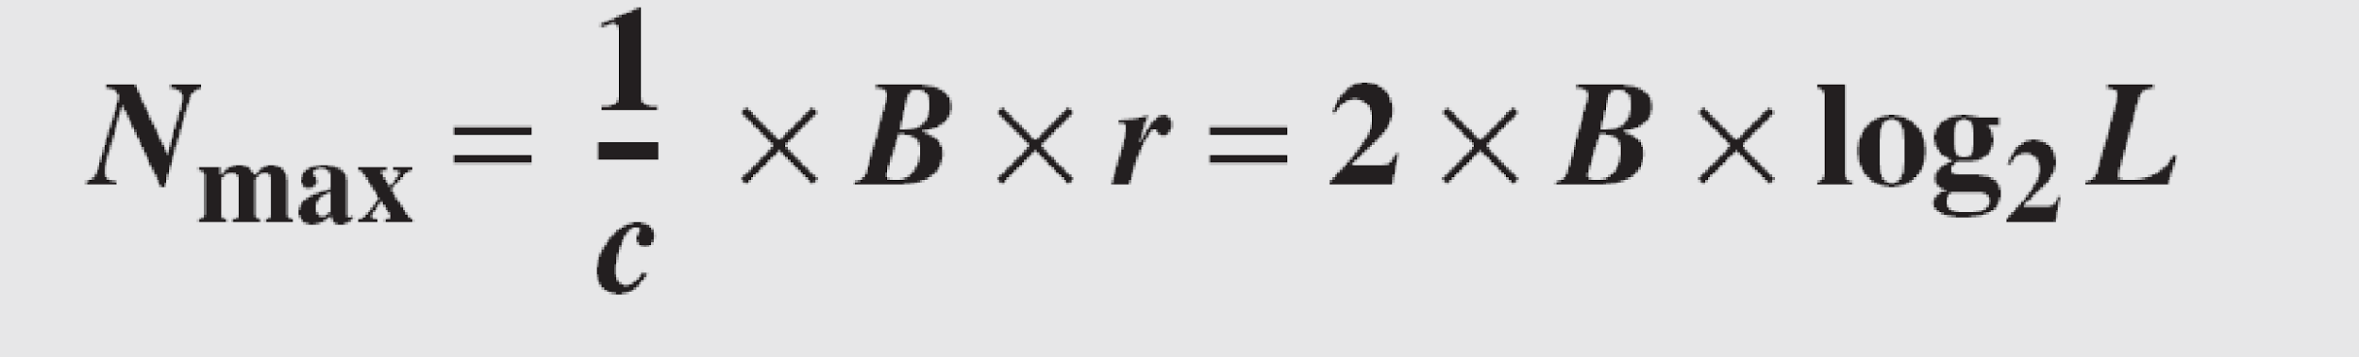
Example 4.2
The maximum data rate of a channel (see Chapter 3) is Nmax = 2 × B × log₂ L (defined by the Nyquist formula). Does this agree with the previous formula for N_{max}?
Solution
A signal with L levels actually can carry log₂L bits per level. If each level corresponds to one signal element and we assume the average case (c = 1/2), then we have

Slide 9
Baseline Wandering
Baseline wandering - a receiver will evaluate the average power of the received signal (called the baseline) and use that to determine the value of the incoming data elements.
If the incoming signal does not vary over a long period of time, the baseline will drift and thus cause errors in detection of incoming data elements.
A good line encoding scheme will prevent long runs of fixed amplitude.

Slide 10
DC Components
DC components in signals are not desirable
Cannot pass thru certain devices
Leave extra (useless) energy on the line
0
1
0
0
1
1
0
1
Signal with DC component
t
0
1
0
0
1
1
0
1
Signal without DC component
t

Slide 11
Self Synchronization
Self synchronization - the clocks at the sender and the receiver must have the same bit interval.
If the receiver clock is faster or slower it will misinterpret the incoming bit stream.

Slide 12
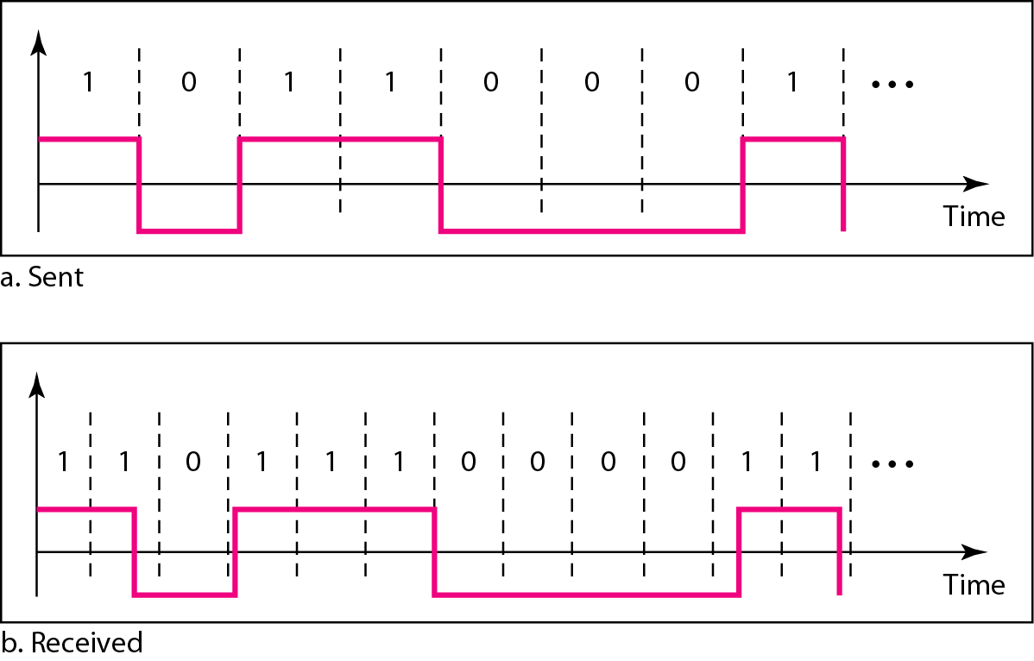
Effect of lack of Synchronization

Slide 13
Other Encoding Considerations
Built-in Error Detection - errors occur during transmission due to line impairments.
Immunity to Noise and Interference - there are line encoding techniques that make the transmitted signal “immune” to noise and interference.
Complexity
Notes:
Built-in Error Detection - errors occur during transmission due to line impairments.
Some codes are constructed such that when an error occurs it can be detected. For example: a particular signal transition is not part of the code. When it occurs, the receiver will know that a symbol error has occurred.
Noise and interference - there are line encoding techniques that make the transmitted signal “immune” to noise and interference.
This means that the signal cannot be corrupted, it is stronger than error detection.
Complexity - the more robust and resilient the code, the more complex it is to implement and the price is often paid in baud rate or required bandwidth.

Slide 14
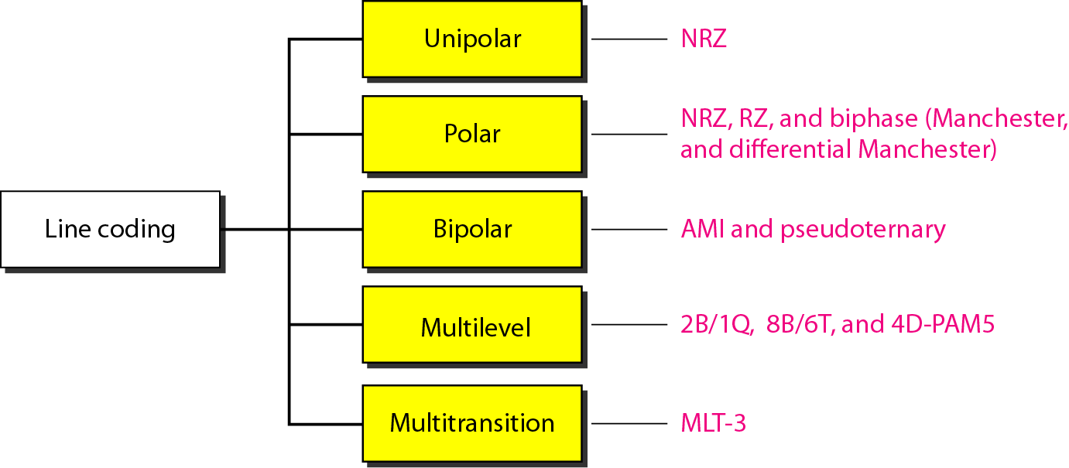
Line Coding Schemes

Slide 15
Line Coding Methods
Unipolar
Uses only one voltage level (one side of time axis)
Polar
Uses two voltage levels (negative and positive)
e.g., NRZ, RZ, Manchester, Differential Manchester
Bipolar
Uses three voltage levels (+, 0, and –) for data bits

Slide 16
Unipolar
Simplest form of digital encoding
⇨Rarely used
Only one polarity of voltage is used
E.g., polarity assigned to 1
0
1
0
0
1
1
0
0
t

Slide 17
Polar
Two voltage levels (+,-) represent data bits
Most popular four
Nonreturn-to-Zero (NRZ)
Return-to-Zero (RZ)
Manchester
Differential Manchester

Slide 18
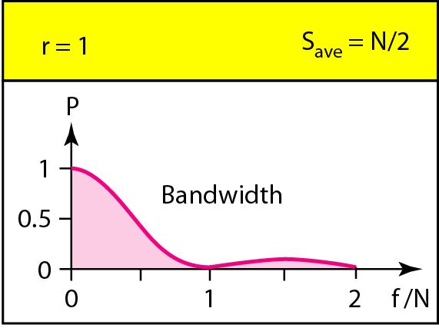
NRZ Encoding
Nonreturn to Zero
NRZ-L (NRZ-Level): Signal level depends on bit value
NRZ-I (NRZ-Invert): Signal is inverted if 1 is encountered
0
1
0
0
1
1
1
0
t
0
1
0
0
1
1
1
0
N = Bit rate
S_{ave} = Average signal rate
t

Slide 19
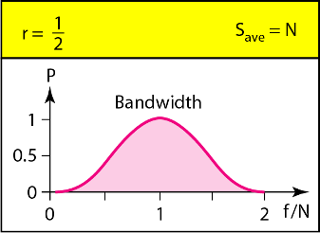
RZ Encoding
Return to Zero
Uses three voltage levels: +, - and 0, but only + and - represent data bits
Half way thru each bit, signal returns to zero
0
1
0
0
1
1
0
0
?
t

Slide 20
Polar Biphase: Manchester Encoding
Uses an inversion at the middle of each bit
For bit representation
For synchronization
0
1
0
0
1
1
0
1
= 0
t
= 1

Slide 21
Polar Biphase: Differential Manchester Encoding
The inversion on the middle of each bit is only for synchronization
Transition at the beginning of each bit tells the value
0
1
0
0
1
1
0
1
t

Slide 22
Manchester and Differential Manchester Encoding
In Manchester and differential Manchester encoding, the transition at the middle of the bit is used for synchronization.
The minimum bandwidth of Manchester and differential Manchester is 2 times that of NRZ.
There is no DC component and no baseline wandering.
None of these codes has error detection.

Slide 23
Bipolar Scheme
Also known as Multilevel binary.
Bipolar encoding uses three voltage levels: positive, negative and zero
Each of all three levels represents a bit
Two schemes:
AMI (Alternate Mark Inversion)
0V always represents binary 0
Binary 1s are represented by alternating positive and negative voltages.
Pseudoternary
The reverse of AMI.

Slide 24
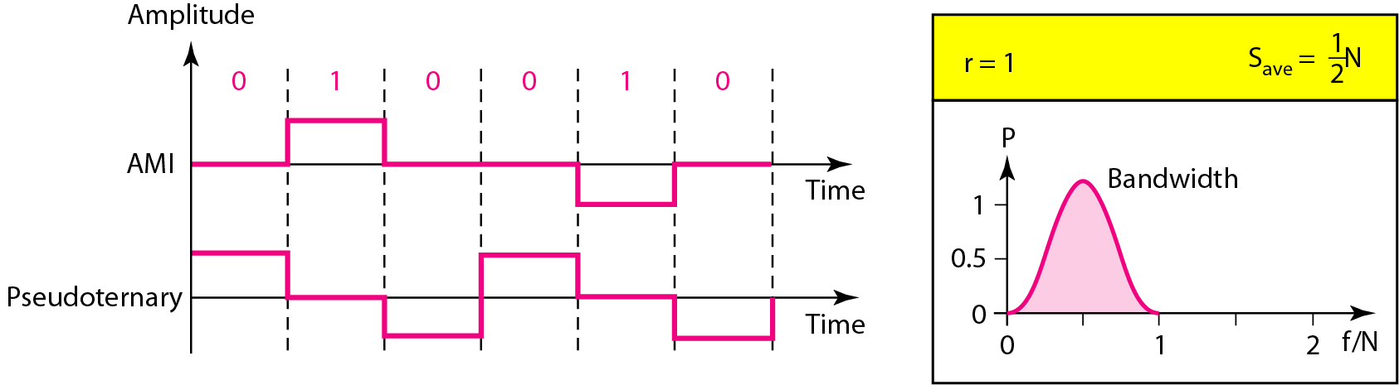
Bipolar Scheme:
AMI and Pseudoternary

Slide 25
Bipolar Scheme
It is a better alternative to NRZ.
Has no DC component or baseline wandering.
Has no self synchronization because long runs of “0”s results in no signal transitions.
No error detection.

Slide 26
Multilevel Schemes
In these schemes we increase the number of data bits per baud thereby increasing the bit rate.
Since we are dealing with binary data we only have 2 types of data element a 1 or a 0.
We can combine the 2 data elements into a pattern of “m” elements to create “2^{m}” symbols.
If we have L signal levels, we can use “n” signal elements to create L^{n} signal elements.
Now we have 2^{m} symbols and L^{n} signals.

Slide 27
Multilevel Schemes
If 2^{m} > L^{n} , we cannot represent the data elements as we don’t have enough signals.
If 2^{m} = L^{n} , we have an exact mapping of one symbol on one signal.
If 2^{m} < L^{n} , we have more signals than symbols and we can choose the signals that are more distinct to represent the symbols and therefore have better noise immunity and error detection.

Slide 28
Representing Multilevel Codes
This type of coding is represented as mBnL, where m is the length of the binary pattern, B represents binary data, n represents the length of the signal pattern and L is the number of levels.
L = B binary,
L = T for 3 ternary,
L = Q for 4 quaternary.

Slide 29
2B1Q (two binary, 1 quaternary)
Bit sequence Voltage level
00 -3
01 -1
10 +3
11 +1
00
11
01
10
01
10
11
00
+3
+1
t
-1
-3
The average signal rate is S = N/4
Data rate is two times faster than by using NRZ-L
No redundancy
It is used in DSL (Digital Subscriber Line) technology

Slide 30
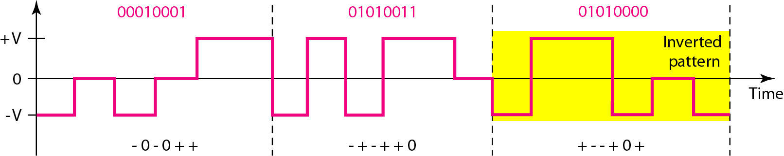
8B6T (Eight binary, six ternary)
2⁸ = 256 data patterns and 3⁶ = 729 different signal patterns
There are 729 – 256 = 473 redundant signal elements to provide synchronization and error detection.
The sender keeps track of the weight.

Slide 31
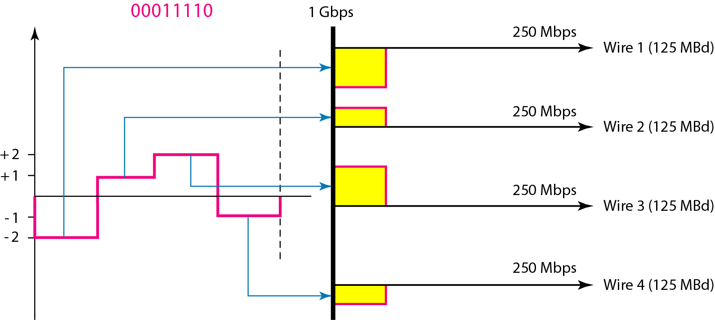
4D-PAM5: Four dimensional five level pulse amplitude modulation
The 4D means that the data is sent over four wires at the same time.
It uses five voltage levels: -2, -1, 0, 1, 2.
0 is only used for error detection.

Slide 32
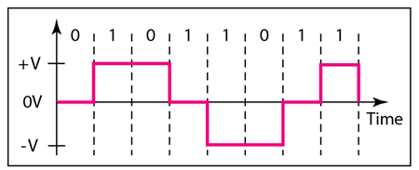
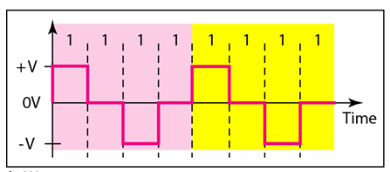
Multi-transition Coding: MLT-3
Multiline Transmission, three level (MLT 3) scheme uses three levels (+V, 0, -V) and three transition rules to move between the levels.
If the next bit is 0, there is no transition
If the next bit is 1 and the current level is not 0, the next level is 0.
If the next bit is 1 and the current level is 0, the next level is the opposite of the last non-zero level.
Typical case
Worst case
4.‹#›

Slide 33
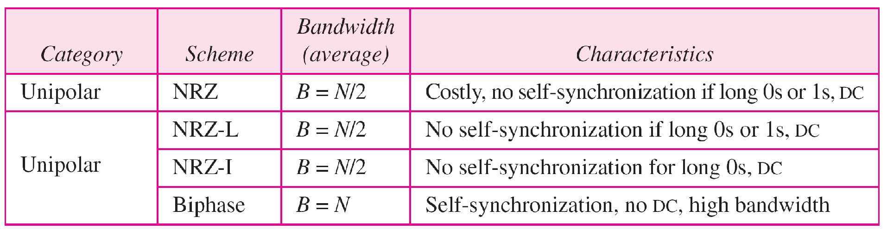
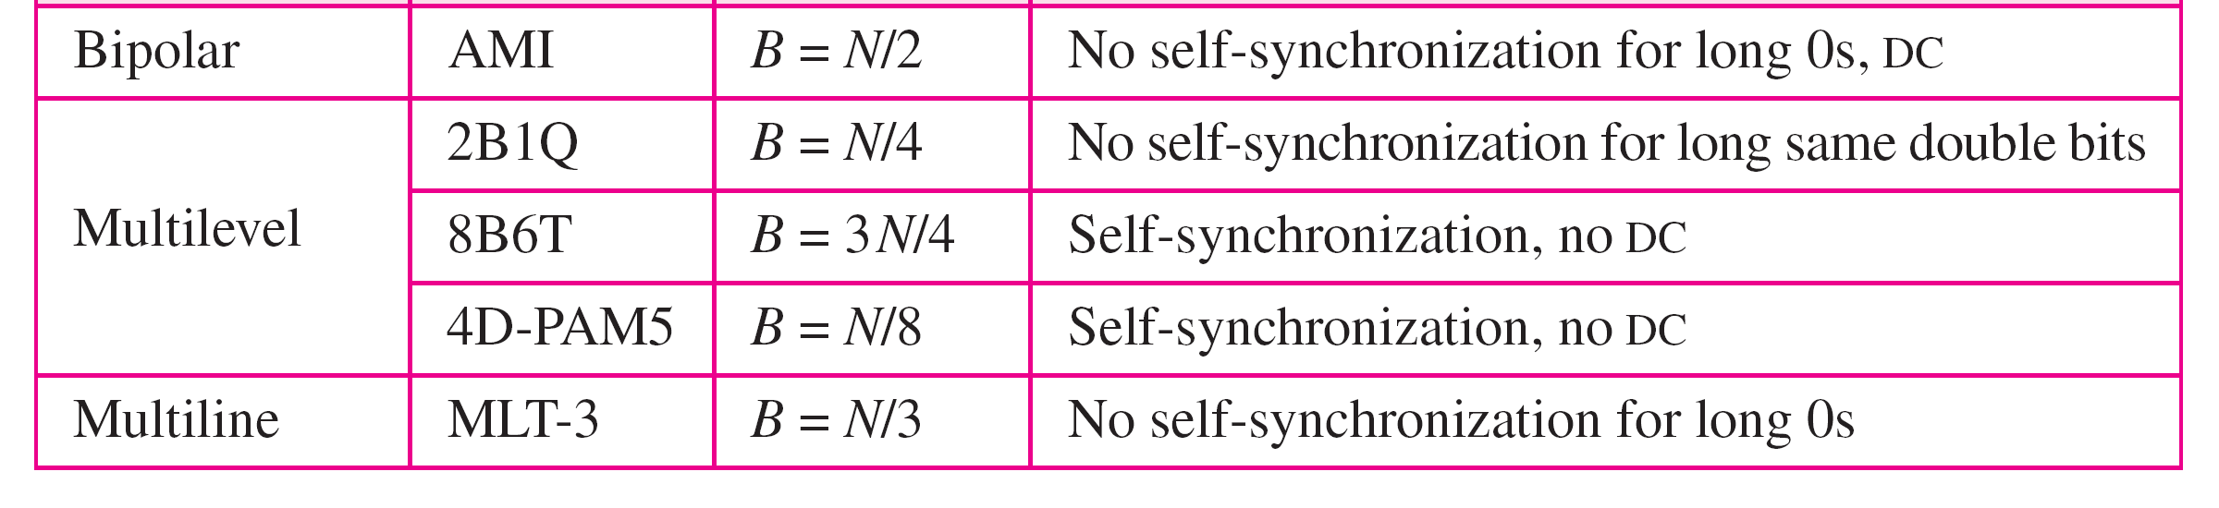
Summary of line coding schemes

Slide 34
Block Coding
Block coding provides the redundancy and improves the performance of line coding.
It changes a block of m bits into a block of n bits, where n is larger than m.
It is also referred to as an mB/nB encoding technique
It involves in three steps: division, substitution and combination
Notes:
Common Characteristics of coding schemes

Slide 35
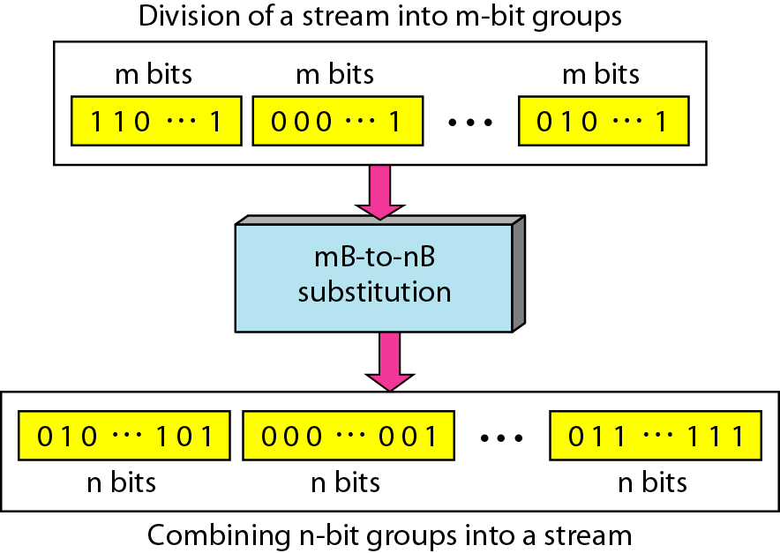
Block Coding Concept

Slide 36
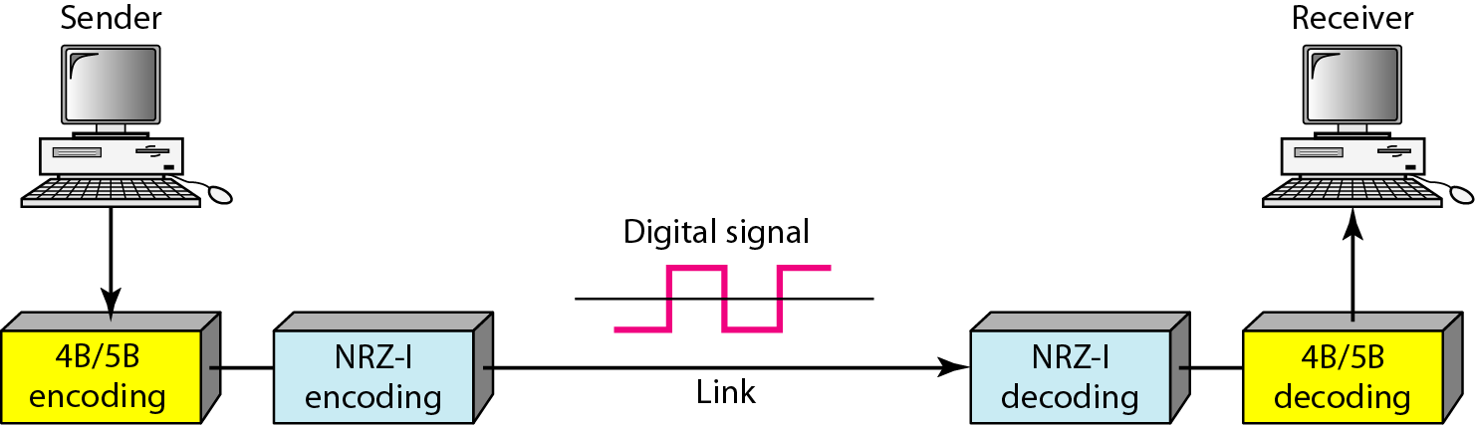
4B/5B (Four binary/five binary)
It was designed to be used in combination with NRZ-I.
To solve the synchronization problem, 4B/5B changes the bit stream prior to encoding with NRZ-I, so that it does not havea long stream of 0s.
Notes:
Common Characteristics of coding schemes

Slide 37
4B/5B Mapping codes
Data Sequence | Code | Data Sequence | Code
0000 | 11110 | 1000 | 10010
0001 | 01001 | 1001 | 10011
0010 | 10100 | 1010 | 10110
0011 | 10101 | 1011 | 10111
0100 | 01010 | 1100 | 11010
0101 | 01011 | 1101 | 11011
0110 | 01110 | 1110 | 11100
0111 | 01111 | 1111 | 11101
Control Sequence | Code
Q (Quiet) | 00000
I (Idle) | 11111
H (Halt) | 00100
J (start delimiter) | 11000
K (start delimiter) | 10001
T (end delimiter) | 01101
S (Set) | 11001
R (Reset) | 00111
Notes:
In4B/5B, the5-bit output that replaces the 4-bit input has no more than one leading
zero(left bit)and no more than two trailing zeros(right bits).So when different groups
Are combined to make a new sequence, there are never more than three consecutive 0s.

Slide 38
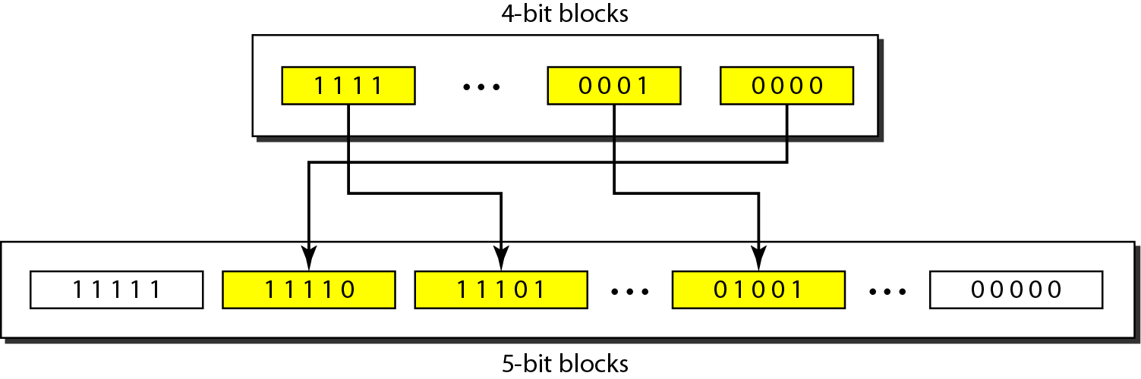
Substitution in 4B/5B block coding

Slide 39
Example 4.5
We need to send data at a 1-Mbps rate. What is the minimum required bandwidth, using a combination of 4B/5B and NRZ-I or Manchester coding?
Solution
→First 4B/5B block coding increases the bit rate to 1.25 Mbps.
The minimum bandwidth using NRZ-I is N/2 or 625 kHz.
The Manchester scheme needs a minimum bandwidth of 1 MHz.
The first choice needs a lower bandwidth, but has a DC component problem; the second choice needs a higher bandwidth, but does not have a DC component problem.

Slide 40
8B/10B
More bits - better error detection
The 8B/10B block code adds more redundant bits and can thereby choose code words that would prevent a long run of a voltage level that would cause DC components.
8 bits of data; substituted by a 10-bit code
4.‹#›

Slide 41
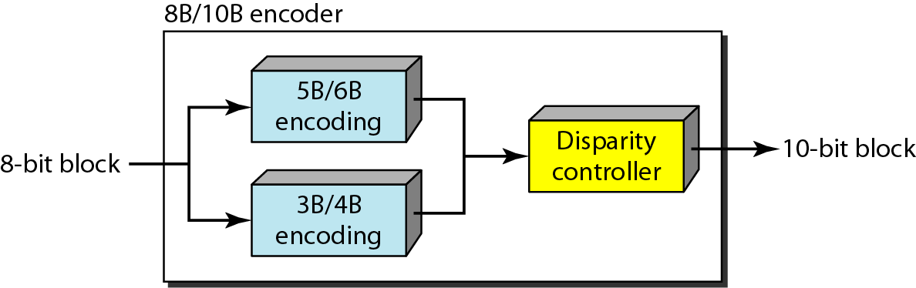
8B/10B
It is a combination of 5B/6B and 3B/4B encoding.
The five most significant bits of a 10-bit block are fed into the 5B/6B encoder
The three least significant bits are fed into the 3B/4B encoder
A disparity controller is used to prevent a long run of consecutive 0s or 1s.
Notes:
Disparity controller keeps track of excess 0s over 1s (or 1s over 0s).

Slide 42
Scrambling
Biphase schemes are not suitable for long-distance communication because of their wide bandwidth requirement.
The combination of block coding and NRZ line coding is not suitable for long-distance communication either, because of the DC component.
Bipolar AMI encoding has a narrow bandwidth and does not create a DC component. However, a long sequence of 0s upsets the synchronization.
The solution is Scrambling.
It is implemented at the same time as encoding (as opposed to block coding).
4.‹#›

Slide 43
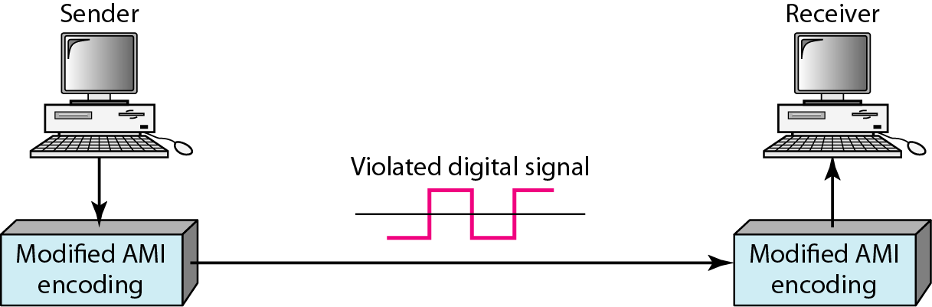
AMI used with Scrambling

Slide 44
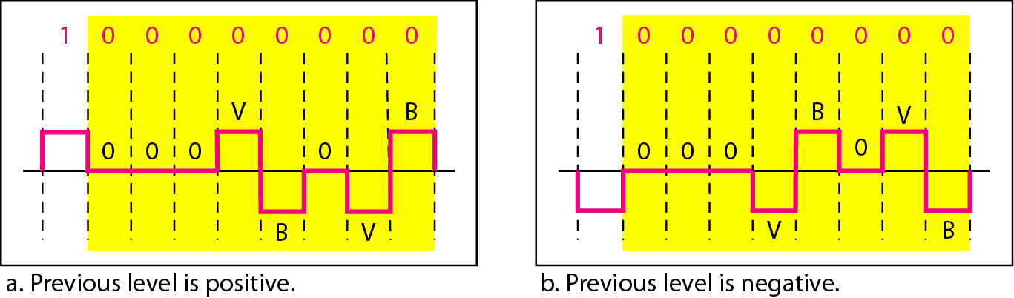
B8ZS
B8ZS (Bipolar with 8-zero substitution) substitutes eight consecutive zeros with 000VB0VB.
The V stands for violation, it violates the AMI rule of encoding; B stands for bipolar, it implements the AMI bipolar encoding rule.
4.‹#›

Slide 45
HDB3
HDB3 (High density bipolar 3-zero) substitutes four consecutive zeros with 000V or B00V depending on the number of nonzero pulses after the last substitution.
There are two rules :
If the number of non zero pulses is odd the substitution is 000V to make total number of non zero pulses even.
If number of non zero pulses is even the substitution is B00V to make total number of non zero pulses even.
4.‹#›

Slide 46
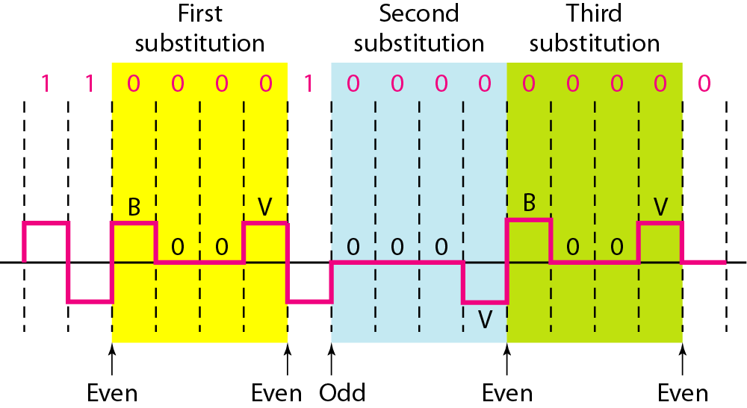
HDB3
If the number of non zero pulses is odd the substitution is 000V to make total number of non zero pulses even.
If number of non zero pulses is even the substitution is B00V to make total number of non zero pulses even.
4.‹#›

Slide 47
Analog-to-Digital Conversion
A digital signal is superior to an analog signal. The tendency today is to change an analog signal to digital data.
Two techniques of analog signal to digital data are:
Pulse Code Modulation (PCM)
Delta Modulation (DM)
4.‹#›

Slide 48
Pulse Code Modulation (PCM)
The most common technique to change an analog signal to digital data (digitization) is called PCM.
A PCM encoder has three processes:
1. The analog signal is sampled.
2. The sampled signal is quantized.
3. The quantized values are encoded as streams of bits.
4.‹#›

Slide 49
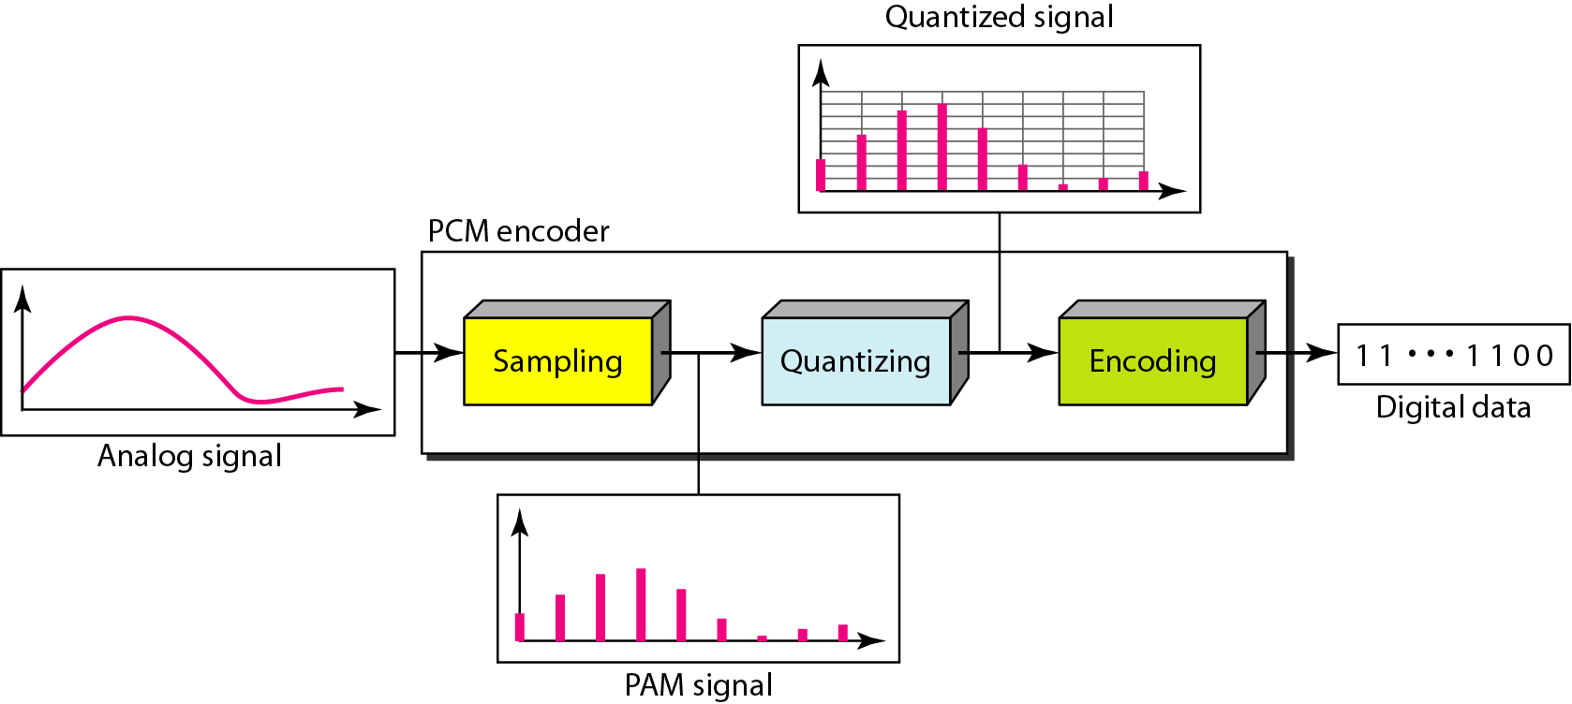
Components of PCM encoder

Slide 50
Sampling
The analog signal is sampled every Ts, where Ts is the sample interval or period.
The inverse of the sampling interval is called the sampling rate or sampling frequency and denoted by fs, where fs = 1/Ts.
The sampling process is sometimes referred to as Pulse Amplitude Modulation (PAM).
4.‹#›

Slide 51
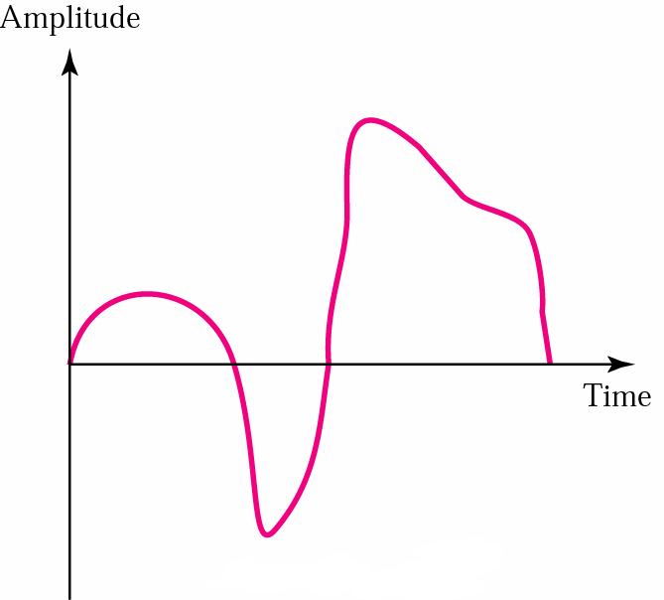
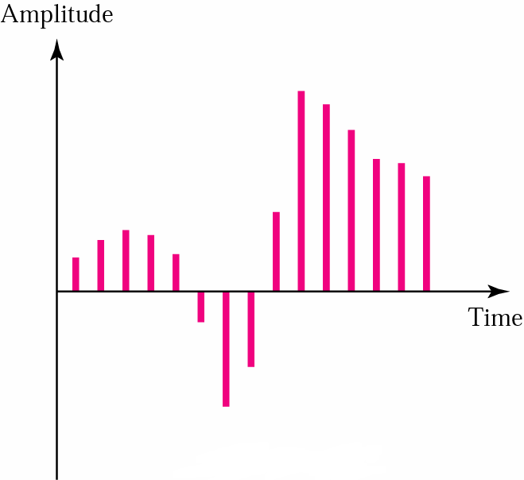
PAM
Pulse Amplitude Modulation (PAM)
Converts an analog signal into a series of pulses by sampling
PAM
Analog signal
PAM signal (Sampled analog data)
4.‹#›

Slide 52
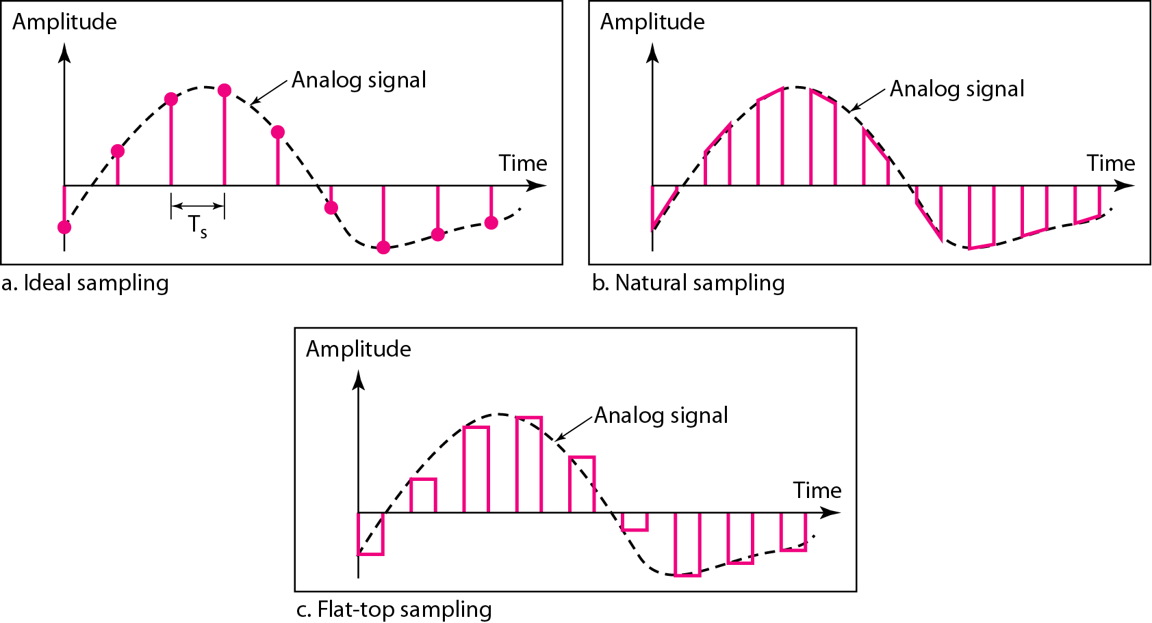
Different Sampling Methods
4.‹#›
Notes:
In ideal sampling, pulses from the analog signal are sampled. This is an ideal sampling method and cannot be easily implemented.
In natural sampling, a high-speed switch is turned on for only the small period of time when the sampling occurs. The result is a sequence of samples that retains the shape of the analog signal.
The most common sampling method, called sample and hold, however, creates flat-top samples by using a circuit.

Slide 53
Sampling Rate
According to the Nyquist theorem, the sampling rate must be at least 2 times the highest frequency contained in the signal.
We can sample a signal only if the signal is band-limited. In other words, a signal with an infinite bandwidth cannot be sampled.
The sampling rate must be at least 2 times the highest frequency, not the bandwidth.
If the analog signal is low-pass, the bandwidth and the highest frequency are the same value. If the analog signal is bandpass, the bandwidth value is lower than the value of the maximum frequency.
4.‹#›

Slide 54
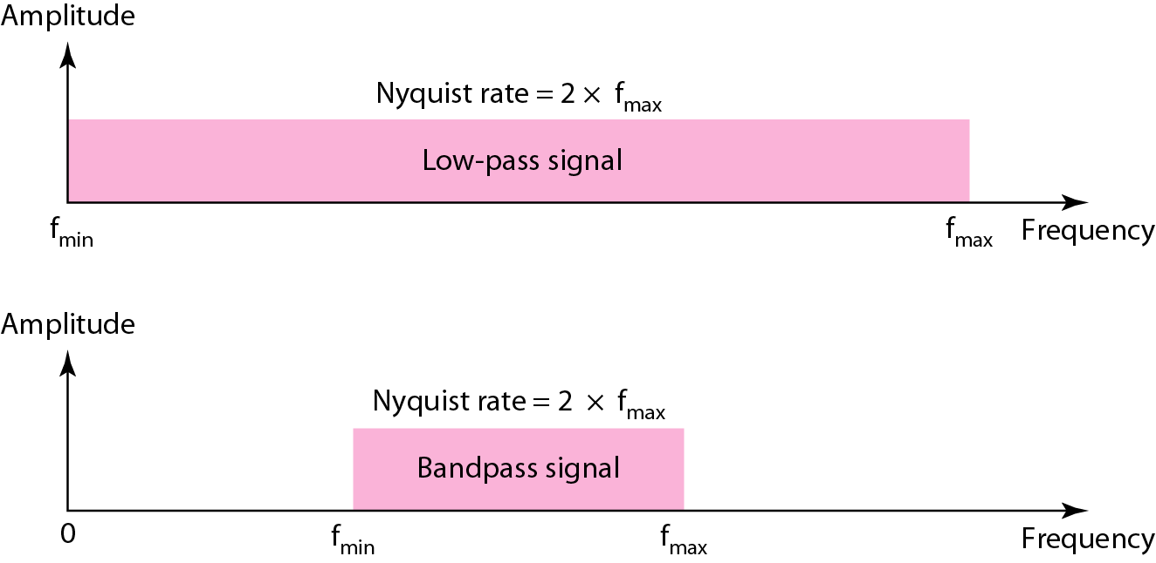
Nyquist Sampling Rate for low-pass and band-pass

Slide 55
Home work
Example 4.6 – 4.11

Slide 56
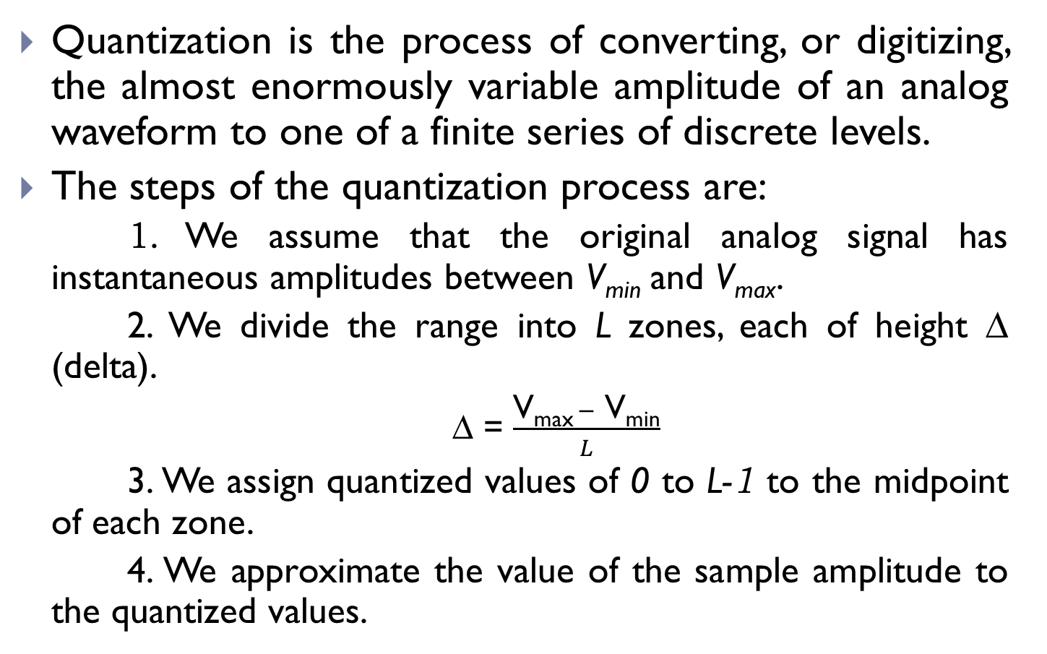
Quantization

Slide 57
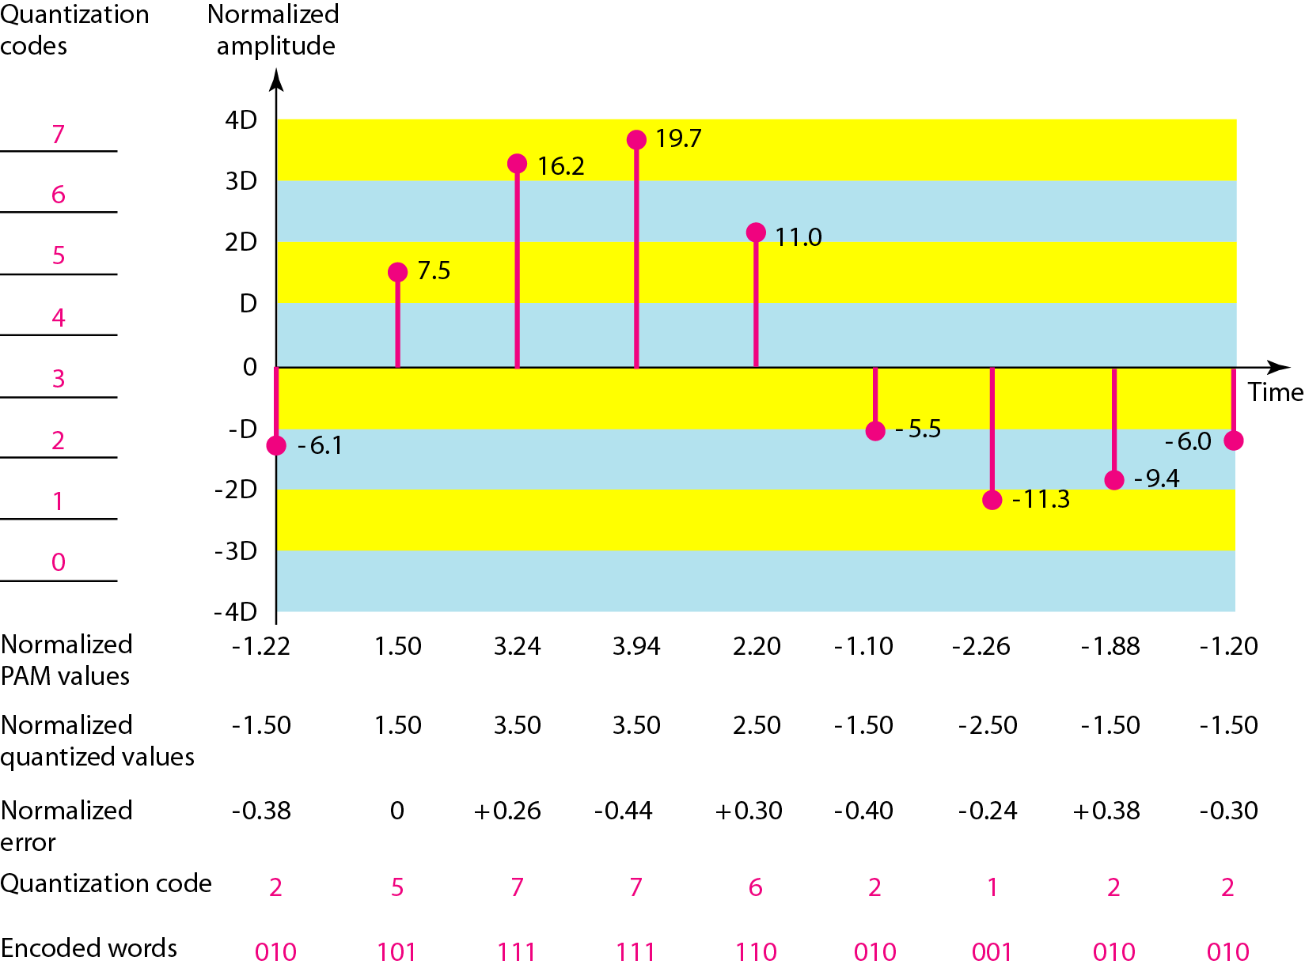
Quantization
Vmax = +20V
Vmin = -20V
L = 8
∆ = 5 V
Normalized value = Actual amplitude/ ∆

Slide 58
Quantization Levels
The choice of L depends on the range of the amplitudes of the analog signal and how accurately we need to recover the signal.
If the amplitude of a signal fluctuates between two values only, we need only two levels.
If the signal has many amplitudes, we need more quantization levels.

Slide 59
Quantization Error and Bit rate
The value of the error for any sample is less than ∆/2
- ∆/2 ≤ error ≤ ∆/2
Quantization error to the SNR_{db} :
SNR_{db}= 6.02n_{b} +1.76 dB; where n_{b} is the bits per sample.
Bit Rate = sampling rate x number of bits per sample
= f_{s} x n_{b}

Slide 60
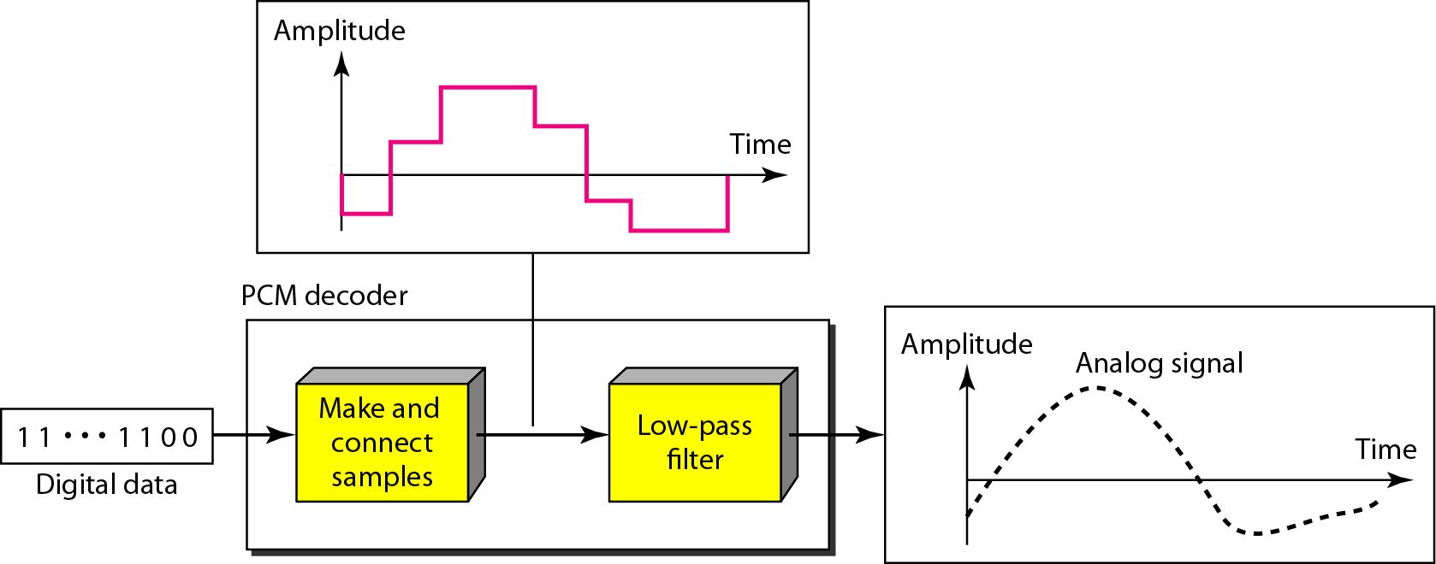
Original Signal Recovery
The recovery of the original signal requires the PCM decoder.
Components of a PCM decoder
Notes:
Original Signal Recovery :
The recovery of the original signal requires the PCM decoder.
1. The decoder first uses circuitry to convert the code words into a pulse that holds the amplitude until the next pulse.
2. After the staircase signal is completed, it is passed through a low-pass filter to smooth the staircase signal into an analog signal.
The filter has the same cutoff frequency as the original signal at the sender.
If the signal has been sampled at (or greater than) the Nyquist sampling rate and if there are enough quantization levels, the original signal will be recreated.
Note that the maximum and minimum values of the original signal can be achieved by using amplification.

Slide 61
PCM Bandwidth
The minimum bandwidth of the digital signal is n_{b} times greater than the bandwidth of the analog signal.
B_{min} = n_{b} x B_{analog}
Maximum data rate of a channel:
N_{max} = 2 x B x log₂L bps
Minimum required bandwidth:
B_{min} = N / (2 x log₂L) Hz

Slide 62
Home Work
Example 4.12 – 4.15

Slide 63
Delta Modulation
PCM → complex
Delta Modulation (DM) → simple
PCM finds the value of the signal amplitude for each sample; whereas DM finds the change from the previous sample.
There are no code words here; bits are sent one after another.

Slide 64
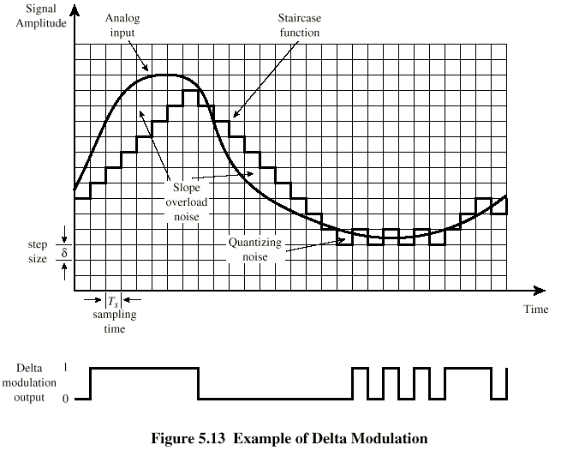
Delta Modulation

Slide 65
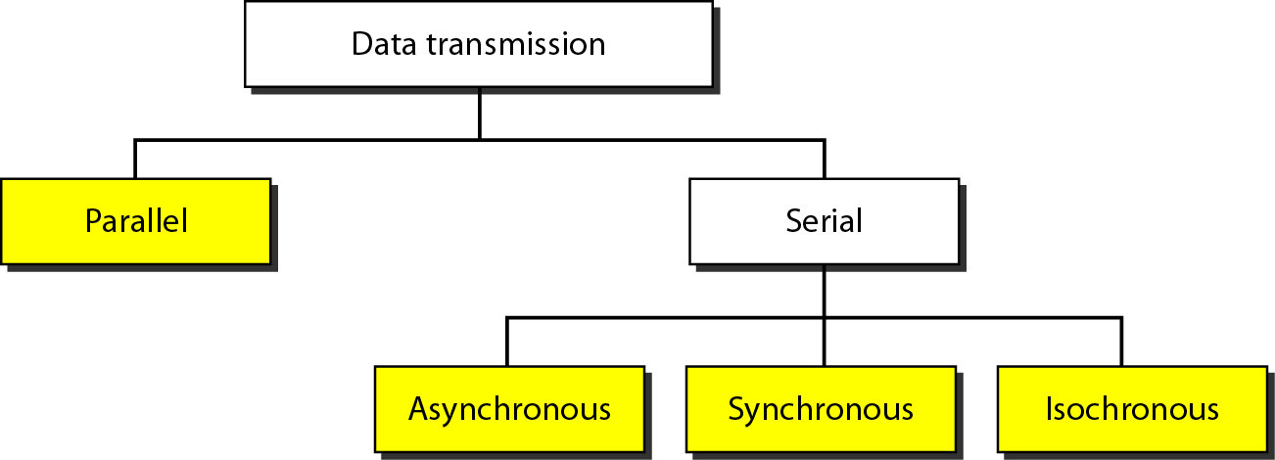
Transmission Modes
The transmission of binary data across a link can be accomplished in either parallel or serial mode.

Slide 66
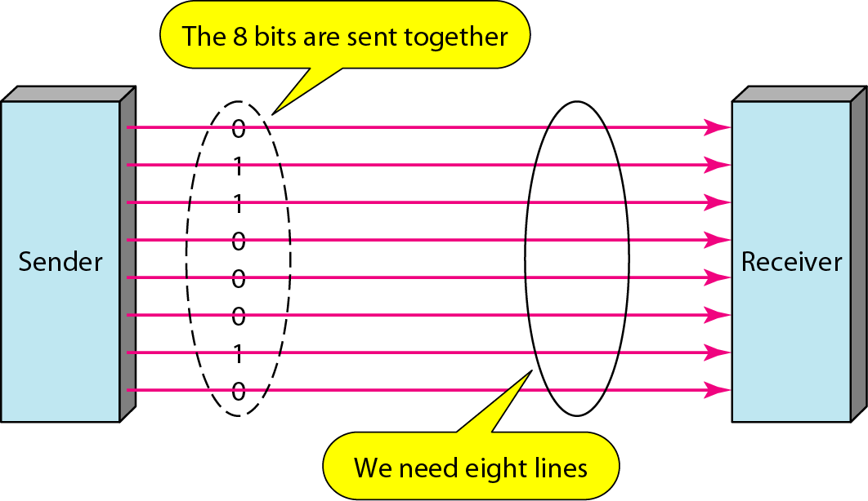
Parallel Transmission
A parallel communication device sends data in multiple bits to the same direction.
For example, the eight bits are transferred in corresponding 8 channels, every channel transmits a bit, and a byte of data is received simultaneously.
Speed
Costly; requires n communication lines
unsuitable for long distance transmission.

Slide 67
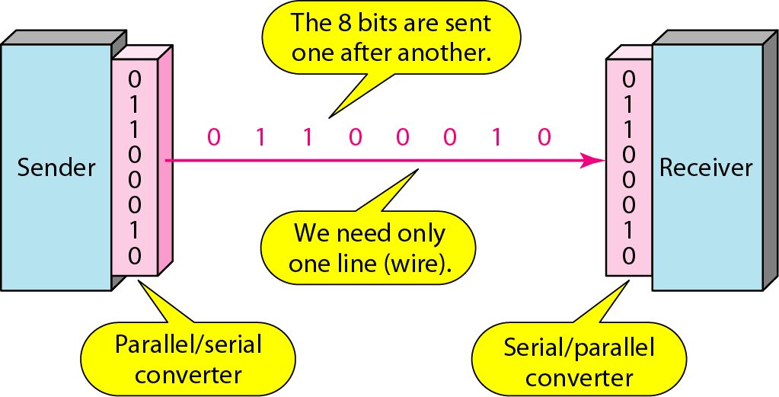
Serial Transmission
A serial communication device transfers data in bits in the same direction.
In serial communication a word of eight bits in length is sent sequentially, and is received after all eight bits are sent, one at a time.
Requires only one communication line
Suitable for long distance transmission.
Requires conversion devices at the interface

Slide 68
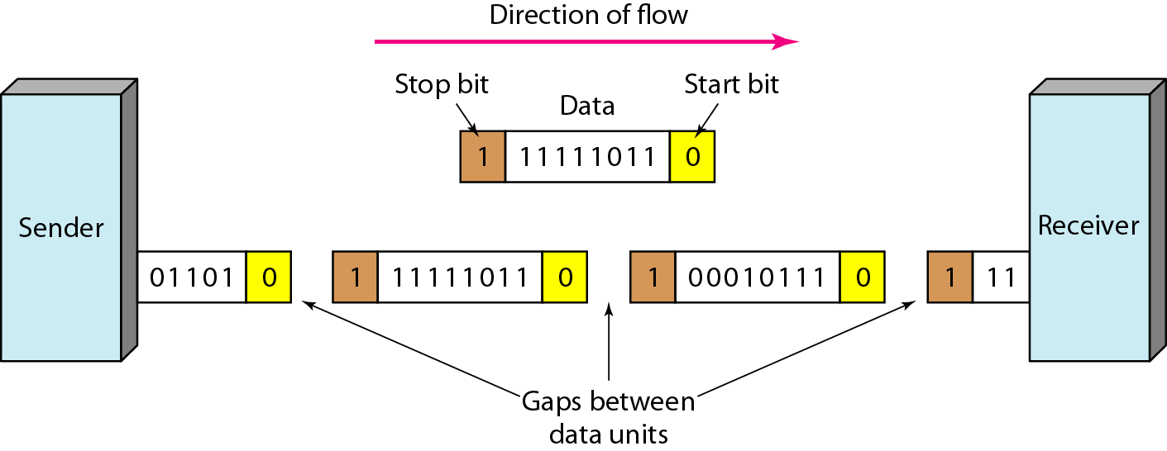
Asynchronous Transmission
In asynchronous transmission, we send 1 start bit (0) at the beginning and 1 or more stop bits (1s) at the end of each byte. There may be a gap between each byte.
Cheap and effective.
Useful for low-speed communication such as the connection of a keyboard to a computer
Notes:
Asynchronous means “asynchronous at the byte level,” but the bits are still synchronized; their durations are the same.one at a time.

Slide 69
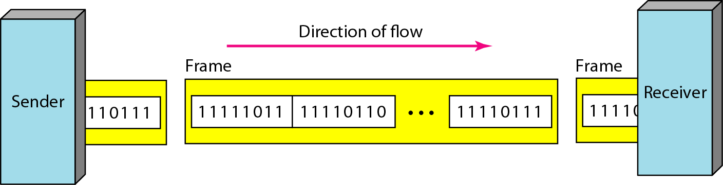
Synchronous Transmission
In synchronous transmission, we send bits one after another without start or stop bits or gaps. It is the responsibility of the receiver to group the bits.
The timing is very important.
Faster than asynchronous transmission.
Useful for high-speed applications such as the transmission of data from one computer to another.
Notes:
Timing becomes very important, therefore, because the accuracy of the received information is completely dependent on the ability of the receiving device to keep an accurate count of the bits as they come in.
The advantage of synchronous transmission is speed. With no extra bits or gaps, synchronous transmission is faster than asynchronous transmission.
For this reason, it is more useful for high-speed applications such as the transmission of data from one computer to another. Byte synchronization is accomplished in the data link layer.

Slide 70
Isochronous Transmission
In real-time audio and video, in which uneven delays between frames are not acceptable, synchronous transmission fails.
For example, TV images are broadcast at the rate of 30 images per second; they must be viewed at the same rate.
If each image is sent by using one or more frames, there should be no delays between frames.
For this type of application, synchronization between characters is not enough; the entire stream of bits must be synchronized.
The isochronous transmission guarantees that the data arrive at a fixed rate.
A number of slides modified from Chaiporn Jaikaeo
and borrowed from the book website

