Slide 1
Traffic Sign Detection Using Lightweight Deep Learning Model
Group Members: Nibir Neelim (21241012)
Sakib Ul Haque (23341128)
Adib Reza (24141197)
Abrar Ahbabul Haque (24166003)

Slide 2
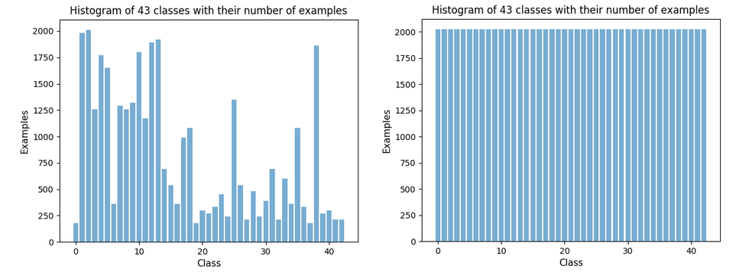
EXPLORATORY DATA ANALYSIS
Dataset Link: https://www.kaggle.com/datasets/valentynsichkar/traffic-signs-preprocessed/data
The dataset used in this paper consists of preprocessed traffic sign data in pickle format
The training dataset is balanced in all of its 43 classes of traffic signs through augmentation, as shown in the histogram
The original images were transformed with the adjustment of brightness and rotation for better generalization of the model
The dataset has diverse traffic signs with 86,989 training samples, 4410 images in the validation set and 12630 images in the test set. The order of the images are shuffled so that the model does not learn any order-dependent patterns from the training data.
Each image in the dataset is a 32x32 pixel with 3 color channels (RGB), but we have resized them to 224x224 for feeding into the models.

Slide 3









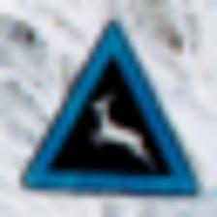


EXPLORATORY DATA ANALYSIS
Sample Images From the Training Set

Slide 4
DESIGN
This paper will investigate the performance of some lightweight deep learning architectures like MobileNet V3 and compare against more complex architectures like ResNet-152 for traffic sign recognition.
Each image in both models is resized to 224x224 pixels to ensure consistent data with the same dimension is received in the input layer
The models will use the training data to learn and adjust its weight
Validation data is used to analyze the model’s performance to tune hyperparameters for avoiding overfitting
The test data will determine the overall final performance of the model for its effectiveness in real life scenarios
For each of the red, green and blue channels, the pixel values of all the images ranging from 0 to 255 were rescaled in the range between 0 and 1 to speed up the learning process.
All base model layers have pretrained weights from the imagenet dataset before training.

Slide 5
ARCHITECTURE
The base models used are
MobileNet V2
MobileNet V3 Large
ResNet152
EfficientNet B7
Additional custom layers are added to the first three models.
The first two models have very low computational expense, while the latter two have high complexities.

Slide 6
METHOD
MobileNet V3 Large
Categorical cross entropy is used as the loss function as the model has to deal with categorical classification tasks of 43 classes where the labels are one-hot encoded.
The learning rate is set at 0.001 for epochs less than 5 and it is decreased to 0.0005 for epochs between 5 and 10. This adjustment of learning rates enables the model to converge faster in the initial phases with higher learning rate and fine-tune better in the later stages with lower learning rate
For the first 10 epochs, all of the layers are set to “trainable”. In the next 10 epochs, the model is trained again, but only the batch normalization layers are frozen to maintain the statistics learned from the original training data.
This is done for fine-tuning the model.
ResNet152
Model was trained for 20 epochs where on each epoch the entire dataset is trained once
In the first phase of the model, only the custom final classification layers are trained from epochs 1 to 10 where the parameters of the base model are frozen to prevent them from being updated as the initial layers have already learned useful representations
In the second phase after epoch 10, all layers of the model are unfrozen except the batch normalization layers as a part of regularization and fine-tuning approach.

Slide 7
METHOD
MobileNet V2:
Very similar approaches are used for this model as well.
Only custom layers are trained for the first 10 training iterations and then in the next 5 epochs all layers are trained except for batch normalization layers.
A low learning rate of 0.00005 was used with adam optimizer.
EfficientNet B7:
This is the largest model that we have tested.
We added no extra layers.
A learning rate of 0.00005 is used.

Slide 8
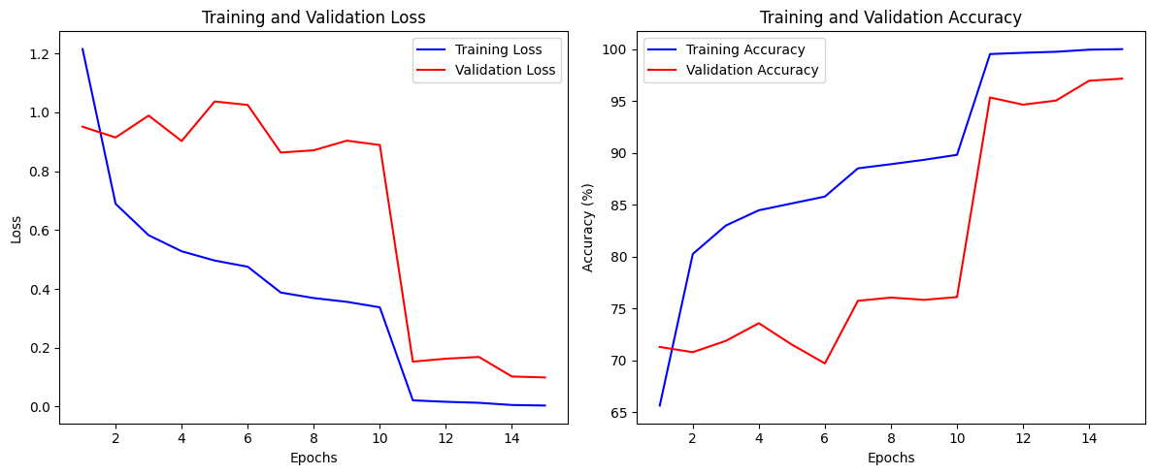
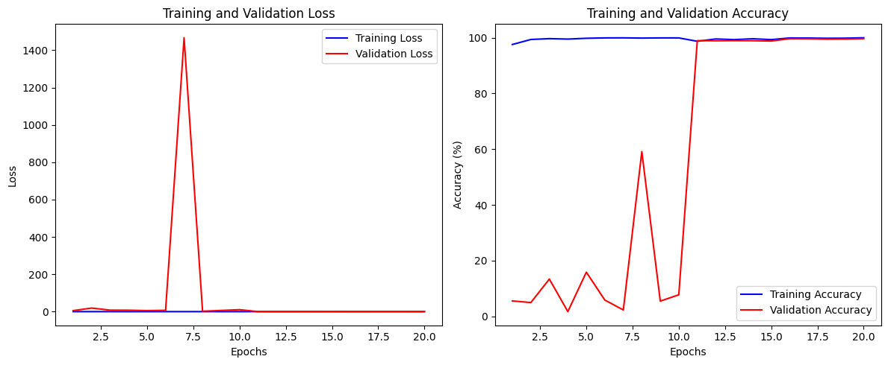
RESULTS
MobileNet V2
MobileNet V3 Large

Slide 9
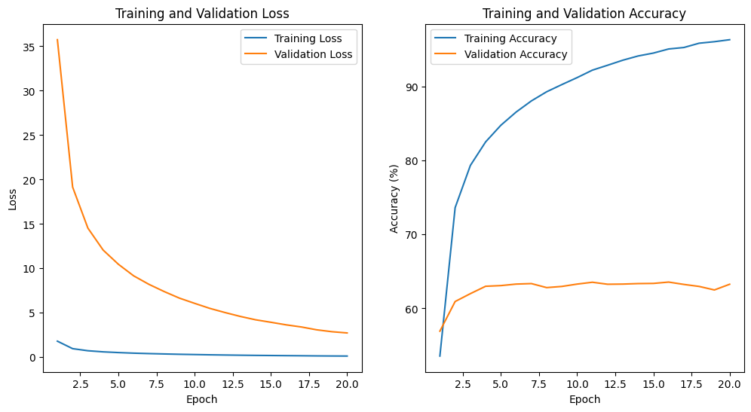
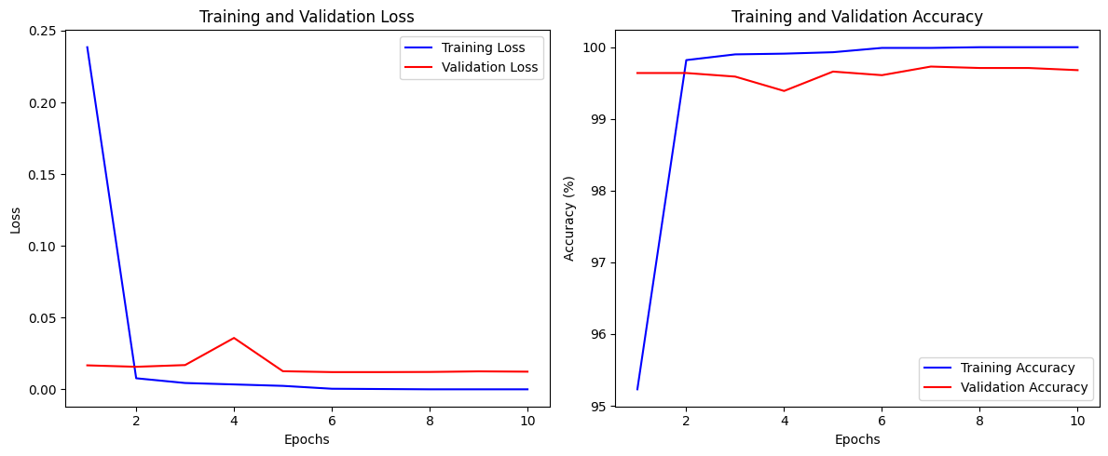
RESULTS
ResNet152
EfficientNet B7

Slide 10
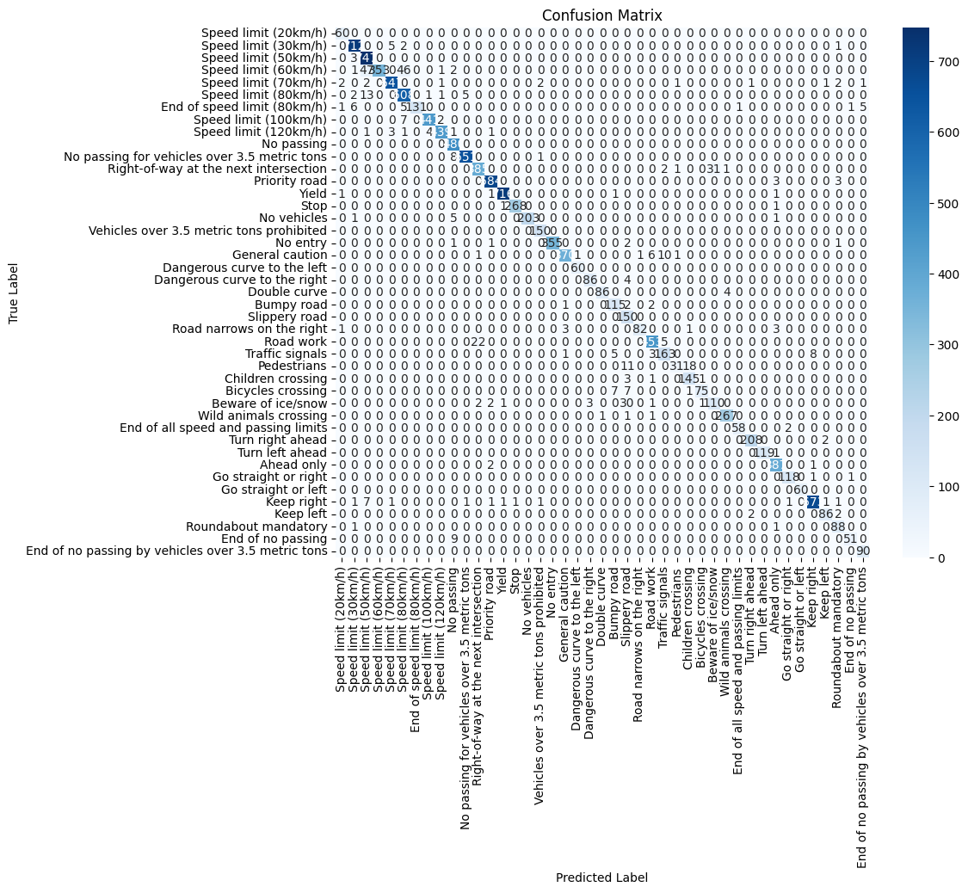
RESULTS

Slide 11
RESULTS
Model | Training Accuracy (%) | Validation Accuracy (%) | Test Accuracy (%) | Macroaverage Precision | Macroaverage Recall | Macroaverage F1 Score
Efficient Net B7 | 100 | 99.68 | 99.06 | 0.99 | 0.98 | 0.98
ResNet152 | 96.36 | 63.27 | 63.66 | 0.55 | 0.54 | 0.54
MobileNet V2 | 99.98 | 97.14 | 95.22 | 0.93 | 0.92 | 0.92
MobileNet V3 Large | 99.99 | 99.68 | 98.53 | 0.97 | 0.97 | 0.97
Table1: Performance Comparison

Slide 12
RESULTS
Model | Parameter Size (MB)
EfficientNet B7 | 243.33
ResNet 152 | 223
MobileNet V3 Large | 13.4
MobileNet V2 | 9.91
Table2: Model Parameter Sizes

Slide 13
AI EXPLAINABILITY
Most deep learning models are black boxes, i.e. we do not know what they are observing in order to make predictions.
Explainable AI helps us look at what features they are focusing on by making them interpretable for humans so we can see if they are using salient features for predictions.
We will use LIME or Local Interpretable Model-agnostic Explanations for the best 3 of our models.
It should be noted that LIME shows approximate local regions, so it is not 100% accurate.
In the next slide are explanations of six images from different classes in the test set.

Slide 14
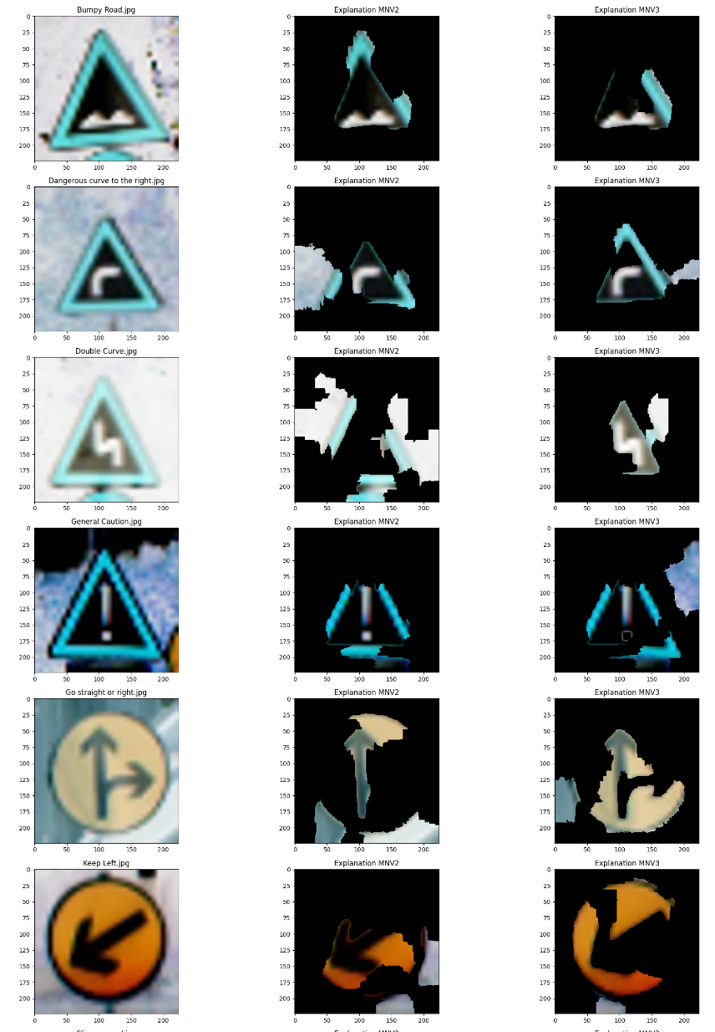
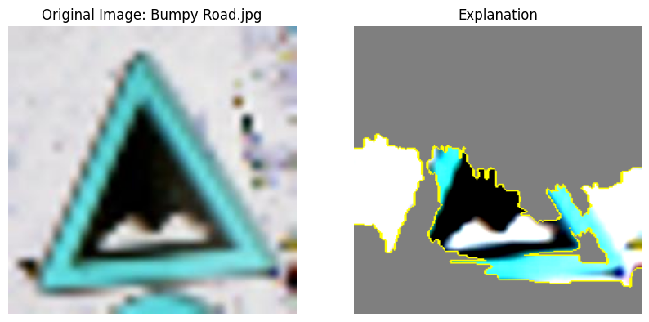
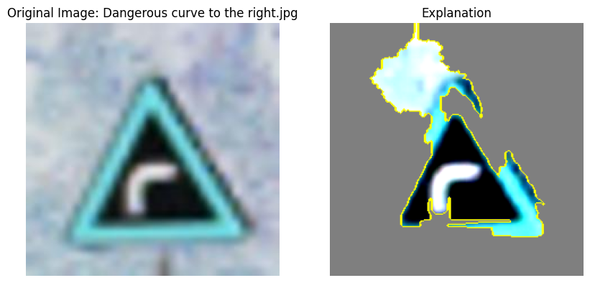
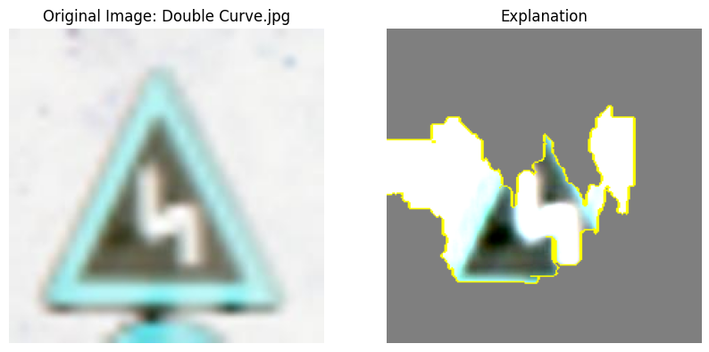
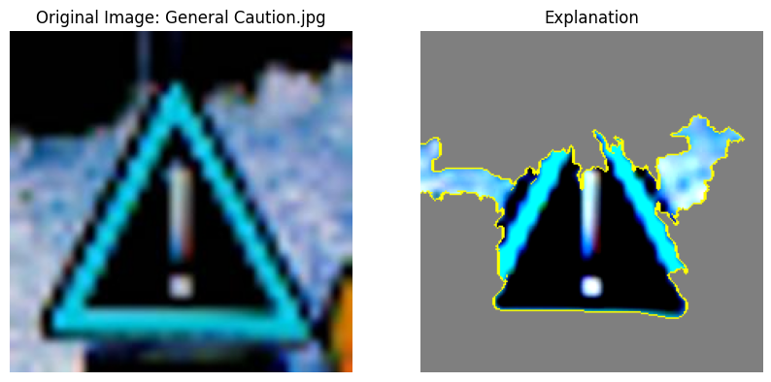
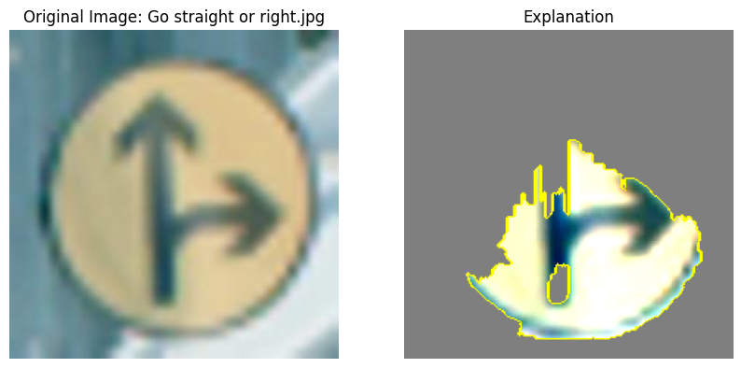
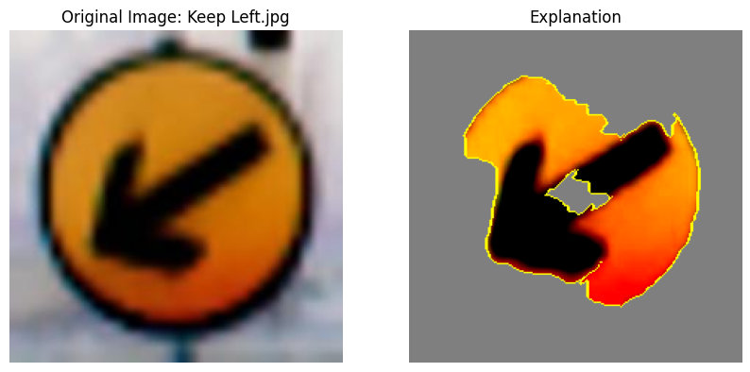
Explanations for EfficientNet B7
Explanations for MobileNet V2 (middle column) and MobileNet V3 Large (right column)

Slide 15
CONCLUSION
Through our research we have seen the capabilities of lightweight deep learning models in traffic sign classification.
Through our experiments we have see that MobileNer V3 Large comes very close in performance to EfficientNet B7, a model that is many times larger and more complex.
It is quite good in generalizing the data.
Even then, a larger dataset with a variety of scenarios or augmentations can be used to train a more robust model.
We hope to do more in the future for the development of more efficient deep learning algorithms for autonomous vehicles.

Slide 16
THANK YOU

