Slide 1

Network IT Company

Slide 2


Team Members
Habiba Dewan Arpita
Sakibul Hasan Rony
201-15-14042
201-15-13877

Slide 3
Table of Contents
01
02
03
04
About Project.
What is done?
How it works?
Future.

Slide 4
Introducton
It Company
A companies network is it’s backbone that helps to connect computers and related devices across department and workgroup networks.

Slide 5
Technologies use in this project.

Slide 6



Networking Devices
Router
Forward data packets between computer networks.
Switch
Use packet Switching to receive process and forward data.
Server
Computer proggram devices that gives functionalities for clints on ftp,dhcp

Slide 7
Process
Communicate with in single lan
Autometically provides IP address
Switching
Routing
DHCP
FTP
Forward packets of one network to another.
File transfer protocol

Slide 8
How it works?

Slide 9
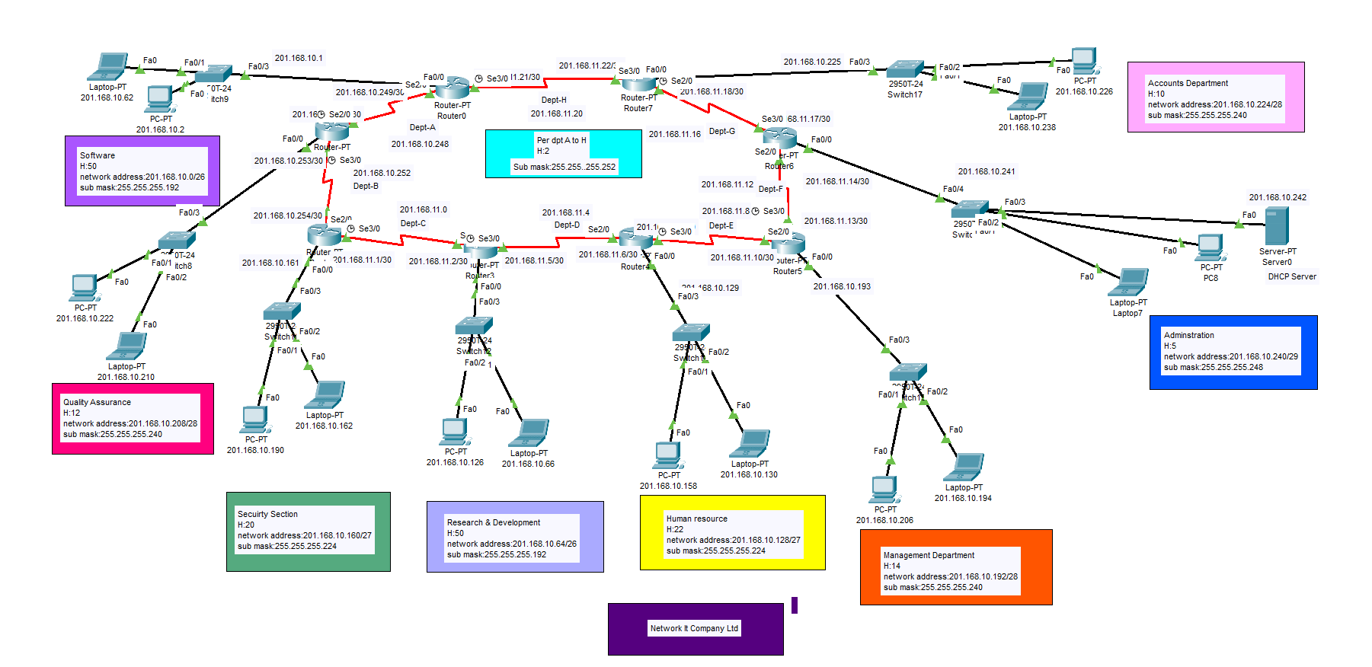

Slide 10
Cli-Code.

Slide 11
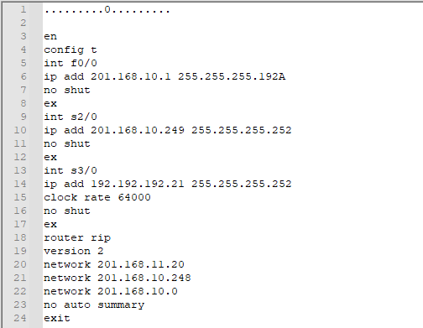
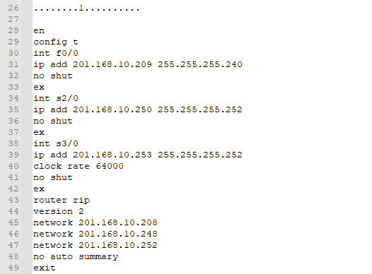
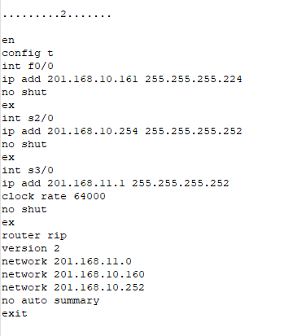

Slide 12
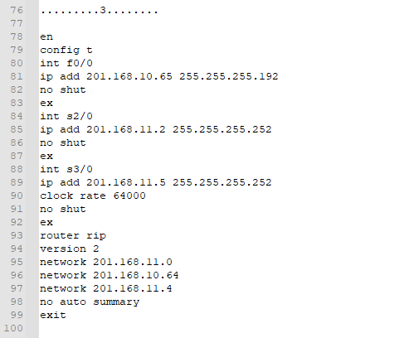
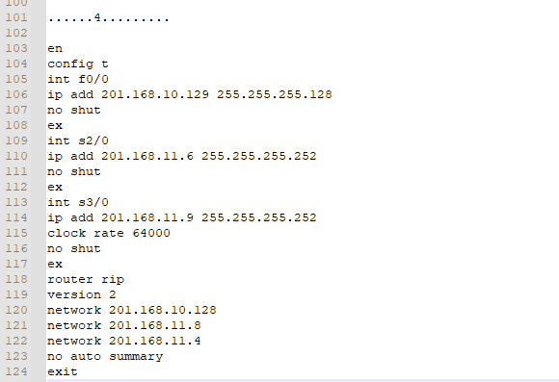
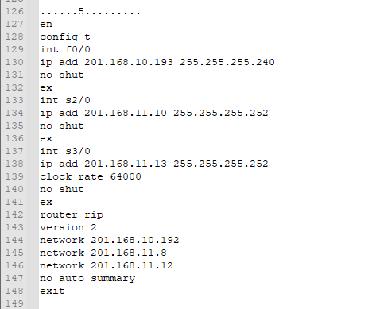

Slide 13
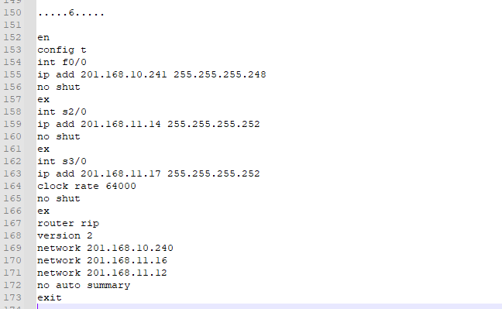
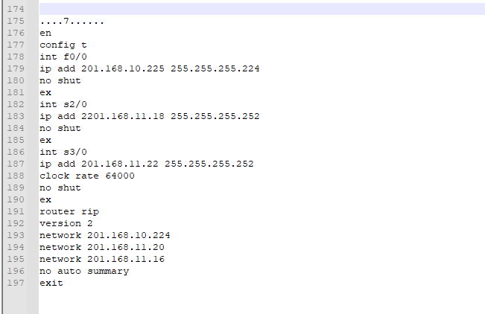

Slide 14
Ping-ing.

Slide 15
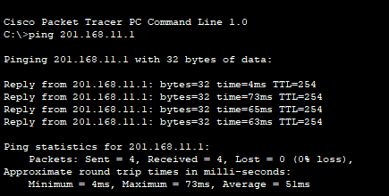
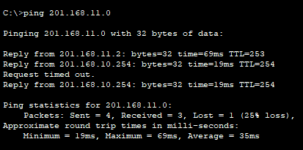
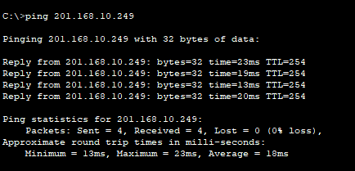
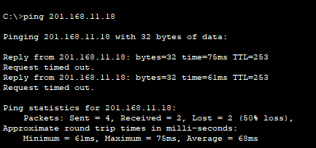

Slide 16
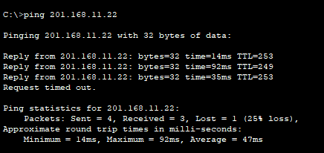
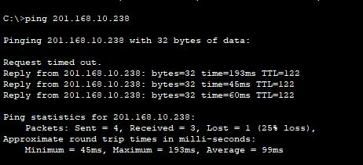
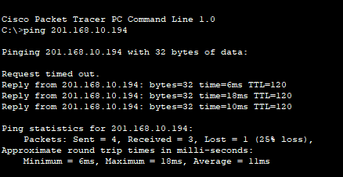
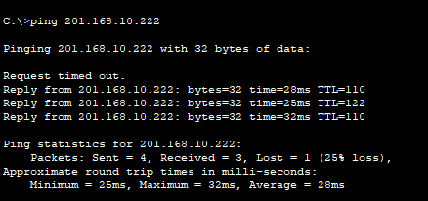

Slide 17
Technologies Can use in future.

Slide 18
Future Work
VLAN
Allow network administrators to automatically limit access to a specified group of users.
Way to map multiple local private addresses to a public one before transferring the information.
NAT
45K

Slide 19
Thanks!
Do you have any questions?

