Slide 1
PYTHON
Han Liu
Refer to Stanford CS231n

Slide 2
Basic Tools
Command Line:
Windows: cmd, PowerShell, Git bash
Mac OS: Terminal, iTerm2
Path: /, ./, ../, ~
pwd, cd, ls, rm, cp, mv, mkdir,…(Ref.)
Editor:
Sublime,Atom,VSCode,PyCharm……

Slide 3
Python
Interpreted, dynamically typed programming language
High-level, almost like pseudocode
+ Easy, OOP, Cross-platform, Open Source
- Slow, Multithreading, Open Source
Python versions:
Python 2.7 and Python 3.x
For this class all code will use Python3

Slide 4
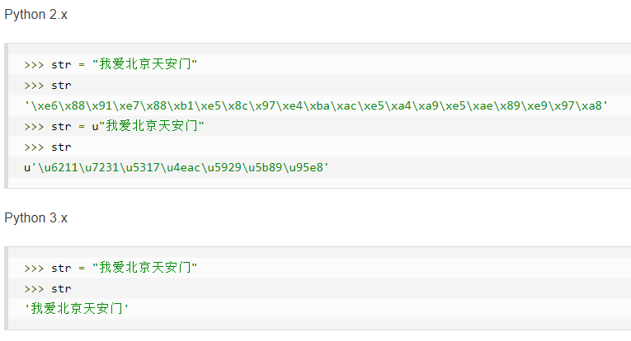
Python2 vs Python3 (Ref.)
1.Unicode

Slide 5
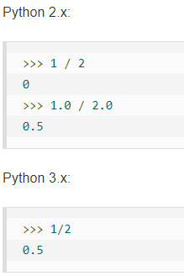
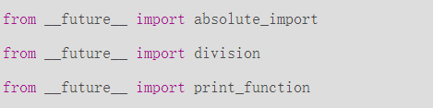
Python2 vs Python3 (Ref.)
2.Division
from __future__ import ……

Slide 6
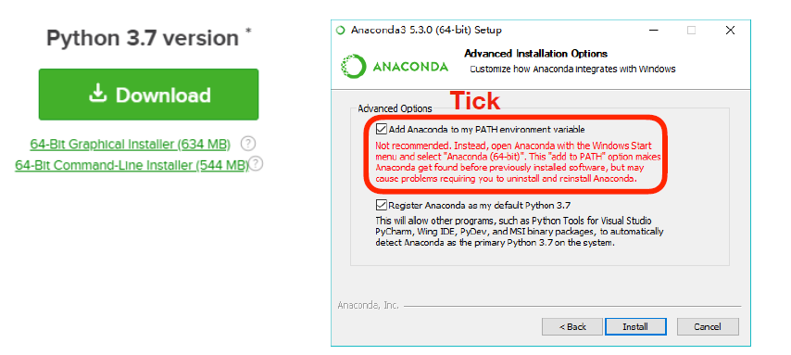
Installation
Anaconda: highly recommended
Separate environment, clean package management
Download: https://www.anaconda.com/distribution/#download-section

Slide 7
Installation (Ref.)
conda create –n [name] python=3.7
conda create –n [name] python=3.7 numpy pandas
Windows: activate [name] / deactivate
Linux/mac: source activate [name] / source deactivate
conda install –n [name] [package name]
ipython, jupyter, numpy, matplotlib, pytorch
conda list, conda env remove –n [name], conda env list

Slide 8
Tsinghua Open Source Mirror
conda config --add channels https://mirrors.tuna.tsinghua.edu.cn/anaconda/pkgs/free/
conda config --add channels https://mirrors.tuna.tsinghua.edu.cn/anaconda/pkgs/main/
conda config --set show_channel_urls yes

Slide 9
Jupyter Notebook
Interactive computational environment
Write and execute Python code in your web browser
Start in command line (After installed Anaconda)
jupyter notebook
Start automatically (Enter http://localhost:8888 in browser)
Refer to https://www.winjourn.cn/archives/591
ssh –p [port] username@[ip] –L 127.0.0.1:1234:127.0.0.1:8888

Slide 10
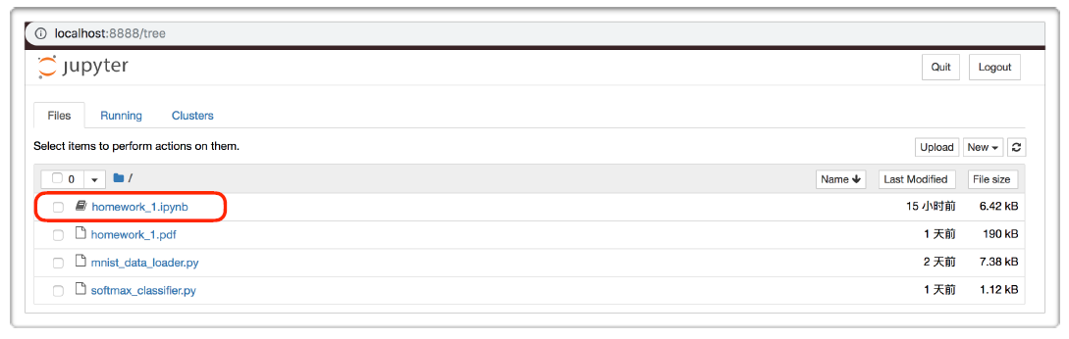
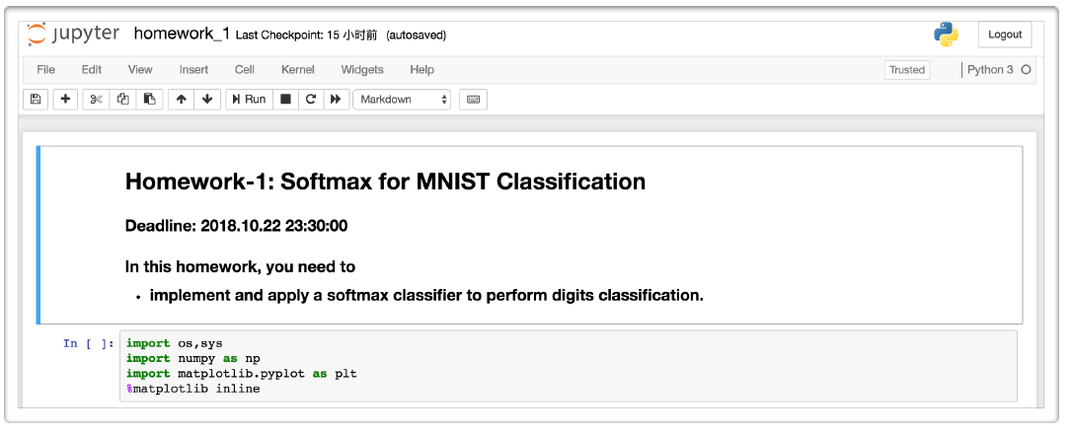

Slide 11
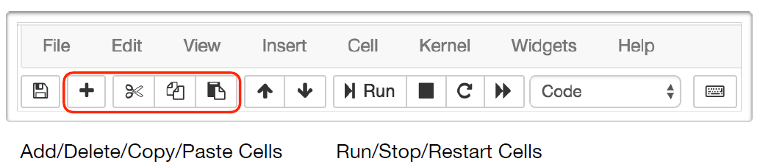
Jupyter Notebook
Cells / Blocks
Toolbar
Global variables are shared between cells.
Remember to save your changes ! (Ctrl+S or File-Save)

Slide 12
Outline
Python
Basic data types
Containers: Lists, Dictionaries, Tuples
Functions, Classes
Numpy
Arrays
Array indexing
Array math
Matplotlib
Plotting, Subplots, Images

Slide 13
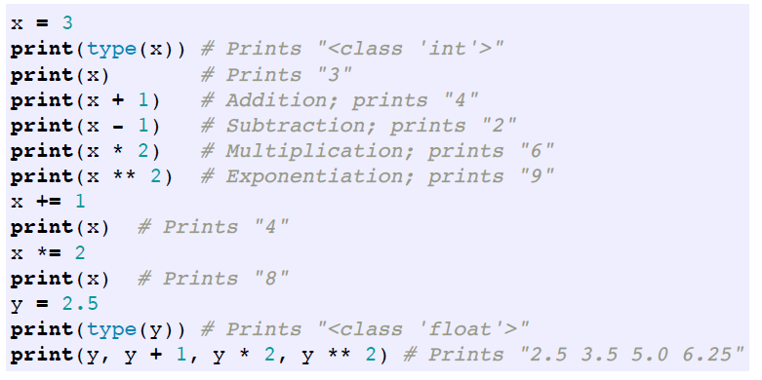
Basic data types
Numbers: Integers and floats work as you would expect from other languages
Note that unlike many languages, Python does not have unary increment (x++) or decrement (x--) operators. (x+=1 and (x-=1 instead)

Slide 14
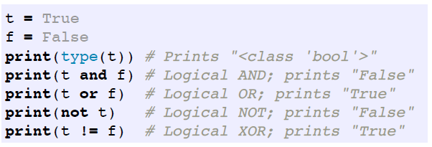
Basic data types
Booleans: Python implements all of the usual operators for Boolean logic
but uses English words rather than symbols (&&, ||, etc.):

Slide 15
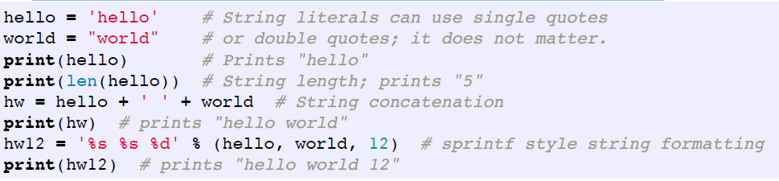
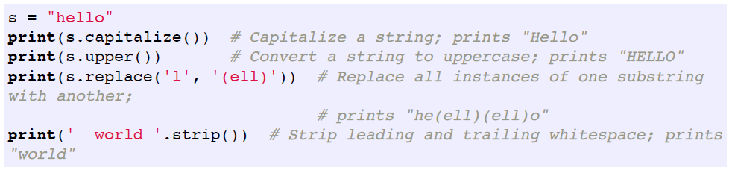
Basic data types
Strings: Python has great support for strings:
String objects have a bunch of useful methods:

Slide 16
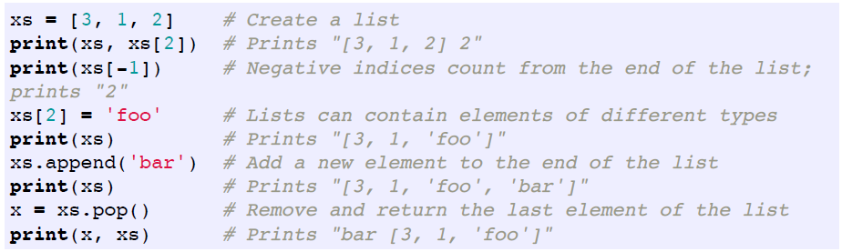
Contatiners
Lists:
A list is the Python equivalent of an array, but is resizeable and can contain elements of different types:

Slide 17
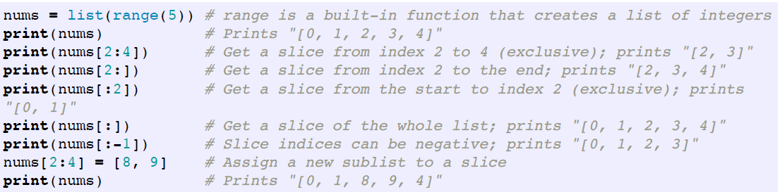
Lists
Slicing
In addition to accessing list elements one at a time, Python provides concise syntax to access sublists; this is known as slicing:
0-indexing
a : b —> [a, b)

Slide 18
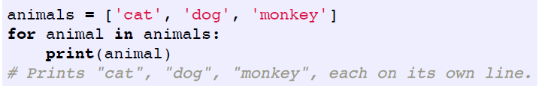
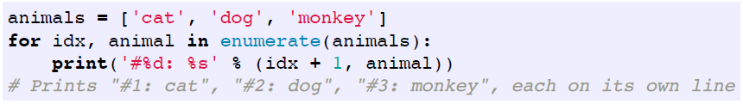
Lists
Loops
You can loop over the elements of a list like this:
If you want to access to the index of each element within the body of a loop, use the built-in enumerate function:

Slide 19
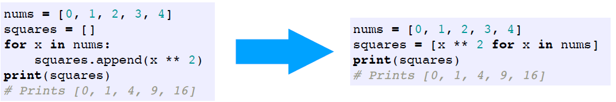
Lists
List comprehensions
When programming, frequently we want to transform one type of data into another.
As a simple example, consider the following code that computes square numbers:
You can make this code simpler using a list comprehension

Slide 20
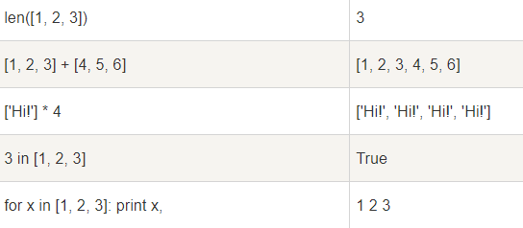
Lists (Ref.)
Operations
len, +, *, in, max, min

Slide 21
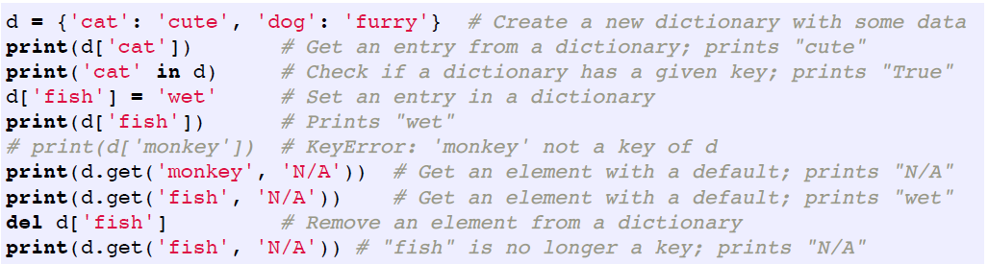
Dictionaries
A dictionary stores (key, value) pairs, similar to a Map in Java or an object in Javascript. You can use it like this:

Slide 22
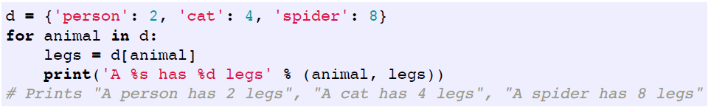
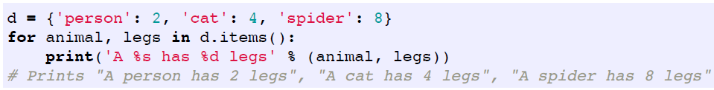
Dictionaries
Loops
It is easy to iterate over the keys in a dictionary:
If you want access to keys and their corresponding values, use the items method:

Slide 23
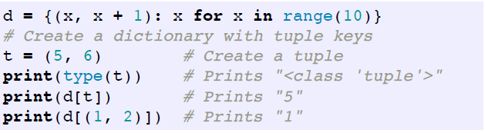
Tuples
A tuple is an immutable ordered list of values.
tuple is in many ways similar to a list
tuples can be used as keys in dictionaries, while lists cannot

Slide 24
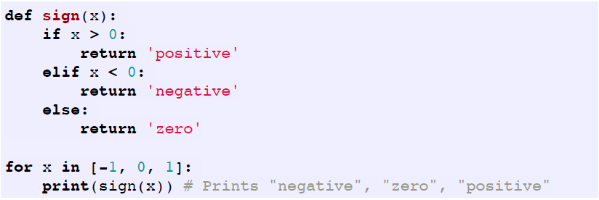
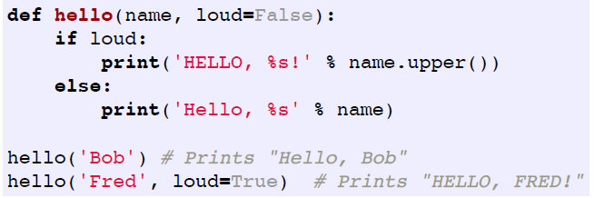
Functions
Python functions are defined using the def keyword
We will often define functions to take optional keyword arguments, like this:

Slide 25
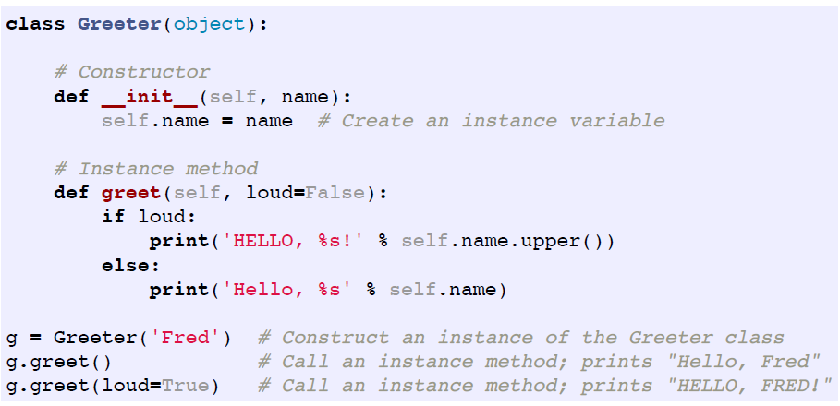
Classes
The syntax for defining classes in Python is straightforward
https://www.runoob.com/python/python-object.html

Slide 26
Numpy
Arrays
A numpy array is a grid of values, all of the same type, and is indexed by a tuple of nonnegative integers
The number of dimensions is the rank of the array; the shape of an array is a tuple of integers giving the size of the array along each dimension.
We can initialize numpy arrays from nested Python lists, and access elements using square brackets

Slide 27
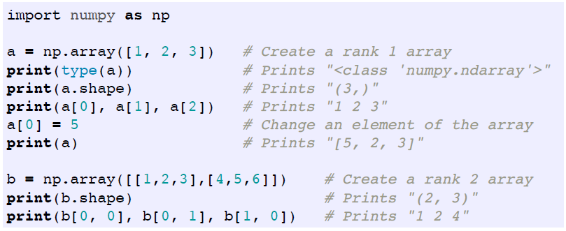
Numpy
Arrays

Slide 28
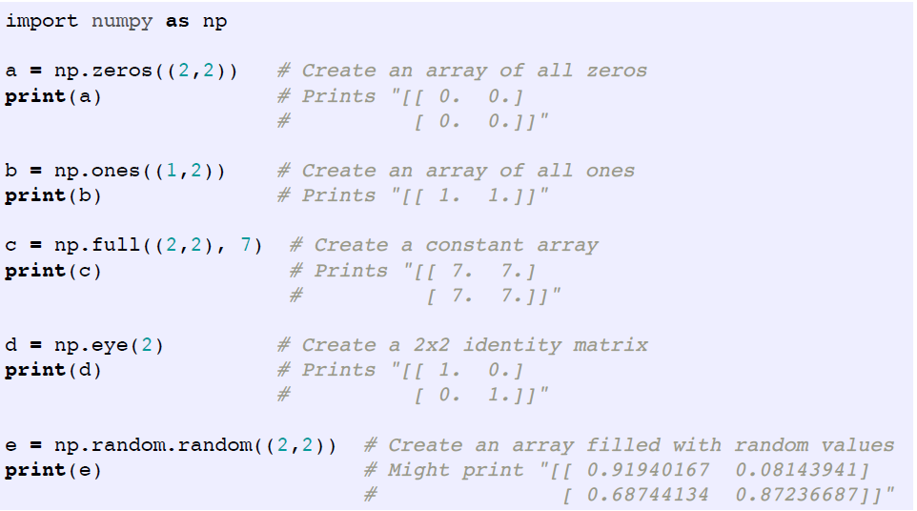
Numpy
Arrays
Numpy also provides many functions to create arrays:

Slide 29
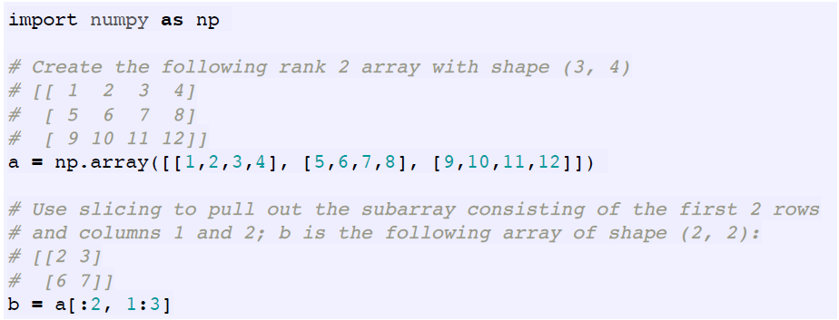
Numpy
Array indexing
Slicing: Similar to Python lists, numpy arrays can be sliced
Since arrays may be multidimensional, you must specify a slice for each dimension of the array:

Slide 30
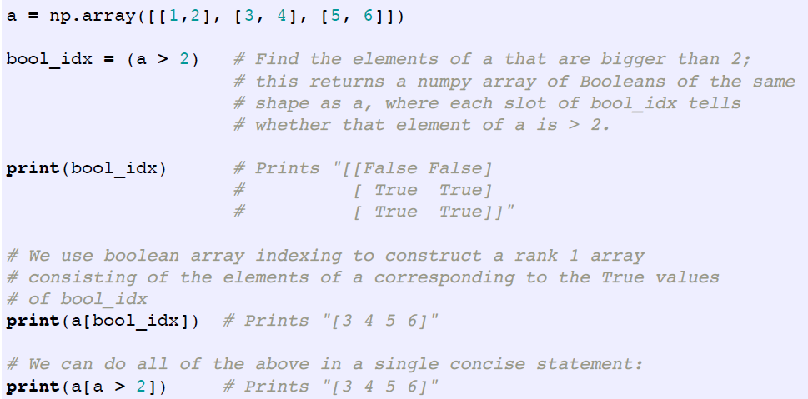
Numpy
Boolean array indexing: lets you pick out arbitrary elements of an array.
Frequently this type of indexing is used to select the elements of an array that satisfy some condition.

Slide 31
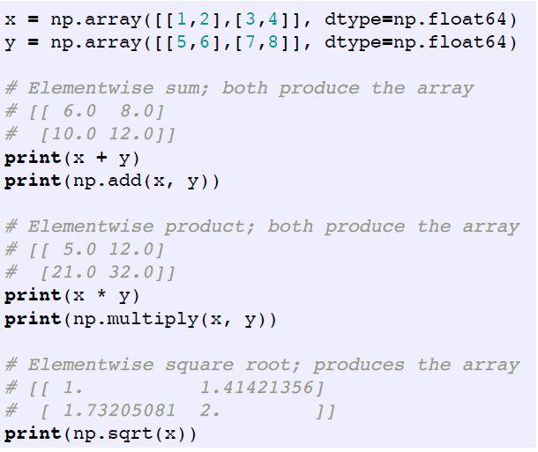
Numpy
Array math
Basic mathematical functions operate elementwise on arrays

Slide 32
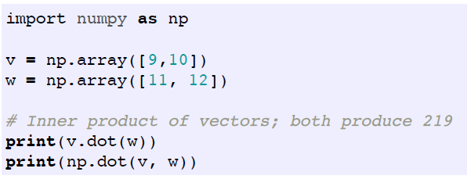
Numpy
Note that unlike MATLAB, * is elementwise multiplication, not matrix multiplication.
We instead use the dot function to compute inner products of vectors, to multiply a vector by a matrix, and to multiply matrices.

Slide 33
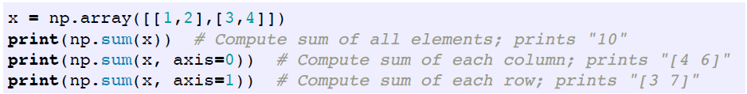
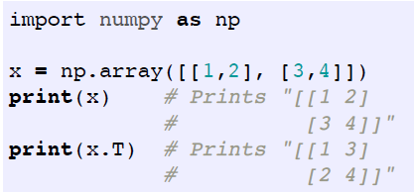
Numpy
Numpy provides many useful functions for performing computations on arrays
one of the most useful is sum:
To transpose a matrix, simply use the T attribute of an array object:

Slide 34
Numpy
Numpy documentation
This brief overview has touched on many of the important things that you need to know about numpy, but is far from complete.
Check out the docs.scipy.org/doc/numpy/reference/ to find out much more about numpy.
Of course, use google & stackoverflow

Slide 35
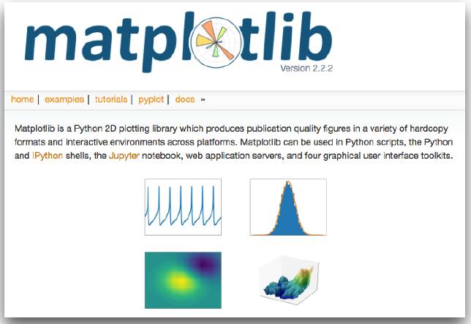
Matplotlib
Matplotlib is a plotting library.
In this section give a brief introduction to the matplotlib.pyplot module, which provides a plotting system similar to that of MATLAB.

Slide 36
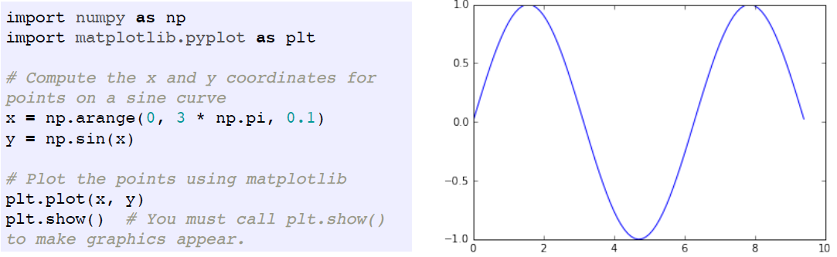
Matplotlib
Plotting
The most important function in matplotlib is plot, which allows you to plot 2D data.

Slide 37
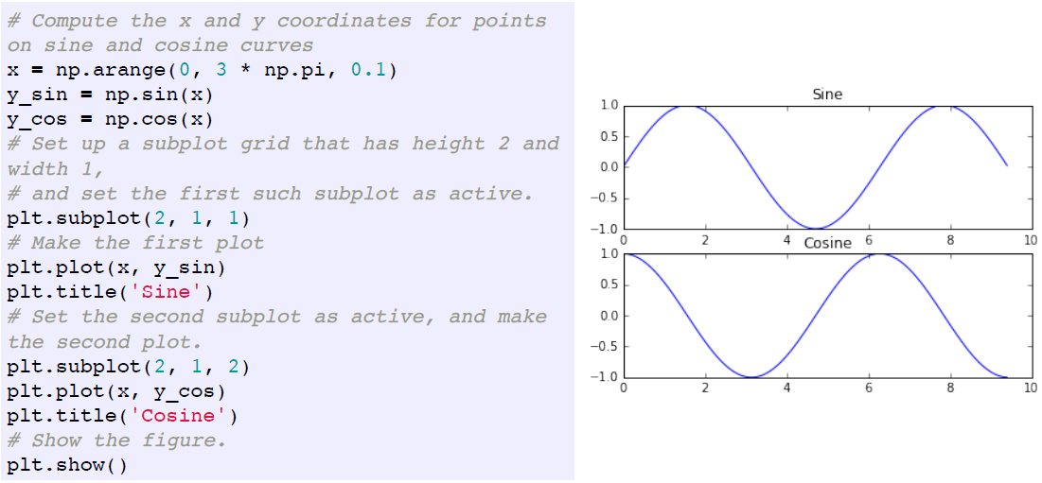
Matplotlib
Subplots
You can plot different things in the same figure using the subplot function

Slide 38
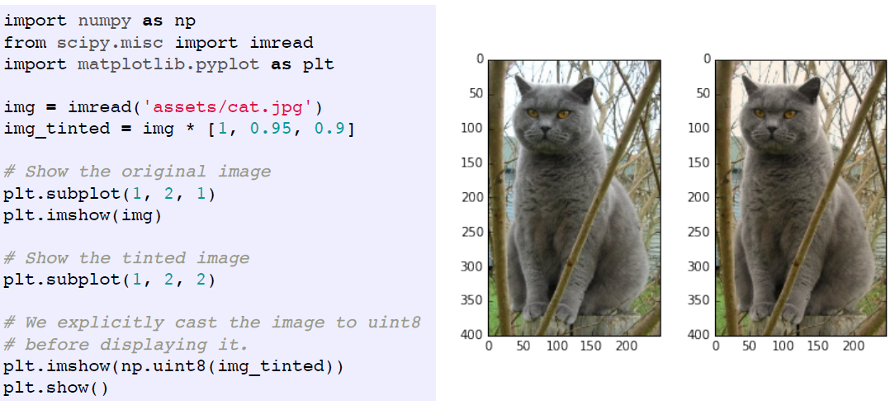
Matplotlib
Images
You can use the imshow function to show images

Slide 39
Useful Resources
Python
Python documentation
Code Academy (online learning and practice)
Learn Python the Hard Way (online ebook)
Google's Python Class
NumPy & Other Libs
Numpy documentation
Python笔记/知乎

Slide 40
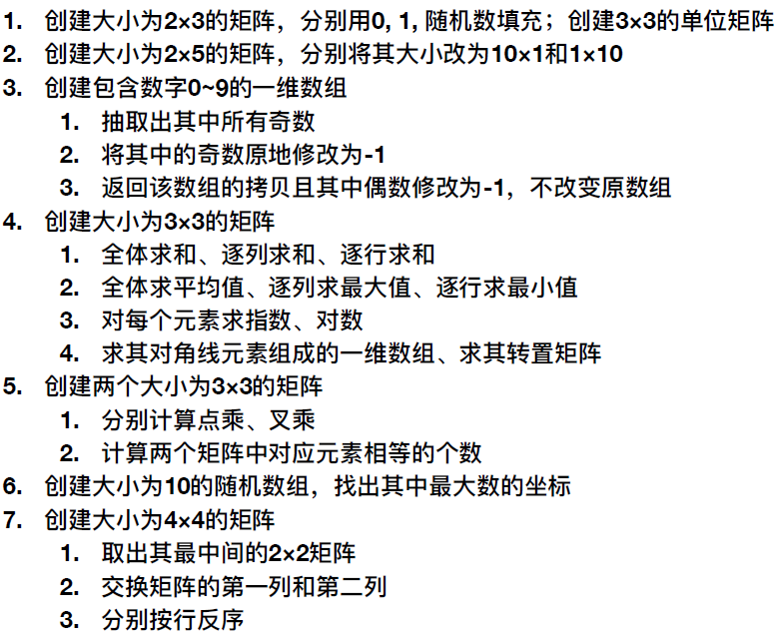
Numpy Exercise

Slide 41
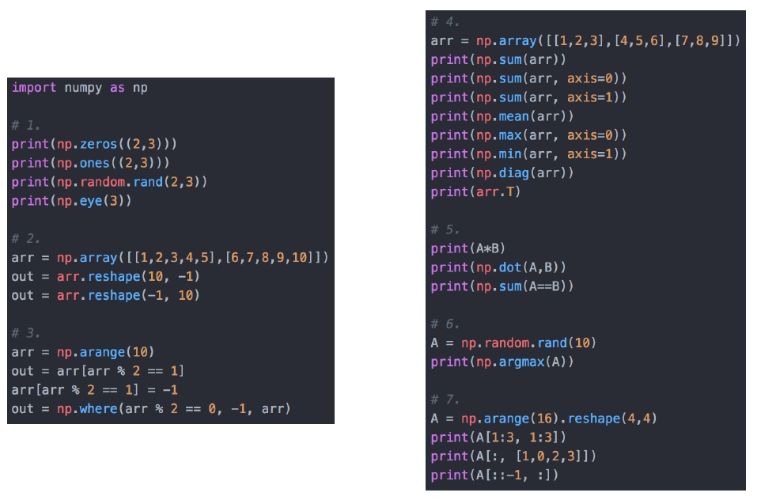
Numpy Exercise

