Slide 1
FWD Interview test
Wong Ling Yit

Slide 2
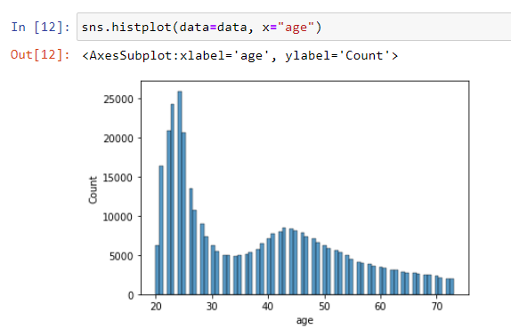
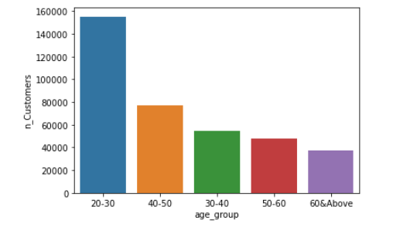
EDA - Exploratory Analysis - Age
We have double hump in our customer’s age profiles, and hence we converted age information to categorical variable to capture non-linearity of the dataset.

Slide 3
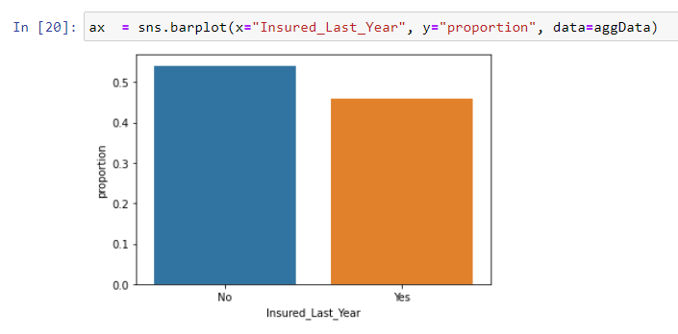
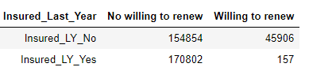
EDA - Exploratory Analysis - Insured Last Year
Only 46% (171K) of the customers were insured last year. Of those who were insured last year, only 157 are willing to renew.
For the customers who weren’t insured, more of them expressed their interest to renew. For the 45,906 customers, it seems weird this group of customers would like to renew? They were not insured with us last year, correct?
Nonetheless, for the rest of the modelling, I only looked at customers who were insured last year.

Slide 4
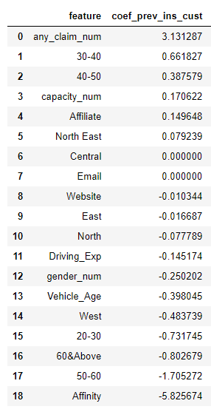
Insights from modelling
Only looked at customers who were insured last year
Negative Signal
Female are more likely to attrite (not renewing policy)
Customers of age group 20 - 30 and 50 & Above are more likely to attrite
Customers through sales channel of Affinity are more likely to attrite
Customers with more driving experience, are more likely to attrite
Customers with older vehicle age, are more likely to attrite
Positive Signal
Customers who made claims before are more likely to renew
Customers with higher engine capacity, are more likely to renew
Customers who purchased from affiliated agency force, are more likely to renew

Slide 5
Recommendation
Customers who purchased from affiliated agency force are more ‘sticky’. For customers who bought from digital channel, it would be best to pair them up with agency force, so that they can get more human touch.
Customers of age group 20 - 30 are more likely to attrite maybe because they are more price sensitive (the younger generation who will compare price online and less loyal to a particular brand), we should always entice them with more product to increase ‘stickiness’. Cross-sell & upsell with rewards, could be a strategy for this group.

Slide 6
Additional Data
Customers with higher engine capacity is a proxy information of affluence, as seen from the study, more affluent customers are more likely to renew. Additional data about customers’ financial information, will be helpful for more robust analysis.
Customers who made claims before are more risk-averse. Hence, if we can get leads data from car repairing workshop, for new customers who had experienced car accident. This will be helpful in the study of new business. Rather than just retent, we can be more aggressive in creating new business.

