Slide 1

DATABASE SYSTEMS
MINI PROJECT
BPL DataVault - SPORTS DATA MANAGEMENT SYSTEM
CSE302- Section 10

Slide 2
Project Members
2023-3-60-223
2023-3-60-490
2023-3-60-222
2023-3-60-195
Md. Abir Rahman
Md. Julfikar Hossain
Sudeepta Mandal
Md. Rashid Uz Zaman

Slide 3
Project Scope
Design an ER diagram and convert it into normalized tables (3NF preferred )
Create database schema with tables, primary keys, foreign keys, and constraints.
Insert sample data to test the database.
Write SQL queries covering: Simple selects with filters. Different types of joins (INNER, LEFT, RIGHT). Aggregations (GROUP BY, HAVING). Subqueries
Build a web application in Oracle APEX including: Forms for data entry and editing. Interactive reports to display data. Charts or dashboards (optional).
Implement simple triggers to automate basic tasks (optional).
Test and validate the application thoroughly.
Prepare a final report including: ER diagram and schema description. Screenshots of the APEX application. Sample SQL queries Summary of challenges and learning outcomes.

Slide 4
Our Concept
The BPL DataVault is a comprehensive cricket database system designed to manage and analyze Bangladesh Premier League data (2024/25 for this project). It stores detailed information about matches, players, teams, venues, umpires, and seasons. The system tracks ball-by-ball events, runs, wickets, venues and match results for accurate record-keeping. It provides insights into player and team performance through queries and reports. Overall, it ensures efficient management of BPL statistics and supports future data analysis.
All Database Concepts Use
Application has interactive frontend
ER Diagram Normalized up to 3NF

Slide 5



Languages Used
Softwares Used
Aggregration
Subqueries
Joins
DBMS Concepts Used

Slide 6
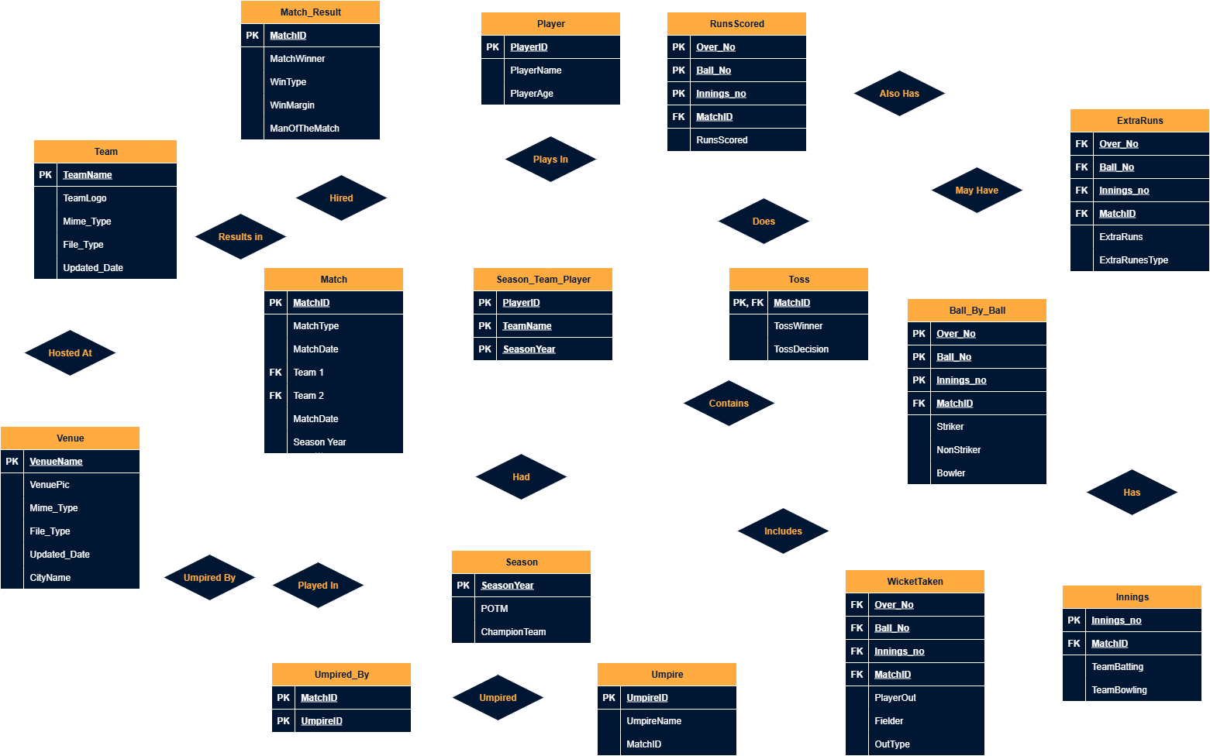
ER Diagram

Slide 7
“It’s Not About the Destination, It’s all about the Journey.
—Someone Famous

Slide 8

Conceptualizing
From Rough ERD to 3NF Normalized ERD

Slide 9
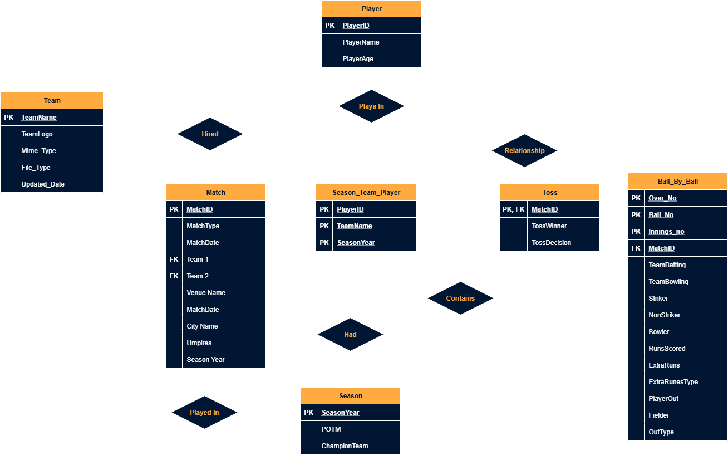
First Draft – 0NF
At first we devised a draft ERD that Was the base of our project

Slide 10
First Draft – 0NF
At first we devised a draft ERD that Was the base of our project

Slide 11
Let’s Make it Better
By Following ERD and Normalization Rules

Slide 12
First Draft – 0NF
At first we devised a draft ERD that Was the base of our project

Slide 13
1st Normal Form – 1NF
1NF demands that every column must have atomic Values. For Match Table, the Umpires attribute is a multivalued attribute because a match has 2 or 3 umpires.

Slide 14
1st Normal Form – 1NF
1NF demands that every column must have atomic Values. For Match Table, the Umpires attribute is a multivalued attribute because a match has 2 or 3 umpires.
To Solve it, We add a table named Umpire, Give it a primary key UmpireId, and add The PK of this table which is MatchID.

Slide 15
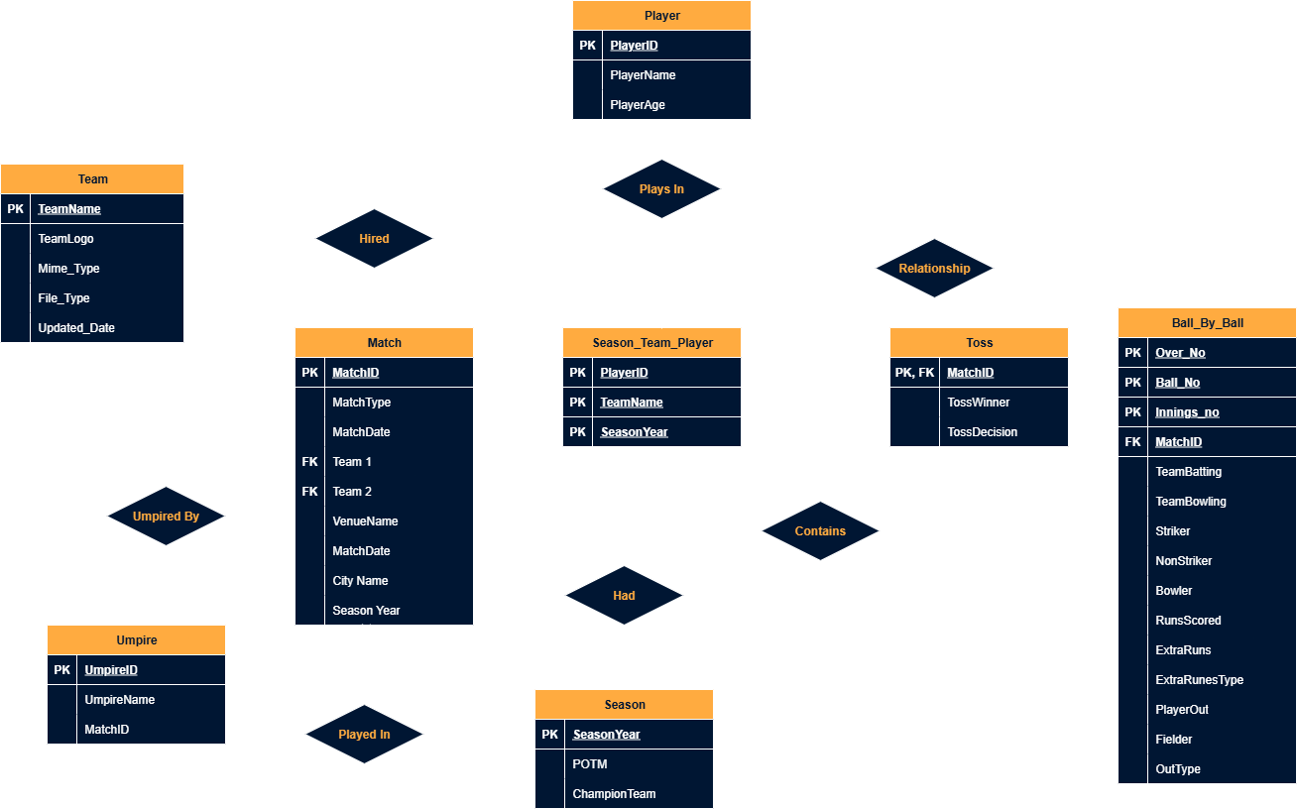
1st Normal Form – 1NF
1NF demands that every column must have atomic Values. For Match Table, the Umpires attribute is a multivalued attribute because a match has 2 or 3 umpires.
To Solve it, We add a table named Umpire, Give it a primary key UmpireId, and add The PK of this table which is MatchID.

Slide 16
Many-To-Many Decomposition
But an Umpire can be umpire in multiple matches as well, resulting in a many-to-many relationship.

Slide 17
Many-To-Many Decomposition
But an Umpire can be umpire in multiple matches as well, resulting in a many-to-many relationship.
To reduce redundancy we have decomposed it by converting the relationship to a table called Umpired_By.

Slide 18
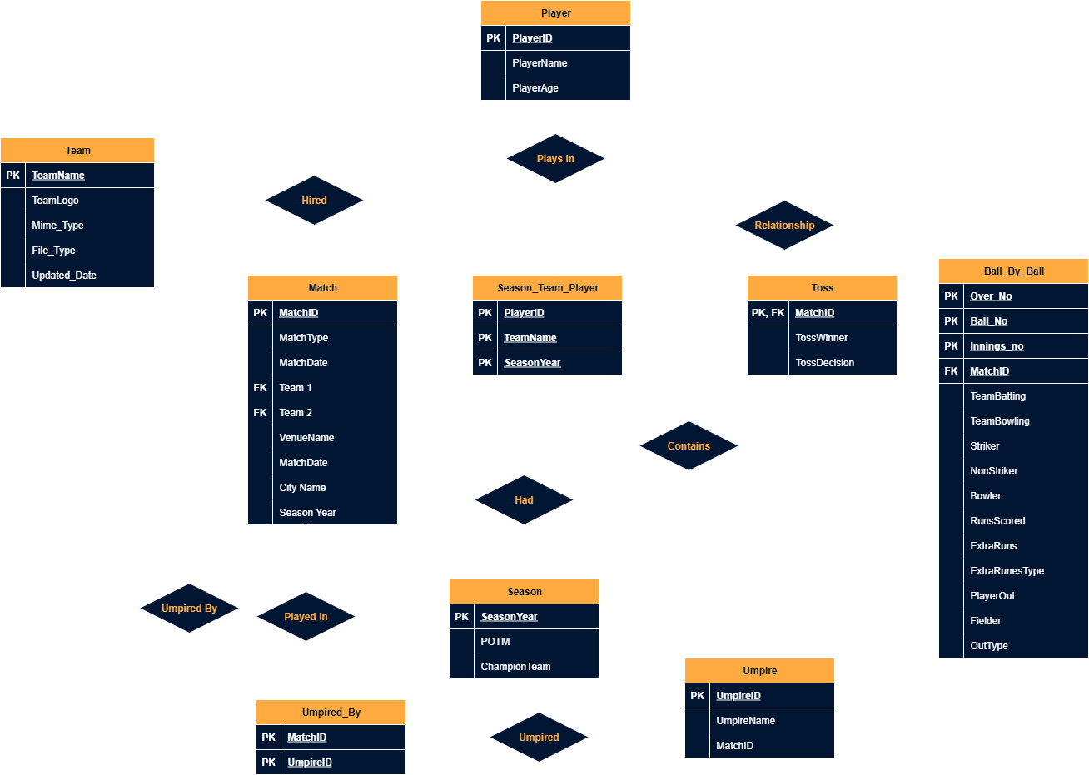
Many-To-Many Decomposition
But an Umpire can be umpire in multiple matches as well, resulting in a many-to-many relationship.
To reduce redundancy we have decomposed it by converting the relationship to a table called Umpired_By.

Slide 19
1st Normal Form – 1NF
Also, Atomic values refer to reduced percentage of NULL values. RunsScored might be 0 or more for any certain Ball but every ball doesn’t yield Extra runs or Player Outs. So those fields will mostly remain NULL.

Slide 20
1st Normal Form – 1NF
Also, Atomic values refer to reduced percentage of NULL values. RunsScored might be 0 or more for any certain Ball but every ball doesn’t yield Extra runs or Player Outs. So those fields will mostly remain NULL.
To Fix This issue, We will create two separate tables and we can either make a new primary key and tag it to that table or tag the composite key.

Slide 21
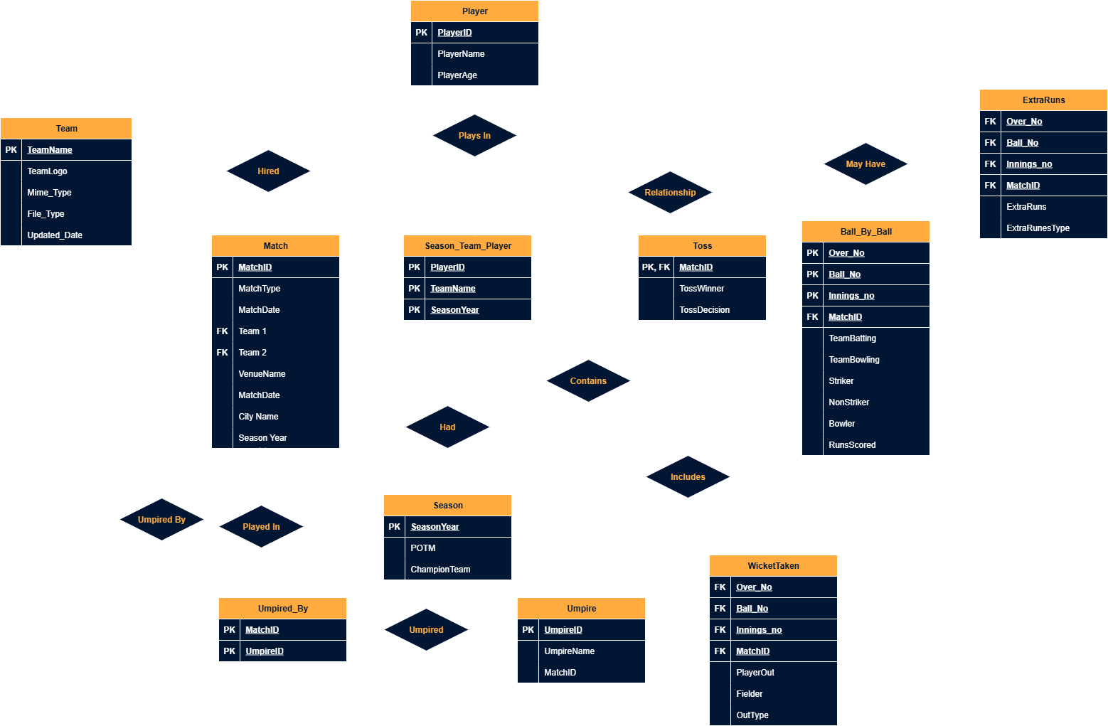
1st Normal Form – 1NF
Also, Atomic values refer to reduced percentage of NULL values. RunsScored might be 0 or more for any certain Ball but every ball doesn’t yield Extra runs or Player Outs. So those fields will mostly remain NULL.
To Fix This issue, We will create two separate tables and we can either make a new primary key and tag it to that table or tag the composite key.

Slide 22
2nd Normal Form - 2NF
2NF Demands There may not be any Partial Dependency and 1NF. Meaning not attribute can depend on part of the candidate key.
Here in Ball_By_ball
Over_No, Ball_No, Innings_no, MatchID -> TeamBatting, TeamBowling But also Innings_no, MatchID -> TeamBatting, TeamBowling

Slide 23
2nd Normal Form - 2NF
2NF Demands There may not be any Partial Dependency and 1NF. Meaning not attribute can depend on part of the candidate key.
Here in Ball_By_ball
Over_No, Ball_No, Innings_no, MatchID -> TeamBatting, TeamBowling But also Innings_no, MatchID -> TeamBatting, TeamBowling
This is a partial dependency. To solve this we create another Table directly with all attributes of the partial dependency.

Slide 24
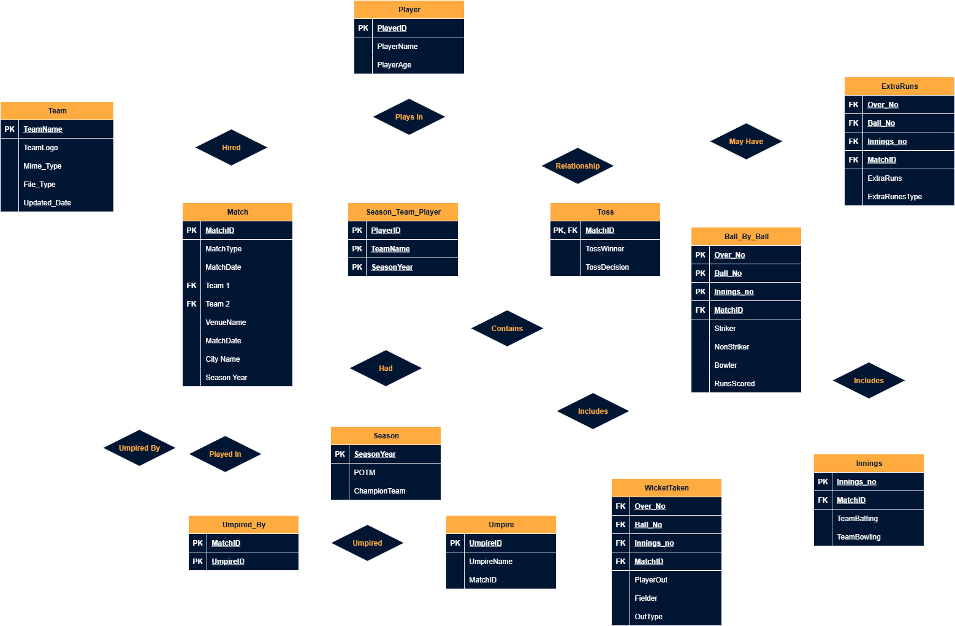
2nd Normal Form - 2NF
2NF Demands There may not be any Partial Dependency and 1NF. Meaning no attribute can depend on part of the candidate key.
Here in Ball_By_ball
Over_No, Ball_No, Innings_no, MatchID -> TeamBatting, TeamBowling But also Innings_no, MatchID -> TeamBatting, TeamBowling
This is a partial dependency. To solve this we create another Table directly with all attributes of the partial dependency.

Slide 25
3rd Normal Form – 3NF
3NF Demands There should not be any Transitive Dependency and 2NF. Meaning no non-prime attribute can depend on another prime attribute and another non-prime attribute at the same time.
Here in Match
MatchID -> CityName
But, VenueName -> CityName MatchID-> VenueName-> CityName VenueName is a non prime attribute. So are other things related to venue which can be queried from the venue name itself. And also from MatchID

Slide 26
3rd Normal Form – 3NF
3NF Demands There should not be any Transitive Dependency and 2NF. Meaning no non-prime attribute can depend on another prime attribute and another non-prime attribute at the same time.
Here in Match
MatchID -> CityName
But, VenueName -> CityName MatchID-> VenueName-> CityName VenueName is a non prime attribute. So are other things related to venue which can be queried from the venue name itself. And also from MatchID
This is a transitive dependency. To solve this we create another Table directly with all attributes of the non-prime dependency.

Slide 27
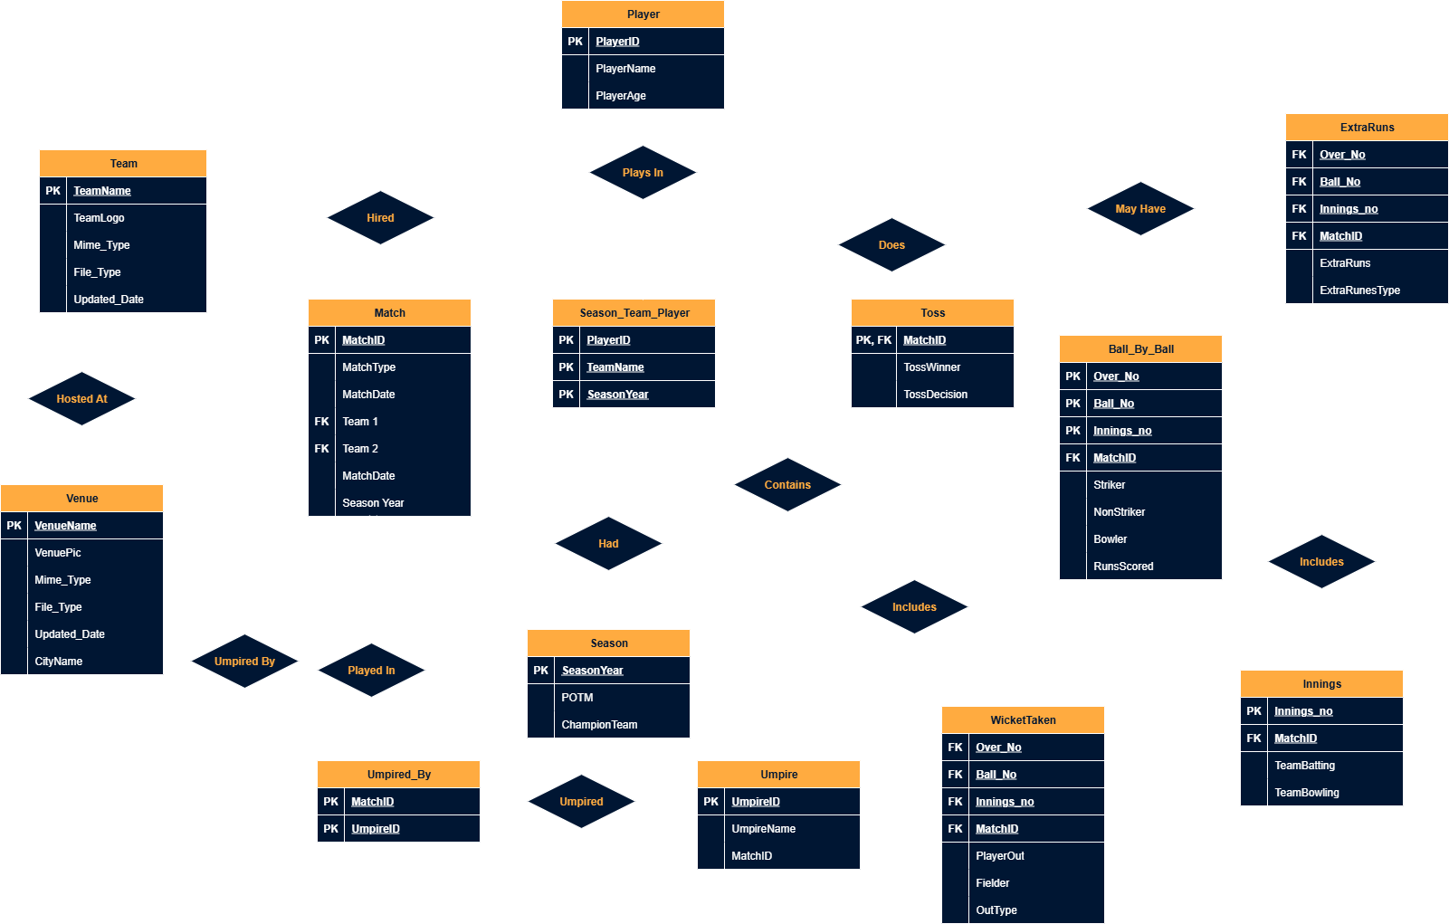
3rd Normal Form – 3NF
3NF Demands There should not be any Transitive Dependency and 2NF. Meaning no non-prime attribute can depend on another prime attribute and another non-prime attribute at the same time.
Here in Match
MatchID -> CityName
But, VenueName -> CityName MatchID-> VenueName-> CityName VenueName is a non prime attribute. So are other things related to venue which can be queried from the venue name itself. And also from MatchID
This is a transitive dependency. To solve this we create another Table directly with all attributes of the non-prime dependency.

Slide 28
3rd Normal Form – 3NF
Normalized Upto 3NF!
3NF Demands There should not be any Transitive Dependency and 2NF. Meaning no non-prime attribute can depend on another prime attribute and another non-prime attribute at the same time.
Here in Match
MatchID -> CityName
But, VenueName -> CityName MatchID-> VenueName-> CityName VenueName is a non prime attribute. So are other things related to venue which can be queried from the venue name itself. And also from MatchID
This is a transitive dependency. To solve this we create another Table directly with all attributes of the non-prime dependency.

Slide 29
Normalized Upto 3NF!
A Few Edits Here and There

Slide 30
A Few Edits Here and There
Normalized Upto 3NF!

Slide 31
SCHEMA
From ER Model to Relation Model

Slide 32
Schema
After some more tweaks, we came up with this schema –
Team (TeamName, TeamLogo, Mime_Type, File_Type, Updated_Date)
Player (PlayerID, PlayerName, PlayerAge)
Venue (VenueName, VenuePic, Mime_Type, File_Type, Updated_Date, CityName)
Umpire (UmpireID, UmpireName, MatchID)
Season (SeasonYear, POTM, ChampionTeam)
Season_Team_Player (PlayerID, TeamName, SeasonYear)
Match (MatchID, MatchType, MatchDate, Team1, Team2, SeasonYear)
Match_Result (MatchID, MatchWinner, WinType, WinMargin, ManOfTheMatch)
Toss (MatchID, TossWinner, TossDecision)
Ball_By_Ball (Over_No, Ball_No, Innings_no, MatchID, Striker, NonStriker, Bowler)
RunsScored (Over_No, Ball_No, Innings_no, MatchID, RunsScored)
ExtraRuns (Over_No, Ball_No, Innings_no, MatchID, ExtraRuns, ExtraRunsType)
WicketTaken (Over_No, Ball_No, Innings_no, MatchID, PlayerOut, Fielder, OutType)
Innings (Innings_no, MatchID, TeamBatting, TeamBowling)
Umpired_By (MatchID, UmpireID)

Slide 33
Implementation
Web App Using Oracle APEX

Slide 34
Implementation Checklist
Project ID
Workspace Name
Workspace Email
Workspace Pass
Auth Type
Authorization
14889
Sakin_Workspace
abirrahman.sakin@gmail.com
#spsakin@329(main)
Custom
Multi User

Slide 35
51
19
09
Reports
Reports
Graphs/Charts
Pages Information
SELECT
b.striker AS player_name,
m.seasonyear,
COUNT(*) AS sixes,
FROM
scoredruns s
JOIN ball_by_ball b
ON s.overno = b.overno
AND s.ball_no = b.ball_no
AND s.inningsno = b.inningsno
AND s.matchid = b.matchid
JOIN match m
ON s.matchid = m.matchid
WHERE
s.runscored = 6
GROUP BY
b.striker, m.seasonyear
With Forms added
Based on Queries, Aggregrate Queries
using queries for data visualization
Uploaded & Displayed Images in reports
Implemented Page-wise Authorization

Slide 36
Possible Queries
Let’s Visualize some queries on our Database
SELECT M.MatchID, SUM(RS.RunsScored) AS TotalRuns
FROM Match M
JOIN RunsScored RS ON M.MatchID = RS.MatchID
GROUP BY M.MatchID
HAVING SUM(RS.RunsScored) > (
SELECT AVG(TotalMatchRuns)
FROM (
SELECT SUM(RS2.RunsScored) AS TotalMatchRuns
FROM RunsScored RS2
GROUP BY RS2.MatchID
) AS MatchTotals
);
SELECT
b.striker AS player_name,
m.seasonyear,
COUNT(*) AS sixes,
FROM
scoredruns s
JOIN ball_by_ball b
ON s.overno = b.overno
AND s.ball_no = b.ball_no
AND s.inningsno = b.inningsno
AND s.matchid = b.matchid
JOIN match m
ON s.matchid = m.matchid
WHERE
s.runscored = 6
GROUP BY
b.striker, m.seasonyear
NATURAL JOIN WITH AGGREGRATION
To Find Out Top Six Scorer in each season, it joins the ScoredRuns with BallByBall and Match to get the names of players who scored the most sizes then group them displaying their names, season and COUNT of Sixes

Slide 37
Possible Queries
Let’s Visualize some queries on our Database
SELECT
wt.fielder AS player_name,
COUNT(*) AS total_catches
FROM
wickettaken wt
WHERE
wt.outtype = ‘caught’;
AND wt.fielder IS NOT NULL
GROUP BY
wt.fielder
ORDER BY
total_catches DESC
FETCH FIRST 5 ROWS ONLY;
SELECT M.MatchID, SUM(RS.RunsScored) AS TotalRuns
FROM Match M
JOIN RunsScored RS ON M.MatchID = RS.MatchID
GROUP BY M.MatchID
HAVING SUM(RS.RunsScored) > (
SELECT AVG(TotalMatchRuns)
FROM (
SELECT SUM(RS2.RunsScored) AS TotalMatchRuns
FROM RunsScored RS2
GROUP BY RS2.MatchID
) AS MatchTotals
);
SUBQUERIES
To Find the matches where the total runs scored were higher than the average total runs of all matches,

Slide 38
Possible Queries
Let’s Visualize some queries on our Database
SELECT
wt.fielder AS player_name,
COUNT(*) AS total_catches
FROM
wickettaken wt
WHERE
wt.outtype = ‘caught’;
AND wt.fielder IS NOT NULL
GROUP BY
wt.fielder
ORDER BY
total_catches DESC
FETCH FIRST 5 ROWS ONLY;
AGGREGRATION
To Find the Top 5 Fielders with most Caught

Slide 39
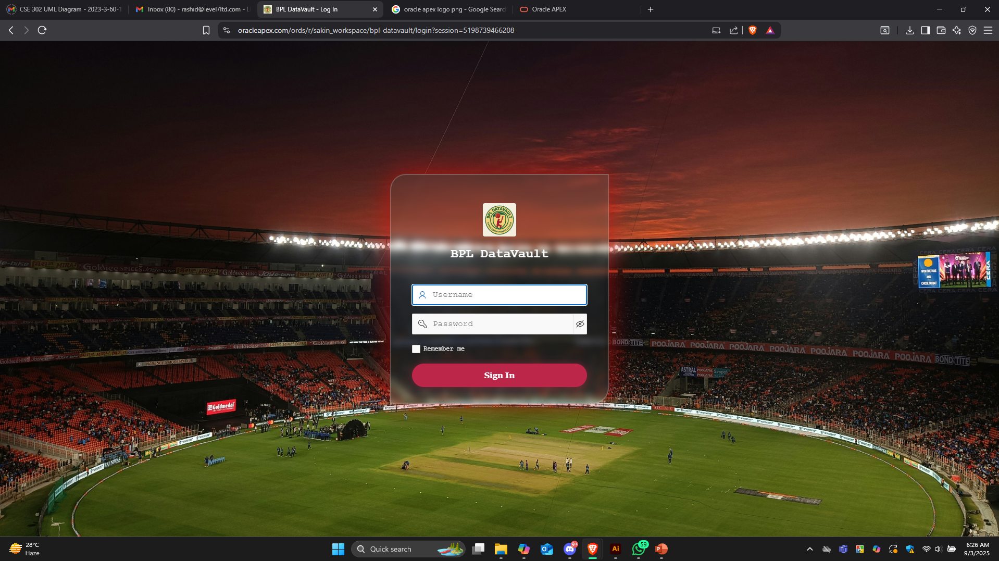
Live Web App
The Webapp is live on the Oracle APEX platform with an interactive UI and use centric UX, enabling people to use the application which in the backend is using SQL Queries to fetch Data.
LIVE APP

Slide 40
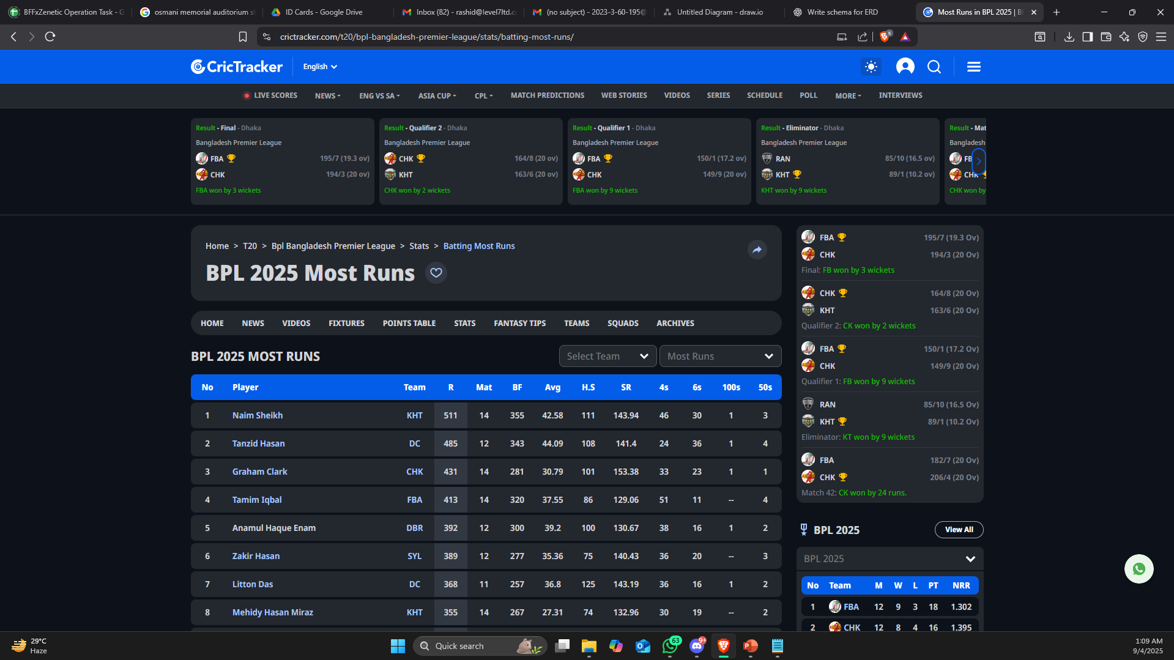
Query Validation
Since it uses real data we can verify our queries using platforms that store cricketing data. For this case we will use Crictracker.
CRICTRACKER LINK

Slide 41
Thank You
For your patience.

