Slide 1
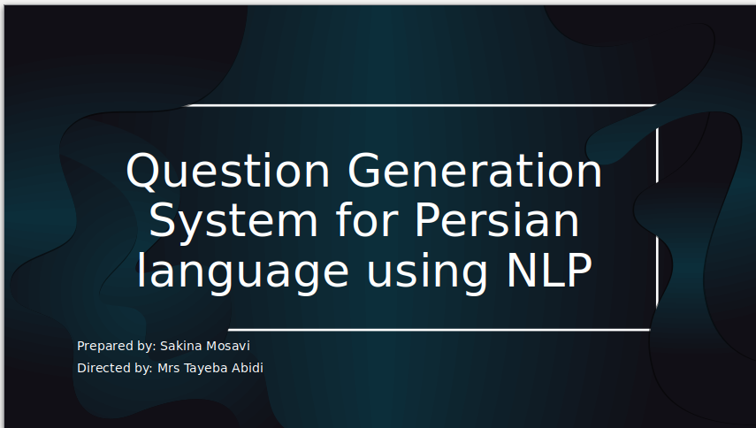

Slide 2
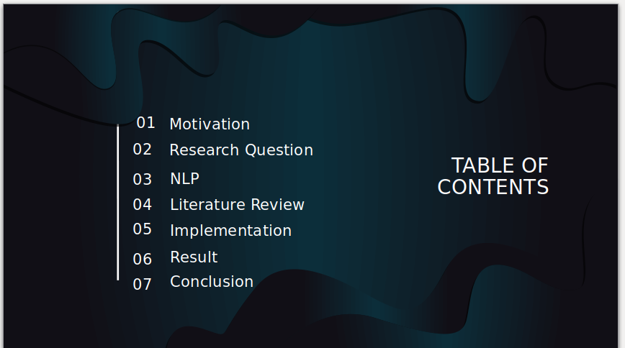
1

Slide 3
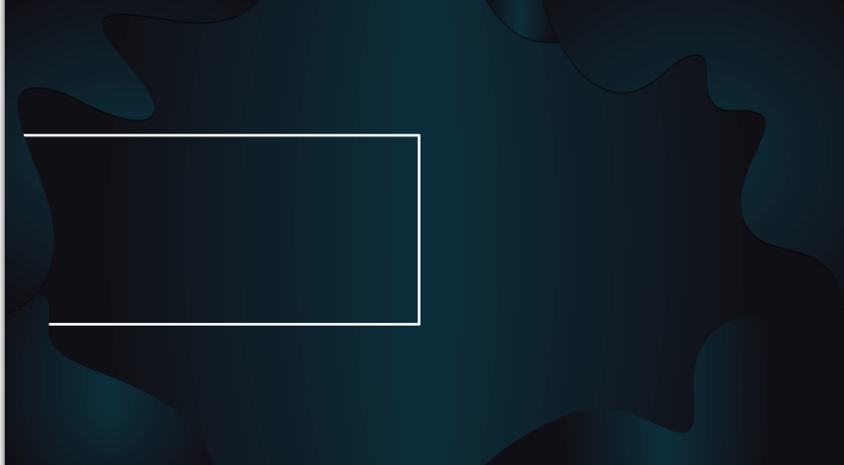
Are available NLP techniques for Persian language enough to develop question generation system?
Research Question
How many kinds of questions are possible to be generated for question generation systems?
What challenges are there toward question generation system in Persian language?
2

Slide 4

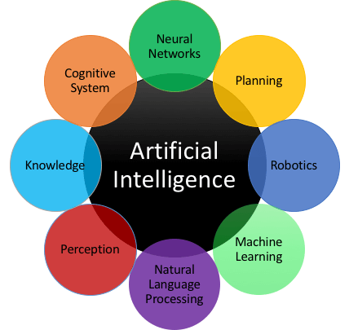
AI
3

Slide 5
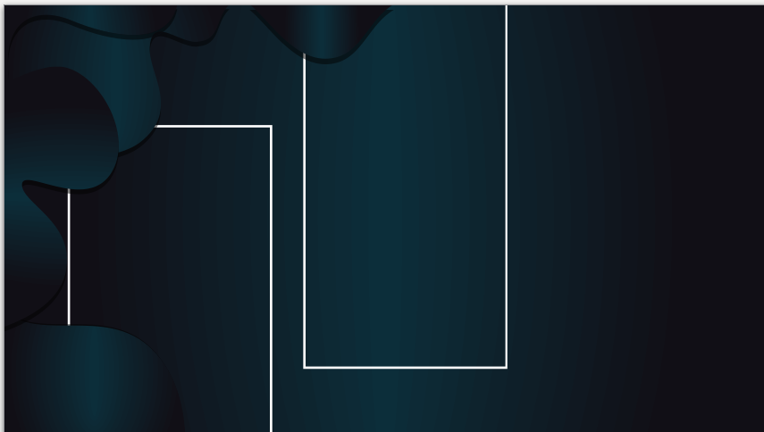

NLP concerned with the interactions between computers and human (natural) languages. In particular how to program computers to process and analyze large amount of natural language data because Machines interpret data in zeros and ones. This is why NLP comes like auto-complete, machine translation
Natural Language Processing
4

Slide 6
STATISTICAL NLP
RULE-BASED
much natural language processing research has relied heavily on machine learning.
Many language-processing systems are designed by hand-coding a set of rules.
NATURAL LANGUAGE PROCESSING
5

Slide 7
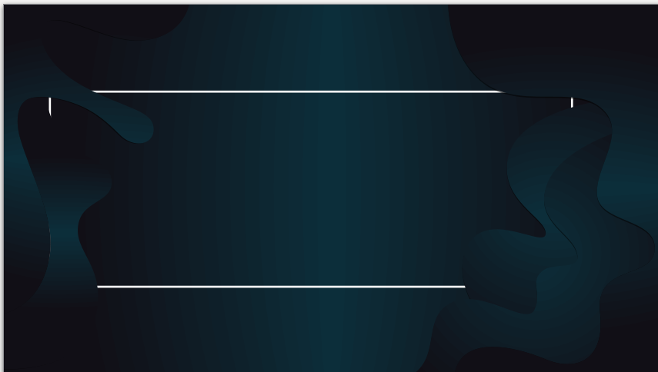
Literature Review
Question Generation from Paragraph at Upenn In 2010.
The semantic role labels are used to identify relevant parts of text before forming questions over them.
Example:[ARG1 One-handed backhand players ] [PRED move ] [ARG2 to the net ] [ARGM-MNR with greater ease than two-handed players] [ARGM-CAU because the shot permits greater forward momentum and ··· ]
6

Slide 8
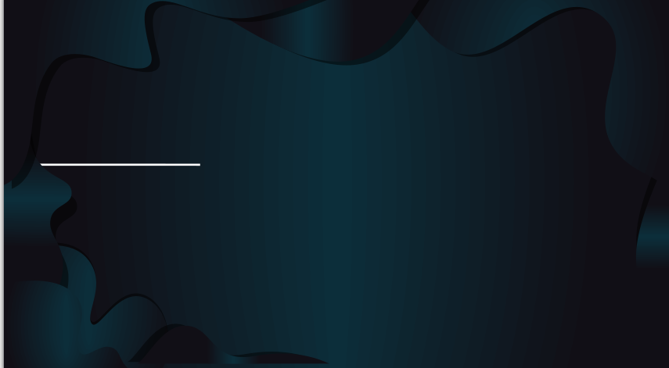
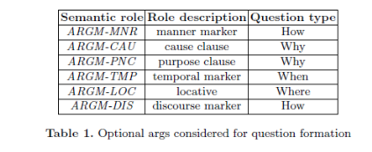
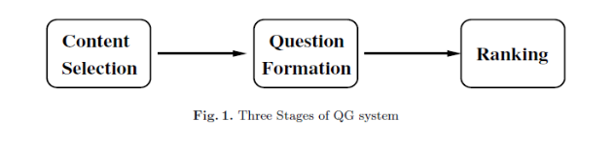
Continue...
7

Slide 9
Quillionz AI
Quillionz is an AI-driven question generator. Including multiple-choice questions, recall questions and short descriptive questions. It shows the power of artificial intelligence and machine learning algorithms to generate the questions within seconds and completely free.
8

Slide 10
Implementation
This system focus on generating questions from natural sentences using NLP. However if the input is a paragraph, first it will separate each sentence and then generates questions. It has four stages
1. preprocessing
2. content selection
3. question generation
4. print the output to a docx file
9

Slide 11

01
Sentence Tokenization
Text Normalization
POS Tagging,NER tagging
Removing “.” from the end of each senetence
Preprocessing
10

Slide 12
02
based on NER role of the word the sentence will be selected to generate question for example if a sentence has a person name it will be the target to generate question on it with who.
Based on the numerical value of the word the target part will be selected
Content Selection
Process of selecting the target for question generation. NER and POS tagging are used
English: SRL, NER
کابل پایتخت افغانستان است
علی احمد در ریاضی۱۰۰ نمره گرفت
11

Slide 13
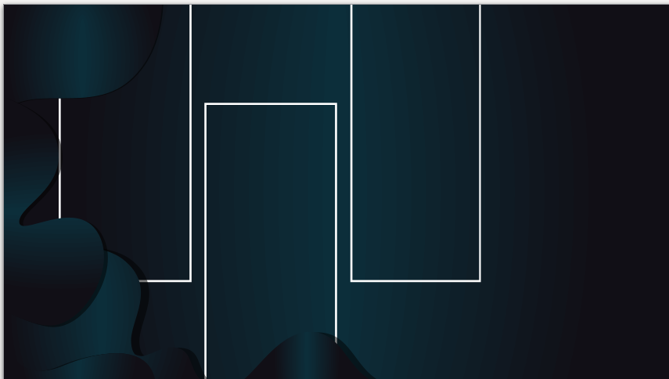
03
Applying the predefined rules
Three kind of Questions
QUESTION GENERATION
True/False questions
Blank Space questions
Short descriptive Questions
Appending question mark
12

Slide 14
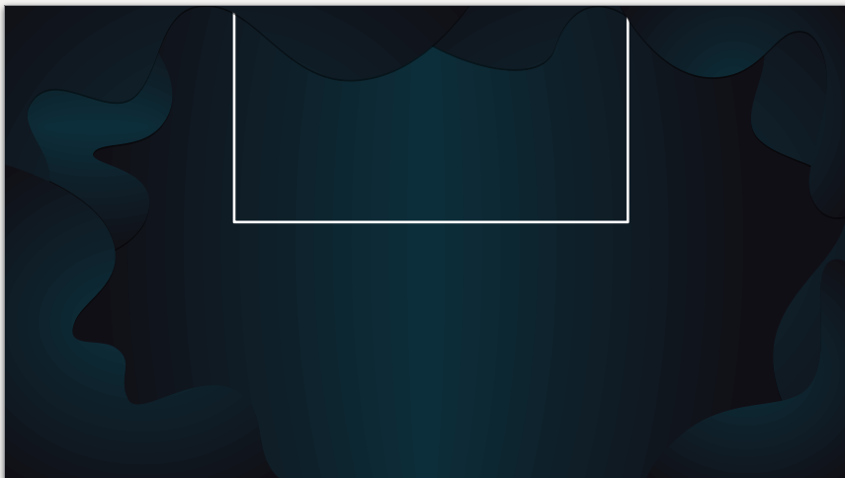
04
Print question(s) to a word file
All generated questions will be print to a file named as you wish.
Each kind of question will have it’s own title.
13

Slide 15
Examples
True/False question
جمله: تا نوامبر ۲۰۱۰ این آلبوم در سراسر جهان حدود ۱۱ میلیون نسخه فروش کرد؟
سؤال: تا نوامبر ۱۸۸۰ این آلبوم در سراسر جهان حدود ۱۱ میلیون نسخه فروش کرد؟
جمله: در ۲۸ اسد روز استقلال وطن عزیز ما افغانستان است که در زمان امان الله خان به دست آمد. ـ
سؤال: در ۲۸ اسد روز استقلال وطن عزیز ما افغانستان است که در زمان امان الله خان به دست آمد؟"
14

Slide 16
Examples
‌Blank space questions
جمله: اولین کسی که از مردان، پیامبری را تصدیق نمود و ایمان آورد، حضرت ابوبکر صدیق بود. ـ
سؤال: ـــــــــــــ کسی که از مردان، پیامبری را تصدیق نمود و ایمان آورد، حضرت ابوبکر صدیق بود؟
جمله: حضرت ابوبکر صدیق از جمله یاران حضرت محمد (ص) بود. ـ
سؤال: ــــــــــــ صدیق از جمله یاران حضرت محمد (ص) بود؟"
15

Slide 17
Examples
Short descriptive questions
جمله: حبیب بورقیبه در ۶ آوریل ۲۰۰۰ در سن ۹۶ سالگی درگذشت ـ
سؤال:چه کسی در ۶ آوریل ۲۰۰۰ در سن ۹۶ سالگی درگذشت؟
سؤال: حبیب بورقیبه در ۶ آوریل چند در سن ۹۶ سالگی درگذشت؟"
جمله: حضرت ابوبکر صدیق از جمله یاران حضرت محمد (ص) بود. ـ
سؤال: در مورد حضرت ابوبکر مختصرا معلومات دهید؟
16

Slide 18
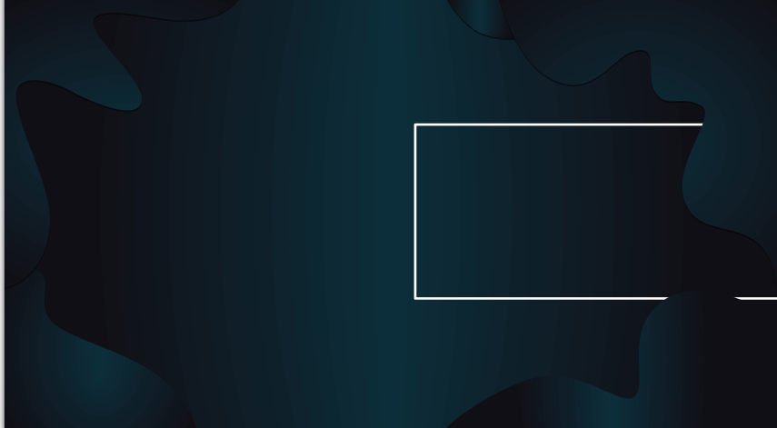
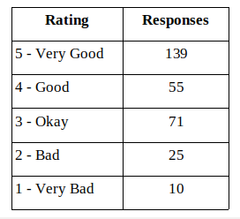
Accuracy
For evaluating this system I preferred human evaluation such that the 15 questions are given to 20 human judges. They could give rate to each generated questions between the range of 1-5 and the result is here:
17

Slide 19
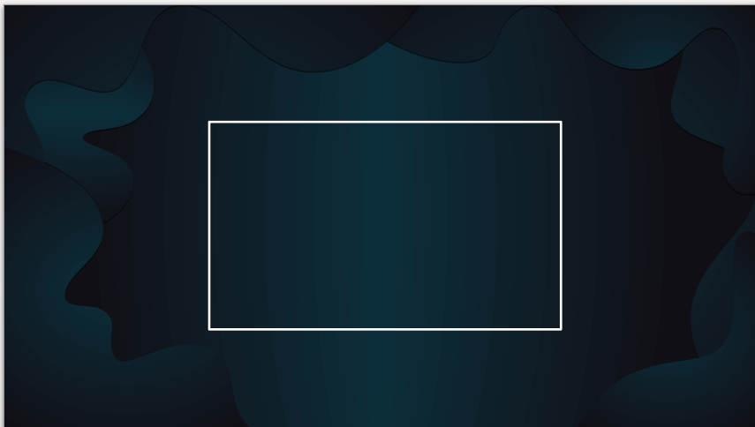
Result
By using available parsers for Persian language its possible to generate questions that are when, where, who, how many questions. But some limitations are exist for this purpose such that the parsers are trained by Farsi language and for Persian specific questions we can’t generate questions. And they would not be parsed through parsers.
18

Slide 20

This question generation system is a rule based system based on POS and NER tagging for Persian language using NLP techniques.
It can generate 3 kind of questions true/false, blank space and short descriptive questions.
A website with automatic question generation service from sentence and pdf file is my future plan.
Conclusion and Future Work
19

Slide 21
References
[1] Yates, T. (2016). Automated generation of questions from factual, natural language sentences.
[2] Keklik, O. (2018). Automatic question generation using natural language processing techniques (Master's thesis, Izmir Institute of Technology).
[3] Rakangor, S., & Ghodasara, Y. (2015). Literature review of automatic question generation systems. International Journal of Scientific and Research Publications, 5(1), 1-5.
[4] Mannem, P., Prasad, R., & Joshi, A. (2010, June). Question generation from paragraphs at UPenn: QGSTEC system description. In Proceedings of QG2010: The Third Workshop on Question Generation (pp. 84-91)
[5] Le, N. T., Kojiri, T., & Pinkwart, N. (2014). Automatic question generation for educational applications–the state of art. In Advanced Computational Methods for Knowledge Engineering(pp. 325-338). Springer, Cham.
20

Slide 22
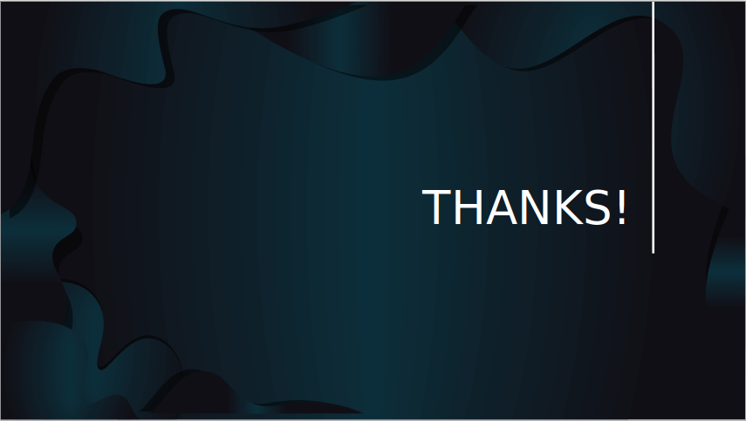
Question?
21

