Slide 1
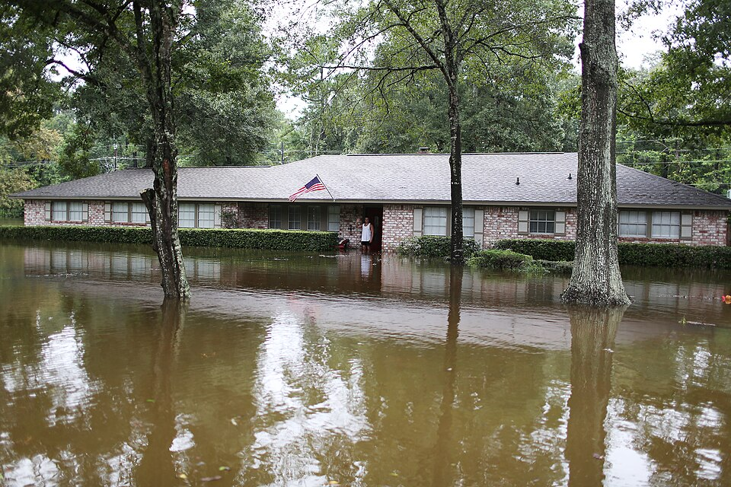
Spatio-Temporal Urban Flood
Hotspot Prediction
Multi-Source Geospatial Data Engineering
and Explainable Deep Learning, Houston TX
COSC 6368 Artificial Intelligence • Fall 2026
Proposal Presentation
Sakina Saifuddin | Aaliyah D. McAfee | Van Bao Nguyen
Notes:
Welcome. Our project predicts which places in Houston are likely to flood, explains why, and puts that information in the hands of every resident through a live tool. 4-minute pitch: research topic, motivation, challenges, what we've built so far, and the end tool.

Slide 2
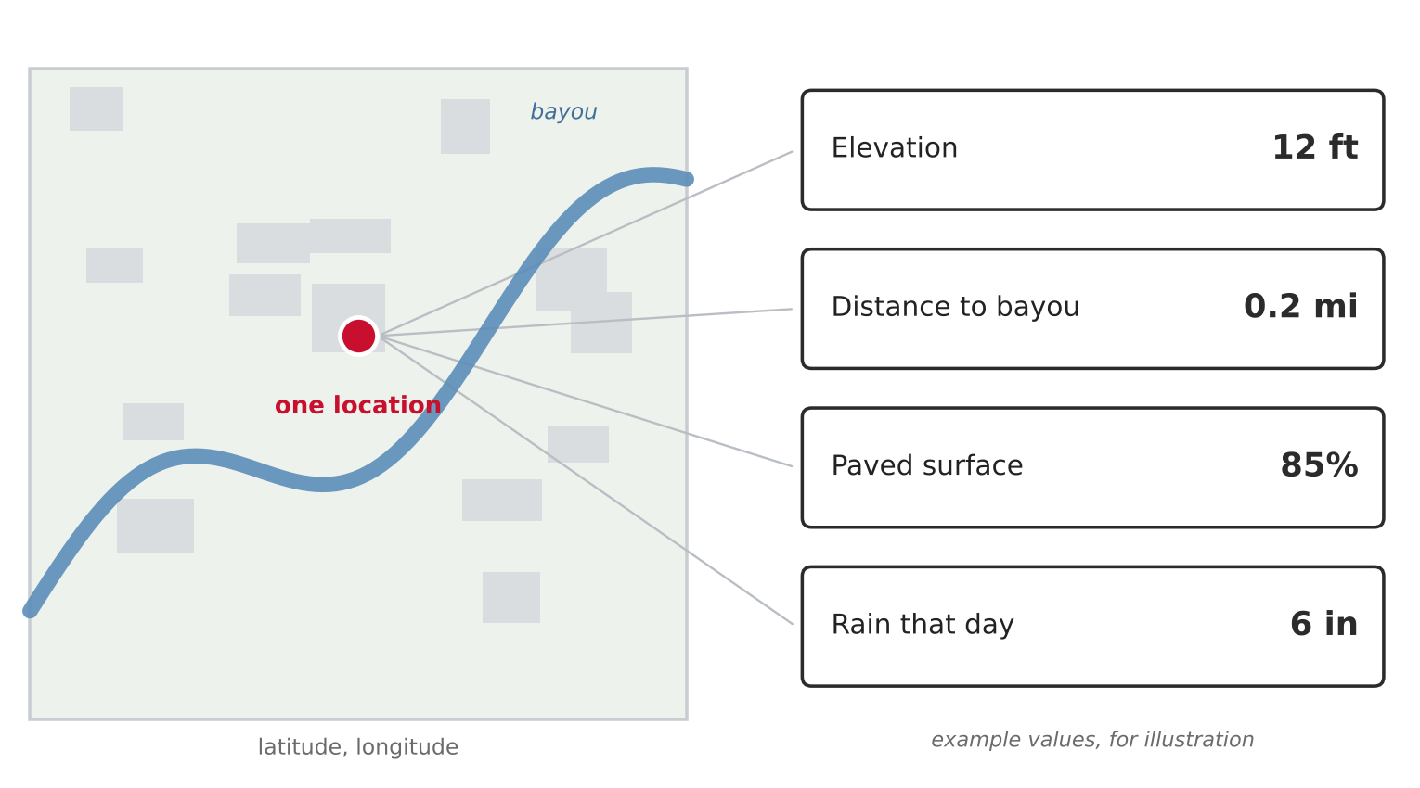
Research Topic
1 Research topic
"Given any location in Houston, is it a flood hotspot — YES or NO — and which factors explain why?"
Closest prior work
Liu, Felton and Mostafavi (2024)
Houston 311 flood data • ~0.80 accuracy • 0.83–0.89 flood detection
sciencedirect.com/science/article/abs/pii/S0198971524000255
Our benchmark to beat: ~80% accuracy, 83–89% flood recall
 | Prior work | Our project
Data | Prepared dataset | Our own — 5 public sources
Models | 1–2 tree models | 5 models incl. neural network + CNN
Explains | No | SHAP on every model
Testing | Random split | Held-out storm (Imelda 2019)
Output | Paper only | Live map tool for residents
One location → look up facts → model answers YES or NO + reasons.
Ground truth = real 311 flood reports, City of Houston.
COSC 6368 Artificial Intelligence • Fall 2026 • 2 / 6
Notes:
Research question: given a location, does it flood? Lookup diagram shows: one point, look up elevation, bayou distance, paved %, rainfall → model says YES or NO. Prior work by Liu 2024 gives our benchmark. Compact table shows 5 key differences vs prior work.

Slide 3
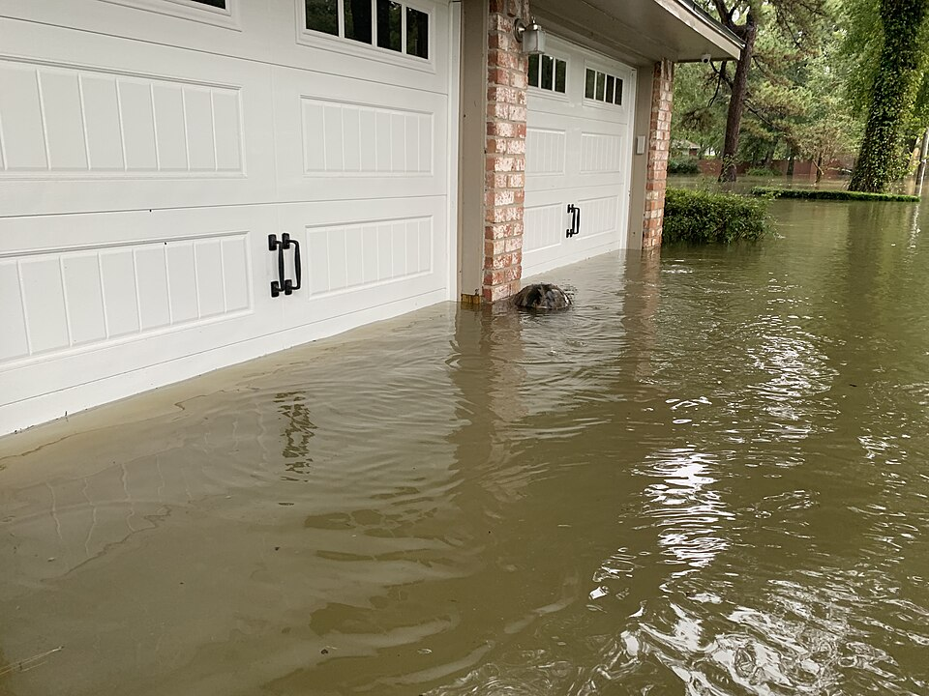
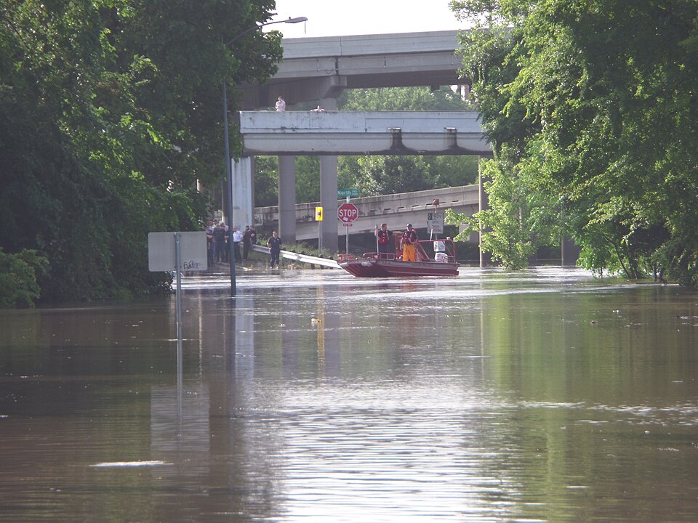
Motivation — Why This Matters
2 Motivation
39"
25–30%
15%
of rain in
one month
of Harris County
underwater
of homes had
flood insurance
Harvey, Aug 2017
Hurricane Harvey
Harris County
2015
2016
2017
2019
Memorial Day
Flood
Tax Day
Flood
Hurricane
Harvey
Tropical Storm
Imelda
Houston floods repeatedly. No tool exists to warn individual residents which specific spot is at risk before a storm hits.
Individual residents
City planners
First responders
Know if YOUR address is high risk before a storm
See which neighborhoods need drainage upgrades most
Pre-position resources at highest-risk areas
COSC 6368 Artificial Intelligence • Fall 2026 • 3 / 6
Notes:
Let the photos and numbers speak. 39 inches of rain, 25-30% of the county underwater, only 15% insured. Four major floods in five years. The red box: no tool exists today that tells a specific resident if their address is at risk. The three boxes show who benefits: residents, city planners, first responders.

Slide 4
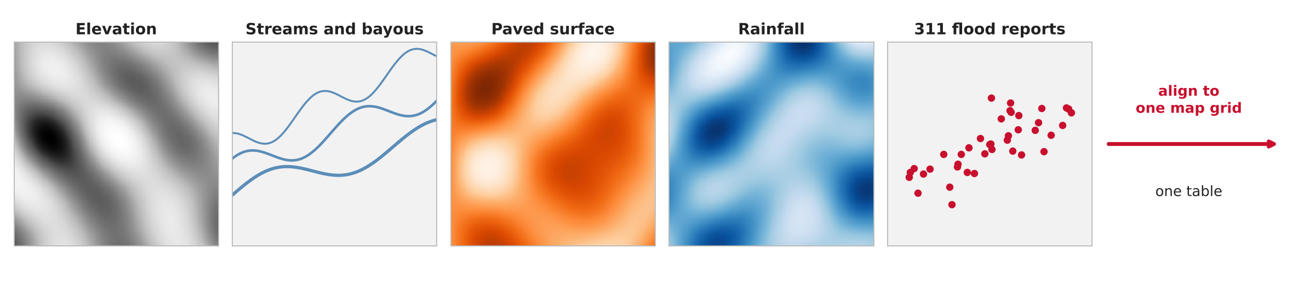
Challenges — and How We Address Them
3 Challenges
Elevation (LiDAR)
Streams & Bayous
Paved % (NLCD)
Rainfall (NOAA)
311 Flood Reports
data.tnris.org
apps.nationalmap.gov
mrlc.gov/viewer
ncei.noaa.gov/cdo-web
houstontx.gov/heatmaps
Challenge: Messy 311 text
Challenge: Sparse rainfall data
1
Fix: Filter flood categories, drop bad rows,
merge duplicates within 50m same day
4
Fix: Interpolate between gauges, attach
each storm date's rainfall amount
Challenge: Huge raster map files
Challenge: Choosing non-flood spots
2
Fix: Clip to Houston boundary, look up
one value per location point
5
Fix: Sample evenly across city, away from
reports, and test by area (no leakage)
Challenge: Mismatched coordinates
Spatio-Temporal:
3
Fix: Convert all 5 layers to one system
(UTM 15N, meters)
Same location, different storm, different rainfall → different risk.
We test on Imelda 2019 — a storm the model never saw.
COSC 6368 Artificial Intelligence • Fall 2026 • 4 / 6
Notes:
The layers diagram shows the 5 sources — all different formats, different coordinate systems. The data engineering challenge is merging them into one clean table. Walk through each of the 5 challenges: messy text, huge files, mismatched coordinates, sparse rainfall, choosing no-flood spots. Bottom right: the temporal part — same location, different storm, different risk.

Slide 5
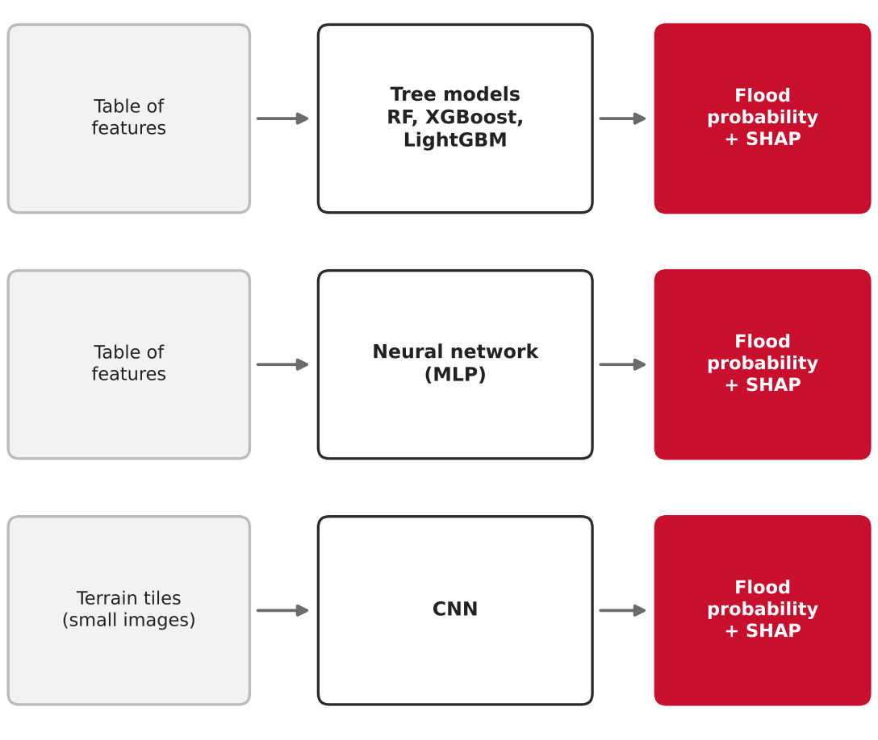
Preliminary Results — What We Have Built
4 Preliminary results
Our 5 models
Done so far
Our real dataset
✓
Topic approved by professor
85,738
✓
Related work reviewed
(benchmark: ~80% accuracy)
Training rows
(2015–2017)
✓
All 5 sources confirmed
downloadable
24,852
✓
Real 311 data downloaded
(2015, 2016, 2017, 2019)
✓
Training set built:
85,738 rows (2015–2017)
Test rows
(Imelda 2019)
✓
Test set built:
24,852 rows (Imelda 2019)
50 / 50
→
Fill 6 feature columns
(elevation, rain, paved…)
Flood YES vs
NO balance
→
Train 5 models + SHAP
All 5 models compared on same split.
SHAP explains every prediction.
7 / 13
Columns filled
so far
COSC 6368 Artificial Intelligence • Fall 2026 • 5 / 6
Notes:
Left: the 5 models — tree models, neural network, CNN. All give flood probability + SHAP reasons. Middle: checklist — 6 items already done, 2 still to do. Right: our real numbers — 85,738 training rows, 24,852 test rows, balanced 50/50, 7 of 13 columns filled so far.

Slide 6
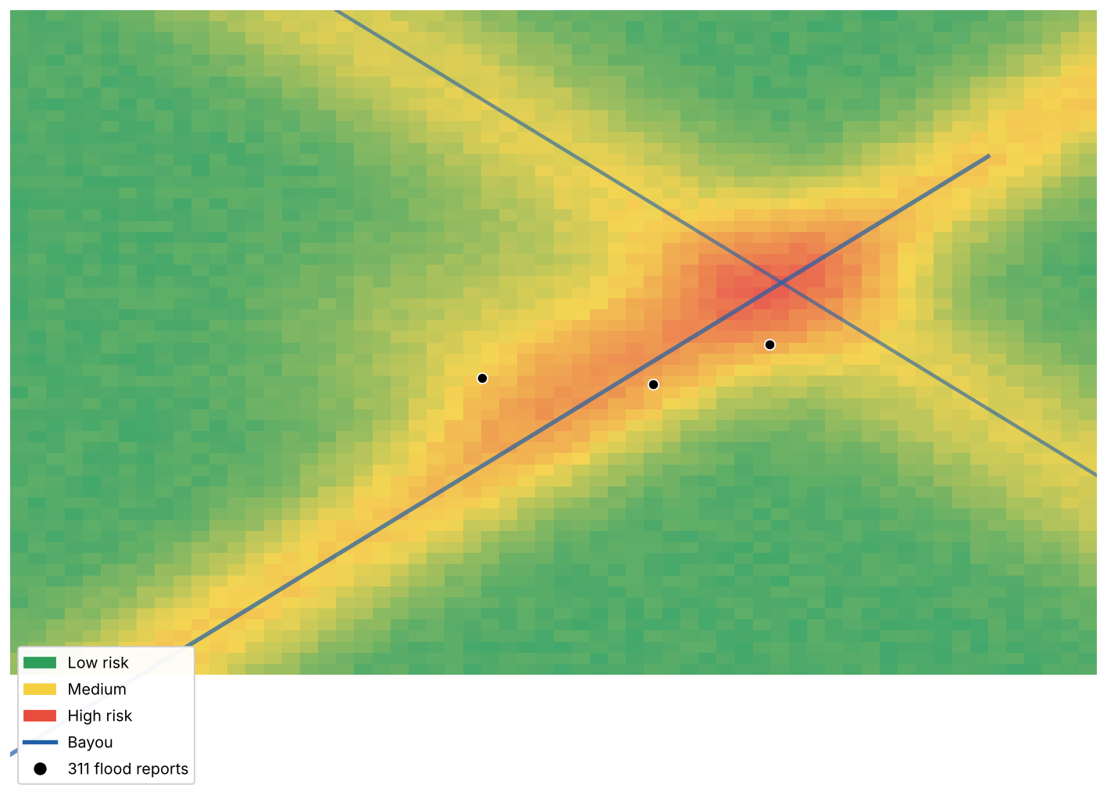
The End Goal — A Tool for Every Houston Resident
4 Preliminary results
What the tool does
Your address risk score
📍
Any Houston resident types their address → sees their flood risk %
Rainfall slider
🌧️
Drag from 1 inch to 20 inches — watch which areas turn red
SHAP explanation
🔍
Click any spot: "High risk because: low elevation, 0.2mi from bayou, 85% paved"
Mockup — not model output yet. Green = lower risk, Red = higher risk, Blue line = bayou, Dots = 311 flood reports.
Storm scenario
⚠️
"What if Harvey-level rain falls today?" — see the risk map instantly
Proposal due Oct 26 | Data engineering: Nov 1–10 | Models: Nov 10–20 | Tool: Nov 20–28 | Final presentation: Nov 30
COSC 6368 Artificial Intelligence • Fall 2026 • 6 / 6
Notes:
This is the end goal. Any Houston resident opens the app, types their address, and sees their flood risk score with an explanation. The rainfall slider lets them ask 'what if 6 inches fall today?' The SHAP panel tells them exactly why their spot is risky. Not an official flood warning — a research prototype that puts data-driven flood intelligence in every resident's hands. Timeline at the bottom shows our remaining milestones.

