Slide 1



CMTFlow: Hierarchical Portfolio Management with Controller-Guided Base
Revision and Daily Refinement
Wenxuan Tong
Joint work with Zihan Feng, Junjie Wu
July 4th, 2026

Slide 2
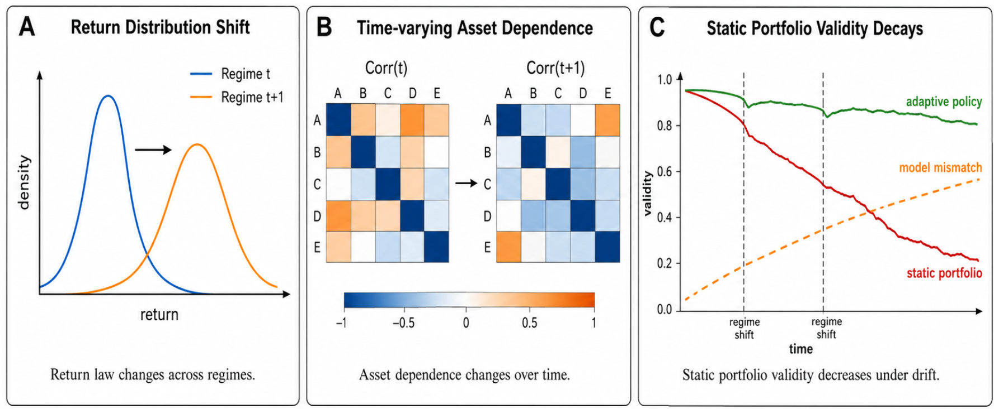
Background
Portfolio Management in Non-Stationary Markets
Portfolio Management (PM) aims to allocate capital across multiple assets under uncertainty, with the goal of maximizing long-horizon risk-adjusted returns. In quantitative trading, many studies try to discover exploitable patterns from historical prices, volumes, and asset relationships, and then construct profitable portfolios.
However, In real financial markets, return distributions, asset correlations, and market regimes evolve over time. A portfolio that works well in one period may gradually become ineffective in another period.
Core question: how can we balance return, risk, cost, and market adaptability?

Slide 3
Problem Definition
Dynamic Portfolio Problem with Drift and Transaction Cost
Given M tradable assets, the strategy determines the portfolio weight vector at each trading day t is $w_{t}={\left(w_{1,t},…,w_{M,t}\right)}^{⊤}, 1^{⊤}w_{t}=1, w_{t}≥0$
The close-to-close gross return vector from day t to day t+1 is $y_{t}={\left(c_{1,t+1}/c_{1,t},…,c_{M,t+1}/c_{M,t}\right)}^{⊤}$
portfolio passively drifts due to price movements is $\tilde{w_{t}}=\frac{y_{t−1}⊙w_{t−1}}{y_{t−1}^{⊤}w_{t−1}}$
Rebalancing from the drifted portfolio $\tilde{w_{t}}$ to the new portfolio $w_{t}$induces transaction cost is $μ_{t}=1−ρ|w_{t}−\tilde{w_{t}|_{1}}$
The portfolio value evolves as $V_{t+1}=V_{t}μ_{t}y_{t}^{⊤}w_{t} .$The objective is to maximize terminal wealth over the full horizon $\max_{\{w_{t}\}_{t=0}^{T−1}}{V_{T}}$

Slide 4



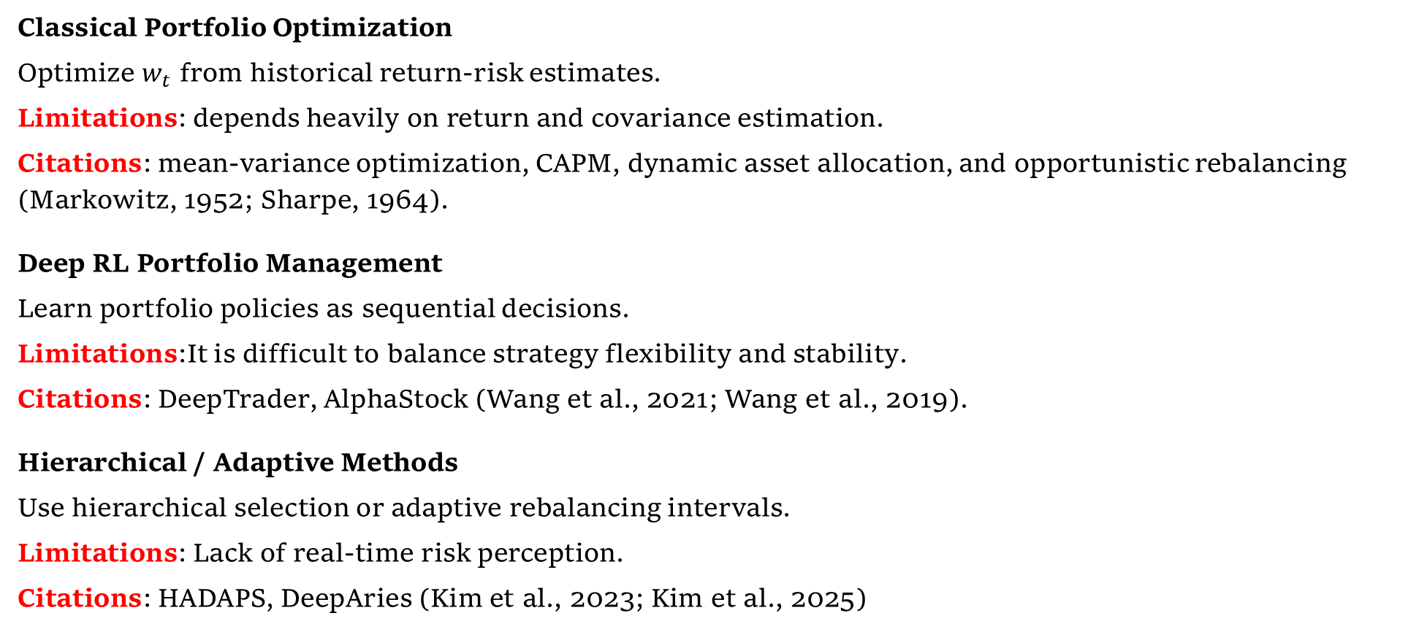
Related Work
Classical Portfolio Optimization
Optimize $w_{t}$ from historical return-risk estimates.
Limitations: depends heavily on return and covariance estimation.
Citations: mean-variance optimization, CAPM, dynamic asset allocation, and opportunistic rebalancing (Markowitz, 1952; Sharpe, 1964).
Deep RL Portfolio Management
Learn portfolio policies as sequential decisions.
Limitations:It is difficult to balance strategy flexibility and stability.
Citations: DeepTrader, AlphaStock (Wang et al., 2021; Wang et al., 2019).
Hierarchical / Adaptive Methods
Use hierarchical selection or adaptive rebalancing intervals.
Limitations: Lack of real-time risk perception.
Citations: HADAPS, DeepAries (Kim et al., 2023; Kim et al., 2025)
Notes:
`Classical methods usually estimate asset return, risk, or covariance, and then solve an optimization problem to obtain portfolio weights w_t.`Representative methods include mean-variance optimization, CAPM(Markowitz, 1952; Sharpe, 1964; Perold and Sharpe, 1988; Sullivan, 2008)
`Deep reinforcement learning methods formulate PM as a sequential decision problem and directly learn a policy from market states to portfolio weights w_t.`
`Hierarchical or adaptive methods improve policy flexibility through adaptive rebalancing intervals, hierarchical asset selection, or multi-module decision making.`

Slide 5
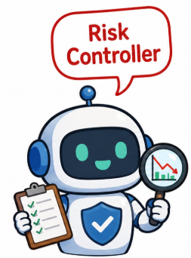
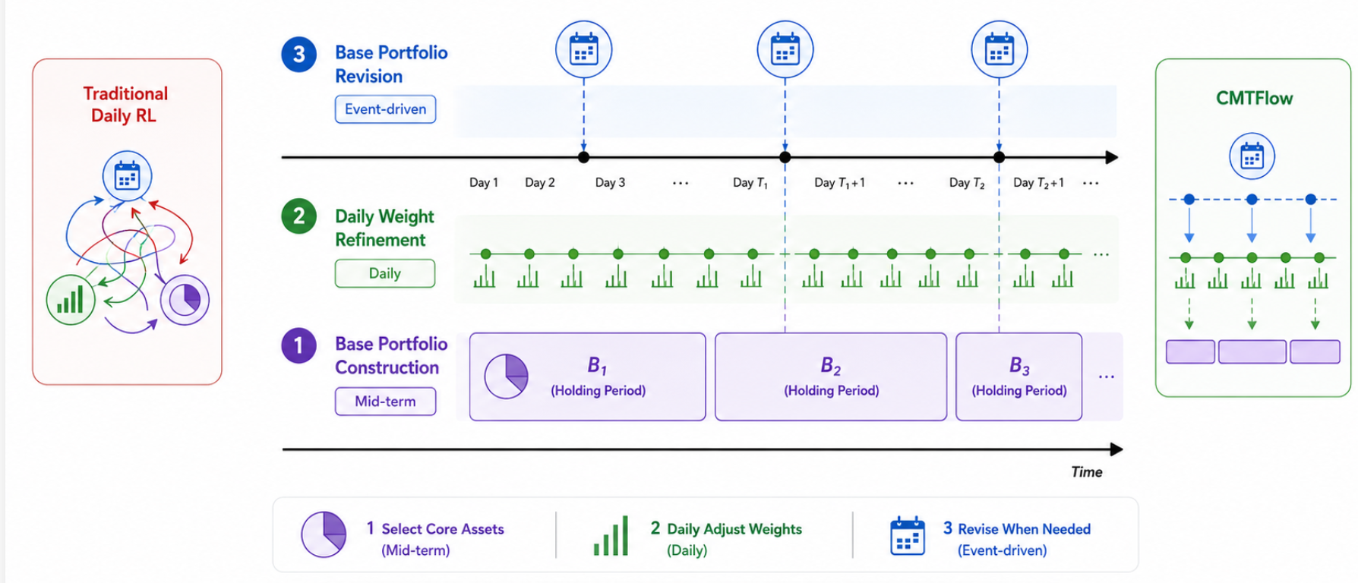
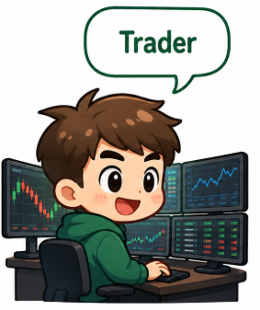

From our daily life
From Real Quantitative Investment Teams
When to Revise？
How to Refine？
What to Hold？
Notes:
`Motivation from Real Quantitative Investment Teams``In a real quantitative investment team, portfolio management is usually not handled by a single policy that re-decides all asset weights every day. Instead, multiple roles cooperate at different time scales.``Portfolio Manager``First determines which assets should be the core holdings over the next period and provides a medium-horizon base allocation framework.``Corresponding CMTFlow module: Outer Actor, which answers WHAT base to hold.``Trader``Adjusts actual execution weights around the base portfolio according to newly arriving prices, volumes, and short-term fluctuations.``Corresponding CMTFlow module: Inner Actor, which answers HOW to refine daily weights.``Risk Controller``Continuously monitors return, drawdown, risk exposure, and candidate replacement portfolios, and triggers revision when the current portfolio may become risky.``Corresponding CMTFlow module: Controller, which answers WHEN to revise.``Core intuition: portfolio management is naturally a multi-scale sequential decision problem, not a single daily weight-output problem.`

Slide 6
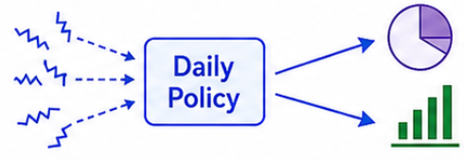
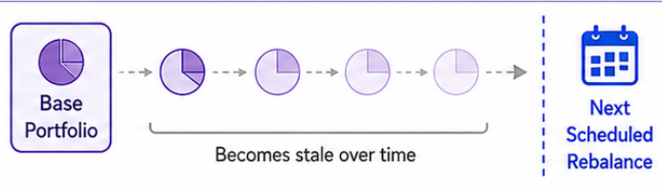
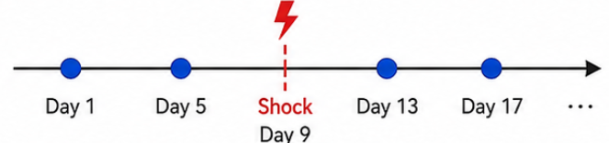
Challenges
The Gap between Existing Methods and Practical Multi-Role Decisions
Challenge 1: Daily policy is noisy
RL policies that execute full daily portfolio adjustments and simultaneously undertake portfolio manager and trader roles are vulnerable to noisy daily market signals, leading to overreactions to short-term swings and volatile turnover rates.
Challenge 2: Fixed holding is inflexible
Rebalancing strategies with predefined fixed holding periods fail to accommodate market regimes evolving at variable speeds, lacking flexibility to adapt to diverse market conditions.
Challenge 3: Lack of real-time risk awareness
Most strategies only formulate portfolio plans at the start of each holding cycle without real-time monitoring of ongoing portfolio risks and performance, making them unable to spot outdated positions and timely switch to alternative portfolios.
Explicitly learn whether and when to revise, what to hold, and how to refine?

Slide 7
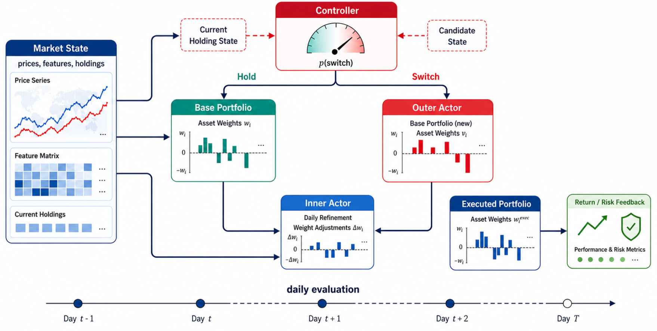
Overview of Our Solution CMTFlow 总体框架
To match the multi-role structure in real investment teams, CMTFlow builds three coordinated reinforcement learning modules.
Controller
Compares the drifted current holding with the outer actor's candidate base and Answer Whether and WHEN to revise.
Outer Actor
Generates a sparse segment-level candidate base portfolio from long-horizon market windows and Answer WHAT base to hold.
Inner Actor
Performs local daily weight refinement inside the asset support of the active base portfolio and Answer HOW to refine.
Notes:
`Overview of CMTFlow``To match the multi-role structure in real investment teams, CMTFlow builds three coordinated reinforcement learning modules.``Controller``Compares the drifted current holding with the candidate base generated by the Outer Actor, and learns whether the current base should be revised.``Question answered: WHEN to revise?``Outer Actor``Generates a sparse segment-level candidate base portfolio from long-horizon market windows.``Question answered: WHAT base to hold?``Inner Actor``Performs local daily weight refinement inside the asset support of the active base portfolio.``Question answered: HOW to refine?``Overall flow: the Controller decides whether to keep or switch the base, the Outer Actor provides candidate bases, and the Inner Actor converts the active base into the final executed portfolio.`

Slide 8
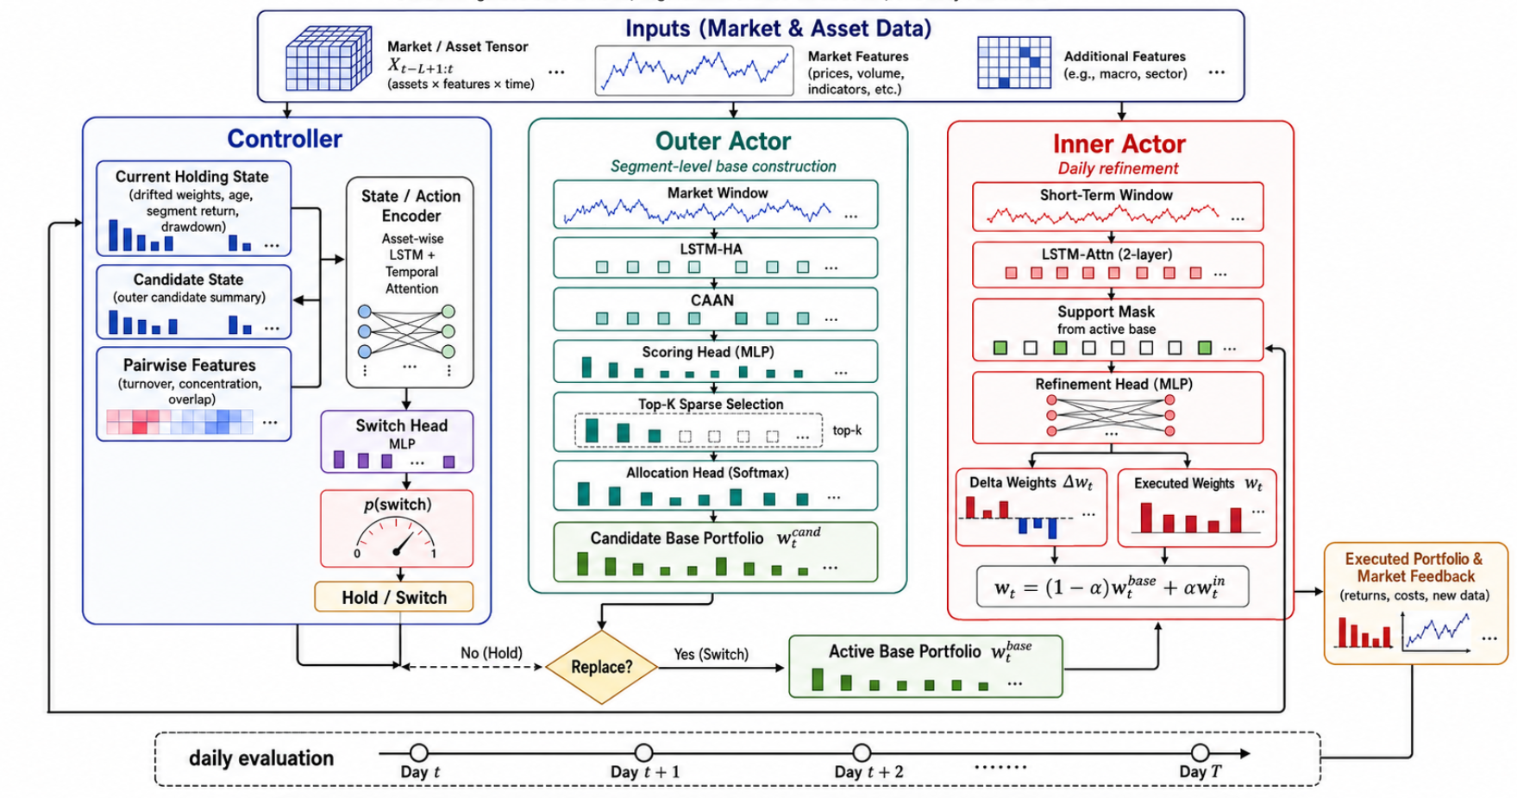
Methodology
The architecture of proposed framework: CTMFlow
Notes:
`The previous slide has already introduced the overall decision flow of CMTFlow: generate a candidate base, let the Controller decide whether to replace the active base, and use the Inner Actor for daily refinement.``Therefore, this slide focuses on the concrete network architecture instead of repeating the daily decision flow.`
`Outer Actor: Medium-horizon base generator``It takes the long-horizon market window X_t^{out} and the drifted portfolio \tilde{w}_t as inputs, and uses a temporal encoder, cross-asset attention, and an MLP head to produce the candidate base portfolio w_t^{out}.``Function: learn what to hold over the next period and provide a stable medium-horizon asset selection and base allocation.``Controller: Risk-aware base revision module``It takes the current active base, the candidate base, the drifted holding state, and risk-related features as inputs, and outputs an exit probability p_t^{exit}.``Function: learn when to revise, converting a fixed holding horizon into a learnable switching decision driven by market states and portfolio risk.``Inner Actor: Daily local refinement module``It takes the short-horizon market window X_t^{in} and the active base support as inputs, and outputs locally refined daily weights w_t^{in} around the base portfolio.``Function: learn how to refine, absorbing daily information without completely overriding the medium-horizon base.``Next, we introduce how each module is formulated as a Markov decision process, including its state, action, reward, and training objective.`

Slide 9
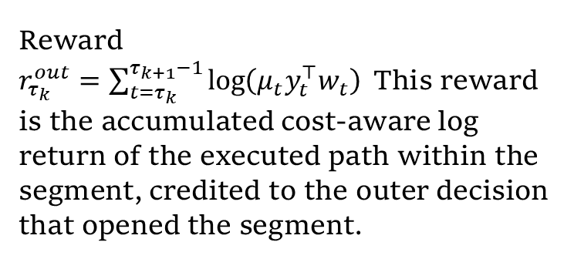
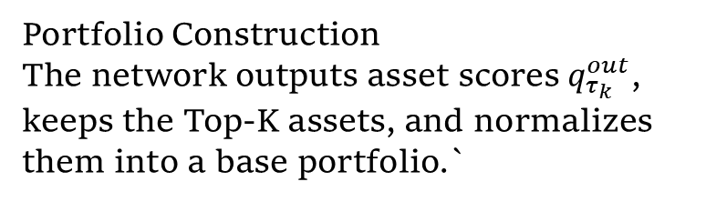
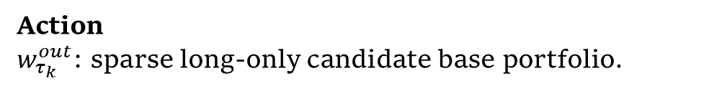
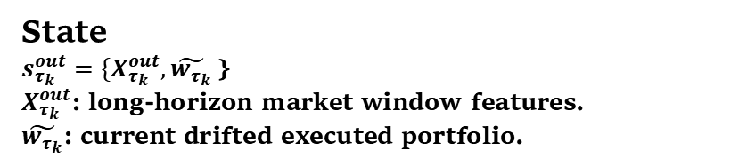
Methodology
Outer Actor: Medium-Horizon Base Portfolio Construction
State
$s_{τ_{k}}^{out}=\{X_{τ_{k}}^{out},\tilde{w_{τ_{k}}}$}
$X_{τ_{k}}^{out}$: long-horizon market window features.
$\tilde{w_{τ_{k}}}$: current drifted executed portfolio.
Portfolio Construction
The network outputs asset scores $q_{τ_{k}}^{out}$, keeps the Top-K assets, and normalizes them into a base portfolio.`
Action
$w_{τ_{k}}^{out}$: sparse long-only candidate base portfolio.
Reward
$r_{τ_{k}}^{out}=\sum_{t=τ_{k}}^{τ_{k+1}−1}{\log\left(μ_{t}y_{t}^{⊤}w_{t}\right)}$This reward is the accumulated cost-aware log return of the executed path within the segment, credited to the outer decision that opened the segment.
Network
LSTM-HA: long-horizon asset-wise temporal modeling
CAAN: cross-asset dependency modeling
MLP head: asset-wise score generation
Notes:
`Role: the Outer Actor operates at the holding-segment level, rather than at the final daily trading level. It answers: WHAT to hold next?`
`X_{\tau_k}^{out}: long-horizon market window for capturing medium-term trends and cross-asset relationships.``\tilde{w}_{\tau_k}: current drifted executed portfolio, providing portfolio context.`
the Outer Actor provides a stable medium-horizon strategic anchor, preventing the strategy from being fully driven by daily noise.`

Slide 10
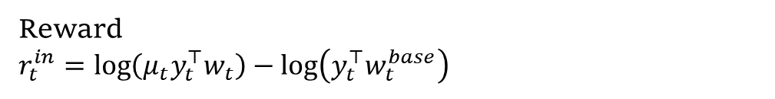
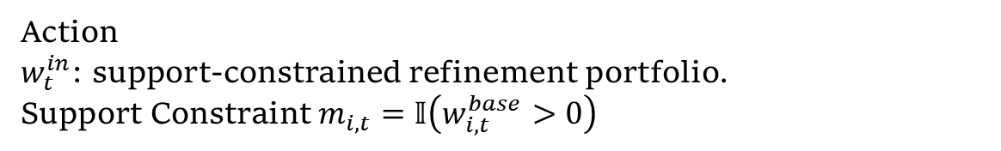
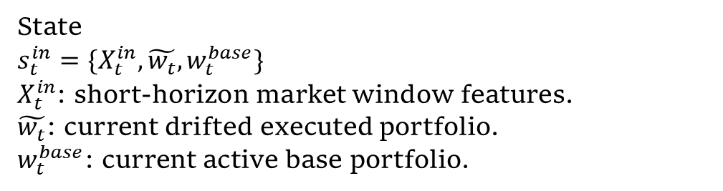
Methodology
Inner Actor: Support-Constrained Daily Refinement
State
$s_{t}^{in}=\{X_{t}^{in},\tilde{w_{t}},w_{t}^{base}\}$
$X_{t}^{in}$: short-horizon market window features.
$\tilde{w_{t}}$: current drifted executed portfolio.
$w_{t}^{base}$: current active base portfolio.
Action
$w_{t}^{in}$: support-constrained refinement portfolio.
Support Constraint $m_{i,t}=𝕀\left(w_{i,t}^{base}>0\right)$
Executed Portfolio $w_{t}=\left(1−α\right)w_{t}^{base}+αw_{t}^{in}$
Reward
$r_{t}^{in}=\log\left(μ_{t}y_{t}^{⊤}w_{t}\right)−\log\left(y_{t}^{⊤}w_{t}^{base}\right)$
Notes:
`Role: the Inner Actor does not re-select the asset universe, but adjusts weights inside the active base portfolio. It answers: HOW to refine daily weights?`
`The Inner Actor can only redistribute weights among assets selected by the active base, and cannot introduce arbitrary new assets.`
This reward measures the incremental value of daily refinement relative to the active base.
the Inner Actor provides daily flexibility while staying anchored to the medium-horizon base portfolio.`

Slide 11
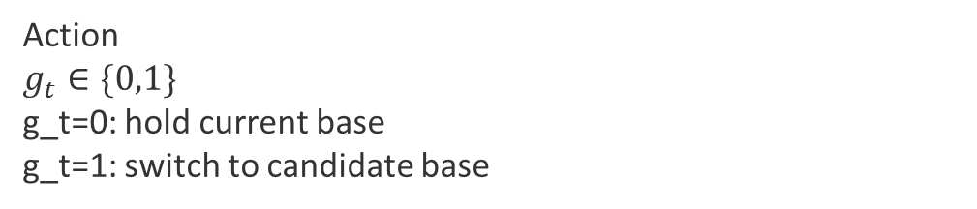
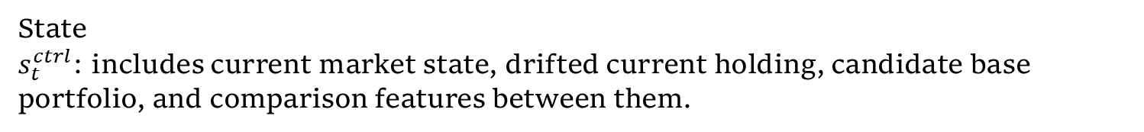
Methodology
Controller: Event-Driven Base Portfolio Revision
State
$s_{t}^{ctrl}$: includes current market state, drifted current holding, candidate base portfolio, and comparison features between them.
Action
$g_{t}∈\{0,1\}$
g_t=0: hold current base
g_t=1: switch to candidate base
Daily update
The Controller is checked every trading day. If the exit probability crosses the threshold, it switches to the candidate base; otherwise it keeps the current base.
Training objective
The Controller compares the investment consequence of the controlled path and the fixed-segment reference path:$r^{ctrl}=λ_{R}\left(\log{V_{T}^{C}}−\log{V_{T}^{B}}\right)−λ_{N}Ω\left(N_{C}\right)`$
Notes:
`Role: the Controller does not allocate capital directly. It decides whether the current active base should continue to be held. It answers: WHEN to revise?`
`Daily update``The Controller is checked every trading day. If the exit probability crosses the threshold, it switches to the candidate base; otherwise it keeps the current base.``If the 30-day maximum-hold cap is reached, revision is forced.`

Slide 12
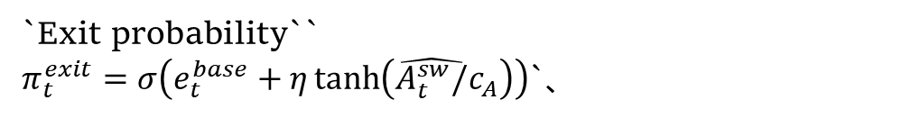
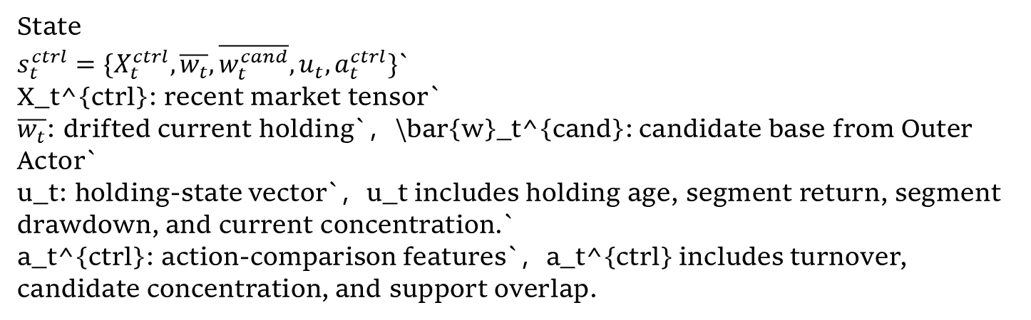
Methodology
Controller State and Exit Probability
State
$s_{t}^{ctrl}=\{X_{t}^{ctrl},\overline{w_{t}},\overline{w_{t}^{cand}},u_{t},a_{t}^{ctrl}\}$`
X_t^{ctrl}: recent market tensor`
$\overline{w_{t}}$: drifted current holding`，\bar{w}_t^{cand}: candidate base from Outer Actor`
u_t: holding-state vector`，u_t includes holding age, segment return, segment drawdown, and current concentration.`
a_t^{ctrl}: action-comparison features`，a_t^{ctrl} includes turnover, candidate concentration, and support overlap.
Auxiliary estimates
holding return, holding risk, switch advantage
`Exit probability``
$π_{t}^{exit}=σ\left(e_{t}^{base}+η\tanh\left(\hat{A_{t}^{sw}/}c_{A}\right)\right)$`、
Notes:
The core design of the controller state is to answer whether the current holding has deteriorated and whether the candidate base is worth switching to.
the exit probability is a nonlinear policy signal, not a one-dimensional future-return predictor.

Slide 13
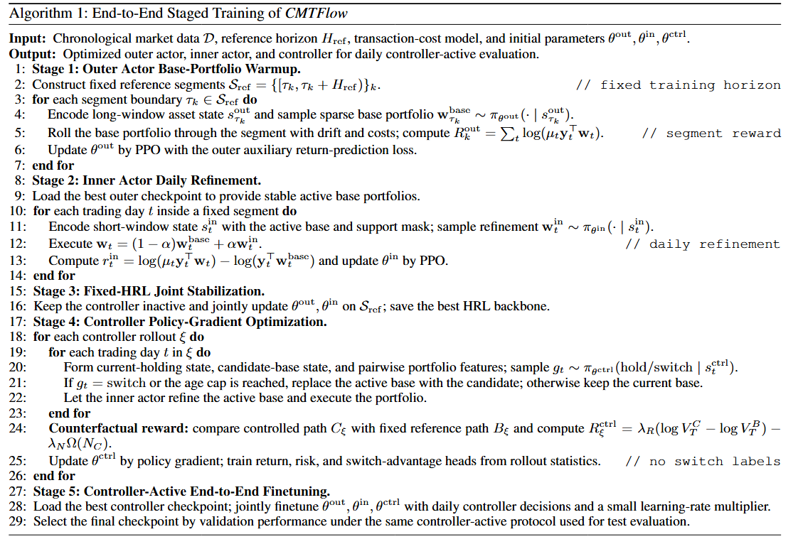
Pseudocode
`Train the Outer Actor alone under fixed 30-day segments to learn a stable segment-level base allocator.`
Notes:
`Why stage-wise training?``The three modules operate at different time scales and receive different reward signals. Training all modules jointly from scratch would be unstable.``Training idea: first obtain a stable fixed-segment HRL backbone, then train the Controller, and finally jointly finetune under the same daily protocol used at test time.`

Slide 14
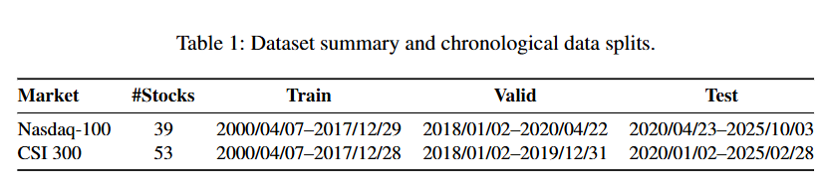
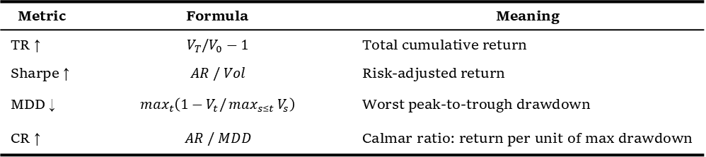
Experimental Setup
Dataset
Evaluated Metrics
Metric | Formula | Meaning
TR ↑ | $$V_{T}/V_{0}−1$$ | Total cumulative return
Sharpe ↑ | $$AR / Vol$$ | Risk-adjusted return
MDD ↓ | $$\max_{t}\left(1−V_{t}/\max_{s≤t}{V_{s}}\right)$$ | Worst peak-to-trough drawdown
CR ↑ | $$AR / MDD$$ | Calmar ratio: return per unit of max drawdown
Notes:
Next, I will introduce the experimental setup of our work.
We conduct experiments on two mainstream financial datasets: the Nasdaq-100 and the CSI 300. For the Nasdaq-100 dataset, we select 39 constituent stocks.
For the CSI 300 dataset, we adopt 53 stocks.

Slide 15
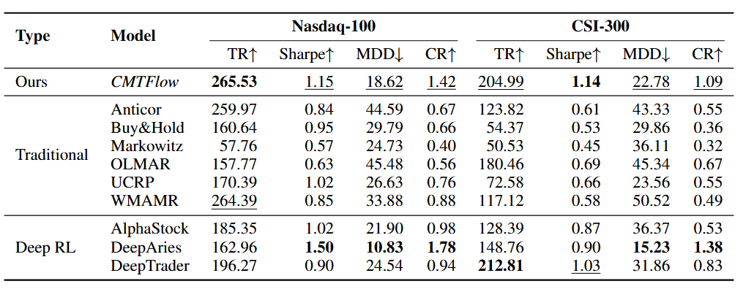
Performance Comparison
Baseline Comparison
Notes:
`This slide highlights that CMTFlow is not the best on every single metric, but it achieves a strong overall balance between return and risk.``Baselines``Traditional / Online: Buy&Hold, Markowitz, UCRP, Anticor, OLMAR, WMAMR``Deep RL: AlphaStock, DeepAries, DeepTrader``Nasdaq-100``CMTFlow obtains the highest matched total return: TR = 265.53%.``Meanwhile, its MDD is 18.62%, much lower than high-return traditional baselines such as WMAMR and Anticor.``DeepAries has better Sharpe, MDD, and CR, but its TR is only 162.96%, substantially lower than CMTFlow.``CSI 300``CMTFlow obtains TR = 204.99%, slightly below DeepTrader's 212.81%.``However, CMTFlow improves Sharpe from 1.03 to 1.14 and reduces MDD from 31.86% to 22.78%.``Its CR is 1.09, second only to DeepAries.``Conclusion: CMTFlow does not simply maximize terminal wealth; it improves return-path quality and the risk-return trade-off.`

Slide 16
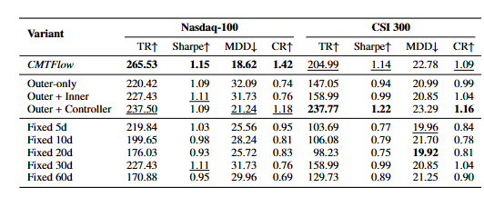
Performance Comparison
Abalation Study
Notes:
This slide shows that the Controller is the main source of adaptation, while the Inner Actor mainly provides local weight refinement and risk control.``Nasdaq-100``Outer-only: TR = 220.42%, MDD = 32.09%, CR = 0.74``Outer + Controller: TR = 237.50%, MDD = 21.24%, CR = 1.18``Full CMTFlow: TR = 265.53%, MDD = 18.62%, CR = 1.42``Interpretation: adding the Controller improves total return, clearly reduces maximum drawdown, and increases CR.``CSI 300``Outer + Controller: TR = 237.77%, Sharpe = 1.22, CR = 1.16``Full CMTFlow: TR = 204.99%, Sharpe = 1.14, MDD = 22.78%, CR = 1.09``Interpretation: in the noisy A-share market, the Inner Actor's return contribution is less stable, but the full model has lower MDD, indicating local risk-control value.``Conclusion: the performance gain mainly comes from learning when to revise the base portfolio.`

Slide 17
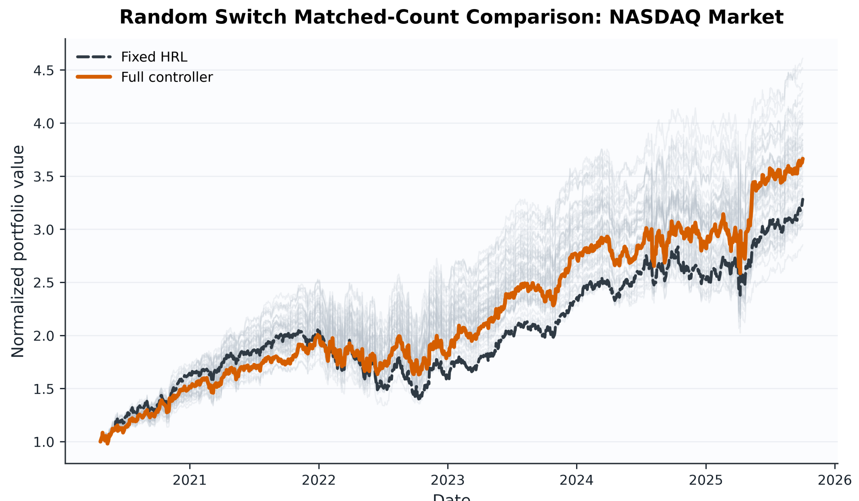
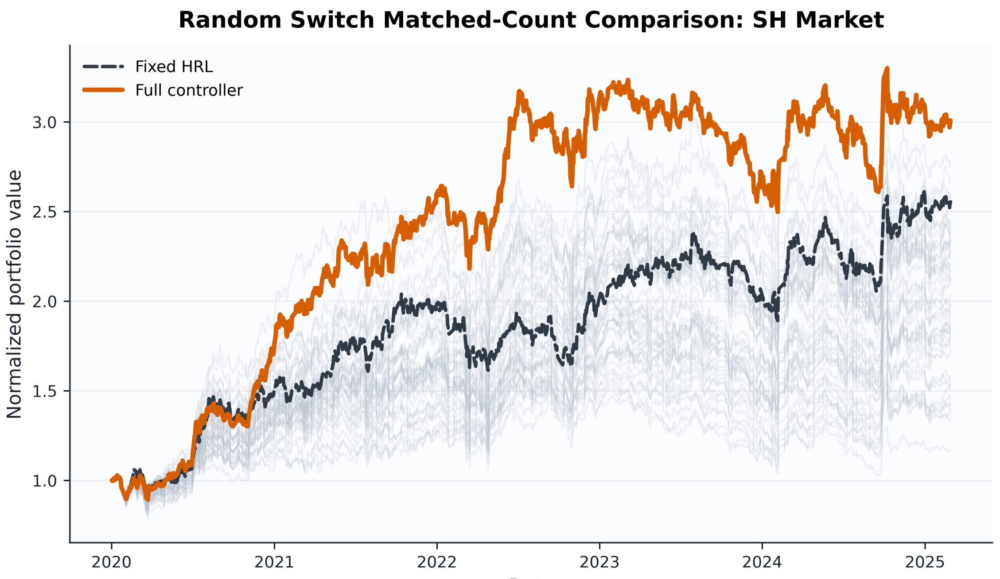
Ablation Analysis
组件间对比，说明controller效果很好，说明inner在高噪声的a股表现较差

Slide 18
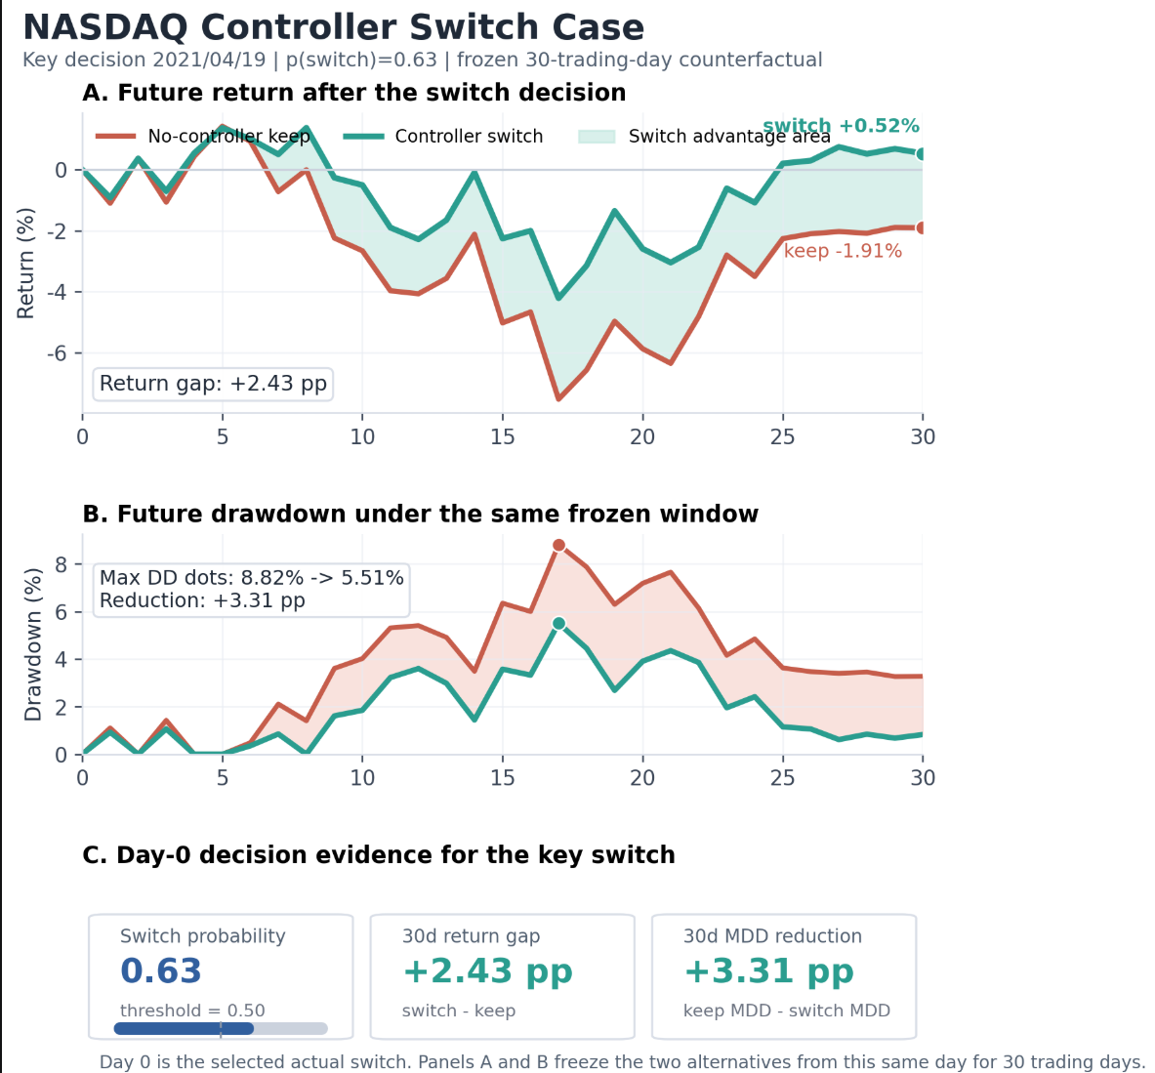
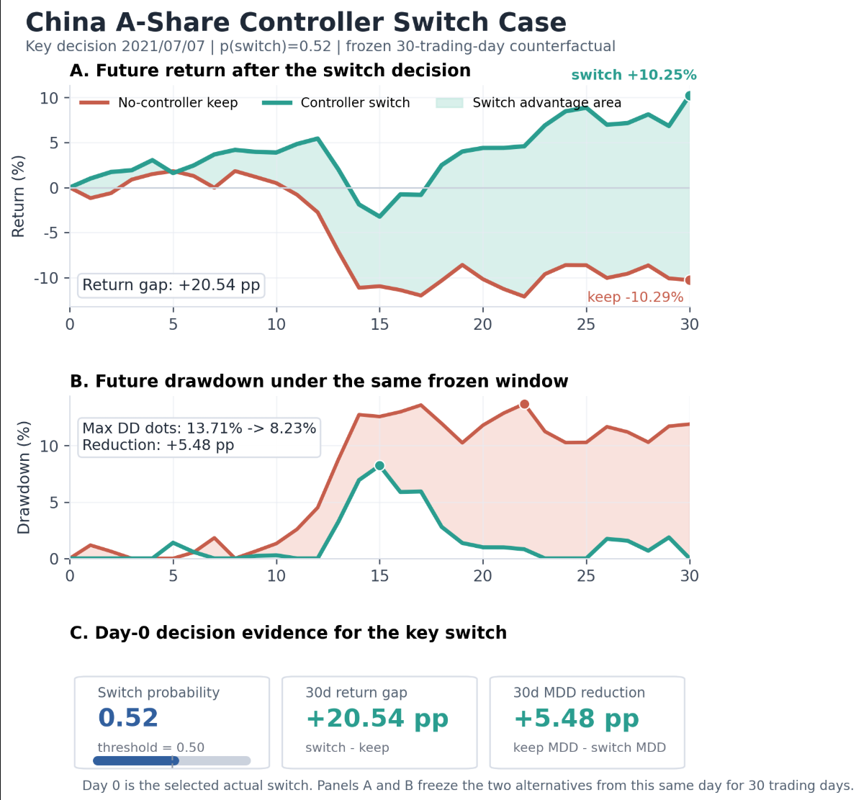
Case Study
Notes:
我们给出了代表性切换案例。核心思想是比较两条路径：如果继续持有旧基础组合会怎样，如果切换到新基础组合会怎样。在 Nasdaq 案例中，控制器在 2021 年 4 月 19 日触发关键切换，使 20 天反事实收益从负 % 改善到负 2.63%，并把未来最大回撤从 8.82% 降到 5.51%。在 CSI 300 案例中，2021 年 7 月 7 日的切换把 20 天反事实收益从负 10.29% 提升到正 10.25%，并降低了未来回撤。这说明控制器确实可以在旧基础组合进一步恶化之前提前退出。

Slide 19
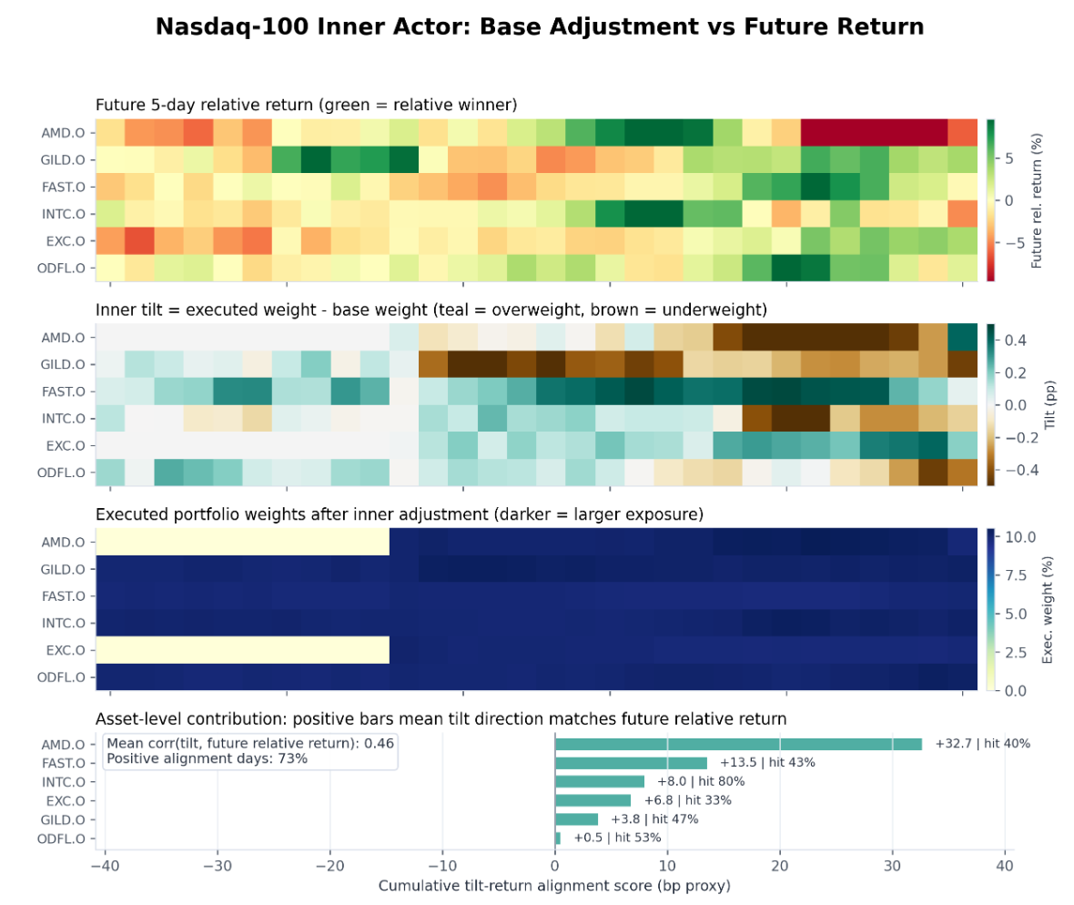
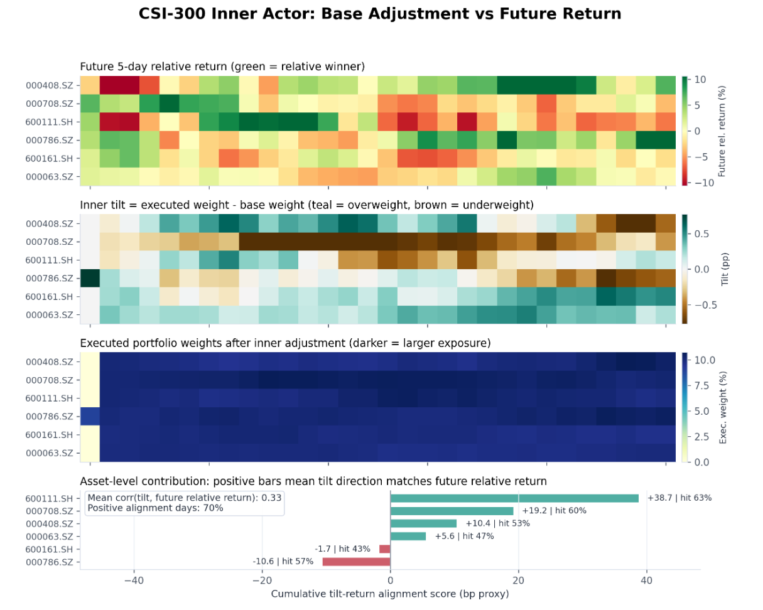
Case Study
平均相关性为 0.33，正向对齐天数为 70%。
inner actor 的调仓方向和未来相对收益有较强共振，平均相关性为 0.46，正向对齐天数为 73%。

Slide 20
Discussion & Conclusion
Main Contributions
Framework innovation
Proposes CMTFlow, a hierarchical portfolio management framework that explicitly decouples three entangled decisions in portfolio RL: when to revise the active base portfolio, what base portfolio to hold, and how to refine daily weights within the active asset support.
Trainable revision controller
Designs a learnable hold/switch controller that enables state-dependent adaptive base-portfolio revision, replacing rigid fixed-frequency rebalancing schedules.
Empirical verification
Achieves a superior risk-return trade-off over matched baselines on Nasdaq-100 and CSI 300. Ablation and interpretability studies confirm the controller as the dominant source of performance gains, and validate the complementary role of the inner actor in local within-segment weight refinement.
Limitations
Limited evaluation scope
Current experiments are restricted to two equity markets, under long-only and proportional transaction cost assumptions.
Room for extension
The framework has not been tested on broader asset classes, realistic market-impact models, or controller designs with explicit risk preferences tailored to different investment mandates.

Slide 21
Thank you for listening !
Any Questions?
(Apologies for the brevity due to time limitation.)
Notes:
Due to ​​time constraints​​, I may not have covered all aspects as thoroughly as I would have liked.
I appreciate your understanding and welcome any ​​further questions or discussion​​ after the session.

