Slide 1



TransG: A Graph-Based Multi-Agent Reinforcement Learning Framework for Proactive Lateral Transshipment in Multi-Location Inventory Systems
Zihan Feng
Joint work with Guannan Liu, Junjie Wu
July 4th, 2025

Slide 2
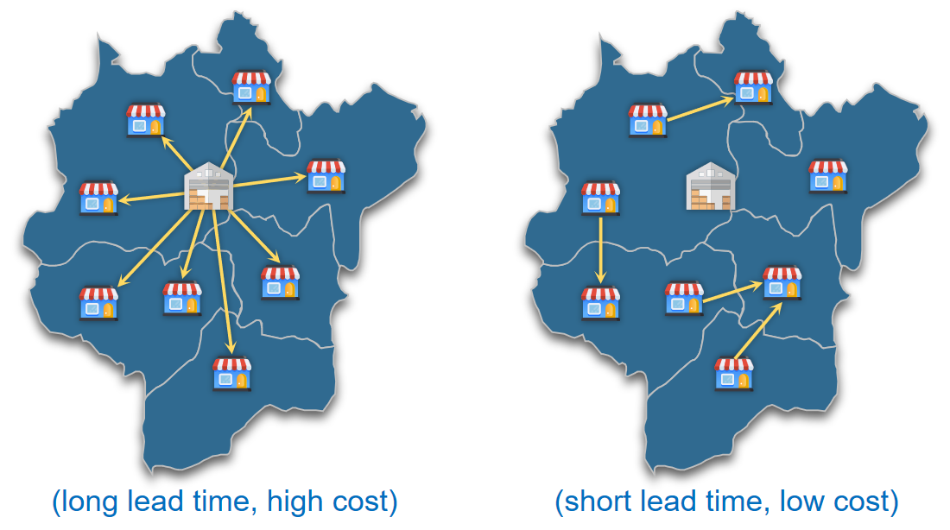
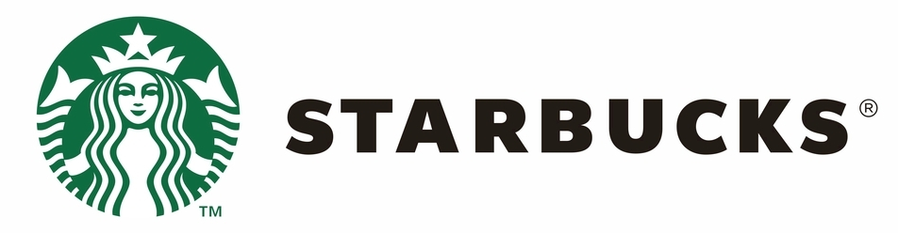
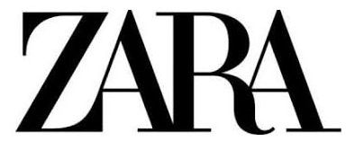


Background
Replenishment: A retailer decides how much of a product to order from upstream suppliers to adjust the inventory levels, thereby meeting customer demand.
Multi-location inventory systems: the retail of many branded products relies on a network of retailers, not sold by just one retailer but a group of retailers works together to meet demand in a certain region, such as: Starbucks, Zara, Lenovo, Alibaba Health.
Transshipment: In multi-location inventory systems, another pratice is the horizontal inventory reallocation among peer retailers within the same echelon. Often with shorter lead time and lower cost, which can help to rebalance inventory, thus compensating for the imbalance caused by long replenishing lead time and further improve service quality.
(a) Replenishment
(b) Transshipment

Slide 3

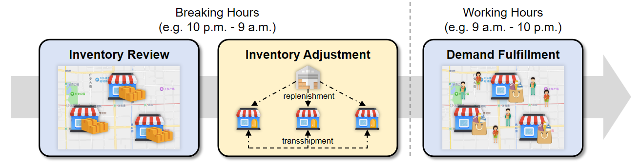
Background
Categories into two types based on the timing: Reactive transshipment and Proactive transshipment.
Reactive Transshipment | occur after the demand fulfillment, is only triggered when facing stockouts | stockouts may still occur, result in delayed responses and suboptimal performances
Proactive Transshipment | happen in ahead of demand fulfillment, used as a preventive measure to avoid future stockouts | forward-looking, balance resources better and reduce the risk of stockouts, leading to improved operational efficiency
The workflow of inventory management with proactive transshipment: three stages repeat day by day, consisting a typical sequential decision-making process.
Notes:
reduce the risk of stockouts, leading to improved operational efficiency

Slide 4
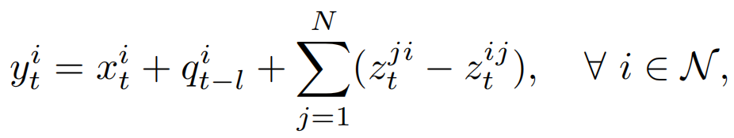



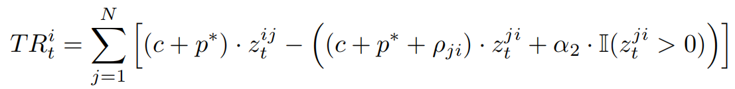
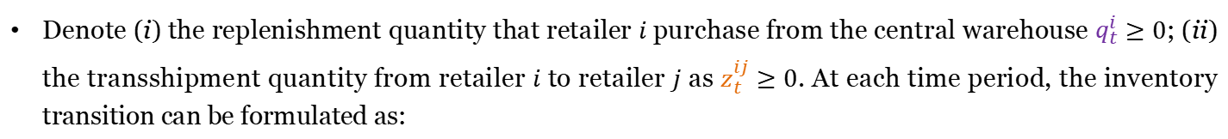


Problem Definition
Consider a two-echelon multi-location inventory system with a central warehouse and a set of $N$ retailers $𝒩=\{1, 2, ⋯ , N\}$. All retailers coorperate towards the maximization of the total profit.
Denote (i) the replenishment quantity that retailer $i$ purchase from the central warehouse $q_{t}^{i}≥0$; (ii) the transshipment quantity from retailer $i$ to retailer $j$ as $z_{t}^{ij}≥0$. At each time period, the inventory transition can be formulated as:
$$q_{t−l}^{i}$$
Inventory Adjustment:
replenishment
Demand Fulfillment:
transshipment
$$z_{t}^{ij}$$
The revenue ${RV}_{t}^{i}$ of retailer $i$ at period $t$ is given as follows:
selling income
ordering cost
holding cost
stock-out cost
trans-out income
(from sending)
trans-in cost (from receiving)

Slide 5
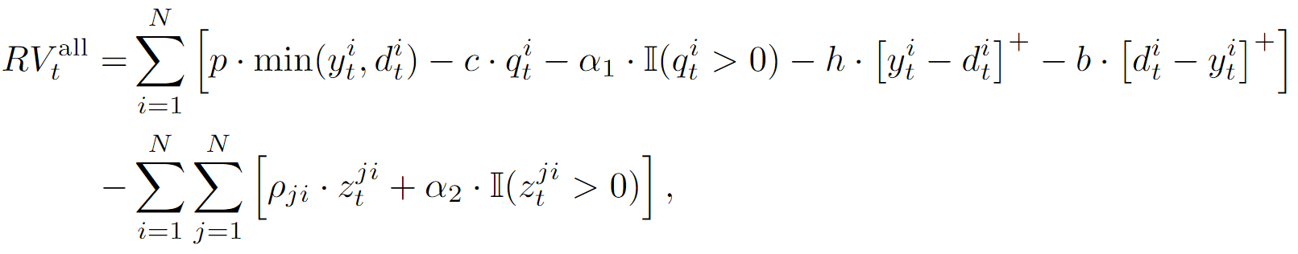
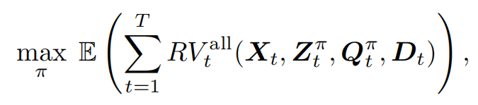
Problem Definition
The revenue ${RV}_{t}^{i}$ of retailer $i$ at period $t$ is given as follows:
selling income
ordering cost
holding cost
stock-out cost
trans-out income
trans-in cost
From the perspective of the overall system, the total revenue ${RV}_{t}^{all}=\sum_{i=1}^{N}{{RV}_{t}^{i}}$ can be calculated as:
The objective of inventory management is to find a inventory adjustment policy $π$ that maximizes the long-term revenue of the overall multi-location inventory system within a period of time:

Slide 6
Related Work
replenishment
Mathematical Optimization
transshipment
Build programming model with specific parameter values derived from problem setting and historical data, and define the overall profit as objective function, solve to get optimal solution (Minner et al. 2003, Vicente et al. 2015).
Limitations: (i) Focus mainly on single-period, hard to deal with multi-period setting due to computational complexity; (ii) Struggle to accommodate real-world dynamics; (iii) Lack foresight into future demands.
Markov Decision Processes (MDPs)
Model as a MDP and solve with dynamic programming to get long-term optimal policies, accounting for evolving demand patterns (Seidscher and Minner 2013, Feng et al. 2017).
Limitations: the multi-period inventory management problem with transshipment is NP-hard (Herer and Tzur 2003), constraining scope to small scale. Some other resort to the approximate dynamic programming (ADP), but still with limitations (Meissner and Senicheva 2018).
Reinforcement Learning (RL)
RL strives to maximize the discounted future benefits. DRL have unique dynamic enviromental adaptability. MARL helps multi-agent systems to foster effective cooperation.
A few studies have tried RL-related methods and still have limitations:
Small scale with 2 or 3 locations (Sampath et al. 2022, Kim et al. 2024), but without scalability.
Decentralized transshipment with MARL (Xu et al. 2023), but limited in decentralized information utilization.
Notes:
传统的优化方法：
给定已知参数（初始库存、需求数值或分布、成本），定义目标函数（成本最小化或者利润最大化），决策变量定义为转运量和补货量。
主要处理静态的问题，也可以扩展到动态，参数翻T倍，规模过大则无法求解；但是不具有动态性。
MDP的方法：
建模为MDP，使用动态规划求解，但是在处理大规模问题时会出现维度诅咒。
RL方法：
动态性、长期考量、考虑合作。

Slide 7

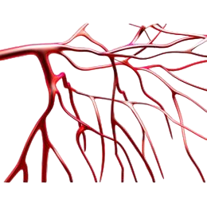

Challenges
When applying RL directly, several nontrivial limitations and challenges still persist.
rep=20
Transshipment involves at least two retailers, should not be made in a fully-decentralized manner:
do transshipment from the global perspective.
prevent conflicts to achieve coordinated decision.
A
C
?
4
3
2
3
Replenishment and Transshipment have different roles:
Replenishment acts as the main mechanism for augmenting inventory, decided with absolute stock.
Transshipment serves as a complementary inventory adjustment mechanism, depending on relative stock.
When modeling, should explicitly account for their differences while recognizing inter-dependencies.
Confliction !!!
1
B
D
rep=12
How should these transshipments
be executed under such circumstances?
Notes:
1. 约束冲突问题：
由于神经网络的黑箱问题，可能出现冲突。
使用MARL的方式进行训练？仅仅从价值上提供一种对齐机制，对于这种动作空间纠缠的情况是无法处理的。
引出问题：应该怎样设置专门的协调机制？
2. 本质上是两种决策：
replenishment和transshipment的角色不同，分别是XXX。两者的动作空间、决策使用的状态空间依赖是不同的。
但是两者间又不是完全没有联系，因此需要合理的建模他们的不同点与彼此之间的联系。
引出问题：应该以怎样的视角来建模这个问题？
the aorta in the human body, which maintains normal functioning.
the capillaries that facilitate human micro-circulation

Slide 8












Overview of Our Solution
We utilize a unified graph structure to capture the intrinsic interdependence between replenishment and transshipment.
node feature
Replenishment:
$$z_{t}^{ij}≥0$$
$${on}_{t}^{i}$$
A
C
A
C
$$q_{t}^{i} =$$
$$π_{rep}\left( \right)$$
edge feature
Transshipment:
$${oe}_{t}^{ij}$$
$$z_{t}^{ij} =$$
$$π_{trans}\left( \right)$$
$$G_{t}$$
B
D
global coordination
B
D
$$z_{t}^{ij}=0$$
$${on}_{t}$$
$$G_{t} =$$
$$Λ_{φ}\left( \right)$$
Original Multi-Location
Inventory System
Model as Directed Graph
node: the retailer
edge: any possible transshipment
transshipment
network
Graph
Generator
features of all nodes
add constraints during training
to control network structure

Slide 9
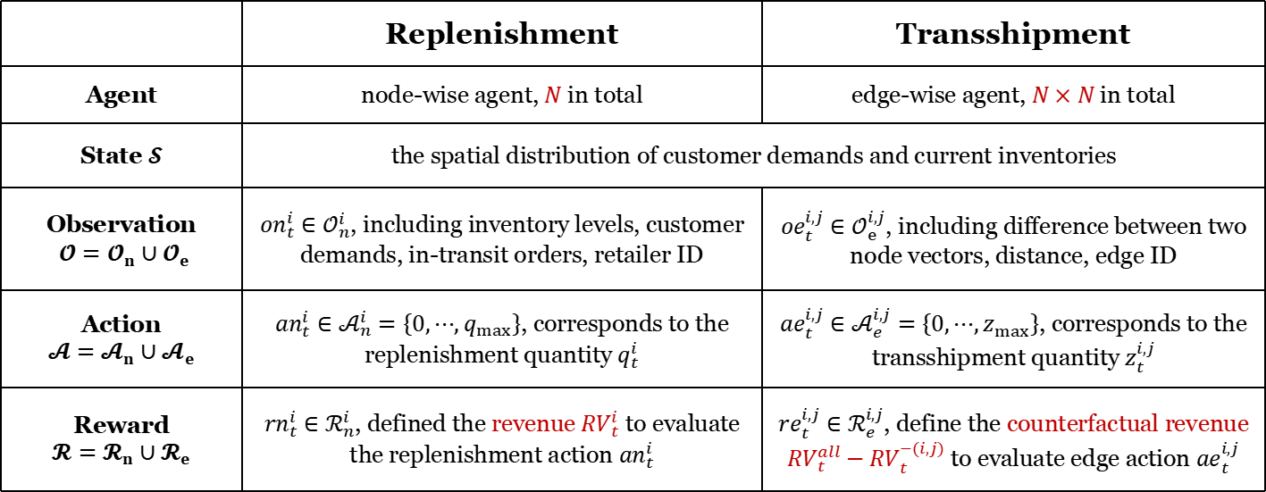

MARL Formulation
Solve with MARL and formulate the corresponding problem as a Partially-Observable Markov Decision Process (POMDP), consisting of the following components:
 | Replenishment | Transshipment
Agent | node-wise agent, $N$ in total | edge-wise agent, $N×N$ in total
State $𝓢$ | the spatial distribution of customer demands and current inventories
Observation $𝓞=𝓞_{n}∪𝓞_{e}$ | ${on}_{t}^{i}∈𝒪_{n}^{i}$, including inventory levels, customer demands, in-transit orders, retailer ID | ${oe}_{t}^{i,j}∈𝒪_{e}^{i,j}$, including difference between two node vectors, distance, edge ID
Action $$𝓐=𝓐_{n}∪𝓐_{e}$$ | ${an}_{t}^{i}∈𝒜_{n}^{i}=\left\{0,⋯,q_{max}\right\}$, corresponds to the replenishment quantity $q_{t}^{i}$ | ${ae}_{t}^{i,j}∈𝒜_{e}^{i,j}=\left\{0,⋯,z_{max}\right\}$, corresponds to the transshipment quantity $z_{t}^{i,j}$
Reward $$𝓡=𝓡_{n}∪𝓡_{e}$$ | ${rn}_{t}^{i}∈ℛ_{n}^{i}$, defined the revenue ${RV}_{t}^{i}$ to evaluate the replenishment action ${an}_{t}^{i}$ | ${re}_{t}^{i,j}∈ℛ_{e}^{i,j}$, define the counterfactual revenue ${RV}_{t}^{all}−{RV}_{t}^{−(i,j)}$ to evaluate edge action ${ae}_{t}^{i,j}$
how much revenue would be lost without transshipment $z_{t}^{i,j}$

Slide 10
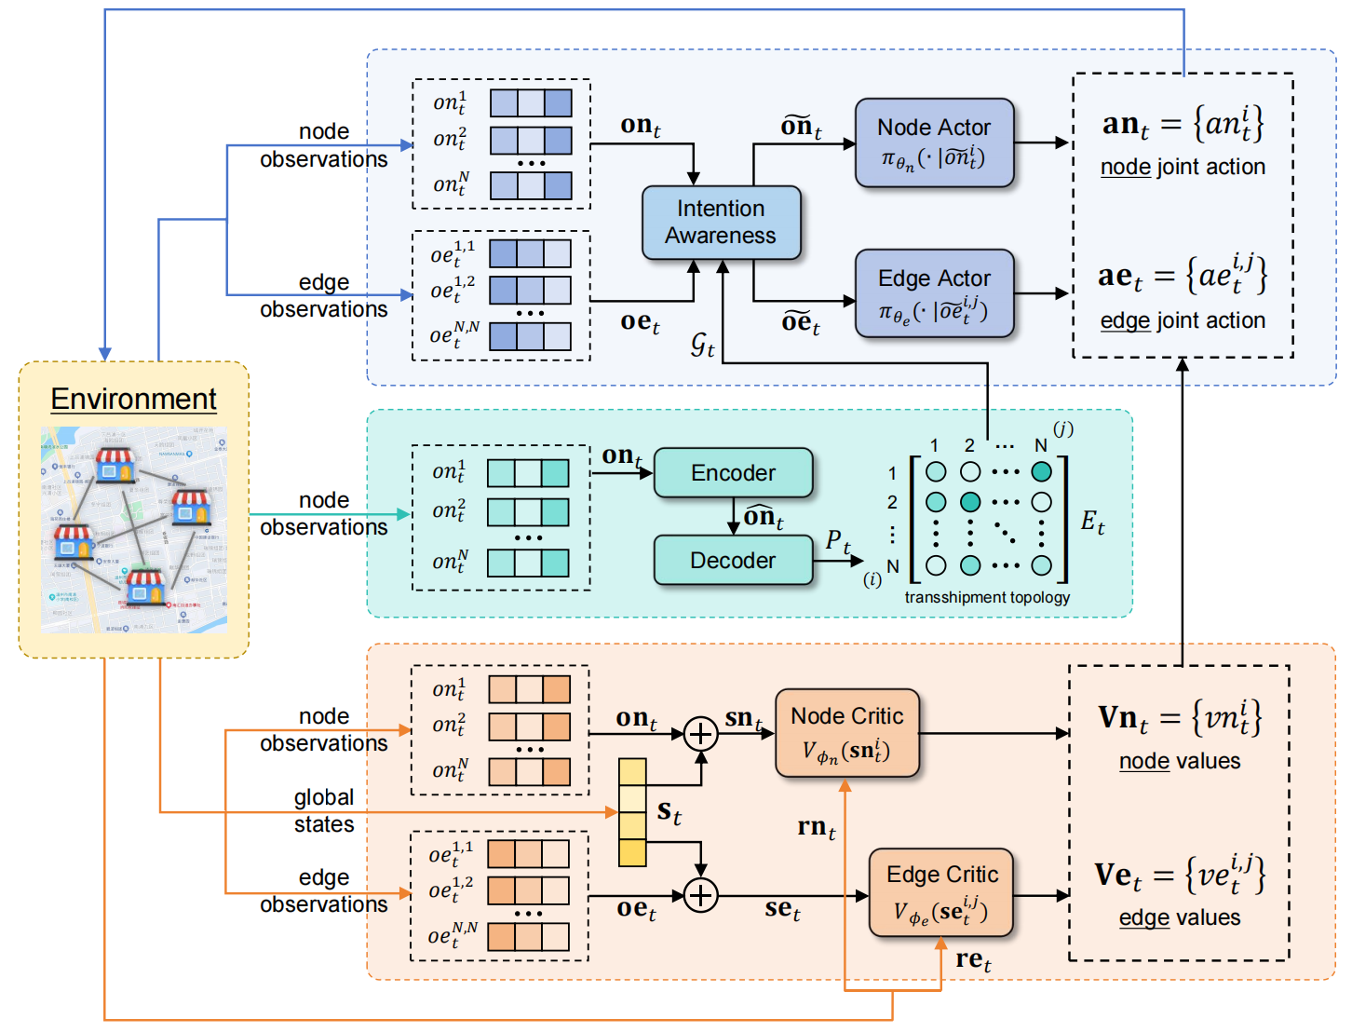
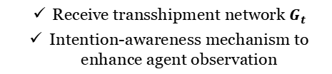

Methodology
The architecture of proposed framework: TransG
Coordinated Policy Generation
Receive transshipment network $G_{t}$
Intention-awareness mechanism to enhance agent observation
Centralized Graph Generator
Generate transshipment network $G_{t}$
Graph-theoretic loss functions for constraint
Critic for Actor Training
Guide policy training
MAPPO Algorithm with agent-specific global observation

Slide 11

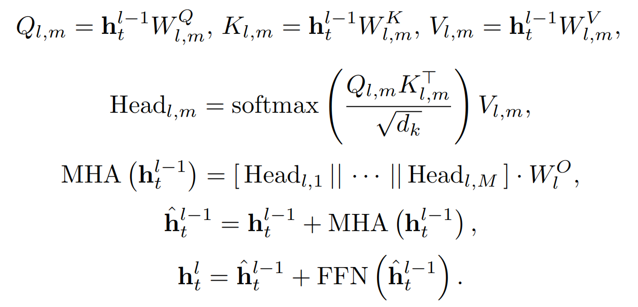
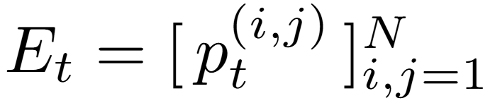


Methodology
Centralized Graph Generator: Encoder-Decoder Structure
Encoder
Extract feature with historical node actions:
Encode with transformer-style attention layers:
Decoder
Construct pairwise relationship between node pairs:
$$N×N$$
sample
$$G_{t}$$
the probability that a directed edge exists between node i and j
transshipment network
adjacency matrix

Slide 12



Methodology
Rules of Transshipment
Two Constraints
Accomplish Coordination
Centralized Graph Generator: Graph-Theoretic Loss Functions
have unnecessary stock movements
Constraint 1: non-cyclic transshipment
A
C
A
B
The equivalent proposition is that the generated graph should satisfy the acyclicity constraint:
B
DAGness Constraint:
where $e^{(∙)}$ is the matrix exponential and $N$ is the number of nodes in the graph.
same distribution but less movement (saving on costs)
2
A
A
Constraint 2: non-chained transshipment
2
B
5
C
B
3
C
Transform the chain-form constraint into the depth constraint of DAG to control the hierarchy:
DAG Depth Constraint:
set $k=1$
where $sum(M) =\sum_{i}{\sum_{j}{M^{ij}}}$ denotes the summation of all elements for a given matrix $M$.
Set $k=1$ to guide the accessible step between any two nodes to be less than 2 but not less than 1, to resist the chain-form transshipment while encouraging regular transshipment.
Notes:
深度约束
任意节点仅允许一步可达，不允许两步可达。
取k=2，如果出现了两步可达，则会使loss变大；同时为了防止过度约束，要鼓励k-1步，也就是一步可达的出现。

Slide 13
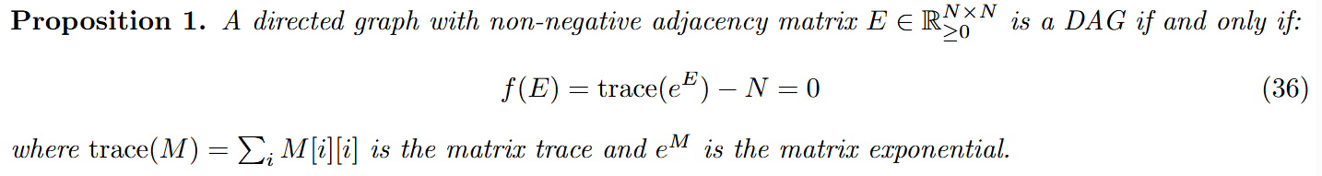
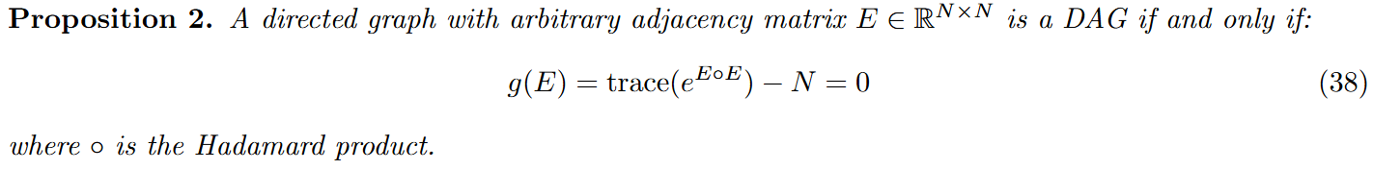
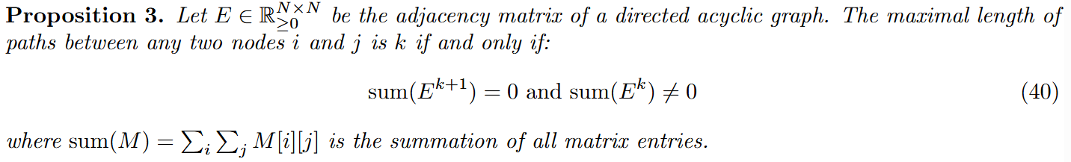
Methodology

Slide 14
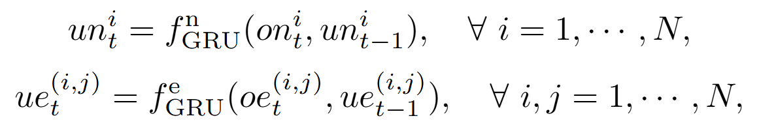
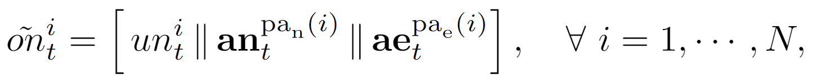
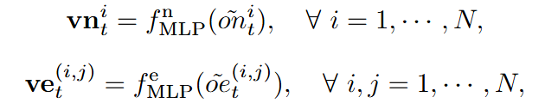

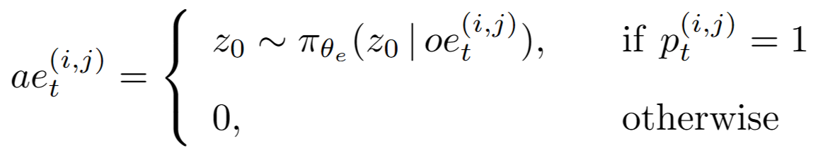
Methodology
Coordinated Policy Generation: Main Procedure
Embed historical information with GRU:
Enhance observation via Intention Awareness:
Map enhanced observation to policy logit:
Sample actions from distribution after softmax:

Slide 15


Methodology
Coordinated Policy Generation: Intention Awareness
Motivation of Intention Awareness
When jointly making replenishment and transshipment decisions together, there exists complex coupling relationships among different retailers.
+0
+0
+?
+10
A
?
B
transshipment quantity from A to B ?
C
+2
D
replenishment quantity of retailer D ?
+20
8
6
12
+5
3
There exists the dependency between decisions of different agents within the same period.
It is essential to enable each agent to perceive other agents’ intentions whose decisions are related, in order to facilitate more cooperative decision-making.
How can we model these decision dependencies?
Fortunately, we have the transshipment network $G_{t}$, which is a DAG!
Notes:
意图感知的动机
在策略生成阶段，一种直接的方式是将节点观测与边观测分别作为补货策略网络与转运策略网络的输入，以得到对应的动作。
但实际上，在每轮的决策中不同零售商间的补货与转运动作存在着复杂的耦合关系，例如：在时间段t，零售商A选择进货10个单位与进货20个单位可能带来完全不同的转运意愿。
尽管这两种决策的观测空间与训练奖励空间在建模时便被定义了紧密的联系，但这只包含了观测信息间的联系，而不包含智能体间意愿动作的联系，而这刚好是补调情形中应当考虑，如果不加考虑，则可能会在决策质量上影响智能体间的协调。
这种信息不是可以通过状态间的表征关联或通讯来解决的，而是需要对彼此之间的意图进行感知。

Slide 16
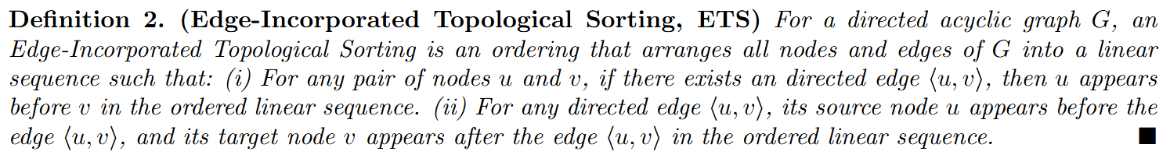
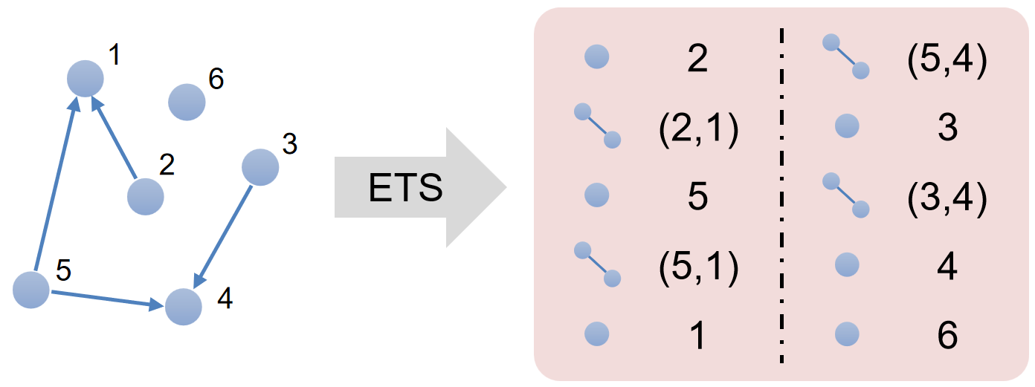

Methodology
Coordinated Policy Generation: Intention Awareness
Intention Awareness via Edge-Incorporated Topological Sorting
Given a DAG, any feasible Topological Sorting (TS) characterizes the dependency among nodes.
Propose an extended “edge-incorporated topological sorting” based on TS, to captures the dependency among both nodes and edges.
Enhance agent observations with actions of the parental entities (N-dim vectors):
$$G_{t}$$
transshipment
replenishment

Slide 17
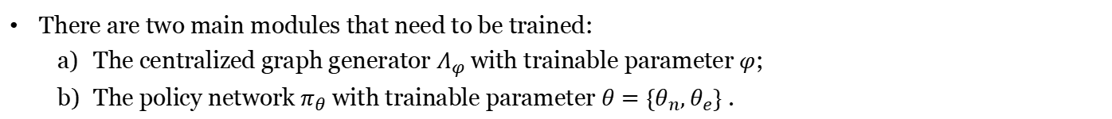
Model Training
There are two main modules that need to be trained:
The centralized graph generator $Λ_{φ}$ with trainable parameter $φ$;
The policy network $π_{θ}$ with trainable parameter $θ=\{θ_{n},θ_{e}\}$ .
Policy Network: Maximize the long-term cumulative rewards for both the replenishment $η_{n}=𝔼\left[\sum_{k=0}^{∞}{γ^{k}∙{rn}_{t+k}^{i}}\right]$ and the transshipment $η_{e}=𝔼\left[\sum_{k=0}^{∞}{γ^{k}∙{re}_{t+k}^{(i,j)}}\right]$
replenishment return
replenishment policy entropy
transshipment return
transshipment policy entropy
Centralized Graph Generator: Maximize its decision effectiveness while considering the two graph-theoretic loss functions.
transshipment return
DAGness loss
DAG depth loss
Select the MAPPO algorithm with actor-critic architecture as the policy solver and use the agent-specific global observations as inputs of value function to coordinate agents. The value function is trained by minimizing the temporal difference loss.

Slide 18
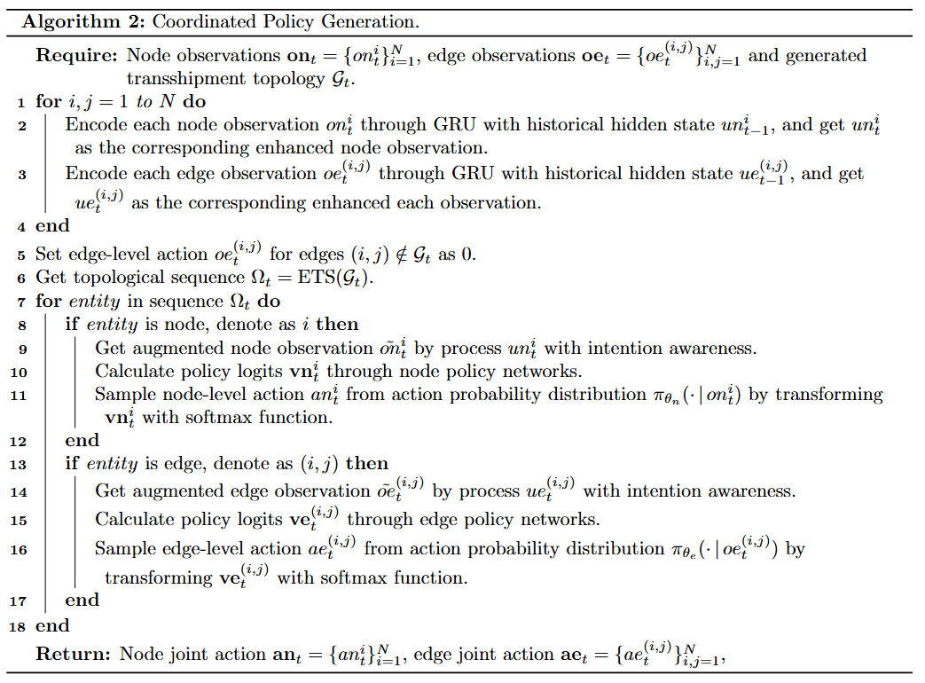
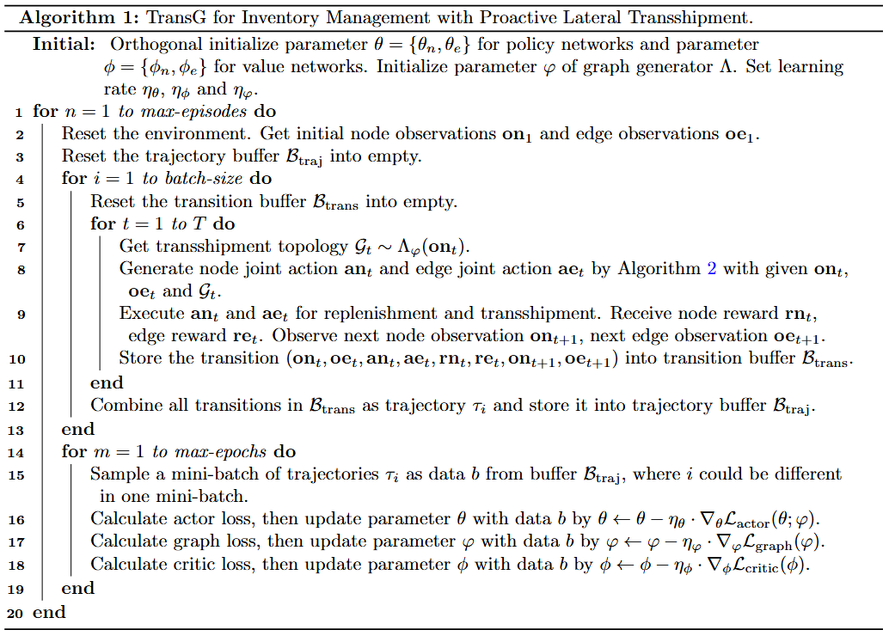
Pseudocode
The complete interaction and update procedures of TransG in Algorithm 1, in which the procedure of action generation in Algorithm 2 is needed.

Slide 19
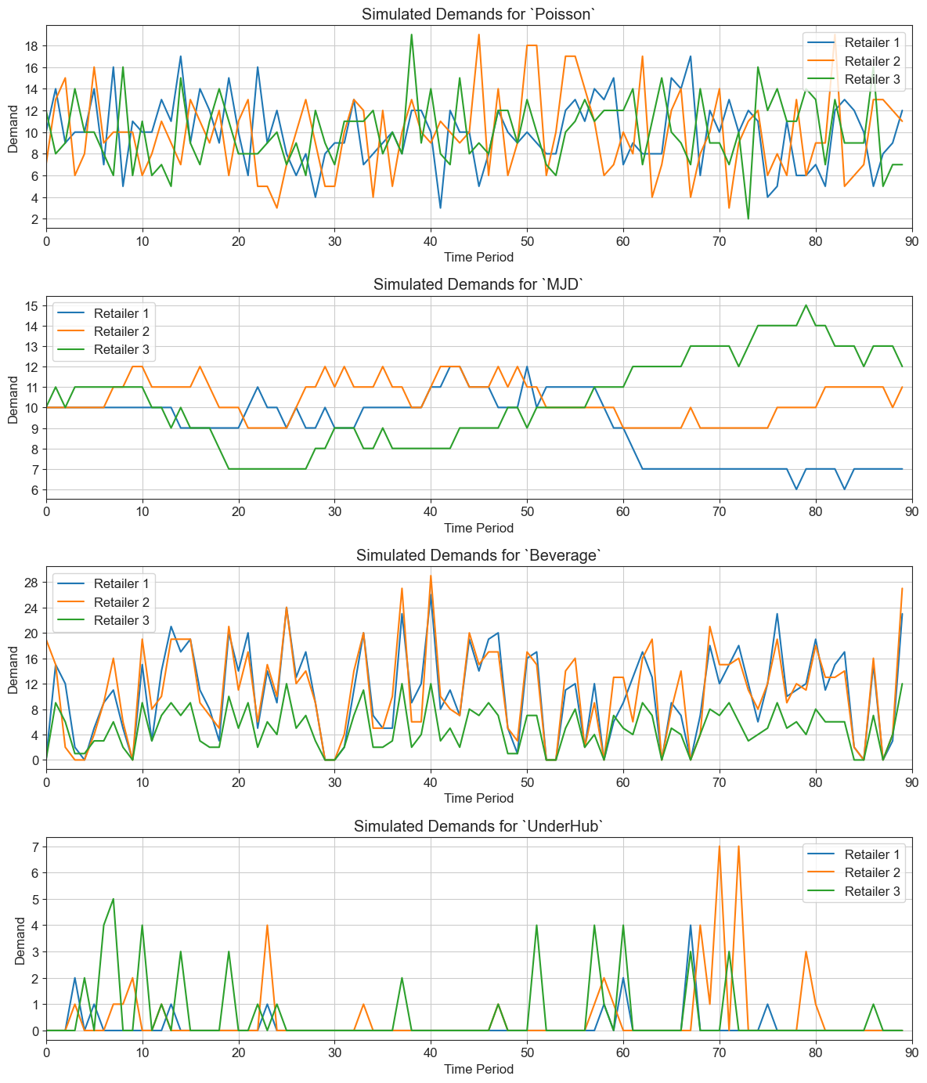
Experimental Setup
Dataset
Poisson: stationary demands sampled from Poisson distributions;
Merton Jump Diffusion (MJD): non-stationary demands generated by Merton jump diffusion model;
Beverage: a real-world supply chain and sales data of a beverage supplier with highly uncertainty demand;
UnderHub: a real-word sales data of a well-known Chinese underwear retail brand with sparse demand.
(5 Retailers)
(9 Retailers)
Evaluated Metrics
Profit: averaged profits of all retailers;
Out-of-Stock Rate (OOS): the proportion of days with lost sales due to stockouts;
Days-in-Inventory (DII): the ratio of inventory quantity to sales volume, a type of turnover rate.
(12 Retailers)
(34 Retailers)

Slide 20
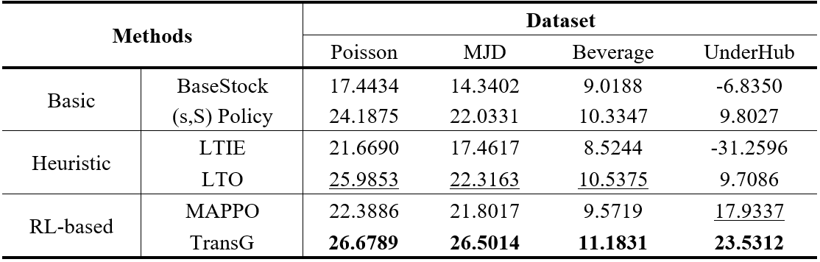
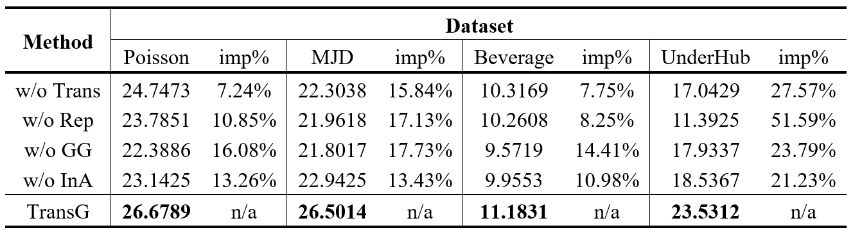
Performance Comparison
Baseline Comparison
Abalation Study
Notes:
Baseline Comparison
最简单的基本库存策略表现最差（无转运策略），sS策略表现更好。
启发式运筹优化表现次之（补货策略使用sS），基于库存平衡思路的启发式转运从长期收益的角度来看表现并不好；LTO是second best，在sS策略上有微小提升。
RL-based策略中纯PPO策略比sS策略表现更好，但是比不过具有转运的策略。MAPPO指的是考虑转运但不进行图约束的策略，效果很差。
Abalation Study
w/o Trans就是PPO算法；w/o Rep将基于强化学习的补货策略换成了sS策略
w/o Topo是指的没有Intention Awareness部分：有的数据集上的表现比w/o Trans还要差，可见意图感知的重要性。

Slide 21
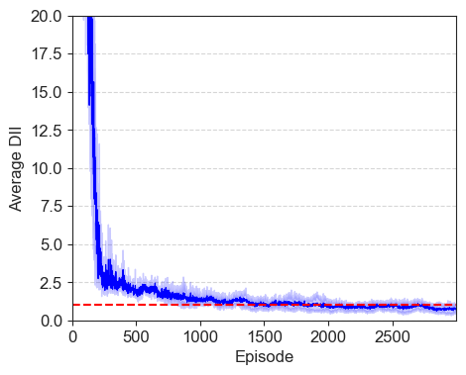
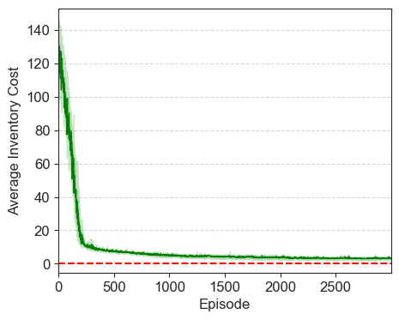
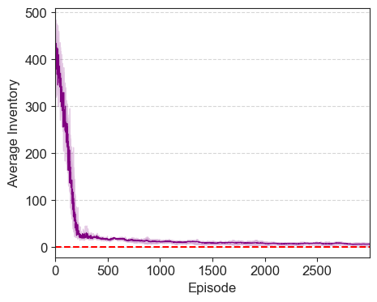



Numerical Results
Optimality Test
If the following conditions are met: (i) zero lead time $l=0$; (ii) no startup inventory $x_{0}^{i}=0$; (iii) lost sales, the optimal policy is replenishment quantity $q_{t}^{i}=d_{t}^{i}$ and no transshipment.
Variables under optimal replenishment policy should be:
DII $→$ 1
Inventory Cost $→$ 0
Inventory $→$ 0
TransG is converging to the optimal solution during training.

Slide 22
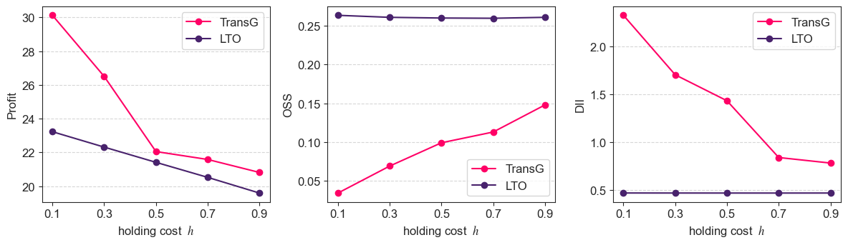
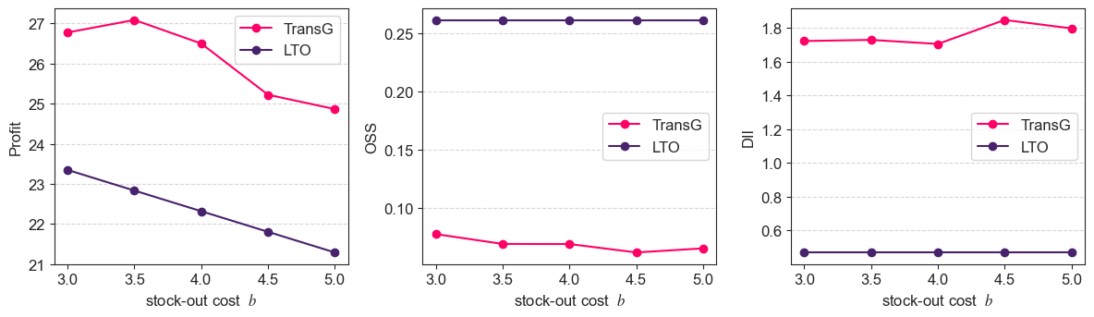
Numerical Results
Sensitivity Analysis
Inventory
Holding Cost
Inventory
Stockout Cost
Notes:
Inventory Holding Cost
随着库存成本的提升，总利润呈下降趋势。
TransG明显对参数更加敏感，能够根据库存成本调整自己的库存水平。
Inventory Stockout Cost
随着缺货成本的提高，总利润下降。

Slide 23
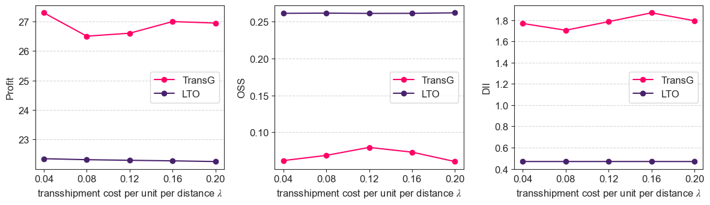
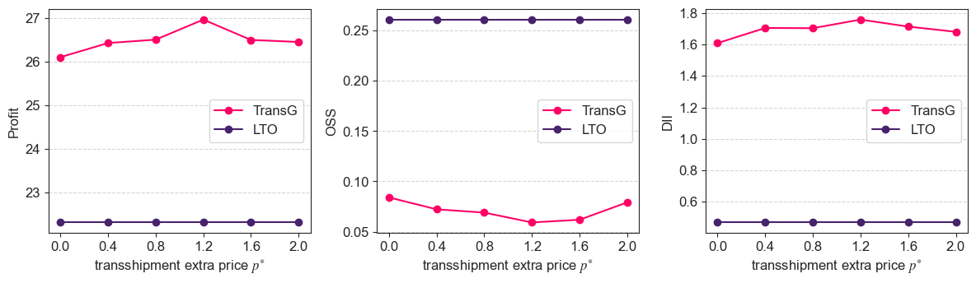
Numerical Results
Sensitivity Analysis
Transshipment Cost
Per Unit Per Distance
Transshipment Extra Price
Notes:
Transshipment Cost Per Unit Per Distance
当单位转运成本上涨时，Profit并不会直接下降，但是智能体会调整策略，通过增加进货量。
Transshipment Extra Price
呈现出V形，p过大或过小都会对转运效果产生抑制效果。

Slide 24
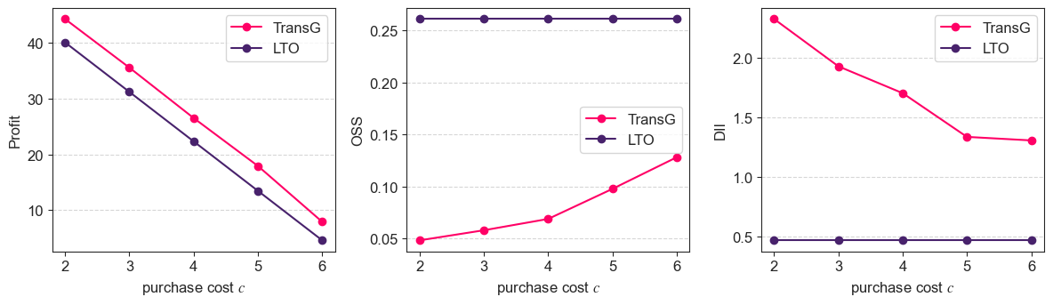
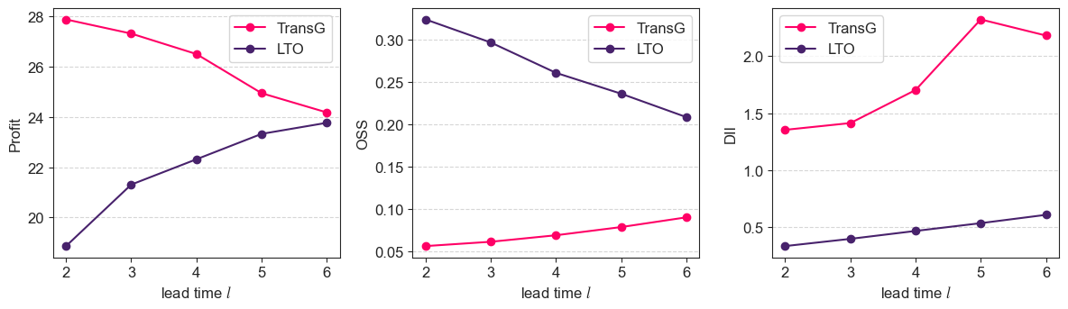
Numerical Results
Sensitivity Analysis
Inventory
Purchase Cost
Lead Time

Slide 25
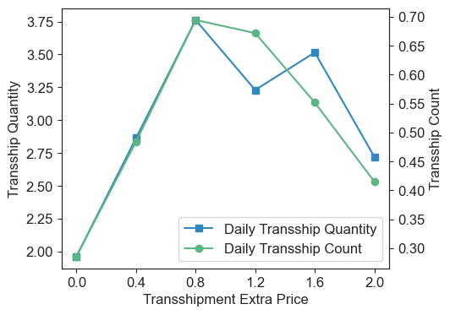
Numerical Results
Sensitivity Analysis
The transportation cost (per unit per distance) is an additional burden that needs to be borne.
Different from the transshipment cost, the transshipment extra price can be adjusted to modulate the transshipment market’s activity.

Slide 26
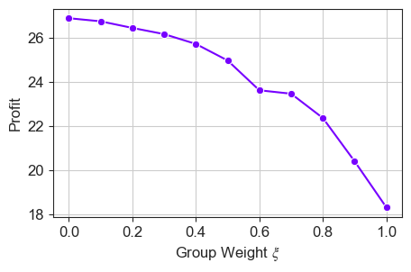
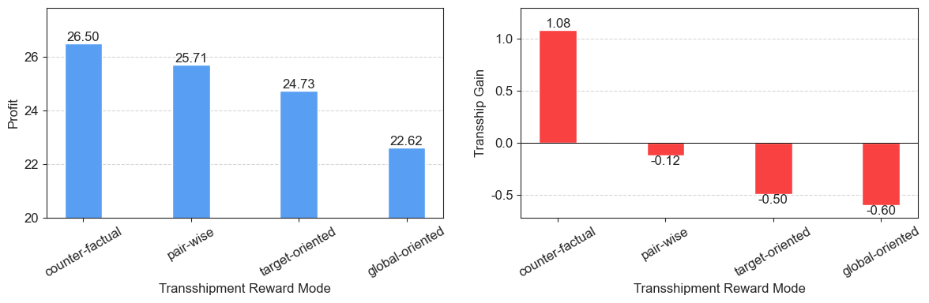


Numerical Results
Effect of Different Reward Setting
Unexpected Finding: When using rewards that focus more on global goal, (i.e., total profit), the performance gets worse.
Replenishment Reward Setting:
hyperparamter of group weight $ξ$
A
counter-factual
${rn}_{t}^{i}=\left(1−ξ\right)∙{RV}_{t}^{i}+ξ∙\sum_{i=1}^{N}{{RV}_{t}^{i}}$
B
target-oriented
(default $ξ=0$)
C
pair-wise
global-oriented
Transshipment Reward Setting:
Notes:
Transshipment Reward Setting: 信息量逐渐减小、弥散（变得不聚焦）

Slide 27
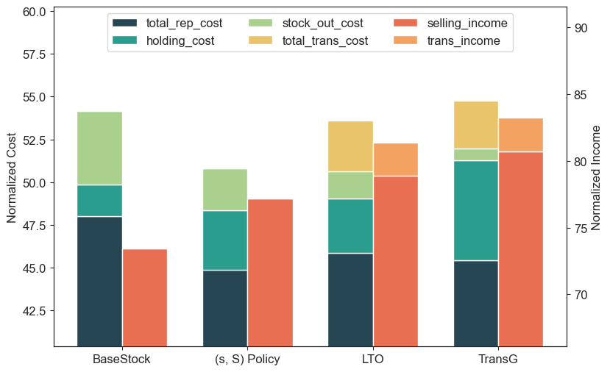
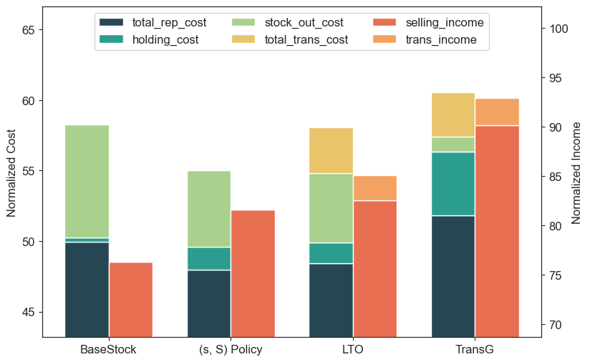
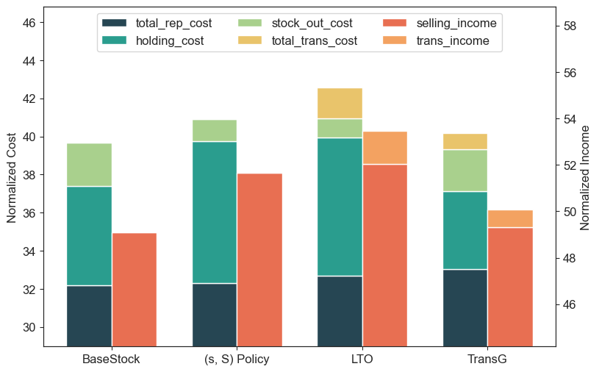
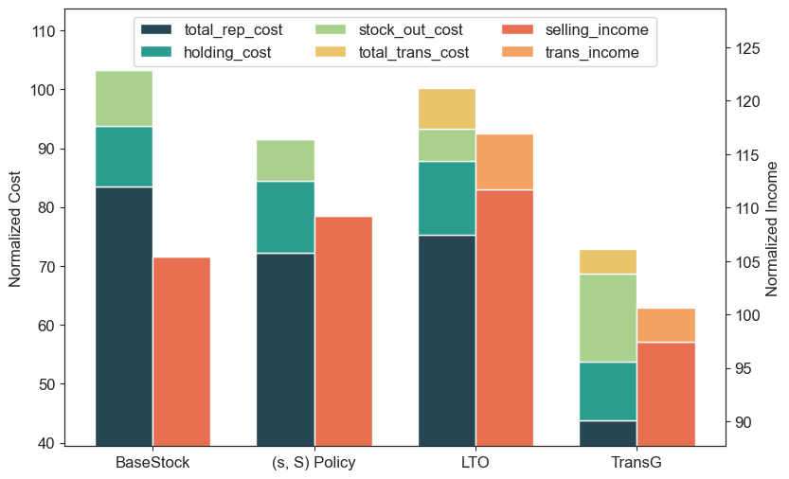



Numerical Results
Cost Structure Analysis
TransG tends to order less when facing unstable demand.
(lowers the holding cost, while slightly increasing the stockout cost)
Poisson
MJD
($b/h=13.3$)
($b/h=13.3$)
Beverage
UnderHub
($b/h=7.5$)
($b/h=66.7$)
Notes:
传统策略：正常进行补货。
LTO：在补货之上多出一部分转运成本和收益，但是整体来说收益更高。
TransG：在LTO的基础上注重调整进货结构，在需求不稳定时倾向于降低自己的持货量，用少量的缺货成本弥补大量的压缩持货成本。

Slide 28
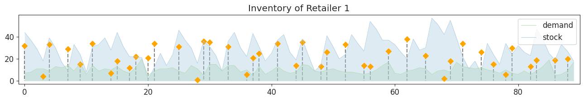
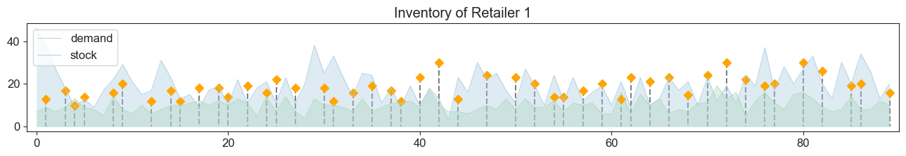
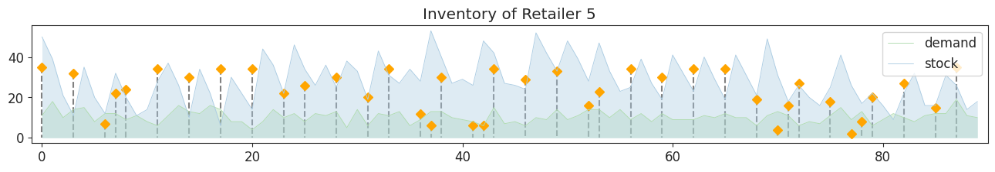
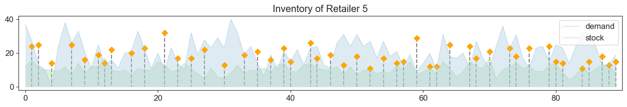






Case Study
Replenishment Policy
TransG
LTO

Slide 29






Case Study
Transshipment Policy
(move large quantities over long distances)
TransG
LTO
Notes:
TransG：模式明显，大量的库存调整。
LTO：短距离，持续、少量的微调。

Slide 30
Discussion & Conclusion
Main Contribution
We propose a graph-based MARL framework, TransG, that unifies inventory replenishment and lateral transshipment via graph-structured MDPs with centralized graph generation and DAG constraints, outperforming baselines in profit.
To the best of our knowledge, we are among the first to solve inventory management problem with lateral transshipment and model MDP based on graph generation perspective.
The graph perspective bridges decentralized decisions with global coordination, offering insights for modeling multi-agent interdependencies which can also be extended to logistics or resource allocation domains.
Limitations
It is still in the preliminary exploration stage, and the structure of each part is relatively simple.
Future research may consider improving the limited performance by:
Designing better mechanisms like topological sorting for integrating graph generation and policy generation stages.
Resolve partial observation issues between replenishment and transshipment decisions.

Slide 31
Thank you for listening !
Any Questions?
(Apologies for the brevity due to time limitation.)
Notes:
Due to ​​time constraints​​, I may not have covered all aspects as thoroughly as I would have liked.
I appreciate your understanding and welcome any ​​further questions or discussion​​ after the session.

