Slide 1

IB9BWO Group B21
Predictive Analysis for Direct Marketing
Yi ZHANG

Slide 2
01
Background
CONTENTS
02
Data Description
03
Insights
04
Recommendations

Slide 3

01
Background

Slide 4


Fields using big data:
E-commerce, logistics and distribution, computer programming and so on.
Capture data profile →
Improvements on business strategies, marketing campaigns & product design

Slide 5


1. Direct Marketing
Personalized customer communication system

Slide 6


1. Direct Marketing
Personal contact
Email
Mail
others
Phone

Slide 7
02
Data Description

Slide 8
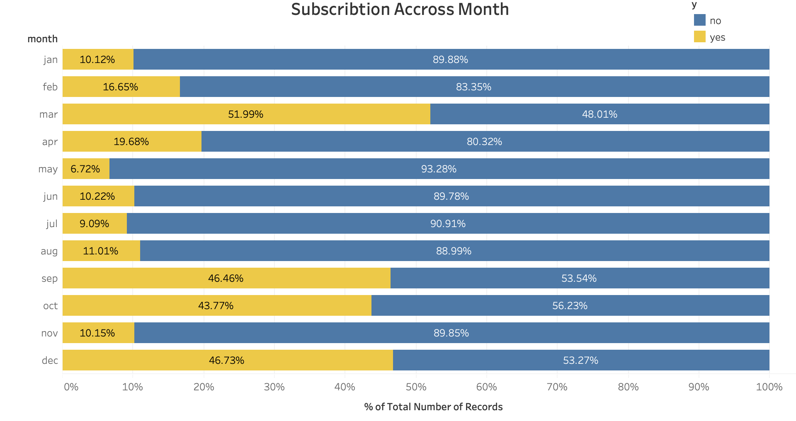
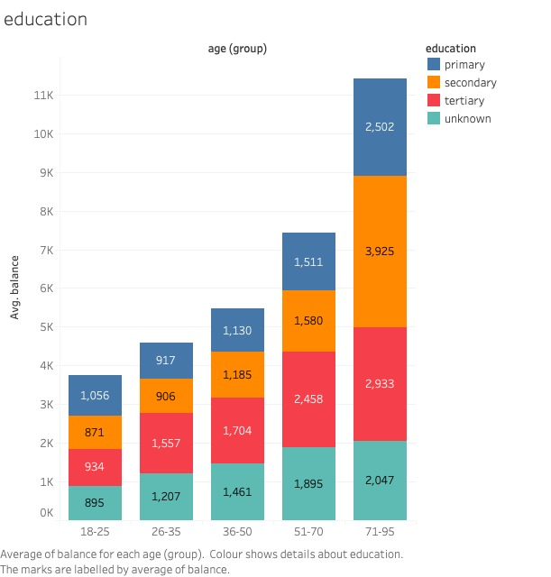
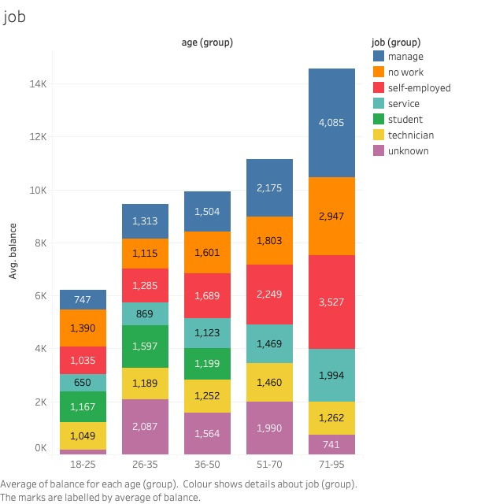
2.1 Bank Client Data

Slide 9
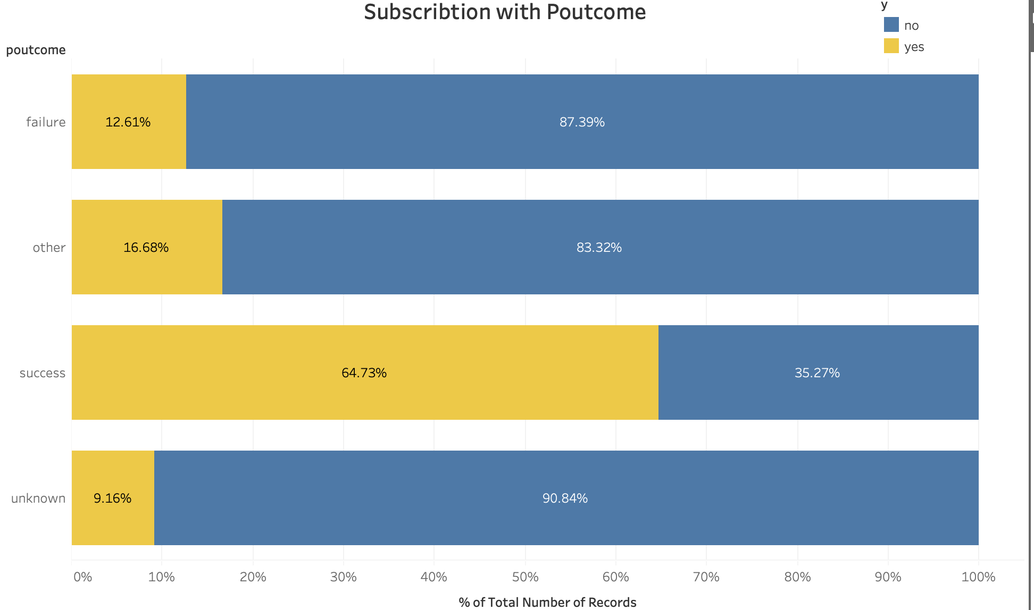
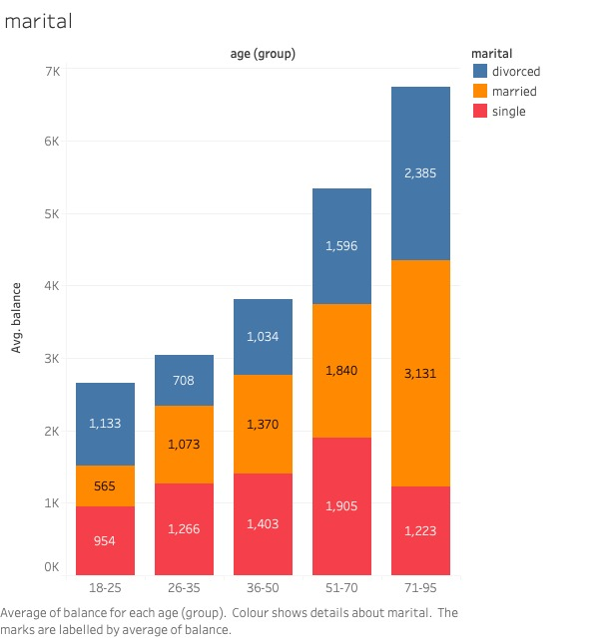
2.1 Bank Client Data

Slide 10
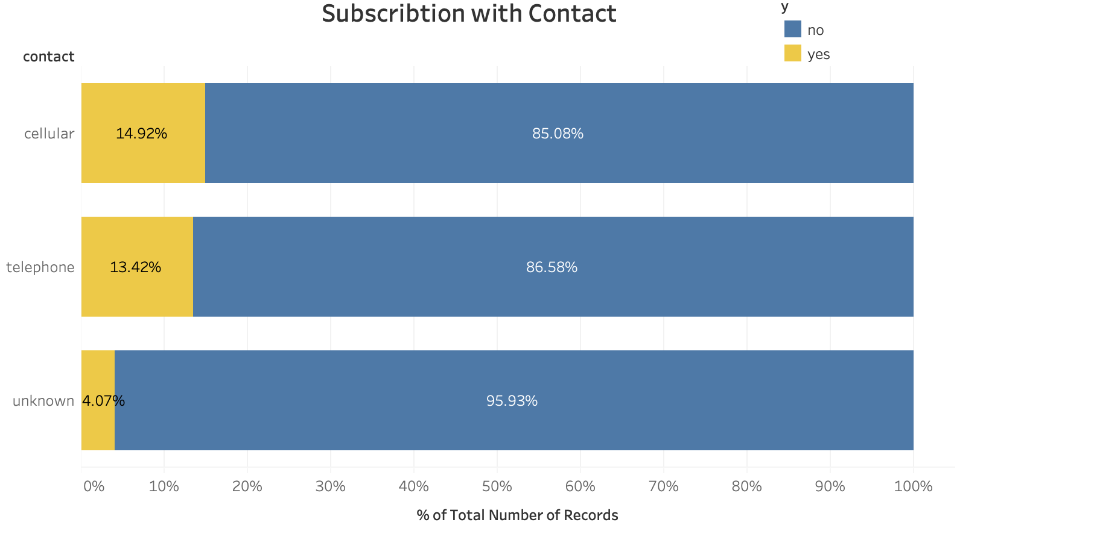
2.1 Bank Client Data

Slide 11
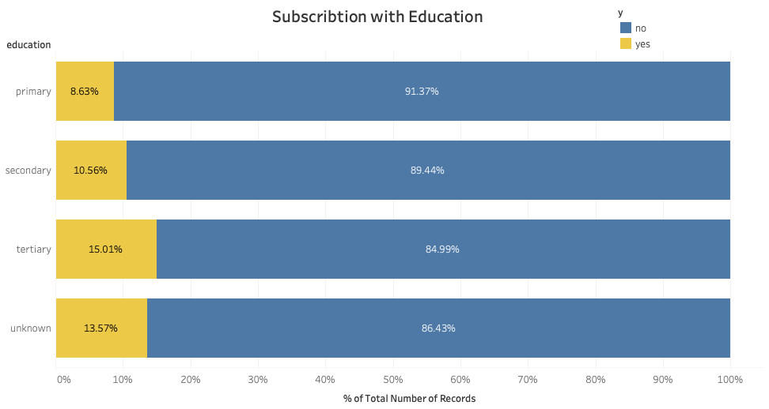
2.1 Bank Client Data

Slide 12
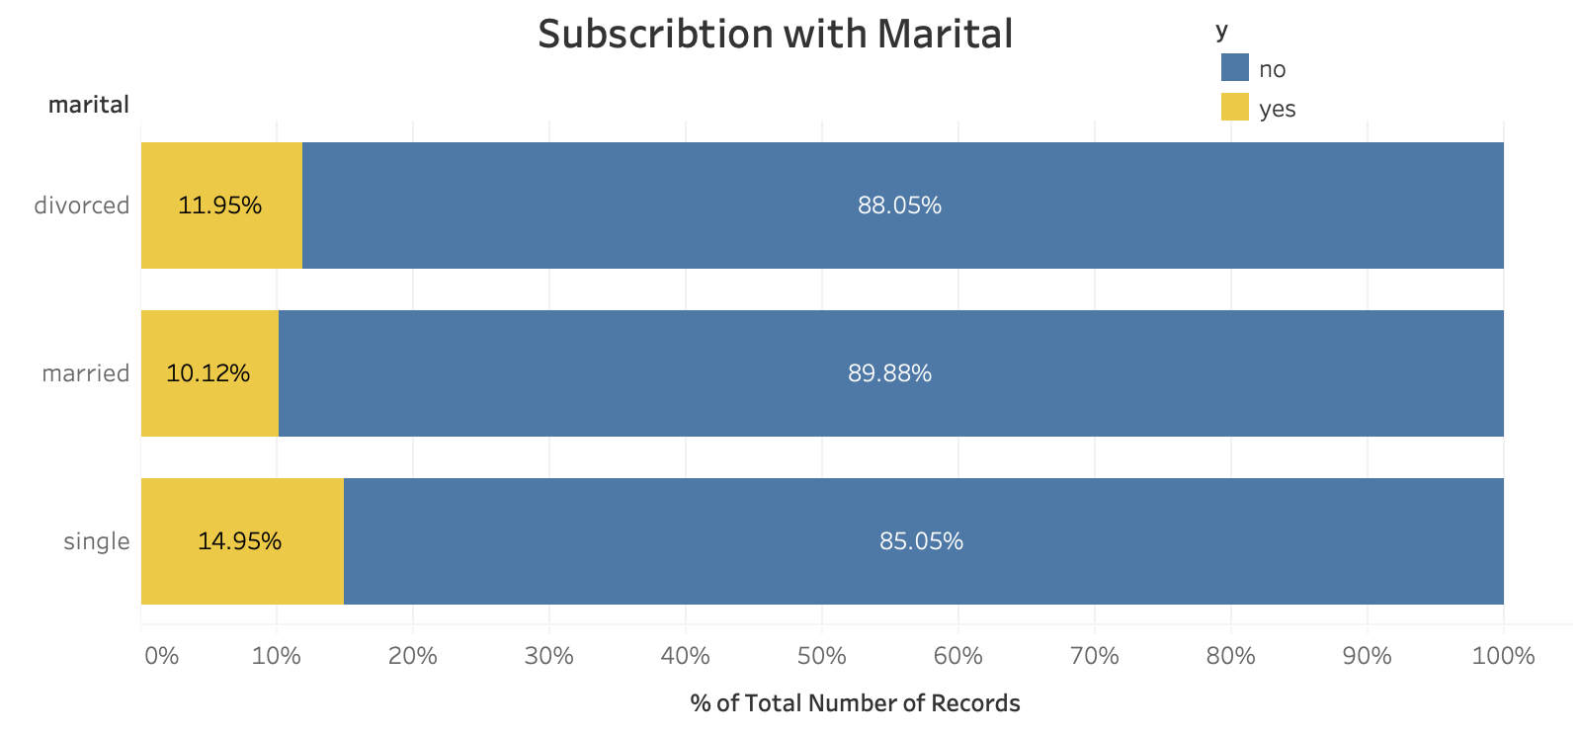
2.1 Bank Client Data
Poutcome - Outcome of the previous marketing campaign
unknown / other / failure / success

Slide 13
03
Insights

Slide 14
3.1 Model Introduction
Decision Tree
Support Vector Machine (SVM)
Naïve Bayes
Random Forest

Slide 15
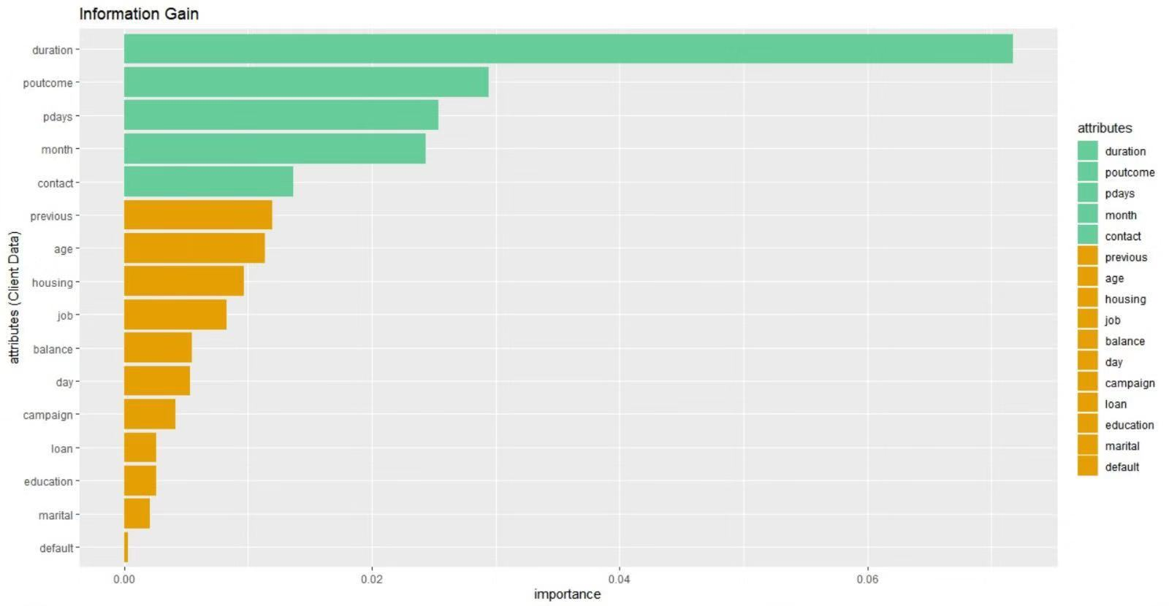
3.1 Model Introduction

Slide 16
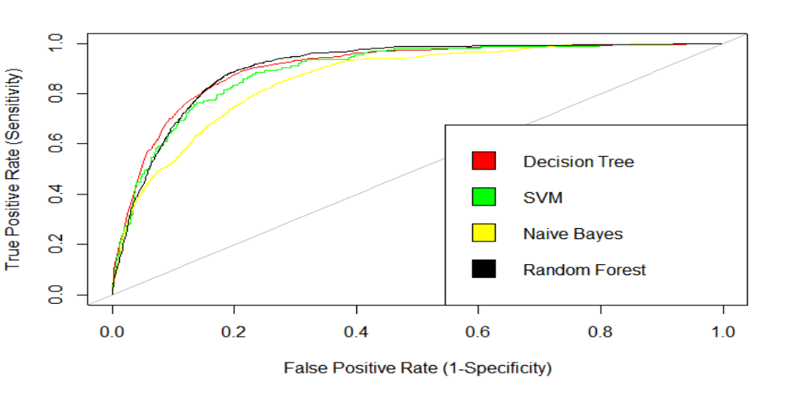
3.2 Results
Receiver Operator Characteristic (ROC) and Area Under the ROC curve (AUC)
 | AUC_SVM | AUC_DT | AUC_NB | AUC_RF
1 | 0.8924599 | 0.9041929 | 0.8597964 | 0.9046292

Slide 17
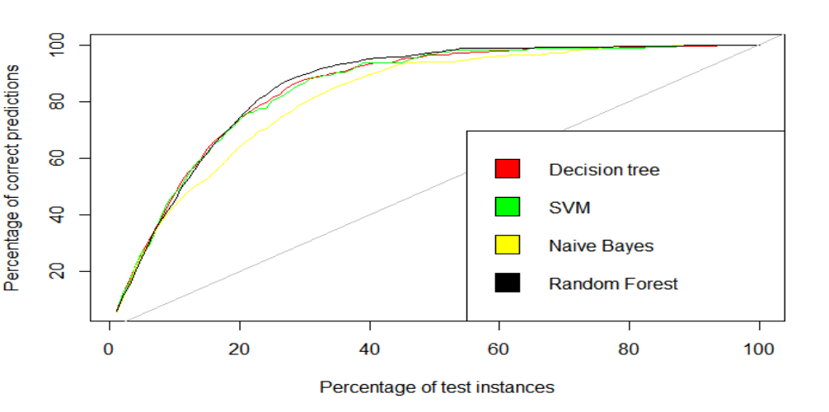
3.2 Results (Cont'd)
Cumulative Response (Gain) Chart

Slide 18
3.2 Results (Cont'd)
ROC, AUC, Cumulative Response (Gain) Chart provides useful information about the models with visualization.
Difficult to conclude which model performs better
Other metrics are required to compare the models

Slide 19
3.2 Results (Cont’d)
Metrics related to the profits and costs of the direct marketing:
Accuracy
- Higher accuracy -> More correct prediction of client responses
Sensitivity
- Higher sensitivity -> Higher marketing profitability (focuses on Profits)
Precision
- Higher prevision-> Higher marketing efficiency (focuses on Costs)
F-measure – balanced metric of Sensitivity and Precision Value
- Focuses on both Profits and Costs

Slide 20
3.2 Results (Cont'd)
Sensitivity is the most important metric in the direct marketing situation
Value of metrics
 | DT (Decision Tree) | SVM | NB (Naïve Bayes) | RF (Random Forest)
Accuracy | 0.8188587 | 0.8443953 | 0.8208493 | 0.8338248
Sensitivity | 0.8550725 | 0.7628205 | 0.6780088 | 0.8399496
Precision | 0.3786272 | 0.4061433 | 0.3592654 | 0.3999400
F-measure | 0.5248501 | 0.5300668 | 0.4696639 | 0.5418699

Slide 21
3.3 Conclusion
ROC, AUC and Cumulative Response (Gain) Chart
-> Not enough to decide the most appropriate model to implement the direct marketing
Accuracy, Sensitivity, Precision and F-measure
-> Due to the cost-efficient characteristic of direct marketing methods, Sensitivity should be considered with more weights than other metrics.
Decision Tree is the most suitable model for selecting customers to contact

Slide 22
04
Recommendations

Slide 23

4. Recommendations
01
Collect more relevant data which can improve the performance of models
02
Lower the costs of direct marketing
03
Highly persuasive design of the direct marketing message
04
Utilize different communication methods

Slide 24
Thanks for watching!

