Slide 1
Face Recognition: A Comparative Study of PCA and NMF in Parts-Based Representations
COMP 6651 – Algorithm Design Techniques
SUMMER 2025
Elston Farel - 40305623
Janmitsinh Panjrolia - 40294468
Sakshi Mulik – 40295793
Prof: Yaser Esmaeili Salehani

Slide 2
Goal/ Objective
To evaluate and compare the effectiveness of PCA and NMF for dimensionality reduction in face recognition tasks.
To analyze classification accuracy, reconstruction error, and runtime efficiency of both PCA and NMF.
To investigate the interpretability of feature representations generated by PCA and NMF.
To assess how well each technique preserves identity-relevant features from high-dimensional facial data.
To provide actionable insights into choosing between PCA and NMF based on performance versus explainability trade-offs.

Slide 3
Group Member’s Role
1. Janmitsinh Panjrolia
Lead author of the IEEE paper
Implemented PCA algorithm and performance analysis
Handled data preprocessing and visualization (Eigenfaces, t-SNE)
2. Sakshi Mulik
Implemented NMF algorithm and interpretability analysis
Designed experiments and hyperparameter tuning (GridSearchCV)
Contributed to the paper’s explainability and ethical sections
3. Elston Farel
Managed code integration and testing pipeline
Prepared the final PowerPoint presentation
Handled formatting, references, and submission of the IEEE paper

Slide 4

Real life Applications
These are the Real-life applications based on our paper:
PCA Applications
Biometric authentication systems
Real-time public surveillance
NMF Applications
Forensic and criminal investigations
Medical imaging and diagnostics
Explainable AI in sensitive domains
Assistive technologies for visually impaired users

Slide 5





Dataset
The ORL database for training and testing:
The ORL Database of Faces is set of face images taken between April 1992 and April 1994 at the lab.
There are ten different images of each of 40 distinct subjects. For some subjects, the images were taken at different times, varying the lighting, facial expressions (open / closed eyes, smiling / not smiling) and facial details.
All the images were taken against a dark homogeneous background with the subjects in an upright, frontal position (with tolerance for some side movement).s / no glasses).
https://www.kaggle.com/datasets/tavarez/the-orl-database-for-training-and-testing/data

Slide 6
Methodology
Used the ORL face dataset with preprocessing (resizing, grayscale conversion, contrast enhancement, normalization).
Applied data augmentation to increase robustness and generalization.
Reduced dimensionality using PCA (with randomized SVD) and NMF (with NNDSVD initialization).
Trained SVM classifiers (RBF kernel for PCA, polynomial kernel for NMF) on transformed features.
Visualized components and feature separability using Eigenfaces, NMF parts, and t-SNE projection.
Stratified data split: 60% train, 20% val, 20% test" and "Hyperparameter tuning using GridSearchCV.

Slide 7
Complexity and Results
PCA:
Time Complexity: O(nd² + d³)
Space Complexity: O(nd + d²)
Class: Polynomial (P)
NMF:
Time Complexity: O(T · n · k · d)
Space Complexity: O(nk + kd)
Class: NP-Hard
Classification Accuracy:
PCA → 92.6%
NMF → 88.6%
Reconstruction Error (MSE):
PCA → Lower (e.g., at k=40: 17.8)
NMF → Higher (e.g., at k=40: 31.4)
Runtime:
PCA → Faster (closed-form SVD)
NMF → Slower (iterative updates)
Interpretability:
PCA → Low (holistic eigenfaces)
NMF → High (parts-based facial features)

Slide 8
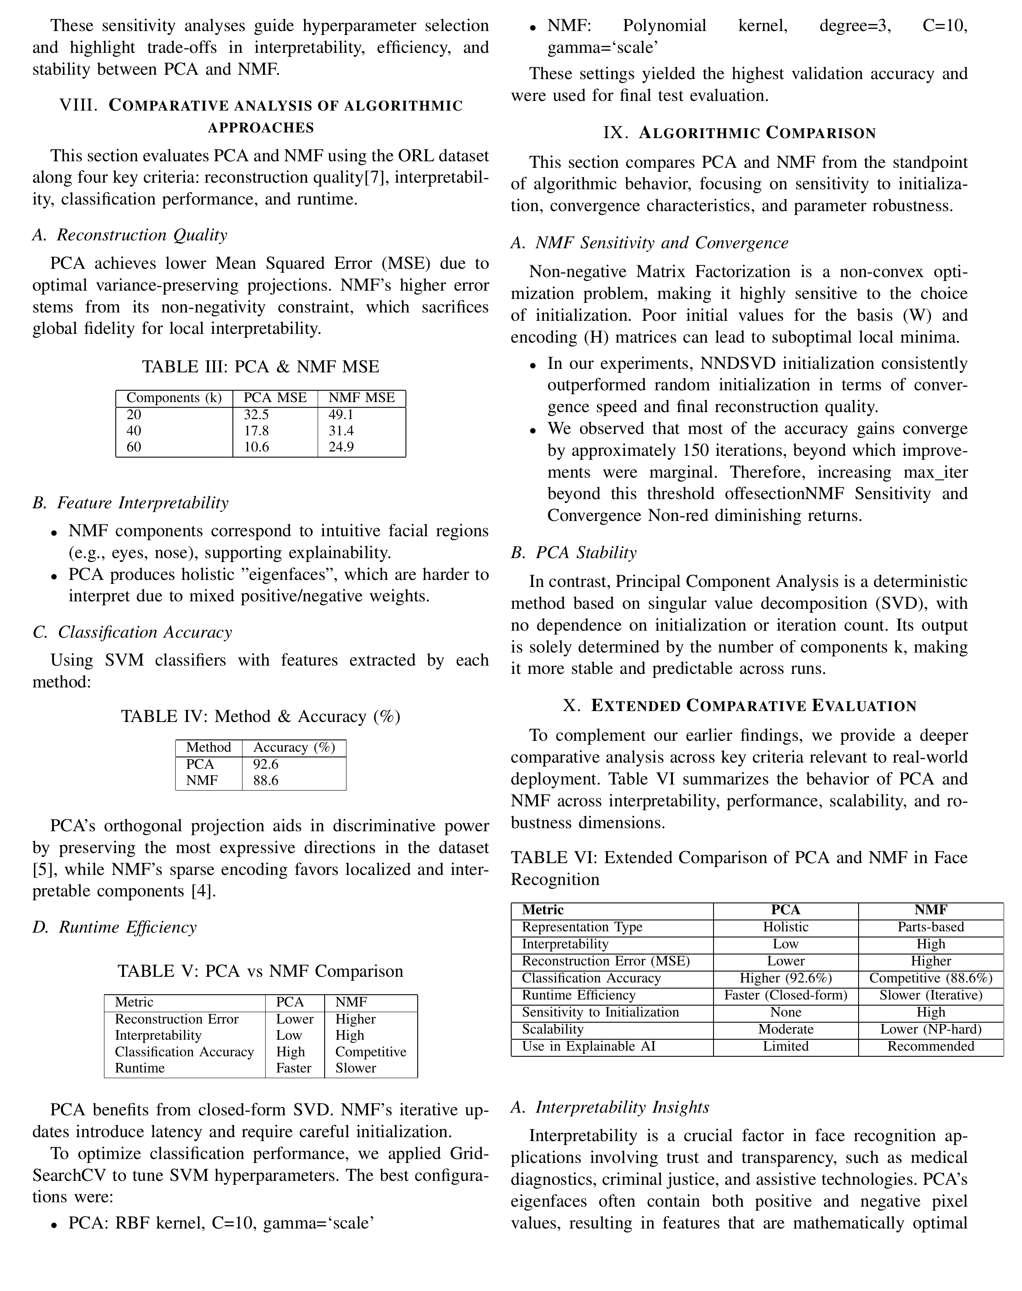
Results : PCA Vs NMF Comparison
Metric PCA NMF
-------------------------------------------------------------------
Reconstruction Error Lower Higher
Interpretability Low High
Classification Accuracy High Competitive
Runtime Faster Slower

Slide 9

Challenges
Dataset bias and limited diversity in gender, skin tone, age, and expressions, affecting model fairness.
Sensitivity to noise and occlusion, especially in real-world conditions with masks, sunglasses, or poor lighting.
Ethical concerns such as privacy risks, surveillance misuse, and potential discrimination.
Scalability limitations, with PCA scaling moderately and NMF facing greater challenges for large datasets.
Parameter sensitivity in NMF, requiring careful initialization and tuning to avoid poor convergence.
Lack of robustness compared to deep learning methods in handling complex and large-scale data.

Slide 10
Conclusion
PCA achieved higher classification accuracy (92.6%) and faster runtime, making it ideal for accuracy-critical and real-time applications.
NMF offered greater interpretability with parts-based facial features, suitable for explainable AI in sensitive domains.
PCA had lower reconstruction error, while NMF’s transparency came at the cost of higher error and sensitivity to initialization.
The choice between PCA and NMF depends on application needs—PCA for performance, NMF for explainability.
Future scope includes hybrid PCA–NMF models, robust variants for noise/occlusion, and deep learning extensions that preserve interpretability.

Slide 11
References & Code link
S. Z. Li and A. K. Jain, Handbook of Face Recognition, Springer, 2005.
D. D. Lee and H. S. Seung, “Learning the parts of objects by non-negative matrix factorization,” Nature, 1999.
I. Jolliffe, Principal Component Analysis, Springer Series in Statistics, 2002.
AT&T Laboratories Cambridge, “The ORL Database of Faces.”
W. Samek, T. Wiegand, and K. Müller, “Explainable artificial intelligence: Understanding, visualizing and interpreting deep learning models,” IEEE Signal Processing Magazine, 2017.
Code Link:
https://github.com/sakkii0910/COMP6651_ADT

Slide 12

For detailed report please go visit the report here : https://github.com/sakkii0910/COMP6651_ADT/tree/main/report
Thank you

