Slide 1
IST 690
Exploring a blockchain
Simulation Tool
Saklain Zaman
School of Information Studies
Syracuse University

Slide 2
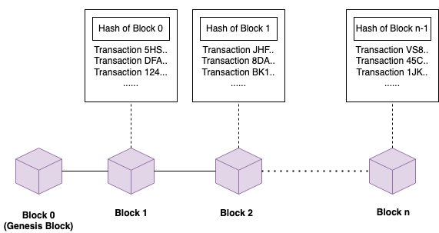
Blockchain
Blockchain is a peer-to-peer technology to store information in a collaborative way which is impossible or difficult to alter or manipulate.
In blockchain, multiple blocks are chained together and each block hold the link (or hash) to the previous block.
Each block contains information in the form of transactions which are verified by the peers in the network.
Once written in the blockchain, the information (or transactions) can’t be tampered with to ensure the immutability of information.

Slide 3
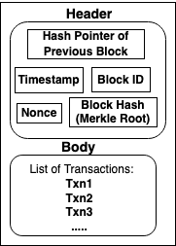
Structure of a block
In a block, the hash pointer to the previous block is stored to maintain the chain of blocks.
Block identifier and the timestamp of block creation are maintained.
Nonce is defined to determine the difficulty of hash calculation.
Hash of the block is also stored for integrity checking to make it tamper-proof.
In the body of the block, the verified transactions between users are listed.
In the simulation, for simplicity, only the block id, hash pointer to previous block and hash of the own block are maintained.

Slide 4
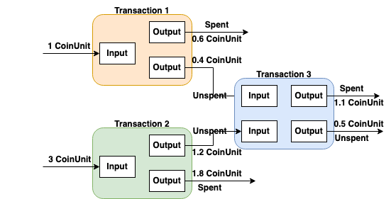
Transactions
The simulation adopts UTXO (Unspent Transaction Output) model for transactions to track the coins. Each transaction have a recipient and a payer.
UTXO is the amount of coins left after the execution of a transaction.
A transaction uses the output of one or more past transactions as the input.
A fraction of the total input coin value will be transferred to the recipient of the transaction (spent coin value) and the remainder (unspent coin value) will be kept by the payer.

Slide 5
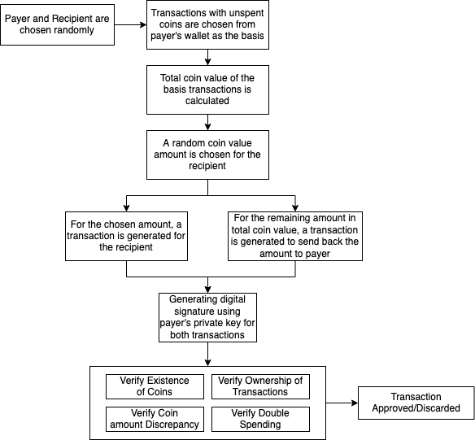
Generation of Transaction
in the Simulation
To simulate a transaction, two users are randomly chosen from the list of users as the payer and the recipient.
The coin value for the input of the transaction comes from the previous unspent transactions of the payer.
A random coin value is chosen which is less than the total coin value of the selected unspent transactions.
The chosen coin value will be sent to the recipient and payer will keep the remainder.
The transaction goes through the verification process to get it approved.

Slide 6
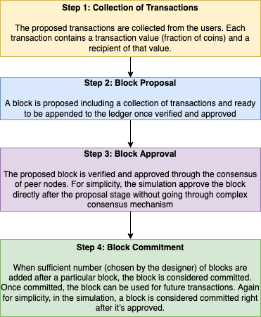
Flow of Block Creation
In order to form a block, the transaction proposals from the users are gathered and verified.
Then a block is proposed containing the list of transactions.
The proposed block is then verified by the peer node in the network to get it approved.
When the proposed block gets approval from enough number of peers, it gets committed to the ledger.

Slide 7
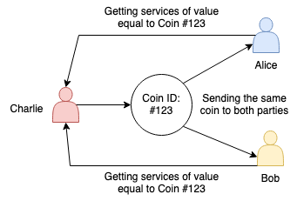
Double Spending Attack
Double spending attack occurs when an attacker tries to spend the same coin more than once.
The attacker Charlie is attempting to send the same coin to both Alice and Bob to gain double profit.
If the attack is successful, the attacker will be able to exploit the network to receive extra monetary benefits.

Slide 8
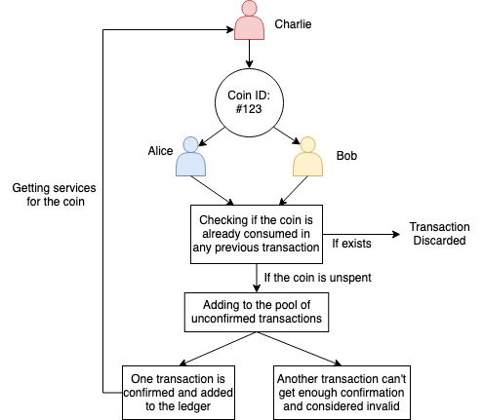
Prevention of Double Spending
Proper validation and verification before confirming a transaction can help to prevent double spending.
The coin must be checked against already published transactions in the ledger to ensure it’s still unspent.
Delaying the confirmation of a transaction till enough number confirmation is received from peer nodes can prevent double spending.

Slide 9
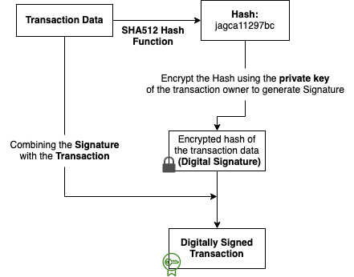
Digital Signature Generation
For Transaction
To make the information in the blockchain tamper-proof, the transactions are digitally signed using transaction owner’s private key.
The generated digital signature is attached with the transaction.
Later, to verify the authenticity and validity of the transaction, the digital signature is evaluated using the public key of the transaction’s owner.

Slide 10
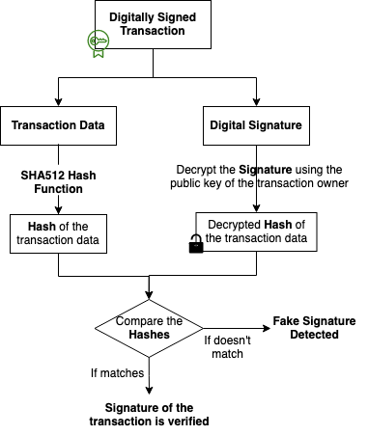
Verification To Detect
Fake Signature
A malicious attacker can attempt to fake the digital signature of a transaction using own private key to get it approved in unauthorized way.
To resist this attack, in the verification phase, the digital signature of the transaction is generated again and compared with the previously stored digital signature.
If the signature is faked, the generated signature in the verification process won’t match with the previously calculated signature with attacker’s private key.

Slide 11
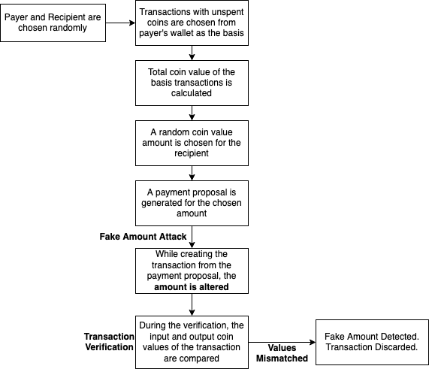
Fake Amount Attack
An attacker can try to tweak the coin value of the transaction proposal before adding it to the ledger to get extra monetary returns.
In blockchain, before a transaction is listed to the ledger, it goes through the verification process to evaluate the validity of the transaction.
The consumed coin value and the output coin value of a transaction are compared, and if the amount is altered by the attacker, both values won’t match in the verification phase.

Slide 12
Thank You!

