Slide 1
Exceptions

Slide 2
What is it?
Errors detected during execution are called exceptions and even if a statement or expression is syntactically correct. It may cause an error when an attempt is made to execute it.

Slide 3
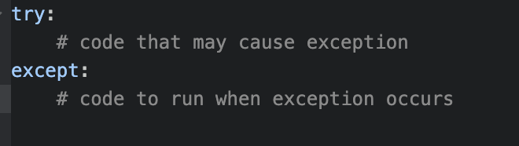
Handle Exception
The [try...except] block is used to handle exceptions in Python.
The try statement works as follows.
If no exception occurs, the except clause is skipped and execution of the try statement is finished.
If an exception occurs, the rest of the clause is skipped. Then, if its match the exception named after the except keyword, the except clause is executed, and then execution continues after the try/except block.
If an exception occurs which does not match the exception named in the except clause, it is passed on to outer try statements; If no handler is found, it is an unhandled exception and execution stops with a message

Slide 4
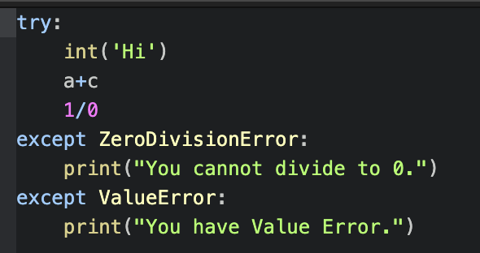

Slide 5
finally
If a finally clause is present, the finally clause will execute as the last task before the try statement completes. The finally clause runs whether or not the try statement produces an exception.

Slide 6
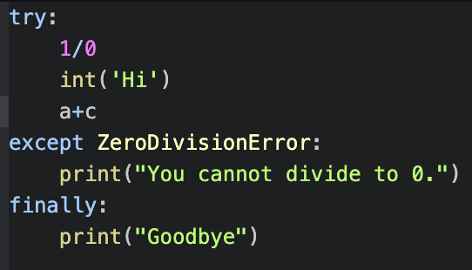


Slide 7
https://github.com/saknzhar/Duplicate-words

Slide 8
Task №1
You need to create console application, that accepts as input Name, Age and GPA. If it has bad arguments, print an informative error message.

Slide 9
Duplicate words
The file word.py contains a simple command-line utility that creates a file containing any number of repetitions of a single word.
Usage: word.py FILE_NAME WORD COUNT
This would result in the creation of a file named 'h.txt' with the contents: hell hell
This utility will do nothing if the file already exists.

Slide 10
The goal for this stage of the lab is to modify the script so that it responds appropriately to incorrect command line arguments. When bad arguments are provided, the script should print an informative error message followed by a usage string.

