Slide 1
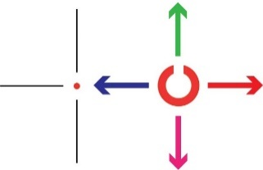
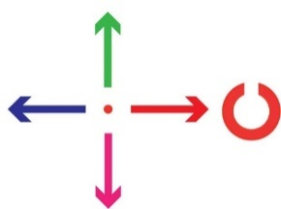
Behavior Model : factors that predict the direction in which the monkey will saccade
Separately modeled two categories of trials (per monkey):
Predictors in logistic regression model (e.g. for U/D task):
Gap direction in current trial: Up or Down
Gap direction in three previous trials: (-1), (-2), (-3)
Saccade direction in three previous trials (separately for U/D vs. L/R saccades)
“Up/Down” task
“Left/Right” task

Slide 2
Mickey’s saccade choices exhibit strong effects from past-trials stimuli and choices

Slide 3




Generalized Linear Model (GLM) for predicting how neural responses depend on behavior factors
“Event response”
50ms binned spike counts
5-trial rolling average baseline firing rate
Trial-by-variable regressor matrix
Free parameters: weights per regressor
Poisson spiking model:
$$\vec{y}$$
$$\vec{ν}$$
$$X$$
$$\vec{w}$$
Fixation → Cue → C
→ Delay → Target
→ Saccade → Reward
$$\vec{y} | \vec{w}∼Poisson[\vec{y};\exp\left(\vec{v}+X\vec{w}\right)]$$
Group LASSO regularized
All basis functions aligned to one type of event → 0 if not important

Slide 4

Hierarchical selection of important task-condition dependencies for event responses
“Event response”
50ms binned spike counts
5-trial rolling average baseline firing rate
Trial-by-variable regressor matrix
Free parameters: weights per regressor
Hierarchical model:
Choose a task condition type C
Construct model with specialization by some combo of C
If best model in (2) is no better than without specialization, stop
Repeat from (1) with best model in (2)
$$\vec{y}$$
$$\vec{ν}$$
$$X$$
$${\vec{w}}_{C(i)}$$
Gap direction
Saccade direction
Past-trial gap, saccade
Fixation → Cue → C
→ Delay → Target
→ Saccade → Reward

Slide 5
Neural responses are heterogeneous and depend on multiple behavioral factors

Slide 6
Neural responses are heterogeneous and depend on multiple behavioral factors

Slide 7
Decoding of task variables from neural activity
200ms binned firing rates aligned to various task events
Neural responses depend on multiple task variables
→ Need to re-balance task design by applying event weights
e.g. Dependence on trial outcome (error/correct) and gap direction:
Outcome | Gap
correct | 0
correct | 180
error | 0
correct | 180
correct | 180
error | 0
error | 180
Outcome | Gap
correct | 0
correct | 180
error | 0
correct | 180
correct | 180
error | 0
error | 180
Balanced design:
no behavioral correlation between task conditions to be decoded
If a cell has gap=180 preference
Can decode condition because of behavioral correlation
trials
trials

Slide 8
Better-performing monkey has sustained neural info about C stimulus gap direction until reward

Slide 9
Worse-performing monkey has more neural info about past outcome than C stimulus gap direction

Slide 10
Responses to random rewards are difficult to obtain statistical significance for

