Slide 1
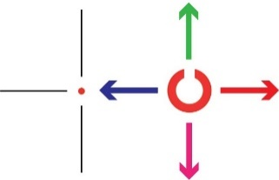
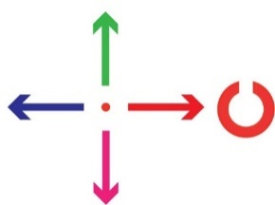
Behavior Model : factors that predict the direction in which the monkey will saccade
Separately modeled two categories of trials (per monkey):
Predictors in logistic regression model (e.g. for U/D task):
Gap direction in current trial: Up or Down
Gap direction in three previous trials: (-1), (-2), (-3)
Saccade direction in
“Up/Down” task
“Left/Right” task

Slide 4
Neural responses are heterogeneous and depend on multiple behavioral factors

