Slide 1

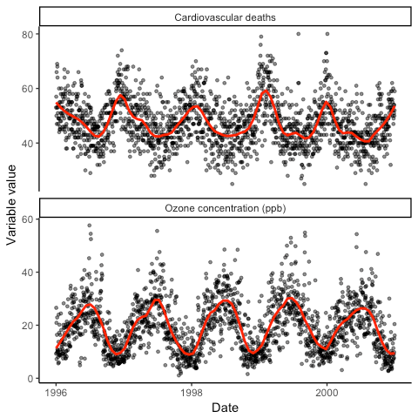
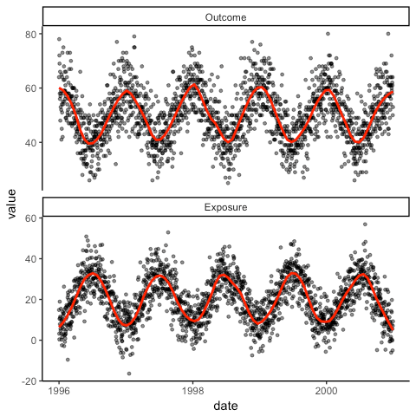
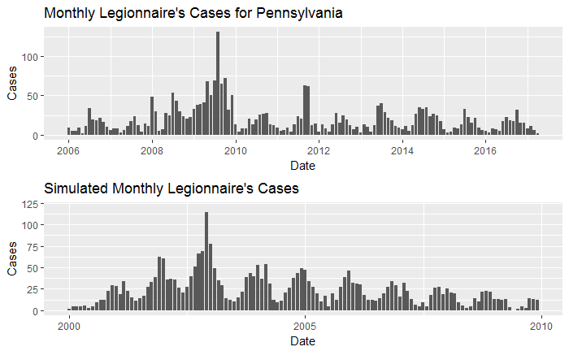
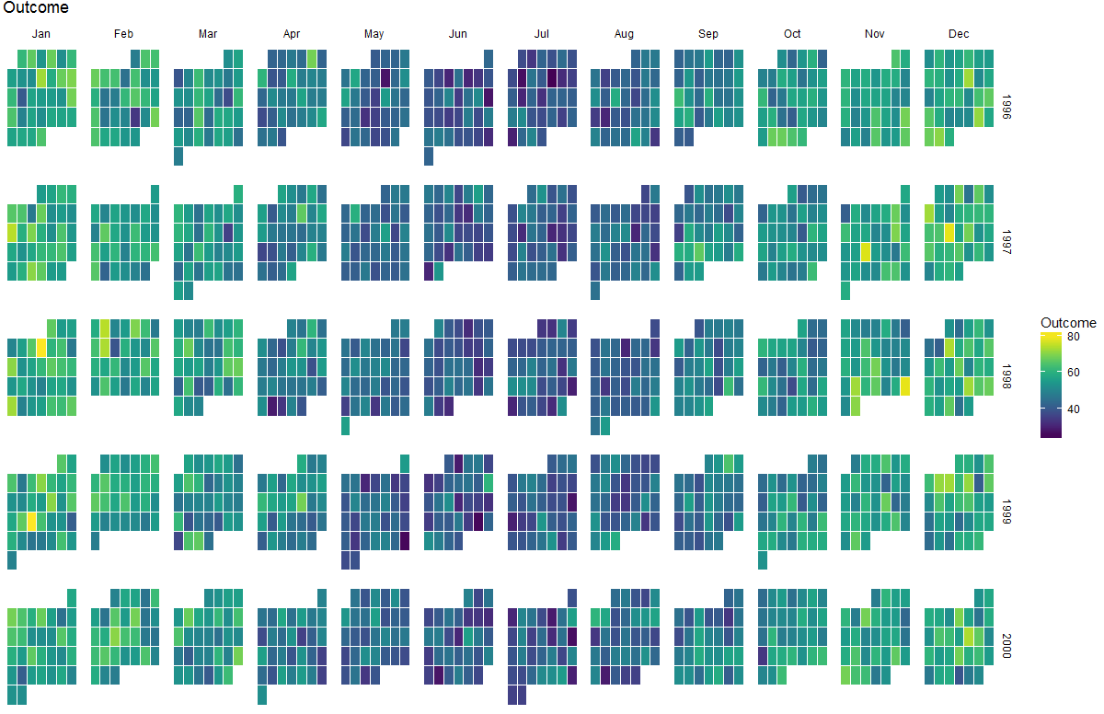
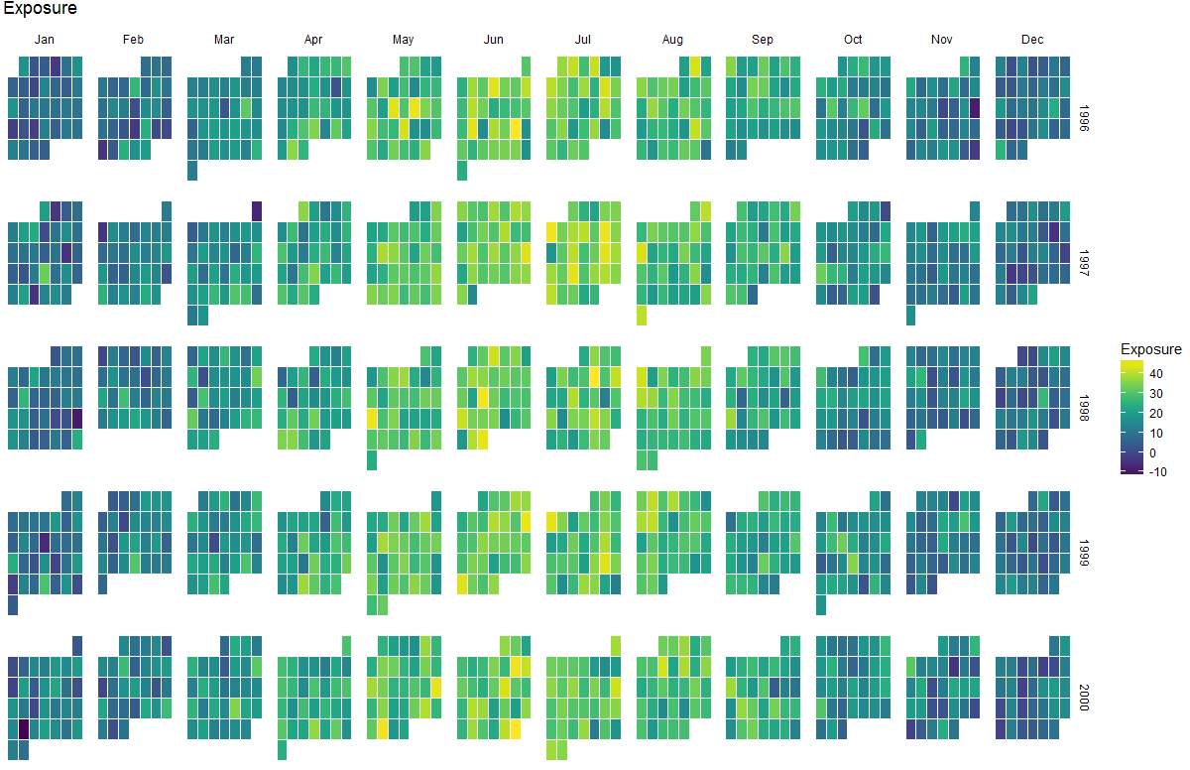
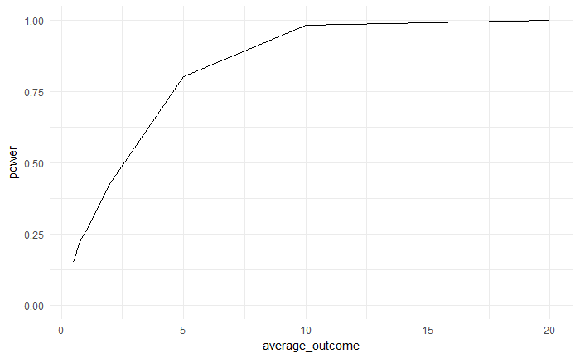
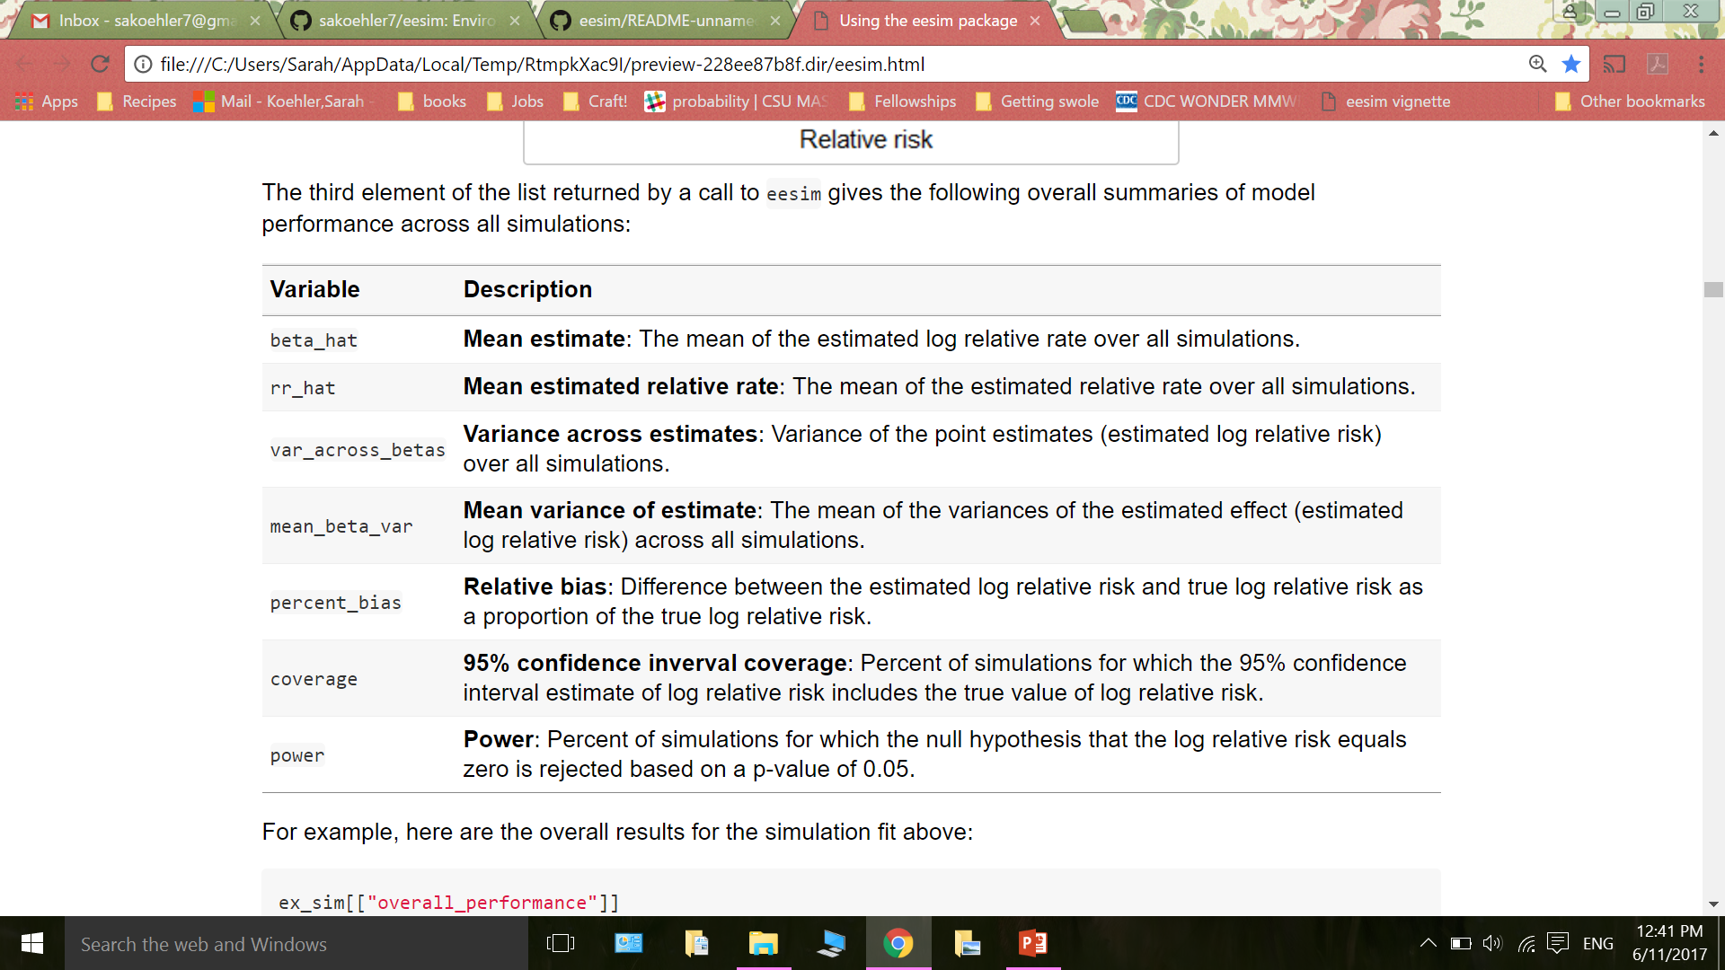
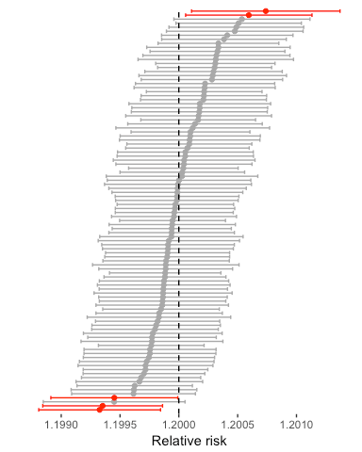
‘eesim’: R Software for Environmental Epidemiology Simulations
Sarah Koehler
Brooke Anderson
Colorado State University
Example: Heat Waves
The `eesim` package includes four main parts, and the user has the option to customize different aspects of the simulation at each of these steps :
1. Generation of exposure data;
2. Generation of outcome data;
3. Fitting models to simulated data; and
4. Evaluating model performance on simulated data.
Here is an example of using `eesim` to perform this process. The plot on the left shows time series of daily ozone concentration (in parts per billion [ppb]) and cardiovascular deaths in Chicago, IL (1996--2000). We used the characteristics of this data to generate a similar dataset, shown on the right, to evaluate model performance.
This simulated data can also be visualized using the `calendar_plot` function that comes with the package:
The `eesim` function can generate multiple similar simulated datasets and investigate the performance of a specified model in estimating the association between exposure and health outcome. `eesim` returns these overall summaries of model performance across all simulations:
Power Analysis and Customization
Simulation studies can be used to determine effective sample size or power when planning or proposing future research studies, especially when modeling of the study data will be particularly complex and when the strong assumptions of classical, analytical power analysis are questionable (Bellan 2015; Johnson 2015; Burton 2009; Alfons 2010; Beaujean 2014; Schoemann 2014).
Here is an example of conducting a power analysis for a planned study of the relationship between Legionnaires' disease (LD) and extreme precipitation in a community.
`eesim` can customize:
Exposure trend
Outcome trend
How exposure influences
the expected outcomes
Randomization from
the trend lines
Models for fitting the
simulated data
Many epidemiologic data sets are of a sensitive nature and not publicly available. Here we compare data from the CDC with data simulated using `eesim`. We obtained the trend using the outcome customization options in the `eesim` function.
This work was supported by a grant from the National Institute of Environmental Health Sciences (R00ES022631) and a fellowship from the Colorado State University Programs for Research and Scholarly Excellence.
Introduction
‘eesim’ is an R package which provides functions to create simulated time series of environmental exposures (e.g., temperature, air pollution) and health outcomes for use in power analysis and simulation studies in environmental epidemiology. This package also provides functions to evaluate the results of simulation studies based on these simulated time series.
Motivation
Simulation studies are important in environmental epidemiology research on air pollution, temperature, and other exposures. For example, simulated data can be used to test new statistical models and perform power analyses. Two current challenges of simulating time series data for epidemiology studies are
methods for simulating are inconsistent, making it difficult to compare results from different studies, and
developing the code to simulate environmental time series for these types of studies can be time consuming.
Simulated data has been used in a number of studies in environmental epidemiology:
Investigating short-term mortality displacement following heat waves (Armstrong 2014)
Comparing experimental designs and model choice (Bateson 1999; Bateson 2001; Peng 2006; Roberts 2006)
Investigating geographic heterogeneity of exposures (Strickland 2015; Gryparis 2009; Butland 2013)
Assessing the performance of a proposed method for estimating the health effects of multi-pollutant exposures (Bobb 2015).
We can use the simulated data to calculate the power for different sample sizes, relative risks, or average outcomes. Since Legionnaire’s disease is relatively rare, we are interested in the power resulting from different amounts of average daily cases. The plot on the left is returned from the `power_calc` function in `eesim`.
References
Alfons A, Templ M, Filzmoser P (2010). “An Object-Oriented Framework for Statistical Simulation: The R Package simFrame.” Journal of Statistical Software, 37(i03).
Armstrong B, Gasparrini A, Hajat S (2014). “Estimating mortality displacement during and after heat waves.” American Journal of Epidemiology, 179(12), 1405-1406.doi: 10.1093/aje/kwu083.
Bateson TF, Schwartz J (1999). “Control for seasonal variation and time trend in case-crossover studies of acute effects of environmental exposures.” Epidemiology, 10(5), 539-544.
Bateson TF, Schwartz J (2001). “Selection bias and confounding in case-crossover analyses of environmental time-series data.“ Epidemiology, 12(6), 654-661.
Beaujean AA (2014). “Sample size determination for regression models using Monte Carlo methods in R.” Practical Assessment, Research & Evaluation, 19(12), 1-16.
Bellan SE, Pulliam JR, Pearson CA, Champredon D, Fox SJ, Skrip L, Galvani AP, Gambhir M, Lopman BA, Porco TC, et al. (2015). “Statistical power and validity of Ebola vaccine trials in Sierra Leone: a simulation study of trial design and analysis.” The Lancet Infectious Diseases, 15(6), 703-710.
Bobb JF, Valeri L, Henn BC, Christiani DC, Wright RO, Mazumdar M, Godleski JJ, Coull BA (2015). “Bayesian kernel machine regression for estimating the health eects of multipollutant mixtures.” Biostatistics, 16(3), 493-508. doi:10.1093/biostatistics/kxu058.
Burton PR, Hansell AL, Fortier I, Manolio TA, Khoury MJ, Little J, Elliott P (2009). “Size matters: just how big is BIG? Quantifying realistic sample size requirements for human genome epidemiology.” International journal of epidemiology, 38(1), 263-273.
Butland BK, Armstrong B, Atkinson RW, Wilkinson P, Heal MR, Doherty RM, Vieno M (2013). “Measurement error in time-series analysis: a simulation study comparing modelled and monitored data.” BMC Medical Research Methodology, 13, 136.
Gryparis A, Paciorek CJ, Zeka A, Schwartz J, Coull BA (2009). “Measurement error caused by spatial misalignment in environmental epidemiology.” Biostatistics, 10(2), 258-274. doi:10.1093/biostatistics/kxn033.
Johnson PC, Barry SJ, Ferguson HM, Müller P (2015). “Power analysis for generalized linear mixed models in ecology and evolution.” Methods in Ecology and Evolution, 6(2), 133-142.
Peng RD, Dominici F, Louis TA (2006). “Model choice in time series studies of air pollution and mortality.” Journal of the Royal Statistical Society: Series A (Statistics in Society), 169(2), 179-203.
Roberts S, Martin MA (2006). “The question of nonlinearity in the dose-response relation between particulate matter air pollution and mortality: Can Akaike's Information Criterion be trusted to take the right turn?” American Journal of Epidemiology, 164(164), 1242-1250. doi:10.1093/aje/kwj335.
Schoemann AM, Miller P, Pornprasertmanit S, Wu W (2014). \Using Monte Carlo simulations to determine power and sample size for planned missing designs." International Journal of Behavioral Development, 38(5), 471-479.
Strickland MJ, Gass KM, Goldman GT, Mulholland JA (2015). “Effects of ambient air pollution measurement error on health effect estimates in time-series studies: a simulation-based analysis.” Journal of Exposure Science and Environmental Epidemiology, 25(2), 160-166.
After running the simulation, you can look at the relative risk point estimate and 95% confidence interval from each of the 100 simulations, as well as which 95% confidence intervals include the true relative rate, using the `coverage_plot` function that comes with the package.

