Slide 1
Stock Prediction
Name: Sako M
Being rich, became easy!

Slide 2
Solution
A platform which can continuously:
Collect
Transport
Monitor
Predict
Using Yahoo Finance library
Ex: To Google Cloud
In Console and Graylog2
Via Linear Regression

Slide 3
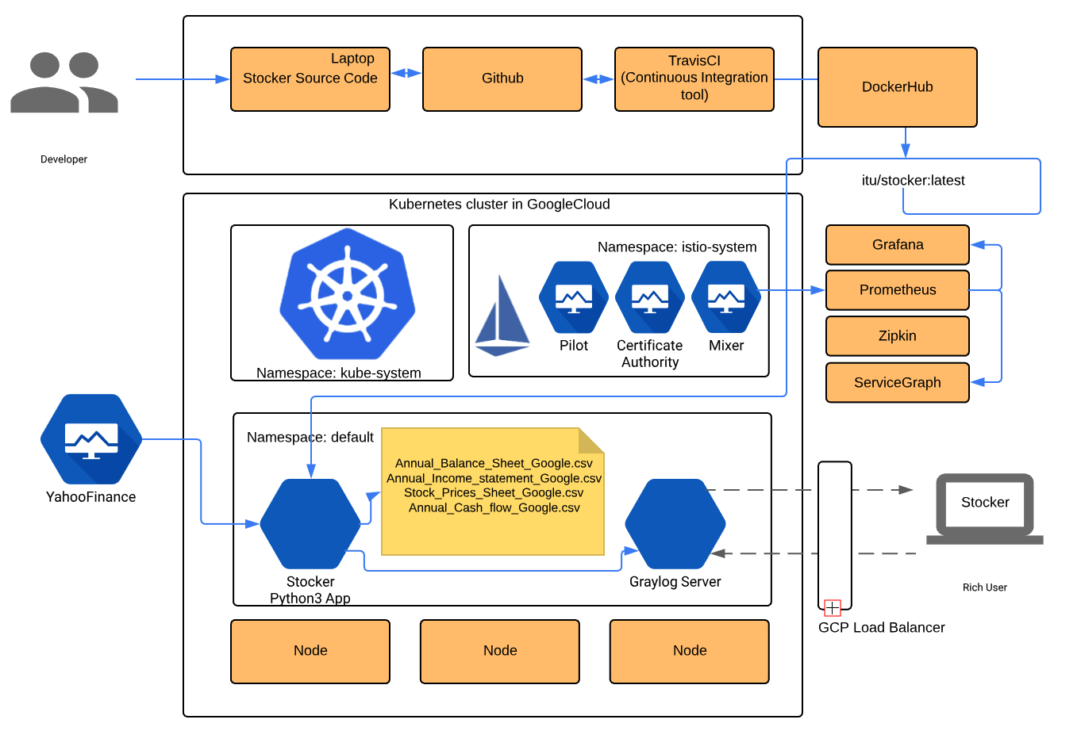
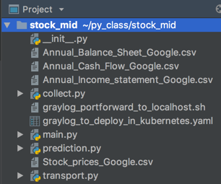
Collect, Convert, Transport and Store
Kubernetes: To deploy application and Graylog2 server.
Istio: Observability, Security and Networking of application.
Github: To store Source Code of our application.
TravisCI: To run test_suite during development
DockerHub: To store artifactory, docker image of our application.
Graylog2: For monitoring,metrics, alert and notification of our application.
Notes:
How do you track your job applications?
What are the challenges you face?
Are you already part of fast growing Open Source world?

Slide 4
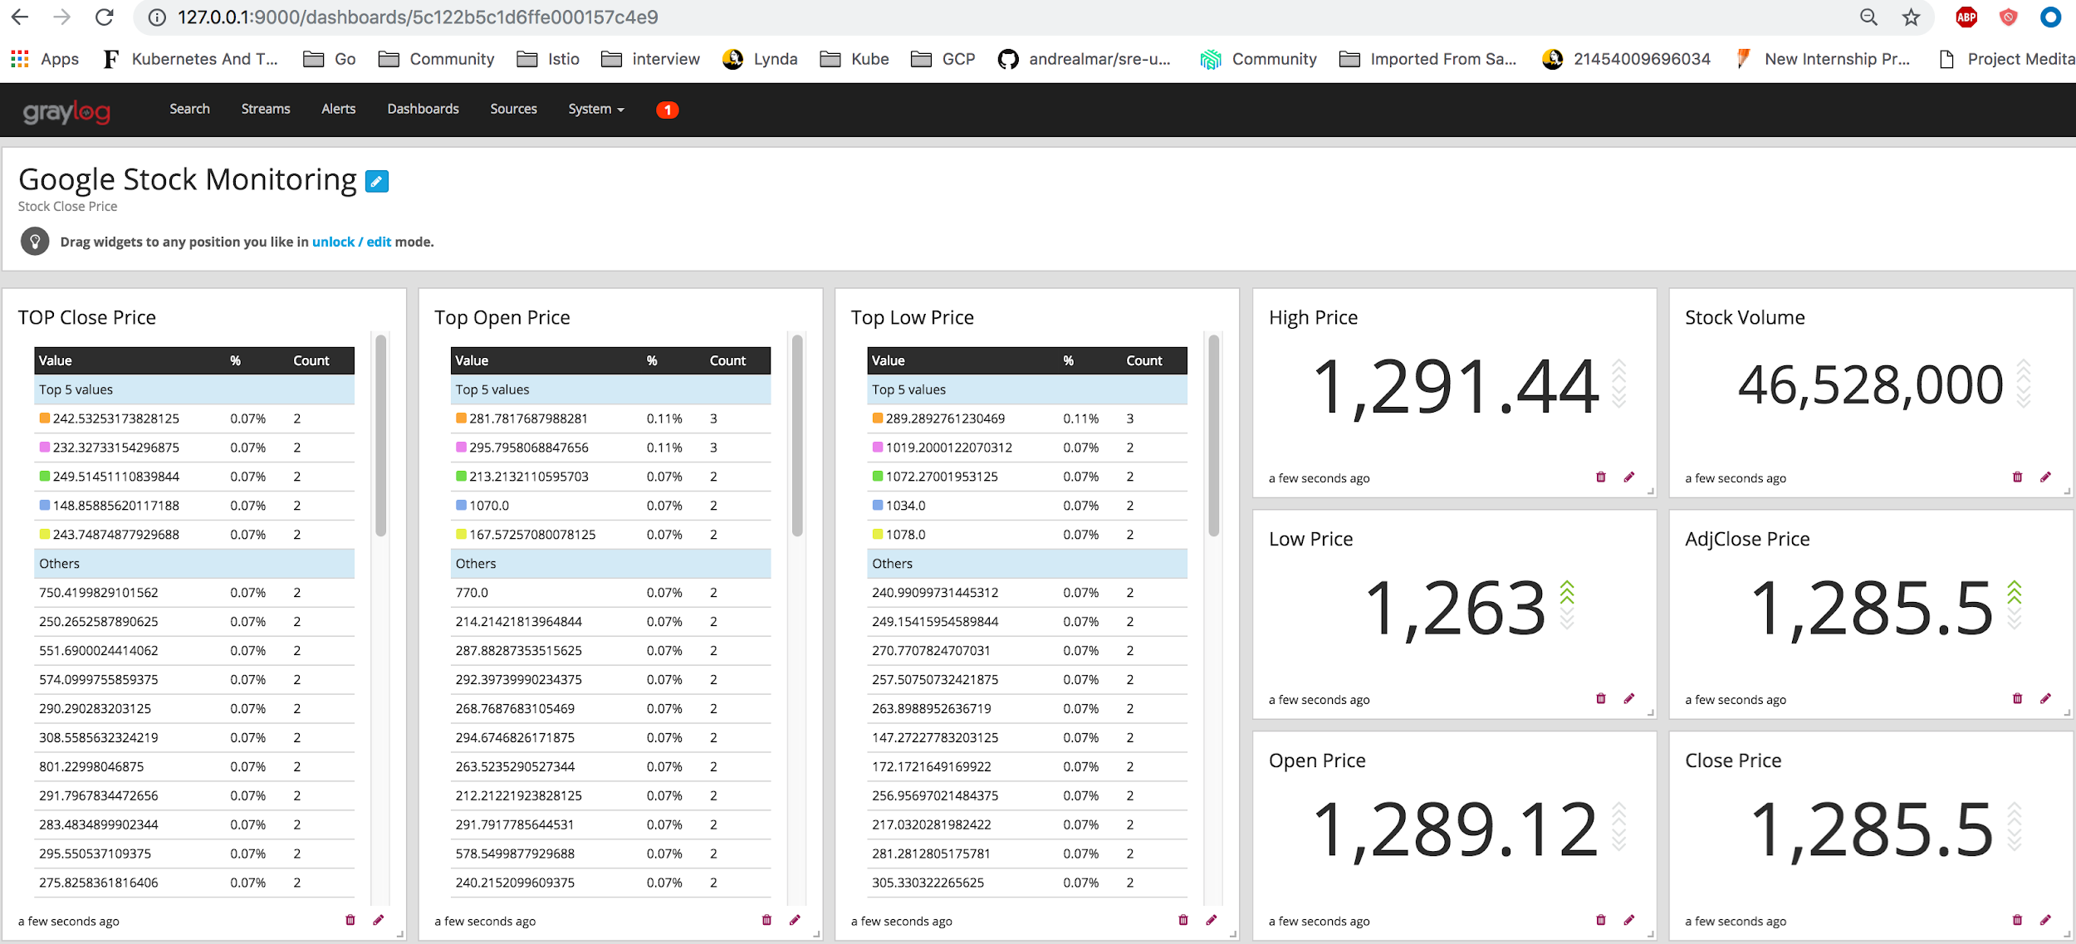
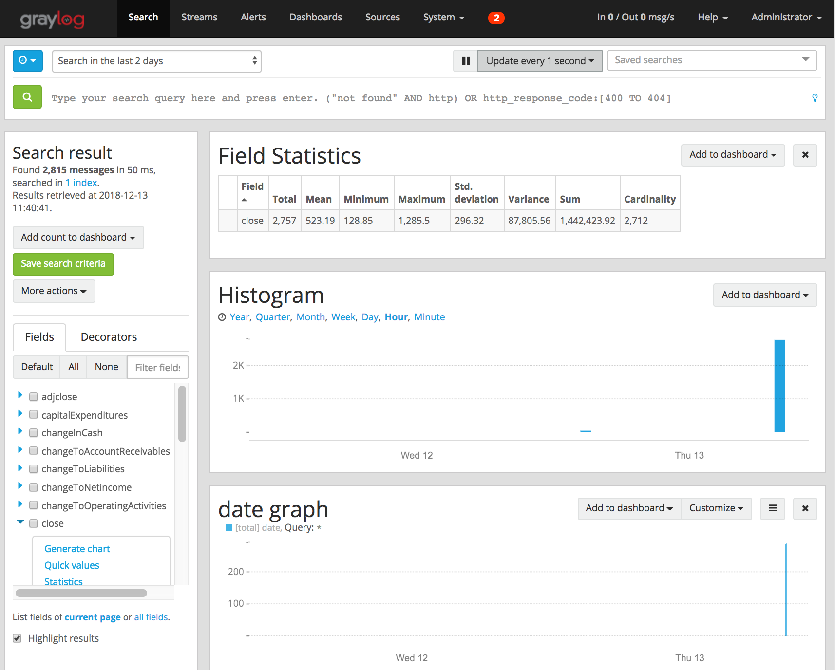
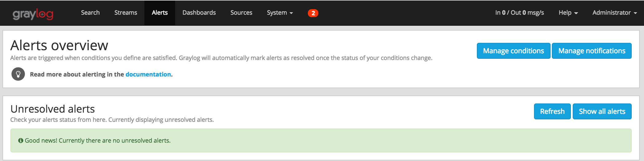




Metrics, Alerts and Notifications
Metrics
Dashboard View
Notifications
Notes:
How do you track your job applications?
What are the challenges you face?
Are you already part of fast growing Open Source world?

Slide 5
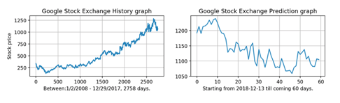
Prediction
Confidence level: 96 %
Statistic Analysis:
======================================
Stock Exchange Data Source: NasdaqGS
Currency: USD
----------------------------------------------------------------
Valuation Measures
----------------------------------------------------------------
main.market CAP: 742544048128
PE(Price to Earnings Ratio): 40.287464
Price to Sales: 5.717771
----------------------------------------------------------------
Stock Measures
----------------------------------------------------------------
Current Price: 1073.54
Current Change: -0.1899414
Current percent change -0.00017689867
Current volume: 1246498
Daily Low: 1064.994
Daily High: 1088.07
Yearly high: 1291.44
Yearly Low: 984
50 day moving avg: 1069.5326
200 day moving avg: 1153.7058
Previous day close price: 1073.73
Open price: 1075.67
10days Average daily volume: 1607487
30 days Average daily volume: 2064629
Beta(3y monthly), stock volatility(>1, risky but profitable): 1.330345
Dividents and splits, Currently, missing in YahooFinancials as well
----------------------------------------------------------------
Divindent Yield None
Annual average Divident yield: None
5y average divident yield: None
Dividend Rate: None
Annual average dividend rate None
Payout Ratio: 0
Ex Evidend Date: -
Financial Highlights: Income/Cash/Balance Sheet
----------------------------------------------------------------
Interest Expense: -109000000
Operating Income: 28882000000
Total Operating Expense: 81973000000
Total Revenue: 110855000000
Cost of Revenue: 45583000000
Income Before Tax: 27193000000
Income Tax Expense: 14531000000
Gross Profit 65272000000
Net Income: 12662000000
Net Income from Continuing Ops: 12662000000
Research and Development Cost: 16625000000
Book Value(Net Asset=TotalAsset-IntangibleAsset(Patent,Goodwill)): 169840000000
EBITDA(Earnings before interest,tax depreciation and amartization): 28882000000
Earnings per share: 26.646998679291404
Notes:
How do you track your job applications?
What are the challenges you face?
Are you already part of fast growing Open Source world?

