Slide 1
Data Pipelines project – Companies’ ESG data
Shweta Yadav

Slide 2
Project Motivation
Oil & Gas to Energy Industry
Energy Transition
Sustainability
Environmental Social and Governance (ESG)

Slide 3
Web Scraping Project
Forbes 2000 companies
Financial Metrics
ESG information
Company data

Slide 4






Dataset sources

Slide 5
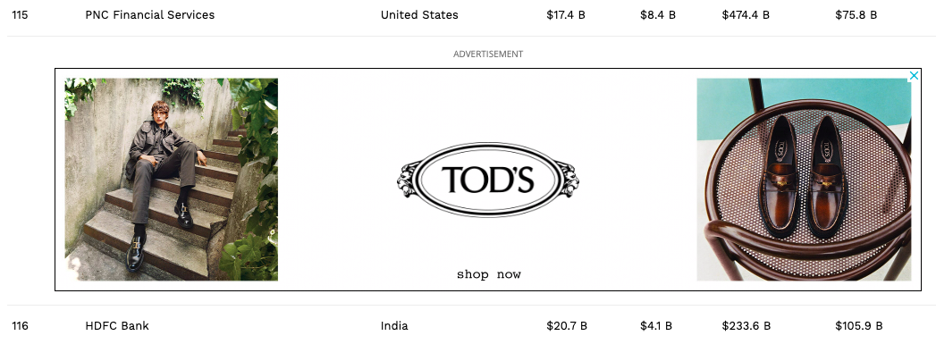
Webpages Layout

Slide 6
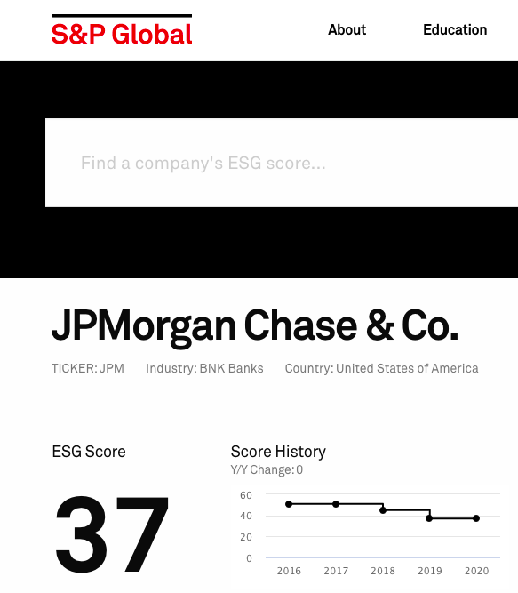
Webpages Layout

Slide 7

Webpages Layout

Slide 8
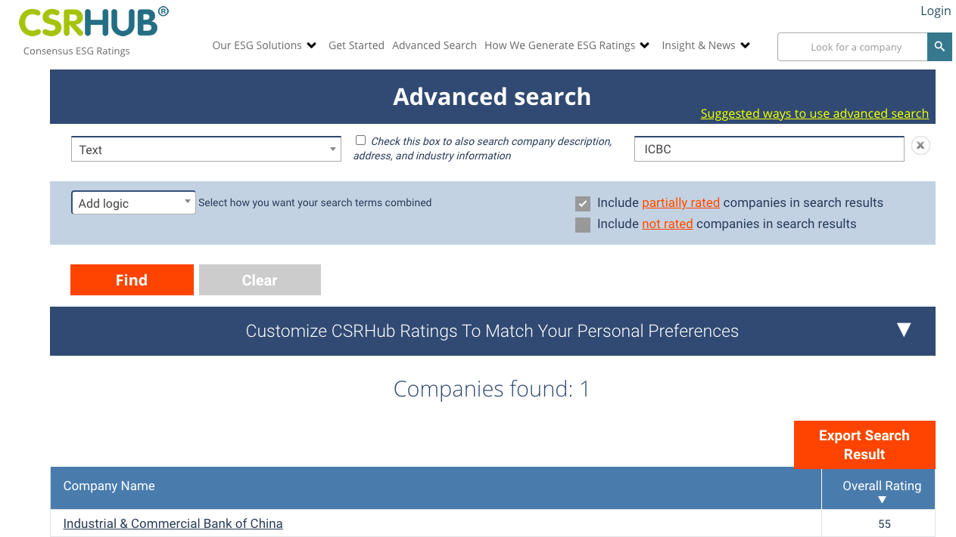
Webpages Layout

Slide 9
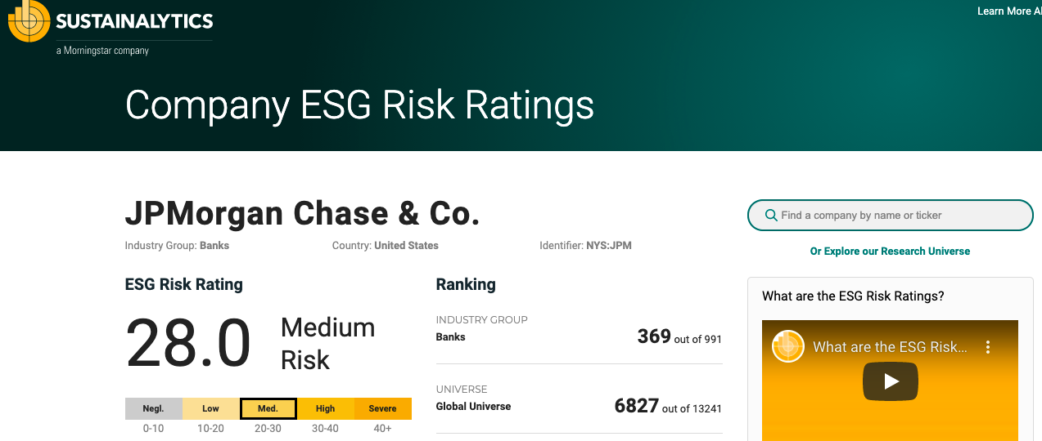
Webpages Layout

Slide 10
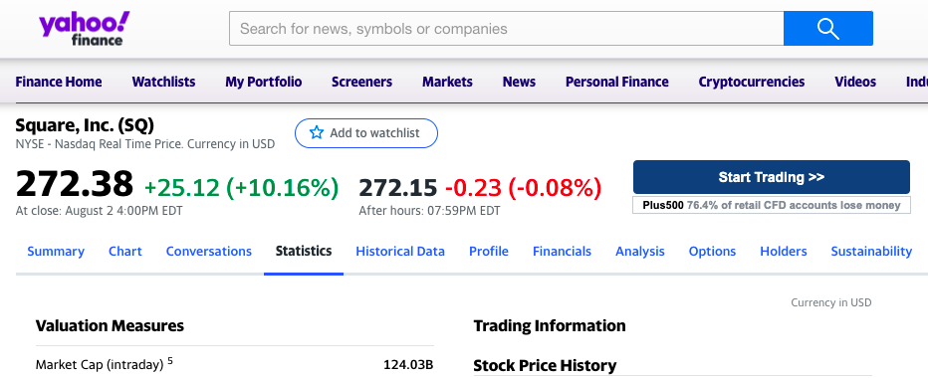
Webpages Layout

Slide 11


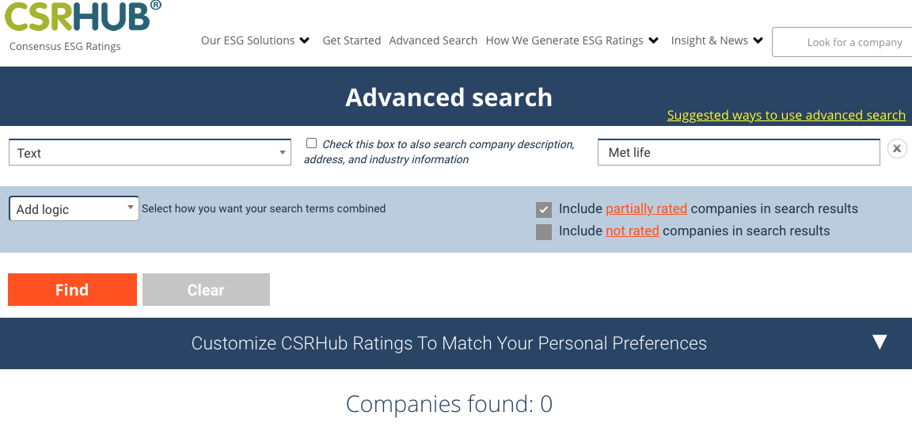
Initial Data Cleaning

Slide 12
Generated Dataset
.
.
.
Company Name | Country | Industry | Market Cap | Price/Earnings | ESG Score
….
.
.
.
.
.
.
.
.
.
.
2000 Rows and 30 columns
.
.
.
Notes:
How they are valued in the market

Slide 13
Classes
AWS EC2
AWS S3

