Slide 2
Optimizing and securing data warehousing in the cloud with Amazon Redshift: Best practices and cost-benefit analysis
Peeyush Singh l Shramish Kafle

Slide 3
Agenda
Introduction: Data Warehousing
Introduction: Amazon Redshift
Overview of Amazon Redshift: Architecture
Overview of Amazon Redshift: Features, and Capabilities
Optimizing Amazon Redshift Performance
Securing Your Redshift Environment
Cost-Benefit Analysis
Conclusion

Slide 4
Introduction: Data Warehousing
Problem: Vast increase in data generation from various sources: IoT, social media, business transactions.
Impact on Business: Necessity for businesses to leverage data for competitive advantage.
Business Needs: Increasing reliance on data analytics to drive decisions.
Benefits of Data Warehousing: Improved customer insights, product innovation, and operational efficiencies.
Challenges in traditional data management:
Traditional data storage solutions struggling to scale efficiently.
High costs and complexities in data storage management.
Difficulty in processing and analyzing large datasets effectively.
Increasing threats and regulatory requirements.

Slide 5
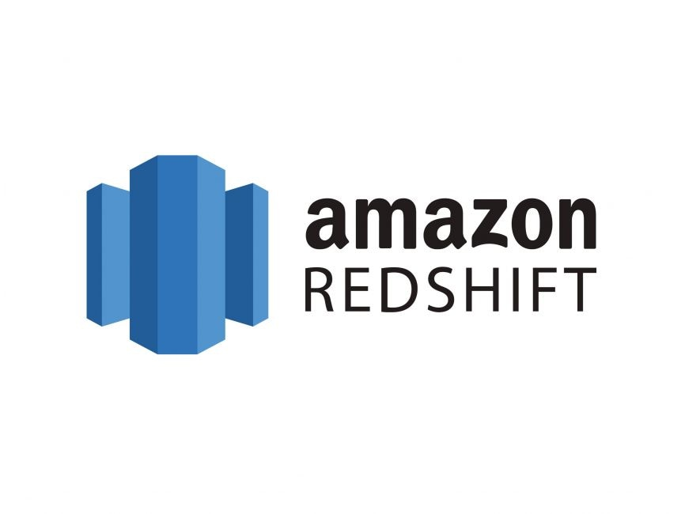
Introduction: Amazon Redshift
Amazon Redshift is a fully managed, petabyte-scale data warehouse service in the cloud.
Launched by Amazon Web Services (AWS) in 2012.
Designed for large-scale data storage and analysis.
Benefits:
Cost-Effective
Cost-efficient pricing models (pay-as-you-go, reserved instances).
Pay only for what you use.
High Availability and Security
Built-in security features including encryption and VPC support.
Ease of Use
SQL-based interface.
Comprehensive management through AWS Management Console.
Key Features:
Scalability
Easily scale from a few hundred gigabytes to a petabyte or more.
Pay only for what you use.
Performance
Columnar storage and data compression.
Massively Parallel Processing (MPP) for fast query performance.
Integration
Seamlessly integrates with AWS services like S3, Glue, and QuickSight.
Management
Automated backups, maintenance, and updates.
Redshift Spectrum allows querying data directly in S3.

Slide 6
Overview of Amazon Redshift: Architecture
Columnar Storage
Efficient storage format that reduces I/O and enhances query performance.
Unlike traditional row-based storage, data in columnar storage is stored by columns rather than rows.
Each column's data is stored together, allowing for efficient data compression and retrieval.
Columns often contain similar data types and repeated values, making them highly compressible. Efficient compression reduces storage space and speeds up data retrieval.
Queries typically access a subset of columns rather than entire rows. Reading only the relevant columns minimizes the amount of data scanned and accelerates query execution.
Ideal for analytical workloads where operations are performed on large datasets and specific columns like aggregations and filtering.
Massively Parallel Processing (MPP)
Distributes data and query load across multiple nodes for fast performance, drastically reducing query times.
MPP uses a cluster of nodes where each node processes a portion of the data.
Leader node: Receives queries and plans the execution strategy and distributes parts of the query to different compute nodes.
Compute nodes: Each node works on a portion of the data simultaneously and results are sent back to the leader node for aggregation.
Scalability: Easily add more nodes to handle larger datasets and more complex queries.
Load Balancing: Distributes the query load evenly across nodes, preventing bottlenecks.
High-Performance Query Execution
Optimized for complex queries and large data sets.
Cost-Based Optimizer: Analyzes multiple execution plans and selects the most efficient one.
Statistics Collection: Gathers and uses data distribution statistics to improve query performance.
Automatic Rewriting: Optimizes queries by rewriting them for better performance.
Concurrency Scaling: Automatically adds capacity to handle multiple concurrent queries.
Result Caching: Stores results of previously executed queries to speed up repeated query executions.
Materialized Views: Precomputed and stored query results for faster access to frequently queried data.

Slide 7
Overview of Amazon Redshift: Features, and Capabilities
Integration with AWS Services
S3 for Data Storage
Seamless Data Loading: Easily load data into Redshift from S3.
Scalable Data Storage: Store vast amounts of data with high durability and availability.
Data Lake Integration: Use S3 as a data lake for storing diverse datasets.
AWS Data Pipeline
Automated Data Workflows: Define data-driven workflows to automate data movement.
Reliable Data Transfer: Ensure data is moved reliably and on schedule.
Integration with Other AWS Services: Connect Redshift with other AWS services for comprehensive data processing.
Amazon QuickSight
Advanced Data Visualization: Create interactive dashboards and visualizations.
Real-Time Analytics: Perform real-time analytics on Redshift data.
Easy-to-Use Interface: User-friendly interface for creating and sharing insights.
Key Features of Amazon Redshift
Automatic Backups
Scheduled Backups: Redshift automatically performs regular backups of your data. Appropriate retention policies can be set.
Point-in-Time Recovery: Allows restoration of data to any specific point in time.
Cross-Region Backups: Replicate snapshots to different AWS regions for disaster recovery.
Data Compression
Columnar Storage Compression: Data is stored in a columnar format, which allows high compression rates.
Reduced Storage Costs: Compressing data minimizes storage requirements and costs.
Faster Query Performance: Compressed data reduces I/O, speeding up query execution.
Redshift Compliance Certifications
HIPAA (Health Insurance Portability and Accountability Act)
Ensures protection of healthcare data.
Compliance with stringent security and privacy standards.
GDPR (General Data Protection Regulation)
Safeguards personal data and enhances data privacy rights.
Requires data protection measures and compliance checks.

Slide 8
Optimizing Amazon Redshift Performance
Cluster management:
Choosing the right cluster size and type for your workload.
Data Volume: Larger datasets require more nodes to ensure efficient processing and storage.
Query Complexity: Complex queries benefit from more compute power and memory.
Node Types: Dense Compute vs. Dense Storage
Dense Compute (DC): High-performance CPUs and large amounts of RAM. Ideal for intensive query processing and performance-critical applications.
Use Case: Real-time analytics and dashboards, High-frequency trading platforms.
Dense Storage (DS): Larger disk storage capacity at a lower cost. Suitable for massive datasets where storage capacity is more critical than compute power.
Use Case: Archiving and historical data analysis, Data lakes with large volumes of infrequently accessed data.
Workload management:
Manages query concurrency and resource allocation.
Define query queues with specific memory and concurrency settings.
Allocates resources dynamically based on workload demands.
Ensures high-priority queries get the necessary resources.
Prevents lower-priority queries from consuming too many resources.
Define queue priorities, memory allocation, and concurrency settings.
Data Distribution Styles:
Determines how data is distributed across nodes.
Types:
KEY: Distributes rows based on the values of one or more columns.
EVEN: Distributes rows evenly across all nodes.
ALL: Copies the entire table to every node.
Sort Keys:
Determines the order in which data is physically stored.
Improves query performance by reducing the amount of data scanned.
Types:
Compound Sort Key: Sorts data based on a combination of columns.
Interleaved Sort Key: Allows for efficient querying on multiple columns.
Data loading and unloading
Parallel Data Loading: Use COPY command with PARALLEL option to load data in parallel.
Data Distribution: Pre-sort data files to align with Redshift's distribution key for optimal loading.
Optimized File Formats: Choose efficient file formats like AVRO, Parquet, or ORC for data loading/unloading.
Data Compression: Compress data files to reduce storage and improve loading/unloading performance.
Tools for Optimization
AWS Glue: Use AWS Glue for data preparation and ETL tasks before loading into Redshift.
Amazon EMR: Process and transform data using Amazon EMR before loading into Redshift.
Data Pipeline: Orchestrate complex data workflows involving Redshift and other AWS services.

Slide 9
Securing Your Redshift Environment
Access Control:
IAM (Identity and Access Management)
Assign minimum necessary permissions to IAM roles and security groups to reduce the risk of unauthorized access.
Multi-Factor Authentication (MFA): Enhance security with MFA for database access.
Database User Roles and Permissions: Define granular permissions for database users and groups.
Cluster Operations: Assign IAM roles to users or applications that need to perform management operations on Redshift clusters, such as cluster creation, deletion, or modification.
Data Access: Use IAM roles to grant permissions for accessing specific Redshift databases, tables, or views based on the principle of least privilege.
Integration with Other AWS Services: IAM roles facilitate secure integration with other AWS services like AWS Glue for ETL tasks or Amazon S3 for data loading.
Security Groups
Inbound Rules: Define rules to allow specific IP addresses, CIDR blocks, or other security groups to access Redshift clusters via designated ports (e.g., port 5439 for Redshift).
Outbound Rules: Specify outbound traffic rules to control communication initiated by Redshift clusters to other resources within the VPC or external endpoints.
VPCs
Isolation: Place your Amazon Redshift clusters within a VPC to isolate them from the public internet and other AWS resources not explicitly allowed access.
Private Subnets: Deploy Redshift clusters in private subnets within the VPC to prevent direct internet access and limit exposure to unauthorized access attempts.
Routing and Access Control: Use route tables and network ACLs (Access Control Lists) within the VPC to manage inbound and outbound traffic flows to and from Redshift clusters.
Data Encryption :
Encryption at Rest: Encrypt data stored in Redshift clusters using AWS KMS (Key Management Service) or HSM (Hardware Security Module).
Encryption in Transit: Secure data transmission with SSL (Secure Sockets Layer) connections between client applications and Redshift clusters.
Automatic Data Encryption: Enable automatic encryption for snapshots, backups, and replicas.
Monitoring & Auditing:
CloudWatch Metrics:
Gain insights into how your Redshift clusters are performing in real-time.
Set alarms to alert you of potential issues before they impact users or applications.
Use metrics to optimize cluster configurations and resource allocation based on workload patterns.
AWS CloudTrail:
Logs API calls made to Redshift, including who made the call, what actions were performed, and from where the request originated.
Tracks changes to Redshift clusters, configurations, security settings, and other AWS resources, enabling you to understand the history of resource modifications.
VPC Flow Logs: Capture network traffic to and from Redshift clusters for security analysis.

Slide 10
Cost-Benefit Analysis
Reserved Instances vs On-demand pricing
On-demand Pricing:
Pay-as-you-go model with no upfront costs.
Flexible but can be more expensive for long-term usage.
Reserved Instances:
Commit to a one- or three-year term for significant discounts.
Ideal for predictable workloads and long-term savings.
Savings Example:
Up to 75% discount compared to on-demand pricing.
Cost Implications of Node Types:
Dense Compute (DC): Higher performance, suitable for intensive queries.
Dense Storage (DS): Larger storage capacity at a lower cost per GB.
Using Concurrency Scaling to Manage Peak Loads
Purpose: Adds capacity during peak loads.
Features: Consistent performance, pay for extra capacity only when used.
Benefits: Ideal for variable query volumes.
Redshift Query/Usage Reports
Purpose: Insights into query performance and usage.
Features: Metrics on execution times, resource utilization.
Benefits: Optimize performance and resource usage.
Cost Components:
Compute Nodes: Cost based on node type (e.g., dc2.large, ds2.xlarge).
Storage: Cost per GB of storage provisioned in Redshift clusters.
Data Transfer: Costs associated with data ingress and egress from Redshift.
Cost Optimization Strategies:
Right-sizing: Selecting appropriate node types based on workload and performance requirements.
Auto-scaling: Dynamically adjusting compute capacity based on workload demands.
Data Compression: Reducing storage costs through efficient data compression techniques.
Reduced Infrastructure Costs:
Reduction in physical server costs, energy usage, and required floor space.
Pay-as-you-go pricing model based on actual usage and storage.
Improved ROI (Return on Investment):
Faster time-to-insight with efficient data processing and query performance.
Decreased need for manual interventions and IT support tasks.
Enables cost-effective analytics and data-driven decision-making.
Performance enhancements in Redshift directly translate to improved operational efficiency and customer satisfaction.
ROI from Redshift is realized through both tangible cost reductions and intangible benefits that drive business growth and competitiveness.

Slide 11
Conclusion
Strategic Importance of Redshift
Scalable Solutions: Amazon Redshift supports scalable, efficient, and secure cloud data warehousing that's essential for modern data-driven strategies.
Integration and Scalability: With seamless integration capabilities with other AWS services, Redshift enables businesses to dynamically scale and adapt to changing data needs while maintaining operational flexibility.
Recap of Main Topics
Performance Optimization: We discussed the importance of configuring your Redshift environment to optimize performance, including right-sizing clusters, choosing effective distribution styles and sort keys, and tuning queries.
Security Measures: We highlighted robust security practices for Redshift, emphasizing encryption, comprehensive access controls, and continuous monitoring to safeguard your data.
Cost Efficiency: We explored various strategies to manage and optimize costs, such as adopting reserved instances, efficiently managing workloads, and using tools like AWS Cost Explorer for regular financial oversight.
Next Steps
Apply Best Practices: Encourage your team to implement the best practices discussed today to optimize your Redshift environment for better performance and security.
Leverage Redshift's Capabilities: Utilize the full potential of Redshift to improve your business's data analysis and intelligence capabilities.
Continuous Improvement: Keep evolving your data strategies by staying updated with the latest in cloud data warehousing technology and practices.

Slide 12
Peeyush Singh | Shramish Kafle

Slide 13
Peeyush Singh | Shramish Kafle

Slide 14

Erklärung der Textebenen, Segoe UI, 20pt, blau
Kapitelüberschrift, Segoe UI, 12pt, grau
Erste Textebene für Fließtext: Segoe UI, 14pt
Zweite Textebene für Bulletpoints: Segoe UI, 14pt
Dritte Textebene für Bulletpoints zweiter ebene: Segoe UI, 14pt
Vierte Textebene für Bulletpoints dritter Ebene: Segoe UI, 12pt
Fünfte Textebene für Aufzählungen: Segoe UI, 14pt
Sechste Textebene für Aufzählungen in zweiter Ebene: Segoe UI, 14pt
Siebte Textebene für Quellenangaben/Anmerkungen: Segoe UI, 12pt, hellgrau
Information Um die Textebenen zu nutzen, verwenden Sie die „Listenebene erhöhen“ oder „Listenebene verringern“ Schaltflächen in der Startleiste:
oder Ihre Tastatur: ALT+Shift+Links oder Rechts.
Achtung Um ein Aufzählungszeichen zu generieren, verwenden Sie bitte ausschließlich die vordefinierten Listenebenen und kreieren Sie diese nicht manuell über die Symbolleiste.

Slide 15
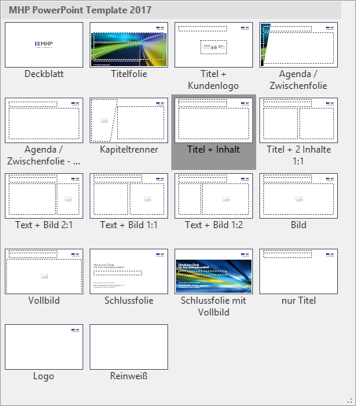
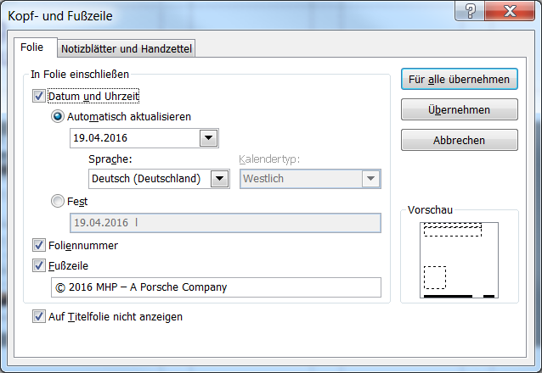
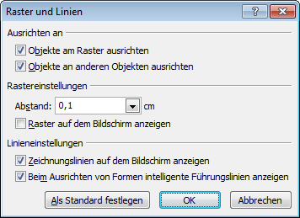

Erklärung der Layouts
Erklärungsfolien
Layouts
Sie können zwischen 18 verschiedenen Layouts wählen.
Zum Ändern gehen Sie auf Start > Layout > und wählen das gewünschte aus.
Kopf und Fußzeile
Zum Ändern der Fußzeile: Einfügen > Kopf- und Fußzeile
Führungslinien anzeigen
Aktivieren Sie die Zeichnungslinien über das Menü „Ansicht“ > Anzeigen > Führungslinien. An den Zeichnungslinien lassen sich Objekte einfacher ausrichten. Optimieren Sie die Einstellungen (wie im Beispiel zu sehen) über Klick auf das Auswahlmenü.

Slide 16
Erklärung des Rasters
Bereich für Titel, Logo und Kapitel
Erklärungsfolien
Bereich für Inhalte
Bereich für Datum, Fußzeile und Foliennummer

