Slide 1
Will India enter a new rate cycle, and how does it reach Nepal?
RBI policy cycles, and Nepal's interest rates under the peg of 1.6 Nepali rupees to the Indian rupee
RateCycle India Nepal | Macroeconomics project | October 2026
Notes:
Two questions. First, is India entering a new interest rate cycle, and how far will it go? Second, because Nepal's rupee is pegged to India's at 1.6, how does India's cycle carry over into Nepal's prices and interest rates?

Slide 2
The answers
Yes
5.75 to 6.00
6 of 12, then 0.5
India entered a hiking cycle on 7 October 2026, repo 5.25 to 5.50. Our model gives a second hike in December a 0.56 chance.
Most likely end by April 2027: 5.75, or 6.00 if oil stays above 110 dollars. A short cycle like 2013 and 2018.
Nepal's market rate followed only 6 of 12 RBI cycles. Since the 2016 corridor the NRB moves 0.5 point per RBI point (p 0.007).
The peg imports India's prices. India's interest rate cycle reaches Nepal through the NRB's own corridor since 2016, while remittance liquidity keeps the market rate on its own path.
Notes:
India: the new cycle has already started; the question now is how long it runs. Nepal: the peg carries India's prices across the border. The market rate follows the RBI only half the time, a coin flip, but since the NRB corridor began in 2016 the NRB's own rate has responded at about half the RBI's move, a significant result in a test declared beforehand (D055).

Slide 3
How the models were trained: seven steps
1
2
3
4
5
6
7
Collect
Choose variables
Features at the cutoff
Targets
Walk forward
Check the skill
Freeze and blind test
1,015 source files from RBI, MOSPI, IMF, BIS, FRED and NRB, each logged with a hash
64 candidates in a ledger; 25 used, each other one kept or dropped with a reason
Only what was published before each decision or month
India: cut, hold or hike. Nepal: moves over 0.5 point in 3 months
Refit at every decision on past outcomes only, up to October 2021
Permutation, stability, block accuracy, replication, ablations
Configuration hashed, then scored once on 2021 to 2026
Data explorer
Variable ledger
Data explorer
Models
Models
Models, stability
Blind backtest
Every choice from step 2 onward was written into the decision log before it was run, and failures stay on the record.
Notes:
The seven steps run in this order and each one feeds the next. The grey line under each step names the page of the Streamlit dashboard where it can be inspected. Every choice in steps 2 to 7 was written into the decision log before it was run.

Slide 4
Steps 1 and 2: data, and a ledger of every variable
Source | What | Files
RBI | Policy statements, policy index, projections | 250
MOSPI | CPI, industrial production | 8
IMF | Nepal CPI, monetary surveys, interest rates | 7
BIS | Policy rates of India and the US | 2
FRED | Brent oil, rupee per dollar, VIX | 3
NRB | Macro tables, time series database | 744
Caldara and Iacoviello | Geopolitical risk index | 1
Files that failed or were incomplete are logged, not silently dropped: 1,015 of 1,177 downloads are usable.
Each variable has a role, a source, a publication lag and a reason for its status, so nothing enters a model unexplained.
Dashboard page: Data explorer, Variable ledger
Notes:
The ledger is data/source_registry/variable_registry.csv. Used means core or in use; excluded includes one variable that was coded and then not used. Each download is in a manifest under data/source_registry/manifests with its address, time and SHA256 hash.

Slide 5
Steps 3 and 4: features at the cutoff, and targets
 | India | Nepal
One row per | RBI decision: 146 since 2001, inter meeting moves included | Month, from the mid 1990s
Target | Cut, hold or hike | Does the published interbank rate rise, or fall, by more than 0.5 point over the next three months?
What is known | Data published at least 7 days before the decision (1 and 30 days as checks) | Interbank and corridor rates lagged one month, monetary data two months, as published
Inputs | Previous decision; revision to the RBI's inflation projection; inflation and projected inflation minus the anchor; industrial growth minus its five year mean; rupee move over three months | Interbank level and momentum; distance to the corridor floor and ceiling; NRB and RBI rate changes; reserves to deposits; NRB foreign asset growth; government deposits at the NRB; credit minus deposit growth; calendar effect
Fixed in advance | Nominal anchor by regime: 5 percent from 2001, 8 in 2014, 6 in 2015, 5 in 2016, then the 4 percent target | The 0.5 point band, set before the classes were counted
The rule is enforced in code: features are joined on publication dates, and a test fails if any input is dated after its cutoff. RBI projections were hand coded from 223 policy statements and count only from the day they were published.
Dashboard page: Data explorer, Models
Notes:
The point in time rule is enforced in code: features are joined on publication dates, and tests fail if any value is dated after its cutoff. RBI projections were hand coded from the policy statements and count only from the day they were published.

Slide 6
Step 5: walk forward training, never looking ahead
Origin 1
Benchmarks, same rules
Majority class, persistence (repeat the last decision) and simple rules are scored on exactly the same origins.
Origin 2
Origin 3
Train on public outcomes Gap Nepal labels not yet known Predict the next one
Expanding window
India from the 41st decision (January 2010); Nepal after 60 months. Rolling and recency weighted windows were tried for Nepal and did not do better overall.
Refit every time
Scaling, coefficients and the calendar effect are estimated inside each window only, so no future mean leaks in.
Tuning without peeking
Penalty strength picked by an inner walk forward on the last 15 training decisions, choosing the simplest within one standard error.
Dashboard page: Models
Notes:
The Nepal gap, or embargo, equals the three month horizon plus the publication lag, so a training label is never one that would still be unknown at the forecast origin. The random forest used fixed shallow settings so that it could not be tuned to the test period.

Slide 7
Step 5: three generations of the India model
Gen 1: realized data
Inflation and growth as published. Complex versions overfitted, which led us to the RBI's own forecasts.
Gen 2: the RBI's own forecast
Adding its inflation projection and its revision: the RBI reacts to news in its forecast.
Gen 3: distance to the anchor
Inflation measured against the anchor of each regime. Six inputs. Chosen as the primary model.
Dashboard page: Models
Notes:
Generation 1 was scored on 80 decisions, generations 2 and 3 on 75, because RBI projections start later. Nepal went the same way: a policy style model (0.35) gave way to a liquidity model (0.42) and then to the two yes or no questions (0.64 for rises, 0.73 for falls in the training years). Every step up was declared before it was run, and the failures stay in the record.

Slide 8
Step 6: is the skill real, and is it stable?
Check | Question it answers | Result
Permutation test | Could shuffled history score as well? | Generation 2: 0.59 against 0.47 for the top 5 percent of 96 shifts; p 0.01
Coefficient stability | Does each effect keep its sign as the window grows? | All 6 India inputs in at least 81 percent of 75 windows; all 8 Nepal inputs in at least 82 percent of 157
Accuracy by period | Is the gain spread over time, not one lucky spell? | India beats persistence in 3 of 4 three year blocks; Nepal in 3 of 5
Benchmarks | Does it beat simple rules on unseen years? | Balanced accuracy 0.69, against 0.55 for persistence and 0.33 for chance
Ablations | Do news, geopolitical or election indices help? | None improved the model; all rejected
Replication | Does a rebuild from raw files give the same output? | Identical file hashes
Dashboard page: Models, stability and replication
Notes:
The permutation test shifts the decision labels in time while keeping their order, which keeps the persistence of policy but breaks the link to the inputs. A coefficient counts as learned only if its sign holds in at least 80 percent of windows, a rule set before the check (D031).

Slide 9
Step 7: freeze, then test once on unseen years
1
2
3
4
Freeze
Blind test
Seal
Use
Models, inputs and benchmarks written into a configuration and hashed with SHA256. The scoring script refuses to run if the hash changes.
Scored once on November 2021 to October 2026: 31 RBI decisions and 57 Nepal months, still refitting at each origin on outcomes public by then.
Nepal forecasts whose outcomes are not yet public are stored now and scored when the NRB publishes.
For the outlook the same model is refitted on all 146 decisions, with nothing added.
Result: India 0.69 balanced accuracy on the blind years, against 0.55 for persistence.
Dashboard page: Blind backtest
Notes:
Results after the freeze that came from designs chosen later, such as the Nepal yes or no questions, are labelled post hoc rather than blind.

Slide 10
India's rate cycles since 2001
Hiking cycle | Hikes | Total
2005 to 2008 | 10 | 300 bp
2010 to 2011 | 13 | 375 bp
2013 to 2014 | 3 | 75 bp
2018 | 2 | 50 bp
2022 to 2023 | 6 | 250 bp
2026, open | 1 so far | 25 bp
Long cycles (2005, 2010, 2022) answered broad inflation and strong demand. Short ones (2013, 2018) answered the rupee and oil. Today's trigger is oil and a weak rupee.
Notes:
A cycle is a run of moves in one direction. Since 2005 hiking cycles have had between 2 and 13 hikes. The 2013 cycle followed the taper tantrum and the rupee's fall; 2018 followed oil and the rupee. Source: reports/tables/rbi_decisions.csv and peg_cycles.csv.

Slide 11
What the RBI reacts to
Smoothing
A hike was followed by another hike 71 percent of the time.
Forecast led
The RBI's own projection revision matters most (p 0.003); realized inflation adds little.
Not significant
Growth gap and the rupee, once inflation and the projection are known.
Notes:
Ordered probit on 115 training decisions with six economic inputs. Bars are average marginal effects on the probability of a hike. Orange bars are significant at 1 percent. Inflation gaps are measured from the nominal anchor of each regime: the multiple indicator years, the Patel glide path and the 4 percent target.

Slide 12
Model against reality: the repo rate
Set before each meeting
Refitted at every decision on past data only, then compared with what the RBI did.
Close on unseen years
From November 2021 the prescribed rate was within 0.14 point of the actual repo on average.
Turns captured
It rises through the 2022 hiking cycle, flattens in 2023 and falls with the 2025 cuts.
Notes:
The prescribed rate is the estimated policy rule of the suggestion engine: the partial adjustment rule refitted in real time at every decision on inflation gap, projection gap and growth gap. Mean absolute distance from the actual repo: 0.14 point on the 31 blind decisions, 0.19 on the 75 training decisions. Source: reports/tables/suggestions_train.csv, suggestions_blind.csv, figure backtest_blind.png.

Slide 13
Model against reality: hikes and cuts
Right direction
The model leaned the right way before 32 of the 42 actual moves, 76 percent.
Unseen years
Balanced accuracy 0.69 on November 2021 to October 2026, against 0.33 for chance.
Cycles, not single moves
The lean builds through each cycle: up in 2010 to 2011 and 2022, down in 2012, 2015, 2019 and 2025.
Notes:
Lean is the probability of a hike minus the probability of a cut from the economic ordered probit, refitted at every decision with only data published before it. Bars mark the decision the RBI actually took. Sources: reports/tables/walk_forward_train_econ_predictions.csv and blind_india_predictions.csv.

Slide 14
Over and underfitting: the three stage check
India: no overfitting
Unseen score is higher than in sample: what the model learned carries over to new years.
Nepal rise: mild gap
0.74 in sample, 0.64 to 0.67 out of sample, and it holds on unseen data.
Nepal fall: the floor
0.73 in training. Since 2021 the rate has sat on the NRB floor, where a fall needs an NRB cut first.
Notes:
An overfitted model scores much better on the data it was fitted to than on new data. None of the final models shows that pattern. Complex models did: the random forest fell to 0.49 on unseen data and a ten feature probit to 0.44 in training, which is why the small models were kept. Source: reports/tables/fit_gap.csv, decision D051.

Slide 15
Will the new cycle continue? A second hike is likely
Scenario | Brent, $ | P(hike) Dec | P(hike) Feb | P(hike) Apr | Expected repo, Apr
Premium persists | 112 | 0.57 | 0.35 | 0.21 | 5.71
Escalation in the Gulf | 135 | 0.56 | 0.56 | 0.26 | 5.81
Easing tensions | 92 | 0.57 | 0.19 | 0.16 | 5.63
AI bust, world slowdown | 90 | 0.55 | 0.16 | 0.10 | 5.57
Stagflation | 125 | 0.55 | 0.45 | 0.20 | 5.74
December: decided already
Inflation 5.5 percent and rising, a recent hike, strong industry: about 0.56 in every scenario.
February: oil decides
Dear oil or a Gulf war keeps hiking; cheaper oil or a world slowdown ends the cycle.
How it is built
Each scenario sets oil, inflation and growth inputs; the same frozen model scores them all.
Notes:
Decision D050. The probit was refitted on all 146 known decisions and not otherwise changed. Oil enters through the RBI's own sensitivity: crude 10 percent above baseline adds about 0.3 points to inflation and takes about 0.2 off growth. The December probabilities are recorded and will be scored after the 2 to 4 December meeting.

Slide 16
Where the cycle ends: repo rate after April 2027
Most likely
One more hike, to 5.75, in December or February.
6.00 or higher
0.48 if the Gulf escalates, 0.33 if oil stays near 112, 0.21 if tensions ease.
Below today
Only an AI driven world slowdown makes it plausible (0.26).
Notes:
Each meeting's probabilities are chained: every branch carries its own previous decision and repo level into the next meeting. Source: reports/tables/india_outlook_paths_20261028.csv.

Slide 17
Next two years: a short cycle, then a slow easing
Peak by April 2027
Expected repo 5.71 if oil stays near 112, 5.81 if the Gulf escalates: one or two more hikes.
Easing from mid 2027
Cuts overtake hikes from June 2027 as the oil shock leaves yearly inflation. October 2028: about 5.25, range 4.25 to 6.25.
Nepal follows at half
At the 0.49 response, the NRB bank rate rises from 5.75 to about 6.0, then drifts back to 5.75 by late 2028.
Notes:
Decisions D057 and D058: the frozen model chained through 12 meetings, shown for the premium persists scenario; the other four peak between 5.63 and 5.81 and all end near 5.2 to 5.26. The first three meetings use the news based inputs of D050. After April 2027 inputs follow declared assumptions: inflation returns to its 2021 to 2026 average of 4.7, the oil effect leaves twelve month inflation from December 2027, and each point of repo above 5.50 lowers inflation by 0.4 point. Beyond a year the assumptions drive the path more than the news, so this is a conditional outlook, not a forecast.

Slide 18
How India's rate cycle reaches Nepal
1 Prices: strong
Two thirds of imports come from India at a fixed rupee price. Inflation correlation 0.88 since 2021.
RBI moves the repo
the driver
Peg at 1.6
Indian rupee moves are Nepali rupee moves
2 NRB policy corridor: 0.5 since 2016
About 0.5 point per RBI point since the corridor began (p 0.007); no response before it.
3 Market rate: a coin flip
Followed the RBI in 6 of 12 cycles. Remittances bought at the peg add reserves and keep it on its own path.
Notes:
Nepal's interest rates and prices are treated here as outcomes of India's cycle. Capital controls resolve the impossible trinity: the peg holds, and the NRB keeps room over its own rate, so India's move arrives through prices, through the NRB's own response, and through liquidity. Sources: peg_channels.csv and peg_cycles.csv, decisions D052 and D053.

Slide 19
The market rate: India's cycles are a coin flip
RBI cycle | RBI change | Nepal interbank | Followed? | NRB bank rate | Followed?
Hike 2001 | 0.50 | 0.44 | same way | 0.00 | no
Cut 2001 to 2004 | minus 3.00 | minus 3.30 | same way | minus 2.00 | same way
Hike 2005 to 2008 | 3.00 | 1.29 | same way | 0.50 | same way
Cut 2008 to 2009 | minus 4.25 | 1.33 | no | 0.25 | no
Hike 2010 to 2011 | 3.75 | minus 10.74 | no | 0.50 | same way
Cut 2012 to 2013 | minus 1.25 | minus 0.39 | same way | 1.00 | no
Hike 2013 to 2014 | 0.75 | minus 0.11 | no | 0.00 | no
Cut 2015 to 2017 | minus 2.00 | 2.53 | no | minus 1.00 | same way
Hike 2018 | 0.50 | minus 2.85 | no | minus 0.50 | no
Cut 2019 to 2020 | minus 2.50 | minus 2.82 | same way | minus 1.50 | same way
Hike 2022 to 2023 | 2.50 | 0.02 | no | 1.50 | same way
Cut 2025 | minus 1.25 | minus 0.30 | same way | minus 0.75 | same way
Market rate: 6 of 12
Nepal's interbank rate moved the RBI's way only half the time: in 2010 it fell 10.7 points while India hiked.
Why it matters
Textbook theory says a peg imports the anchor's interest rate. Capital controls stop that: the peg alone does not carry India's rate.
Notes:
Change from the month before the RBI's first move to three months after its last, in percentage points. Same way means a move of more than 0.1 point in the RBI's direction. The monthly test of decision D055 agrees: no significant response of the interbank rate before or during the corridor (p 0.50 and 0.51). Decision D053, reports/tables/peg_cycles.csv.

Slide 20
Channel 1: India's inflation becomes Nepal's
Correlation 0.88
Since November 2021, the years of India's last full hiking and cutting cycles. 0.66 since 2013.
Why
A fixed rupee price makes India's goods, fuel and food prices Nepal's import prices.
For the new cycle
An RBI hike that cools India's inflation cools Nepal's too, without the NRB moving.
Notes:
Monthly CPI inflation on both sides; Nepal's series ends in March 2026 and twelve months in 2006 and 2007 that repeated the year before in the IMF file are left missing. Source: reports/tables/peg_channels.csv, decision D052.

Slide 21
Channel 2: since 2016 the NRB follows the RBI at 0.5
RBI cycle | RBI | NRB | Ratio
Cut 2019 to 2020 | minus 2.50 | minus 1.50 | 0.6
Hike 2022 to 2023 | 2.50 | 1.50 | 0.6
Cut 2025 | minus 1.25 | minus 0.75 | 0.6
Monthly test, 2001 to 2026: 0.49 per RBI point in the corridor years (95 percent interval 0.14 to 0.85, p 0.007), 0.02 before (p 0.58). The last three cycles all fit.
At this response, a cycle ending at 5.75 to 6.00 implies an NRB move of about 0.25 to 0.37 point.
Notes:
Change from the month before the RBI's first move to three months after its last. Over all twelve complete RBI cycles since 2001 the NRB bank rate moved the same way in 7, the 91 day treasury bill in 7 and the interbank rate in 6; the response became regular once the NRB corridor was in place. Treasury bill changes since 2019: minus 0.65, plus 2.08, minus 0.35. Sources: reports/tables/peg_cycles.csv and peg_policy_response.csv, decisions D053, D055 and D056.

Slide 22
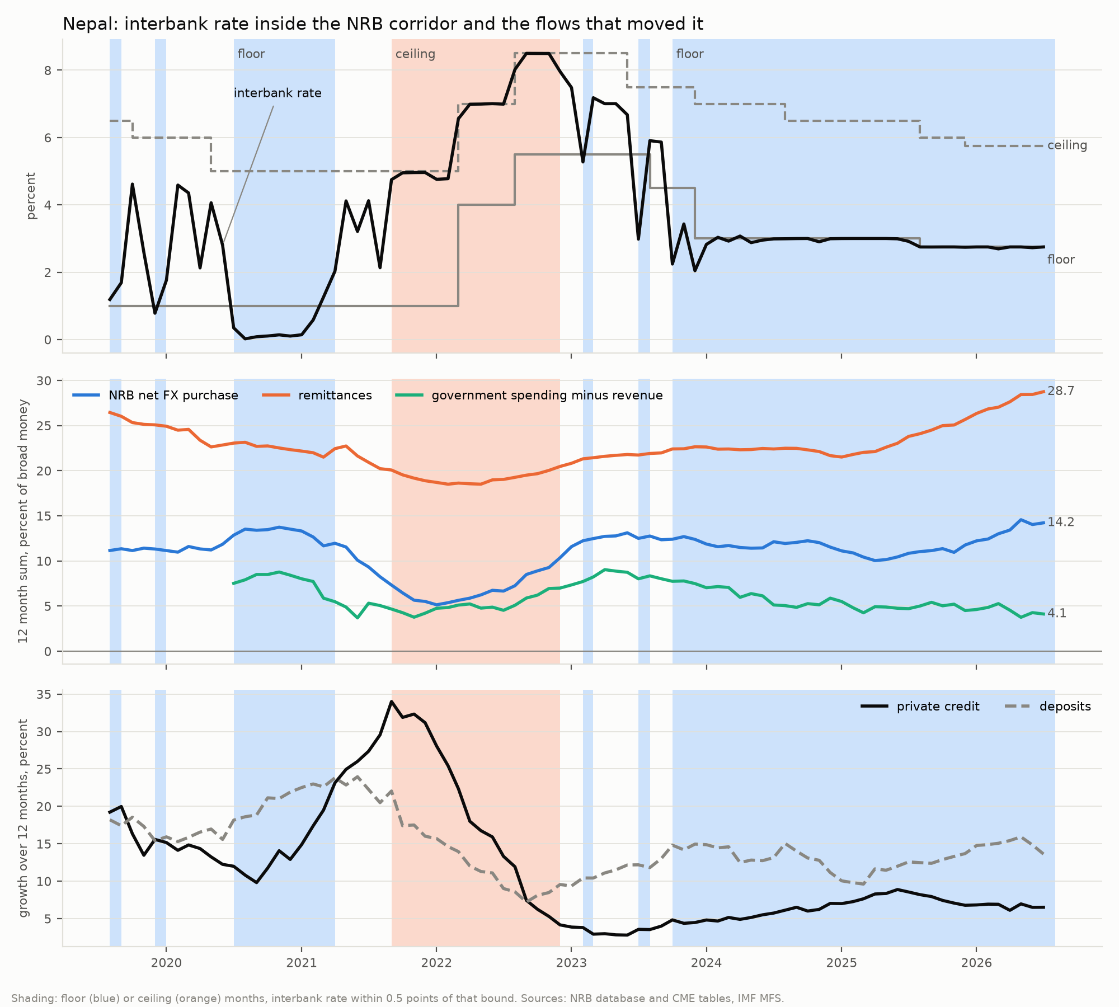
Channel 3: liquidity decides the market rate
Floor, 2020 to 2021, 9 months
Interbank 0.3 percent. Deposits grew 21 percent, credit 14; excess reserves 3.6 percent of deposits.
Ceiling, 2021 to 2022, 15 months
Interbank 6.5 percent. Credit grew 20 percent, deposits 13; excess reserves fell to 0.35; NRB never net absorbing.
Floor, 2023 to 2026, 34 months
Interbank 2.9 percent. Credit 6.5, deposits 13; remittances 29 percent of broad money a year; NRB absorbing in 94 percent of months.
Notes:
Under the peg the NRB must buy the foreign currency that remittances bring in, and each purchase creates bank reserves. When deposits grow faster than credit, the surplus pushes the interbank rate to the floor of the corridor; when credit outruns deposits, it rises to the ceiling. Slow government spending did not cause the current floor: the fiscal injection was smaller during it. Decision D049.

Slide 23
Model against reality: Nepal's interbank rate
India is an input
The model reads the RBI's repo change of the last three months with Nepal's corridor and liquidity.
Training years
Leaned the right way before 65 percent of rises and 73 percent of falls, 2008 to 2021.
2021 to 2026
Quiet months called quiet 94 percent of the time; balanced accuracy for rises 0.67.
Notes:
Binary logistic model of decision D039, refitted at every origin with a four month gap so no training label was unknown at the origin. Lean is P(rise) minus P(fall). Results from November 2021 are labelled post hoc because the design was chosen afterwards. The last three months, August to October 2026, are sealed forecasts awaiting NRB data. Source: reports/tables/nepal_binary_predictions.csv.

Slide 24
What India's new cycle means for Nepal
Prices first
India's inflation is 5.5 percent and rising with oil and a weaker rupee. Through the peg this reaches Nepal's prices directly; an RBI hike that works in India works in Nepal.
NRB corridor next
At the 0.5 response measured since 2016, a cycle ending at 5.75 to 6.00 means an NRB move of about 0.25 to 0.37 point.
Market rate: liquidity decides
The interbank rate sits on the NRB floor of 2.75 percent, held there by remittance reserves. It follows India once liquidity tightens.
The Gulf link
Remittances, 29 percent of broad money a year, come largely from the Gulf. A Gulf war would raise India's oil bill and drain Nepal's liquidity together.
Notes:
The NRB estimate applies the corridor era response of decision D056 to the outlook range and is an implication, not a model forecast. The frozen Nepal model's sealed forecast for October 2026 is rise 0.29, fall 0.24.

Slide 25
Conclusion
India has entered a new hiking cycle. A second hike is more likely than not; the cycle most likely ends at 5.75 to 6.00, and oil decides which.
The peg carries India's prices into Nepal (0.88 since 2021). Nepal's market rate followed the RBI in only 6 of 12 cycles, but since the 2016 corridor the NRB moves about 0.5 point per RBI point.
Over two years the model sees a short cycle peaking near 5.75 by April 2027, then easing back towards 5.25 by late 2028, with the NRB following at half strength. First test: December, against our recorded 0.56.
Notes:
Code, data manifests and the decision log are in the project repository; every number in this deck comes from a committed table.

