Slide 1
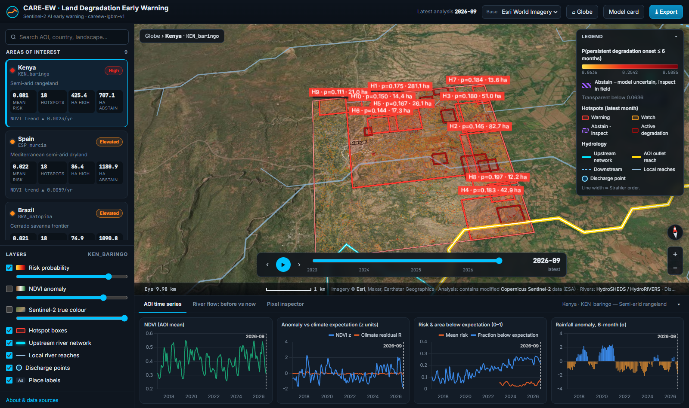
AI PROJECT · CONFERENCE PRESENTATION
CARE-EW
Climate-Adjusted, Resilience-Enhanced Early Warning of persistent land degradation from Sentinel-2 satellite imagery
Ankur Bhattarai · 24BCE2954
Team member 2 · ____________
Team member 3 · ____________
17 landscapes · 9 countries · 4.29 million pixel-months · 10 m resolution
CARE-EW · satellite early warning of persistent land degradation
1
Notes:
Introduce the project in one sentence: we use free satellite images and machine learning to warn, months ahead, where land is starting a long-lasting decline that the weather does not explain. The next two slides define every technical word used in the talk, so the audience can refer back to them.

Slide 2
Key terms 1/2 · satellites, land and GIS
1
Remote sensing
Measuring the Earth from a distance; here, cameras on satellites.
2
Sentinel-2
European satellite pair imaging all land every ~5 days at 10 m detail in 13 colour bands.
3
Pixel
One 10 m × 10 m square of ground: the unit we make a prediction for.
4
Spectral band
One colour channel the camera records, e.g. red or near-infrared (NIR).
5
Reflectance (BOA, L2A)
Share of sunlight the ground reflects (0–1), corrected for the atmosphere.
6
Cloud mask (SCL)
ESA's per-pixel flag for cloud, shadow and snow, so those pixels are dropped.
7
Monthly composite
Median of all clear images in a month: one clean picture per month.
8
NDVI
Greenness index (NIR − Red)/(NIR + Red): bare soil ≈ 0.1, dense crop ≈ 0.8.
9
NDMI · NBR · BSI
Companion indices for leaf moisture, burn scars and bare soil.
10
MODIS
NASA sensor, coarser (250 m) but imaging since 2000: gives the long history.
11
ERA5 / ERA5-Land
Reanalysis: gap-free global weather (rain, temperature, soil water) from models + observations.
12
Land cover (WorldCover)
ESA 10 m map labelling every pixel tree, shrub, grass, crop, bare …
13
DEM
Digital elevation model: a map of ground height (NASADEM, 30 m).
14
GIS
Geographic information systems: software and methods for maps and location data.
15
AOI
Area of interest: one 5.12 × 5.12 km study landscape.
16
STAC / Planetary Computer
Online catalogue and archive we search and download imagery from.
17
Land degradation
Long-lasting loss of the land's ability to grow vegetation and hold soil.
18
VHR imagery
Very-high-resolution (< 1 m) imagery; used to check warnings by eye.
CARE-EW · satellite early warning of persistent land degradation
2
Notes:
Walk through the satellite vocabulary. Stress three things: a pixel is 10 m; NDVI is a greenness number from two colours; ERA5 is the weather record we use to tell drought apart from damage.

Slide 3
Key terms 2/2 · machine learning and evaluation
1
Machine learning (ML)
Software that learns a pattern from examples instead of hand-written rules.
2
Feature
One input number per pixel-month, e.g. the 3-month NDVI change. We use 64.
3
Label (y)
The answer to learn: 1 if a persistent decline starts within 6 months, else 0.
4
Baseline (μ)
Normal value for that pixel and calendar month: median over 2017–2020.
5
Anomaly z-score
How many typical deviations this month is from normal: z = (Y − μ)/σ.
6
MAD
Median absolute deviation, a robust spread; σ = 1.4826 × MAD.
7
Residual (R)
The part of the anomaly NOT explained by weather or by similar neighbours.
8
Resilience · AC1
How fast land recovers; rising lag-1 autocorrelation = slower recovery = warning sign.
9
LightGBM
Gradient-boosted decision trees: many small trees, each correcting the previous ones.
10
Overfitting
Memorising training data, so accuracy collapses on new places or years.
11
Calibration
Re-mapping scores so that “0.2” really means a 20 % chance (isotonic regression).
12
Conformal prediction
Adds a guarantee: answer “event”, “no event”, or abstain when unsure.
13
SHAP
Explains a prediction by how much each feature pushed it up or down.
14
Spatial block split
Test pixels come from 1 km blocks never used in training: no leakage.
15
Confusion matrix
Counts of hits (TP), false alarms (FP), misses (FN), correct no's (TN).
16
Precision · Recall
Share of warnings that were right · share of real events we caught.
17
ROC-AUC · PR-AUC
Ranking quality over all thresholds; PR-AUC suits rare events like ours.
18
Base rate · Lift
Share of positives (2.5 %); lift = PR-AUC ÷ base rate = × better than chance.
CARE-EW · satellite early warning of persistent land degradation
3
Notes:
Walk through the AI vocabulary. The essential idea: the model outputs a probability; we check it is honest (calibration), say when it is unsure (conformal), and measure it on places it never saw (spatial blocks).

Slide 4
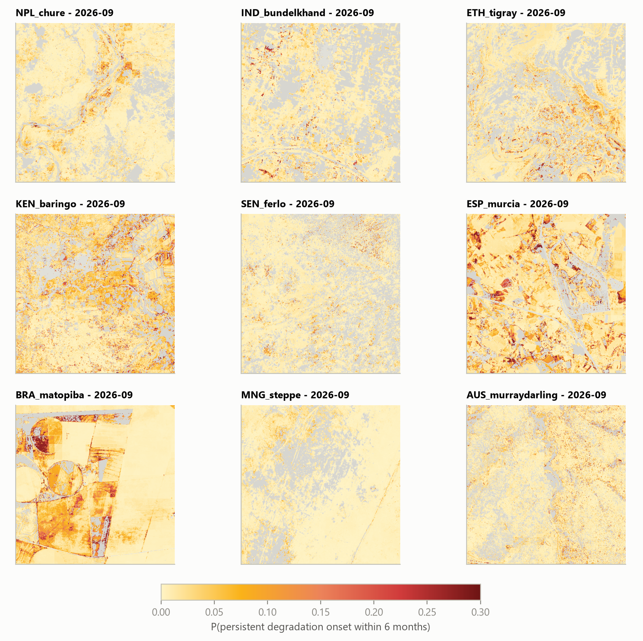
Why an early warning, not another damage map
The problem
Over-grazing, mining, clearing and erosion strip vegetation slowly. When it is obvious, recovery is slow and expensive.
1
The gap
Common tools (e.g. SDG 15.3.1 trend maps) report damage after it happened, at 250 m–1 km, and struggle to separate drought from human-driven decline.
2
Our aim
For every 10 m pixel and month, the probability that a persistent decline starts in the next 6 months, after removing what the weather explains, plus an honest “not sure”.
3
i
EXPLAINER
Persistent — below expectation for ≥ 6 months in a row, not a single bad month
Early warning — a forecast issued before the decline starts (here up to 6 months)
Predicted risk maps, nine study areas, Sept 2026 (red = higher probability)
CARE-EW · satellite early warning of persistent land degradation
4
Notes:
Land degradation is slow. Maps that show where vegetation already declined arrive too late for cheap action, and they confuse a dry year with real damage. Our question is predictive: will this pixel start a persistent, weather-unexplained decline within six months?

Slide 5
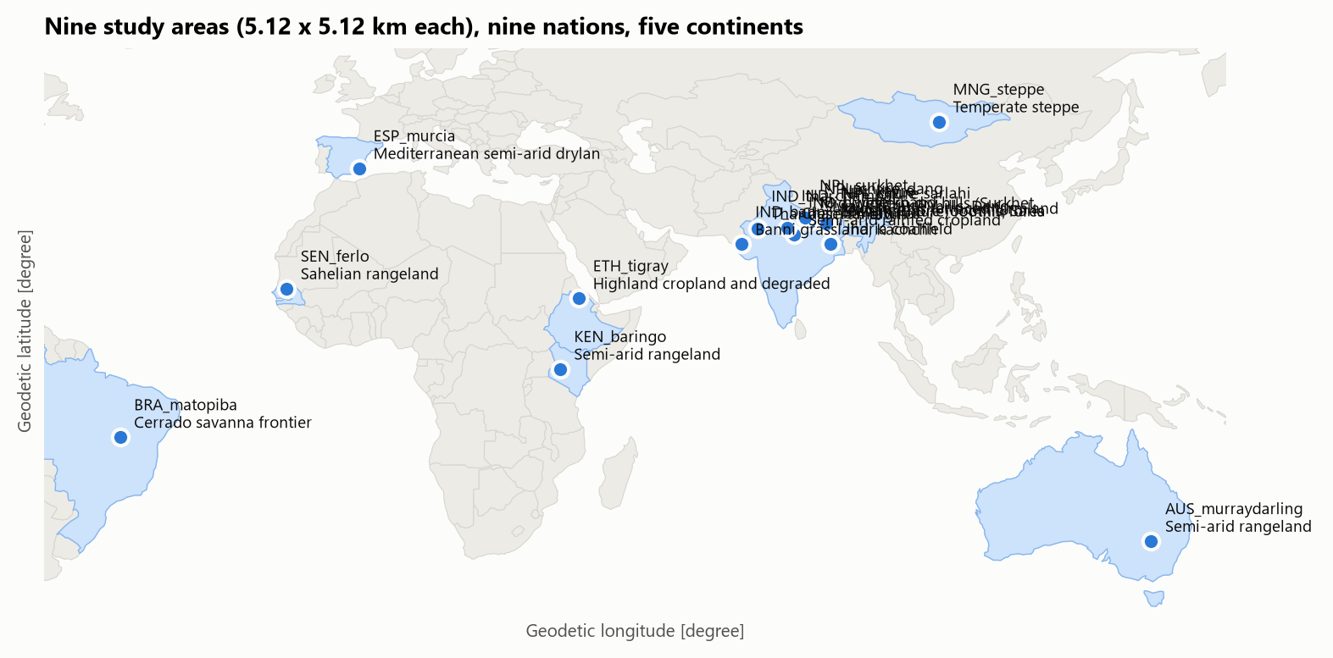
17 landscapes, 9 countries, 7 open data sources
Source | What we use | Detail
Sentinel-2 L2A | NDVI, NDMI, NBR, BSI | 10 m, 2017–2026
MODIS MOD13Q1 | NDVI history | 250 m, 2000–
ERA5 / ERA5-Land | rain, temperature, soil water | 9–31 km
ESA WorldCover | land-cover class | 10 m
NASADEM | elevation, slope | 30 m
JRC water · HydroRIVERS | distance to water, rivers | 30 m / vector
GloFAS | river discharge | ~5 km
Study areas (Nepal and India hold 9 of the 17 sites)
i
EXPLAINER
4.29 M
64
2.5 %
L2A — Sentinel-2 product already corrected for the atmosphere
Reanalysis — weather model re-run with past observations to fill every gap
Discharge — volume of water flowing in a river, m³/s
pixel-months
rows in the dataset
features
per pixel-month
positives
rare-event problem
CARE-EW · satellite early warning of persistent land degradation
5
Notes:
Each study area is 5.12 km square. Landscapes span drylands, rangelands, cropland, forest frontier and mining areas on five continents. All inputs are free and open; Sentinel-2 drives the 10 m detail.

Slide 6
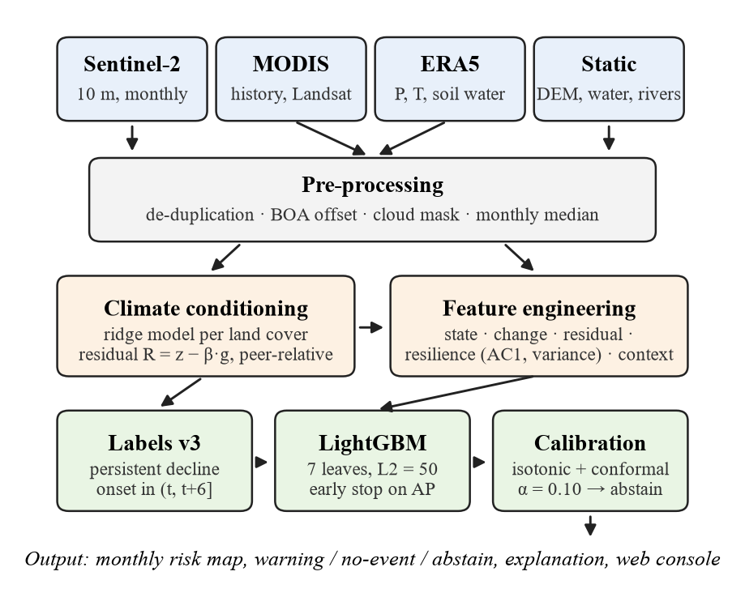
From raw images to a warning: the pipeline
1
Clean remove duplicates, fix the +1000 offset, mask cloud, take the monthly median
2
Normalise compare each month with that pixel's own 2017–2020 normal → z-score
3
Remove climate ridge model of the weather's effect; subtract it and the neighbours' median → residual R
4
Label mark where a ≥ 6-month unexplained decline begins; target = onset within 6 months
5
Learn 64 features → LightGBM → isotonic calibration → conformal abstain
6
Serve monthly risk map, hotspots and explanations in the web console
i
EXPLAINER
Pipeline — fixed chain of steps run the same way for every area
Median composite — middle value of a month's clear images; ignores outliers
Ridge — linear regression with a penalty that keeps weights small and stable
CARE-EW · satellite early warning of persistent land degradation
6
Notes:
Explain the flow top to bottom. Inputs are cleaned into monthly pictures; a climate model removes what the weather explains; features describe state, change, residual and resilience; LightGBM predicts; calibration and conformal prediction make the probability honest.

Slide 7
Worked example 1 · from a raw pixel to an anomaly
1 · Raw → reflectance
2 · Greenness (NDVI)
3 · Normal for this month
4 · Anomaly z-score
Red band DN = 2 500
NIR band DN = 5 000
ρ = (DN − 1 000) / 10 000
Red = 0.15 · NIR = 0.40
NDVI = (NIR − Red)/(NIR + Red)
= (0.40 − 0.15)/(0.40 + 0.15)
= 0.25 / 0.55
= 0.45
μ = median NDVI of all
Julys 2017–2020 = 0.60
MAD = 0.04
σ = 1.4826 × 0.04 = 0.059
z = (Y − μ) / σ
= (0.45 − 0.60) / 0.059
= −2.5
well below normal
Why this matters: each pixel is compared with its own past, so a naturally sparse desert pixel and a lush forest pixel are judged on the same scale.
i
EXPLAINER
i
SYMBOLS
DN — digital number: the integer the satellite stores
+1000 offset — added by ESA to images processed since 2022; we subtract it
σ floor 0.02 — σ is never below 0.02 so tiny wobbles do not look extreme
μ (mu) — the pixel's normal value for that calendar month
σ (sigma) — the pixel's typical deviation from normal
1.4826 — constant that makes MAD comparable to a standard deviation
CARE-EW · satellite early warning of persistent land degradation
7
Notes:
Go through the arithmetic slowly. The +1000 offset was added by ESA from processing baseline 04.00 (2022); forgetting it makes recent images look darker and would invent a fake decline. The z-score of −2.5 means this month is 2.5 typical deviations below this pixel's normal for this calendar month.

Slide 8
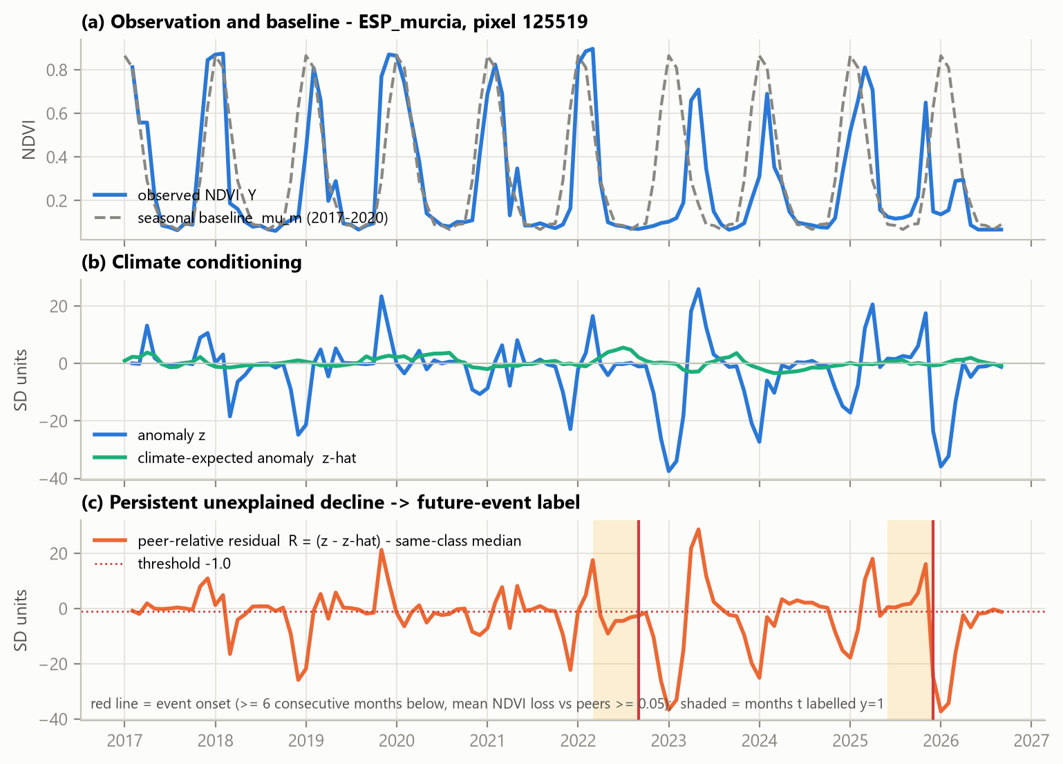
Worked example 2 · separating drought from damage
R = (z − β·g) − median of same-land-cover peers
 | Drought year | Normal-rain year
Anomaly z | −2.5 | −2.5
Weather-expected g (β = 1) | −2.0 | 0.0
z − β·g | −0.5 | −2.5
Peers' median | −0.3 | 0.0
Residual R | −0.2 | −2.5
Below expectation? (R ≤ −1) | No: weather explains it | Yes
Label rule: onset = ≥ 6 months in a row below expectation (and ≥ 0.02 NDVI under peers), ≥ 75 % of months observed, mean loss ≥ 0.05 NDVI. Target yₜ = 1 if an onset falls in months t+1 … t+6.
i
EXPLAINER
Real pixel (Spain): observation, climate-expected, residual, labelled onsets
g, β — g = weather-predicted anomaly from rain, temperature, soil water; β = how strongly this pixel follows it (0–3)
Peers — pixels of the same land cover in the same area
CARE-EW · satellite early warning of persistent land degradation
8
Notes:
Same z-score, two different stories. In a drought year the weather model expects the drop, so the residual is small and nothing is flagged. In a normal-rain year the same drop is unexplained, and if it persists six months it becomes a labelled degradation onset. The figure shows a real Spanish pixel.

Slide 9
What the model sees and how it learns
State
current NDVI, σ, land cover
Change
NDVI change over 3, 12, 36 months
LightGBM setting | Plain meaning
7 leaves per tree | each tree is a tiny rule set → less memorising
≥ 4 000 pixels per leaf | no rule may rest on a handful of pixels
40 % features · 70 % rows | each tree sees a random subset → diversity
L2 = 50 · extra-trees | strong penalty, random split points → smooth
learning rate 0.03 | small steps; many trees add up slowly
early stop on PR-AUC | stop when validation score stops improving
A1
A2
A3
Climate
rain, temperature, soil-water anomalies
A4
Residual
R mean, minimum, months below, run length
A5
Resilience
AC1, variance (24 mo), MODIS 5-year signals
A6
Context
distance to river, slope, elevation, water
Training: 800,784 rows, 14 s on a laptop CPU (Core 5 210H).
i
EXPLAINER
Decision tree — a flowchart of yes/no questions on features ending in a score
Gradient boosting — add trees one by one, each fixing the errors left so far
AC1 — correlation of a month with the month before; near 1 = slow recovery
Regularisation — rules that stop a model from becoming too complex
i
EXPLAINER
Leaf — end point of a tree, holding one score
Early stopping — halting training at the best validation score
Validation set — held-out data used only to tune, never to report
CARE-EW · satellite early warning of persistent land degradation
9
Notes:
Sixty-four features in six groups. The resilience group is the novel part: when land loses resilience it recovers more slowly, which shows up as rising autocorrelation and variance before the decline. LightGBM is deliberately kept small and heavily regularised so it generalises to new places.

Slide 10
Honest probabilities and honest testing
Set | Months | Pixel-months | Used for
Train | ≤ 2022-03 | 800,784 | fit the trees
Early stop | 2023-03 … 12 | 169,049 | when to stop
Calibration | 2023-03 … 12 | 378,057 | isotonic + conformal
Test | ≥ 2024-12, test blocks | 132,230 | every reported number
!
WARNING p ≥ 0.129
≈ 5× the 2.5 % base rate
✓
NO EVENT conformal: no event
NPV 99.6 %
?
ABSTAIN conformal: both possible
52 % of pixel-months → inspect
1 km blocks are split 60/20/20, so neighbouring pixels never sit on both sides of the train/test line.
i
EXPLAINER
i
EXPLAINER
Isotonic calibration — step-wise mapping from raw score to observed frequency, learnt on the calibration set
Conformal, α = 0.10 — sets of answers that contain the truth ≥ 90 % of the time; a two-answer set means “abstain”
Data leakage — test information sneaking into training; inflates scores
NPV — of the “no event” calls, the share that were right
Threshold 0.129 — the cut-off that maximises F1 on the calibration set
Abstain — the model says “inspect in the field” instead of guessing
Base rate — share of pixel-months that truly had an onset ahead (2.5 %)
CARE-EW · satellite early warning of persistent land degradation
10
Notes:
Two ideas. First, the score is calibrated so 0.13 really means about a 13 % chance, and conformal prediction lets the model abstain when it cannot be confident. Second, test pixels are from different 1 km blocks and a later time than training, with gaps so the 6-month label window cannot leak.

Slide 11
Headline results on 132,230 unseen test pixel-months
0.805
0.144
ROC-AUC
95 % CI 0.766–0.838
PR-AUC
95 % CI 0.112–0.184
5.7×
0.0025
better than chance
lift = 0.144 ÷ 0.025
calibration error (ECE)
Brier score 0.0228
i
EXPLAINER
i
BASELINES
95 % CI — range from bootstrap resamples of the test blocks
ECE — average gap between predicted and observed frequency (0 = perfect)
Brier — mean squared error of the probability (lower = better)
Persistence — “what was bad stays bad”: recent anomaly as the score
Residual rule — hand-made score from the recent residual R, no ML
RF, S2-only — random forest on Sentinel-2 features only
CARE-EW · satellite early warning of persistent land degradation
11
Notes:
ROC-AUC 0.805 means: pick one pixel that degraded and one that did not; 80 % of the time the model ranks the degrading one higher. PR-AUC 0.144 is 5.7 times the 0.025 chance level. Brackets are 95 % bootstrap confidence intervals. All three simpler baselines are far behind.

Slide 12
Confusion matrix at the warning threshold (p ≥ 0.129)
Actual outcome in next 6 months
Metric | Formula | Value
Precision | TP/(TP+FP) = 963/4,431 | 0.217
Recall | TP/(TP+FN) = 963/3,327 | 0.289
F1 | 2·P·R/(P+R) | 0.248
Specificity | TN/(TN+FP) | 0.973
False-alarm rate | FP/(FP+TN) | 0.027
Accuracy | (TP+TN)/132,230 | 0.956
“Always no” accuracy | 128,903/132,230 | 0.975
Onset
No onset
963
TP · hits
3,468
FP · false alarms
Warned
2,364
FN · misses
125,435
TN · correct no's
Not warned
i
EXPLAINER
Specificity — share of non-events correctly left unwarned
False-alarm rate — share of non-events wrongly warned (2.7 %)
F1 — one number balancing precision and recall
i
EXPLAINER
Why not accuracy? — with 2.5 % positives, saying “no” to everything already scores 97.5 %
Precision 0.217 — 1 in 5 warnings is right, vs 1 in 40 by chance
CARE-EW · satellite early warning of persistent land degradation
12
Notes:
Read the four boxes, then the arithmetic. Accuracy is 95.6 %, but a model that always says 'no' would score 97.5 % because events are rare, so accuracy is the wrong yardstick. Precision 0.22 means about one warning in five is followed by an onset, versus one in forty by chance.

Slide 13
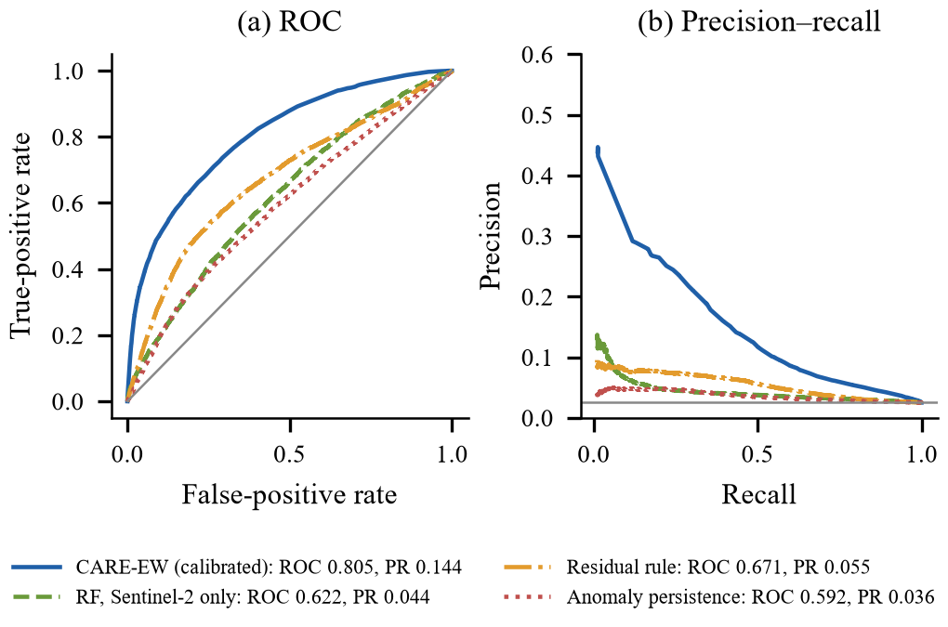
Which ingredients matter · curves and ablation
(a) ROC and (b) precision–recall curves on the test set
i
EXPLAINER
i
EXPLAINER
ROC curve — hit rate vs false-alarm rate as the threshold slides
PR curve — precision vs recall; the honest view for rare events
Ablation — remove or add one ingredient at a time to measure what it contributes
CARE-EW · satellite early warning of persistent land degradation
13
Notes:
Left: CARE-EW's curves sit above every baseline at every threshold. Right: we add feature groups one at a time. State, change and climate alone barely beat chance; the jump comes from the climate-adjusted residual (A4) and resilience (A5). Ablation values are the raw model score before calibration.

Slide 14
Does it work somewhere new, and in a later year?
New site | ROC | Lift
Sindhupalchok | 0.873 | 9.8×
Singrauli | 0.876 | 6.8×
Udayapur | 0.844 | 7.0×
Kailali | 0.803 | 10.1×
Shivalik | 0.782 | 12.7×
Marathwada | 0.597 | 1.7×
All six | 0.839 | 8.6×
Six sites never used in development (Nepal, India). Weakest: Marathwada cropland.
i
EXPLAINER
Leave-one-country-out — the model has never seen a single pixel of that country
Walk-forward — always train on the past, test on the following year, like real use
CARE-EW · satellite early warning of persistent land degradation
14
Notes:
Leave-one-country-out: train without a country, test on it. Every country beats chance, from 2.3× (Brazil) to 13.8× (Australia); Mongolia had no events to score. Walk-forward: retrain each January and test on the next year; skill grows as more history accumulates. Six brand-new sites added later scored 8.6× lift.

Slide 15
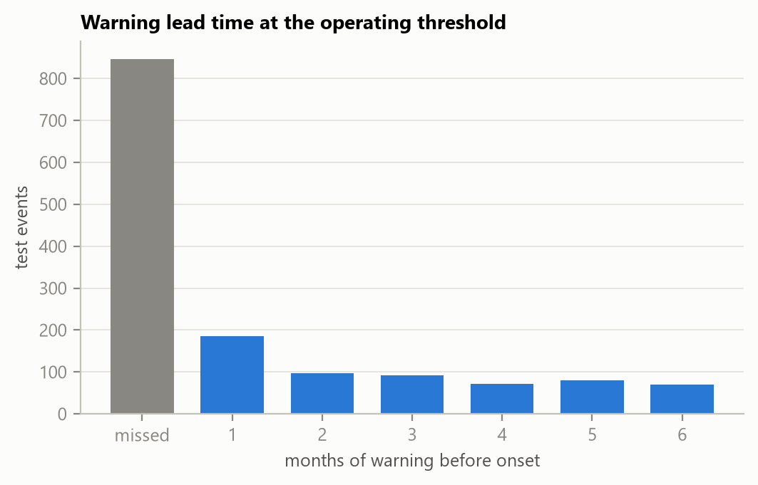
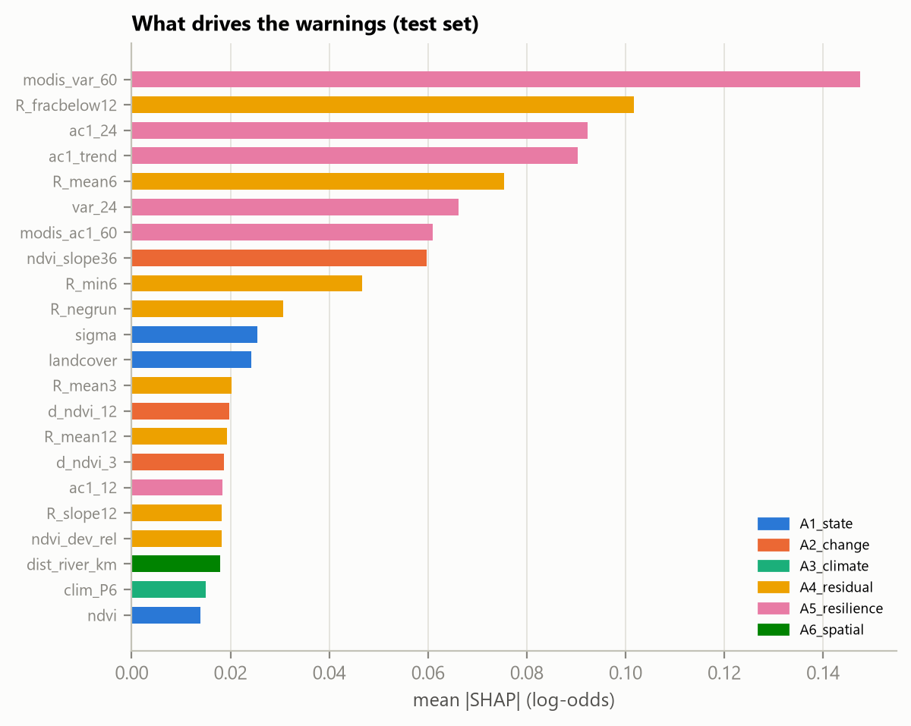
When it warns, and why
41%
of 1,444 onsets warned
3 mo
median lead time
Months of warning before onset (grey = missed)
Land cover | PR-AUC | ROC-AUC
Shrubland | 0.275 | 0.858
Grassland | 0.218 | 0.870
Bare / sparse | 0.123 | 0.755
Tree cover | 0.110 | 0.812
Cropland | 0.096 | 0.743
i
EXPLAINER
modis_var_60 — variance of MODIS NDVI over the last 60 months
R_fracbelow12 — share of the last 12 months with residual below −1
ac1_24 · ac1_trend — lag-1 autocorrelation over 24 months, and its slope
Lead time — months between the warning and the onset
CARE-EW · satellite early warning of persistent land degradation
15
Notes:
Of 1,444 test onsets, 41% received a warning beforehand; the median lead is 3 months. SHAP shows the top drivers are resilience signals (5-year MODIS variance, AC1 and its trend) and the residual (share of the last 12 months below expectation). It works best in shrub and grassland, weakest in cropland, where farming cycles mimic decline.

Slide 16
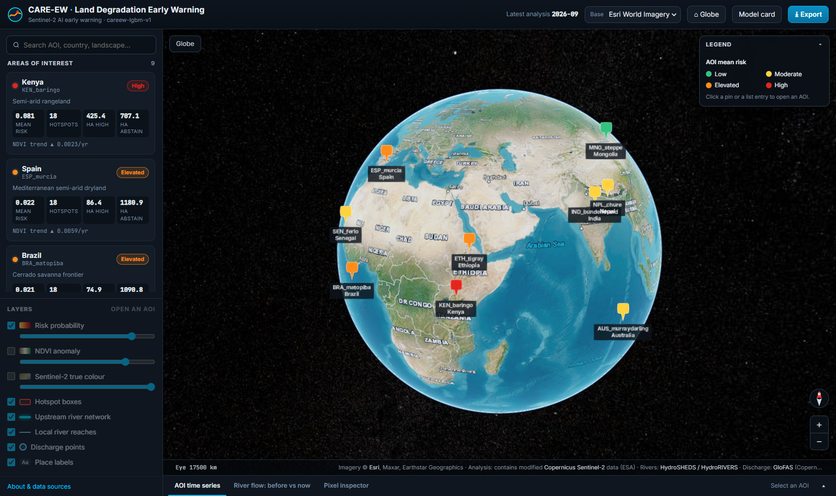
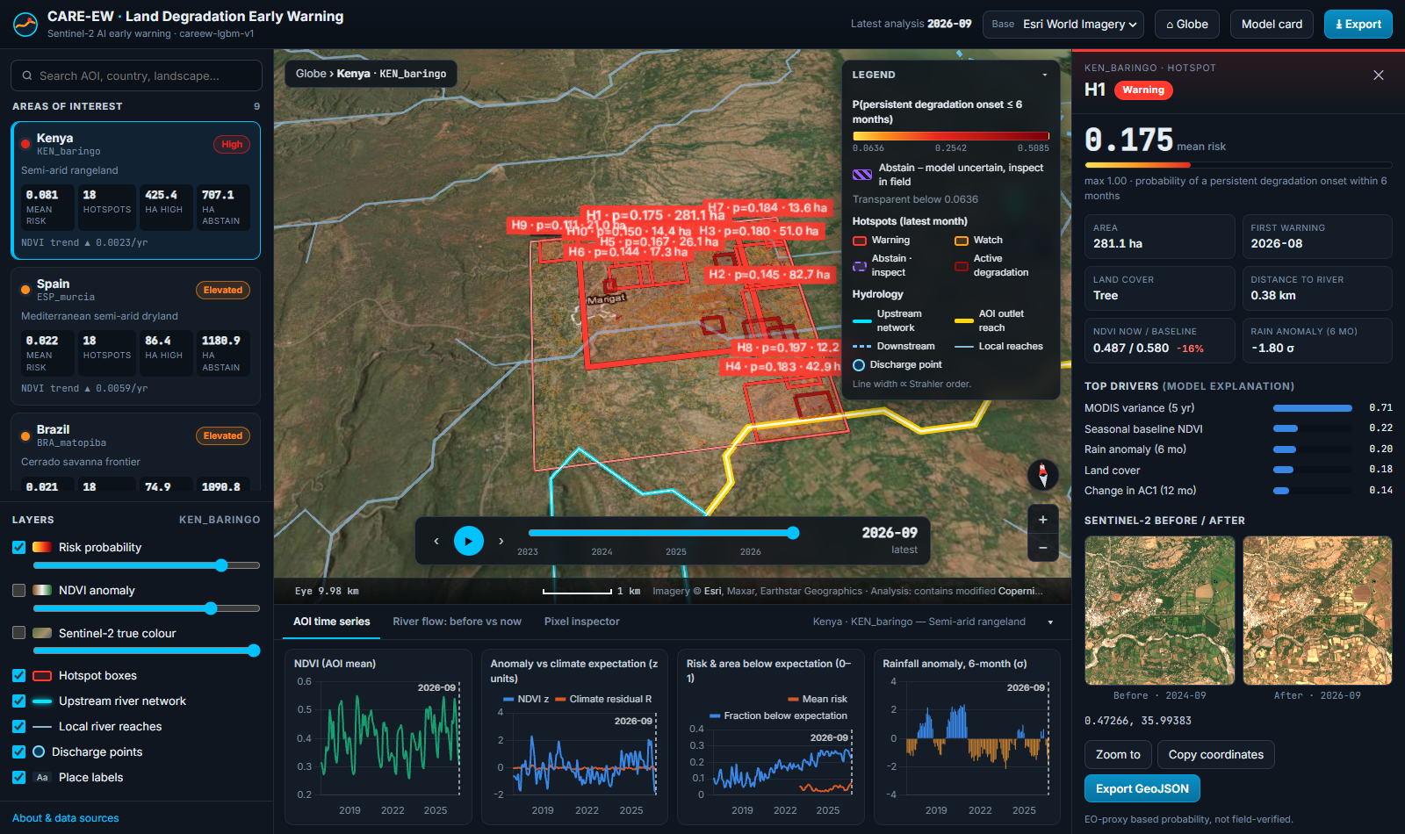
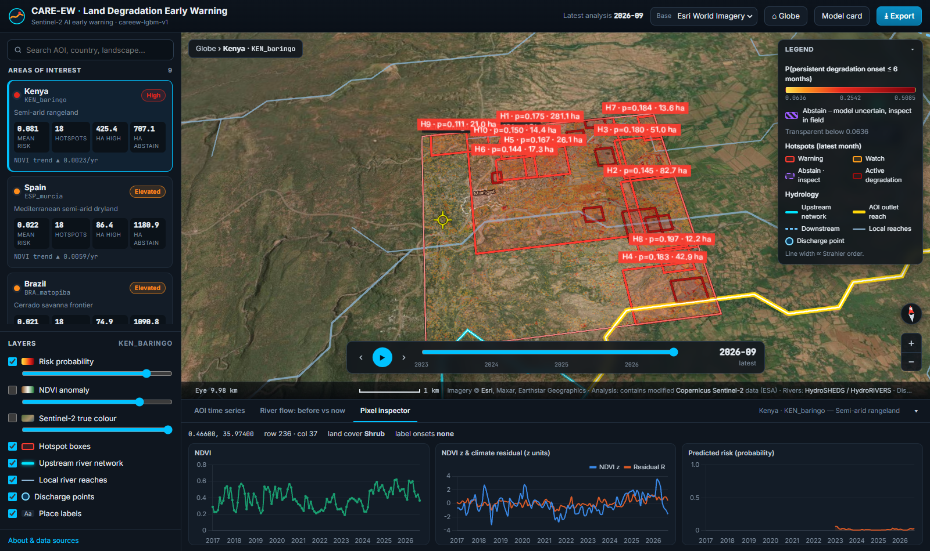
Application demo 1 · from the globe to a single pixel
i
EXPLAINER
Hotspot — a cluster of high-risk pixels, ranked H1, H2 …
Risk layer — colour = calibrated probability of an onset within 6 months
Hatching — pixels where the model abstains (inspect in the field)
Before/after chips — Sentinel-2 true-colour images of the hotspot
Esri imagery — high-detail basemap for context
1 Globe: every study area coloured by mean risk
2 Area view: hotspots H1–H8, river network, time slider
3 Hotspot panel: risk 0.175, drivers, before/after
4 Pixel inspector: NDVI, z vs residual R, predicted risk
CARE-EW · satellite early warning of persistent land degradation
16
Notes:
Live web console (FastAPI + CesiumJS). Start on the globe with each study area coloured by mean risk; open an area to see hotspots over Esri imagery with rivers; click a hotspot for its risk, area, first warning, top drivers and Sentinel-2 before/after chips; the pixel inspector shows that pixel's full history.

Slide 17
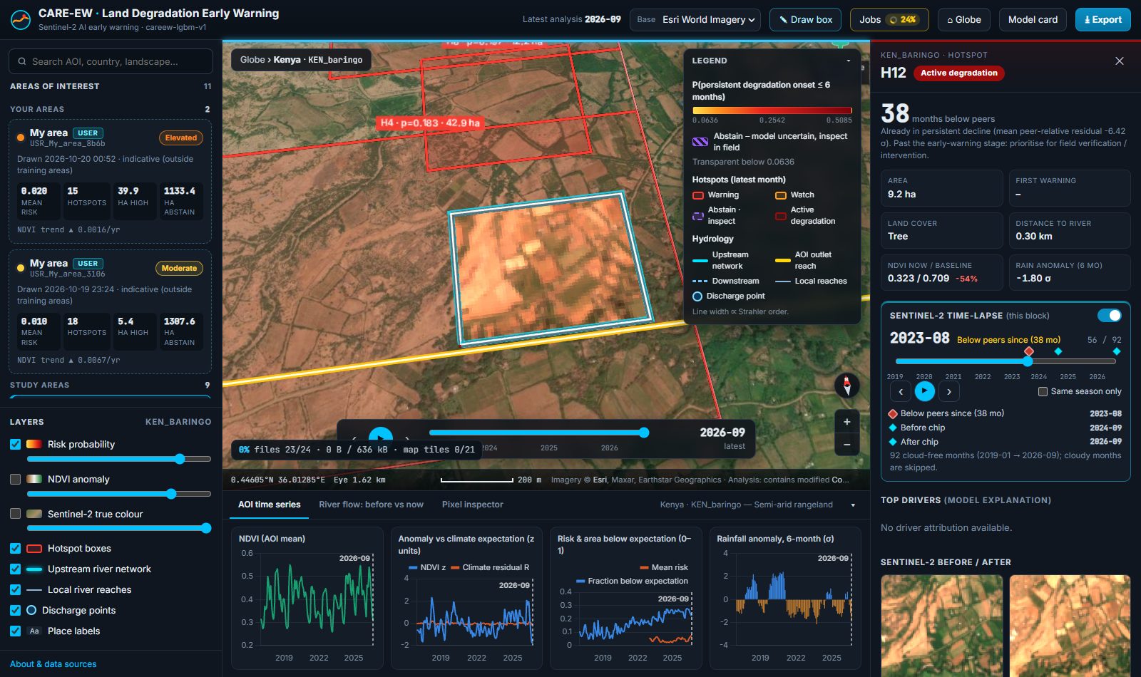
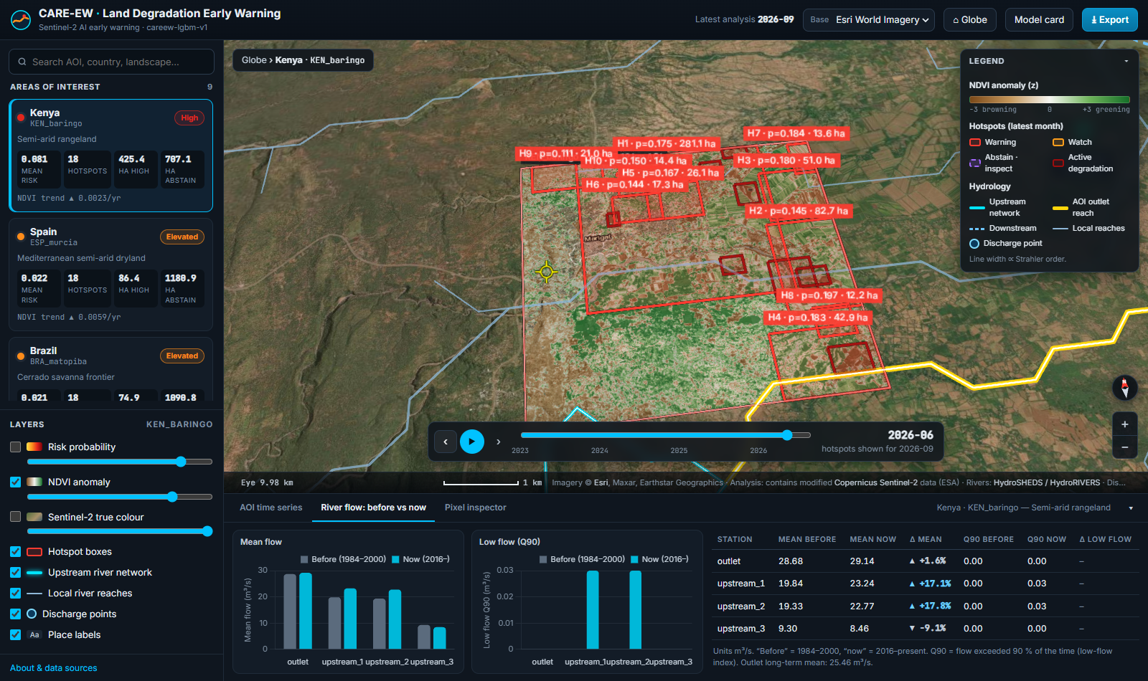
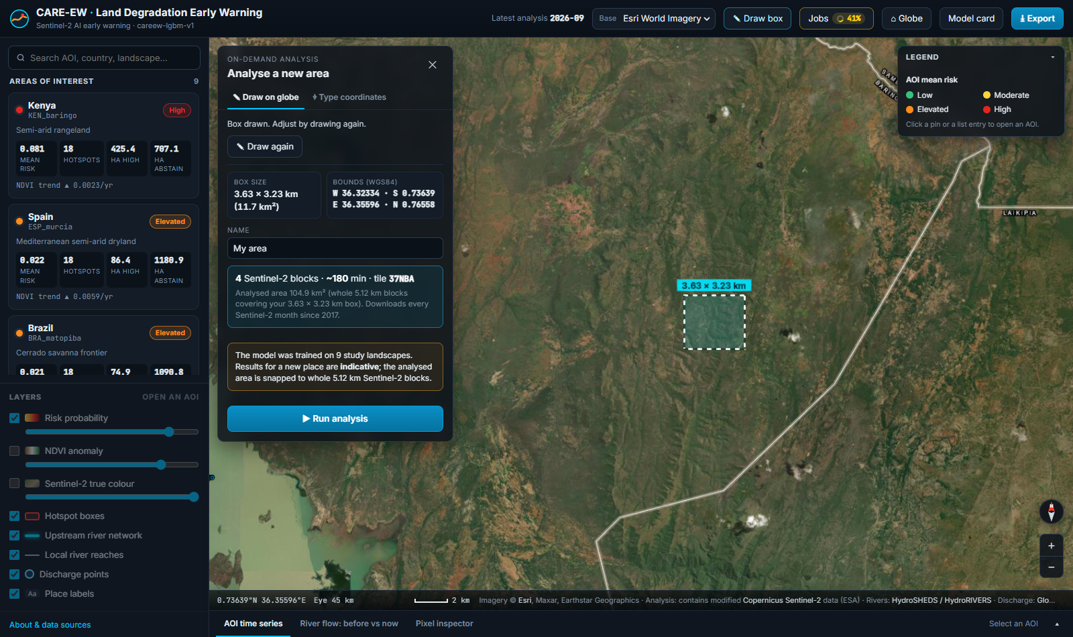
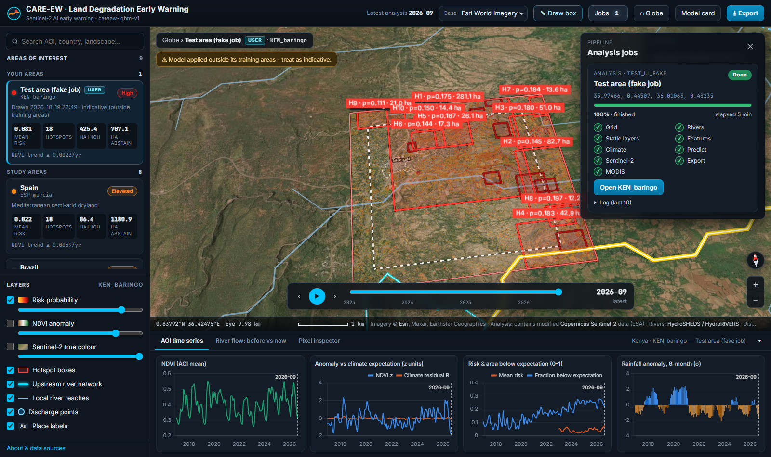
Application demo 2 · time-lapse, rivers and any new area
i
EXPLAINER
Time-lapse — monthly images played in order; cloudy months skipped
Below peers — residual R ≤ −1 versus same-cover neighbours
Low flow (Q90) — flow exceeded 90 % of the time: dry-season water
On-demand job — the full pipeline run for a user-drawn area
Indicative — outside training areas; treat with caution
1 Time-lapse: H12 below peers for 38 months
2 NDVI anomaly layer + river flow before vs now
3 Draw a box anywhere: size and download plan
4 Job finished: new area opens with hotspots
CARE-EW · satellite early warning of persistent land degradation
17
Notes:
The time-lapse plays every cloud-free Sentinel-2 month for a hotspot and marks when it fell below peers. The river tab compares mean and low flow before 2000 with today. Draw box lets a user analyse a new 5 km area: the server downloads the data, runs the same pipeline, and opens the result, with a warning that it is outside the training areas.

Slide 18
A blind check against sub-metre imagery, and our limits
▪ 233 usable pairs of 276 sampled (43 lacked imagery)
▪ Warned: 21 / 107 = 19.6 %
▪ Control: 26 / 106 = 24.5 %
▪ Difference −4.9 pp (95 % CI −15.3 to +6.4)
▪ Fisher p = 0.85
▪ Power ≈ 38 % to detect +10 pp
Limitations
▪ Labels come from the same satellite data, not field visits
▪ Precision 0.22: most warnings are not followed by an onset
▪ Weakest on cropland (farming cycles)
▪ Optical only: clouds hide monsoon months
▪ Wayback dates are approximate
i
EXPLAINER
Blind test — the reviewer does not know which points were warnings, so cannot be biased
Fisher p = 0.85 — how often pure chance would give a gap at least this favourable to the model; 0.85 = no evidence of a difference
Statistical power — chance a study detects an effect that is really there
CARE-EW · satellite early warning of persistent land degradation
18
Notes:
We sampled 276 points (half warnings, half controls), fetched Esri Wayback images before and after, and judged visible change without knowing which was which. The first pass was done by an AI reviewer; answers were hashed before unblinding. No detectable difference, and the test was underpowered, so it neither confirms nor refutes the model. An independent human review is the next step.

Slide 19
Conclusion and next steps
5.7×
0.805
3 mo
52 %
better than chance at finding future onsets on unseen land
ROC-AUC; 0.839 on six brand-new sites
median warning lead; 41 % of onsets warned
abstains instead of guessing; NPV 99.6 %
Next steps
i
EXPLAINER
▪ Independent human review of the VHR sample, larger and better powered
▪ Prospective test: freeze the model, score warnings issued from 2027
▪ Crop-aware labels to stop farming cycles reading as decline
▪ Add Sentinel-1 radar, which sees through cloud
Prospective test — predictions made before the outcome exists, the strongest proof
Sentinel-1 — radar satellite; measures surface structure day or night through cloud
Crop-aware labels — labels that know the planting calendar
CARE-EW · satellite early warning of persistent land degradation
19
Notes:
Summarise: a 10 m, climate-adjusted, resilience-aware early warning that ranks future degradation 5.7 times better than chance on unseen places, generalises across countries and later years, is calibrated, says when it is unsure, and ships as a working web application. Then the honest next steps.

Slide 20
References
[1] UNCCD, Global Land Outlook, 2nd ed., “Land Restoration for Recovery and Resilience.” Bonn, Germany: United Nations Convention to Combat Desertification, 2022.
[2] N. C. Sims et al., “Good practice guidance: SDG indicator 15.3.1,” UNCCD, Bonn, Germany, 2021.
[3] R. Prăvălie, “Exploring the multiple land degradation pathways across the planet,” Earth-Sci. Rev., 2021.
[4] A. L. Burrell, J. P. Evans, and M. G. De Kauwe, “Anthropogenic climate change has driven over 5 million km² of drylands towards desertification,” Nature Commun., 2020.
[5] A. Berdyyev, Y. A. Al-Masnay, M. Juliev, and J. Abuduwaili, “Desertification monitoring using machine learning techniques with multiple indicators derived from Sentinel-2 in Turkmenistan,” Remote Sens., 2024.
[6] T. M. Bury et al., “Deep learning for early warning signals of tipping points,” Proc. Natl. Acad. Sci. USA, 2021.
[7] V. Dakos et al., “Tipping point detection and early warnings in climate, ecological, and human systems,” Earth Syst. Dyn., 2024.
[8] T. M. Lenton et al., “A resilience sensing system for the biosphere,” Phil. Trans. R. Soc. B, 2022.
[9] T. Smith, D. Traxl, and N. Boers, “Empirical evidence for recent global shifts in vegetation resilience,” Nature Clim. Change, 2022.
[10] C. A. Boulton, T. M. Lenton, and N. Boers, “Pronounced loss of Amazon rainforest resilience since the early 2000s,” Nature Clim. Change, 2022.
[11] P. Ploton et al., “Spatial validation reveals poor predictive performance of large-scale ecological mapping models,” Nature Commun., 4540, 2020.
[12] H. Meyer and E. Pebesma, “Predicting into unknown space? Estimating the area of applicability of spatial prediction models,” Methods Ecol. Evol., 2021.
[13] C. Schiller, J. Költzow, S. Schwarz, F. Schiefer, and F. E. Fassnacht, “Forest disturbance detection in Central Europe using transformers and Sentinel-2 time series,” Remote Sens. Environ., 2024.
[14] R. N. Masolele et al., “Spatial and temporal deep learning methods for deriving land-use following deforestation: A pan-tropical case study using Landsat time series,” Remote Sens. Environ., 2021.
[15] J. Reiche et al., “Forest disturbance alerts for the Congo Basin using Sentinel-1,” Environ. Res. Lett., 024005, 2021.
[16] M. Berdugo et al., “Global ecosystem thresholds driven by aridity,” Science, 2020.
[17] D. Zanaga et al., “ESA WorldCover 10 m 2021 v200,” Zenodo, 2022.
[18] L. Grinsztajn, E. Oyallon, and G. Varoquaux, “Why do tree-based models still outperform deep learning on typical tabular data?” in Proc. NeurIPS Datasets and Benchmarks Track, 2022.
[19] T. Silva Filho et al., “Classifier calibration: A survey on how to assess and improve predicted class probabilities,” Mach. Learn., 2023.
[20] V. Vovk, A. Gammerman, and G. Shafer, Algorithmic Learning in a Random World, 2nd ed. Cham, Switzerland: Springer, 2022.
[21] A. N. Angelopoulos and S. Bates, “Conformal prediction: A gentle introduction,” Found. Trends Mach. Learn., 2023.
[22] C. Northcutt, L. Jiang, and I. Chuang, “Confident learning: Estimating uncertainty in dataset labels,” J. Artif. Intell. Res., 2021.
[23] D. Phiri et al., “Sentinel-2 data for land cover/use mapping: A review,” Remote Sens., 2020.
[24] J. Muñoz-Sabater et al., “ERA5-Land: A state-of-the-art global reanalysis dataset for land applications,” Earth Syst. Sci. Data, 2021.
[25] K. Didan, “MOD13Q1 MODIS/Terra vegetation indices 16-day L3 global 250 m SIN grid V061,” NASA EOSDIS Land Processes DAAC, 2021.
[26] Q. Yuan et al., “Deep learning in environmental remote sensing: Achievements and challenges,” Remote Sens. Environ., 2020.
[27] H. Hersbach et al., “The ERA5 global reanalysis,” Q. J. R. Meteorol. Soc., 2020.
[28] M. A. Wulder et al., “Fifty years of Landsat science and impacts,” Remote Sens. Environ., 113195, 2022.
[29] M. Amani et al., “Google Earth Engine cloud computing platform for remote sensing big data applications: A comprehensive review,” IEEE J. Sel. Topics Appl. Earth Observ. Remote Sens., 2020.
[30] L. Poggio et al., “SoilGrids 2.0: Producing soil information for the globe with quantified spatial uncertainty,” SOIL, 2021.
[31] T. Kattenborn, J. Leitloff, F. Schiefer, and S. Hinz, “Review on convolutional neural networks (CNN) in vegetation remote sensing,” ISPRS J. Photogramm. Remote Sens., 2021.
[32] S. M. Lundberg et al., “From local explanations to global understanding with explainable AI for trees,” Nature Mach. Intell., 2020.
[33] A. H. Pickens et al., “Mapping and sampling to characterize global inland water dynamics from 1999 to 2018 with full Landsat time-series,” Remote Sens. Environ., 2020.
[34] G. Forzieri, V. Dakos, N. G. McDowell, A. Ramdane, and A. Cescatti, “Emerging signals of declining forest resilience under climate change,” Nature, 2022.
[35] C. F. Brown et al., “Dynamic World, near real-time global 10 m land use land cover mapping,” Sci. Data, 2022.
[36] D. Valle, R. Izbicki, and R. V. Leite, “Quantifying uncertainty in land-use land-cover classification using conformal statistics,” Remote Sens. Environ., 2023.
[37] Microsoft Open Source et al., “microsoft/PlanetaryComputer: October 2022,” Zenodo, 2022.
CARE-EW · satellite early warning of persistent land degradation
20
Notes:
All references are from 2020 or later and concern land degradation, Earth-observation data, GIS, machine learning and computer vision. Full details are in the conference paper.

