Slide 1
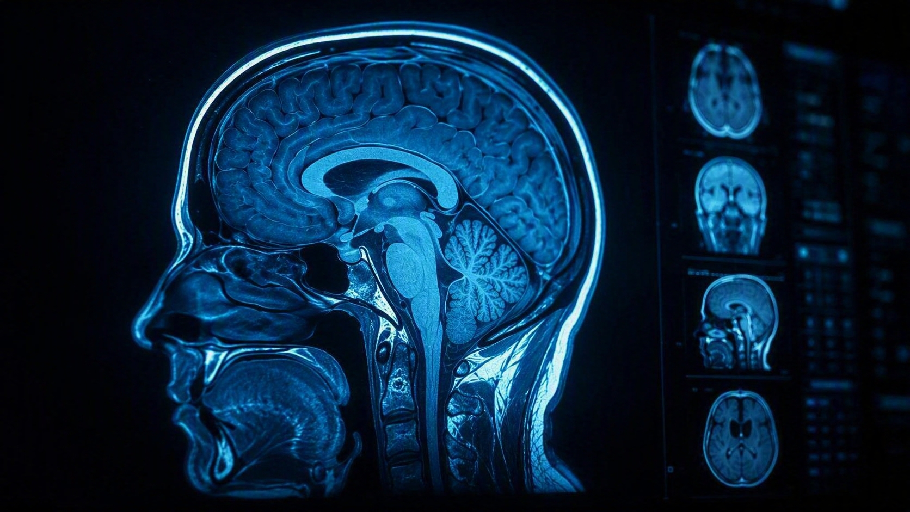
AI-ASSISTED EMERGENCY CT TRIAGE
NeuroTriage AI
Prioritizing suspected intracranial hemorrhage for faster clinical review
MBA AI for Business | Management of AI products
Prototype — simulated/anonymized data — not for clinical use

Slide 2
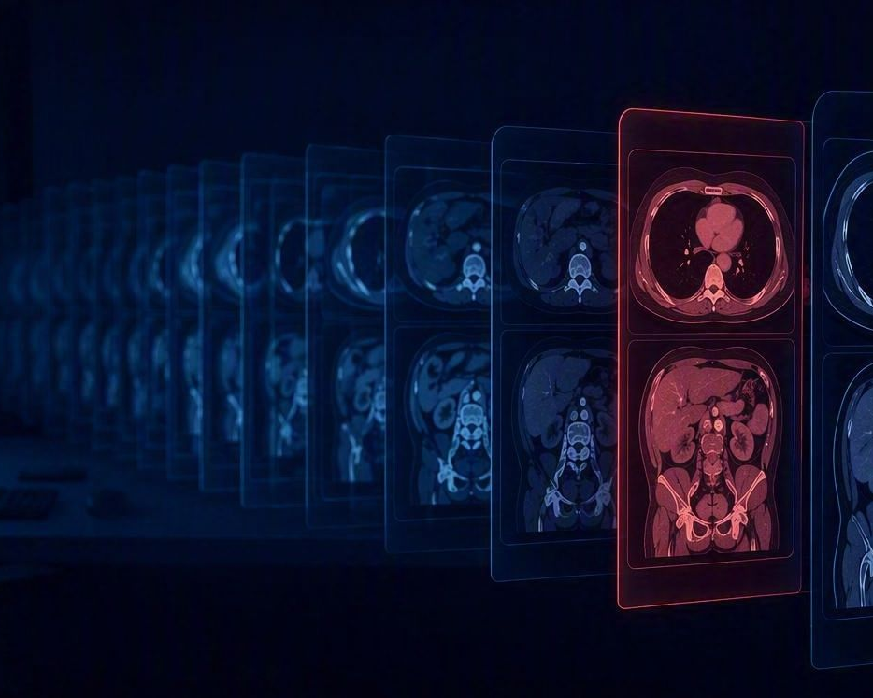
THE PROBLEM
The worklist can become the bottleneck
Emergency brain CTs compete for attention in a busy radiology workflow.
01
High volume
Multiple CT studies may arrive within a short period.
02
Unequal urgency
A critical finding may be buried among routine examinations.
03
Time-sensitive decisions
Suspected intracranial hemorrhage requires rapid recognition and review.
One critical study, buried in the queue
The opportunity: use AI to identify potentially critical studies early and bring them to the radiologist's attention sooner.
NeuroTriage AI · Prototype — simulated/anonymized data — not for clinical use
2

Slide 3





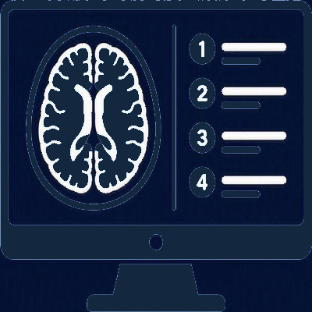


END-TO-END JOURNEY
From patient arrival to diagnosis
1
2
3
4
5
6
7
Patient arrives by ambulance
CT scan performed
Images & data captured
Data sent to PACS
NeuroTriage AI analyzes & prioritizes worklist
Radiologist reviews prioritized study
Report finalized & shared with care team
What is PACS?
Picture Archiving and Communication System — the hospital imaging system that stores, manages and delivers medical images to the right people at the right time.
NeuroTriage AI sits inside this journey — it does not replace PACS or the radiologist, it surfaces potentially urgent studies sooner.
NeuroTriage AI · Prototype — simulated/anonymized data — not for clinical use
3

Slide 4
THE PRODUCT CONCEPT
From image analysis to actionable prioritization
1
2
3
4
Detect
Assess
Prioritize
Present
Identify patterns suggestive of intracranial hemorrhage.
Generate a finding, confidence and location.
Translate the assessment into Critical / High / Moderate / Routine priority.
Bring the case forward for human review.
The product value is not simply detecting an abnormality — it is helping the right case receive attention at the right time.
NeuroTriage AI · Prototype — simulated/anonymized data — not for clinical use
4

Slide 5
THE AI DECISION LOOP
AI supports a human-in-the-loop decision
CT Study
Human remains accountable
AI Assessment
AI provides decision support
Clinician reviews the evidence
Clinician can override the AI
Feedback is captured
Finding + Confidence + Location
Priority
Confirm
Radiologist Review
Feedback /
Learning opportunity
Override
NeuroTriage AI · Prototype — simulated/anonymized data — not for clinical use
5

Slide 6
WHAT WE BUILT
A working MVP — not just a concept
Realistic data layer
AI-assisted workflow
Reading experience
Anonymized DICOM CT studies
6 real study datasets
4 ICH-positive cases
2 normal cases
Finding assessment
Confidence score
Priority classification
Hemorrhage location
Automatic worklist reprioritization
CT slice navigation
AI overlay
Jump to Finding
Brain / Blood-ICH windowing
Confirm / Override
The prototype demonstrates the end-to-end product workflow, from CT study arrival to clinician decision.
AI inference is simulated for this prototype; the workflow is designed to support a future validated AI inference service.
NeuroTriage AI · Prototype — simulated/anonymized data — not for clinical use
6

Slide 7
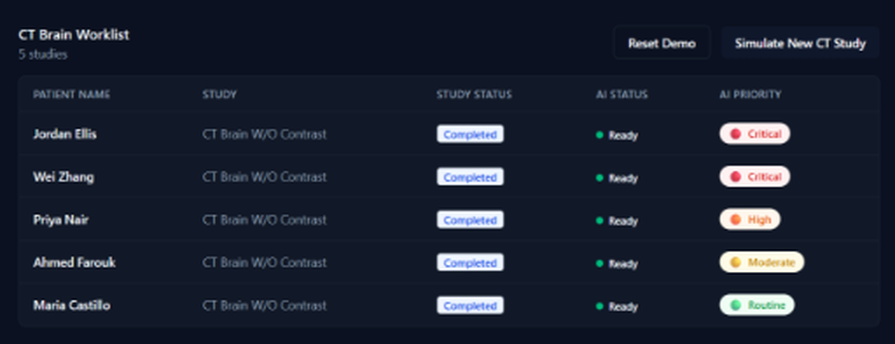
PROTOTYPE — INTELLIGENT WORKLIST
Critical cases rise to the top
CT Brain Worklist · prototype screen
Critical → immediate attention
High → elevated priority
Moderate → routine escalation
Routine → standard workflow
Simulate New CT Study → the worklist reorders automatically
As studies become available, the worklist automatically reprioritizes based on the AI assessment. Screen shown is the working prototype with simulated, anonymized studies.
NeuroTriage AI · Prototype — simulated/anonymized data — not for clinical use
7

Slide 8
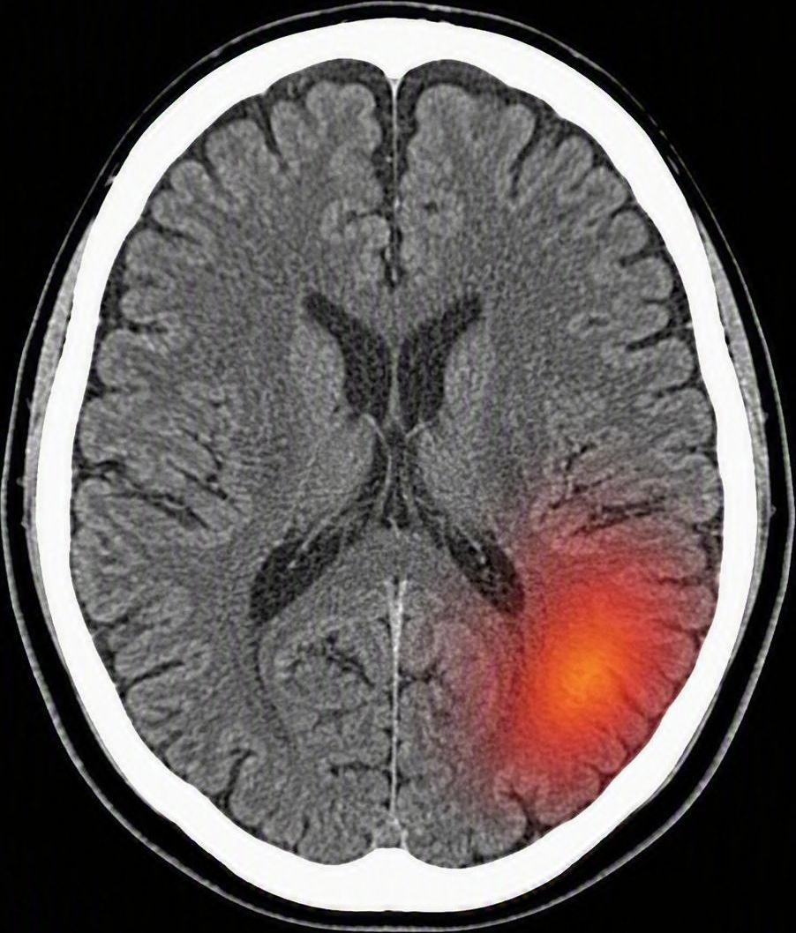
PROTOTYPE — READING EXPERIENCE
From “something is urgent” to “show me where”
1. AI Assessment
Suspected ICH · 93% confidence
2. Explainable location
Left parietal lobe
3. Jump to Finding
One click takes the reviewer directly to the highlighted slice.
Brain ↔ Blood/ICH windowing allows the reviewer to inspect the finding under different display settings.
NeuroTriage AI · Prototype — simulated/anonymized data — not for clinical use
8

Slide 9
TRUST BY DESIGN
AI recommends. The clinician decides.
AI
HUMAN
SYSTEM
Detection
Confidence
Prioritization
Visual indication
Review
Clinical context
Confirmation
Override
Audit and feedback
Transparent workflow
Explicit uncertainty
The prototype deliberately avoids presenting AI output as a final diagnosis.
NeuroTriage AI · Prototype — simulated/anonymized data — not for clinical use
9

Slide 10
BUSINESS & CUSTOMER VALUE
What value could NeuroTriage AI create?
Patient
Clinician
Hospital
Business
Potentially faster identification of urgent cases.
Reduced effort in finding high-priority examinations.
More efficient use of radiology capacity.
Potential platform for AI-assisted workflow products.
Potential pilot KPIs
Time from study completion → radiologist review
Time to review of suspected ICH
Sensitivity / false-negative rate
False-positive rate
Override rate
AI adoption / usage
Impact on radiologist workflow
These are proposed success measures — they were not validated by this prototype.
NeuroTriage AI · Prototype — simulated/anonymized data — not for clinical use
10

Slide 11
SCOPE AND LIMITATIONS
A successful prototype is not a clinical validation
Demonstrated
Not yet demonstrated
End-to-end workflow
Real anonymized CT DICOM integration
Window/level handling
AI-style prioritization
Human confirmation / override
Worklist reprioritization
Explainable visual indication
Clinical diagnostic performance
Generalization across populations and scanners
Prospective clinical benefit
Regulatory clearance
Production-scale integration
Patient outcome improvement
The prototype validates the product concept and workflow — not clinical efficacy.
NeuroTriage AI · Prototype — simulated/anonymized data — not for clinical use
11

Slide 12

RECOMMENDATION & ROADMAP
From prototype to controlled pilot
1 — Prototype
2 — Technical validation
3 — Controlled clinical pilot
4 — Scale
Workflow validated
Real DICOM demonstrated
Human-in-the-loop interaction
Dataset expansion
Model performance
False-positive / false-negative analysis
Robustness testing
Workflow integration
Radiologist evaluation
Prospective performance
User feedback
Regulatory pathway
PACS / workflow integration
Deployment
Continuous monitoring
Recommendation: proceed to controlled validation, with clinical performance, workflow impact, safety and regulatory requirements treated as explicit stage gates.
NeuroTriage AI · Prototype — simulated/anonymized data — not for clinical use
12

Slide 13
SUPPORTING DETAIL
AI assessment + confidence → priority
How the prototype translates an assessment and its confidence into a worklist priority
AI ASSESSMENT
CONFIDENCE
WORKLIST PRIORITY
Suspected ICH
High ≥ 80%
Critical
Suspected ICH
Medium < 80%
High
No suspicious findings
Medium < 80%
Moderate
No suspicious findings
High > 80%
Routine
This directly explains why the worklist is ordered the way it is.
Prototype prioritization rule — thresholds are configurable and not clinically validated.
NeuroTriage AI · Prototype — simulated/anonymized data — not for clinical use
13

