Slide 1


ECHO SERVER
BY : SAKSHAM KUMAR

Slide 2

❯❯ ls Content
DIFFERENT TYPES OF I/O : BLOCKING AND NON-BLOCKING
EVENT DRIVEN I/O AND EVENT LOOP
USE OF EVENT LOOP IN NODE JS

Slide 3
❯❯ cd Content/Types_Of_IO
BLOCKING I/O
NON - BLOCKING I/0

Slide 4


Blocking and non-blocking I/O refer to how input/output operations (like reading from a file, network, or console) are handled in a program.
BLOCKING I/O
NON - BLOCKING I/O
Execution is paused until the request is executed
Program continues to execute other tasks while checking if the I/O operation is finished.
TASK 1
TASK 1
TASK 1
TASK 2
TASK 2
TASK 2
TASK 3

Slide 5


ANALOGY
In a restaurant, the waiter takes multiple orders without waiting for one to be completed before moving to the next table.
NON BLOCKING I/O works in a similar way
Now, imagine a restaurant where a waiter takes one order at a time and does not serve anyone else until the current order is fully prepared. BLOCKING I/O works like this

Slide 6
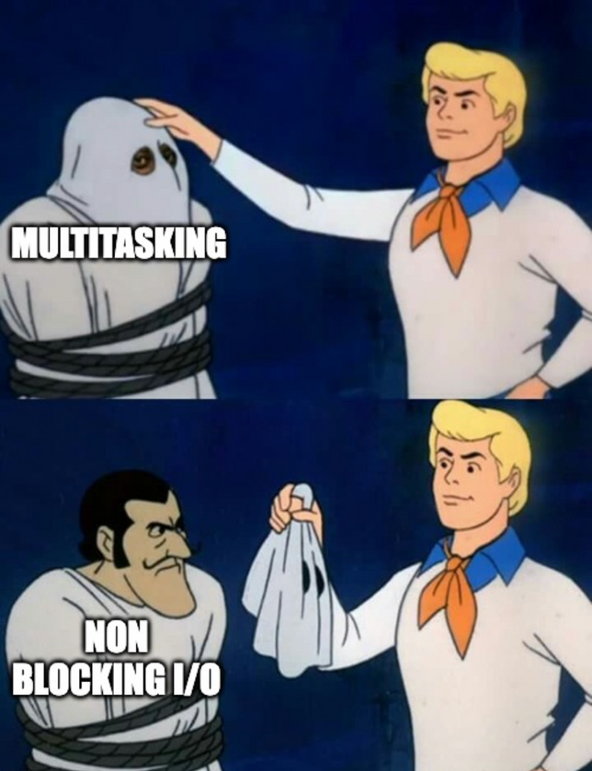
A Good Server
In technical terms, a server is a software, or device that provides services or data to other clients over a network
There can be different type of servers - Web Servers, Database Servers, File Servers, SSH servers, etc
A Good server must handle multiple client requests at the same time with less performance impact.

Slide 7
SINGLE THREAD VS MULTI THREADING
In a process, a thread represents a unit of execution inside it.
One single thread is executed at a time.
Uses fewer system resources
Slower for complex tasks, might freeze if a task takes too long.
No concurrency.
Process executes multiples threads at a time
Uses more system resources
Can handle multiple requests at once.
Supports concurrency – multiple tasks run in parallel.
Note that multi threading is not Non - Blocking I/O as tasks can be blocked if threads wait on resources

Slide 8
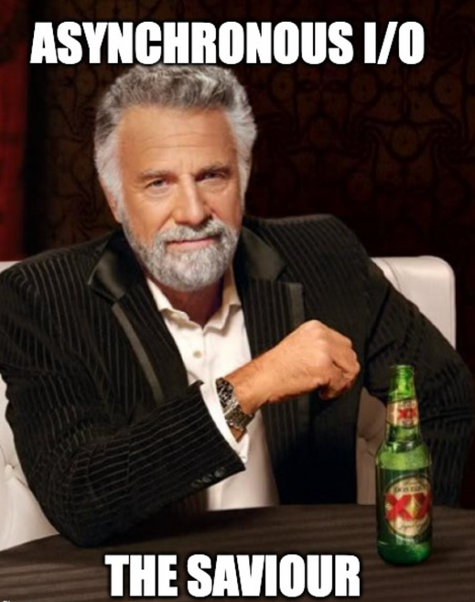
❯❯ CAN A CONCURRENCY LIKE MULTITHREADING BE ACHIEVED WITH USING LESS RESOURCES ?
YES, Asynchronous I/O does that.
It uses a single thread which switches between tasks without blocking.
Concurrency is achieved via Non - Blocking I/O and event loops
Uses less system resources as compared to multi-threading.

Slide 9
❯❯ cd ../Event_Driven_Architecture
USED TO HANDLE MULTIPLE TASKS CONCURRENTLY USING A SINGLE THREAD
TASK QUEUE
TIMERS, I/O OPERATIONS, ETC.
CALL STACK
EVENT
LOOP
MICRO TASK QUEUE
PROMISES ...
CALL STACK - It is a stack data structure (last in, first out) which keeps track of the function running and the functions to be executed next.
TASK QUEUE - It is a queue data structure (first in, last out). Functions regarding web APIs such as timers (eg, setTimeout(), etc.), I/O operations, etc.
MICRO TASK QUEUE - It is also a queue, but more prioritized than task queue. Functions regarding Promises (then(), catch(), finally()), the code after `await` keyword, queueMicroTask().

Slide 10
When a promise or queueMicroTask() occurs in the call stack, it is pushed to micro tasks queue.
While if a Web API function occurs in the call stack, it is pushed to tasks queue.
If the call stack is empty, first the functions in the micro tasks queue are executed in the call stack.
When the micro tasks queue gets empty, the functions in the tasks queue are executed in the call stack.
In this way, the thread doesn’t have to wait for a function to finish, it instead can proceed to run other functions in the call stack.

Slide 11
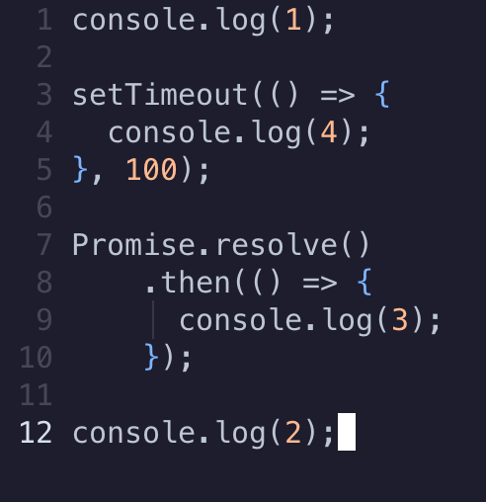

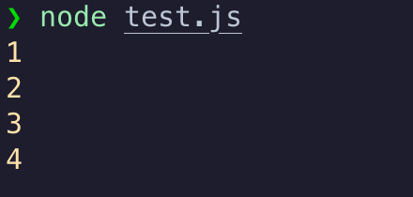
❯❯ cd ../Event_Loop_In_Node_js
CALL STACK
WEB API
INPUT
console.log(1)
TASK QUEUE
OUTPUT
MICRO TASK QUEUE

Slide 12

setTimeout is a web API function so, it is moved to Task Queue.
CALL STACK
WEB API
INPUT
setTimeout(....);
setTimeout(....);
TASK QUEUE
setTimeout(....);
OUTPUT
MICRO TASK QUEUE

Slide 13
Promise is moved to Micro Task Queue (given higher priority than setTimeout)
CALL STACK
WEB API
INPUT
Promise.resolve().then(...)
TASK QUEUE
setTimeout(....);
OUTPUT
MICRO TASK QUEUE
Promise.resolve().then(...)

Slide 14
CALL STACK
WEB API
INPUT
console.log(2)
TASK QUEUE
setTimeout(....);
OUTPUT
MICRO TASK QUEUE
Promise.resolve().then(...)

Slide 15
CALL STACK
WEB API
INPUT
console.log(3)
This function is immediately moved to the call stack
TASK QUEUE
setTimeout(....);
Promise.resolve().then(...)
MICRO TASK QUEUE
OUTPUT

Slide 16
CALL STACK
WEB API
INPUT
console.log(4)
Finally, function from task queue is moved to call stack and executed
TASK QUEUE
setTimeout(....);
OUTPUT
MICRO TASK QUEUE

Slide 17
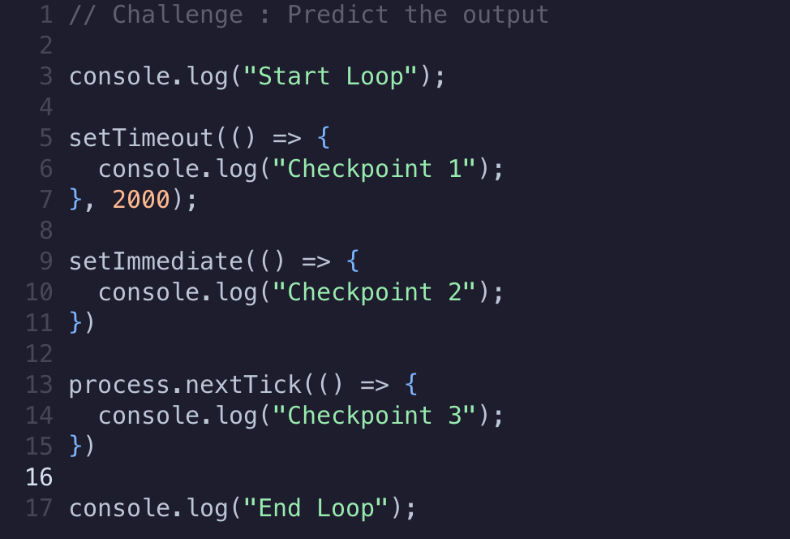
❯❯ cd ../Challenges
1 ❯❯ Predict_The_Output

Slide 18
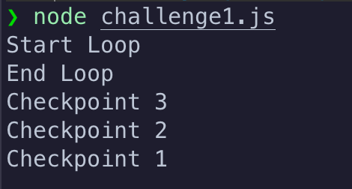
1 ❯❯ Predict_The_Output
setTimeout(..) being a Web API is executed at last.
setIntemediate(..) belong to Macro tasks queue which are given more priority than Tasks queue and less priority than Micro Tasks queue
process.nextTick(..) being in Micro tasks queue is executed first.

Slide 19
1 ❯❯ Predict_The_Output
setTimeout(..) being a Web API is executed at last.
setIntemediate(..) belong to Macro tasks queue which are given more priority than Tasks queue and less priority than Micro Tasks queue
process.nextTick(..) being in Micro tasks queue is executed first.

Slide 20
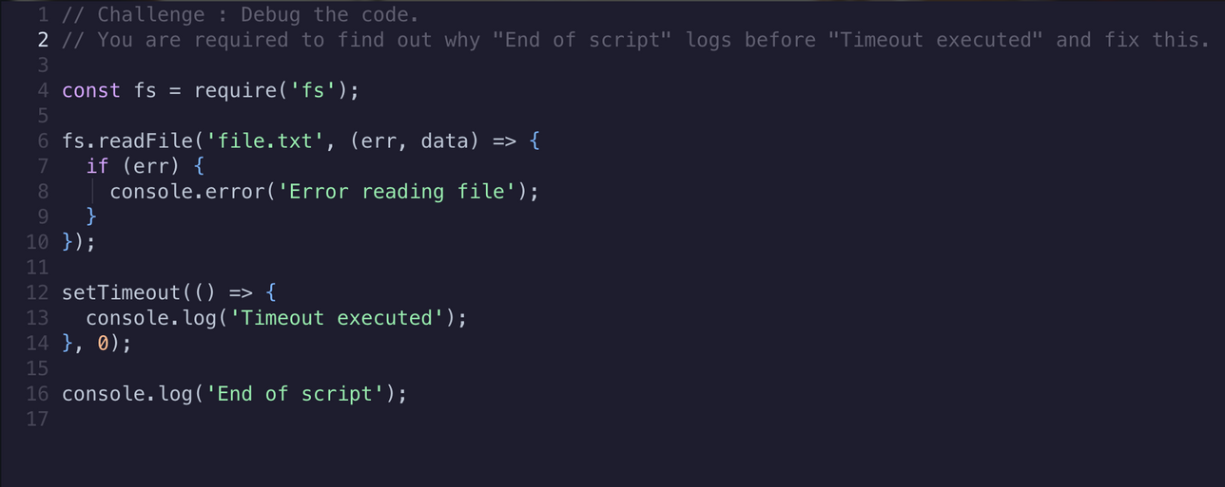

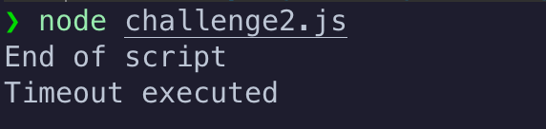
2 ❯❯ Debug_Challenge

Slide 21
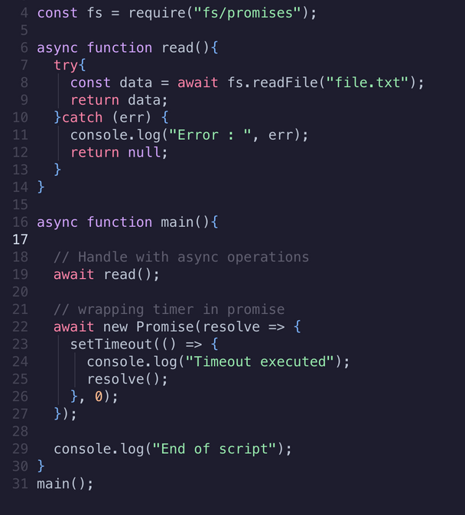
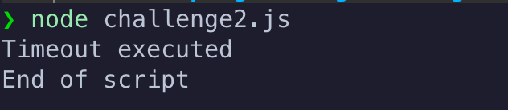
2 ❯❯ Debug_Challenge
FIXED CODE :

Slide 22
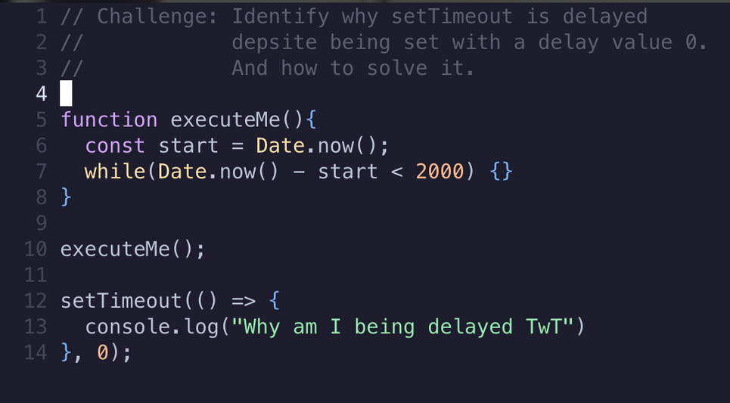
2 ❯❯ Fix_The_Code

Slide 23
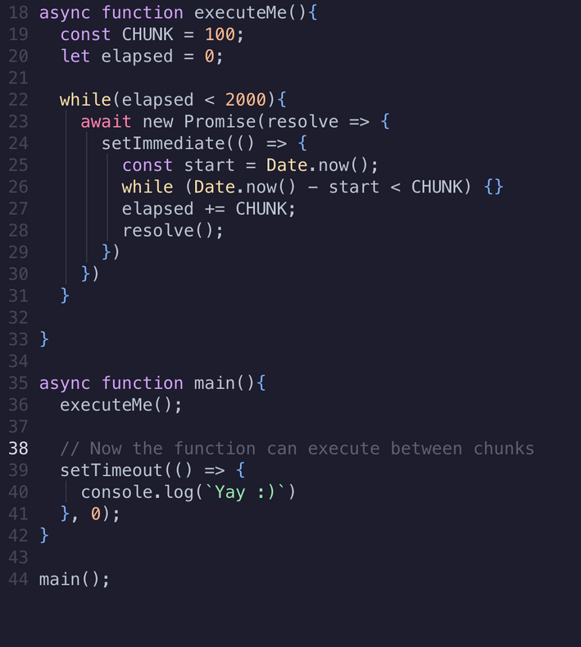
2 ❯❯ Fix_The_Code
Improved Code
Split blocking operation into chunks
So, even after a 2 min dealy, timeout executes because the event loop is controlled.
setIntermmediate queues chucks in the MacroTasks Queue, which prevents the blocking of other functions

Slide 24
thank
you

