Slide 1
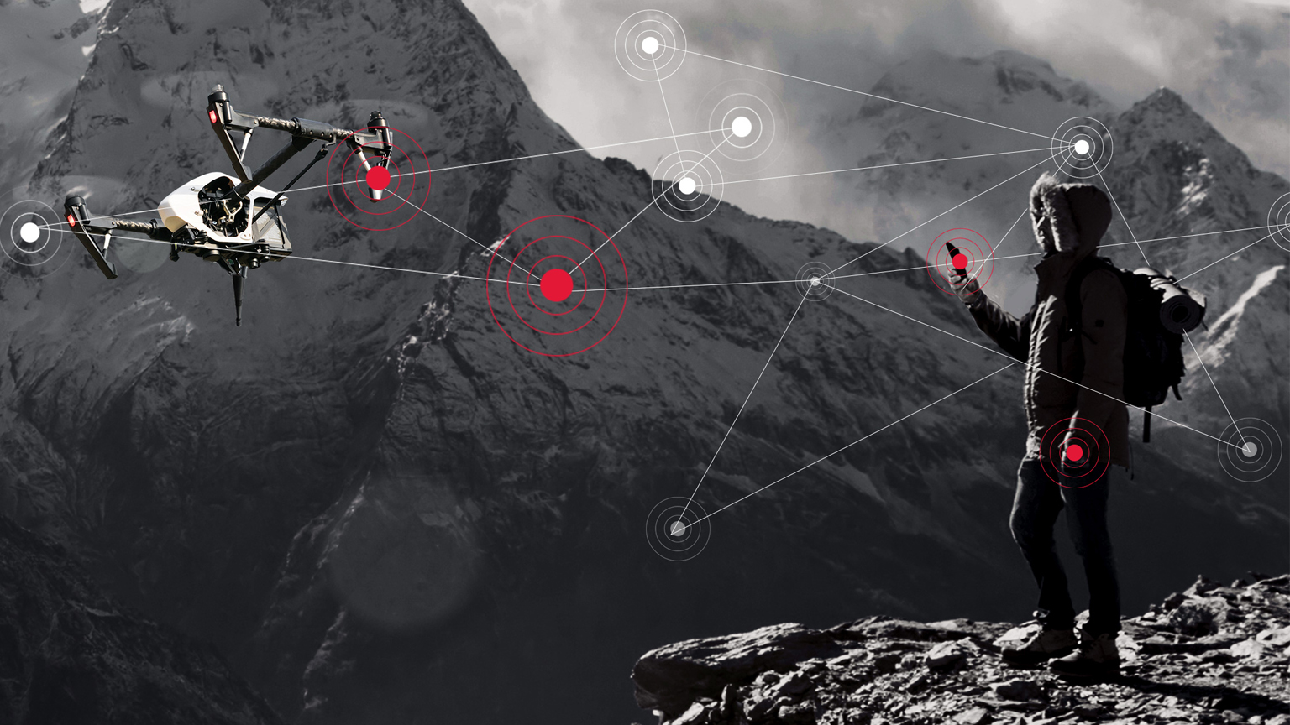
SMART DRONE
BY –
SHUBHANKAR GUPTA (PRN-1614110139)
SAKSHAM GUPTA (PRN-1614110140)
SHASHWAT PANDE (PRN-1614110170)
UNDER THE GUIDANCE OF:
Prof. S.U.RASAL

Slide 2
OBJECTIVES
INTRODUCTION
HOW IT’S MADE?
WHAT IT LOOKS LIKE
HOW IT WORKS?
LICENSE PLATE RECOGNITION PIPELINE
MODEL WORKING
BENEFITS & FUTURE SCOPE
CONCLUSION

Slide 3
INTRODUCTION
A quadcopter drone will be used to develop a License plate (ALP) recognition systems.
The drone will be programmed to fly along a user defined path and will communicate image and navigation data with a host system through Wi-Fi.
A computer vision pipeline will be developed to perform license plate recognition on incoming image from the drone.
License number will be extracted from the image from vehicles database and corresponding fine for illegal parking will be sent on owner’s phone through message.

Slide 4
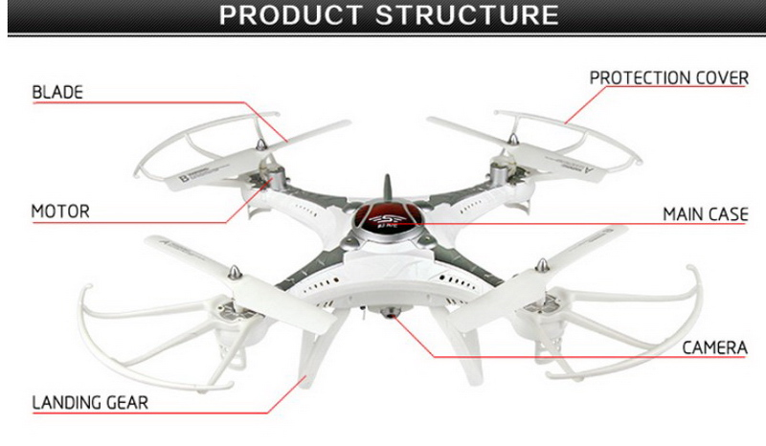
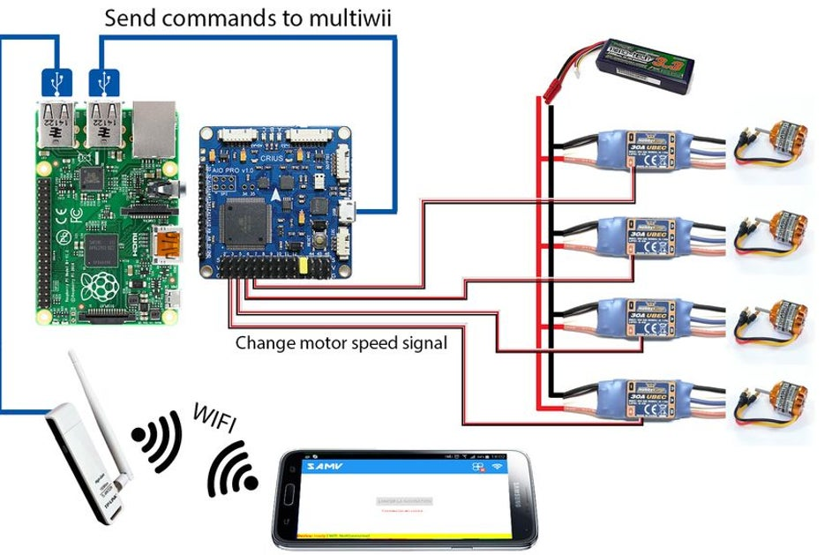
How It’s Made??

Slide 5
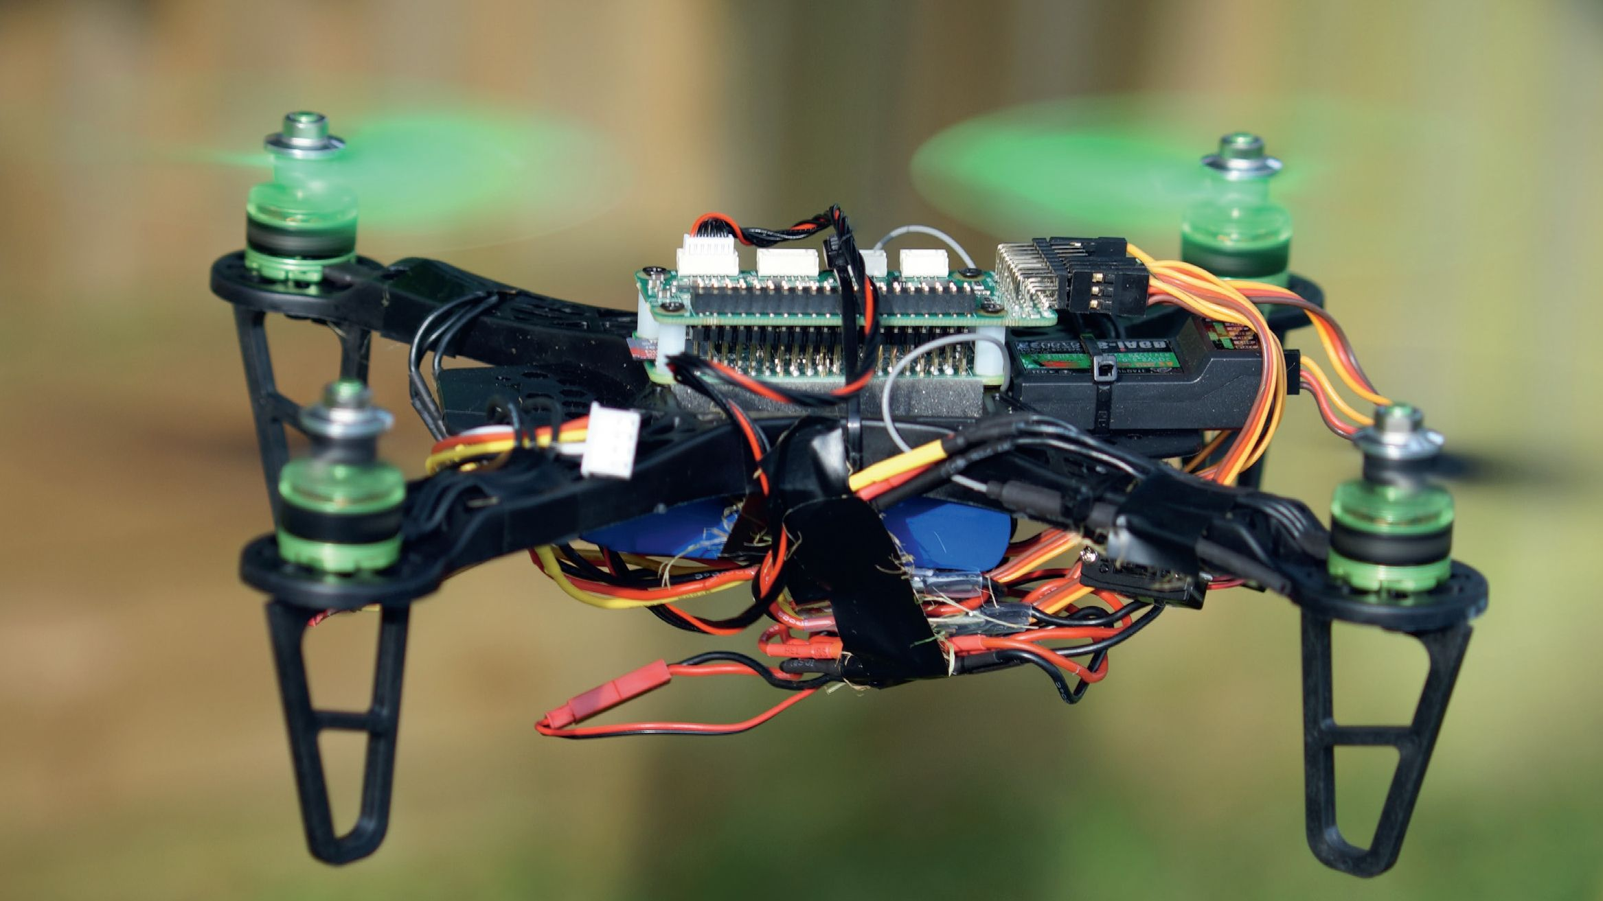
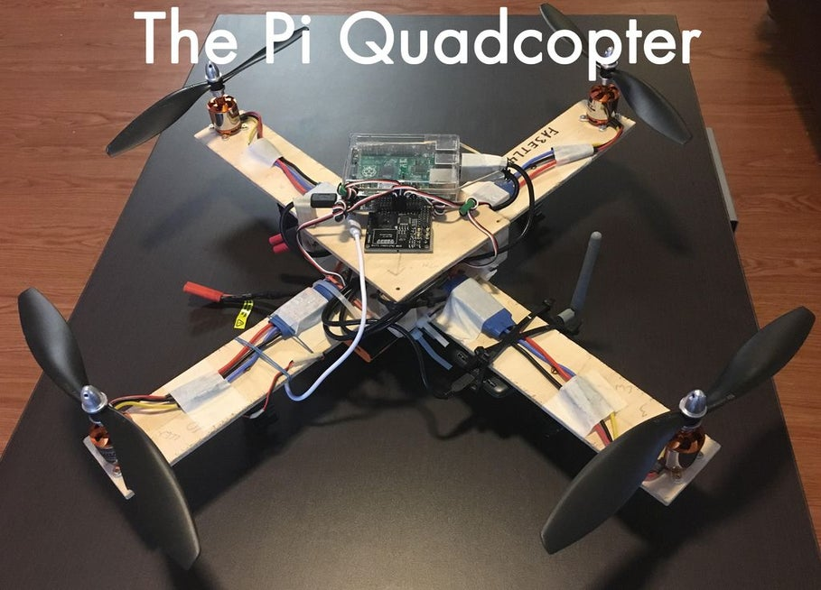
What it looks like?

Slide 6
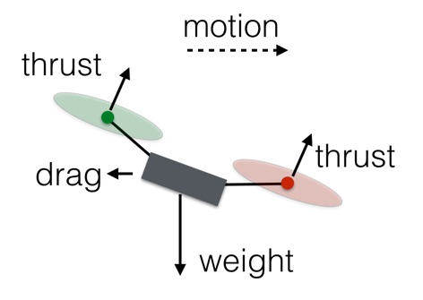
HOW IT WORKS ??
Drone use rotors for propulsion and control . As spinning blades push air down . The basic idea behind lift, which comes down the controlling the upward and downward force. The faster the rotors spin, the greater the lift, and vice versa.
In vertical plane drone can do 3 things : hover , climb, or descend.
To hover : the net thrust of the four rotors pushing the drone up must be equal to gravitational force pulling it down
To climb: just increase the thrust so that there is no upward force that is greater than weight

Slide 7
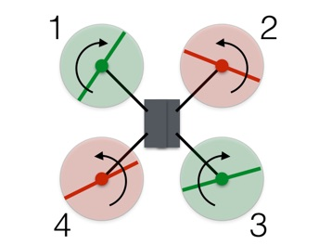
In the diagram it can be clearly seen that the rotors 1 and rotor 3 are rotating clockwise and rotor 2 and rotor 4 are rotating anticlockwise this is done so as to achieve the angular momentum zero (-2,-2,+2,+2)
Suppose if we want to rotate right so here we assign values (-1) to rotor 1 instead of (-2) now new angular momentum become +1 so it would rotate clockwise direction

Slide 8
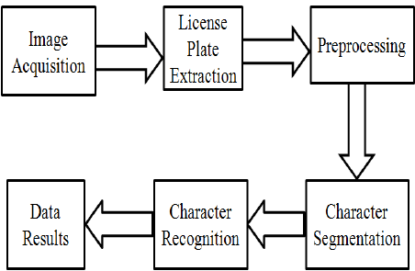
License Plate Recognition Pipeline

Slide 9
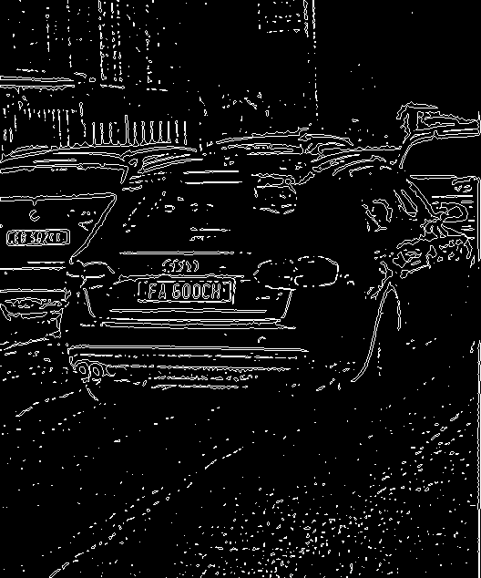
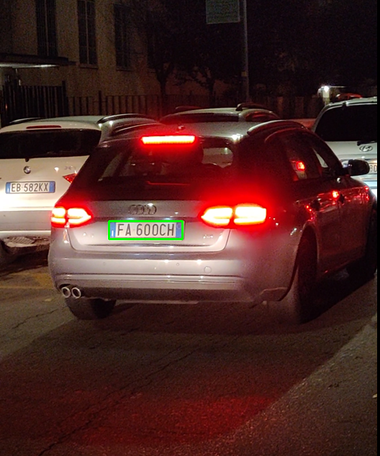
License Plate Detection (ROI)
Pre-processing - greyscale, Binarization
Connected component analysis

Slide 10
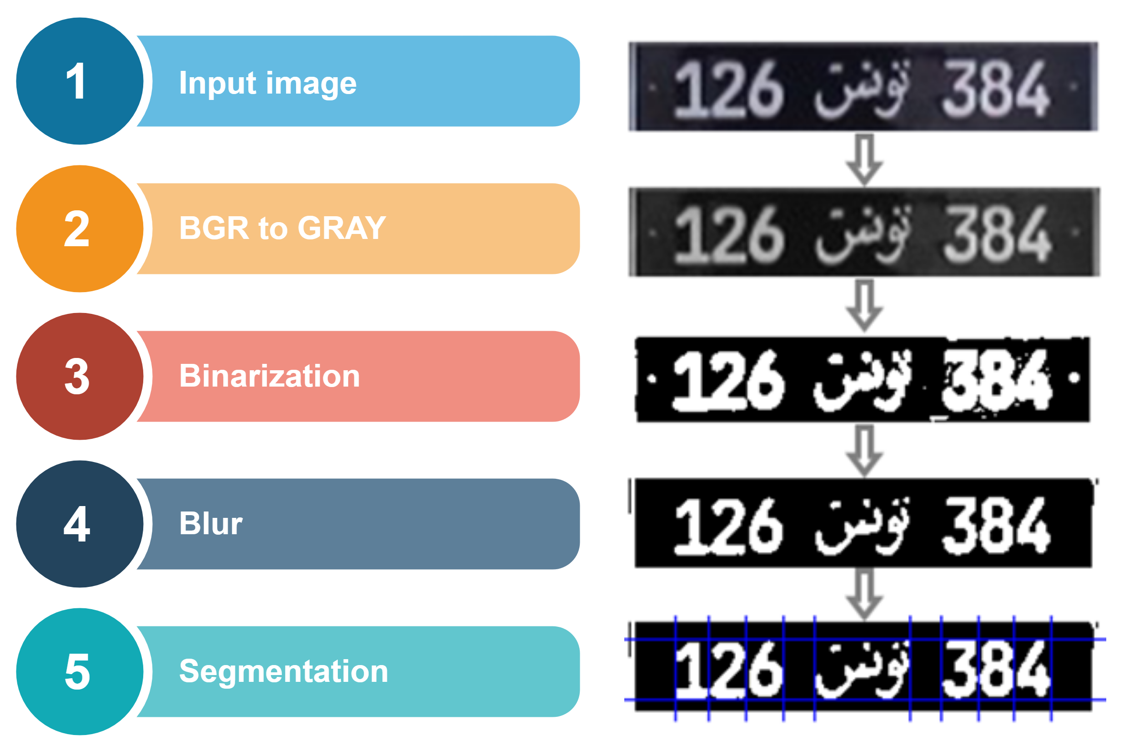
License Plate

Slide 11
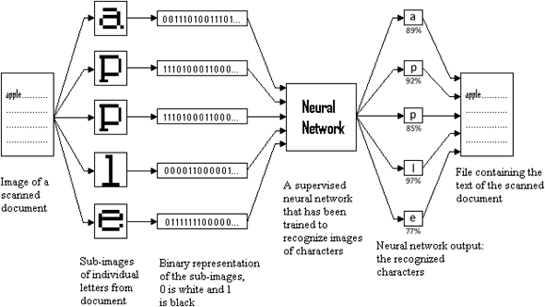
License Plate Character Recognition
Input-Individual characters
OCR-45fps

Slide 12
Model working
The flight control loop and the license plate recognition pipeline.
Receive navigation data, license plate image, send control and configuration commands and to receive the video data for processing.
Navigation data and images are received by the host computer from the drone.
Analysis of image.
License plate number processing.

Slide 13
Salient Features
A traffic monitoring solution that checks for any vehicles being parked at illegal parking spaces.
Offer solution to the owner by redirecting them to legal parking lots provided by the local government.
Failure in compliance of using these legal parking lots enables them in being legible for a government issued fine.
This will ensure in smooth traffic flow as well as reducing the pollution to greater extent.
Detection of stolen, blacklisted, unregistered cars.

Slide 14
Suggesting Nearest Location
These messages would be sent to user’s mobile phone and alert him about specific events recorded by my Pi.
The only reliable solution is to use an SMS Gateway.
Radio Frequency signals sent from satellites and ground stations are received by the GPS. GPS makes use of these signals to determine its exact position.
The signals received from the satellites and ground stations contain time stamps of the time when the signals were transmitted.
Using the speed of the signal, the distance between the satellites and the GPS receiver can be determined using a simple formula for distance using speed and time.

Slide 15
BENEFITS & FUTURE SCOPE

Slide 16
Conclusion
The drone can be used to subvert the role of actual traffic personnel by automatically chastising the wrongful owner.
Help make the road less congested and more immune to traffic related accidents.
Bring a more successful, accurate and organized way of handling the traffic plight of high-density areas.
Help us tackle the problem of illegal encroachment of roads and reduce the carbon emissions.

Slide 17
THANK YOU

