Slide 1
e-Rakt
We connect the helpless with the helpful
Do you feel you don’t have much to offer? You have the most precious resource of all: the ability to save a life by donating blood! Help share this invaluable gift with someone in need.
- Saksham Garg & Tushar Garg
- IT (C)
- 1802913144 & 1802913175

Slide 2
Context and Goal
1
e-Rakt is a web application which acts as an intermediary between Blood Donors and Blood Donee . In word e-Rakt e stands for digital and Rakt stands for Blood .
It works for the betterment and help of society, and leads towards a better world.

Slide 3
Statement of work/Goals
2
It is a web application which allows donors to donate blood or financial help as they desire, and we provide that help to persons in need.
People can participate in this and help each other in their time of need through our website.
Its goal is to reach everyone in the society , and works to help those who are in need.

Slide 4
Technical Solution Overview
Bootstrap4
Bootstrap is a free and open-source CSS framework directed at responsive, mobile-first front-end web development.
HTML5
A markup language used for structuring and presenting content on the World Wide Web.
JavaScript
A programming language that conforms to the ECMAScript specification.
CSS3
MySQL
Cascading Style Sheets is a style sheet language used for describing the presentation of a document written in a markup language like HTML.
MySQL is an open-source relational database management system.

Slide 5
Problem Statement -
3
Project to solve current Blood requirement problems and state a business plan.

Slide 6
Project Decription -
4
We have made a web application that meets with the current Blood requirement problems, by working as an intermediary between Blood Donors and Blood Donee by providing donors contact information after approptiate verification .
To cope up with business plan and as a little source of income for management team we will provide hosital advertiesments and some medical suppliers too.

Slide 7
Project Goals and Objectives -
5
The main objective of this project is to help peoples and make them help each other in their time of need.
People just need to register their information on our site and if someone require specific blood type which matches yours in your region the your contact information will be provided to them after certain verifications , then they'll try contacting and request you for your blood .
if someone need financial support then we will help then with you pre-donated funds, and surely will notify you when your donated money is being used.

Slide 8
Critical Success Factors -
6
Project recures Donors on the constant basis, this will maintain the help cycle continous.
Everyone who gets the help must register themselves and motivate others as well to register .

Slide 9
The User's Perspective
Donate Blood
Request Blood
User just need to register his/her name to be a volunteer in the time of need.
Request any kind of blood anywhere-anytime.
Join in
Donate Capital
Join us and help in saving lives.
Capital donation will be a great help token.

Slide 10
REQUEST BLOOD
DONATE BLOOD
SOMEONE's HERO
Find blood donors near your location and request the needed blood type.
Help someone in their time of need, in your local region.
Saving a life is a noble work that starts very simply and easily. Donate Blood or donate Money, every form of contribution you make is important.
Join our cause and help us save more lives. Everyone should have the right to get a blood transfusion. In as little as few minutes, you can become someone's unnamed, unknown, but all-important Hero. Life s valuable help each other on this network . Every Life Matters.

Slide 11
Implementation
7

Slide 12
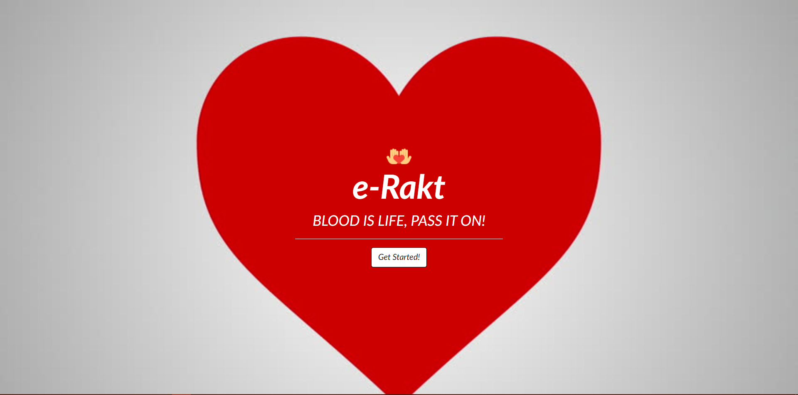
First Page:

Slide 13
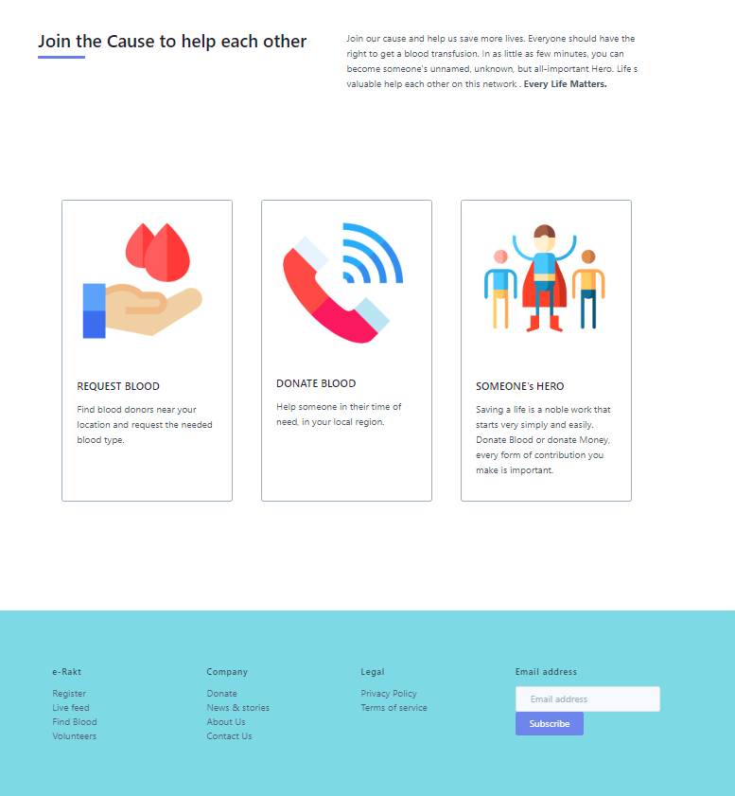
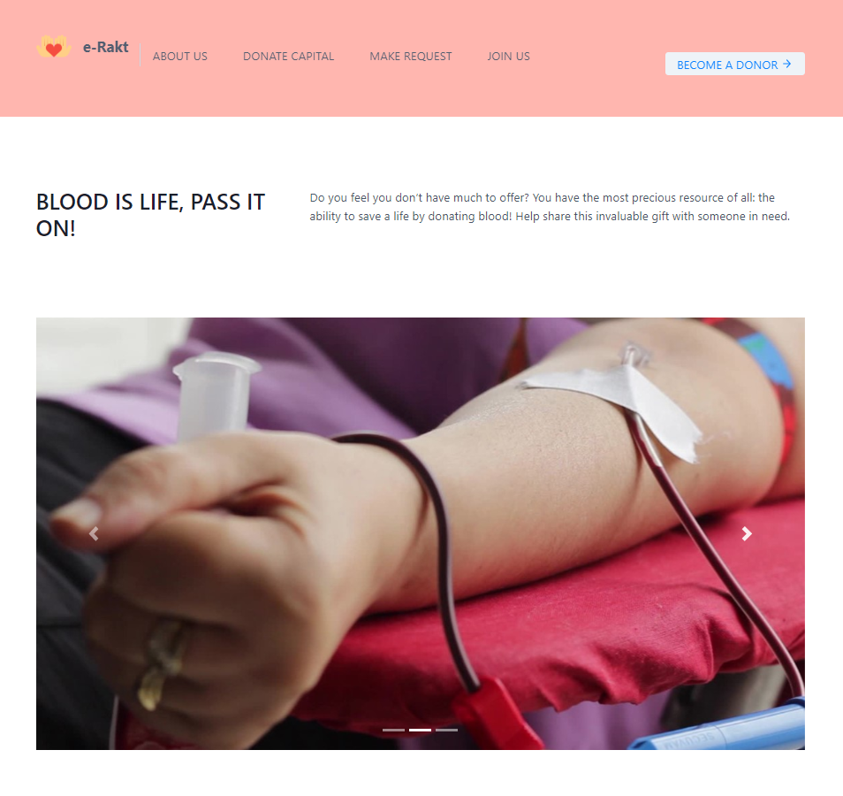
Index Page:

Slide 14
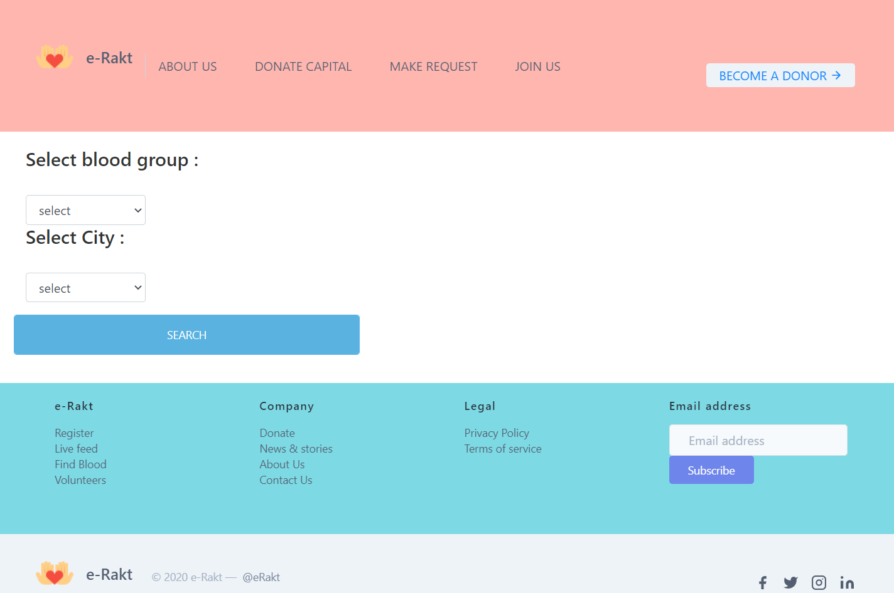
Blood Donation Page:

Slide 15
Conclusion
8
It was a wonderful and learning experience for me while working on this project. This project took me through the various phases of project development and gave me real insight into the world of Animal Husbandary . The joy of work and the thrill involved while tackling the various problems and challenges gave me a feel of developers industry.
I enjoyed each and every bit of work. I had put into this project e-Rakt.

Slide 16
THANKS FOR WATCHING

