Slide 1
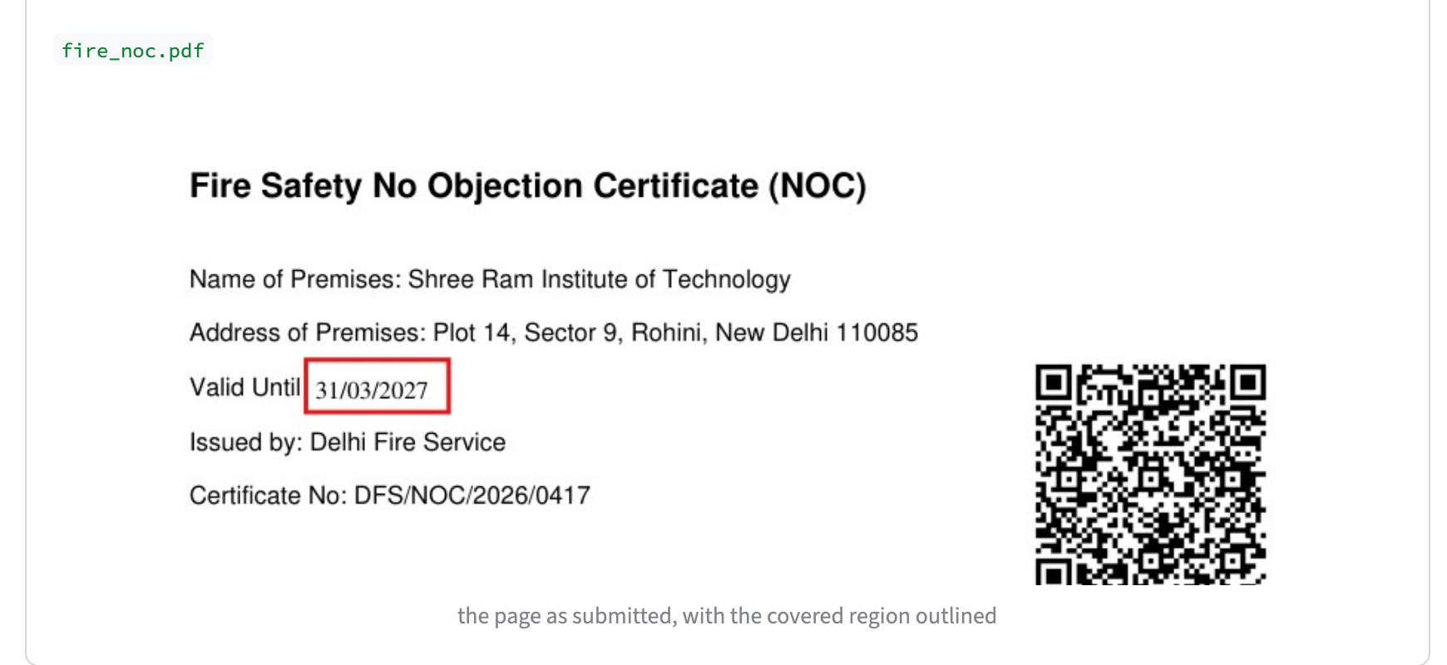
SMART INDIA HACKATHON 2026
TITLE PAGE
Problem Statement ID
SIH26261
Pramaan
Problem Statement Title
AI-Powered Application Validation, Document Authentication and Regulatory Compliance Verification
Every AICTE application verdict, with proof
Theme
Smart Automation
PS Category
Software
Team ID
Team Name (Registered on portal)
Notes:
Pramaan means proof. It checks an AICTE application end to end and every result comes with its evidence.

Slide 2
Team Name
IDEA TITLE
SMART INDIA
HACKATHON 2026
From manual scrutiny to one verdict, with proof
Today
01
Read
typed PDFs, scans and phone photos
OCR runs offline on the server
• Officials read every land, building, fire and faculty document by hand
• An edited certificate looks genuine to the eye
• Nobody can compare one faculty list with every other institution's
02
Check norms
faculty ratio, built-up area, fire validity
from the AICTE handbook, with annexure cited
Proposed Solution
Pramaan reads an institution's whole application, checks it against the AICTE Approval Process Handbook, against itself and against every earlier application, and returns one verdict with quoted evidence.
03
Authenticate
edit marks, QR vs page, digital signatures
COMPLIANT
REJECT
HUMAN REVIEW
04
Remember
same faculty or certificate at two
institutions is caught across applications
Rule: never approves what it is unsure of. Unreadable text, unverified AI readings and edit marks all go to an officer, with the reason.
@SIH Idea submission- Template
2
Notes:
Officials read every document by hand. Pramaan reads the whole application and gives one of three verdicts, and it never approves something it is unsure of.

Slide 3
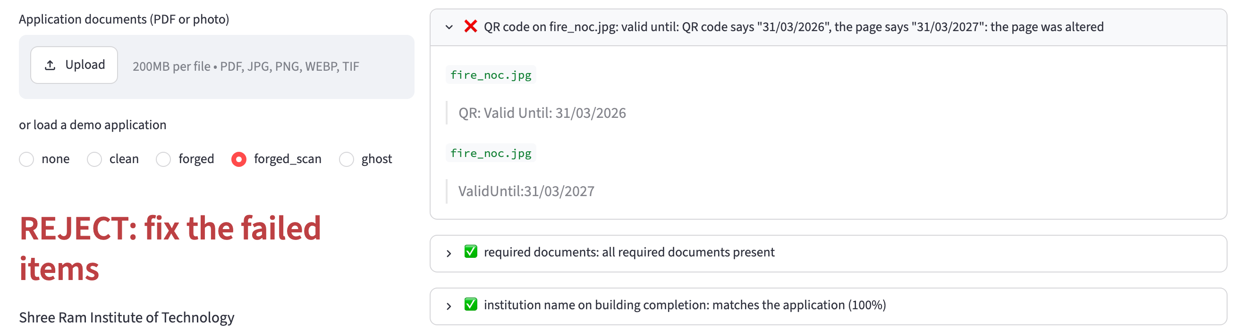
Team Name
TECHNICAL APPROACH
SMART INDIA
HACKATHON 2026
AI proposes. Code verifies.
Read
PyMuPDF
RapidOCR
Classify
document
type
Extract
labels, then
Gemini
Verify
quote must be
in the text
Check
norms and
cross-document
Authenticate
edits, QR,
signature
Registry
against earlier
applications
Verdict
with quoted
evidence
Python
FastAPI
Streamlit
SQLite
PyMuPDF
RapidOCR
OpenCV
pyHanko
Example: a forger prints and scans the page, so no edit marks survive. The issuer's QR code still holds the true date, so Pramaan rejects it.
Gemini
RapidFuzz
ReportLab
pytest
@SIH Idea submission- Template
3
Notes:
Label matching reads standard forms. Gemini reads free-form letters, but a value is kept only if its source line is in the document and numbers match exactly. Then the rule engine, forensics and registry run.

Slide 4
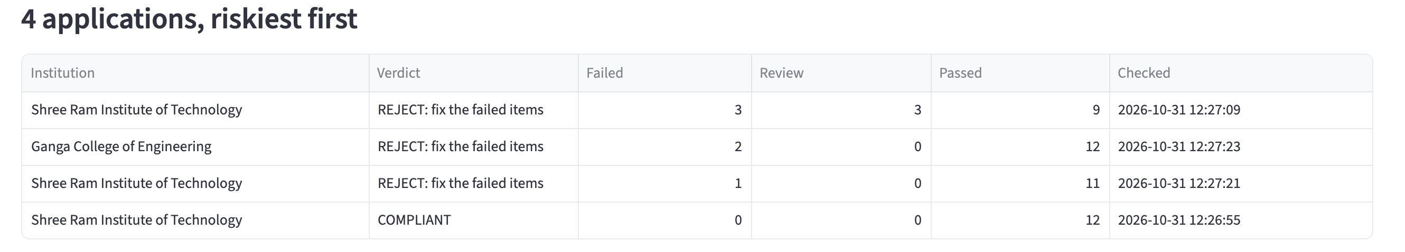
Team Name
FEASIBILITY AND VIABILITY
SMART INDIA
HACKATHON 2026
Working prototype, real norms, honest limits
28
7
<1 s
REST
Risks and how we handle them
Real scans are messier than our samples
Tested on synthetic documents so far; unreadable fields go to a human
automated tests
all passing
document types
read
per demo application
on a laptop
API ready for
portal integration
AI can invent a value
Kept only if its source line is in the document, numbers exact
A careful paste on a photo with no QR
Not caught yet; issuer QR and signatures are the defence
Viability
• Open-source stack; OCR and every rule run on the server
• Norms live in one config file, updated each handbook cycle
Sensitive documents
AI reader is optional; offline mode sends nothing out
@SIH Idea submission- Template
4
Notes:
This is built and running. The norms come from the actual handbook. Be upfront that all test documents so far are synthetic, and that signatures are checked for integrity, not yet against the CCA root list.

Slide 5
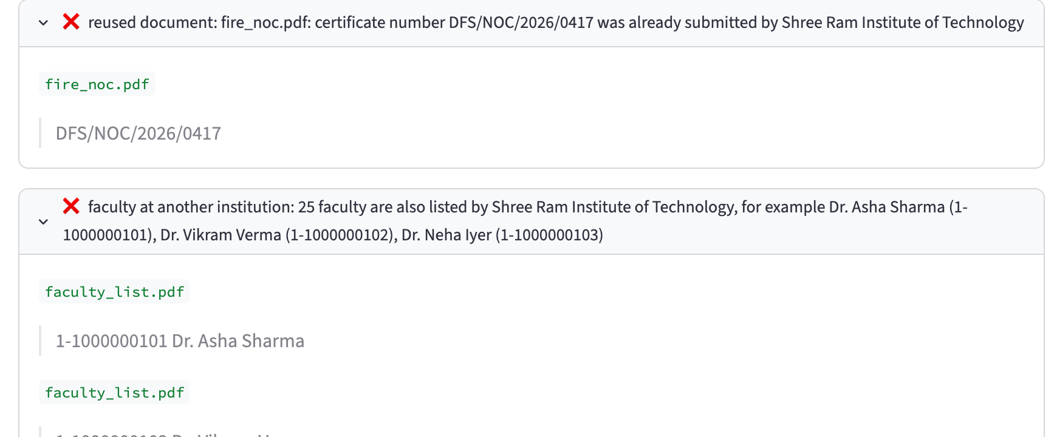
Team Name
IMPACT AND BENEFITS
SMART INDIA
HACKATHON 2026
Faster scrutiny, harder fraud, decisions you can audit
AICTE officers
Honest institutions
Students
Government
• Clean files verified at once
• Riskiest applications first
• Every finding quotes its source
• Know exactly what to fix
• Consistent rules for everyone
• No first-glance bias
• Real faculty, not names on paper
• Safer, fire-certified buildings
• Trustworthy approvals
• Audit trail for every decision
• Ghost faculty detected at scale
• Portal plugs in over REST
Caught across applications
A second college lists 25 faculty already on another institution's record, and reuses its fire certificate number.
Every document looks fine alone. Only memory across applications finds it.
@SIH Idea submission- Template
5
Notes:
The impact is less time on clean applications and more officer attention on risky ones. Ghost faculty is the strongest example, because no check on one file can find it.

Slide 6
Team Name
RESEARCH AND REFERENCES
SMART INDIA
HACKATHON 2026
Built on the AICTE handbook and published standards
Regulation
Standards and research
AICTE Approval Process Handbook 2024-27
Annexure 3 (land, area), Annexure 5 (faculty), clause 6.17
ISO 32000-2
PDF structure, incremental updates, signatures
AICTE Act, 1987
Statutory basis for approval of technical institutions
ISO/IEC 18004
QR code symbology
Information Technology Act, 2000
Legal recognition of digital signatures
Du et al., 2020, PP-OCR
Lightweight OCR, arXiv:2009.09941; basis of RapidOCR
Digital Personal Data Protection Act, 2023
Handling of faculty and applicant data
Levenshtein, 1966
Edit distance, used for name matching
@SIH Idea submission- Template
6
Notes:
Every norm in the system cites the handbook annexure it comes from.

