Slide 1
Report Coursera Capstone Project
Bangalore most common venues

Slide 2
STATUS SUMMARY
Description of the Problem
Data Preparation
Methodology
Result
Indian Restaurants are most popular in the Bangalore.
Cafes are 2nd most popular in Bangalore
Although, the Clusters have variations, a very visible presence is the predominance of restaurants.

Slide 3
Introduction
Description of the Problem
We are well versed on development in Bangalore and how they have emerged has a most fine country in the world. Bangalore is known for pubs, restaurants, night life, industrial sector. However, we will concentrate on restaurant section which are increasing with varieties. The real deal is that as much as there are many fine restaurants in Bangalore – Asian, Middle Eastern, Latin and American restaurants, it’s very difficult to find good place to dine in the finest of Indian cuisine.

Slide 4
Background
A successful restaurant chain in North-India is looking to expand operation into South India through Bangalore. They want to create a high-end restaurant that comes with organic mix and healthy. Their target is not only Indians, but all communities which would like to taste something different. Since the Bangalore demography is so big, my client needs deeper insight from available data in other to decide where to establish their first restaurant. This company spends a lot on research and provides customers with data insight into the ingredients used at restaurants.

Slide 5
Target Audience
Considering the diversity in Bangalore where most people are multiregional based. Bangalore is a place where different shades live. Most people reside in Bangalore are migrants where they come for job or education from India. Definitely, by looking at the population we can determine there is highly shortage of Indian restaurants in Bangalore.

Slide 6
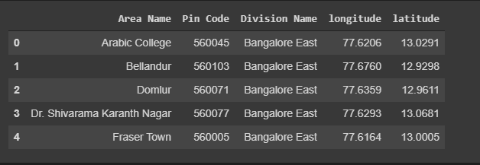
Data Preparation

Slide 7
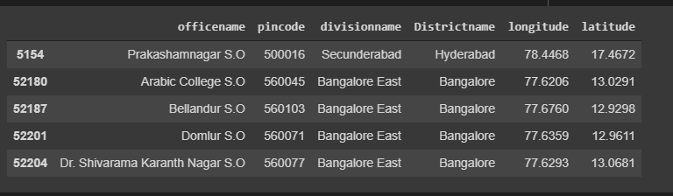
Description of Data
This project will rely on public data from data.gov.in and Foursquare. Within the Bangalore Area, there are areas that are within the Bangalore Area Postcode. The focus of this project will be the neighborhoods are that are within the Bangalore Post Code area. The Bangalore Area consists of 4 divisions and. Our data will be from the link https://data.gov.in/resources/all-india-pincode-directory-contact-details-along-latitude-andlongitude

Slide 8
Methodology
Data Exploration

Slide 9
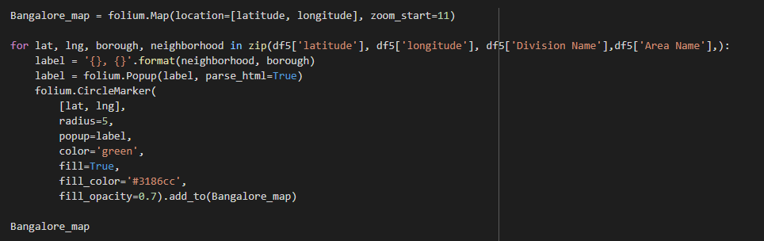

Slide 10
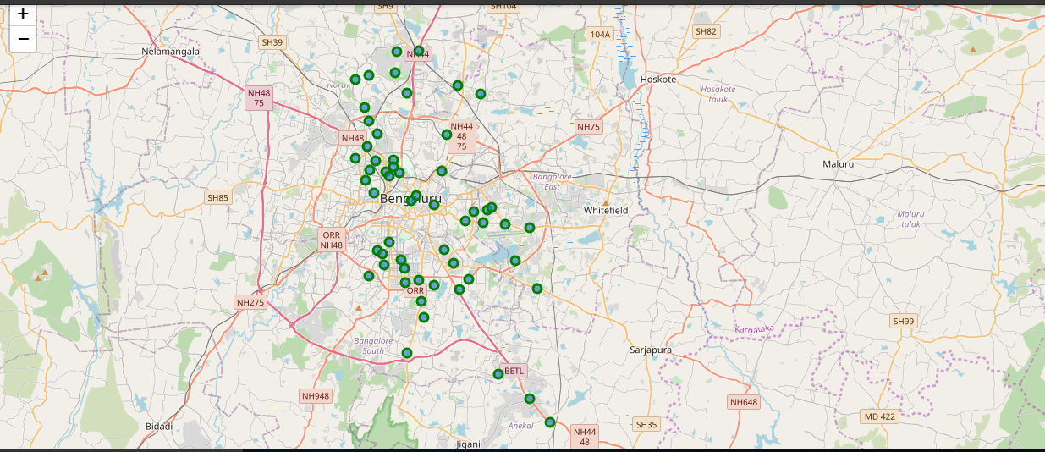

Slide 11
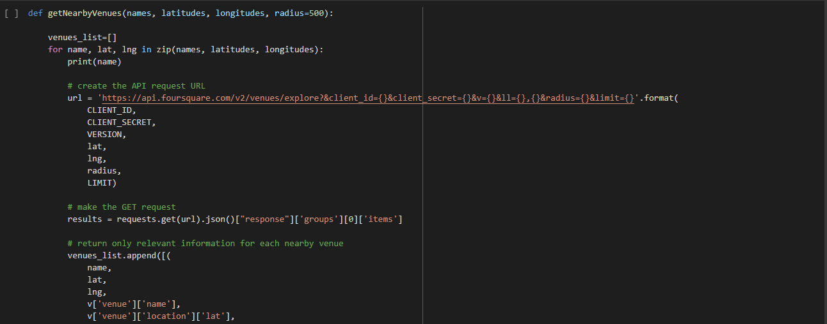
Clustering

Slide 12
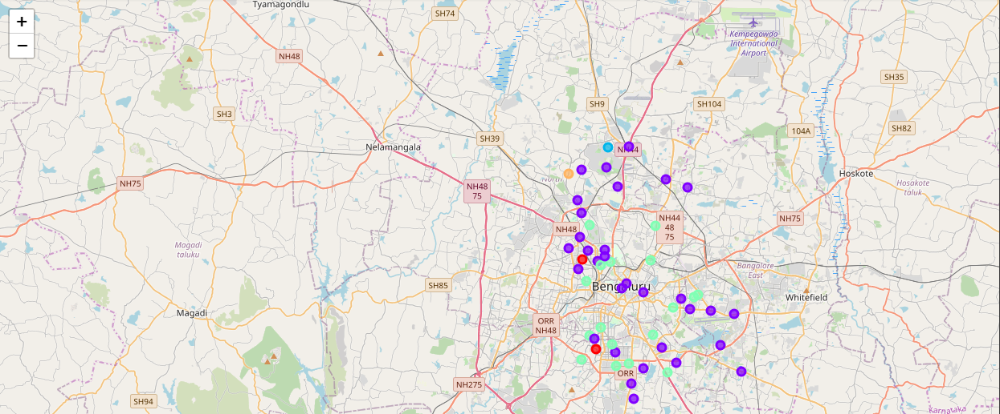

Slide 13
Result
The following are the highlights clusters above:
1] Indian Restaurants are most popular in the Bangalore.
2] Cafes are 2nd most popular in Bangalore
4] Although, the Clusters have variations, a very visible presence is the predominance of restaurants.

Slide 14
Discussion and Conclusion
It’s been visible from cluster 3 and 4 that Indian Restaurant cannot play vital role in Restaurant competition and bad chance to set up. Their proximity to other amenities and accessibility to station are huge. 2 clusters do not have top restaurants that could rival their standards if they are created. And the chances to resources needed is quite high as Lewisham and Lambeth. In conclusion, this project would have had better results if there were more data in terms of per capita income data within the area, traffic access, corporates of more venues exploration with the Foursquare. Also, getting the ratings and feedbacks of the current restaurants within the clusters would have helped in providing more insight into the best location.

Slide 15
END
HAPPY LEARNING

