Slide 1

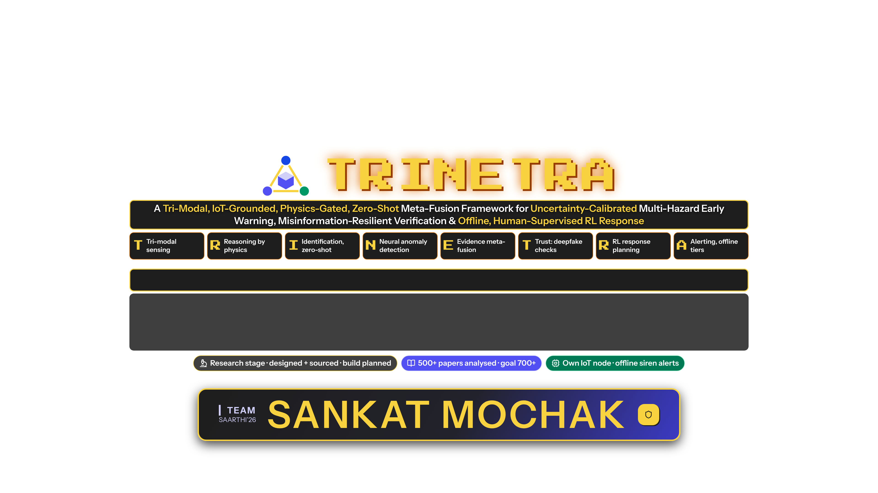


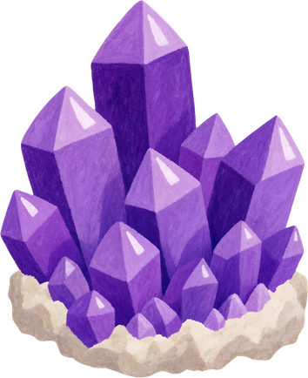
SAARTHI’26 Submission
Track: Disaster Resilience · Multi-Hazard Early Warning, India
Team Leader Name: Saksham Aggarwal
Team Member(s) Name: Utkarsh Saini, Mohit Kaintura, Naina Joshi
College Name: Graphic Era Hill University, Dehradun
SANKAT MOCHAK
Notes:
Namaste. We are team SANKAT MOCHAK from Graphic Era Hill University, Dehradun.
Track (self-identified): Disaster Resilience - multi-hazard early warning for India.
TRINETRA means 'three eyes': satellites, cameras and our own low-cost IoT sensor nodes. A physics gate checks all three before any alarm.
Each letter of the title maps to a real part of the design.
Status: research stage. Designed and sourced, build planned. We have analysed 500+ papers and are working toward 700+ for a true state-of-the-art review. We are also building an IoT prototype node.

Slide 2

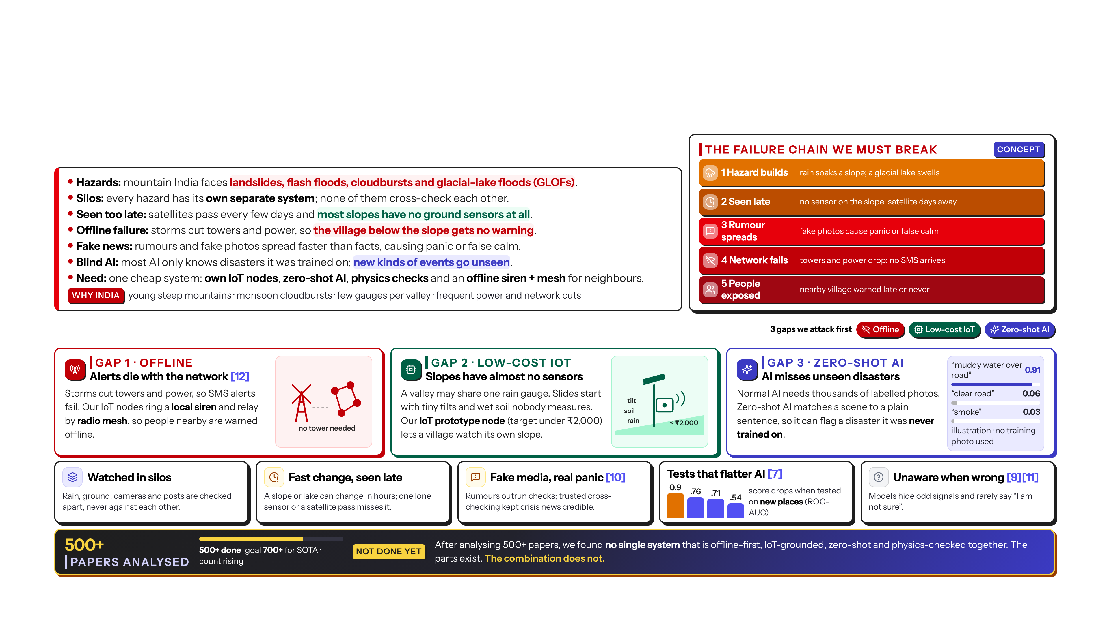

Problem Statement
Problem Statement:
Detailed description about the problem:
SANKAT MOCHAK
2
Notes:
Problem: mountain India faces landslides, flash floods, cloudbursts and glacial-lake floods, and each is watched by a separate system.
Three gaps we attack first. Gap 1, offline: storms cut towers and power, so app and SMS alerts fail when needed most [12]. Gap 2, IoT: slopes have almost no ground sensors; our IoT prototype node, capped under 2,000 rupees, lets a village watch its own slope. Gap 3, zero-shot: normal AI only knows disasters it was trained on; zero-shot AI matches a scene to a plain sentence, so it can flag a disaster it never saw.
Supporting gaps: silos, late detection, fake media [10], models that look good only on familiar places [7], models that do not know when they are wrong [9][11].
Conclusion from 500+ papers: not done yet. Parts exist, but no single system combines offline alerts, IoT ground truth, zero-shot AI and physics checks.

Slide 3
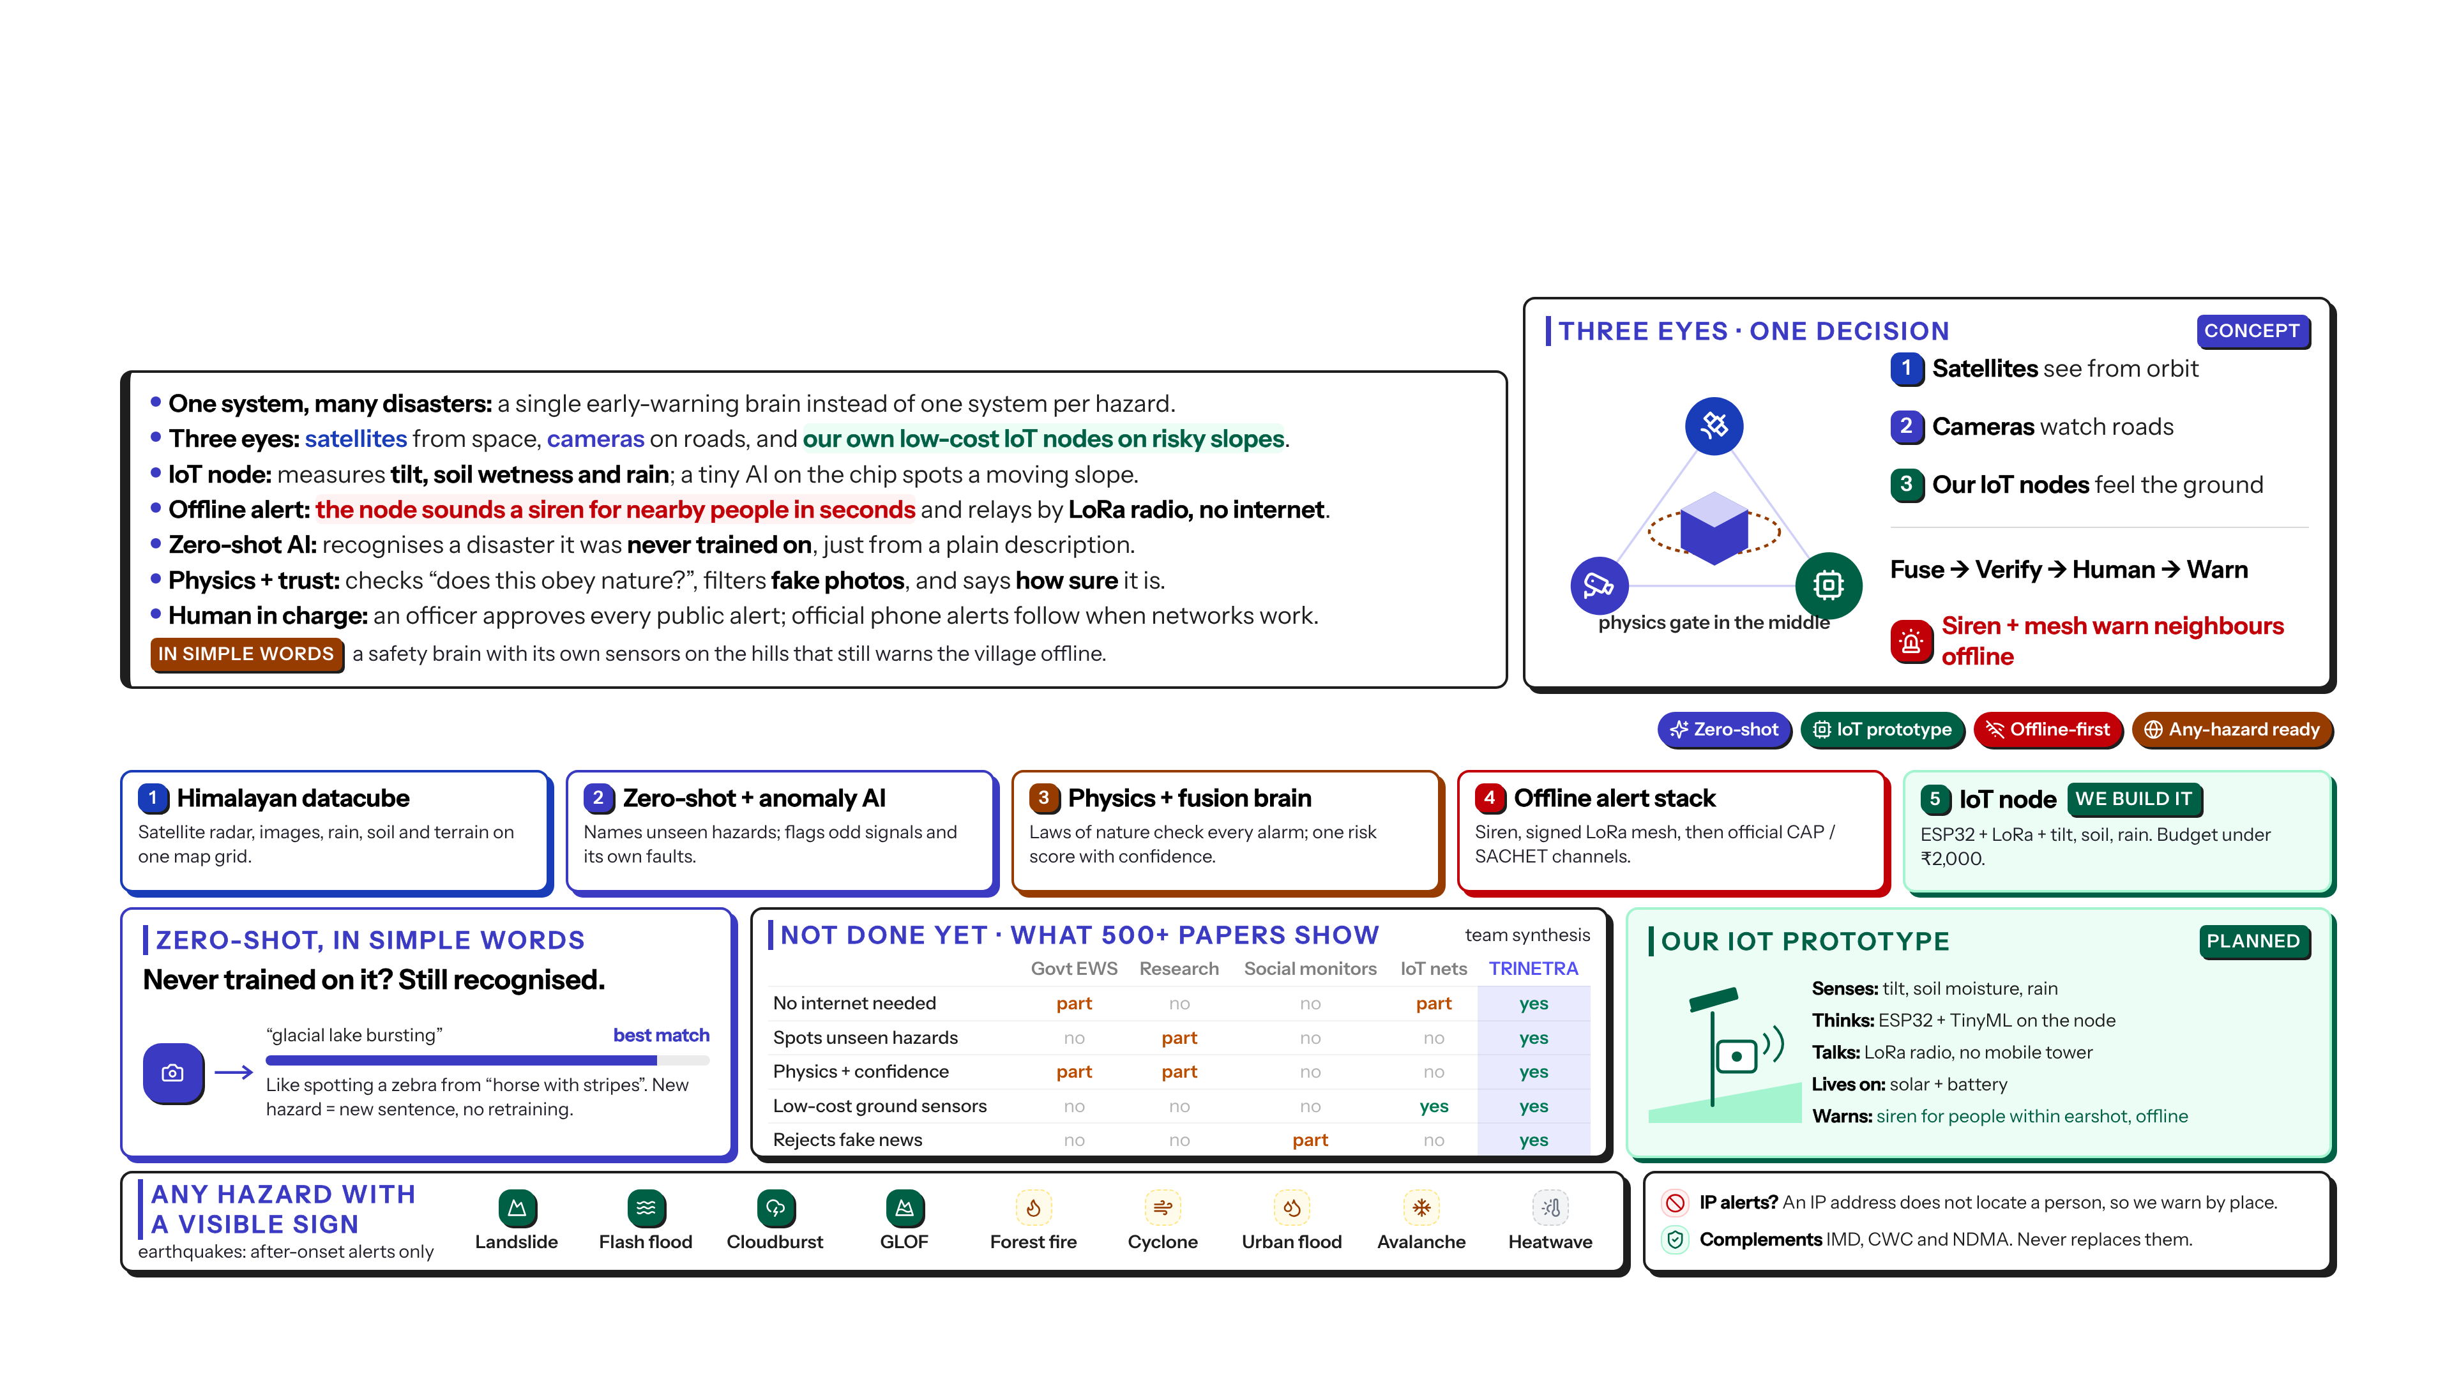
Proposed Solution
Solution Statement:
Detailed Solution description:
SANKAT MOCHAK
3
Notes:
Solution: three eyes, one physics referee, one decision. Fuse, verify, a human decides, warn by tier.
If it is unsure, it abstains and escalates. It never guesses silently.
Five things we build: the Himalayan datacube, zero-shot plus anomaly AI, the physics and fusion brain, the offline alert stack, and our IoT prototype node.
Zero-shot in simple words: like recognising a zebra from 'a horse with stripes'. A new hazard needs only a new sentence, not retraining. That is why the framework can extend to any hazard with a visible or measurable sign. Earthquakes are the exception: alerts after onset only.
The matrix summarises our synthesis of 500+ papers: each existing family covers some parts; none covers all.
An IP address does not locate a person, so we warn by place. We complement IMD, CWC and NDMA; we never replace them.

Slide 4

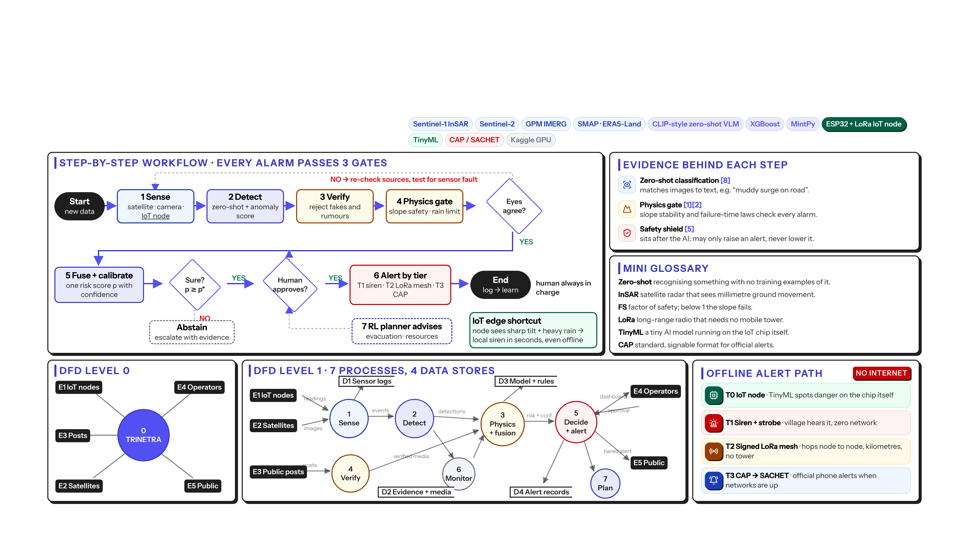
Technical Approach
Technologies To Be Used:
4
SANKAT MOCHAK
Notes:
Workflow: sense, detect, verify, physics gate. Do the eyes agree? If not, re-check and test for sensor faults.
Then fuse into one risk score with confidence. Is it above the threshold? Does a human approve? Only then alert by tier.
The IoT edge shortcut: if a node sees a sharp tilt plus heavy rain, it can sound the local siren in seconds, even with no network.
Below: DFD level 0 and level 1, and the offline-first alert path: T0 IoT node, T1 siren, T2 signed LoRa mesh, T3 CAP to SACHET.
The safety shield may only raise an alert, never lower it [5].

Slide 5

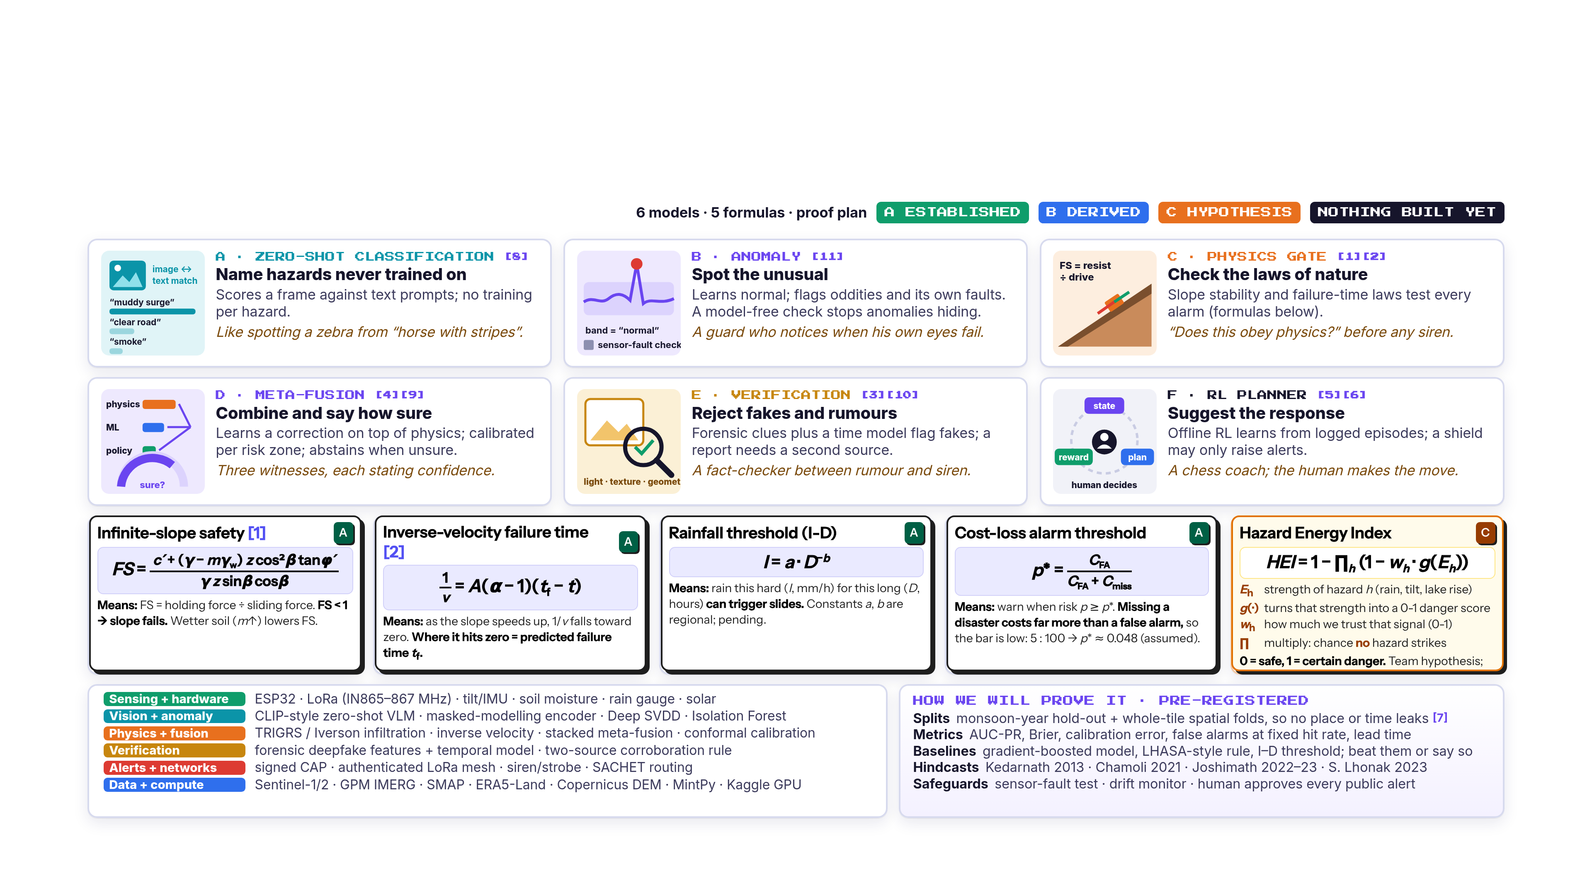
Detailed Description:
5
SANKAT MOCHAK
Notes:
Six model cards, each with an everyday analogy, and five formulas tagged established, derived or hypothesis.
The Hazard Energy Index is a team hypothesis; validation is pending.
Evaluation is pre-registered: hold out whole map tiles and monsoon years, report calibration and false alarms, beat baselines or say so, and hindcast Kedarnath 2013, Chamoli 2021, Joshimath 2022-23 and South Lhonak 2023.

Slide 6

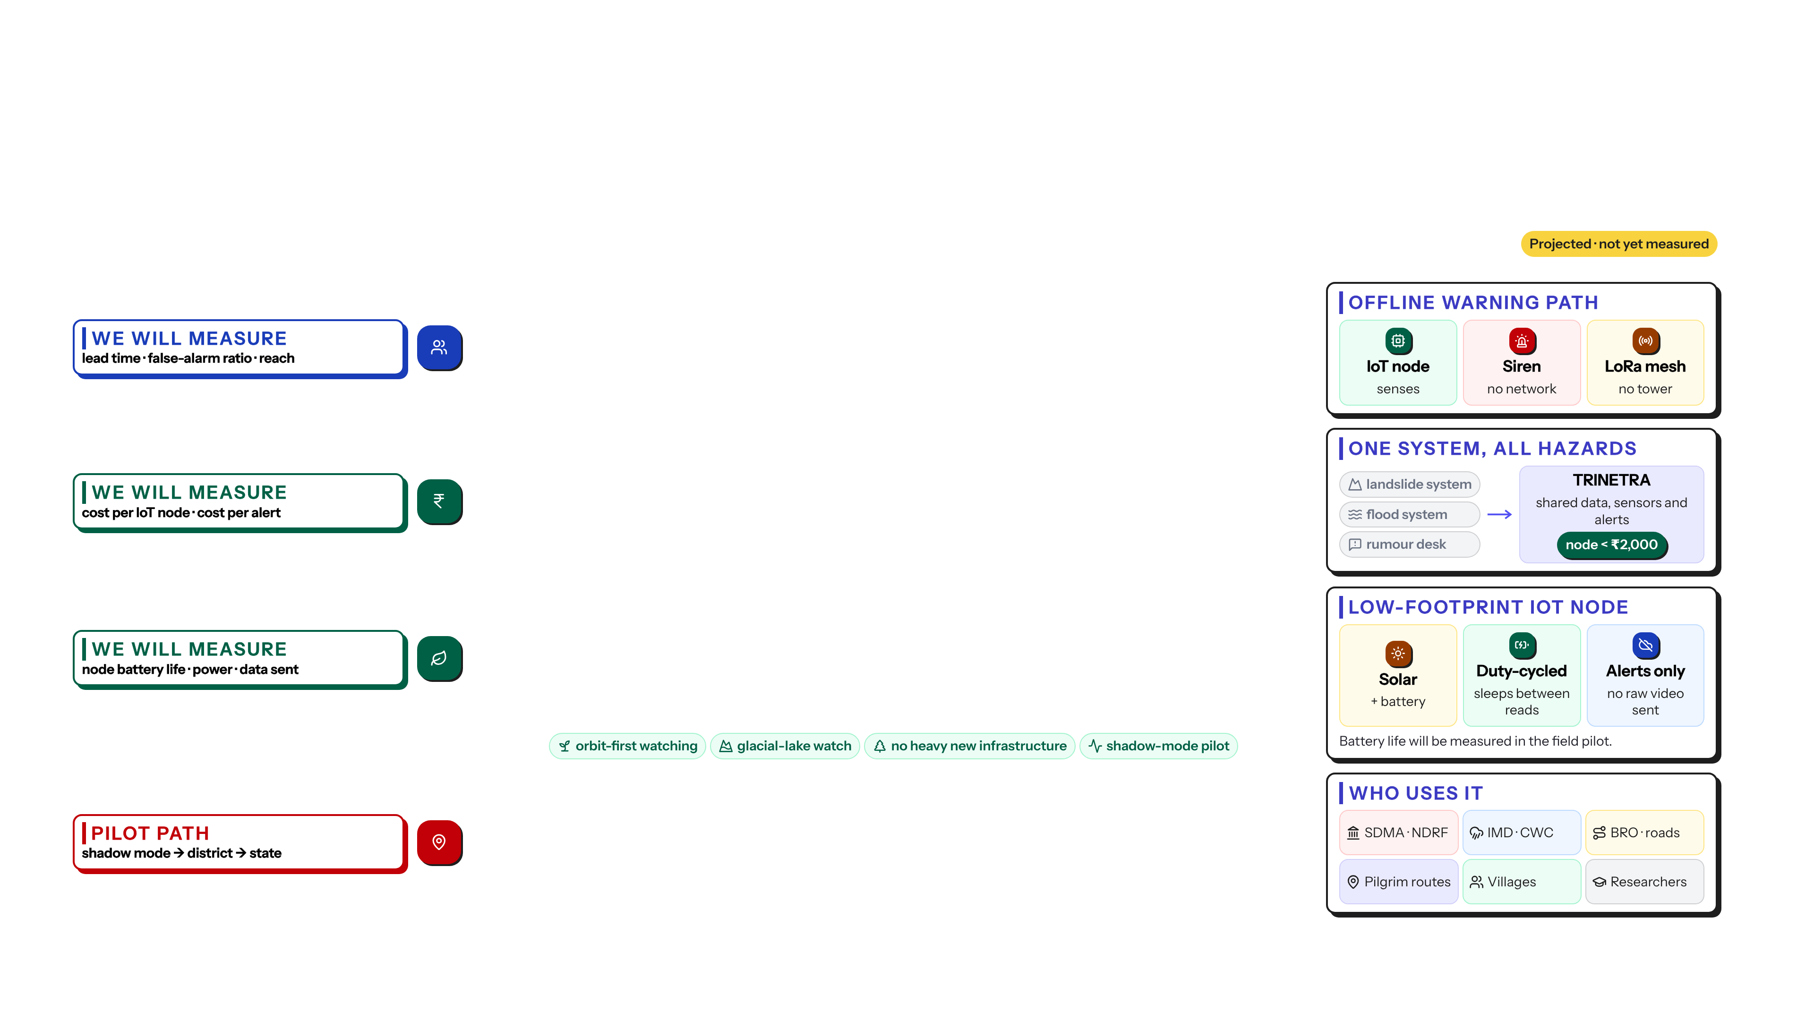
Impact and Benefits
Impact Metric | Details
Social Impact | ▸ Lead time: earlier, uncertainty-aware warnings; targets from published benchmarks. ▸ Works offline: T1 siren + T2 LoRa mesh keep warning villages when towers or power fail. ▸ Fewer false alarms: physics gate + two-source rule before any public siren, protecting trust. ▸ Anti-rumour: deepfake and misinformation checks stop fake photos from driving panic or false calm. ▸ Inclusive: plain multilingual alerts by place, not by phone number or IP; tested with communities. ▸ Human in charge: an operator approves every public alert; the AI only advises.
Economic Impact | ▸ Low-cost node: our IoT prototype node, capped under INR 2,000 (BOM pending). ▸ Free data backbone: Sentinel-1/2, GPM IMERG, SMAP, ERA5-Land (licences to be verified). ▸ Reuse CCTV: zero-shot classification on existing road and bridge cameras; no new camera network. ▸ One framework: many hazards instead of a separate system per hazard; less duplicate monitoring. ▸ Protects lifelines: earlier hill-road and bridge closure decisions (benefit to be modelled in pilot). ▸ Open + modular: local teams and startups can extend the stack; costs measured in the pilot.
Environmental Impact | ▸ Low power: solar-assisted, duty-cycled nodes; on-device TinyML sends alerts, not raw data. ▸ Orbit-first: slopes, water and vegetation watched from space; no heavy new infrastructure. ▸ Glacial-lake watch: Sentinel-2 and SAR track GLOF risk (designed; validation pending). ▸ Climate adaptation: long-term hazard logs (D1-D4) support planning for changing monsoons. ▸ Small footprint: few nodes per slope, low-power radio; battery life measured in the field. ▸ Staged pilot: shadow mode first, running beside existing systems; no disruption.
Target Audience | ▸ Disaster agencies: DEOCs, SDMA, SDRF / NDRF get decision support (complement, not replace). ▸ Forecast bodies: IMD and CWC gain cross-checked ground truth from sensors and cameras. ▸ Infrastructure: BRO, NH authorities and bridge operators on single-valley Himalayan roads. ▸ Pilgrimage routes: administrators of Kedarnath, Badrinath and similar seasonal-crowd corridors. ▸ Communities: village volunteers and panchayats receiving siren and mesh alerts. ▸ Researchers: open benchmark, honest spatial tests; regulation under expert review.
6
SANKAT MOCHAK
Notes:
All impact items are projections, not measurements.
Social: warnings reach people offline through IoT node, siren and LoRa mesh. Economic: one framework instead of one system per hazard, with an IoT node capped under 2,000 rupees. Environmental: solar, duty-cycled nodes that send alerts, not raw video. Users: SDMA and NDRF, IMD and CWC, BRO, pilgrimage routes, villages and researchers.
Regulatory points are under expert review.

Slide 7

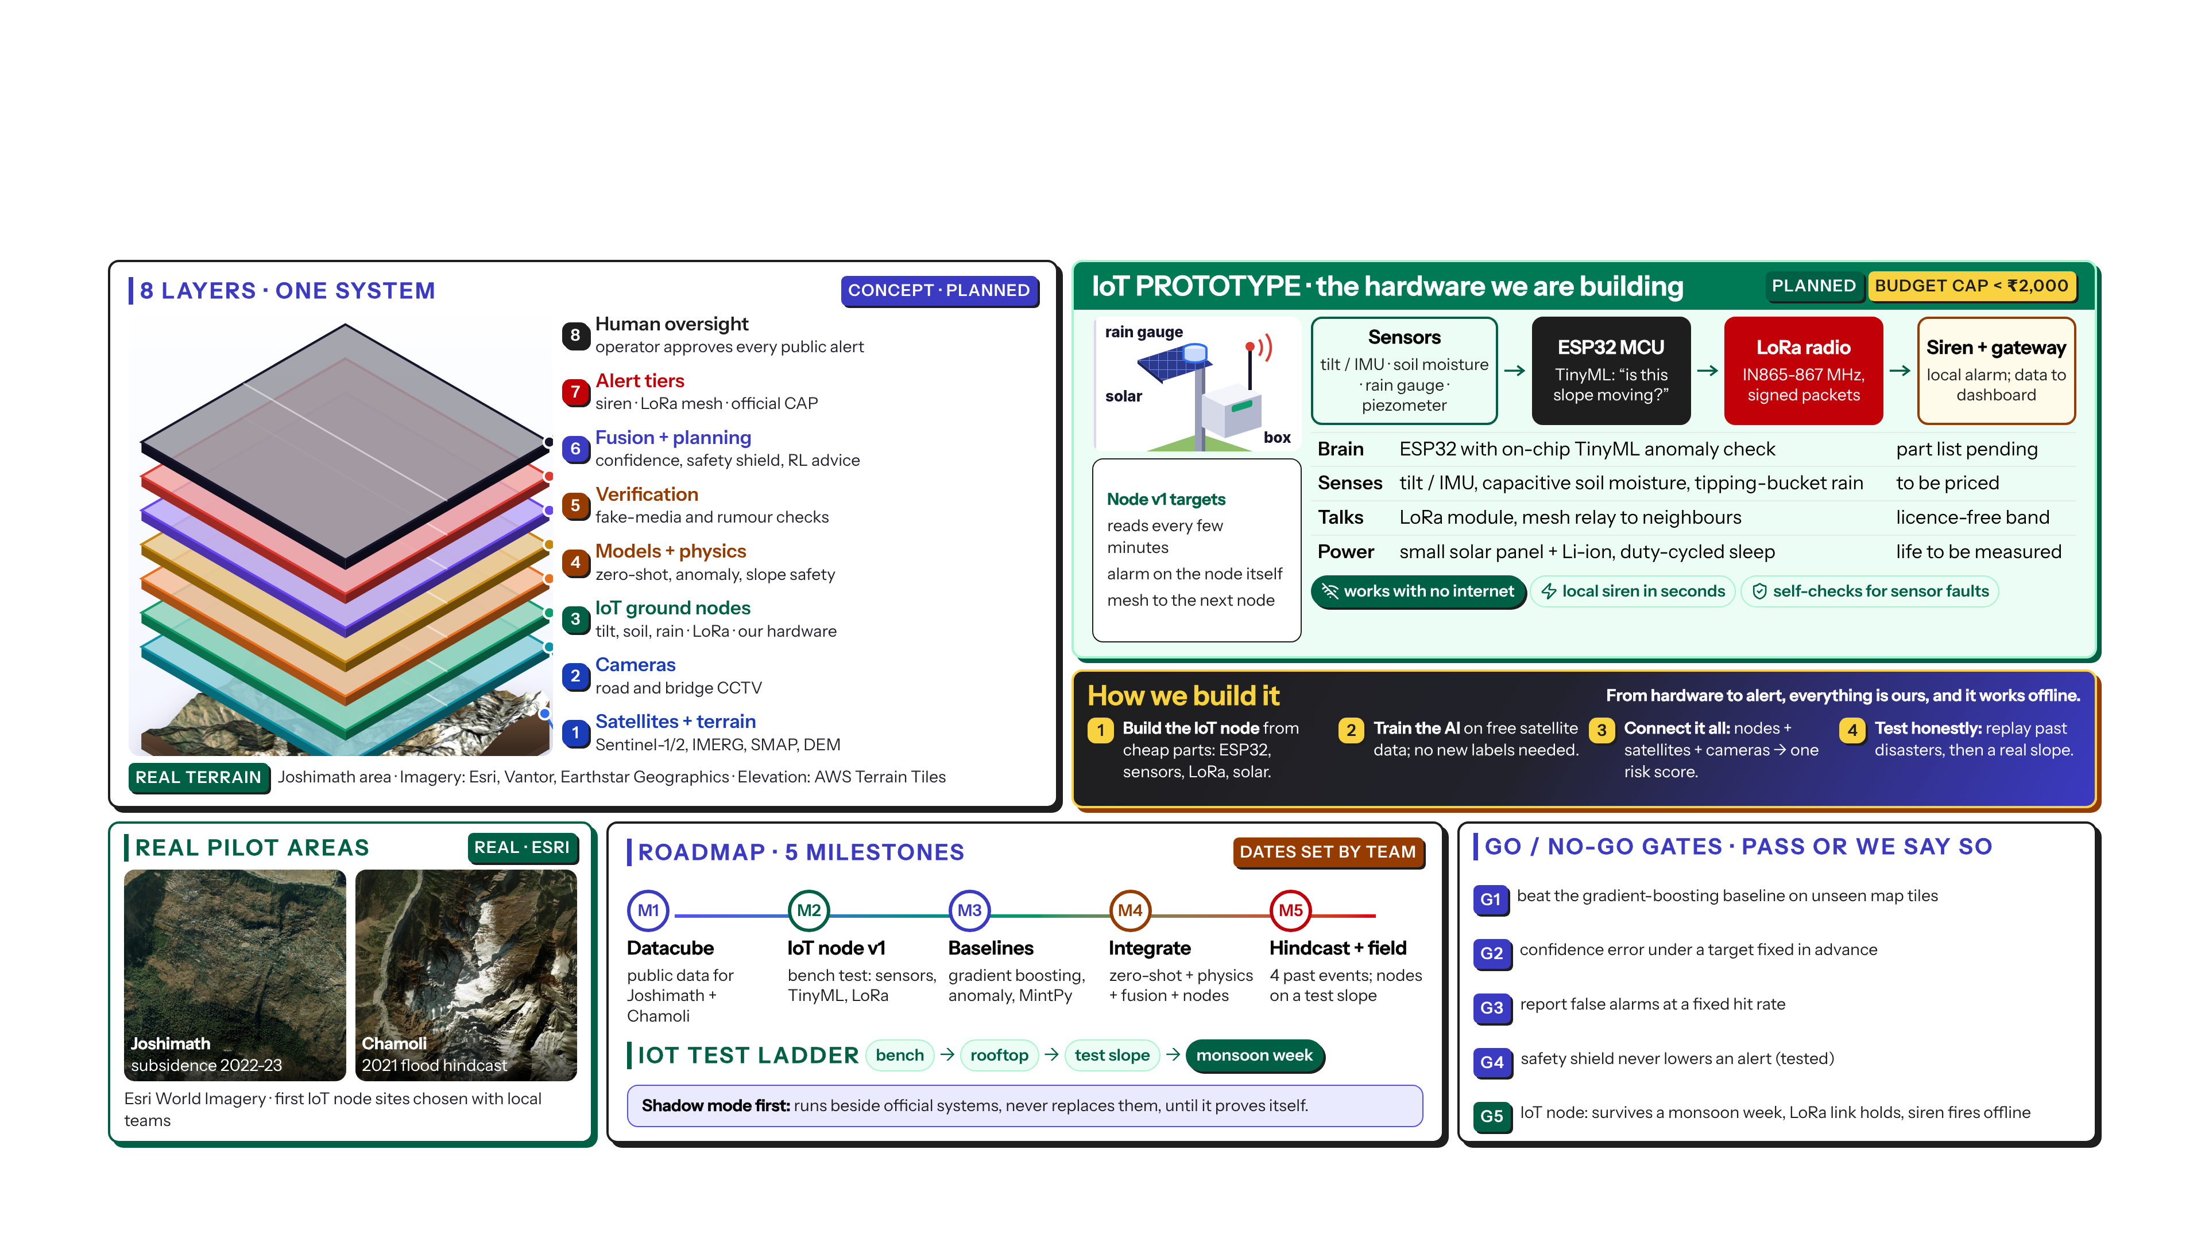
Prototype
SANKAT MOCHAK
7
Notes:
The prototype is planned. On the left, eight layers on real Joshimath terrain.
The hero is our IoT prototype: sensors for tilt, soil moisture and rain; an ESP32 running a tiny AI model that asks 'is this slope moving?'; a LoRa radio that needs no mobile tower; and a siren and gateway. Solar and battery power, duty-cycled. Budget cap under 2,000 rupees; the parts list is still being priced.
Test ladder: bench, rooftop, test slope, then a monsoon week.
Roadmap: datacube, IoT node v1, baselines, integration, hindcast and field test. Go/no-go gate G5 is for the node: it must survive a monsoon week, hold its LoRa link and fire the siren offline.

Slide 8


Research & References
Research Work:
Links:
› Copernicus Data Space (Sentinel-1/2)
› NASA GPM IMERG rainfall
› NASA SMAP soil moisture (NSIDC)
› ERA5-Land reanalysis (Copernicus CDS)
› NASA landslide hazard (LHASA / COOLR)
› ASF HyP3 InSAR processing
› ISRIC SoilGrids
› arXiv (all cited preprints)
› Esri World Imagery (S7 imagery)
› AWS Terrain Tiles (S7 elevation)
› Team research repository (GitHub)
› Full ledger (500+ papers): REFERENCES_FULL.md
SANKAT MOCHAK
8
Notes:
We have analysed 500+ papers across eight workstreams, and the count keeps rising. Our goal is 700+ for a true state-of-the-art review.
Twelve key references are numbered as cited on slides 2 to 7. Links are clickable.
Conclusion: not done yet. No reviewed system joins offline alerts, IoT nodes, zero-shot AI and physics checks in one. That is our contribution.
Thank you. We welcome questions, especially on the physics and the IoT node.

Slide 9
APPENDIX · DEEP DIVE
The Science Behind the Three Eyes
Layman-friendly on top, full physics underneath — fire + mountain hazards, the fusion brain, the architecture, the data, and our honesty rules.
Every claim is tagged A (established) · B (derived) · C (hypothesis, not yet validated).
SANKAT MOCHAK
Appendix A1

Slide 10
NEW CAPABILITY — not in the main deck
TRINETRA · SANKAT MOCHAK
The Fourth Eye: Fire & Thermal Hazard
In one line: the same three eyes that watch slopes can watch for fire — a camera sees flame/smoke, physics checks if it behaves like real fire, and only then it warns.
Camera eye
Physics referee
IoT eye
Edge AI on cheap CCTV/ESP32-CAM flags flame & smoke pixels (YOLO-tiny).
Plume, flicker & smoke-optics checks reject steam, headlights, reflections.
Heat / gas / smoke on the same ₹2,000 node; multi-node agreement before alarm.
Why it is honest (Rule 19): fire output is ADVISORY — a human confirms; it never trips a public alarm by itself, and it fails safe to “uncertain”, never to a silent all-clear.
Adds to the framework at zero extra sensors on the vision/IoT nodes already planned — fire is just “one more sentence” for the zero-shot eye plus a dedicated physics gate (next slides).
Source: P21 fire-physics deep dive — 56 papers, 20 established blocks (EF-01…EF-20) + 7 novel candidates (ND-1…ND-7). All source-reported; nothing measured by us yet.
SANKAT MOCHAK
Appendix A2

Slide 11
PHYSICS FORMULA BANK I
TRINETRA · SANKAT MOCHAK
Mountain Hazards — the equations behind the alarm
A · ESTABLISHED
B · DERIVED
C · HYPOTHESIS (unvalidated)
A
A
A
Slope stability (Factor of Safety)
Rain-driven pore pressure (Iverson)
Failure-time forecast (Fukuzono)
Is the slope still holding? FS<1 means it can slide.
How fast rain soaks in and weakens the slope.
When creep speeds up, 1/velocity falls to zero at collapse.
FS = (c′ + (σₙ−u)·tanφ′) / (γ·z·sinβ·cosβ)
ψ(Z,t): slope enters ONLY via D₁ = D₀ / cos²β
1/v = A·(α−1)·(t_f − t), α ≈ 2
Infinite-slope / TRIGRS. Rain raises pore-pressure u → FS drops.
Iverson (2000) transient head; we fixed a double-count bug here.
Inverse-velocity method; straight line → read off t_f.
A
A
A
Rainfall trigger threshold (Caine)
Flood runoff & routing
When to actually alarm (Bayes)
How much rain, how fast, before slides usually start.
How much rain becomes a flood wave, and how fast it travels.
Balance missed disasters vs false alarms — pick the cost-optimal line.
I = a·D^(−b) (intensity vs duration)
Q = (P−0.2S)²/(P+0.8S) ; v = (1/n)·R^(2/3)·√S
p* = C_FA / (C_FA + C_miss) (≈ 0.048)
Locally re-fitted, not a borrowed constant.
SCS-CN runoff + Manning velocity (flash-flood / GLOF routing).
Cost-loss optimal threshold; same model sets the alarm point.
SANKAT MOCHAK
Appendix A3

Slide 12
PHYSICS FORMULA BANK II
TRINETRA · SANKAT MOCHAK
Fire & Thermal — established blocks + our new candidates
A · ESTABLISHED
B · DERIVED
C · HYPOTHESIS (unvalidated)
A
A
A
Does the plume behave like fire? (Byram)
Smoke dims the heat (Radiative transfer)
Fire flickers at a known rate (Strouhal)
Real fire plumes bend & rise in a specific way vs wind.
Smoke blocks IR, so a pixel can look cooler than the real fire.
Flames pulse ~1.5–5 Hz depending on size — a fingerprint.
N_c = buoyant power / flow power (critical Froude)
dI/ds = −(κ+σ)·I + j
f_p ≈ 1.5·D^(−1/2)
EF-13 Byram convective number — regime check.
EF-14 RTE + EF-15 soot — feeds the smoke-temperature fix (C).
EF-16 puffing frequency — basis for the de-aliasing fix (C).
C
C
C
See flicker on a cheap/slow camera (ND-1)
True heat behind smoke (ND-2)
One early-warning number (ND-3)
Low-fps CCTV scrambles the flicker; we un-scramble it.
Undo smoke dimming to recover the real plume temperature.
Blend heat-rise, gas-rise & radiation into a scene-proof score.
match energy in the Strouhal-predicted aliased band
L_obs = τ_s·L_fire + (1−τ_s)·L_smoke → solve T̂
Π_ig = Σ wᵢ·(scaleᵢ)·(rateᵢ)
ND-1 de-aliased flicker — novel hypothesis, UNVALIDATED.
ND-2 — novel; uncertainty grows as smoke thickens (fail-safe).
ND-3 dimensionless ignition index — novel hypothesis.
SANKAT MOCHAK
Appendix A4

Slide 13
THE FUSION BRAIN (P22)
TRINETRA · SANKAT MOCHAK
How the three eyes become one careful decision
In one line: a weighted referee that trusts each eye by how reliable and physically-consistent it is, and deliberately leans toward caution when a trustworthy eye raises alarm.
C · NOVEL OPERATOR (unvalidated)
NF-1 · Consistency cᵢ
Agrees with physics? cᵢ = exp(−((pᵢ−φ)₊)²/2σ²)
PHARAOH mean — adaptive-order fusion
NF-2 · Reliability rᵢ(t)
Fρ(p;w) = ( Σ wᵢ·pᵢ^ρ )^(1/ρ)
Track-record & drift down-weight a flaky sensor over time.
NF-3 · Conflict → uncertainty
order ρ(t) = 1 + κ·D·S (D = disagreement, S = credible-alarm salience)
Eyes disagree? U* = Σ wᵢuᵢ + λ·D (don’t fake confidence).
Normal times → behaves like a careful average. When a reliable, physics-consistent eye shouts ‘danger’, ρ rises so the mean bends toward it (anti-complacency). Fails open to ‘uncertain’.
NF-4 · Salience S
S = maxᵢ [ rᵢ·cᵢ·ψ(pᵢ) ] — is any trustworthy alarm credible?
Effective weight w̃ᵢ = availability · reliability rᵢ · consistency cᵢ · e^(−uᵢ/τ). Six fusion models (FM-1…FM-6) derived; linear FM-1 is the safe fallback. Source: P22. Nothing measured.
SANKAT MOCHAK
Appendix A5

Slide 14
SYSTEM ARCHITECTURE
TRINETRA · SANKAT MOCHAK
Three compute tiers, nine workstreams, one decision
TIER 0 · NODE (≤₹2000)
NINE WORKSTREAMS
ESP32 / ESP32-CAM. Tiny on-device checks: tilt Z-score, stage, on-node FS, flicker screen. Deep-sleep + solar. Raw video stays local.
WS1a Fire physics
WS1b Geo physics
WS2 Deepfake / misinfo
WS3 Offline alerting
WS4 CCTV perception
WS5 RL + meta-fusion
WS6 Robustness / calibration
WS7 IoT nodes
WS8 Anomaly detection
TIER 1 · GATEWAY
Edge SoC + LoRa concentrator. CCTV detector, anomaly, physics gate, local fusion + safety shield, siren drive. Works with the cloud OFFLINE.
TIER 2 · CLOUD / KAGGLE
Frozen EO foundation-model embeddings, training, hindcast & evaluation, model registry. Never on the life-safety critical path.
THE SINGLE DECISION FUNCTION
level = max( conformal_level(fused_risk, p*) , shield_floor )
The hard safety shield can only RAISE an alert, never lower it.
SANKAT MOCHAK
Appendix A6

Slide 15
DATA BACKBONE & HONEST EVALUATION
TRINETRA · SANKAT MOCHAK
Why the numbers will be believable
FREE DATA BACKBONE
THE ADMISSION GATE (no number without it)
Sentinel-1 InSAR (deformation) · Sentinel-2 optical
GPM IMERG rain · SMAP soil · ERA5-Land
MODIS / VIIRS active-fire · ITS_LIVE glaciers
NASA FIRMS · Earthdata · Copernicus · USGS
52 catalogued free datasets (D113–D164)
Fire/smoke, flood/SAR, landslide, InSAR,
seismic, air-quality, crisis, deepfake
✓ Spatial cross-validation (hold out whole map tiles)
✓ Hold out monsoon YEARS (no time leakage)
✓ Beat mandatory baselines, or say ‘does not beat’
✓ Report calibration + false-alarms-per-day + CIs
✓ Cost-loss Value Score as the primary metric
✓ Hindcast: Kedarnath’13, Chamoli’21, Joshimath’22, S.Lhonak’23
✓ Class A / B / C labels on every physics block
✓ Rule 19: advisory, human-in-the-loop, fail-safe
Honest status: all datasets are candidates — links & licenses to be verified before use; India portals (Bhuvan, MOSDAC, VEDAS, NRSC, IMD, CWC, GSI) need manual checks. Free-only rule.
SANKAT MOCHAK
Appendix A7

Slide 16
WHAT IS NEW — AND WHY IT IS HONEST
TRINETRA · SANKAT MOCHAK
Our contribution, stated carefully
THE CONTRIBUTION
In our review of 500+ papers, no single system combines offline-first alerting + cheap IoT ground truth + zero-shot & anomaly AI + a physics referee — across mountain hazards AND fire. That integration, done honestly, is our contribution.
Novel, but labelled
Safe by design
Buildable & cheap
PHARAOH operator, NF-1…NF-4, ND-1…ND-7 are Class-C hypotheses — UNVALIDATED. ‘Novel’ means ‘not found in our limited search’, not ‘proven first’.
Advisory only; a human decides; the shield can only raise an alarm; the system abstains and escalates when unsure — it never guesses silently.
≤₹2,000 node, offline-first, runs within a 30 GPU-h/week student budget; foundation models are reused, not retrained.
Status: research stage — designed, sourced, build planned. We welcome questions, especially on the physics and the IoT node. Dhanyavaad.
SANKAT MOCHAK
Appendix A8

