Slide 1

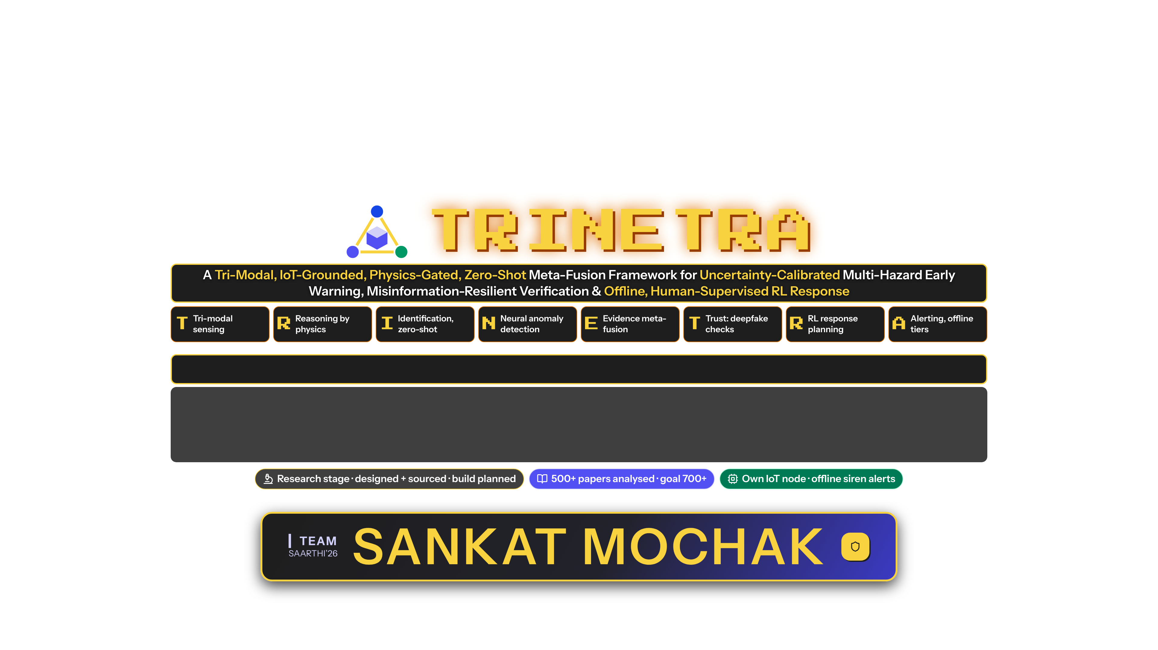


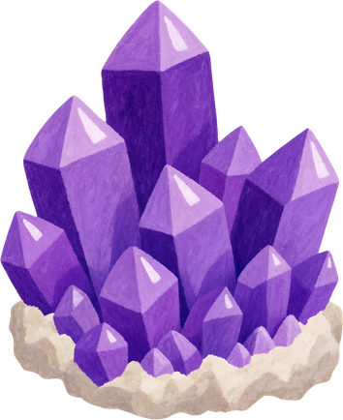
SAARTHI’26 Submission
Track: Disaster Resilience · Multi-Hazard Early Warning, India
Team Leader Name: Saksham Aggarwal
Team Member(s) Name: Utkarsh Saini, Mohit Kaintura, Naina Joshi
College Name: Graphic Era Hill University, Dehradun
SANKAT MOCHAK
Notes:
Namaste. We are team SANKAT MOCHAK from Graphic Era Hill University, Dehradun.
Track (self-identified): Disaster Resilience - multi-hazard early warning for India.
TRINETRA means 'three eyes': satellites, cameras and our own low-cost IoT sensor nodes. A physics gate checks all three before any alarm.
Each letter of the title maps to a real part of the design.
Status: research stage. Designed and sourced, build planned. We have analysed 500+ papers and are working toward 700+ for a true state-of-the-art review. We are also building an IoT prototype node.

Slide 2

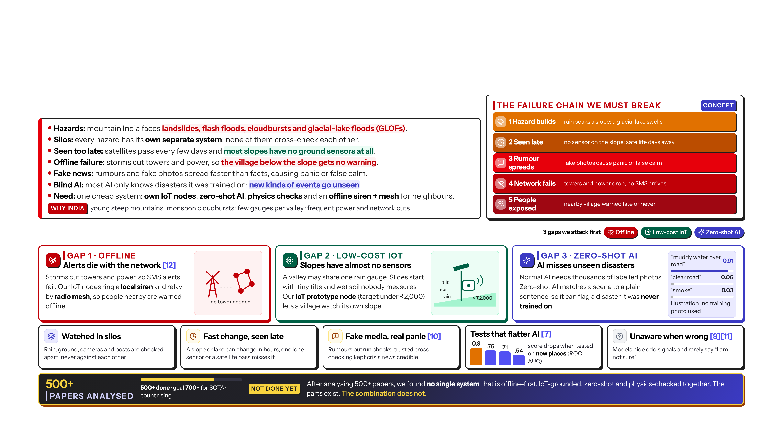

Problem Statement
Problem Statement:
Detailed description about the problem:
SANKAT MOCHAK
2
Notes:
Problem: mountain India faces landslides, flash floods, cloudbursts and glacial-lake floods, and each is watched by a separate system.
Three gaps we attack first. Gap 1, offline: storms cut towers and power, so app and SMS alerts fail when needed most [12]. Gap 2, IoT: slopes have almost no ground sensors; our IoT prototype node, capped under 2,000 rupees, lets a village watch its own slope. Gap 3, zero-shot: normal AI only knows disasters it was trained on; zero-shot AI matches a scene to a plain sentence, so it can flag a disaster it never saw.
Supporting gaps: silos, late detection, fake media [10], models that look good only on familiar places [7], models that do not know when they are wrong [9][11].
Conclusion from 500+ papers: not done yet. Parts exist, but no single system combines offline alerts, IoT ground truth, zero-shot AI and physics checks.

Slide 3
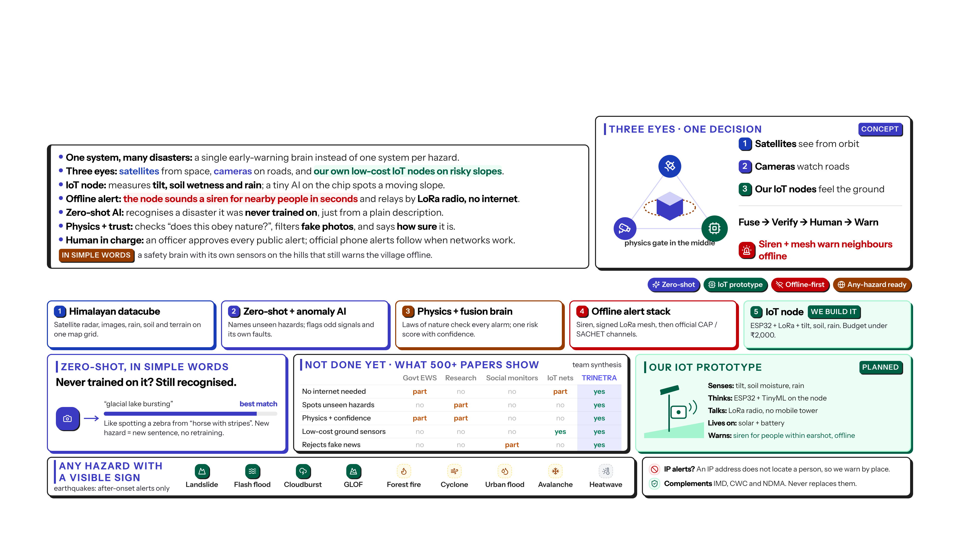
Proposed Solution
Solution Statement:
Detailed Solution description:
SANKAT MOCHAK
3
Notes:
Solution: three eyes, one physics referee, one decision. Fuse, verify, a human decides, warn by tier.
If it is unsure, it abstains and escalates. It never guesses silently.
Five things we build: the Himalayan datacube, zero-shot plus anomaly AI, the physics and fusion brain, the offline alert stack, and our IoT prototype node.
Zero-shot in simple words: like recognising a zebra from 'a horse with stripes'. A new hazard needs only a new sentence, not retraining. That is why the framework can extend to any hazard with a visible or measurable sign. Earthquakes are the exception: alerts after onset only.
The matrix summarises our synthesis of 500+ papers: each existing family covers some parts; none covers all.
An IP address does not locate a person, so we warn by place. We complement IMD, CWC and NDMA; we never replace them.

Slide 4

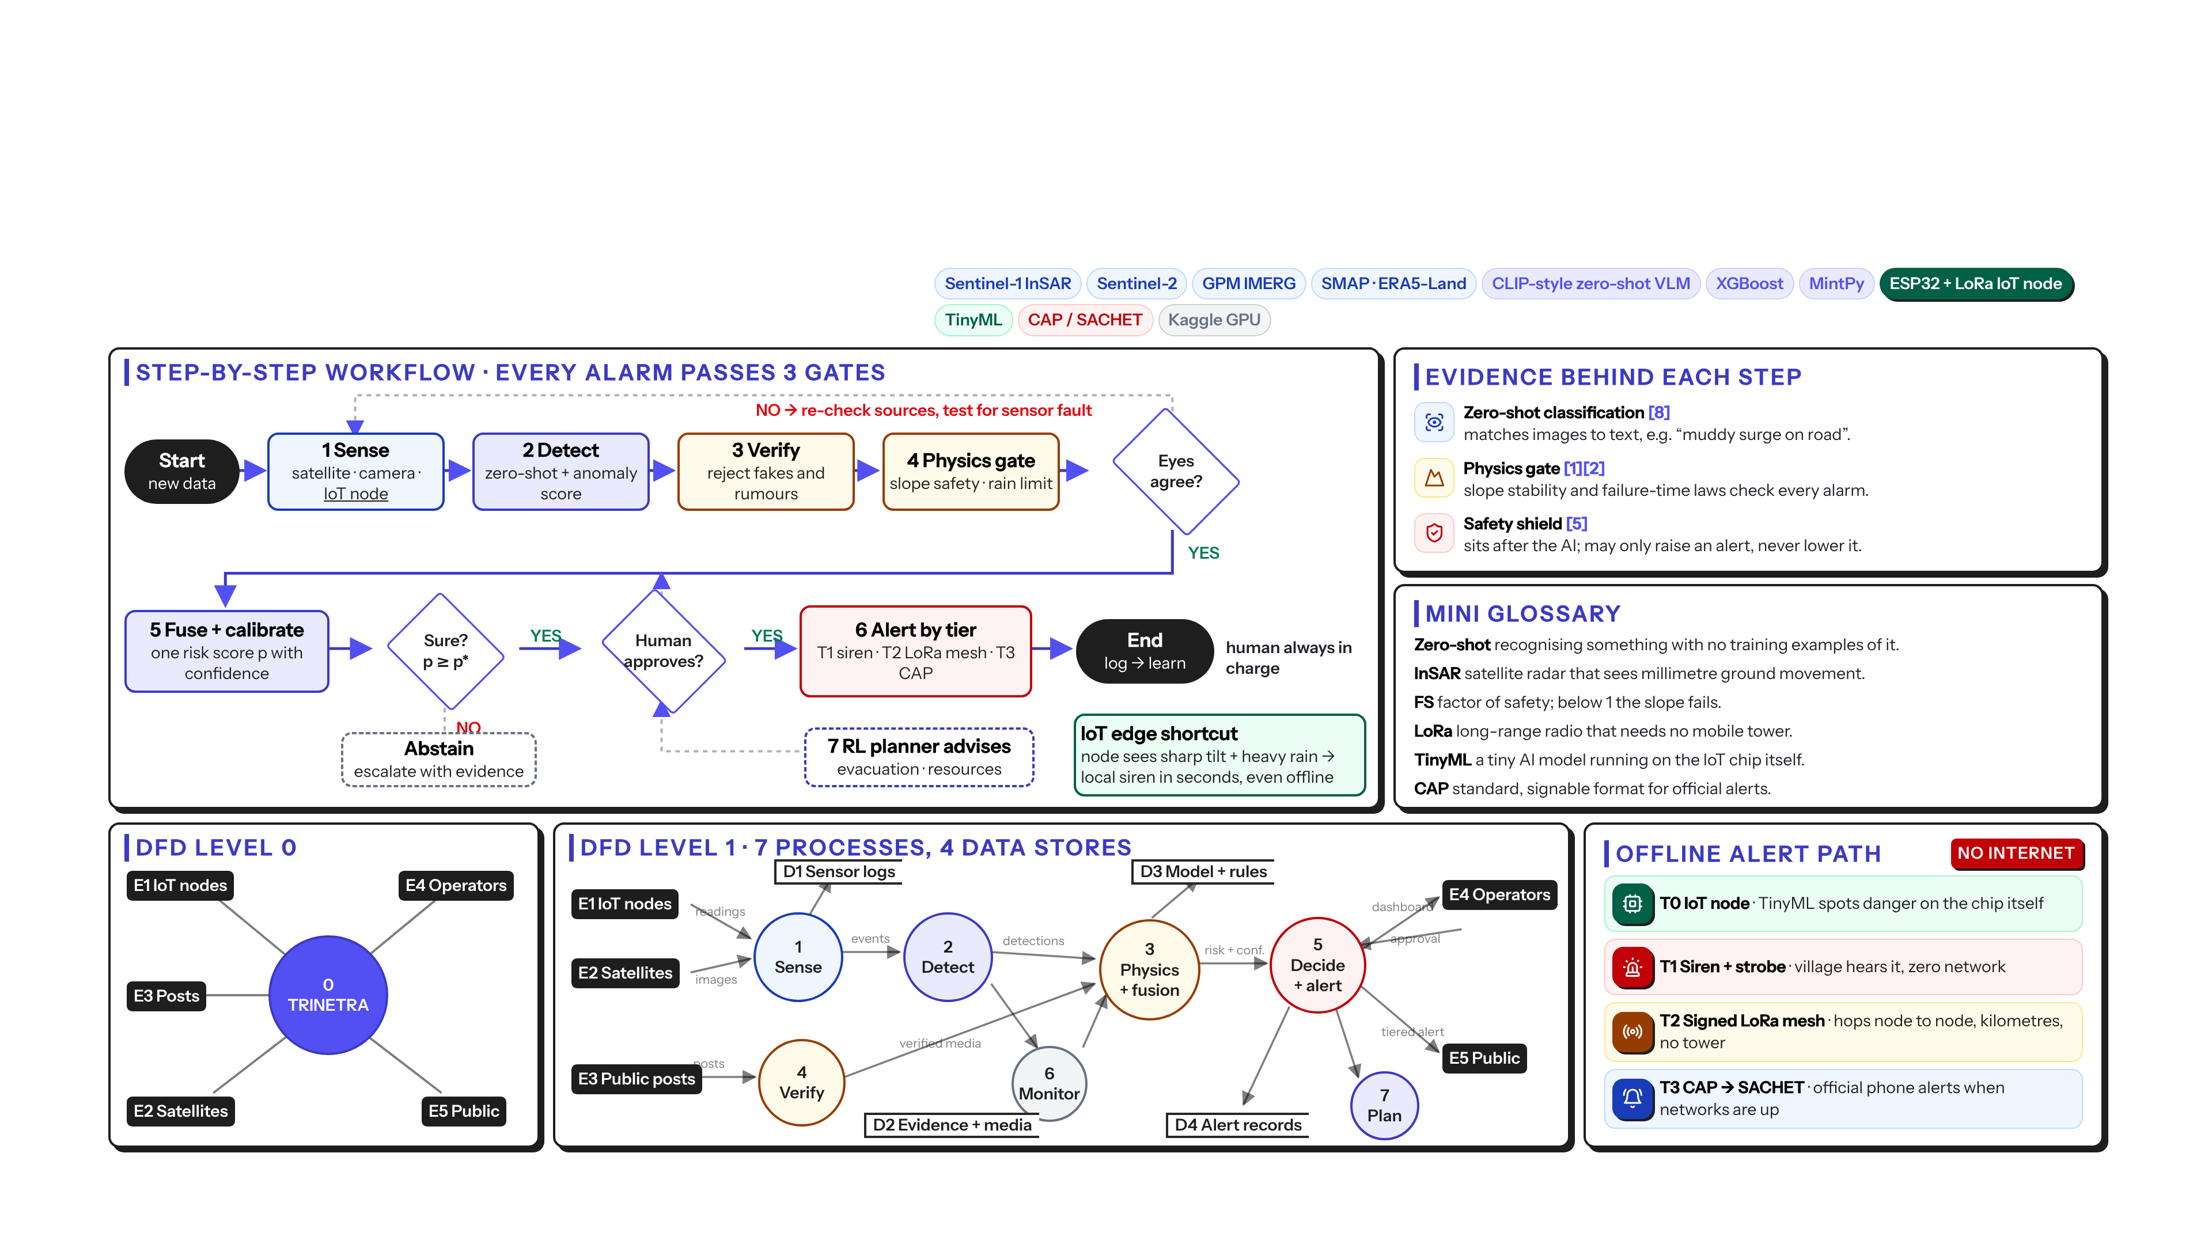
Technical Approach
Technologies To Be Used:
4
SANKAT MOCHAK
Notes:
Workflow: sense, detect, verify, physics gate. Do the eyes agree? If not, re-check and test for sensor faults.
Then fuse into one risk score with confidence. Is it above the threshold? Does a human approve? Only then alert by tier.
The IoT edge shortcut: if a node sees a sharp tilt plus heavy rain, it can sound the local siren in seconds, even with no network.
Below: DFD level 0 and level 1, and the offline-first alert path: T0 IoT node, T1 siren, T2 signed LoRa mesh, T3 CAP to SACHET.
The safety shield may only raise an alert, never lower it [5].

Slide 5

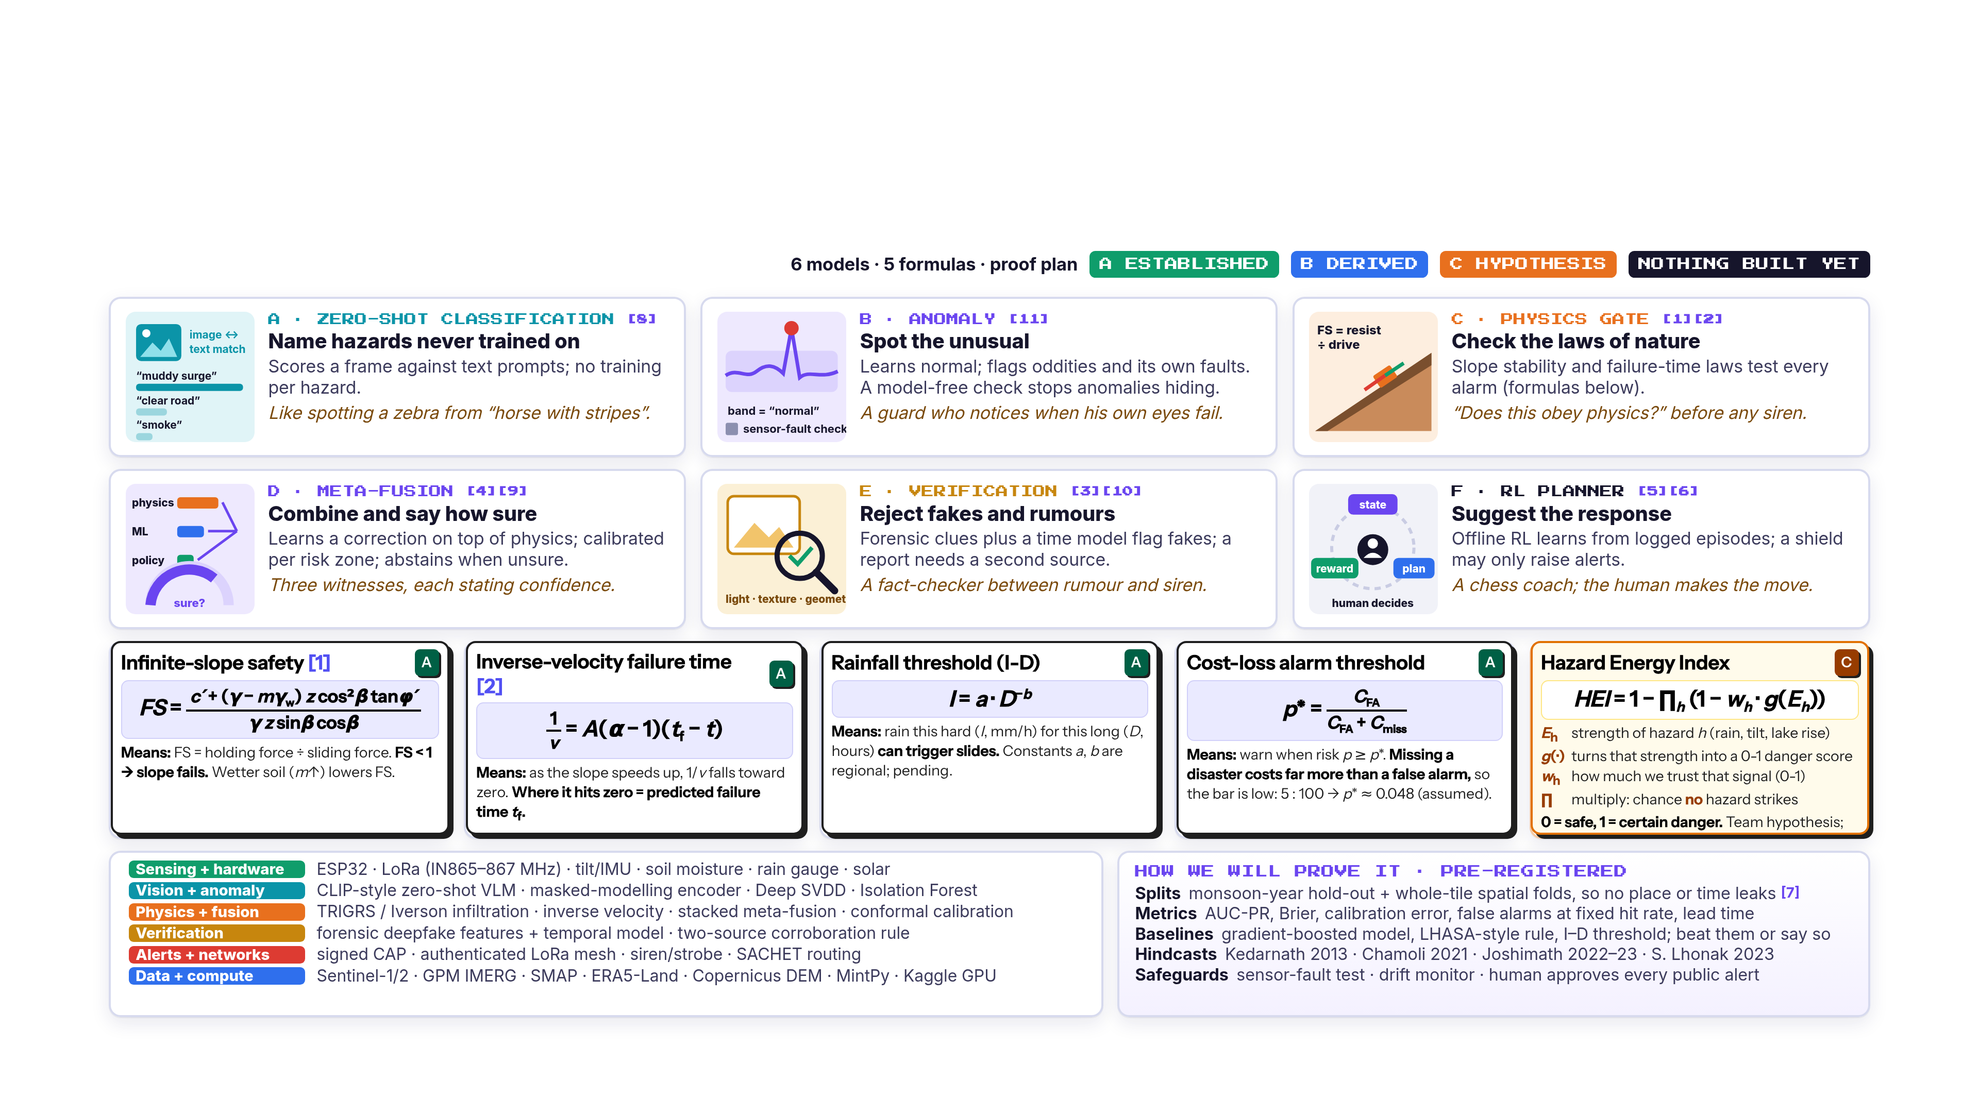
Detailed Description:
5
SANKAT MOCHAK
Notes:
Six model cards, each with an everyday analogy, and five formulas tagged established, derived or hypothesis.
The Hazard Energy Index is a team hypothesis; validation is pending.
Evaluation is pre-registered: hold out whole map tiles and monsoon years, report calibration and false alarms, beat baselines or say so, and hindcast Kedarnath 2013, Chamoli 2021, Joshimath 2022-23 and South Lhonak 2023.

Slide 6

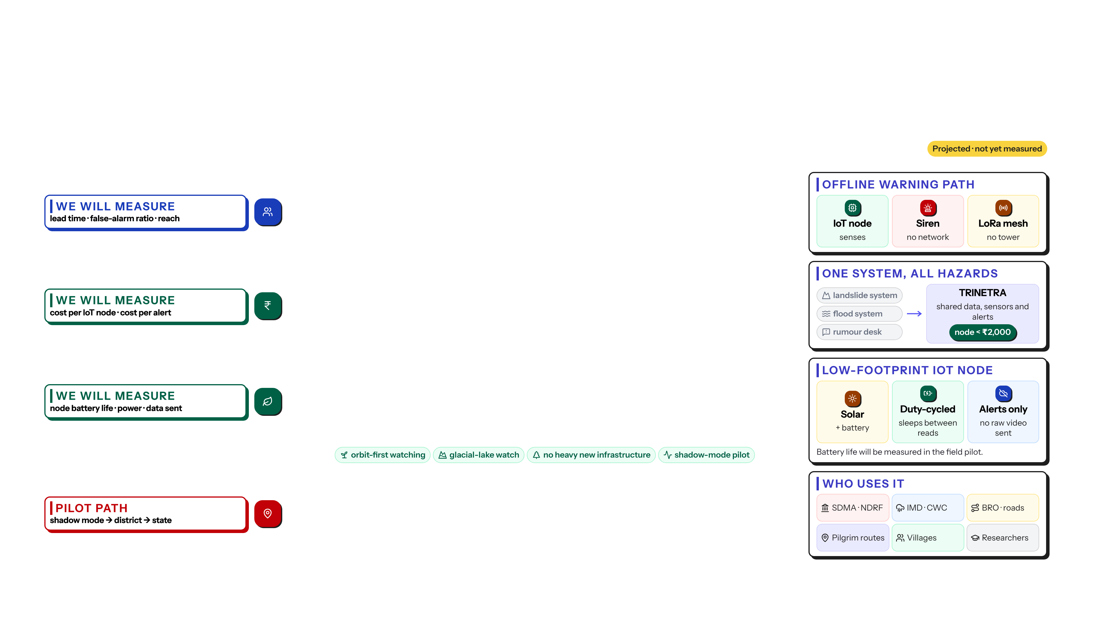
Impact and Benefits
Impact Metric | Details
Social Impact | ▸ Lead time: earlier, uncertainty-aware warnings; targets from published benchmarks. ▸ Works offline: T1 siren + T2 LoRa mesh keep warning villages when towers or power fail. ▸ Fewer false alarms: physics gate + two-source rule before any public siren, protecting trust. ▸ Anti-rumour: deepfake and misinformation checks stop fake photos from driving panic or false calm. ▸ Inclusive: plain multilingual alerts by place, not by phone number or IP; tested with communities. ▸ Human in charge: an operator approves every public alert; the AI only advises.
Economic Impact | ▸ Low-cost node: our IoT prototype node, capped under INR 2,000 (BOM pending). ▸ Free data backbone: Sentinel-1/2, GPM IMERG, SMAP, ERA5-Land (licences to be verified). ▸ Reuse CCTV: zero-shot classification on existing road and bridge cameras; no new camera network. ▸ One framework: many hazards instead of a separate system per hazard; less duplicate monitoring. ▸ Protects lifelines: earlier hill-road and bridge closure decisions (benefit to be modelled in pilot). ▸ Open + modular: local teams and startups can extend the stack; costs measured in the pilot.
Environmental Impact | ▸ Low power: solar-assisted, duty-cycled nodes; on-device TinyML sends alerts, not raw data. ▸ Orbit-first: slopes, water and vegetation watched from space; no heavy new infrastructure. ▸ Glacial-lake watch: Sentinel-2 and SAR track GLOF risk (designed; validation pending). ▸ Climate adaptation: long-term hazard logs (D1-D4) support planning for changing monsoons. ▸ Small footprint: few nodes per slope, low-power radio; battery life measured in the field. ▸ Staged pilot: shadow mode first, running beside existing systems; no disruption.
Target Audience | ▸ Disaster agencies: DEOCs, SDMA, SDRF / NDRF get decision support (complement, not replace). ▸ Forecast bodies: IMD and CWC gain cross-checked ground truth from sensors and cameras. ▸ Infrastructure: BRO, NH authorities and bridge operators on single-valley Himalayan roads. ▸ Pilgrimage routes: administrators of Kedarnath, Badrinath and similar seasonal-crowd corridors. ▸ Communities: village volunteers and panchayats receiving siren and mesh alerts. ▸ Researchers: open benchmark, honest spatial tests; regulation under expert review.
6
SANKAT MOCHAK
Notes:
All impact items are projections, not measurements.
Social: warnings reach people offline through IoT node, siren and LoRa mesh. Economic: one framework instead of one system per hazard, with an IoT node capped under 2,000 rupees. Environmental: solar, duty-cycled nodes that send alerts, not raw video. Users: SDMA and NDRF, IMD and CWC, BRO, pilgrimage routes, villages and researchers.
Regulatory points are under expert review.

Slide 7

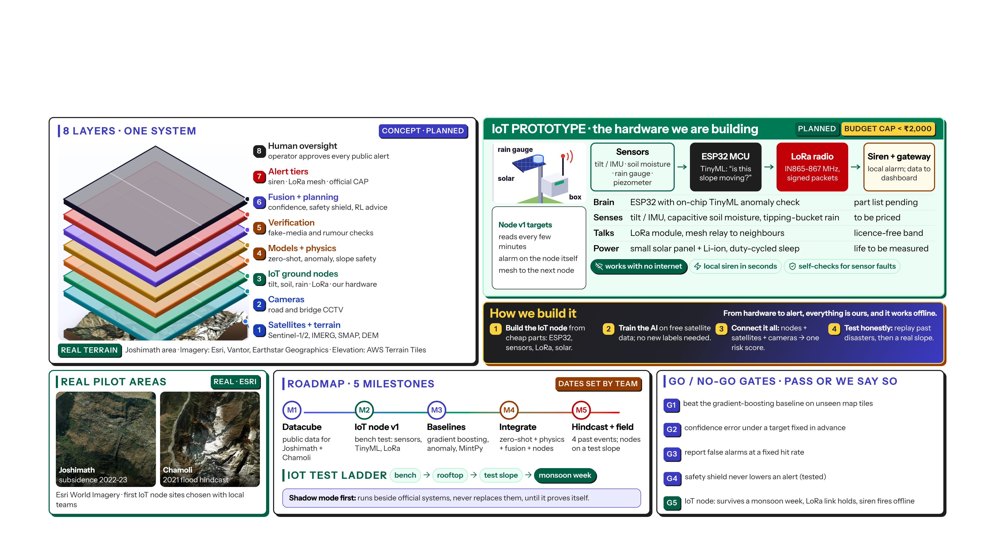
Prototype
SANKAT MOCHAK
7
Notes:
The prototype is planned. On the left, eight layers on real Joshimath terrain.
The hero is our IoT prototype: sensors for tilt, soil moisture and rain; an ESP32 running a tiny AI model that asks 'is this slope moving?'; a LoRa radio that needs no mobile tower; and a siren and gateway. Solar and battery power, duty-cycled. Budget cap under 2,000 rupees; the parts list is still being priced.
Test ladder: bench, rooftop, test slope, then a monsoon week.
Roadmap: datacube, IoT node v1, baselines, integration, hindcast and field test. Go/no-go gate G5 is for the node: it must survive a monsoon week, hold its LoRa link and fire the siren offline.

Slide 8


Research & References
Research Work:
Links:
› Copernicus Data Space (Sentinel-1/2)
› NASA GPM IMERG rainfall
› NASA SMAP soil moisture (NSIDC)
› ERA5-Land reanalysis (Copernicus CDS)
› NASA landslide hazard (LHASA / COOLR)
› ASF HyP3 InSAR processing
› ISRIC SoilGrids
› arXiv (all cited preprints)
› Esri World Imagery (S7 imagery)
› AWS Terrain Tiles (S7 elevation)
› Team research repository (GitHub)
› Full ledger (500+ papers): REFERENCES_FULL.md
SANKAT MOCHAK
8
Notes:
We have analysed 500+ papers across eight workstreams, and the count keeps rising. Our goal is 700+ for a true state-of-the-art review.
Twelve key references are numbered as cited on slides 2 to 7. Links are clickable.
Conclusion: not done yet. No reviewed system joins offline alerts, IoT nodes, zero-shot AI and physics checks in one. That is our contribution.
Thank you. We welcome questions, especially on the physics and the IoT node.

