Slide 1
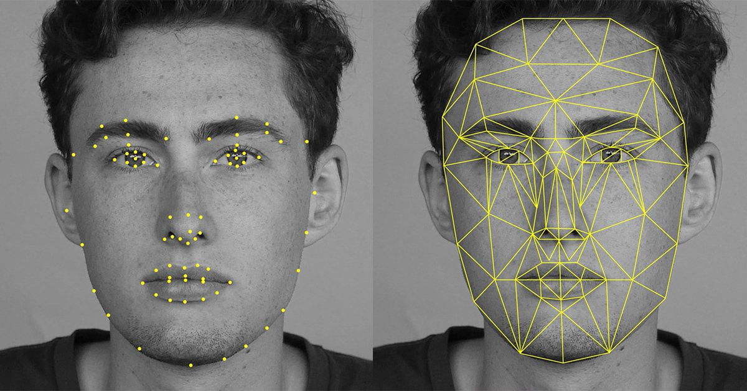

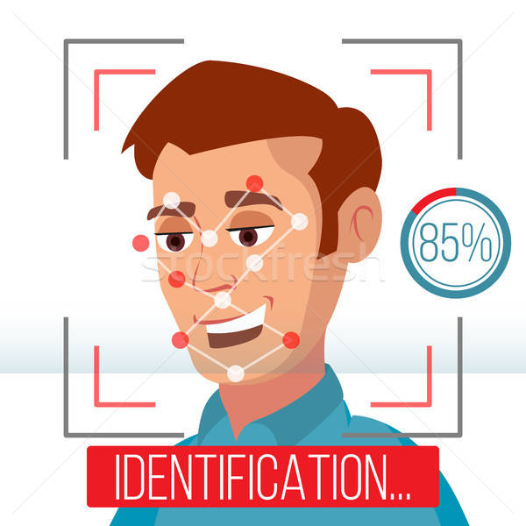
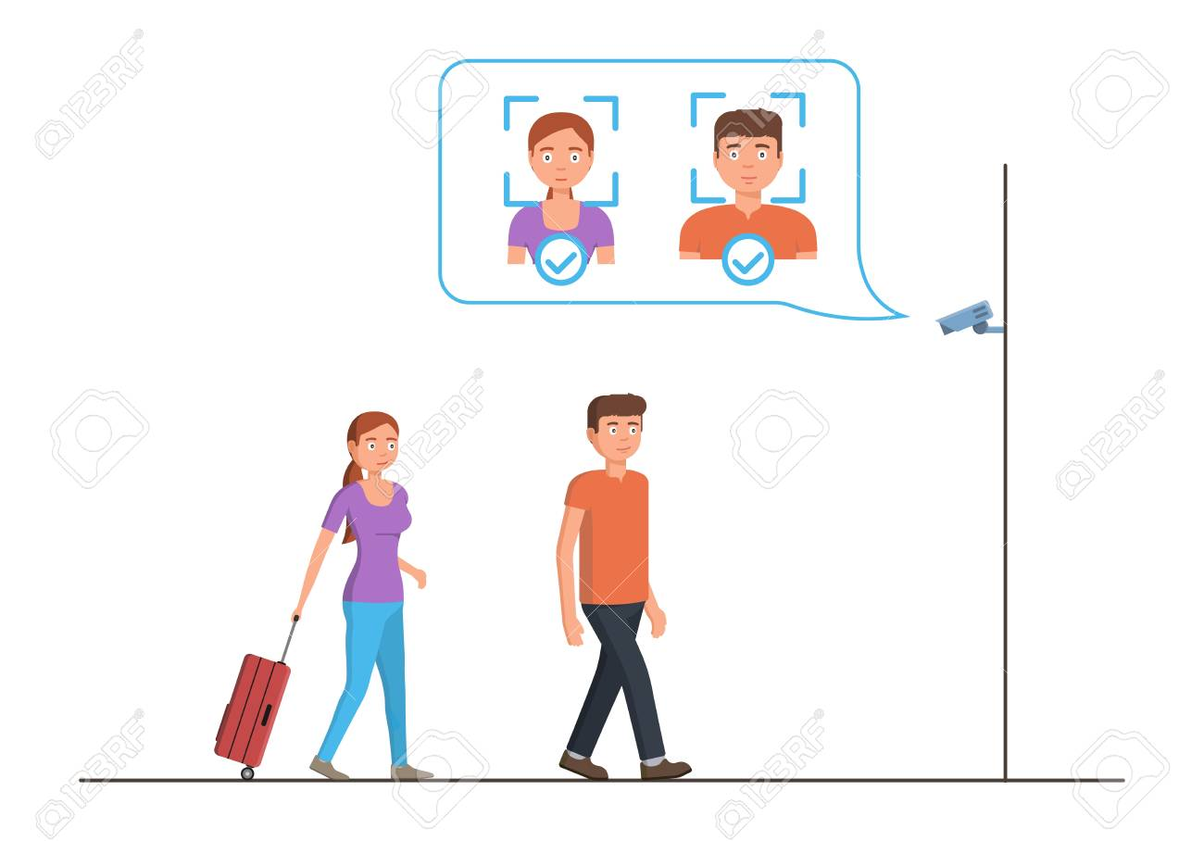
SIH 2020
Organization - Dte of IT & Cyber Security, DRDO
Problem Statement – Video based dynamic human authentication
system for access control
Team Name – UCHIHAS
Team Leader - Sanyam Mittal
College Code/AISHE Code - U-0175

Slide 2

Video based dynamic human authentication system for access control
Category – Software Domain Bucket – Security and Surveillance
Organization – Dte of IT & Cyber Security, DRDO
Though there exists a technology for face recognition based authentication but dynamic human recognition based authentication is highly challenging. For a given entrance gate a hardware-software solution is needed to identify every unique person who enters or exit the gate, with log of all previous entry/exit time, photo/videos recorded which implies that there will not be a previous history of an individual on the first entry. The system should immediately alert the security if it is a new person and the security will decide to allow/restrict that person entering inside the premises. Whereas, the system should learn from its previous history of videos/images dynamically to allow a known person. For a given size of the gate, the number of cameras with optimal resolution required is also to be worked out as part of solution. The solution should be scalable and preferably based open source.

Slide 3

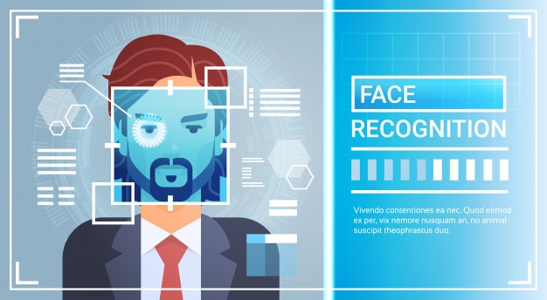

Current Static Available
Static User Authentications System
A person has to individually stand in front of camera to get access and wastes 1 min (approx.)
It can’t cover a large entrance
It can be easily surpassed as with single authorization more than 1-2 people can enter if move rapidly.
Need of Hour
Dynamic User Authentications System
It can easily detect a group of people until the faces are hidden and can cover a large entrance.
Data recorded is also being used to train the model without pausing (Manual or frequent)
Upper Body Detection would also be used for more accuracy for detection only.

Slide 4



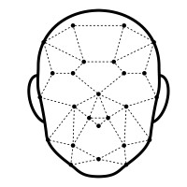
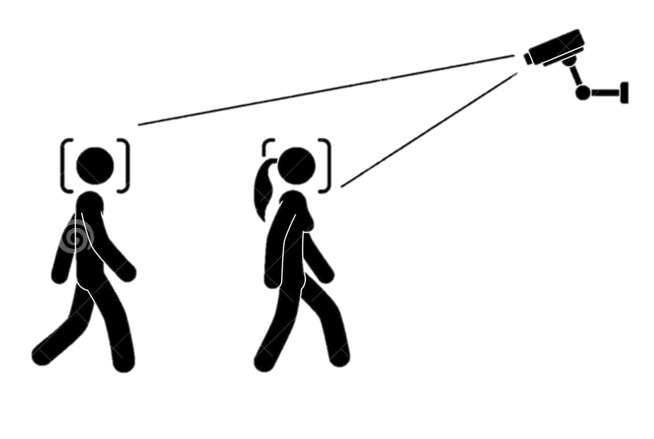
As mentioned earlier, Face Recognition is already achieved with 99% accuracy using Python Face Recognition Open Source Library.
We just Need to connect our Face recognition model with Django (Python Web Framework) which will make connection of Backend and Frontend easy to maintain & use with a more secure database.
We can maintain every Person’s Profile with Unique ID no. with logs model of 7 columns “Person, Entry Gate No./Lab name, Entry Time, Entry Pic, Exit Gate No./Lab Name, Exit Time, Exit Pic”
Suppose a Person1 enters in a LAB from any Gate, Django will create a Row with
Person = Person1 (One-to-One field with person’s profile)
Entry details would be saved, initially Exit details would be empty/null
When the Person1 exits from any Gate of that LAB, Django will GET the Row existing for the Person1 and will update the Exit details.

Slide 5







Technology Stack
Python Face Recognition Library (Pre Trained Model to Detect Faces) with 99.38% accuracy or any other Face Recognition method
Python Open CV
Django Framework
MySQL, Postgres (or any other database)
For Frontend – HTML, CSS, Bootstrap, JavaScript, jQuery
Why ?
Easy Integration with Python Modules
Most secured option
Can easily handle Huge Data
Desirable Frontend - GUI
DJANGO REST FRAMEWORK for other UI (if needed)

Slide 6
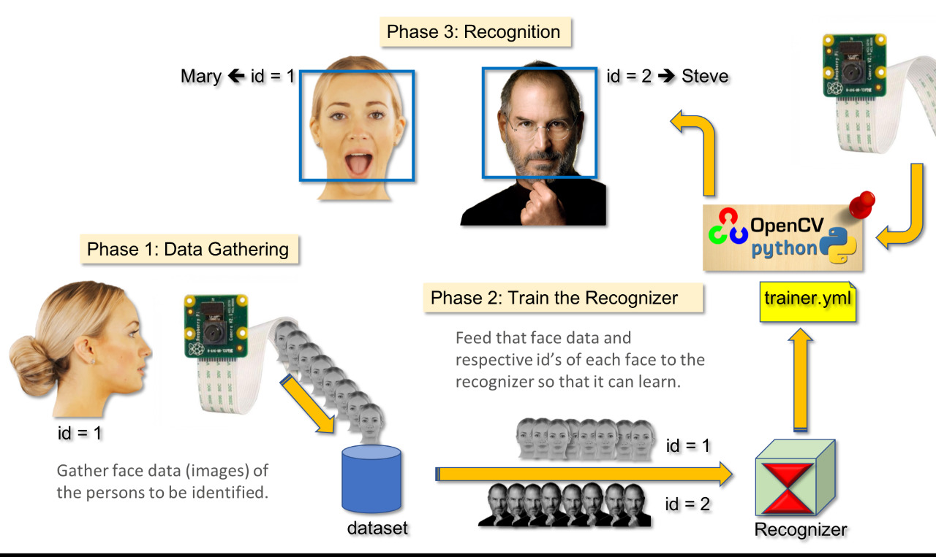
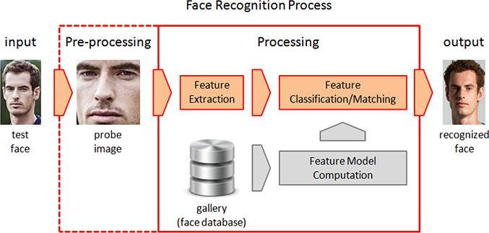
Face Detection
Face Recognition would depend upon training data. To overcome ageing, we would update our data with constant number of photos and schedule the training process which can also be done through manual methods.
Face Detection is already achieved with 99.38 % accuracy with Python Face Recognition Open Source Library
Face Recognition

Slide 7


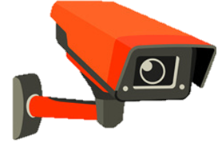
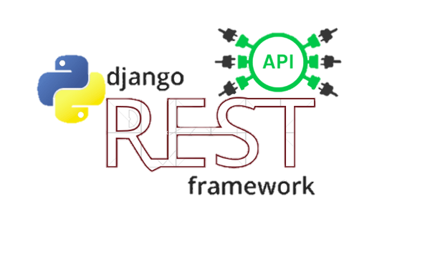
Entry
Output
Permissions
Or Alarm
Media
Web App
Face recognition
Other UI
Platforms
Exit

Slide 8
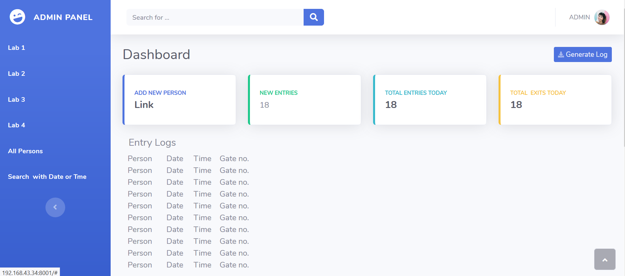
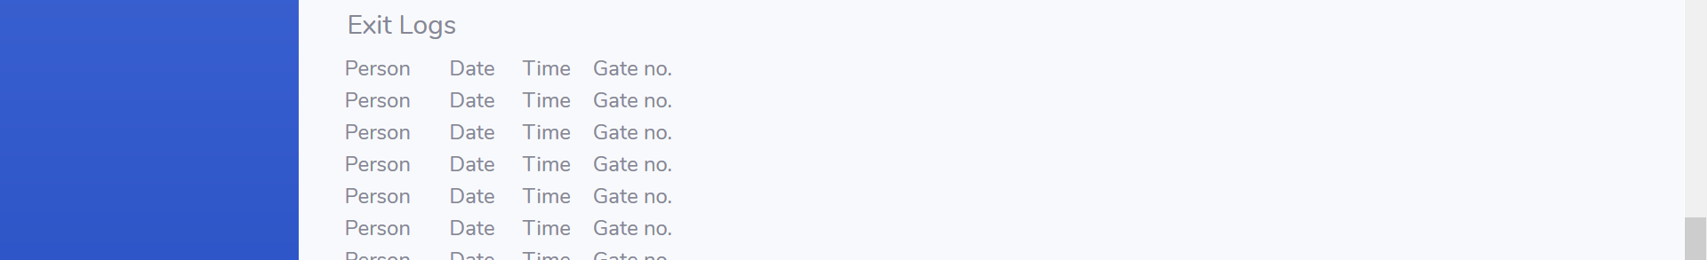

Slide 9

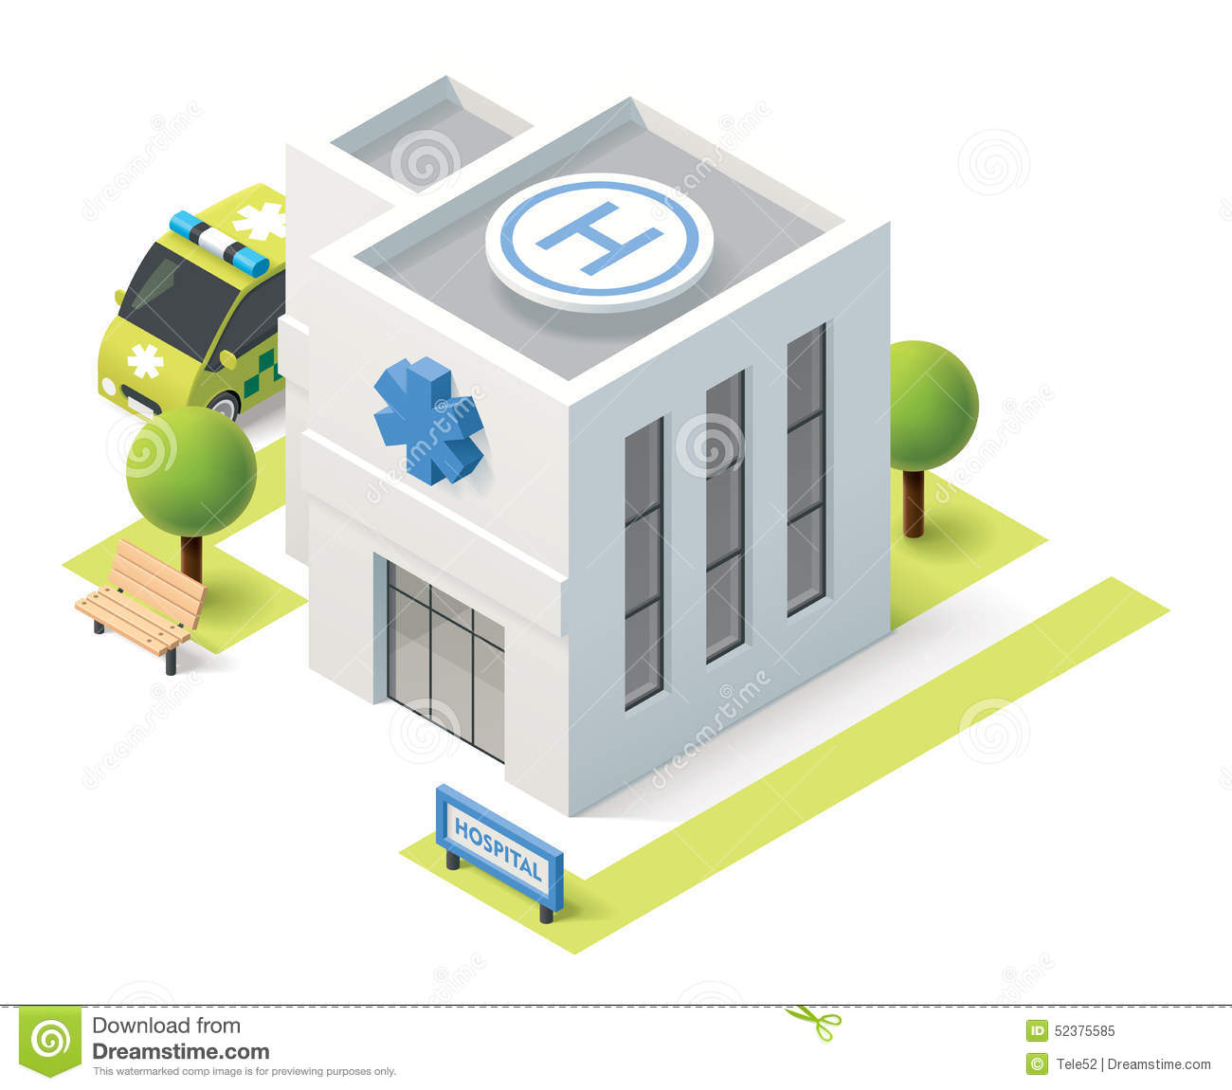
Usage in DRDO
We can Implement this solution to every Lab/Department, Gate
Providing permissions to Persons for entry and if a Person is Authorized/New it will raise an Alarm or will Notify the considered authority.
By this we can also keep track location of person in Lab also (if wanted)
A sample Logs Generated
Person | Entry Gate/Lab | Entry Time | Entry Image | Exit Gate/Lab | Exit Time | Exit Image
Rohan | Main Gate | 9:00 am | URL | Empty | Empty | Empty
Chirag | Main Gate | 9:10 am | URL | Empty | Empty | Empty
Rohan | Lab1 Gate1 | 9:12 am | URL | Empty | Empty | Empty
Chirag | Main Gate | 9:10 am | URL | Main Gate | 9:50 am | URL
Rohan | Lab1 Gate1 | 9:12 am | URL | Lab1 Gate2 | 10:23 am | URL
Rohan | Main Gate | 9:00am | URL | Main Gate | 11:29 | URL

