Slide 1
OBJECTIVE EXAM
Shreya Patel (B16CS025)
Saksham Gupta (B16CS030)

Slide 2
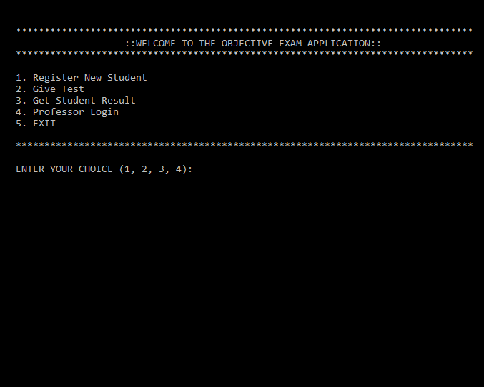
Key Features
An objective exam portal for the students to attempt the exam of desired course.
Students should register using his name and date of birth. He can also view his result.
A convenient way for the faculties (Admin) to generate and manage database of questions.
Faculty member (Admin) can also view result of the student.

Slide 3
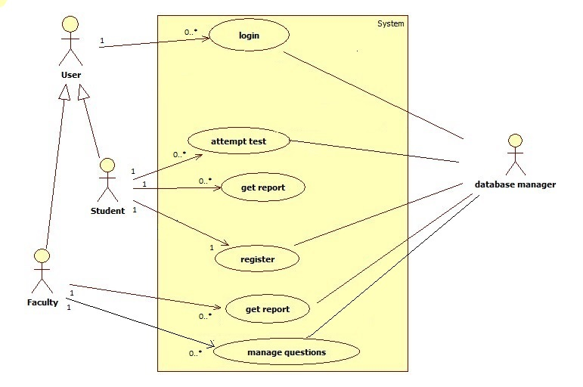
Design
MAIN USERS
Student
Faculty member (Admin)
USECASES
Login : Admin , Student
Register : Student
Attempt Test : Student
View Result : Admin, Student
Manage Questions : Admin

Slide 4
Database/Files
Used ‘.dat’ files to create the database of students and questions.
Students database : STUDENT.DAT
Questions database :
ENGLISH_QUES.DAT
PHYSICS_QUES.DAT
CHEMISTRY_QUES.DAT
MATHS_QUES.DAT

Slide 5
Things that could not be implemented
Time constraint while attempting test.
Additional Features Implemented
Faculty member (Admin) can edit student details.
He can edit number of questions to be asked for test and marks assigned to a question.
Assigning rank

Slide 6
Unit and System Testing
The test cases were identified to check -
Functionalities of the software
Whether exceptions are handled properly or not
NO use of any Automated tools
All the test cases are verified for different inputs

Slide 7
Testing
Hostel Expenditure Planning

Slide 8
Use cases tested
Password Validation
Registration of Director
Group discussion
Add or change director
Personal message
Make plans or set goals
Delete any file

Slide 9
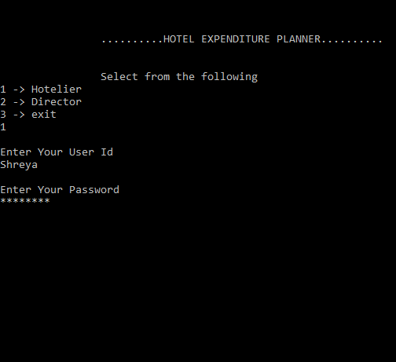
Testing
Identified functionalities of the software and detected activities more vulnerable to faults.
Wrong data values were given as input to identify the errors
17 functions tested out of which 6 functions were incorrect
Login functionality was not working properly.

Slide 10
Conclusion
Software provides an easy assessment platform for student and faculty.
Well tested over all possible inputs.

Slide 11
DEMO

Slide 12
THANK YOU
Presented by
Shreya Patel (B16CS025)
Saksham Gupta(B16CS030)

