Slide 1
OBJECTIVE EXAM
Shreya Patel (B16CS025)
Saksham Gupta (B16CS030)

Slide 2
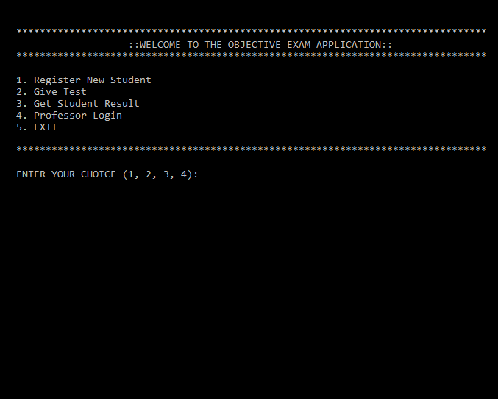
Key Features
An objective exam portal for the students to attempt the exam of desired course.
Students should register using his name and date of birth. He can also view his result.
A convenient way for the faculties (Admin) to generate and manage database of questions.
Faculty member (Admin) can also view result of the student.

Slide 3
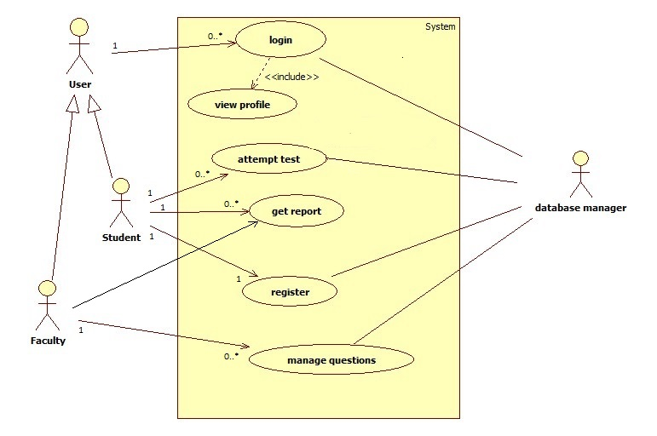
Design
MAIN USERS
Student
Faculty member (Admin)
USECASES
Login : Admin , Student
Register : Student
Attempt Test : Student
View Result : Admin, Student
Manage Questions : Admin

Slide 4
Structure of the database/ file system
Used ‘.dat’ files to create the database of students and questions.
Students database : STUDENT.DAT
Questions database :
ENGLISH_QUES.DAT
PHYSICS_QUES.DAT
CHEMISTRY_QUES.DAT
MATHS_QUES.DAT

Slide 5
Things that could not be implemented
Time constraint while attempting test.
Deleting question from the database by the faculty member (Admin).
Additional Features Implemented
Faculty member (Admin) can edit student details.
He can edit number of questions to be asked for test and marks assigned to a question.
Assigning rank

Slide 6
Statistics of unit and system testing
The test cases were identified to check the following :
Functionalities of the software
Whether exceptions are handled properly or not
Whether any automated tools were used
Any test cases missed
Any other points related to testing you want to highlight

Slide 7
Testing
Hostel Expenditure Planning

Slide 8
List of Use cases tested

Slide 9
Statistics of the test cases
How many functions tested
How many functions were correct, how many were incorrect
Any problem that you wanted to highlight that the dev team has missed

Slide 10
Conclusion

Slide 11
Thank you
Presented by
Shreya Patel (B16CS025)
Saksham Gupta(B16CS030)

