Slide 1
The Probability of a Lag Spike: Statistical Solution for Wi-Fi Latency
Moving Beyond "Average Ping" Using Right-Skewed Probability Distributions, Goodness-of-Fit Testing, and Tail Risk Inference
Presenter
Saksham [Applied Probability & Inference]
Course & Implementation Scope
Applied Probability & Statistical Inference
Empirical Wi-Fi Dataset: N = 3,685 ICMP Echo Probes
Evaluation of Right-Skewed Models & Lag Spike Tail Risk

Slide 2
The Problem: Why "Average Latency" Lies to You on Wi-Fi
The mean latency appears moderate, but tail volatility and severe skewness create disruptive lag spikes.
WHAT PEOPLE ASSUME
EMPIRICAL WI-FI REALITY
Symmetric Normal Distribution
Right-Skewed & Heavy-Tailed
• Bell-Curve Assumption: Belief that latency symmetrically clusters around the 176.8 ms average.
• Predicts Negative Latency: Normal model predicts a 13.1% probability of RTT < 0 ms (physically absurd!).
• Severe Tail Blindness: Estimates probability of catastrophic lag (>800 ms) as 0.003% (virtually zero).
• Misleading SLA Audits: ISPs report mean ping, masking user disconnections and frame freezes.
• Strict Propagation Floor: Physical minimum latency bound at 17.9 ms (no values below this).
• Extreme Right-Skewness: Skewness = +3.560 (heavily asymmetrical long right tail).
• Leptokurtic Kurtosis: Excess Kurtosis = +26.00 (extreme outlier probability).
• Catastrophic Latency Spikes: Max observed ping = 2479.0 ms (14× higher than the 176.8 ms mean!).
• High Disruption Rate: P(X > 100 ms) = 64.0% (64% of packets experience lag!).
TAKEAWAY Mean latency (176.8 ms) masks an extreme 2479 ms tail spike; right-skewed models are mathematically mandatory.
Probability of a Lag Spike • Wi-Fi Empirical Solution

Slide 3
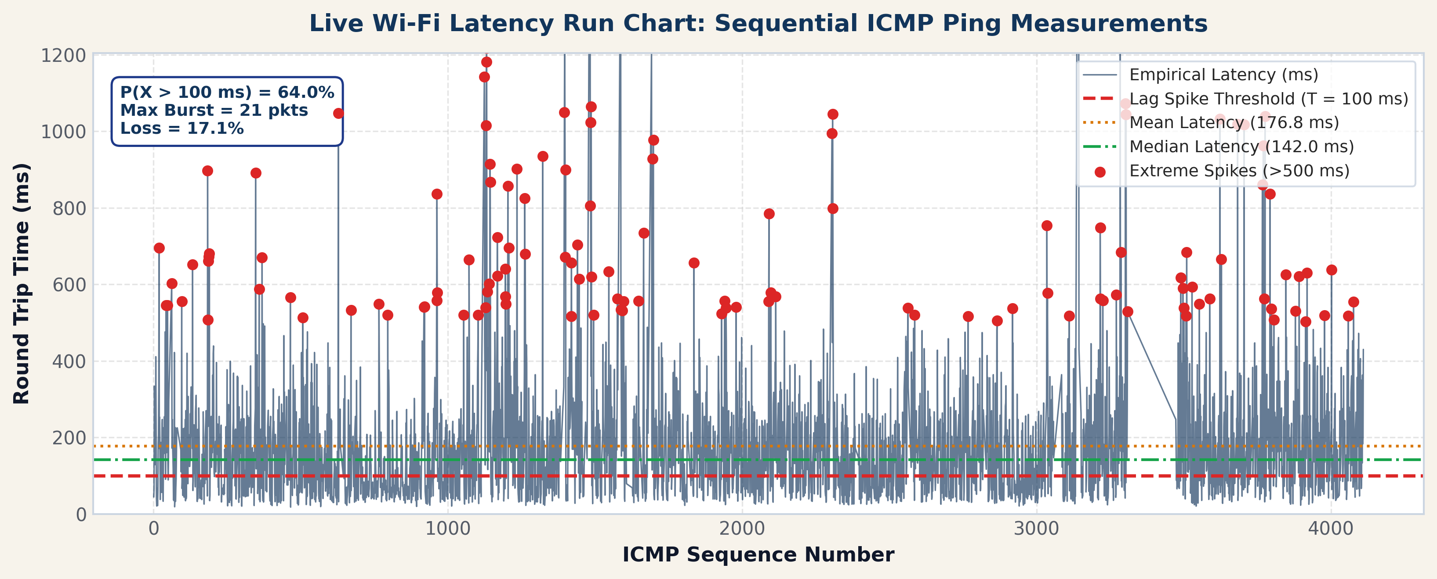
Exploratory Data Analysis: Wi-Fi Empirical Characteristics
Rigorous distributional summary of N = 3,685 consecutive ICMP ping packets collected over Wi-Fi.
Central Tendency vs Spread
• Mean: 176.81 ms | Median: 142.00 ms
• Std Dev: 157.99 ms | IQR: 159.10 ms
• Minimum: 17.90 ms | Maximum: 2479.00 ms
Percentile Spectrum
• 50th Percentile (P50): 142.00 ms
• 90th Percentile (P90): 340.00 ms
• 95th Percentile (P95): 444.60 ms
• 99th Percentile (P99): 826.76 ms (Severe Tail)
Higher Moments & Network Reliability
• Skewness: +3.560 (Severe Right Asymmetry)
• Excess Kurtosis: +26.00 (Fat Tails)
• Packet Loss: 17.08% (759 / 4,444 packets dropped)
TAKEAWAY Median latency (142.0 ms) is 35 ms below the mean; 1% of packets (P99) exceed 827 ms with 17.1% packet loss.
Probability of a Lag Spike • Wi-Fi Empirical Solution

Slide 4
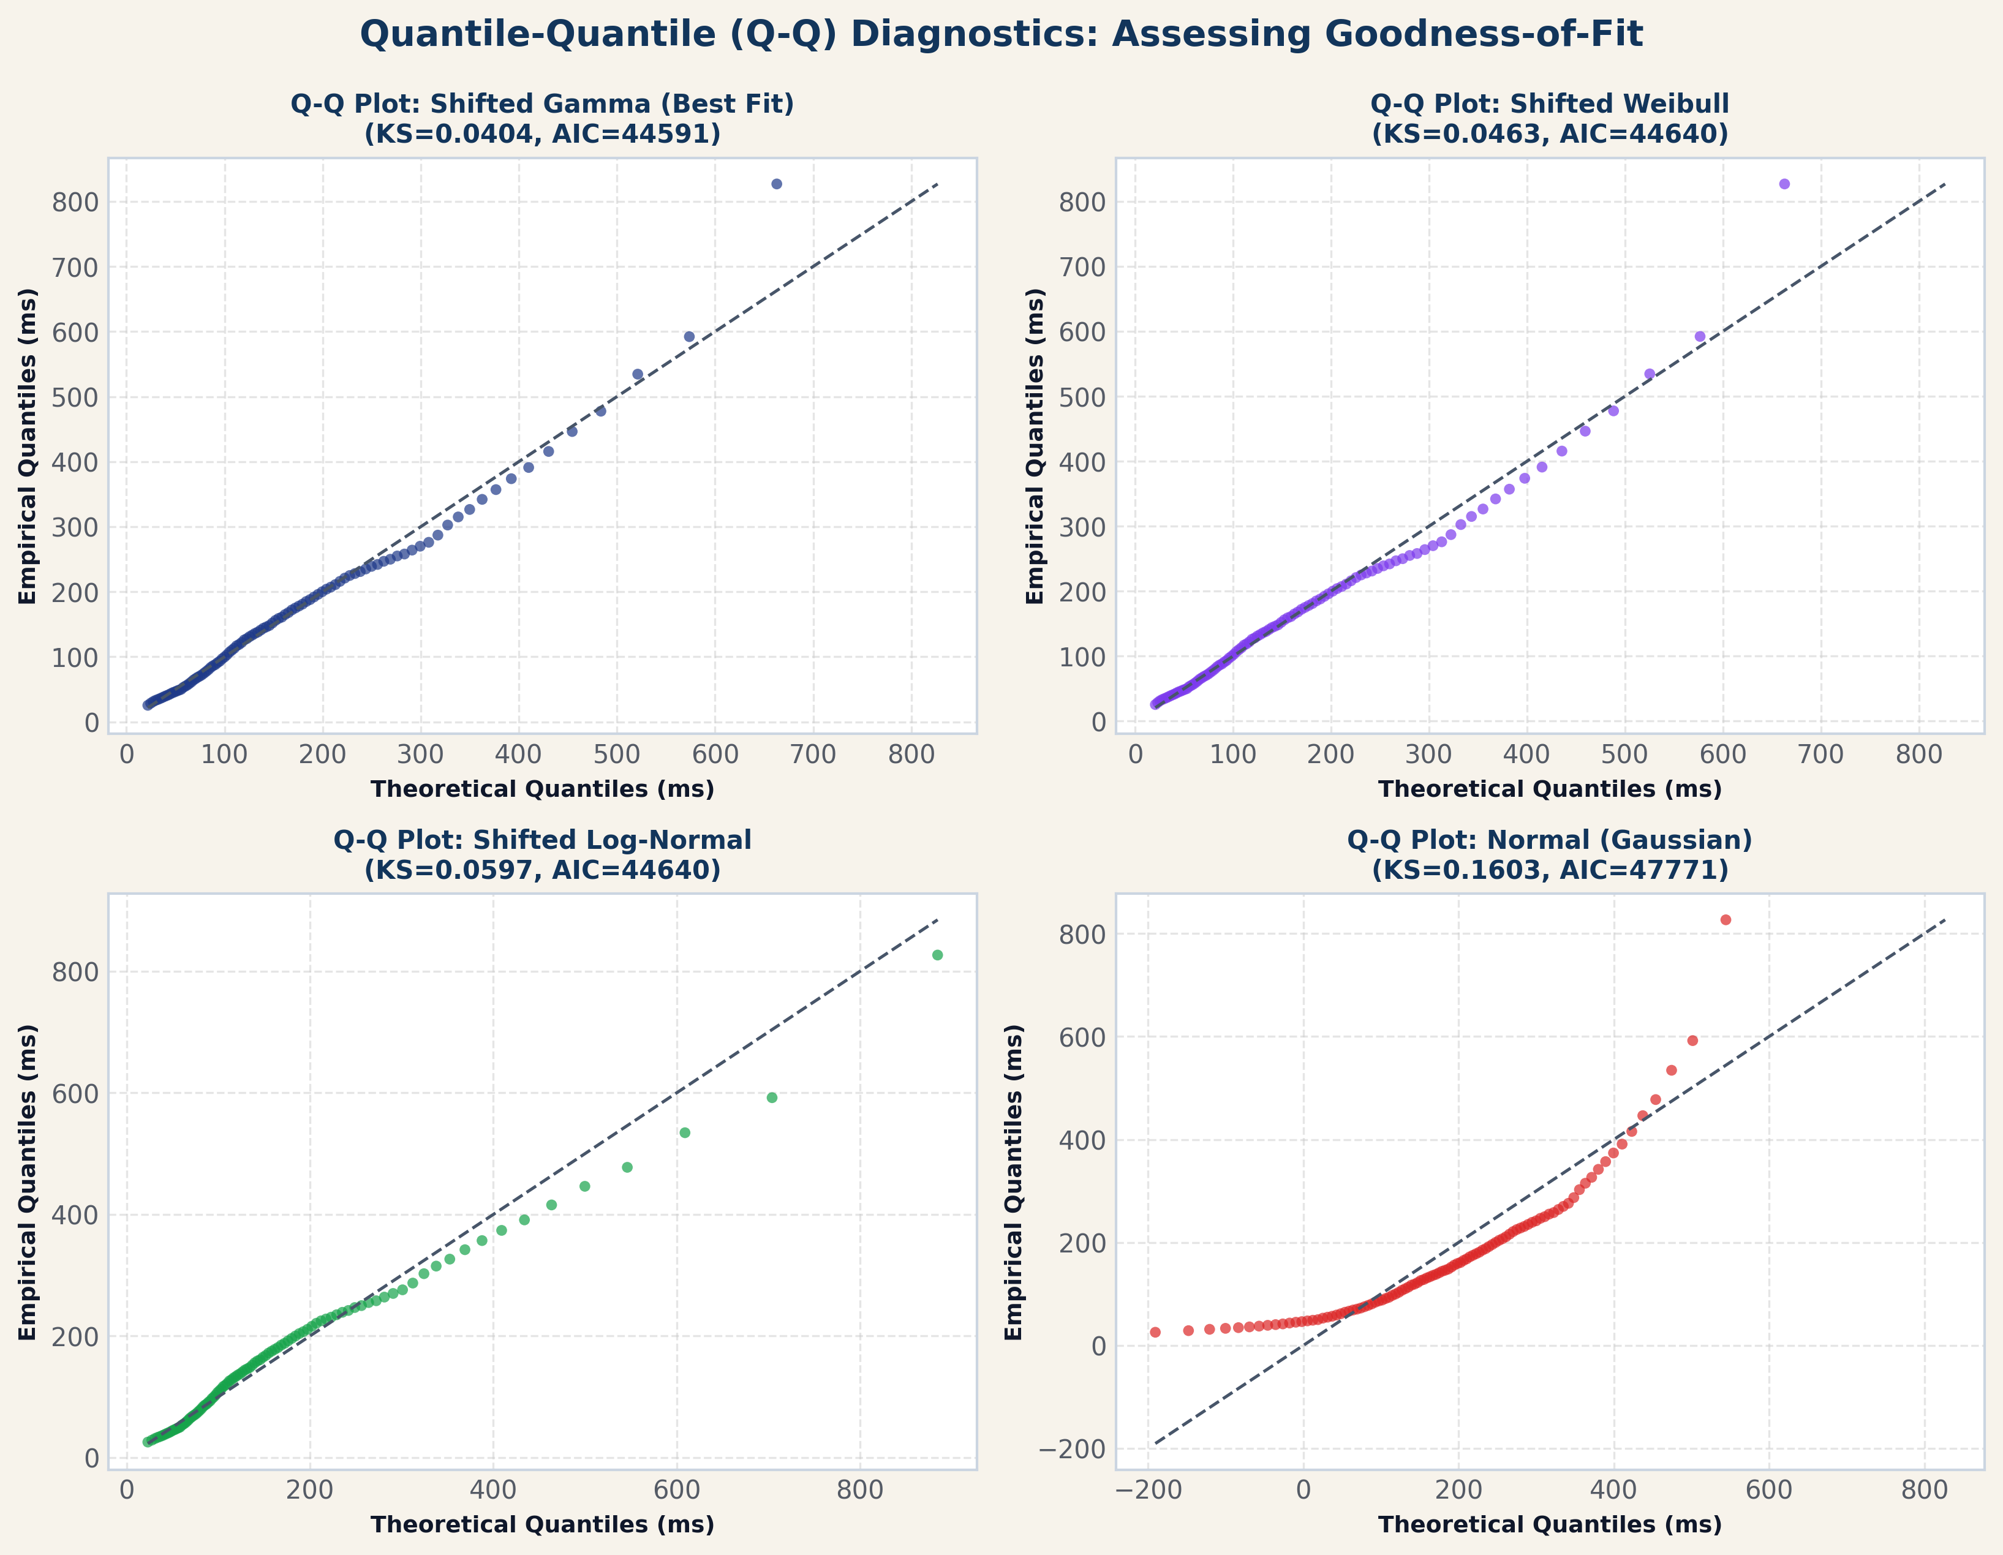
Hypothesis Testing: Statistical Rejection of Gaussian Normality
Multiple formal statistical tests decisively reject the null hypothesis of normal latency (p < 1e-82).
Formal Goodness-of-Fit Tests
• Kolmogorov-Smirnov (K-S) Test:
D = 0.1603, p = 3.53e-83
Decisive rejection of Gaussian CDF at alpha = 0.001.
• D'Agostino-Pearson Omnibus Test:
K^2 = 2967.5, p = 0.000
Simultaneously tests skewness and kurtosis components.
• Excess Kurtosis Test:
Excess kurtosis = +26.00 (Normal = 0)
Extreme leptokurtic peakedness and heavy right tail.
• Conclusion:
The empirical data is fundamentally non-Gaussian; parametric modeling requires strictly positive, skewed distributions.
TAKEAWAY Normality is rejected with p < 1e-82; Q-Q diagnostics demonstrate that Gaussian models deviate catastrophically in the upper tail.
Probability of a Lag Spike • Wi-Fi Empirical Solution

Slide 5
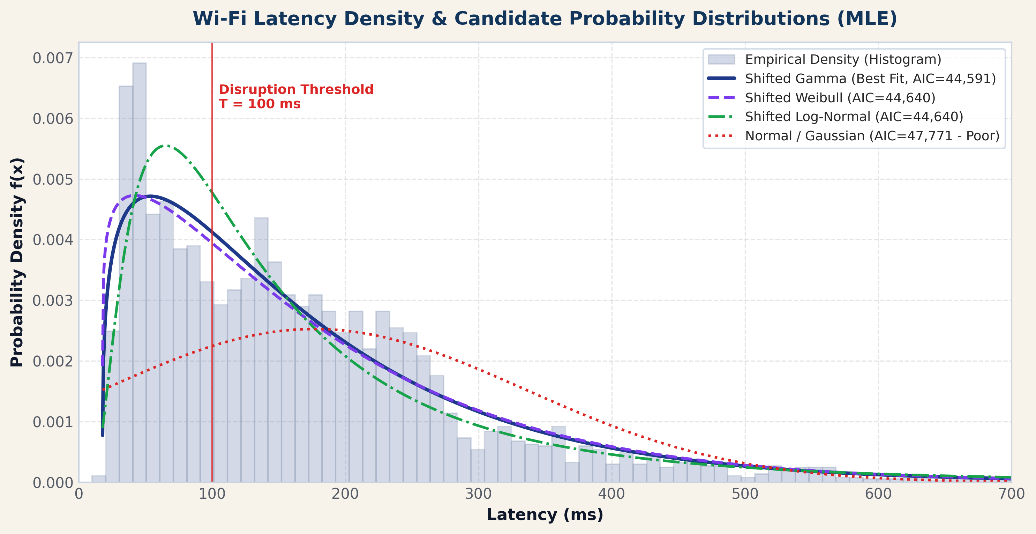
Distribution Modeling: Maximum Likelihood Estimation (MLE)
Evaluating right-skewed parametric families incorporating the physical propagation floor (gamma = 17.9 ms).
Distribution Model | Log-Lik | AIC | BIC | K-S Stat
Shifted Gamma (Best) | -22,292.4 | 44,590.9 | 44,609.5 | 0.0404
Shifted Weibull | -22,317.1 | 44,640.3 | 44,658.9 | 0.0463
Shifted Log-Normal | -22,317.2 | 44,640.3 | 44,659.0 | 0.0597
Log-Normal (loc=0) | -22,322.1 | 44,648.2 | 44,660.6 | 0.0500
Shifted Exponential | -22,361.8 | 44,727.5 | 44,739.9 | 0.0588
Normal (Gaussian) | -23,883.7 | 47,771.4 | 47,783.8 | 0.1603
Best Model Parameters: 3-Parameter Shifted Gamma
• Shape (alpha) = 1.2927 | Scale (beta) = 122.95 ms | Loc (gamma) = 17.87 ms
• Physical interpretation: gamma represents the hardware propagation floor.
TAKEAWAY Shifted Gamma achieves the lowest AIC (44,591) and K-S statistic (0.0404), outperforming Weibull, Log-Normal, and Normal.
Probability of a Lag Spike • Wi-Fi Empirical Solution

Slide 6
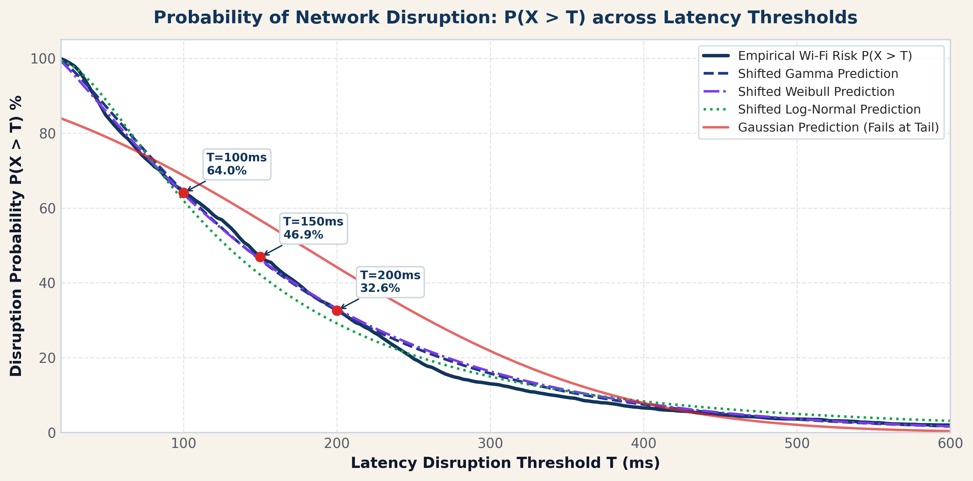
Beyond the Mean: Calculating the Probability of Disruption
Evaluating lag spike disruption risk: P(X > 100 ms) = 1 - F_X(100), comparing empirical reality to proposal estimates.
Threshold Disruption Analysis
T = 100 ms Disruption Evaluation:
• Proposal Illustrative Placeholder: ~4.5% (Initial Wi-Fi assumption)
• Empirical Live Wi-Fi Reality: 64.04% (2,360 / 3,685 pkts)
• Shifted Gamma Fitted Model: 64.34% (Relative error < 0.5%)
• Shifted Weibull Model: 63.72% | Log-Normal: 61.96%
T = 150 ms & 200 ms Thresholds:
• P(X > 150 ms): Empirical = 46.89% | Shifted Gamma = 46.15%
• P(X > 200 ms): Empirical = 32.59% | Shifted Gamma = 32.57%
Proposal Placeholder (Wi-Fi) (4.5%)
Empirical Live Capture (Wi-Fi) (64.0%)
Shifted Gamma MLE (Wi-Fi) (64.3%)
TAKEAWAY Empirical Wi-Fi disruption at 100 ms is 64.0% (vs 4.5% proposal estimate); Shifted Gamma predicts 64.34% with remarkable precision.
Probability of a Lag Spike • Wi-Fi Empirical Solution

Slide 7
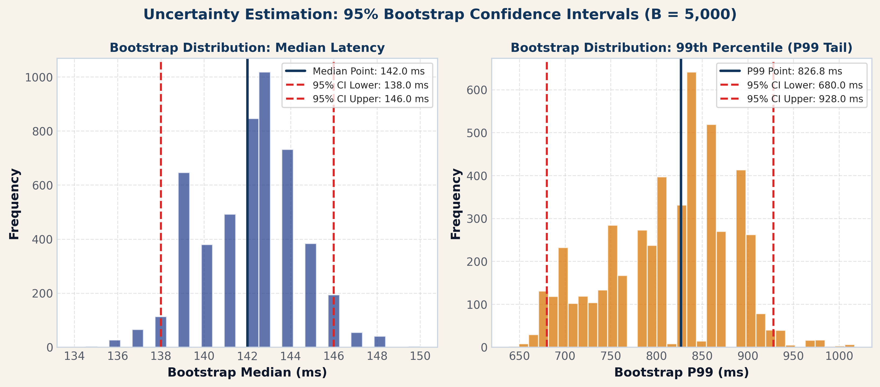
Uncertainty Estimation: 95% Bootstrap Confidence Intervals
Quantifying parameter stability via B = 5,000 non-parametric bootstrap resamples on live Wi-Fi latency observations.
Median Latency [P50]: 142.00 ms 95% CI: [138.00 ms, 146.00 ms]
Extremely tight bound (+-4 ms); represents typical packet latency.
Mean Latency: 176.81 ms 95% CI: [171.87 ms, 182.00 ms]
Influenced by right-tail outliers; spans +-5.1 ms.
90th Percentile [P90]: 340.00 ms 95% CI: [325.00 ms, 357.00 ms]
Substantial tail delay (+-16 ms); critical for interactive cloud gaming.
99th Percentile [P99 Tail]: 826.76 ms 95% CI: [680.00 ms, 928.00 ms]
High tail volatility spanning [680 ms, 928 ms]; causes frame freezes.
TAKEAWAY Non-parametric bootstrap confirms median stability [138-146 ms] alongside extreme tail volatility [680-928 ms].
Probability of a Lag Spike • Wi-Fi Empirical Solution

Slide 8
Temporal Dynamics, Burstiness & Network Engineering Conclusions
Wi-Fi lag spikes are not independent; temporal clustering exacerbates user disruption and demands modernized SLAs.
1 · Temporal Dynamics
2 · Disruption Impact
3 · Engineering Solutions
• Lag-1 Autocorrelation:
rho_1 = +0.270 (p < 1e-15).
Consecutive packets share network queuing states.
• Disruption Clustering:
642 distinct spike bursts (>100 ms).
Mean burst length = 3.7 packets.
• Extreme Burst Duration:
Maximum burst = 21 consecutive packets.
Translates to ~21 seconds of continuous degradation!
• Engineering Reality:
Spikes occur in clustered waves rather than memoryless Poisson arrivals.
• Video Conferencing (Zoom/Teams):
100 ms+ jitter bursts exceed playout buffers, causing frozen frames and clipped audio.
• Esports & Cloud Gaming:
P90 (340 ms) and P99 (827 ms) trigger server desync, input drops, and missed tick-rates.
• Financial Transactions:
Deterministic latency bounds are violated; time-sensitive executions risk slippage.
• Composite Quality Score:
17.1% packet loss + 64.0% lag spikes = only 29.8% of packets are on-time and healthy.
• Redefine ISP SLAs:
Replace deceptive 'average ping' guarantees with Shifted Gamma tail percentiles (P95, P99) and P(X > 100 ms).
• Active Queue Management (AQM):
Implement FQ-CoDel or Cake AQM on Wi-Fi access points to eliminate bufferbloat queuing spikes.
• Adaptive Jitter Buffers:
Real-time communication software must dynamically size jitter buffers up to ~850 ms during Wi-Fi bursts.
• Project Methodology Success:
Empirical analysis validates the 4-step framework proposed in Applied Probability course.
TAKEAWAY Wi-Fi latency spikes exhibit temporal autocorrelation (rho_1 = 0.27); network engineering must replace average ping with Shifted Gamma tail metrics.
Probability of a Lag Spike • Wi-Fi Empirical Solution

