Slide 1
Inventory Management System
A Python Django Project

Slide 2
Introduction
This project demonstrates an Inventory Management System built using Python and Django. It helps in managing products, stock levels, and transactions efficiently.

Slide 3
Features
1. User Authentication and Authorization
2. Add, Update, and Delete Inventory Items
3. Real-Time Stock Tracking
4. Reporting and Data Export
5. Dashboard with Insights

Slide 4
System Architecture
Database
Server

Slide 5
Technologies Used
- Python
- Django Framework
- SQLite Database
- HTML, CSS, JavaScript (Frontend)
- Bootstrap for Responsive Design

Slide 6
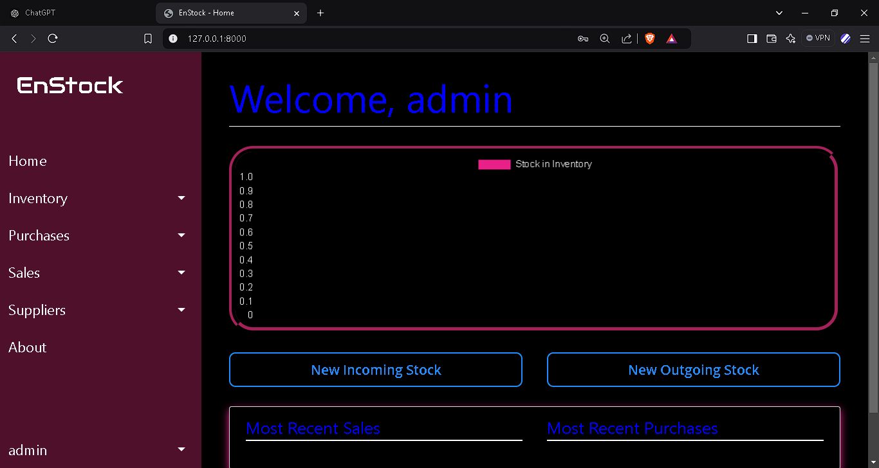
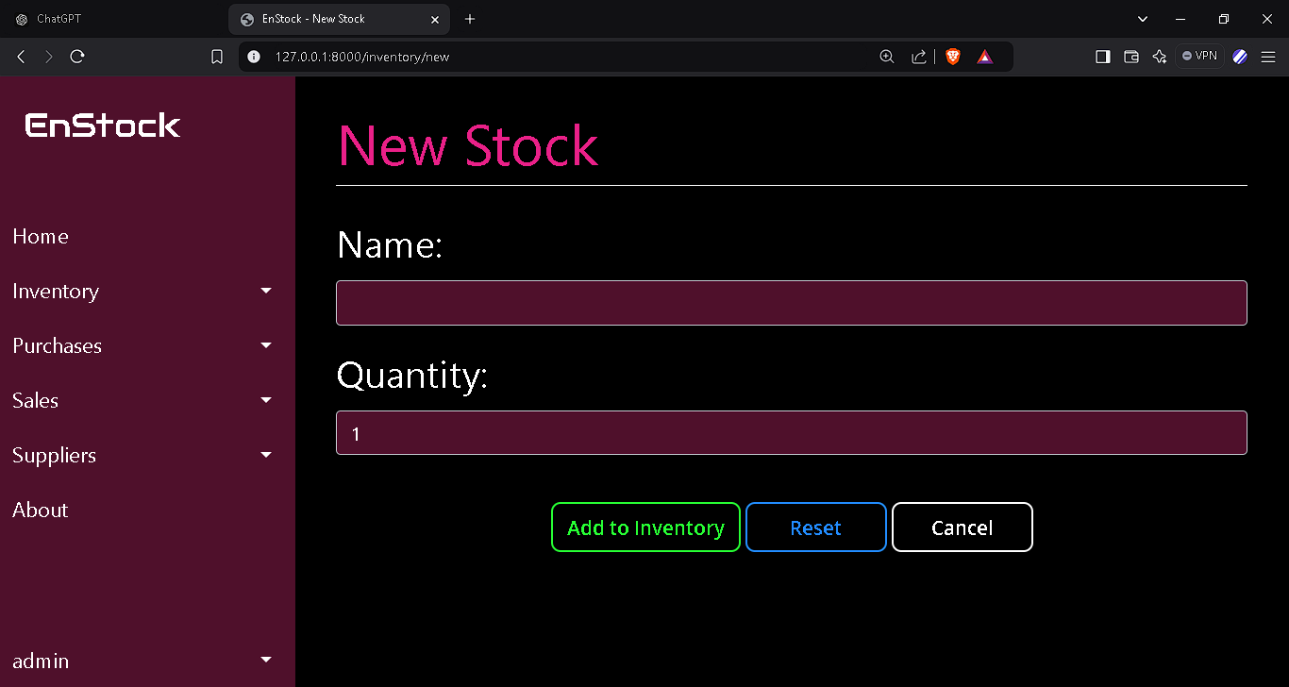
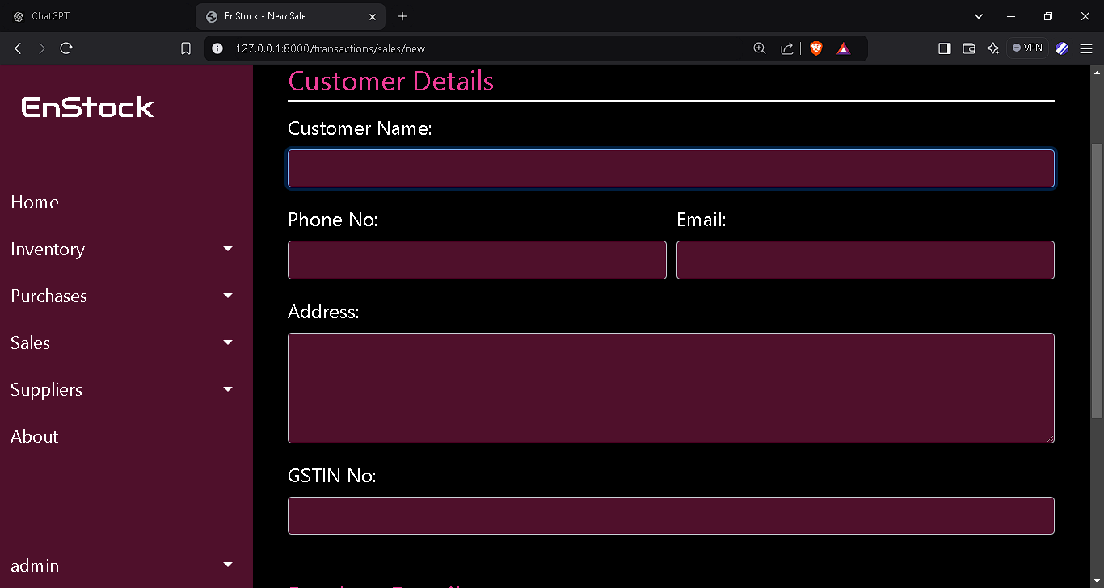
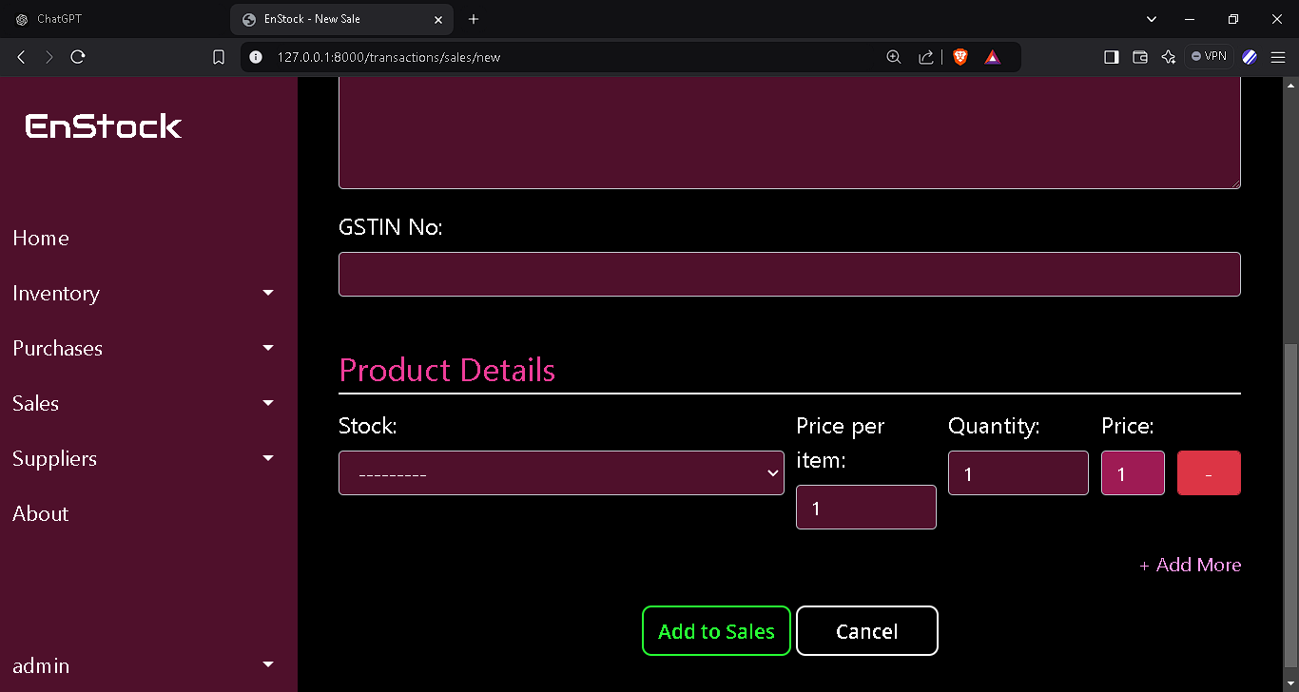
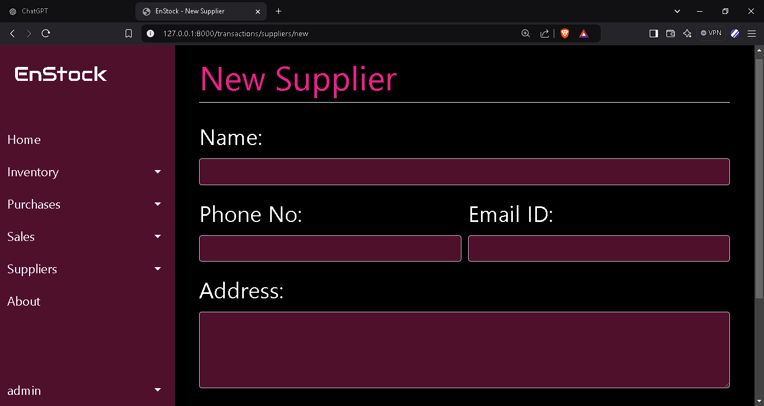
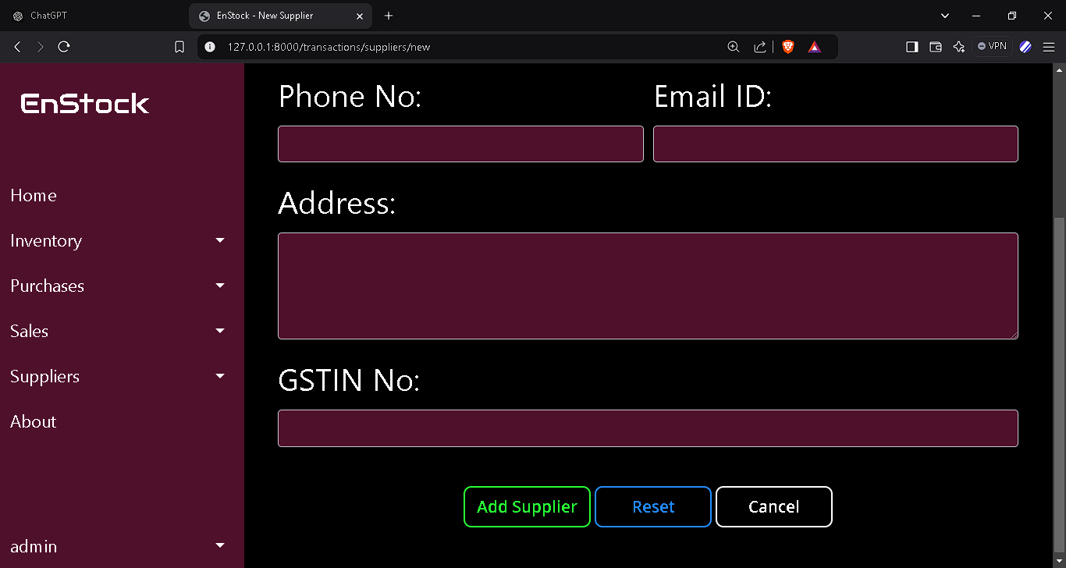
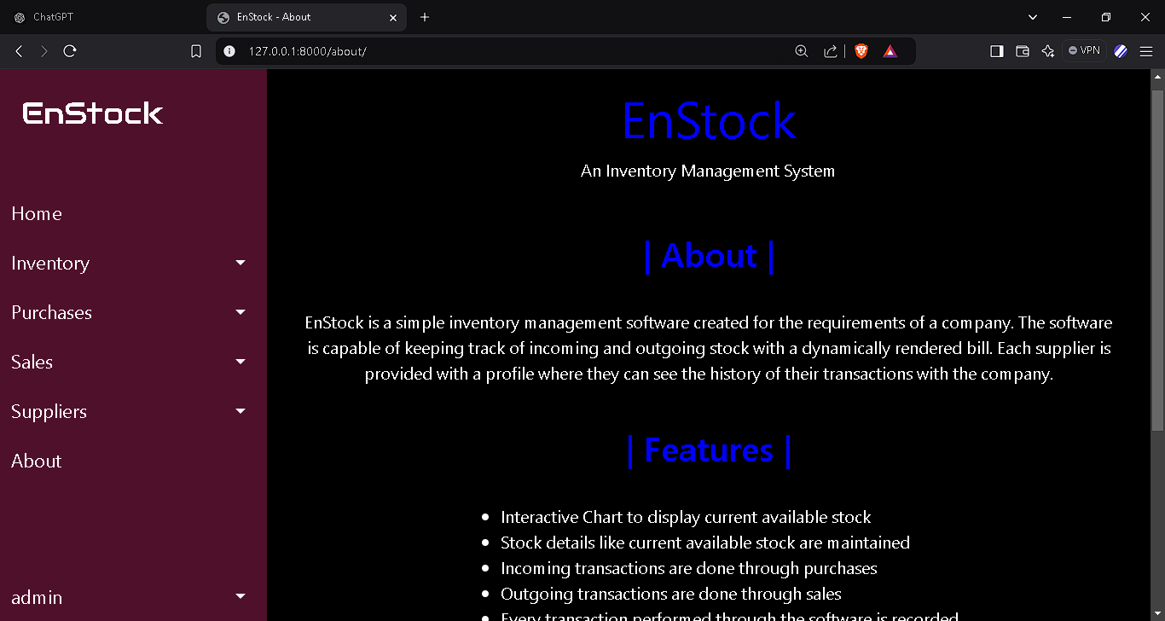
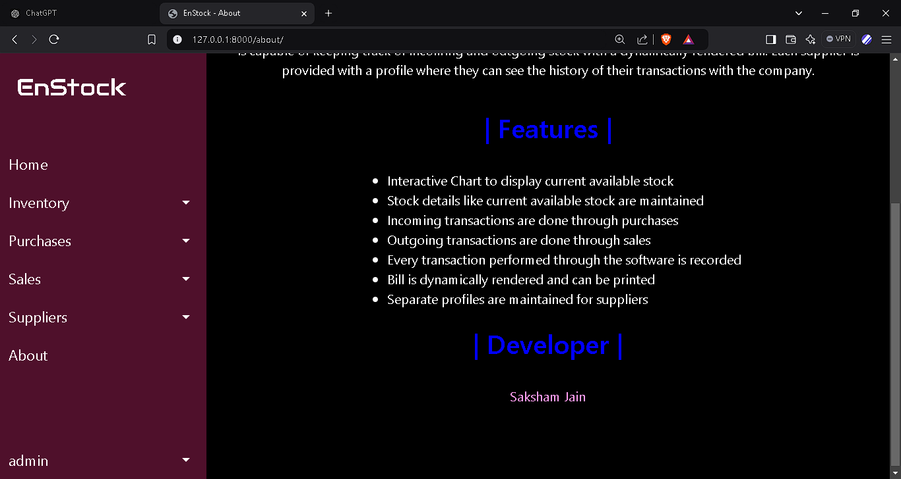
Demo Screenshots

Slide 7
Conclusion
The Inventory Management System built using Django simplifies the tracking and management of inventory.
It is scalable, efficient, and user-friendly.

