Slide 1
Fraud Transaction Detection using AI and Blockchain
Securing the Future of Digital Transactions

Slide 2
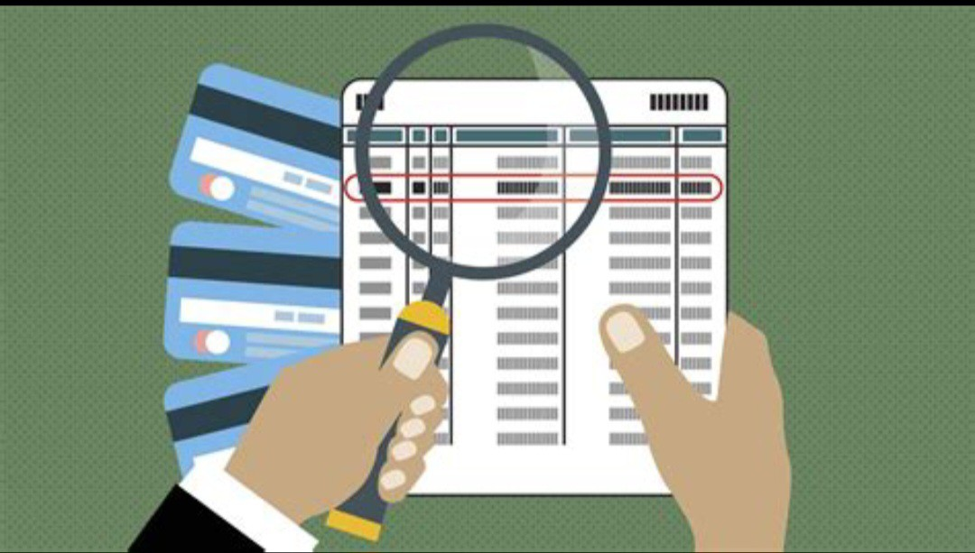
The Problem
Traditional banking systems rely on paper or basic digital logs.
These records can be easily tampered with.
Fraudulent transactions can be manipulated to appear valid.

Slide 3
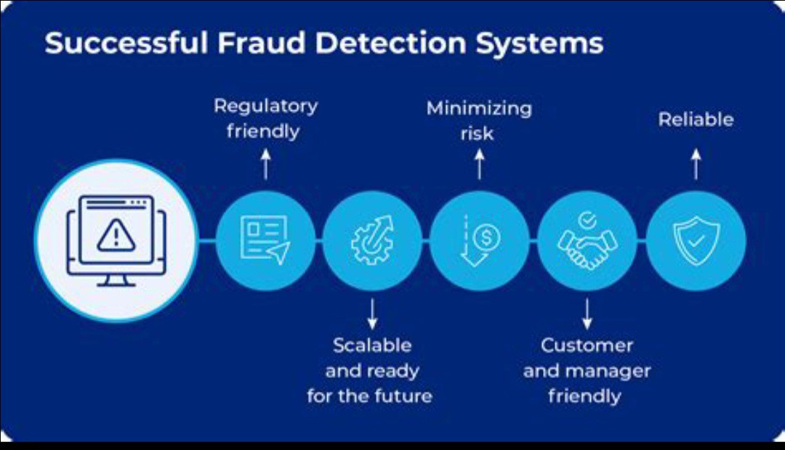
The Solution
Use AI to detect fraud and non-fraud transactions.
Store only non-fraudulent transactions on a tamper-proof blockchain.
Ensure integrity and transparency in financial records.

Slide 4
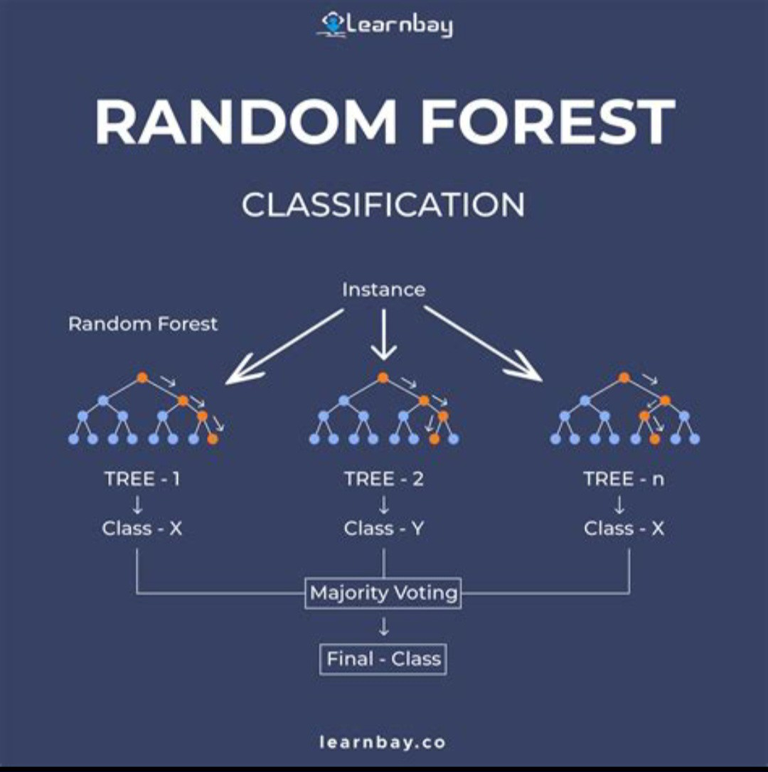
How It Works
Train a machine learning model using Random Forest Classifier.
Data features include: Profession, Income, Card Details, Transaction Amount, Fraud Label.
Fraud detection based on transaction amount and income.
Store non-fraud data to blockchain.

Slide 5

Blockchain Integration
Smart contract written in Solidity to store data.
Used Ganache for local blockchain, Metamask for wallet interaction, Truffle for deployment.
Once stored, data is immutable and transparent.

Slide 6
Technologies Used
Python
Random Forest Classifier
Flask API
Postman
Ganache
Metamask
Truffle
Solidity

Slide 7
Benefits
Real-time fraud detection.
Secure and transparent transaction records.
Tamper-proof storage of non-fraudulent data.
Builds trust in digital payments.

Slide 8
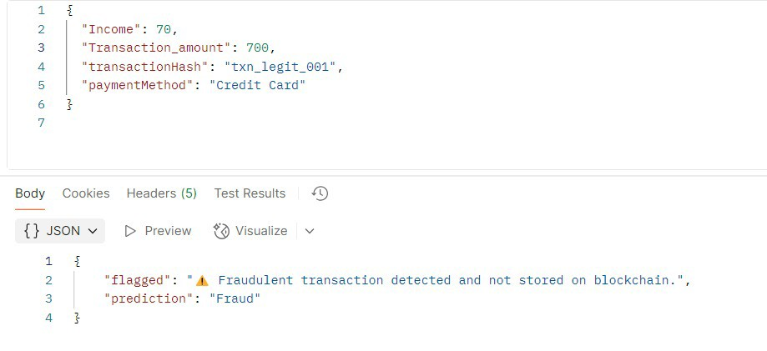
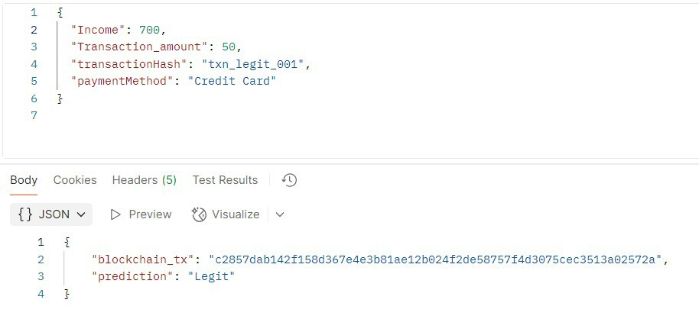
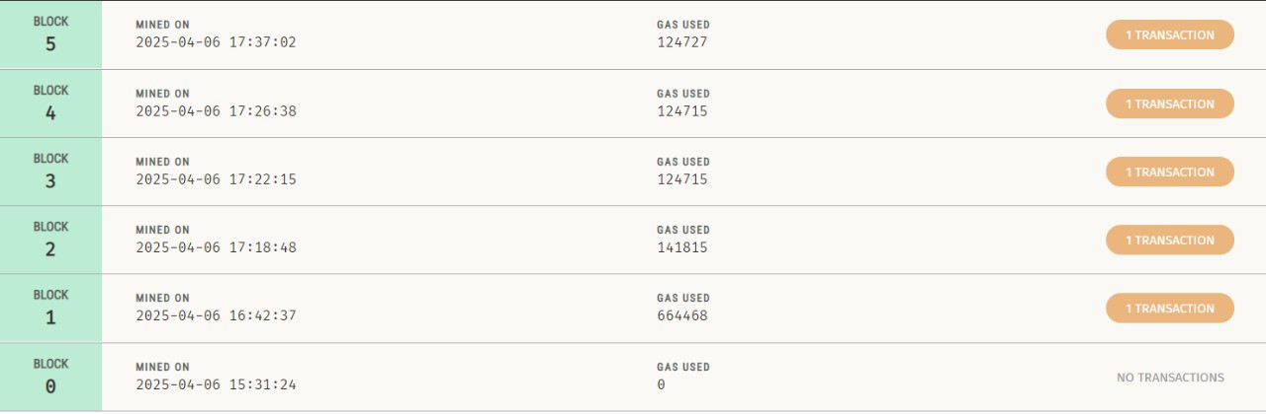
Demo Snapshots

Slide 9
Conclusion
AI and Blockchain together enhance financial security.
Our project ensures trustworthy transaction records.
Future work: Expand dataset, improve model accuracy, and integrate with real bank APIs.

Slide 10
Thank You

