Slide 1
ODIN Results
Wenhu Chen

Slide 2
ODIN Baseline Results
Method | Temperature | Eps | FPR at TPR=0.95 | Samples
Baseline | 1 | 0 | 0.292480325937 | 2048
ODIN (Liang et al.) | 5 | 0.00005 | 0.28710923481 | 2048
Auto-Encoder ODIN

Slide 3
ODIN Results
 | Snips | Atis
Basline (No Finetune, use T=1000, eps=0.0001) | Train: --- | Train: ---
 | Val: 0.27 | Val: 0.67
Baseline (Finetune T, eps) | Train: 0.06 | Train: 0.48
 | Val: 0.27 | Val: 0.70
Baseline Adversarial | Train: 0 | Train: 0.324970388143
 | Val: 0 | Val: 0.498643635112
Baseline Adversarial (Finetune T, eps) | Train: 0 | Train: 0.273022351528
 | Val: 0 | Val: 0.439023200479
We assume there exists some out-of-distribution available data and use it for finetunning the
Hyperparameters (termperature and epsilons)

Slide 4
Dirichlet OoD-detection (no inp-preprocessing)
Model | OOD-Dataset | Method | FPR at TPR=0.95 | Detection Error | AUROC | AUPR In | AUPR Out
VGG13 CIFAR-10 | iSUN | Baseline | 43.8 | 11.4 | 94.0 | 95.5 | 91.5
 |  | Baseline-Entropy | 35.3 | 11.3 | 94.6 | 95.7 | 93.1
 |  | ODIN | 22.4 | 10.2 | 95.8 | 96.3 | 94.9
 |  | Dirichlet | 25 | 12.6 | 94.5 | 95.4 | 93.2
 | LSUN-resized | Baseline/ Dirichlet | 41.9/28.3 | 11.5/13.1 | 94.0/94.2 | 95.1/94.5 | 92.2/93.6
 | Tiny-ImageNet | Baseline/ Dirichlet | 43.8/35.9 | 12.0/13.7 | 93.5/93.2 | 94.6/93.8 | 91.7/92.0
VGG13 SVHN | iSUN | Baseline/ Dirichlet | 10.0/4.3 | 6.0/3.9 | 98.0/98.9 | 99.3/99.6 | 93.7/97.6
 | LSUN-resized | Baseline/ Dirichlet | 9.4/9.2 | 5.7/5.4 | 98.1/98.5 | 99.3/99.4 | 94.3/96.9
 | Tiny-ImageNet | Baseline/ Dirichlet | 11.4/13.18 | 6.2/7.4 | 97.8/97.9 | 99.2/99.2 | 93.7/95.7

Slide 5
Dirichlet OoD-detection (no inp-preprocessing)
Model | OOD-Dataset | Method | FPR at TPR=0.95 | Detection Error | AUROC | AUPR In | AUPR Out
VGG13 CIFAR-10 | iSUN | Subjective Logic | 0.75 | 0.20 | 0.85 | 0.88 | 0.77
 |  | Entropy | 0.63 | 0.15 | 0.89 | 0.92 | 0.82
 | LSUN-resized
 | Tiny-ImageNet
VGG13 SVHN | iSUN
 | LSUN-resized
 | Tiny-ImageNet

Slide 6
Bias ablation With entropy
K1 | Dataset | ood | FPR at TPR=0.95 | Detection Error | AUROC | AUPR In | AUPR Out
10 | CIFAR10 | iSUN | 0.63 | 0.15 | 0.89 | 0.92 | 0.82
2 | CIFAR10 | iSUN | 0.50 | 0.14 | 0.91 | 0.93 | 0.86
1 | CIFAR10 | iSUN | 0.47 | 0.145 | 0.917 | 0.933 | 0.876
0.1 | CIFAR10 | iSUN | 0.47 | 0144 | 0.918 | 0.934 | 0.880
Semantic Label
10 | CIFAR10 | iSUN | 0.71 | 0.17 | 0.88 | 0.916 | 0.80
1 | CIFAR10 | iSUN | 0.41 | 0.14 | 0.92 | 0.93 | 0.90
0.1 | CIFAR10 | iSUN | 0.34 | 0.14 | 0.92 | 0.93 | 0.90

Slide 7
Detection
Model | OOD-Dataset | Method | FPR at TPR=0.95 | Detection Error | AUROC | AUPR In | AUPR Out
VGG13 CIFAR-10 | iSUN | Baseline | 43.8 | 11.4 | 94.0 | 95.5 | 91.5
 |  | ODIN | 22.4 | 10.2 | 95.8 | 96.3 | 94.9
 |  | Confidence | 16.3 | 8.5 | 97.5 | 98.0 | 96.9
 |  | Dirichlet | 8.1 | 6.0 | 98.5 | 98.8 | 98.3
 | LSUN-resized | Baseline | 41.9 | 11.5 | 94.0 | 95.1 | 92.2
 |  | ODIN | 20.2 | 9.8 | 95.9 | 95.8 | 95.8
 |  | Confidence | 16.4 | 8.3 | 97.5 | 97.8 | 97.2
 |  | Dirichlet | 7.1 | 5.6 | 98.6 | 98.8 | 98.5
 | Tiny-ImageNet | Baseline | 43.8 | 12.0 | 93.5 | 94.6 | 91.7
 |  | ODIN | 24.3 | 11.3 | 95.7 | 95.9 | 95.9
 |  | Confidence | 18.4 | 9.4 | 97.0 | 97.3 | 96.9
 |  | Dirichlet | 10.8 | 6.91 | 98.1 | 98.2 | 98.1
VGG13 SVHN | iSUN | Baseline | 10.0 | 6.0 | 98.0 | 99.3 | 93.7
 |  | ODIN | 1.69 | 2.95 | 99.5 | 99.8 | 98.8
 |  | Confidence | 0.9 | 2.3 | 99.7 | 99.9 | 98.9
 |  | Dirichlet | 0.5 | 1.8 | 99.7 | 99.9 | 99.6
 | LSUN-resized | Baseline | 9.4 | 5.7 | 98.1 | 99.3 | 94.3
 |  | ODIN | 1.4 | 2.6 | 99.6 | 99.7 | 99.1
 |  | Confidence | 1.0 | 2.3 | 99.7 | 99.9 | 99.0
 |  | Dirichlet | 0.8 | 2.2 | 99.8 | 99.9 | 99.2
 | Tiny-ImageNet | Baseline | 11.4 | 6.2 | 97.8 | 99.2 | 93.7
 |  | ODIN | 2.3 | 3.4 | 99.3 | 99.7 | 98.6
 |  | Confidence | 1.5 | 2.8 | 99.5 | 99.8 | 98.7
 |  | Dirichlet | 1.4 | 2.3 | 99.7 | 99.8 | 99.2

Slide 8
Detection
Model | OOD-Dataset | Method | FPR at TPR=0.95 | Detection Error | AUROC | AUPR In | AUPR Out
ResNet18 CIFAR-10 | iSUN | Baseline | 52.6 | 13.6 | 92.4 | 94.6 | 88.9
 |  | ODIN | 22.7 | 9.6 | 96.3 | 97.2 | 95.0
 |  | Semantic | 21.5 | 9.2 | 96.3 | 97.1 | 94.3
 |  | Dirichlet | 12.9 | 7.4 | 97.6 | 98.1 | 97.0
 | LSUN-resized | Baseline | 50.2 | 12.3 | 93.1 | 94.8 | 90.8
 |  | ODIN | 17.9 | 8.4 | 96.9 | 97.5 | 96.3
 |  | Semantic | 23.0 | 14.0 | 96.0 | 96.7 | 94.8
 |  | Dirichlet | 9.7 | 6.3 | 98.1 | 98.3 | 97.9
 | Tiny-ImageNet | Baseline | 59.0 | 15.1 | 91.1 | 93.2 | 88.1
 |  | ODIN | 32.1 | 11.2 | 94.9 | 95.8 | 93.6
 |  | Semantic | 32.1 | 13.1 | 93.2 | 94.2 | 90.6
 |  | Dirichlet | 21.5 | 9.2 | 96.3 | 96.9 | 95.7
WideResNet-16-8 SVHN | iSUN | Baseline | 9.6 | 5.9 | 98.0 | 99.3 | 93.4
 |  | ODIN | 1.1 | 2.7 | 99.6 | 99.8 | 99.1
 |  | Dirichlet | 0.8 | 1.8 | 99.8 | 99.9 | 99.5
 | LSUN-resized | Baseline | 9.5 | 5.8 | 98.0 | 99.3 | 94.0
 |  | ODIN | 1.5 | 2.9 | 99.6 | 99.8 | 99.0
 |  | Dirichlet | 0.6 | 1.5 | 99.8 | 99.9 | 99.5
 | Tiny-ImageNet | Baseline | 10.6 | 6.1 | 97.8 | 99.2 | 93.6
 |  | ODIN | 2.1 | 3.2 | 99.5 | 99.8 | 98.8
 |  | Dirichlet | 1.8 | 2.8 | 99.8 | 99.8 | 99.5

Slide 9
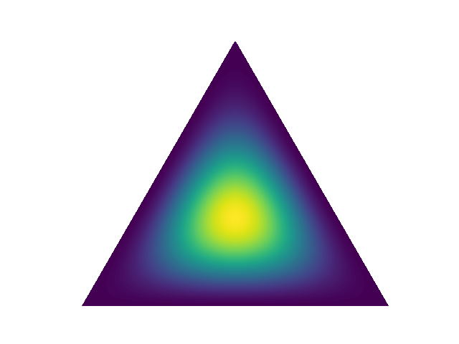
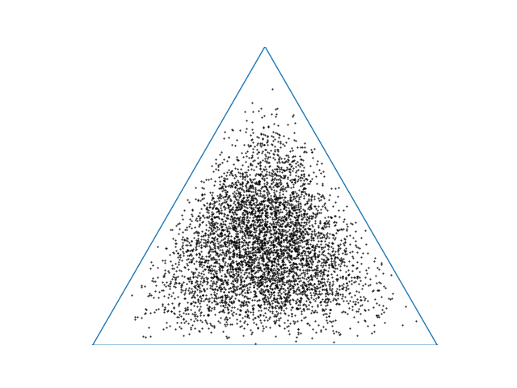
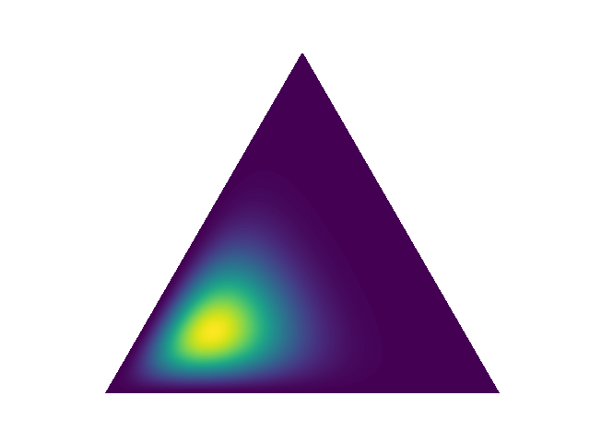
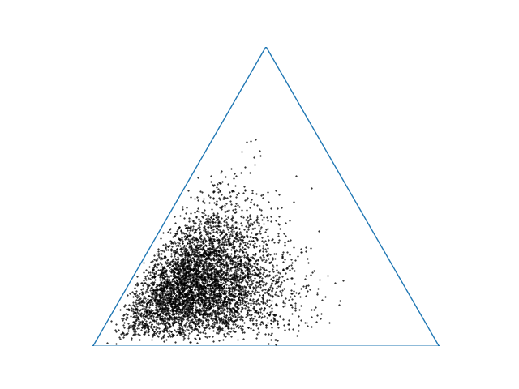

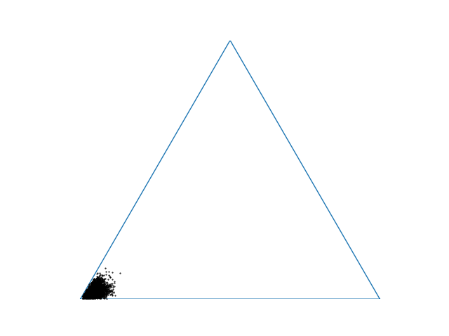
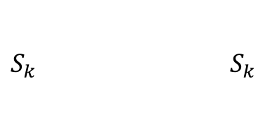
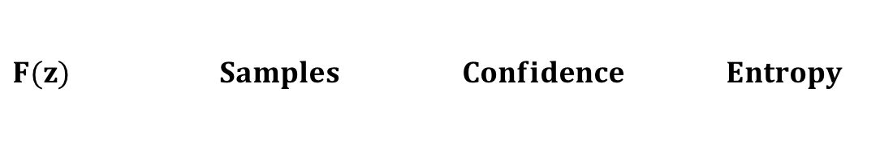








Classification
$F(z)$ $Samples$ $Confidence$ $Entropy$
$$z$$
Very Uncertain
High
Dirichlet
$$α$$
Deterministic
$$L_{n}$$
$$o_{2}$$
Medium Confident
Medium
Deterministic
$$L_{2}$$
$$o_{1}$$
Deterministic
$$L_{1}$$
Very Confident
Low
$$x$$
Input
$S_{k}$ ${ S}_{k}$

Slide 11
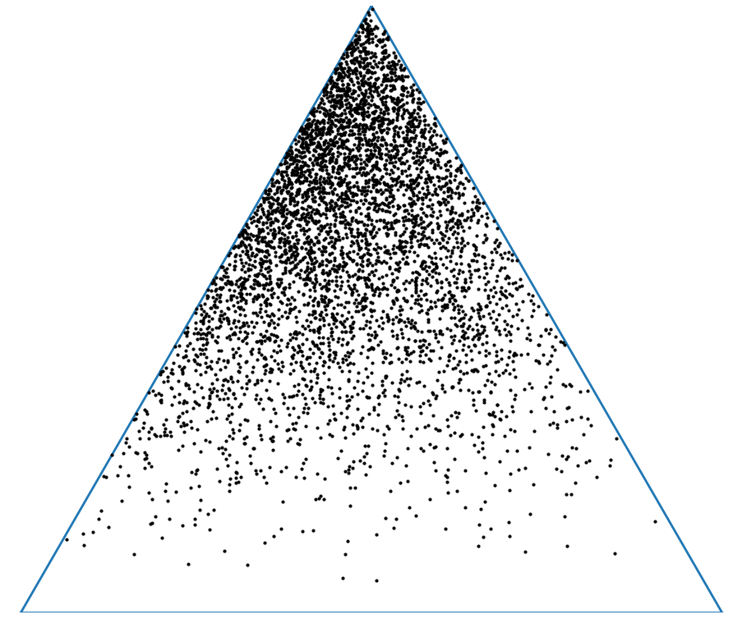
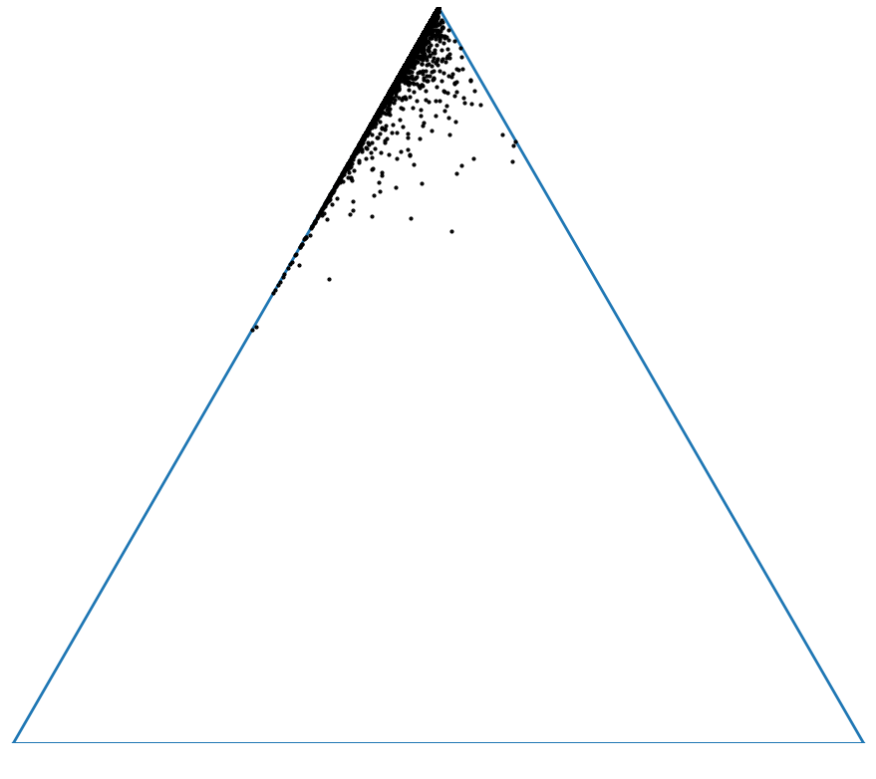
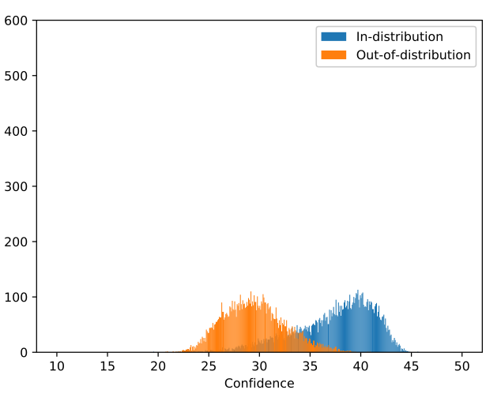

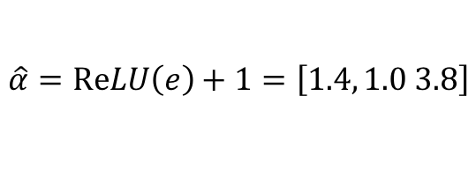
Before Smoothing
After Smoothing
Before Smoothing
Before Smoothing
$$α=\exp\left(e\right)=\left[1.49, 0.04, 16.44\right]$$
$$\hat{α}=\operatorname{ReLU}\left(e\right)+1=\left[1.4, 1.0 3.8\right]$$
Before Smoothing | After Smoothing | Before Smoothing | After Smoothing

Slide 13
\eta | Accuracy | FPR at TPR=0.95 (ResNet18 on CIFAAR10/iSUN)
0 | 94.2 | 0.45
0.001 | 94.2 | 0.26
0.01 | 94.1 | 0.13
0.1 | 94.1 | 0.28
1 | 93.4 | 0.29
10 | 88.7 | 0.42

